Slide 1
Diabetes Prediction using Machine Learning
Major Project under the guidance of T.Naresh(Asst.Prof)
RGUKT R.K VALLEY
Team
Mahesh Kuntumalla(R161249)
Hemanth Mekala(R161871)

Slide 2
OUTLINE
Introduction
Project workflow
Technology used
Tools used
How it works and execution
Web App building

Slide 3
Introduction
In this project we build a model where it predict that a person have diabetics or not by using a simple model called svm(support vector model) in Machine Learning

Slide 4
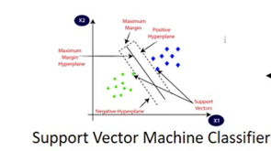
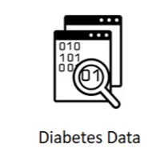
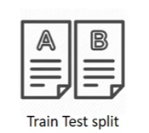
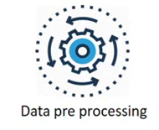
Project workflow

Slide 5
Diabetics data
This dataset is originally from the National Institute of Diabetes and Digestive and Kidney Diseases. The objective of the dataset is to diagnostically predict whether or not a patient has diabetes, based on certain diagnostic measurements included in the dataset. .

Slide 6
Data preprocessing
Data preprocessing in Machine Learning refers to the technique of preparing (cleaning and organizing) the raw data to make it suitable for a building and training Machine Learning models.
Important technique is Data Standardization

Slide 7
Data Standardization
The process of rescaling the attributes so that they have mean as 0 and variance as 1
The ultimate goal to perform standardization is to bring down all the features to a common scale without distorting the differences in the range of the values.

Slide 8
Train-Test-split
Train/Test is a method to measure the accuracy of your model. It is called Train/Test because you split the the data set into two sets: a training set and a testing set
You train the model using the training set.
You test the model using the testing set.

Slide 9
Model building
We used svm(support vector machine) for building our model to predict the model.
Why only support vector machine?

Slide 10
support vector machine
Support Vector Machine(SVM) is a supervised machine learning algorithm used for both classification and regression. Though we say regression problems as well its best suited for classification. The objective of SVM algorithm is to find a hyperplane in an N-dimensional space that distinctly classifies the data points

Slide 11
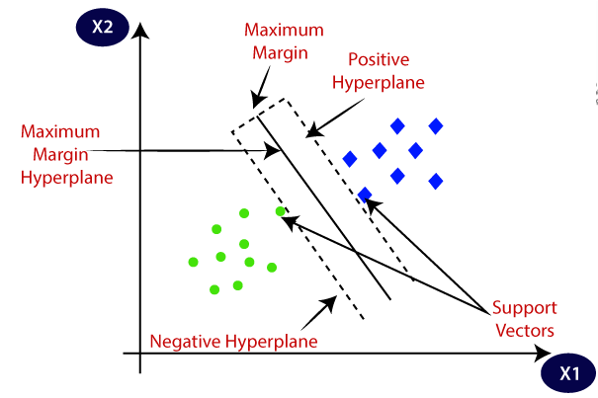
Contd.
The goal of the SVM algorithm is to create the best line or decision boundary that can segregate n-dimensional space into classes so that we can easily put the new data point in the correct category in the future. This best decision boundary is called a hyperplane.

Slide 12
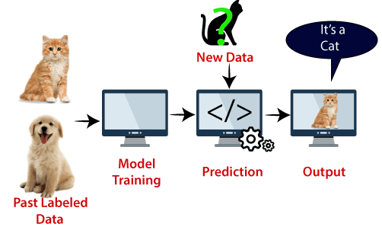
Contd.
Ex:- cat and dog classification

Slide 13
Technology used and Tools
Machine learning (svm)
Python (jupyter notebook)
Streamlit (For building web app)

Slide 14
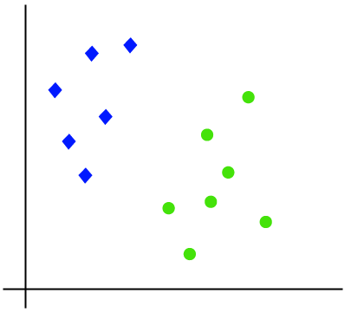
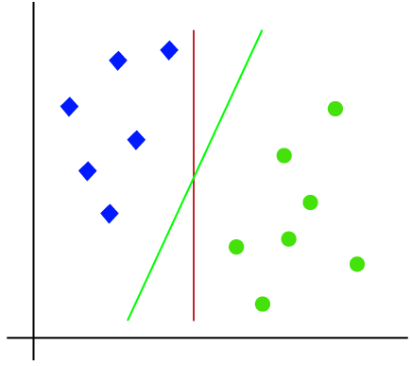
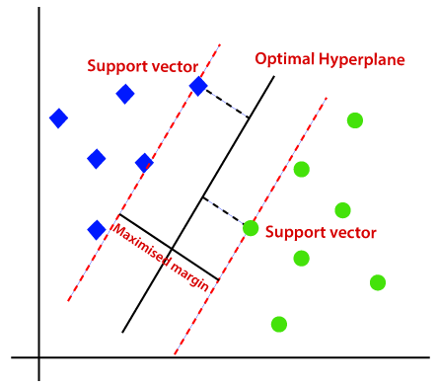
How it works and execution

Slide 15
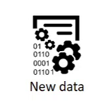
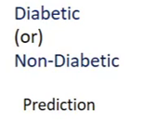
Contd.

Slide 16

Building web App
Streamlit is an open-source Python library that makes it easy to create and share beautiful, custom web apps for machine learning and data science. In just a few minutes you can build and deploy powerful data apps.

Slide 17


