Slide 1

Visualization of Data, Understanding and Interpretation
Unit 2 : Advanced Visualization & Storytelling
(UE24CS342AA9)
Visualization of Data, Understanding and Interpretation
Dr.Prajwala TR (Course Instructor)
Dept. of CSE, PES University, Bangalore

Slide 2
Visualization of Data, Understanding and Interpretation
Acknowledgement
The slides are prepared from various resources from the Universities from abroad and India. Also, some material is taken from reliable resources from internet throughout this course.

Slide 3
Visualization of Data, Understanding and Interpretation
Lecture Overview- static and interactive visualizations
UNIT 2: Advanced Visualization & Story Telling.
In this lecture, we will cover:
  Narrative vs. Exploratory Paradigms: Establish how static and interactive visualizations partition control of the cognitive thread between the presenter and the viewer.
  The Physical and Cognitive Interaction Loops: Model selection mechanics via Fitts' Law, evaluate the performance penalty of lag, and construct a drill-down epistemic cost hierarchy.
  Visual Thinking Design Patterns: Analyze and implement brushing, coordinated multiple views, dynamic queries, and near-neighbor highlighting to navigate high-dimensional spaces.

Slide 4
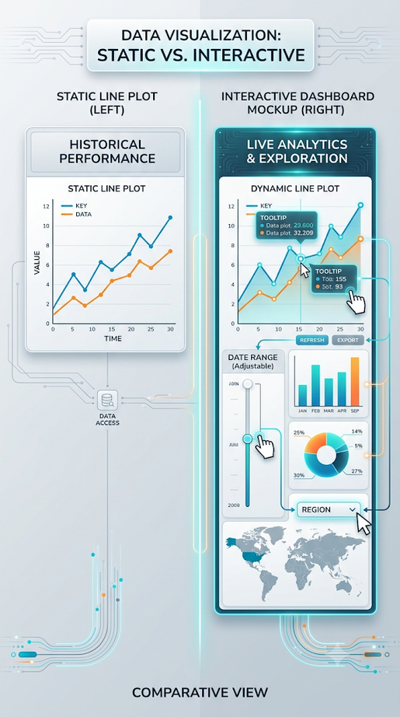
Visualization of Data, Understanding and Interpretation
Static vs Interactive Visualizations (TB 3, Sec 9.4)
• Static representations restrict the visual display to pre-computed, unalterable visual structures.
• Interactive environments construct a dynamic interface that allows the user to perform physical operations to manipulate the displayed structure in real-time.
• Static visualizations rely heavily on accompanying spoken or written language to establish the primary narrative context.
• Interactive visualizations rely on automated, computed responses to user inputs, transforming the interface into an external cognitive support tool.
• The transition to interaction becomes necessary when the complexity of the dataset exceeds the spatial resolution limits of a single static monitor.

Slide 5
Visualization of Data, Understanding and Interpretation
Static vs Interactive Visualizations
What are Static Visualizations?
  Static visualizations are commonly seen as infographics posted on the web or printed as handouts. Usually focused on a specific data story, users can’t go beyond a single view to explore additional stories beyond what’s in front of them. The story is specifically captured in an engaging single page layout.
What are Interactive Visualizations?
  Interactive visualizations are commonly seen on the web only as applications. Users can select specific data points to build a visualized story of their choosing. Better known as Data Visualization Apps, these visualizations allow the user to be part of the data visualization process by building a story of their choosing.
Which is better?
The target customer, data story, and ROI are 3 important indicators that can help figure out which is best.
ref: https://boostlabs.com/static-vs-interactive-visualizations-choose/

Slide 6
Visualization of Data, Understanding and Interpretation
Static vs Interactive Visualizations
Target Customer – This is your audience. How do they prefer to receive and interact with their information? Some audiences prefer static reports where others want to be engaged with their visualized outcome.
Data Story – How complex is the story? Isolating on a specific data story is required for static visualizations. With an abundance of data, having just one static representation may not be enough to really visualize the whole story. An interactive visualization provides the solution for larger data sets with complex stories and can provide relevant information for extended periods of time.
ROI is difficult to measure because the value of a visualization depends on its impact. It can be assessed using three factors:
  Customer Engagement: Interactive visualizations increase engagement, capture more insights, and improve conversions.
  Content Quality: Shareable and engaging visualizations can reach a wider audience and generate more interaction.
  Content Schedule: Interactive dashboards are easier to update over time, while static visuals often require rebuilding, increasing costs.

Slide 7
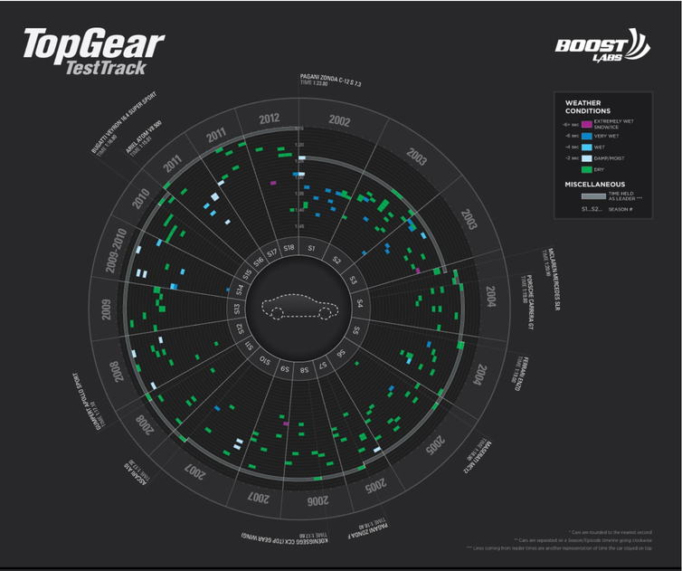
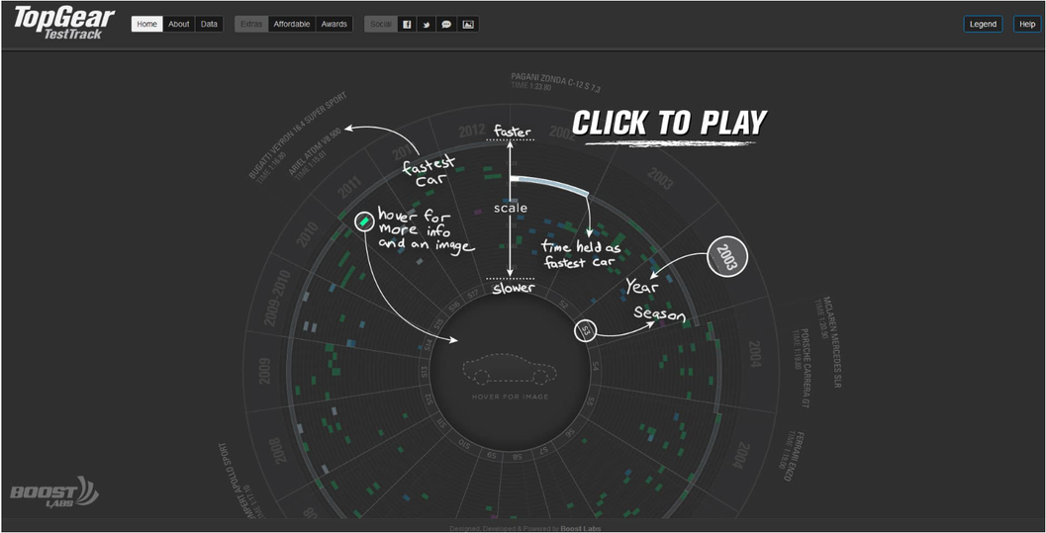
Visualization of Data, Understanding and Interpretation
Static vs Interactive Visualizations
Static visualizations statistically have a lower engagement time frame than Interactive Visualizations for obvious reasons.
An experiment to see which had the longest average session time. The test used two portfolio items:
This Top Gear Selector Wheel (static), contains 185 car lap times.
Same infographic but allow the enthusiast to get more specific information faster and be able to take control over how the data is being digested (interactive).
Static Visualization = 15 seconds
Interactive Visualization = 1 minute and 4 seconds

Slide 8
Visualization of Data, Understanding and Interpretation
Static vs Interactive Visualizations
The test supported our assumptions that interactive will promote longer engagement times.
In addition, the volume of unique visits for the interactive visualization were twice the amount compared to the static visualization unique visit count.
  Interactive Visualization Applications can be built to display on all devices (web and mobile) and be able to be print friendly
  Static Visualizations are at least 5x cheaper to build than Interactive visualizations
  Interactive Visualizations can be built so that all users, regardless of disability status, can access the information
There isn’t a one size that fits all solution.
Notes:
A/B testing

Slide 9
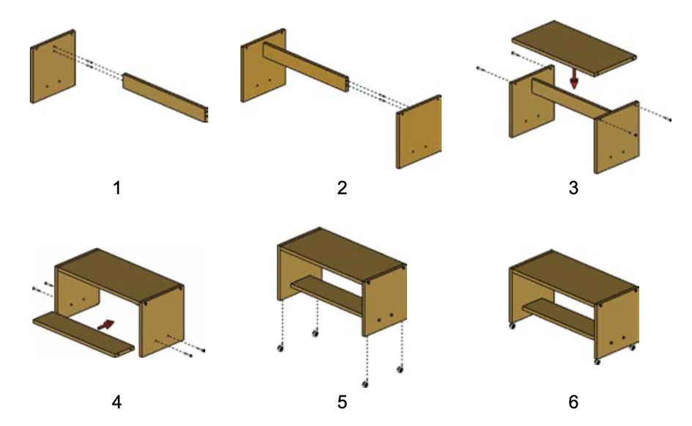
Visualization of Data, Understanding and Interpretation
Narrative Control and the Cognitive Thread-static (TB 3, Sec 9.4)
• In static data presentation, the author maintains absolute control over the sequence of visual events and cognitive framing.
• In exploratory interaction, the cognitive sequence is driven dynamically by the analyst's active search goals.
• Slide decks and formal reports function in a hybrid mode, where the narrative structure is authored but navigation remains reader-driven.
• Overloading an active presentation with unnecessary interactive elements disrupts attention and breaks the presenter's narrative thread.
• The level of user control should match the context: presentation-oriented visuals require author-driven constraint, whereas diagnostic applications require high user autonomy.
Sequence of static frames that maintain step-by-step narrative continuity.
Narrative control = controlling what the viewer notices, in what order, and what conclusion they are likely to draw.
Cognitive thread = the mental path the viewer follows while understanding the visualization.
Think of it as a chain of questions and answers in the viewer's mind.

Slide 10
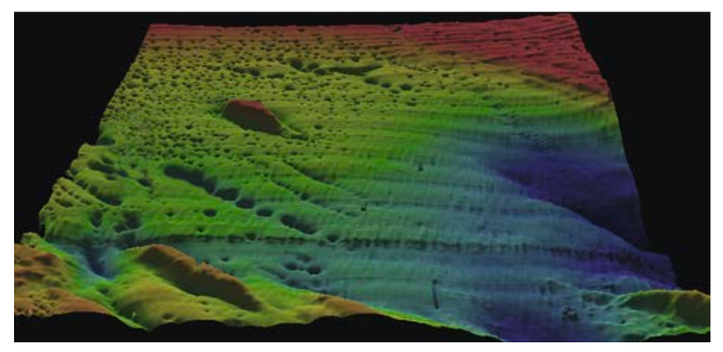
Visualization of Data, Understanding and Interpretation
Limitations of Static Visualizations (TB 3, Sec 10.1)
• Static visual channels hit a physical layout wall when trying to display high-dimensional datasets with dozens of attributes.
• Representing massive datasets statically causes extreme visual clutter, making individual data points and categorical structures impossible to resolve.
• Static graphics fail to naturally represent complex temporal changes or multi-step causal relationships without resorting to dense multi-frame arrays.
• Attempting to display all data simultaneously forces the eye to perform exhaustive, high-cost manual scans across a cluttered canvas.
• Interactive scaling resolves these limits by hiding non-essential context and serving detailed parameters strictly on demand.
Passamaquoddy Bay heights field. The visual emphasizes how a static visual projection reveals patterns but cannot support direct attribute querying without interactive tools.
3D height/elevation field of Passamaquoddy Bay. The colors and surface shape represent variations in the data.

Slide 11

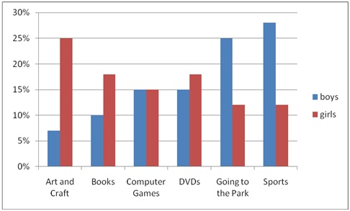

Slide 12
Static vs. Interactive Visualization
Two ways to present data — and when each one wins
S
Static
I
Interactive
A fixed image that doesn't change once created.
Lets the viewer explore — hover, click, filter, zoom.
Examples: printed charts, PDF reports, PNG/JPG images
Quick to make, easy to share
Looks the same for every viewer
Great for print or offline use
Shows only one fixed view of the data
Examples: Tableau, Power BI, D3.js, Plotly dashboards
Viewer can filter, zoom, and drill into details
Reveals patterns a static chart would miss
Needs more build effort and a suitable platform
Best for large or complex datasets

Slide 13
At a Glance: Choosing the Right Approach
Aspect | Static | Interactive
Viewer control | None | High — filter, zoom, hover, click
Best for | Reports, presentations, print | Dashboards, exploratory analysis
Common tools | Excel, Matplotlib, Illustrator | Tableau, Power BI, D3.js, Plotly
Build complexity | Lower | Higher
Data depth shown | One fixed view | Multiple views, on demand
Takeaway
Use static visuals for simple, one-time storytelling — like a report or slide. Use interactive visuals when you want your audience to explore the data themselves, or when the dataset is too rich to capture in a single image.

Slide 14
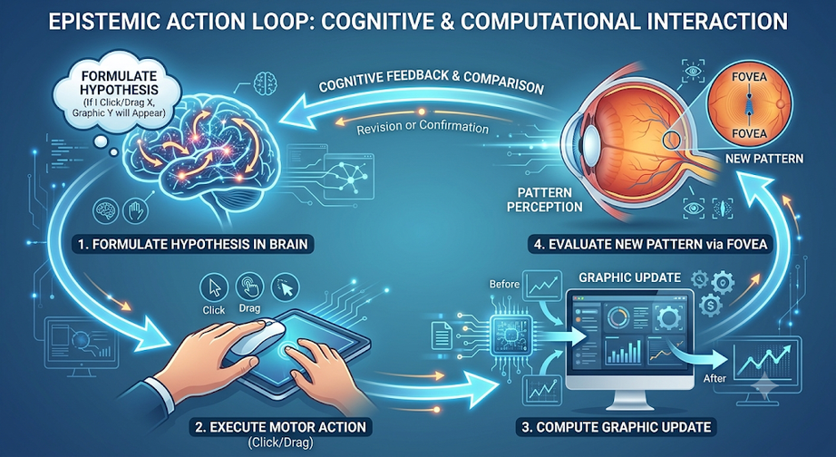
Visualization of Data, Understanding and Interpretation
Epistemic Actions and Visual Exploration -interactive (TB 3, Sec 10.1)
• An epistemic action is any physical manipulation of the visualization interface designed to uncover previously hidden information. An epistemic action is any physical action someone takes on a visualization's interface (clicking, dragging, zooming, etc.) specifically to reveal information that was hidden, rather than to change the underlying data.
• pragmatic actions that physically alter the underlying database, epistemic actions alter the visual state to help human cognitive processing.
• Basic epistemic actions include eye movements, cursor hovers, window selections, and dynamic zoom operations.
• The primary goal of interaction design is to reduce the temporal and cognitive costs of executing these epistemic actions.
why interactivity in visualizations matters — because small, low-effort user actions (not changing data, just changing its display) let people discover insights faster.
• Interactive systems allow analysts to dynamically execute visual queries, transforming abstract datasets into solvable visual patterns.

Slide 15
Visualization of Data, Understanding and Interpretation
Epistemic Actions and Visual Exploration (TB 3, Sec 10.1)
Google Maps / Instagram scrolling
Pinch-to-zoom on a map is a pragmatic vs epistemic action in action: you're not changing the city's actual layout (pragmatic), you're just changing what's visible to help your brain understand it (epistemic).
Scrolling through a messy Excel sheet or a dashboard (e.g., checking cricket stats, stock prices, or Spotify Wrapped-style data)
Hovering over a bar in a chart to see its tooltip value = a textbook epistemic action — you didn't change the data, you revealed hidden information.
YouTube Analytics
A content creator has a dashboard showing views, watch time, and subscribers.
Select Last 28 days → Epistemic
Edit/delete an incorrect analytics record → Pragmatic

Slide 16
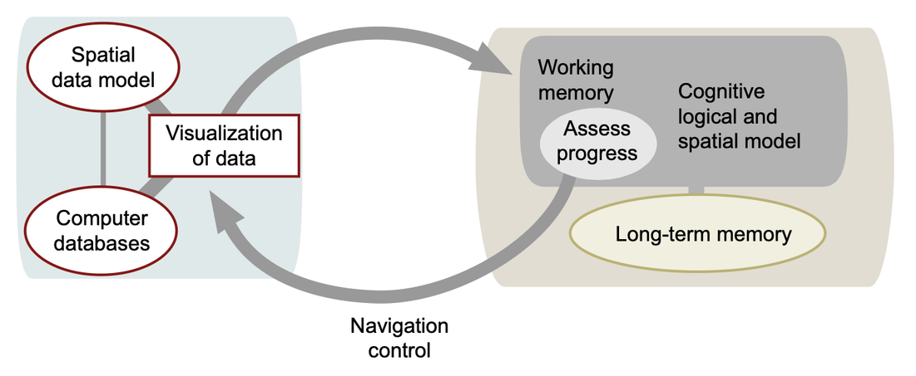
Visualization of Data, Understanding and Interpretation
The Human-Computer Navigation Control Loop (TB 3, Sec 10.3)
• Human visual navigation is modeled as a set of interlocking feedback loops that operate across distinct cognitive timescales.
• The lowest loop coordinates physical eye-hand movements, demanding instant, sub-second visual updates to maintain tracking stability.
• The intermediate loop coordinates spatial navigation, allowing users to build a cognitive map of the data landscape.
• The highest loop drives analytical problem-solving, where hypotheses are formed, tested, and revised through active visual manipulation.
• Delays or disruptions in any of these feedback loops instantly degrade the user's analytical performance and break their train of thought.
The Navigation Control Loop
model that explains how humans interact with an interactive visualization.
Notes:
Intermediate loop — Spatial navigation
As you pan, scroll, or zoom through data, this loop helps you build a mental map of where things are in the visualization — so you remember "the outlier was up and to the left" without having to relocate it from scratch each time.
model that explains how humans interact with an interactive visualization.

Slide 17
Visualization of Data, Understanding and Interpretation
The Human-Computer Navigation Control Loop (TB 3, Sec 10.3)
Google Maps to navigate to a new café in an unfamiliar part of the city
Loop 1 — Eye-Hand Coordination (fastest, sub-second)-As you ride, your eyes are locked on the little blue arrow (your position) and the road ahead. Your hand makes tiny adjustments to your phone mount angle or taps to keep the screen active.
Loop 2 — Spatial Navigation (intermediate, seconds)
As you keep riding, you start building a mental map of the area — "okay, I already passed the big yellow building, so the café should be after this next signal." You're not staring at the phone constantly anymore; you glance at it occasionally because your brain is now holding a spatial model of the route.
Loop 3 — Analytical Problem-Solving (slowest, deliberate)
Suddenly Maps says "arriving in 2 minutes" but you don't see any café — just a residential building. Now you're actively reasoning: "Maybe the entrance is around the back? Maybe the pin is slightly off, like it usually is for small shops? Let me zoom in and check street view." You form a hypothesis, test it (zoom, rotate map, look at satellite view), and revise based on what you see.
Notes:
Intermediate loop — Spatial navigation
As you pan, scroll, or zoom through data, this loop helps you build a mental map of where things are in the visualization — so you remember "the outlier was up and to the left" without having to relocate it from scratch each time.

Slide 18
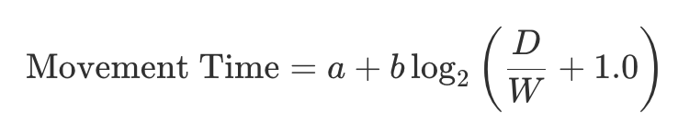
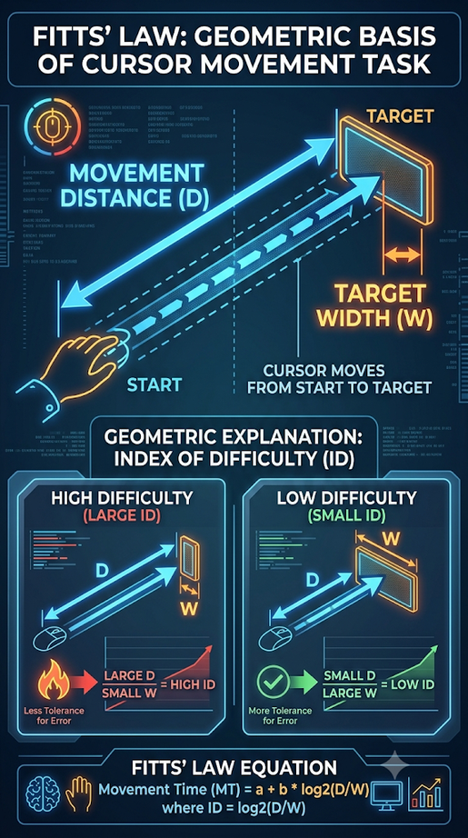
Visualization of Data, Understanding and Interpretation
Fitts' Law (TB 3, Sec 10.2)
Fitts' Law provides a rigorous mathematical model of the time required to move a cursor to a target on a screen:
• The index of difficulty is determined by the ratio of target distance (D) to target width (W).
• The index of performance (1/b) represents the human motor system's processing throughput, typically averaging 4 bits per second for mouse
• To minimize selection time, critical interactive targets must be designed with larger target areas or placed closer to the user's current cursor position.
This law provides a standardized framework for evaluating and optimizing the physical usability of visualization interfaces.

Slide 19
Visualization of Data, Understanding and Interpretation
Fitts' Law (TB 3, Sec 10.2)
Fitts' Law provides a rigorous mathematical model of the time required to move a cursor to a target on a screen:
a and b are empirically determined constants — they aren't fixed universal numbers, but are found experimentally for a specific input device (mouse, touchscreen, trackpad, stylus, etc.)
a (the intercept)
Represents the fixed start/stop overhead of a movement — the small, constant delay that exists regardless of how far or how small the target is (e.g., reaction time, the time to initiate movement, or the mechanical/device-specific delay before motion even starts).
b (the slope)
Represents how much extra time is added per unit of difficulty — essentially, how "sensitive" the device/user is to increasing distance or decreasing target size.
Its inverse, 1/b, is called the index of performance — measured in bits per second, representing the throughput of the human motor system for that device.
A smaller b means the person/device can handle increasing difficulty more efficiently (less time penalty per added bit of difficulty).

Slide 20
Visualization of Data, Understanding and Interpretation
Fitts' Law (Numerical) (TB 3, Sec 10.2)
An interface designer is testing a new mouse on a computer screen.
The user needs to click a button located 16 cm away from the current cursor position. The button width is 2 cm. Through previous testing, the designer established the system constants as a = 0.2 seconds and b = 0.1 seconds/bit.
Using Fitts's Law, what is the predicted Movement Time (MT) required for the user to click the button?
Solution
Formula for Index of Difficulty:
  ID = log₂(D/W + 1)
ID Calculation:
  log₂(16/2 + 1) = log₂(9) ≈ 3.17 bits
Formula for Movement Time:
  MT = a + b(ID)
MT Calculation: 0.2 + 0.1 × 3.17 = 0.517 seconds

Slide 21
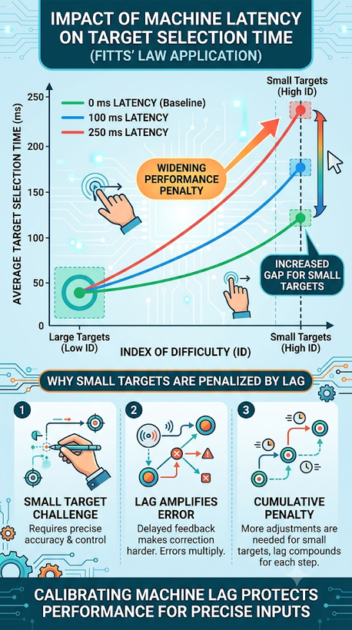
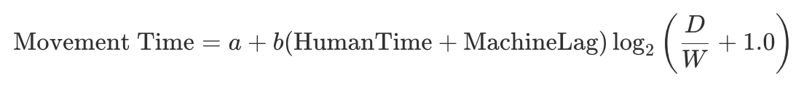
Visualization of Data, Understanding and Interpretation
The Perceptual Penalty of Machine Lag (TB 3, Sec 10.2)
Machine lag is the physical delay between a user's motor action and the corresponding visual update on the screen.
Incorporating lag modifies the Fitts' Law movement time equation to account for system latency:
• The performance penalty of lag scales non-linearly, causing disproportionately larger delays as interaction targets get smaller.(Non-linear penalty, worse for smaller targets)
• Even a fraction of a second of lag can cause users to overcorrect their cursor movements, breaking natural eye-hand coordination.
• Real-time interfaces must prioritize keeping latency below 100 milliseconds to preserve smooth interaction during highly analytical tasks.
Notes:
Because MachineLag is multiplied by the log₂(D/W+1) term — not just added on its own — its effect gets amplified when D/W is large (i.e., when the target is small or far away). This is exactly what the infographic on the right shows: the gap between the "0ms," "100ms," and "250ms" latency curves widens dramatically as targets get smaller (higher index of difficulty).

Slide 22
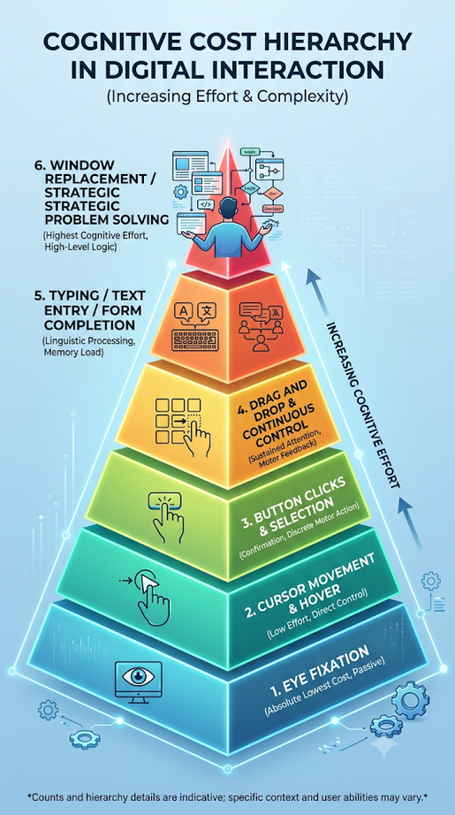
Visualization of Data, Understanding and Interpretation
The Drill-Down Epistemic Cost Hierarchy (TB 2, Sec 10.4)
• Eye Fixation (lowest cost): Moving attention to an adjacent screen element takes only 100 to 200 milliseconds, allowing up to 3 queries per second.
• Hover Query (low cost): Simply moving the cursor over a data element instantly reveals pop-up details, averaging about 1 second of user time.
• Click-to-Open Panel (moderate cost): Clicking on an element opens a persistent side or overlay panel, costing approximately 2 seconds.
• Window Replacement (highest cost): Opening a new window that entirely replaces the current view disrupts context and forces a heavy cognitive restart.
• Design Rule: Always prioritize lower-cost interaction patterns to preserve the analyst's short-term visual working memory.
Notes:
Machine Lag → Cost Hierarchy: the lag slide showed that slow interactions hurt you; the hierarchy slide just lists interactions in order from fastest/cheapest (eye fixation) to slowest/most expensive (opening a new window), so you know which ones to avoid.

Slide 23
Visualization of Data, Understanding and Interpretation
The Focus-Context Problem (TB 3, Sec 10.3)
• The focus-context problem arises from the mismatch between the need to inspect fine-grained details and the need to maintain an overall structural view of the dataset.
• In large information spaces, detail views must be visually tied to their broader environmental context to remain interpretable.
• This cognitive challenge spans multiple disciplines, including geographic maps, temporal datasets, and software system architectures.
• A perfect design allows users to smoothly transition between local details and global overviews with minimal cognitive disruption.
• We can solve this problem using three primary interaction models: multiple linked windows, geometric distortion, or rapid zooming.
You can't see fine detail and the big picture at the same time on one screen — you need a way to switch between "zoomed in" and "zoomed out" without getting lost.
Google Maps — when you zoom into your street (detail), you lose sight of the city (context). A mini-map in the corner, or smooth zoom animation, solves this by keeping you oriented as you switch between the two.

Slide 24
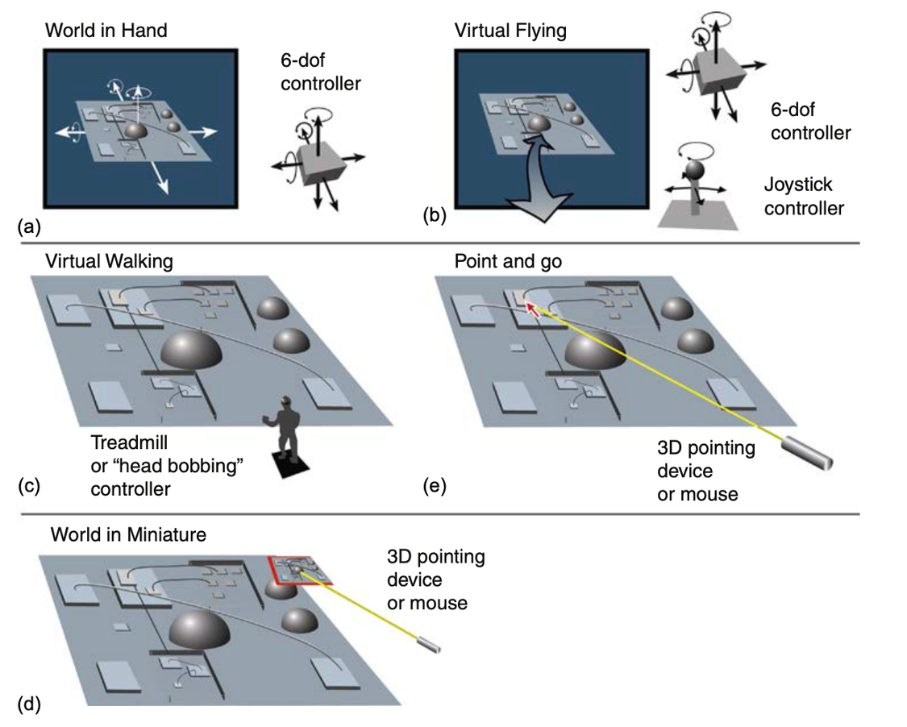
Visualization of Data, Understanding and Interpretation
Spatial Navigation Metaphors for 3D Interfaces (TB 3, Sec 10.2)- solution 1
• The Power of Metaphors: Interactive metaphors provide users with familiar mental models to help them navigate complex 3D virtual spaces efficiently.
• World-in-Hand: The user metaphorically grabs and manipulates a compact 3D data object as if holding it, which is highly efficient for localized inspection.
• Flying: The user flies through a large terrain in an unconstrained way, which works best when speed automatically scales to the surrounding detail.
• Point and Go: The user points directly to a target destination, and the camera teleport-walks them there smoothly along a safe path.
• Degrees of Freedom Constraints: Minimizing the degrees of freedom to only what is necessary (e.g., locking roll and yaw) drastically reduces navigation errors.
Notes:
Focus-context said you need smooth detail↔overview transitions; these navigation metaphors are the actual controls (grab, fly, point, constrain) that make those transitions usable in 3D space.
Focus-context said "you need to move between zoomed-in detail and zoomed-out overview smoothly." The image shows the actual hand controls that do that switching in 3D — e.g., "World-in-Hand" lets you hold the whole scene close for detail, "Flying" lets you zoom out and cover the whole terrain, "Point-and-Go" jumps you straight from overview to a specific detail spot. So the image is just showing how (with what physical controller) a user actually performs the detail↔overview switch that focus-context said was needed.

Slide 25
Visualization of Data, Understanding and Interpretation
Spatial Navigation Metaphors for 3D Interfaces (TB 3, Sec 10.2)- solution 1
World-in-Hand — you hold the whole object in your hand and rotate it. Great focus (you see detail up close), but you lose the surrounding environment (no context).
Flying — you fly freely through the space. Good context (you see the whole terrain), but hard to focus on one specific detail while moving fast.
Walking — you move at ground level like a real person. Natural, but slow and limited view.
Point and Go — you point where you want to go, and it smoothly takes you there. Balances both — you get moved to your focus point without losing track of the path.
World in Miniature — you get a tiny model of the whole space in your hand to navigate the big one. Strong context (see everything), weaker focus (details are tiny).
Good 3D interface design means picking (or combining) the metaphor that matches the user's current goal

Slide 26
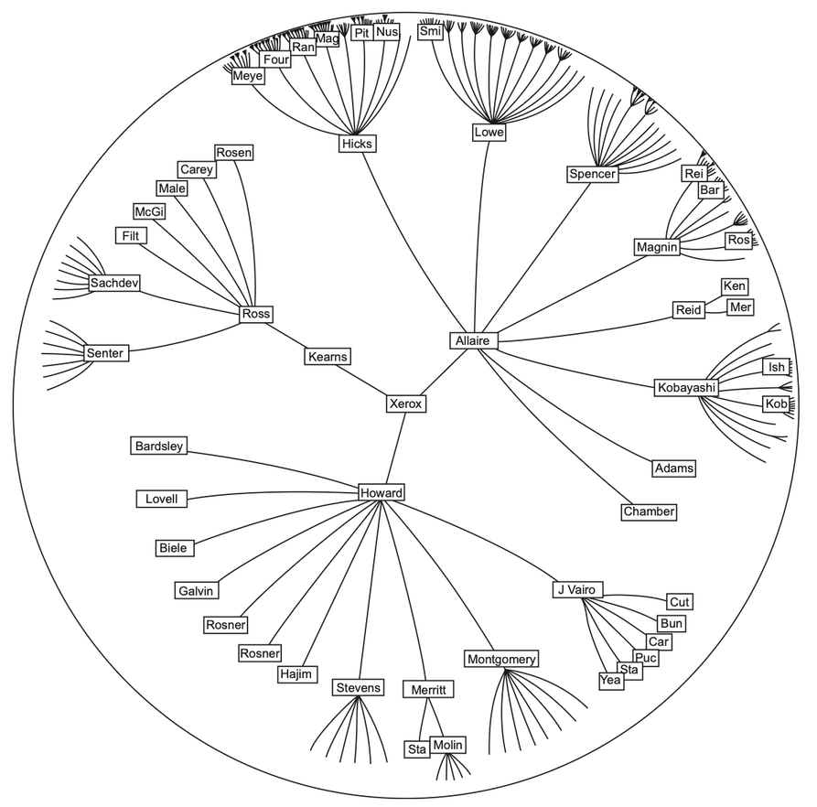
Visualization of Data, Understanding and Interpretation
Spatial Distortion: Geometric Fisheye Views (TB 3, Sec 10.2) – solution 2
• Geometric Distortion: Fisheye distortion expands the visual space allocated to a focal target while compressing the surrounding data.
• Hyperbolic Browsing: Complex hierarchies can be projected onto a hyperbolic plane where dragging a node to the center automatically expands its branches.
• Perceptual Limitations: Distorting spatial layouts can disorient users by shifting landmarks to completely new locations on the screen.
• Scale Limits: Geometric fisheye distortion should be constrained to a maximum scaling factor of five to ensure patterns remain recognizable.
• Visual Preservation: The system must preserve topological features so that spatial relationships remain interpretable during distortion.
Hyperbolic tree browser from Lamping et al. (1995). The focus can be changed by dragging a node from the periphery to the center.
Notes:
hat a real fisheye lens does:
Whatever's directly in the center of the frame appears large, sharp, and magnified
Everything toward the edges gets increasingly compressed, curved, and squished together — creating that classic bulging, "wrap-around" distorted look you see in fisheye photos (like a room photographed to look like it's inside a glass ball)

Slide 27
macOS Dock magnification
When you move your mouse over the row of app icons at the bottom of a Mac, the icon directly under your cursor grows large (easy to identify and click), while the icons on either side shrink slightly and compress toward the edges — without any icon actually disappearing or the dock changing its overall length.
Focal point (cursor position) = magnified, like the center of a fisheye lens
Surrounding icons = compressed but still visible, like the edges of a fisheye photo
You always keep the full context (every app is still there, still in order) while getting detail (a big, clear icon) exactly where you're looking

Slide 28
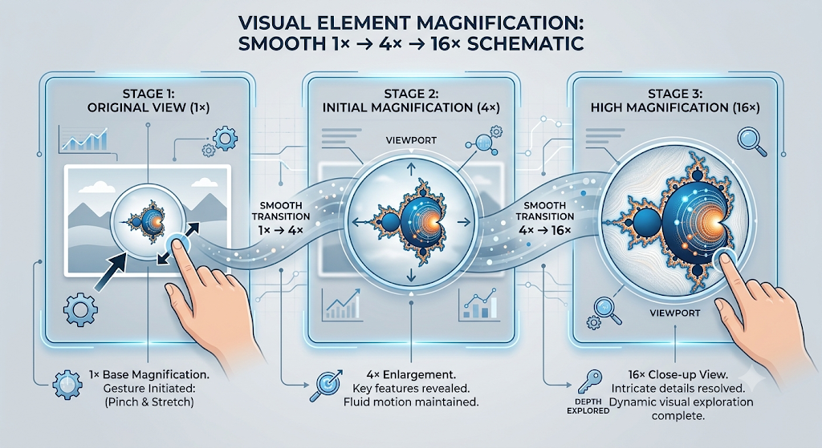
Visualization of Data, Understanding and Interpretation
Rapid Zooming and Google Earth Mechanics (TB 3, Sec 10.3)- solution 3
• Rapid zooming bypasses the spatial distortions of geometric fisheye views by enabling smooth, continuous scale transitions on a single viewport canvas.
• Smooth temporal animations are required during zoom transitions to help the observer maintain object identity and global context across scale boundaries.
• A transition speed of under one second prevents visual search fatigue and supports the seamless integration of detailed views and broad contexts.
• Standard zoom scaling rates should default to a factor of three to four times magnification per second to optimize human perceptual tracking.
• Providing visual coordinate grids or a persistent background minimal prevents the user from becoming disoriented in large virtual spaces.
Instead of distorting the layout (like fisheye did) or showing two separate synced windows, this approach keeps one single continuous view and just smoothly zooms in/out through scale — pinch-to-zoom style (as shown in the image: 1× → 4× → 16×).

Slide 29
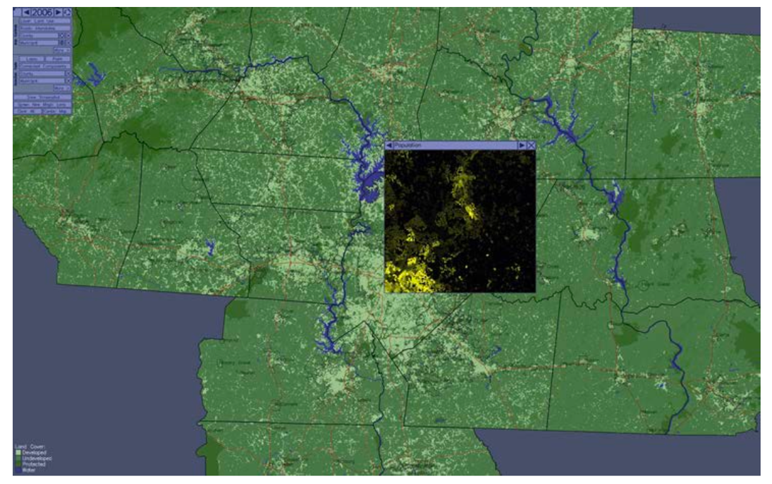
Visualization of Data, Understanding and Interpretation
Interactive Magic Lenses (TB 3, Sec 10.3)
• A magic lens functions as a dynamic, coordinate-linked visual filter that overlays and reveals hidden data attributes over the current focal area.
• Coordinated two-handed interfaces increase productivity by dedicating lens positioning to the non-dominant hand and detailed selection to the dominant hand.
• Transparent toolglass palettes minimize cognitive friction by showing interactive filtering options directly over the visual elements being modified.
• Offset lenses linked by connector lines prevent the active focus region from directly obscuring adjacent or surrounding environmental context.
• Overlaying population densities directly over physical geographic maps illustrates how lenses seamlessly integrate abstract variables with underlying spatial layouts.
A "magic lens" is a movable window you drag over a visualization that reveals a different layer of data underneath the same spot — without replacing or leaving the main view.
A magic lens showing population density with a background map showing land-use patterns.
Notes:
This is a variant of geometric distortion — instead of warping shape/size (like fisheye did), it swaps in different content at the focal point while everything outside the lens stays as normal geographic context. So it's solving the same focus-context problem, but the "distortion" here is about data layers, not spatial scale — you get local detail (population density) without losing the surrounding context (the actual map/terrain).

Slide 30
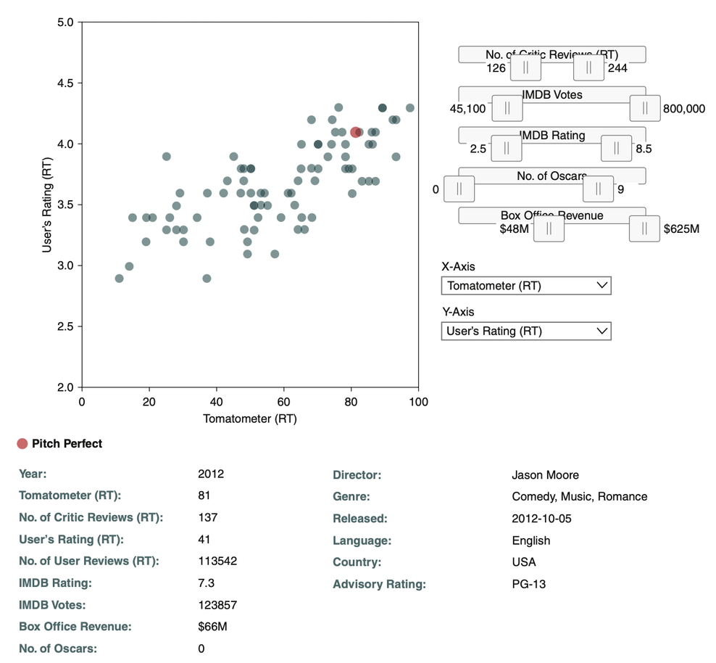
Visualization of Data, Understanding and Interpretation
Interacting with Non-Spatial Data: Dynamic Queries (TB 3, Sec 10.4)
• Dynamic querying allows real-time interactive partitioning of highly multidimensional datasets using double-ended range sliders.
• Continuous slider manipulation filters out unwanted data points instantly, allowing target visual structures to emerge from the noise.
• Display update response times must remain below 100 milliseconds to preserve the user's cognitive flow during continuous visual scanning.
• Up to 100,000 multi-attribute data points can be navigated effectively using five or fewer synchronized query sliders.
• Visual information scent must be embedded into slider tracks to indicate where dense clusters of data exist before filtering occurs.
Pitch Perfect (highlighted in red) has a Tomatometer of 81 — meaning 81% of critic reviews were positive — paired with a User's Rating of 4.1, showing fairly strong agreement between critics and audiences.
Aperture JS movie database dashboard with double-ended range query sliders filtering ratings and box office revenue in real-time.
Notes:
New topicnteracting with non-spatial data (like a movie database) using double-ended range sliders instead of maps or zooming. Since there's no physical "space" to navigate here (just attributes like rating, votes, revenue), the interaction pattern is filtering, not spatial exploration.
Tomatometer is Rotten Tomatoes' film-critic rating score. It's the percentage of professional critic reviews for a movie that are classified as positive

Slide 31
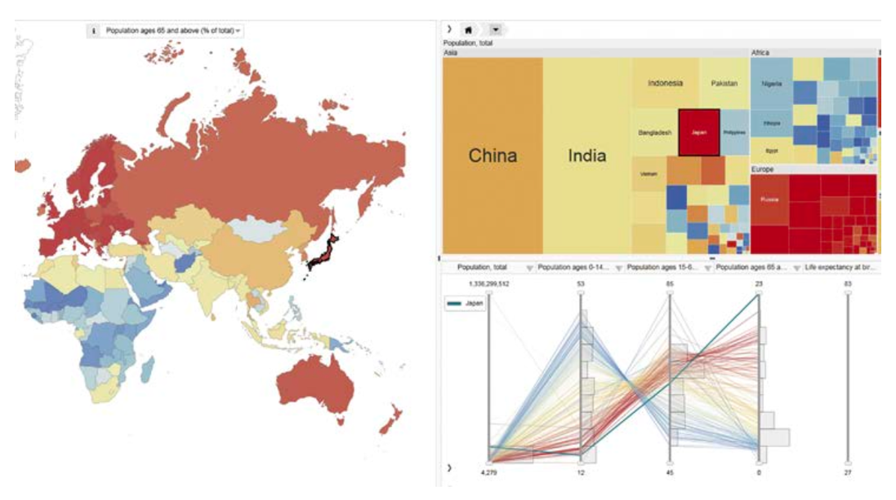
Visualization of Data, Understanding and Interpretation
Coordinated Multiple Views and Cross-View Brushing (TB 3, Sec 12.5)
• Coordinated Multiple Views –same dataset in several chart formats
Composite visualizations display the same multi-dimensional dataset across several different adjacent chart formats simultaneously.
• Cross-view brushing highlights a user-selected subset of data points across all open windows to reveal complex multi-attribute correlations.(interaction that links those views together )
• Side-by-side eye movements replace heavy cognitive working memory loads when synchronized views show related parameters simultaneously.
• Muting(dimming) the contrast of unselected categories is a highly effective highlighting strategy that makes the selected subset pop out preattentively.
• Maintaining absolute consistency in category colors and shapes across all charts ensures immediate mapping of concepts during transitions.
Pattern that works for both spatial and non-spatial data simultaneously,
OECD regional dataset where selecting Japan highlights its metrics in the map, treemap, and parallel coordinate views.
Notes:
New pattern that works for both spatial and non-spatial data simultaneously,
Look closely at the example on this slide: the three linked views are:
A map (spatial — geographic)
A treemap (non-spatial — hierarchical/proportional)
A parallel coordinates plot (non-spatial — multi-attribute)
Coordinated Multiple Views (CMV): Showing the same dataset in several different chart types at the same time, placed side by side (e.g., a map + a treemap + a scatter plot), so each view reveals a different aspect of the data that a single chart couldn't show alone.
Cross-View Brushing: The interaction that links those views together — when you select or hover over a data point in one view, the same data point automatically gets highlighted in every other view too, so you can instantly see how one item relates across all the different attributes/perspectives being shown.
On a dashboard with a map, a bar chart, and a line graph of sales data — if you click on "California" in the bar chart, brushing would automatically highlight California's region on the map and its trend line on the line graph too, all at once — so you don't have to manually search for "California" in each separate chart.

Slide 32
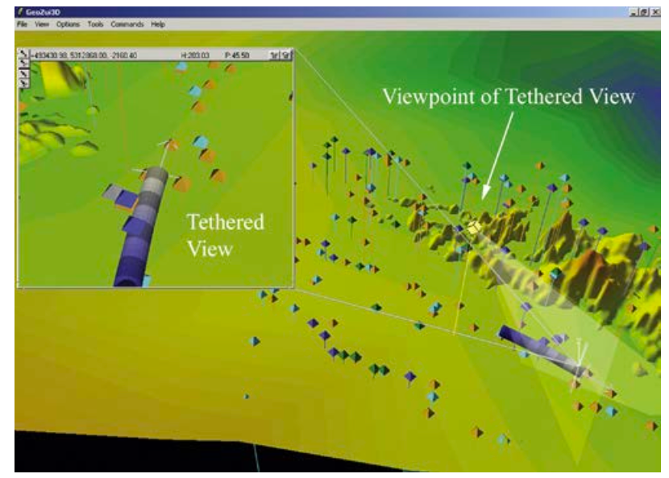
Visualization of Data, Understanding and Interpretation
Visual Momentum and Slide Transitions (TB 3, Sec 9.4)
• Visual momentum measures how easily an observer can link information across consecutive camera cuts or sudden display transitions.
• Grouping identical visualization formats sequentially minimizes the cognitive re-orientation cost of learning new coordinates and axes.
• Using persistent visual anchors like constant scales, grids, and labeled axes helps the brain track visual entities across slides.
• Inset overview (minimaps) provide continuous spatial context and orientation cues when users zoom deeply into detailed focal areas.
• Smooth camera transition paths prevent disorientation in 3D data spaces by maintaining directionality and scale changes during movement.
Tethered magnifier window utilizing coordinate frames to preserve spatial momentum.

Slide 33
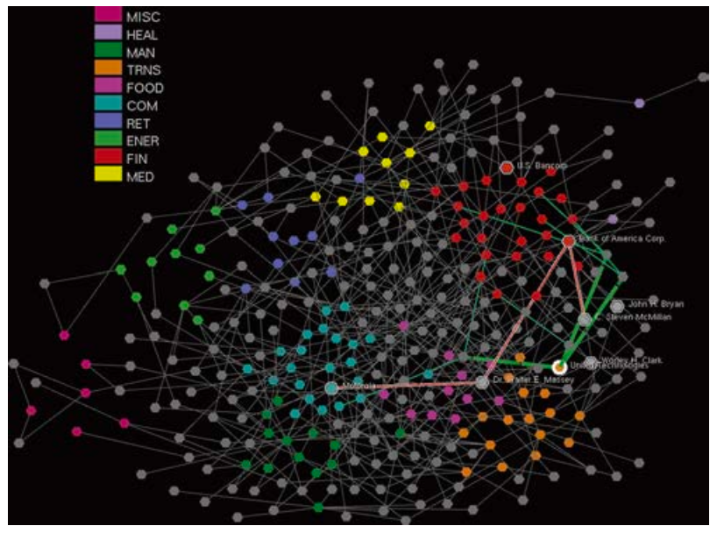
Visualization of Data, Understanding and Interpretation
Network Zooming and Degree-of-Relevance Highlighting (TB 3, Sec 12.5)
• The solution,
Degree-of-relevance highlighting enables the analysis of dense network diagrams by dynamically fading out currently irrelevant nodes and links.
• Selecting or hovering over a node triggers a breadth-first search to highlight connected entities within a small path radius.
• Limiting highlighted path lengths to two or three links prevents the screen from becoming overloaded with secondary relationships.
• High-degree nodes with thousands of edges should be isolated using database search inputs rather than direct manual expansion.
• Dynamic highlighting bypasses static layout limits by allowing edge crossings to remain readable through localized user interactions.
MEgraph network display utilizing motion and edge-highlighting to trace board-of-director connections.
When a network graph has thousands of nodes and edges, it turns into an unreadable tangled mess ("hairball"). You can't tell what's connected to what.?
DoR- Degree-of-relevance is basically a score for "how closely related is this node to the thing I'm currently focused on?"
Notes:
It's another form of solving the focus-context problem (Slide 23) — but for network/graph data
It's a direct real-world example of epistemic actions (Slide 14) — hovering over a node

Slide 34
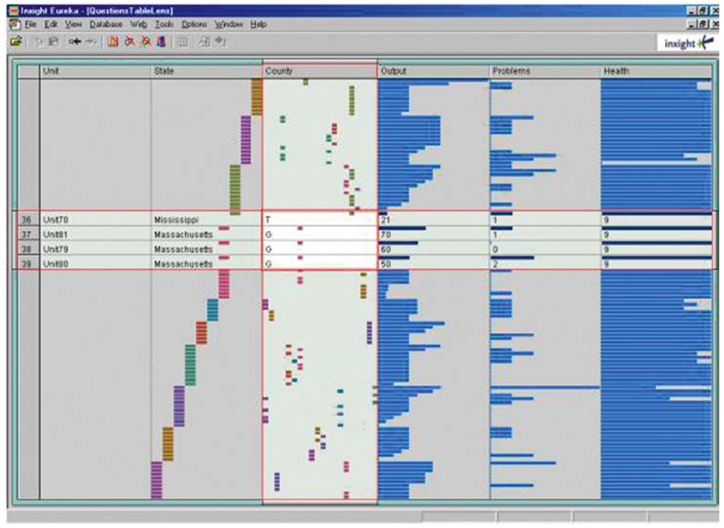
Visualization of Data, Understanding and Interpretation
Table Lens: Making Tabular Data Interactive (TB 3, Sec 10.4)
• The Table Lens maps raw spreadsheet rows into visual columns of mini bar charts, showing both local details and global trends.
• Row-wise expansion allows users to view specific text details on demand while keeping the surrounding numeric trends in view.
• Sorting column values dynamically reorganizes the table to reveal multi-attribute correlations and categorical clustering instantly.
• This spreadsheet-inspired interface beats traditional parallel coordinate plots in user testing for complex decision-making tasks.
• Mapping quantitative values to bar widths leverages preattentive human shape processing to scan thousands of records in seconds.
Table Lens interface with columns sorted and selected rows expanded to display text.
Notes:
Table Lens is a specific visualization tool/technique, originally developed as a research prototype (by Ramana Rao and Stuart Card at Xerox PARC in the 1990s) for browsing large spreadsheets and tables interactively.

Slide 35
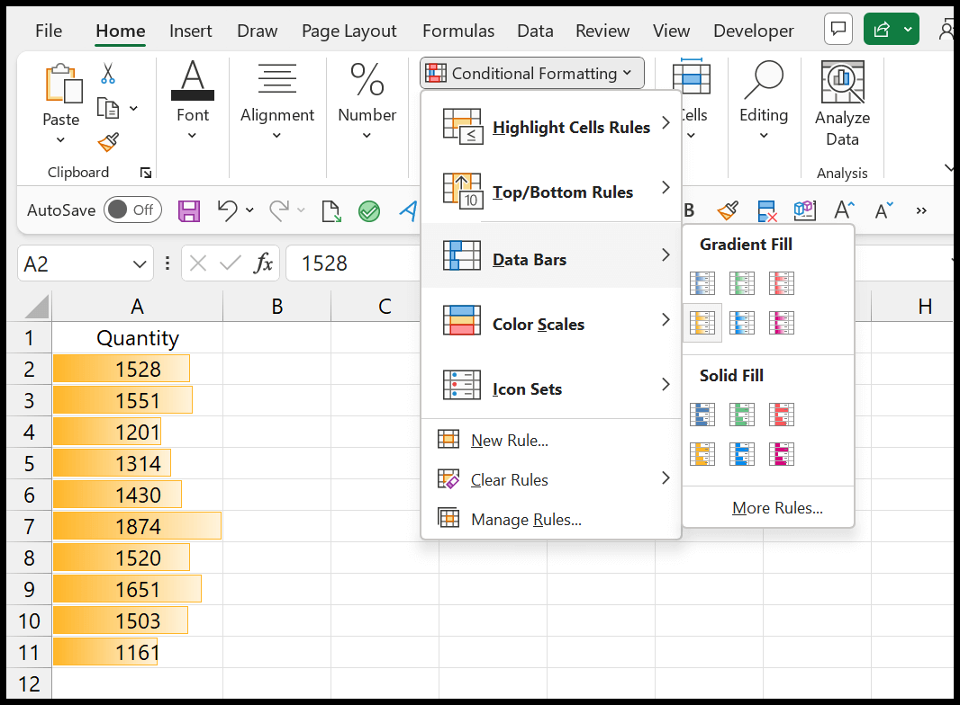
Excel or Google Sheets and applied conditional formatting → Data Bars to a column of numbers, that's a Table Lens in action:
A column of raw sales figures (e.g., ₹12,000 to ₹85,000) gets a colored horizontal bar drawn inside each cell, proportional to its value
You instantly spot the highest and lowest performers just by scanning bar lengths — no need to read every number
You can still click into any cell to see the exact value (row-wise detail on demand)
Sorting the column re-orders the bars, instantly showing you the ranking visually

Slide 36
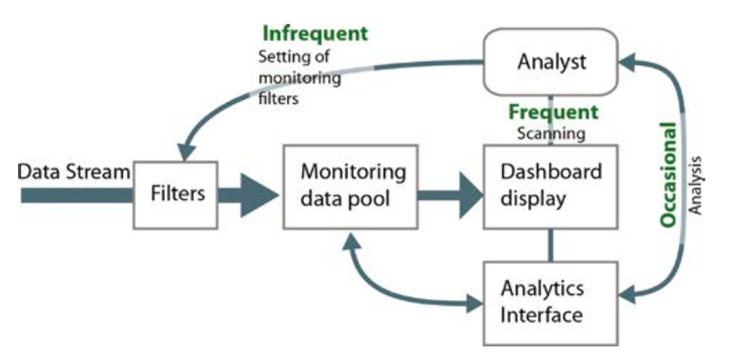
Visualization of Data, Understanding and Interpretation
Visual Monitoring and Analytics Dashboard Patterns (TB 3, Sec 12.5)
• Operational monitoring dashboards must display all critical indicators on a single screen without requiring user interaction.
• Dashboard processes operate across three timescales spanning long-term filter editing, mid-term analysis, and continuous peripheral scanning.
• Subtle motion or blinking highlights should be used for critical alerts because the human peripheral visual system is highly sensitive to motion.
• Using a second screen for deep analytical drills prevents operators from hiding or losing track of the primary monitoring overview.
• Introducing periodic false alerts into repetitive monitoring workflows helps prevent change blindness and maintains operator focus.
Interlocking timescales of monitoring workflows
Infrequent — setting up monitoring filters (done rarely, e.g., once a shift)
Frequent — continuous scanning of the dashboard display (the operator's eyes constantly glancing over it)
Occasional — deeper analysis when something looks off (switching to the Analytics Interface)
Notes:
Focus context The focus shifts from "how do I explore this data" to "how do I keep watching this data without missing anything important."

Slide 37
Visualization of Data, Understanding and Interpretation
Visual Monitoring and Analytics Dashboard Patterns (TB 3, Sec 12.5)
hospital ICU patient monitor
The screen next to a patient's bed continuously displays vital signs — heart rate, blood pressure, oxygen levels — all visible at a glance, with zero interaction needed. The nurse doesn't click anything to see this; it's just always there (matches: "display all critical indicators without requiring user interaction").
If a vital sign goes dangerously low (like oxygen dropping), the screen flashes/blinks red and beeps
The main monitor stays focused on live vitals (frequent scanning); if the nurse needs to review the patient's history or run deeper analysis, they check a separate computer/second screen
Hospitals also periodically run test alarms (a similar concept to the "deliberate false alerts") to make sure staff stay alert and responsive, rather than tuning out the constant beeping over a long shift
continuous passive monitoring (vitals) + occasional deep analysis (records) + motion-based alerts (blinking/beeping) for anything critical.
Notes:
Focus context The focus shifts from "how do I explore this data" to "how do I keep watching this data without missing anything important."

Slide 38
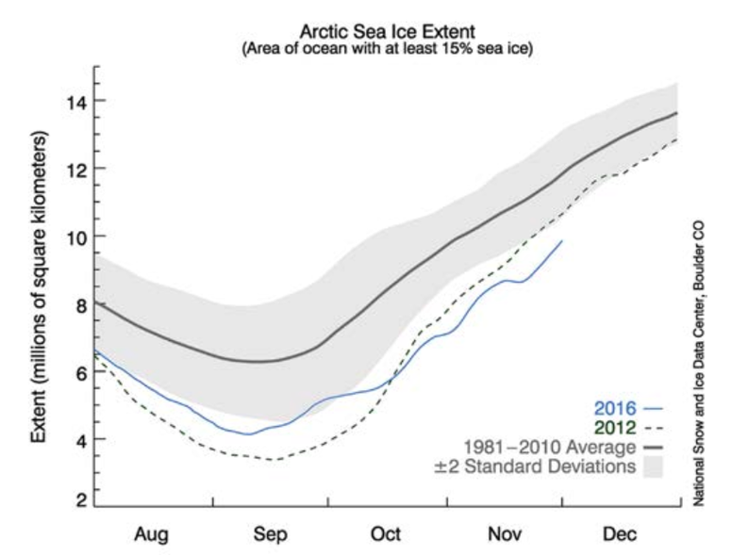
Visualization of Data, Understanding and Interpretation
Model-Based Interactive Planning (TB 3, Sec 12.5)
• Model-based planning combines human visual intuition with computational simulations in a real-time predictive loop.
• Adjusting parameter sliders allows users to immediately observe how simulated systems evolve over years or decades.
• Visualizing error bands or multiple shaded uncertainty ranges prevents users from assuming predictive simulations are perfectly precise.
• Making model rules transparent allows engineers and decision-makers to verify, trust, and debug the projected scenarios.
• Comparing baseline and alternative scenarios side-by-side helps identify complex cause-and-effect relationships within abstract models.
A technique for using visualizations to interact with predictive/simulation models — not just displaying past/current data, but letting users explore "what will happen if..."
Forecasting line chart overlaid with shaded bands representing predictive uncertainty ranges.
A gray shaded band = the historical average range (±2 standard deviations) — representing normal/expected variability
A solid gray line = the 1981–2010 average
A dashed line (2012) and blue line (2016) = actual observed years, both falling well below the historical average band — visually making it obvious these years were abnormally low

Slide 39
Visualization of Data, Understanding and Interpretation
Model-Based Interactive Planning (TB 3, Sec 12.5)
COVID-19 case projection dashboards
These dashboards let public health officials and the public interact with a live epidemic model:
Parameter sliders — you could adjust inputs like "mask compliance rate," "vaccination rate," or "social distancing level," and the projected case/death curve for the coming weeks or months would instantly redraw
Shaded uncertainty bands — nearly every COVID forecast chart showed a shaded region around the projected line (best-case to worst-case range),
Baseline vs. alternative scenarios — dashboards commonly showed "if no intervention" vs. "if lockdown continues" as two overlaid lines, so policymakers could visually compare the cause-and-effect impact of different decisions before committing to one
Model transparency — reputable dashboards published their underlying assumptions (transmission rate, recovery time, etc.), so epidemiologists could verify and debug the model's logic rather than blindly trusting a black-box number

Slide 40
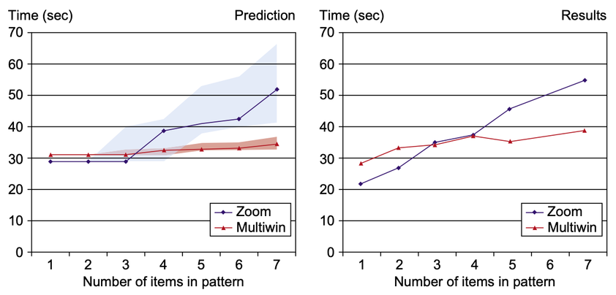
Visualization of Data, Understanding and Interpretation
Cognitive Bottlenecks: Working Memory Limits (TB 3, Sec 11.2)
• Visual working memory is extremely limited, storing only 3 to 5 simple visual elements at any given moment.
• Visual search patterns are planned and executed using top-down attentional maps, moving sequentially from one fixation point to another.
• Change blindness occurs because our internal memory of a scene is highly simplified; if a visual transition is not animated or highlighted, our brains often miss massive changes.
• Static diagrams support visual comparisons by letting the eye scan back and forth between elements on a single high-resolution screen.
• Interactive transitions must happen quickly and smoothly to prevent the user's working memory from dropping key context during the transition.
Model predictions are shown on the left. Measured task performance is shown on the right. Multiple windows speed performance relative to the use of a zooming
interface when the number of objects to be compared is five or more.
predicts that Zoom gets progressively slower than Multiwin as the number of items increases (LHS)
Once you need to compare 5 or more items, using multiple separate windows is actually faster than zooming back and forth
Notes:
Mutiwin- multiwindow

Slide 41
Data type | Focus-context solution
Spatial/geographic | Fisheye distortion, Rapid Zooming, 3D navigation metaphors, Magic Lenses
Hierarchical | Hyperbolic/fisheye browsing (tree structures)
Network/graph | Degree-of-relevance highlighting
Tabular/spreadsheet | Table Lens (compact bar-chart overview + row expansion for detail)
Non-spatial multi-attribute | Dynamic Queries (filtering technique, not officially named a focus-context solution)
Mixed spatial + non-spatial | Coordinated Multiple Views / Cross-View Brushing

Slide 42
Visualization of Data, Understanding and Interpretation
MCQs
1. A dashboard allows an analyst to freely select data points, filter attributes, and change the displayed view while investigating an unfamiliar dataset. Which characteristic best describes this interaction?
A. Author-controlled narrative
B. Exploratory interaction
C. Static visual framing
D. Precomputed presentation
Answer: B
Exploratory = you're driving the car, deciding the route as you go
Author-controlled narrative = you're a passenger on a guided tour with fixed stops
Static/Precomputed = you're just looking at a photo of someone else's trip

Slide 43
Visualization of Data, Understanding and Interpretation
MCQs
2. According to Fitts' Law, what happens to movement time when you reduce both target distance (D) and target width (W) by 50%?
A. Movement time doubles
B. Movement time is cut in half
C. Movement time remains unchanged
D. Movement time increases exponentially
Answer: C

Slide 44
Visualization of Data, Understanding and Interpretation
MCQs
4. A user selects a subset of countries in a map, and the same countries are automatically highlighted in a treemap and parallel-coordinate plot. What technique is being demonstrated?
A. Dynamic querying
B. Cross-view brushing
C. Geometric distortion
D. Rapid zooming
Answer: B

Slide 45
Visualization of Data, Understanding and Interpretation
MCQs
5. A visualization contains thousands of records, and the analyst wants to identify patterns by interactively filtering numerical ranges. Which technique is most appropriate?
A. Static framing
B. Window replacement
C. Dynamic queries
D. Narrative sequencing
Answer: C

Slide 46
Thank You

