Slide 1

Visualization of Data, Understanding and Interpretation
Unit 2 : Advanced Visualization & Storytelling
(UE24CS342AA9)
Visualization of Data, Understanding and Interpretation
Dr.Prajwala TR (Course Instructor)
Dept. of CSE, PES University, Bangalore

Slide 2
Visualization of Data, Understanding and Interpretation
Acknowledgement
The slides are prepared from various resources from the Universities from abroad and India. Also, some material is taken from reliable resources from internet throughout this course.

Slide 3
Visualization of Data, Understanding and Interpretation
Lecture Overview-dimensionality reduction
In this lecture, we will cover:
  Understanding high-dimensional data and the need for dimensionality reduction
  Mathematical foundations of PCA, including centering, standardization, covariance, eigenvalues, eigenvectors, projection, and explained variance
  Understanding t-SNE and UMAP through neighborhood preservation, probability distributions, embeddings, and parameter effects
  Comparing PCA, t-SNE, and UMAP for different visualization objectives
  Exploring real-world applications in image analysis, text, genomics, and machine-learning embeddings

Slide 4

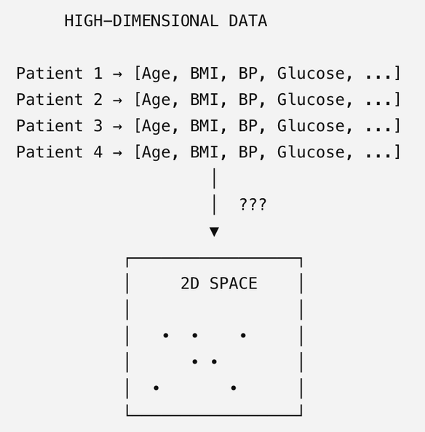
Visualization of Data, Understanding and Interpretation
The High-Dimensional Visualization Problem
A dataset may contain dozens, hundreds, or thousands of variables for each observation.
For example, a single patient may be described by:
Age · Height · Weight · BMI · Blood Pressure · Glucose · Heart Rate · … · 100+ measurements
Each patient is therefore a point in a high-dimensional feature space:
where p is the number of dimensions.
The visualization problem
A scatter plot can directly show: 2 dimensions → 2D
but what about: 50 dimensions → ?
We need a way to transform high-dimensional data into a lower-dimensional representation that can be visually explored.
Dimensionality reduction converts high-dimensional measurements into a low-dimensional representation that can be visualized and interpreted.

Slide 5
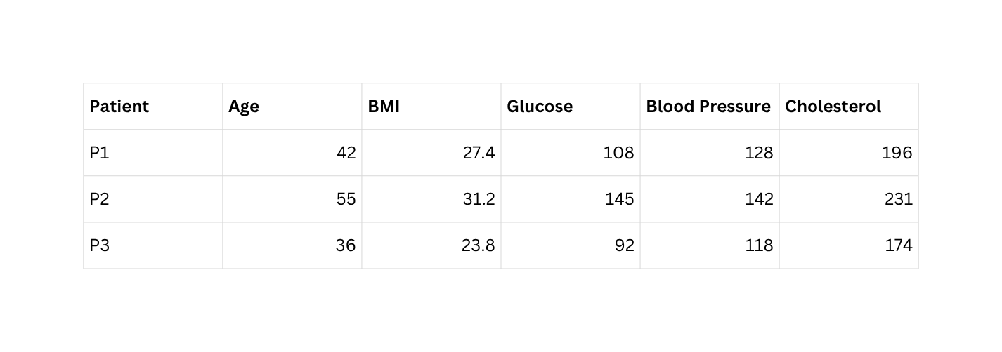
Visualization of Data, Understanding and Interpretation
The High-Dimensional Visualization Problem
What Does “Dimension” Actually Mean?
A dimension is a measurable attribute of an observation.
In a dataset, each dimension corresponds to one attribute, variable, or feature used to describe an observation.
Consider a dataset of patients:
Here:
  Rows → observations / data entities
  Columns → dimensions / attributes
  Values → measurements of each dimension

Slide 6

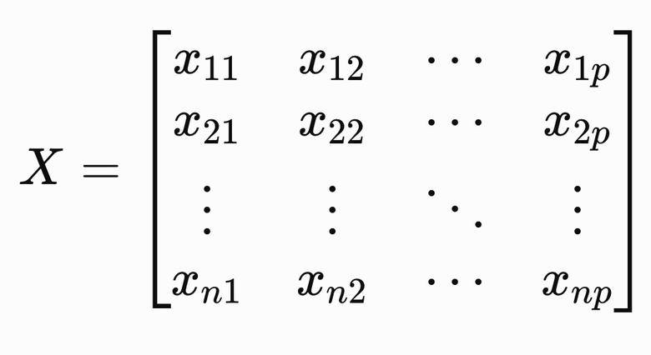
Visualization of Data, Understanding and Interpretation
The High-Dimensional Visualization Problem
Therefore, this dataset has 5 dimensions:
Each patient can be viewed as one point in a 5-dimensional feature space.
Why Dimensions Matter?
  With 1 dimension, we can visualize a distribution directly.
  With 2 dimensions, we can use a scatter plot.
  With 3 dimensions, we can attempt a 3D representation.
  Beyond 3 dimensions, direct spatial visualization becomes difficult.
So a dataset with p features can be represented mathematically as:
where:
  n = number of observations
  p = number of dimensions/features
  Each observation is a point in p-dimensional space.

Slide 7
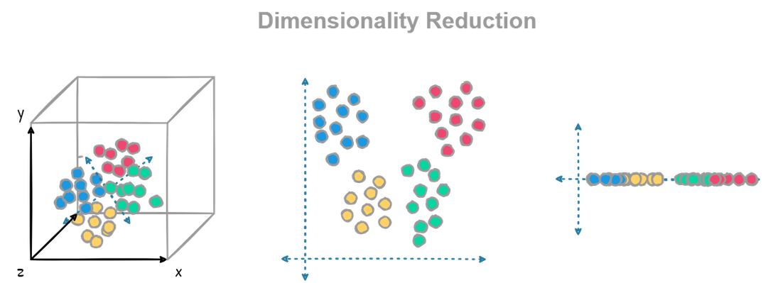
Visualization of Data, Understanding and Interpretation
Dimension Reduction (TB 1, Sec 12.3)
Why Do We Need Dimension Reduction?
  So far, we have explored relationships between two variables using scatter plots and multiple variables using correlation matrices (correlograms).
  However, real-world datasets often contain dozens or even hundreds of correlated variables, making them difficult to visualize and interpret.
  Dimension reduction transforms these high-dimensional datasets into a small number of new variables that preserve most of the important information, allowing patterns, clusters, and relationships to be visualized more easily.
Why is it Important?
  Removes redundant information caused by highly correlated variables.
  Simplifies complex datasets while retaining most of the underlying structure.
  Enables visualization of high-dimensional data in two or three dimensions for easier interpretation. (Typical visualization methods: PCA, t-SNE, UMAP)

Slide 8
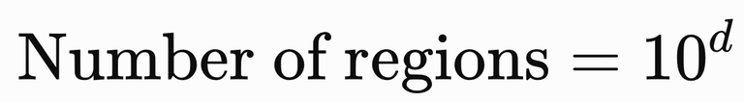
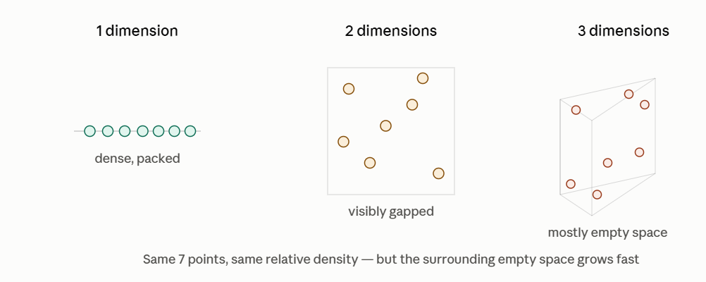
Visualization of Data, Understanding and Interpretation
The Curse of Dimensionality
As the number of dimensions increases, the data space grows extremely rapidly, making it harder to sample, compare, and visualize observations effectively.
For a grid with 10 intervals per dimension:
Example: Suppose each dimension is divided into 10 equal bins.
Why is this a problem?
  Data points become increasingly sparse in the available space.
  Distances and similarities can become less informative as dimensions increase.
  Direct visualization becomes difficult because the display has limited spatial dimensions and perceptual bandwidth.
As dimensions increase, the space grows exponentially.

Slide 9
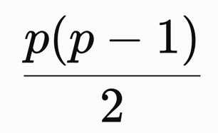
Visualization of Data, Understanding and Interpretation
The Curse of Dimensionality
Another Example:
For p variables, the number of unique pairwise relationships is:
Therefore,
  p = 5 → 10
  p = 10 → 45
  p = 30 → 435
  p = 100 → 4,950
This creates the following problems:
  Too many variables
  Too many pairwise relationships
  Human visual space is limited

Slide 10
Visualization of Data, Understanding and Interpretation
Redundant Information
Many Variables Can Describe the Same Underlying Pattern
High-dimensional datasets often contain correlated variables, meaning that several measurements change together and therefore carry overlapping information. Consider measurements of a person's physical characteristics: Height · Weight · Arm Length · Leg Length · Waist · Hip · Chest
A larger person will generally tend to be:
  taller
  heavier
  longer in the arms and legs
  larger in waist, hip, and chest circumference
Therefore, these 7 dimensions do not necessarily represent 7 independent pieces of information.
Instead of thinking: 7 variables → 7 independent dimensions
we can think of the measurements as being driven largely by a smaller number of underlying factors:

Slide 11
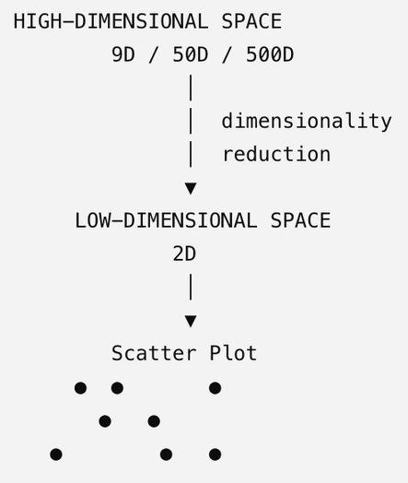
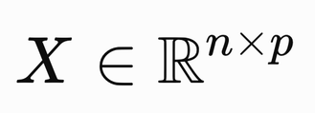
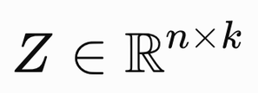

Visualization of Data, Understanding and Interpretation
What Does Dimension Reduction Actually Do?
From High-Dimensional Measurements to a Low-Dimensional Representation
Dimensionality reduction does not simply delete columns from a dataset. Instead, it derives a new, lower-dimensional representation from the original high-dimensional data.
Suppose we have:
where n = observations and p = measured dimensions.
The goal is to construct:
where:
For example: 100 measured dimensions → 2 derived dimensions
What happens to the information?
The original data contains many patterns, relationships, and variations. A reduction method tries to retain the most useful structure while representing the data with fewer dimensions.
A useful way to think about the process is:
High-dimensional data → Find important structure → Construct a lower-dimensional representation → Visualize in 2D / 3D

Slide 12
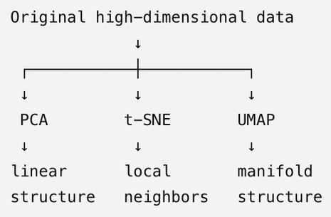
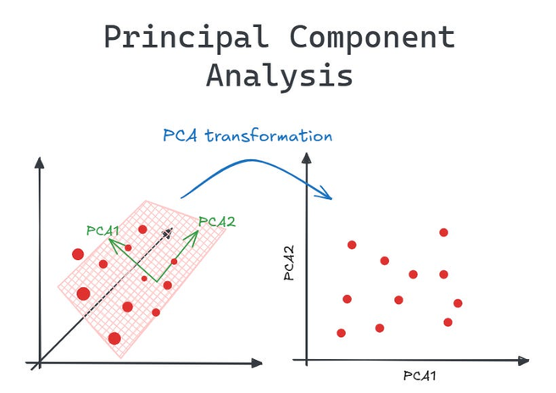
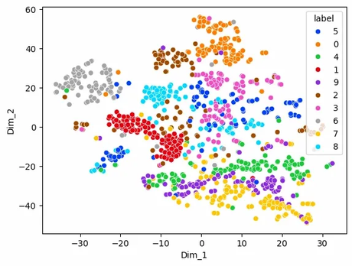
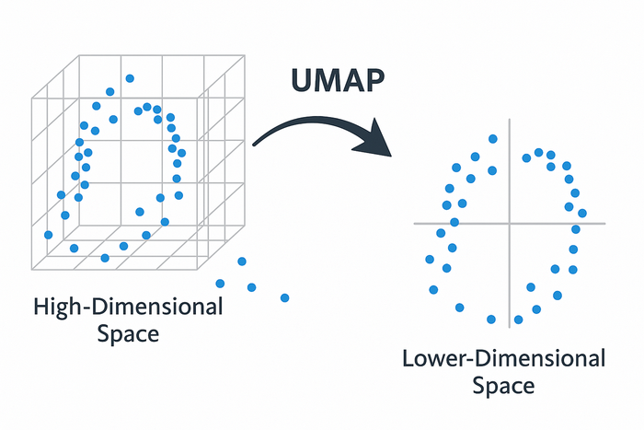
Visualization of Data, Understanding and Interpretation
Common Dimension Reduction Techniques
Technique | Purpose
PCA (Principal Component Analysis) | Finds new axes that capture the maximum variation in the data.
t-SNE (t-distributed Stochastic Neighbor Embedding) | Preserves local neighborhoods to reveal clusters in complex datasets.
UMAP (Uniform Manifold Approximation and Projection) | Preserves both local and global structure while providing fast, scalable visualization.

Slide 13
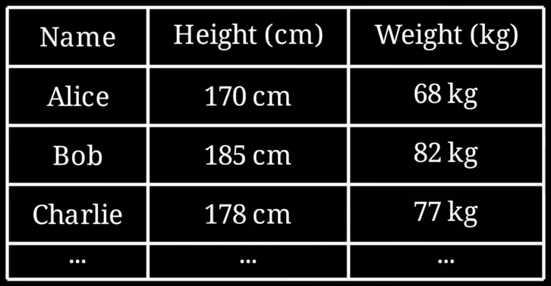
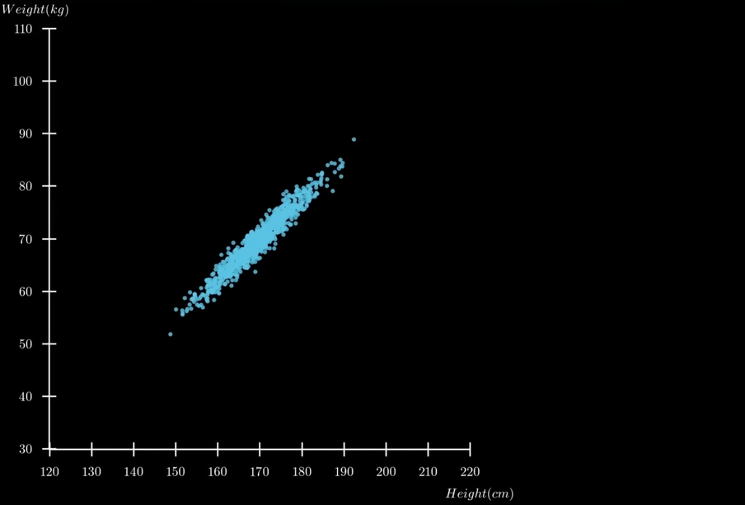
Visualization of Data, Understanding and Interpretation
Principle Component Analysis
Principal Component Analysis (PCA) is a dimension reduction technique that transforms correlated variables into a smaller set of uncorrelated variables called principal components, while preserving most of the variation in the data.
Let us understand this visually with the help of an example:
  Imagine we have gathered information (weight, height) of a 1000 people
  We can plot this data in the form of a graph to observe how this data is distributed (scatter plot)
Source: https://youtu.be/o_cAOa5fMhE?si=cliXzpQ5YuL8NYnQ

Slide 14
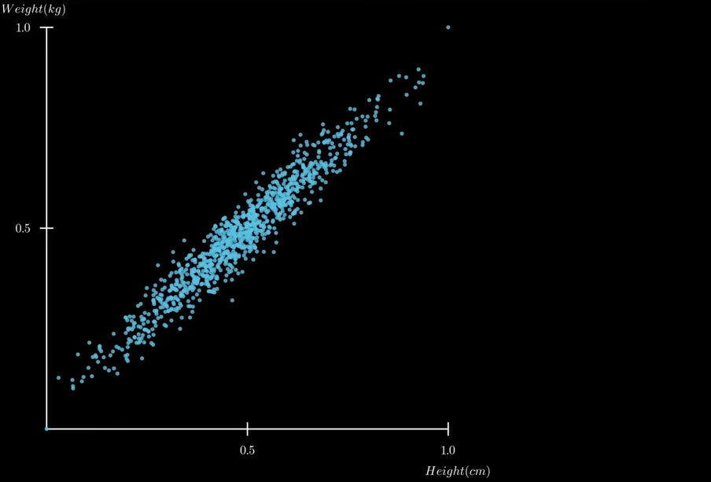
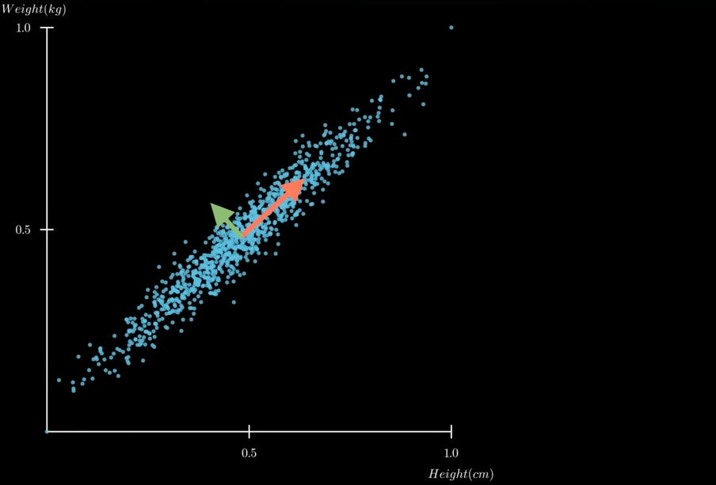
Visualization of Data, Understanding and Interpretation
Principle Component Analysis
  We can then normalize this data. Here, it means bringing the data to a range between 0-1. The result of normalization gives the fist figure
  We can notice that the data varies along 2 directions represented by the two arrow in the second figure
  We can also say that the data varies greatly along the red arrow in comparison to the green. Hence, the variation along the red arrow is more significant than the green arrow
  These arrows are called principal components

Slide 15
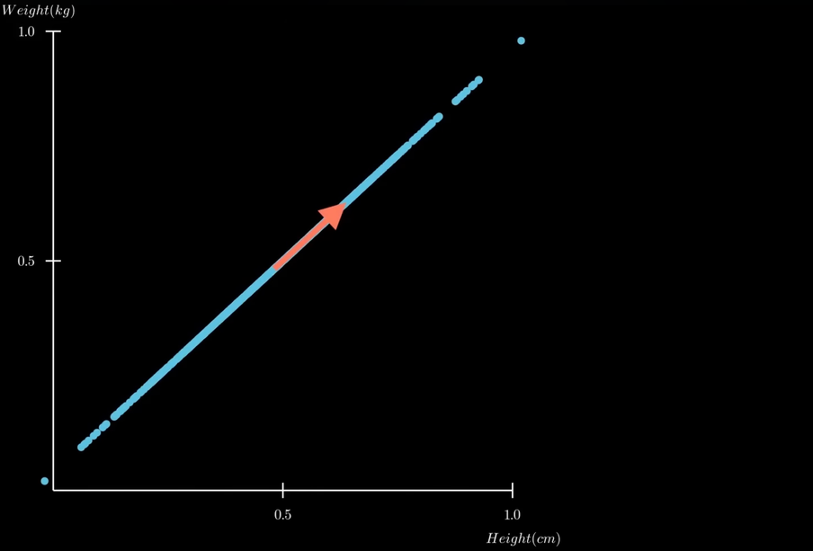
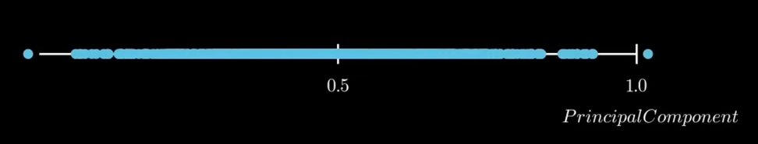
Visualization of Data, Understanding and Interpretation
Principle Component Analysis
  Suppose we want to represent this 2D data on a single axis
  One way to do that is to project the data onto the largest principal component axis (red axis)
  The final 1D graph is given in the second figure
  However, you might wonder why we can’t project the data directly as given onto the horizontal axis
  When you revert back to the 2D graph, it seems that just projecting to this axis yields a very similar result
  To understand this better, lets change the dataset

Slide 16
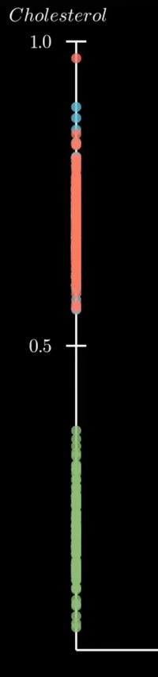
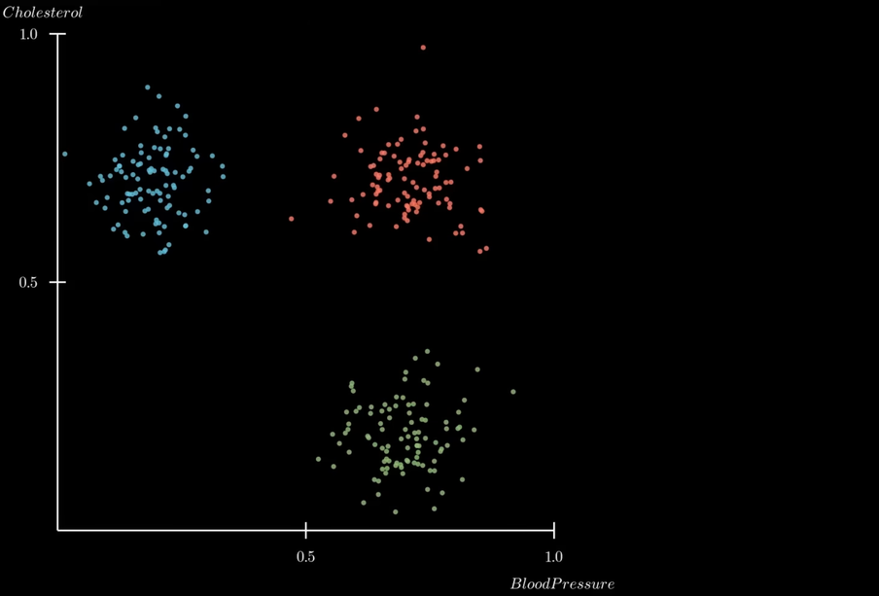
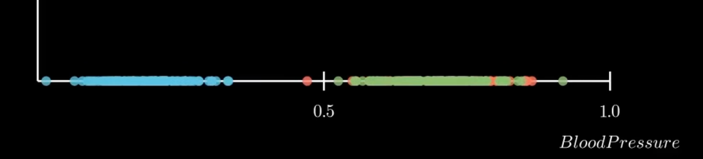
Visualization of Data, Understanding and Interpretation
Principle Component Analysis
  The new dataset records blood pressure and cholestrol levels of several patients
  When we plot this distribution, we find that the data forms 3 distinct clusters
  If we project the data onto the x-axis or y-axis, we see only 2 distinct clusters
  This means that we’ve combined 2 different populations in our low dimensional representation, which is incorrect
  Now, lets see what happens when we project the data along the principal component

Slide 17
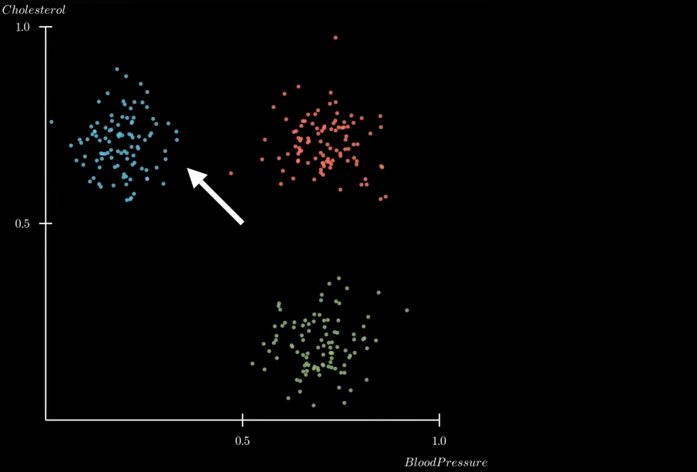
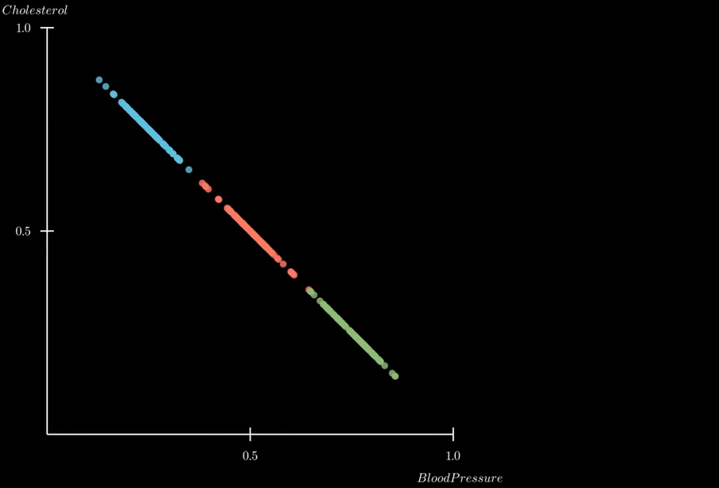
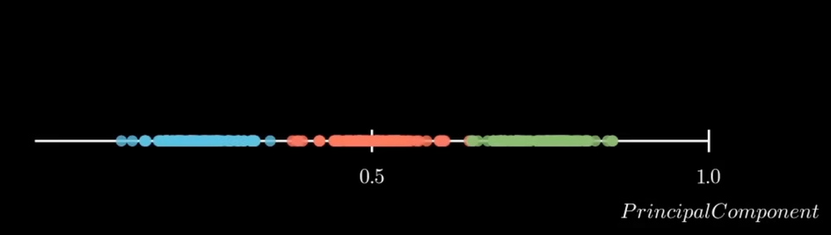
Visualization of Data, Understanding and Interpretation
Principle Component Analysis
  This time, we successfully retain all 3 clusters in our low dimensional representation
  This low dimensional representation preserves the main features of our original data, which is much better than the simple projections we tried previously
  Now, lets try and understand how we can compute these principle components mathematically

Slide 18
Pointers for PCA
High number of dimensions to low number of dimensions- find principal components
Number of PC<= number of attributes
PC1,PC2,PC3…. PC1-high priority
Orthogonal property-PC1 and PC2 are independent

Slide 19
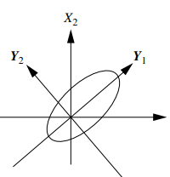
PCA Procedure
The basic procedure is as follows:
The input data are normalized, so that each attribute falls within the same range
PCA computes k orthonormal vectors that provide a basis for the normalized input data. These vectors are referred to as the principal components
The principal components are sorted in order of decreasing “significance” or strength. the sorted axes are such that the first axis shows the most variance among the data, the second axis shows the next highest variance, and so on.
the data size can be reduced by eliminating the weaker components, that is, those with low variance. Using the strongest principal components, it should be possible to reconstruct a good approximation of the original data.
This means each principal component tells you something new about the data that the others don't, leading to a clearer and more efficient understanding of the structure within the data.
Notes:
Why orthonormal?
Imagine a dataset that has two main directions of variance, say along the x-axis and the y-axis. If these directions are orthogonal, the data's variance along the x-axis does not influence the variance along the y-axis. This means each principal component tells you something new about the data that the others don't, leading to a clearer and more efficient understanding of the structure within the data.

Slide 20
DATA ANALYTICS
PCA - Steps
Step 1: Standardize the dataset.
Step 2: Calculate the covariance matrix for the features in the dataset.
Step 3: Calculate the eigenvalues and eigenvectors for the covariance matrix.
Step 4: Sort eigenvalues and their corresponding eigenvectors.
Step 5: Pick k eigenvalues and form a matrix of eigenvectors.
Step 6: Transform the original matrix
Lets go step by step
Notes:
Eigenvectors represent directions.
eigenvalue is a number that tells us how the data set is spread out on the line which is an Eigenvector.

Slide 21
EXTRA
Thus, PCA is a method that brings together:
A measure of how each variable is associated with one another. (Covariance matrix.)
The directions in which our data are dispersed. (Eigenvalues.)
The relative importance of these different directions. (Eigenvector)

Slide 22
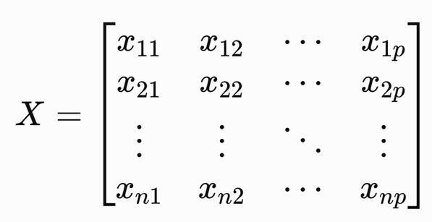
Visualization of Data, Understanding and Interpretation
How to Compute Principal Components
Suppose we have n observations measured across p variables:
Each row represents an observation, while each column represents a measured variable.
PCA transforms these original variables into a new set of variables called principal components (PCs). Wilke describes these PCs as linear combinations of standardized original variables, ordered so that PC1 captures the greatest possible variation, PC2 the next greatest, and so on.
Steps: X → Center → Scale → Covariance → Eigenvectors → Projection

Slide 23
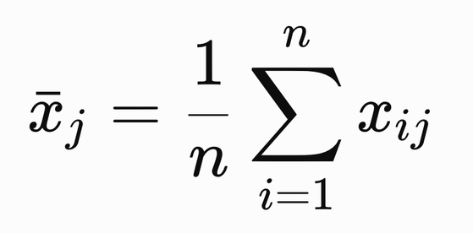
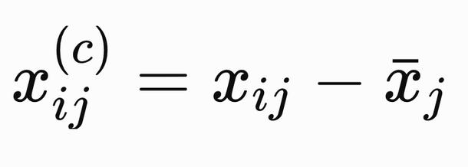
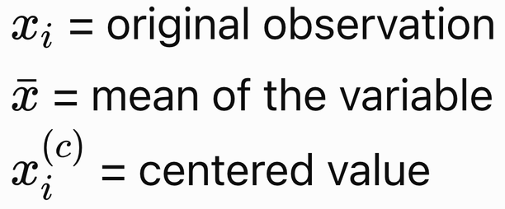
Visualization of Data, Understanding and Interpretation
How to Compute Principal Components
Step 1: Center the Data
For each variable, calculate its mean:
Then subtract the mean from every observation:
This moves the center of the data cloud to the origin: Mean of every variable = 0​
Centering does not change the spread of the data. It only changes its location.

Slide 24
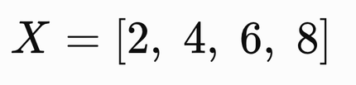
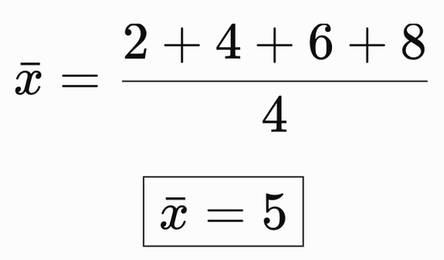
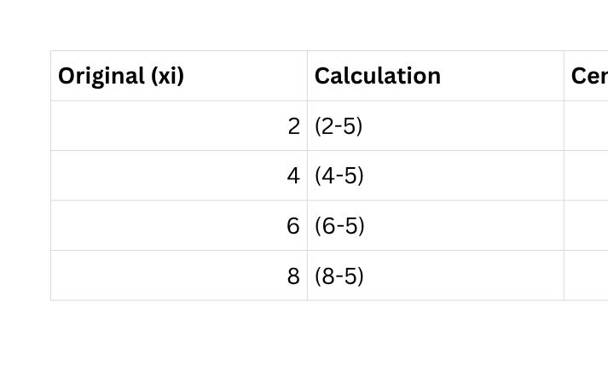
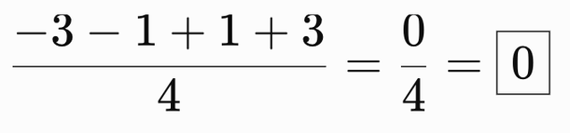
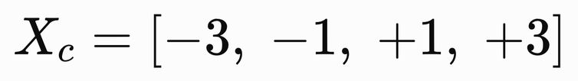
Visualization of Data, Understanding and Interpretation
How to Compute Principal Components
Step 1: Worked Example
Suppose the values of a variable are:
Simple one variable dataset
  Calculate the mean
  Subtract the mean from every value
Check
The mean of the centered values must be zero:
Therefore:

Slide 25
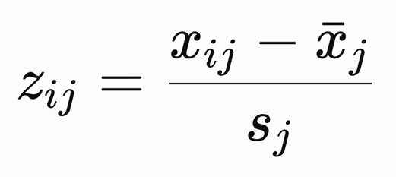
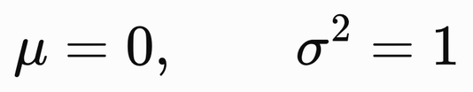
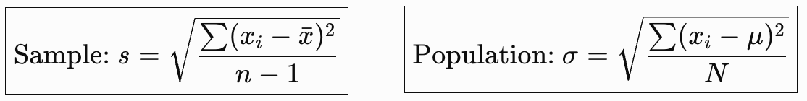
Visualization of Data, Understanding and Interpretation
How to Compute Principal Components
Step 2: Standardize the Variables
When variables are measured on different scales, their variances are not directly comparable.
Standardize each variable using:
where sj​ is the standard deviation of variable j
*note: the numerator implies mean centering
After standardization:
This prevents a variable with numerically large units from dominating PCA simply because of its scale.

Slide 26

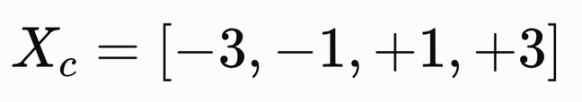
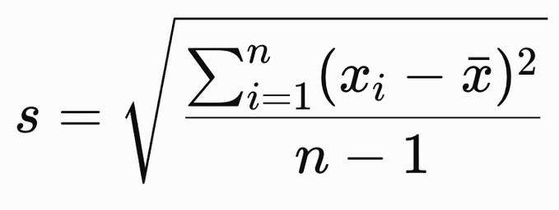
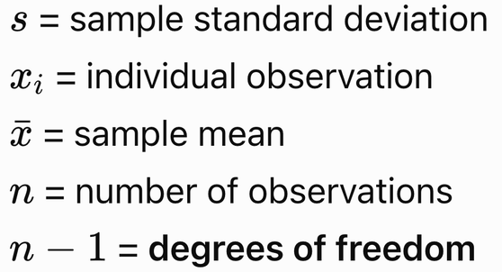
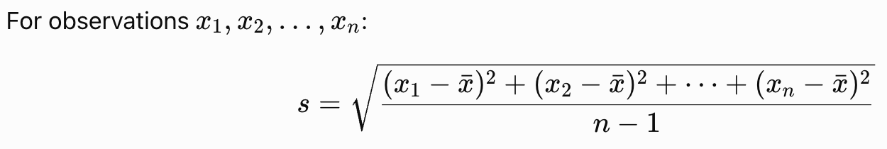
Visualization of Data, Understanding and Interpretation
How to Compute Principal Components
Step 2: Worked Example
Using the same data from the previous example, we already calculated:
  Calculate the standard deviation
Sample Standard Deviation Formula:
Expanded Form:

Slide 27
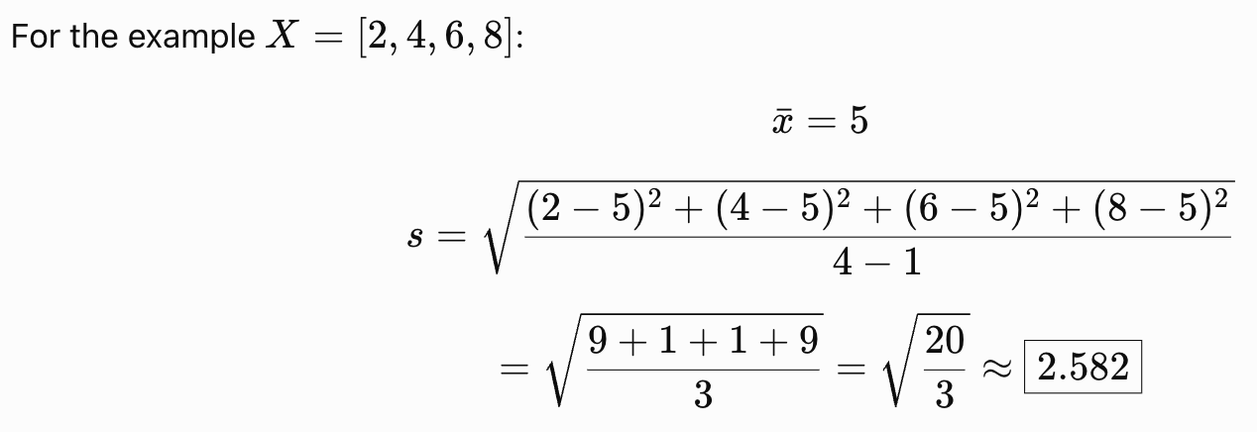
Visualization of Data, Understanding and Interpretation
How to Compute Principal Components
Note!
  Sample standard deviation: Used when the data represents a sample from a larger population. It divides by n−1 to account for the fact that the population mean is being estimated from the sample.
  Population standard deviation: Used when the data contains the entire population of interest. It divides by N because the true population mean is known.

Slide 28
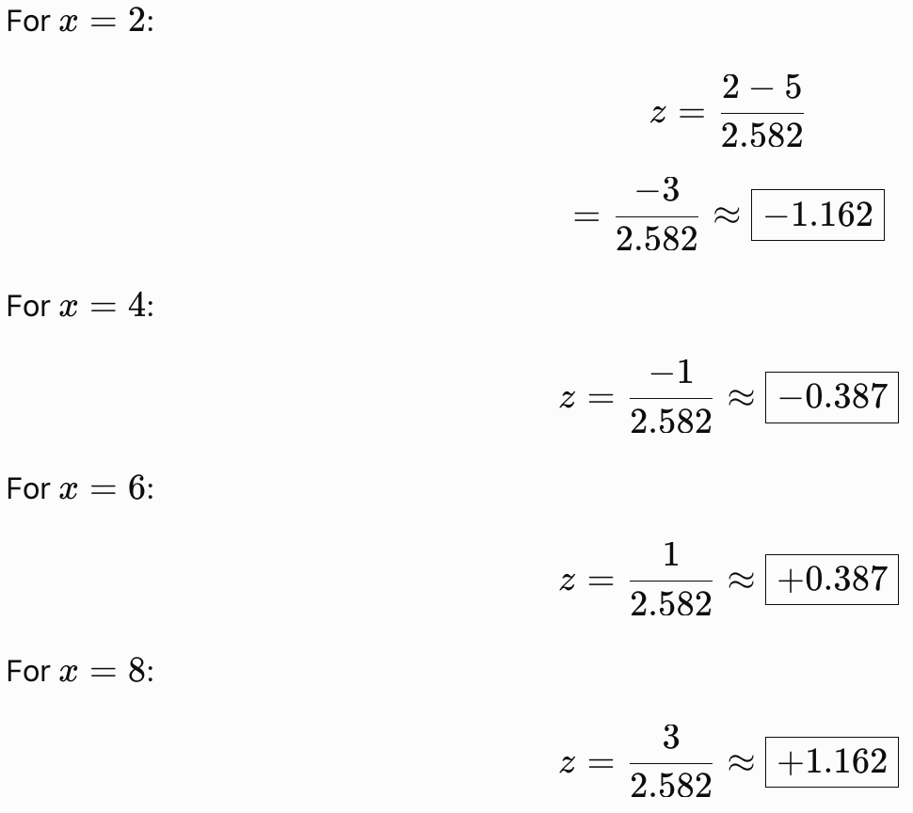
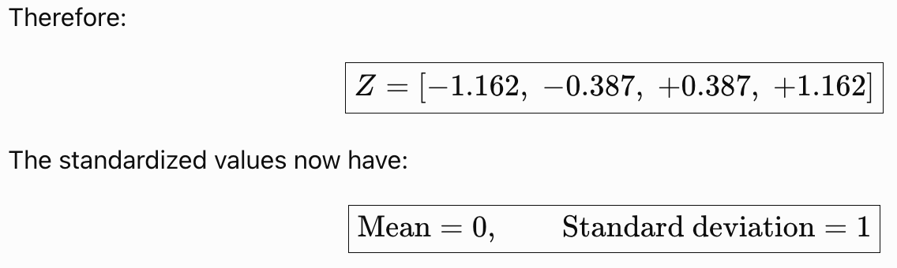
Visualization of Data, Understanding and Interpretation
How to Compute Principal Components
  Divide every centered value by s

Slide 29
Visualization of Data, Understanding and Interpretation
How to Compute Principal Components
Why Is Standardization Important?
PCA is sensitive to the scale of the variables. Consider two variables describing people:
  Age: 20 – 60 years
  Annual income: ₹20,000 – ₹80,000
Their numerical scales are very different.
If PCA is performed directly on the raw measurements, a variable with a much larger numerical scale can have a much larger variance and therefore dominate the principal components.
Example: Var(Age) = 100, but Var(Income) = 400,000,000
The variance of income is enormously larger because of its units and scale, not necessarily because income contains more meaningful structure.
After standardization, both variables are transformed so they are expressed in the same unit:
How many standard deviations is this observation from the mean?
  z = 2 means the observation is 2 standard deviations above the mean.
  z = −1.5 means the observation is 1.5 standard deviations below the mean.

Slide 30
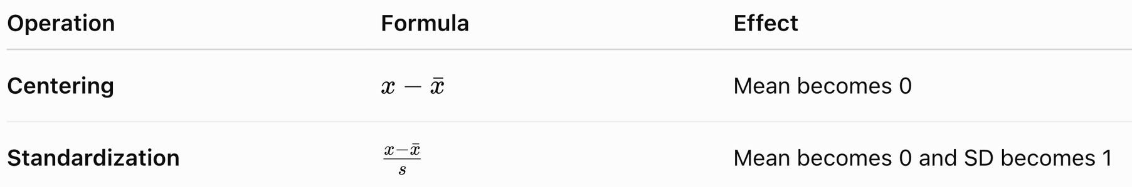
Visualization of Data, Understanding and Interpretation
How to Compute Principal Components
Why PCA benefits from this
PCA compares variables based on their patterns of variation and relationships, rather than allowing measurement units to determine which variable dominates.
  Centering answers: “Where is the data centered?”
  Standardization answers: “How far is each value from the mean relative to the variable's spread?”
This distinction will make the subsequent covariance-matrix calculation much easier for students to follow.

Slide 31
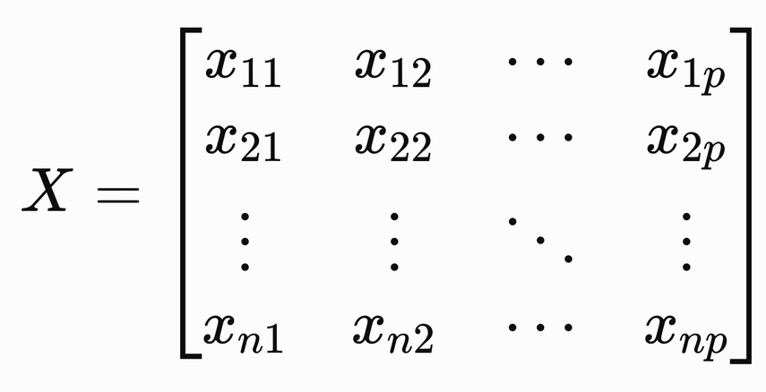
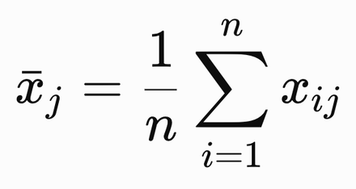

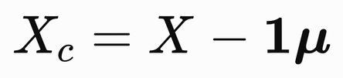
Visualization of Data, Understanding and Interpretation
How to Compute Principal Components
Step 3: Mean Centering in Matrix Form
Mean centering shifts every variable so that its mean becomes zero.
Suppose our dataset contains n observations and p variables:
The mean of variable j is:
The vector containing the means of all variables is:
We subtract these column means from every observation:
where 1 is an n×1 vector of ones.

Slide 32



Visualization of Data, Understanding and Interpretation
How to Compute Principal Components
Consider 2 variable dataset-next example
Step 3: Worked Example
Consider:
There are 3 observations and 2 variables.
  Calculate the column means
  Subtract the row means from every row

Slide 33

Visualization of Data, Understanding and Interpretation
How to Compute Principal Components
  Verify the result

Slide 34

Visualization of Data, Understanding and Interpretation
How to Compute Principal Components
Matrix Interpretation

Slide 35

Visualization of Data, Understanding and Interpretation
How to Compute Principal Components
Important!
Relationship With Step 2 — Standardization:

Slide 36

Visualization of Data, Understanding and Interpretation
How to Compute Principal Components
Step 4: Construct the Covariance Matrix
After centering/standardizing the variables, PCA needs to determine how the variables vary together. Covariance measures whether two variables tend to increase or decrease together.
For two variables X and Y:
  Positive covariance: both variables tend to increase/decrease together.
  Negative covariance: one tends to increase when the other decreases.
  Covariance near 0: little linear co-variation.
Feature | Covariance | Correlation
Definition | Measures how two variables change together. | Measures both the strength and direction of the linear relationship.
Range | Any real number (−∞ to +∞). | Always between −1 and +1.
Units | Depends on the units of the variables. | Unitless (standardized).
Interpretation | Magnitude is hard to interpret because it depends on scale. | Easy to interpret because values are standardized.
Covariance answers: "Do these variables move together?"
Correlation answers: "How strongly do they move together?"

Slide 37

Visualization of Data, Understanding and Interpretation
How to Compute Principal Components
Constructing the Covariance Matrix

Slide 38



Visualization of Data, Understanding and Interpretation
How to Compute Principal Components
Step 4: Worked Example
Use the centered matrix from Step 3:
  n = 3 observations
  p = 2 variables
  Calculate variance of X1
  Calculate variance of X2

Slide 39


Visualization of Data, Understanding and Interpretation
How to Compute Principal Components
  Calculate covariance between X1 and X2
The positive value makes sense: when X1​ increases, X2​ also increases.
  Build the covariance matrix

Slide 40



Visualization of Data, Understanding and Interpretation
How to Compute Principal Components
Therefore:
Notice the symmetry:
Matrix Shortcut
Instead of calculating every element individually, the covariance matrix can be obtained directly from the centered data matrix:

Slide 41

Visualization of Data, Understanding and Interpretation
How to Compute Principal Components

Slide 42

Visualization of Data, Understanding and Interpretation
How to Compute Principal Components
Why Is This Step Important?
The covariance matrix summarizes the variation and relationships among all variables in a single mathematical object.
PCA uses this matrix to find the directions in which the data has the greatest variance.
The next step is therefore: Covariance Matrix → Eigenvalues + Eigenvectors​
The eigenvectors will give us the new principal directions, while the eigenvalues will tell us how much variance each direction captures.
Important:
PCA convention: if we use the standardized matrix from Step 2 rather than merely the centered matrix, then the same calculation
produces the correlation matrix, because every standardized variable has variance 1. This is the convention used in Wilke's PCA treatment, where variables are standardized to zero mean and unit variance before determining the principal directions.

Slide 43
Visualization of Data, Understanding and Interpretation
How to Compute Principal Components
Step 5: Eigenvalues and Eigenvectors
The covariance matrix tells us how the variables vary together, but PCA still needs to find the new directions in which the data should be viewed. PCA obtains these directions by calculating the eigenvectors of the covariance matrix. At the same time, the corresponding eigenvalues tell us how much variance exists along each direction.
  Eigenvector → direction of a principal component
  Eigenvalue → variance captured along that direction
The eigenvectors are ordered by decreasing eigenvalue: λ1 > λ2 > λ3 > ...
so that:

Slide 44


Visualization of Data, Understanding and Interpretation
How to Compute Principal Components
Step 5: Worked Example
From Step 4, we obtained:
Part A: Calculate the Eigenvalues

Slide 45

Visualization of Data, Understanding and Interpretation
How to Compute Principal Components

Slide 46

Visualization of Data, Understanding and Interpretation
How to Compute Principal Components

Slide 47

Visualization of Data, Understanding and Interpretation
How to Compute Principal Components
Part B: Interpret the Eigenvalues
Interpretation
All variation in this particular example lies along one direction.
That makes sense because our original variables were perfectly linearly related: X2​ = 2X1 ​+ 6
So although we started with 2 variables, the data effectively contains only 1 direction of variation.

Slide 48



Visualization of Data, Understanding and Interpretation
How to Compute Principal Components
Part C: Calculate the Eigenvector for λ1​ = 20
Therefore, we can choose:
But PCA requires unit eigenvectors, so we normalize it.

Slide 49

Visualization of Data, Understanding and Interpretation
How to Compute Principal Components
Therefore, we can choose:

Slide 50


Visualization of Data, Understanding and Interpretation
How to Compute Principal Components
Part D: Calculate the Eigenvector for λ2 = 0

Slide 51

Visualization of Data, Understanding and Interpretation
How to Compute Principal Components
Final PCA Directions

Slide 52


Visualization of Data, Understanding and Interpretation
How to Compute Principal Components
What Have We Actually Found?
The eigenvector gives the direction of the new axis.
The eigenvalue tells us how much variation lies along that axis.
Therefore:
  Eigenvector = direction​
  Eigenvalue = importance / variance
Important: The sign of an eigenvector is arbitrary
The vectors below represent the same principal direction. Reversing the sign only reverses the direction of the axis; it does not change the PCA solution.
Now that we have the principal directions v1​, v2​, the next step is to project every observation onto those directions: Z = Xc​V

Slide 53
Visualization of Data, Understanding and Interpretation
How to Compute Principal Components
Step 6: Project the Data onto the Principal Components
We have now found the principal directions using eigenvectors.
The next question is where does each observation lie along these new directions?
Projection converts every original observation into its coordinates in the new principal-component coordinate system. If the centered/standardized data matrix is Xc​, and the selected eigenvectors are placed into a matrix V, then: Z = Xc​V
  Xc​ = centered data matrix
  V = matrix of eigenvectors
  Z = data represented in principal-component coordinates
The columns of Z are the principal-component scores.

Slide 54


Visualization of Data, Understanding and Interpretation
How to Compute Principal Components
Step 6: Worked Example
Continuing the previous example,
Therefore, the eigenvector matrix is:

Slide 55

Visualization of Data, Understanding and Interpretation
How to Compute Principal Components
  Calculate the PCA Scores

Slide 56

Visualization of Data, Understanding and Interpretation
How to Compute Principal Components
Observation A

Slide 57

Visualization of Data, Understanding and Interpretation
How to Compute Principal Components

Slide 58

Visualization of Data, Understanding and Interpretation
How to Compute Principal Components
Observation B

Slide 59

Visualization of Data, Understanding and Interpretation
How to Compute Principal Components
Observation C

Slide 60

Visualization of Data, Understanding and Interpretation
How to Compute Principal Components
Observation C

Slide 61

Visualization of Data, Understanding and Interpretation
How to Compute Principal Components
Final Transformed Dataset

Slide 62

Visualization of Data, Understanding and Interpretation
How to Compute Principal Components
What Does This Mean Visually?
Originally, the observations were described using: (X1​, X2​)
After PCA, they are described using: (PC1, PC2)
So we can plot the transformed observations:
The points now lie entirely along the PC1 axis.
That is exactly what we would expect because: λ1​ = 20, λ2​ = 0
so PC1 contains 100% of the variance.

Slide 63

Visualization of Data, Understanding and Interpretation
How to Compute Principal Components
Projection of a Single Observation
It is also useful to understand the calculation without the entire matrix.

Slide 64


Visualization of Data, Understanding and Interpretation
How to Compute Principal Components
Why Is Projection Important?
Eigenvectors tell us which directions should we use?
Projection tells us where does each observation fall along those directions?
This distinction is fundamental:
  Eigenvectors → new axes​
  Projection → new coordinates​
Once every observation has PC scores, we can finally create the visualization: PC1 on x-axis, PC2 on y-axis
Dimensionality Reduction Happens Here​
Suppose the original dataset has p = 100 variables, but we retain only the first two eigenvectors:
Then:
Therefore: 100D → 2D​

Slide 65

Visualization of Data, Understanding and Interpretation
Explaining Variance & Choosing k
How Many Principal Components Should We Keep?
Each principal component has an eigenvalue λi​ representing the amount of variance it captures.

Slide 66




Visualization of Data, Understanding and Interpretation
Explaining Variance & Choosing k
k≪p while retaining most of the meaningful structure. That's the practical rule of thumb this section is teaching: pick the smallest $k$k where CEV is "high enough" (often 80–95%, depending on convention).
So keeping just the first 2 components ($k=2$k=2, versus the original $p=4$p=4) already captures 80% of the total variance

Slide 67


Visualization of Data, Understanding and Interpretation
Explaining Variance & Choosing k
Thus, if the target is ≥ 90% variance, choose: k = 3

Slide 68

Visualization of Data, Understanding and Interpretation
PCA Numericals
Extra Questions:
1) A dataset contains the following three observations for a single variable: X={2,4,6}
  Calculate the mean of the variable.
  Subtract the mean from each observation to obtain the mean-centered values.
  Verify that the mean of the centered data is zero.
2) A dataset contains three principal components with eigenvalues: λ1​ = 8, λ2​ = 2, λ3​ = 1
  Calculate the percentage of variance explained by PC1.
  Calculate the cumulative percentage of variance explained by PC1 and PC2.
  If we want to retain at least 90% of the total variance, how many principal components should be retained?
3) A centered observation is represented by: x = [2, 4].
  Using the projection formula: PC1​=xv1​, calculate the PC1 score of the observation.
  The first principal component has the unit eigenvector:

Slide 69

Visualization of Data, Understanding and Interpretation
PCA Numericals
Answers:
1)

Slide 70

Visualization of Data, Understanding and Interpretation
PCA Numericals
Answers:
2)

Slide 71
Visualization of Data, Understanding and Interpretation
PCA Numericals
Answers:
2)

Slide 72

Visualization of Data, Understanding and Interpretation
PCA Numericals
Answers:
3)

Slide 73
Visualization of Data, Understanding and Interpretation
What Is t-SNE?
PCA Looks for Linear Structure
PCA finds new axes that capture the maximum variance in the data.
This works well when important structure is approximately linear, but some datasets contain non-linear relationships that cannot be represented effectively by a straight-line projection.
Example: A Curved / Spring-Like Dataset
Imagine two classes arranged along a curved structure in 3D.
High-dimensional structure → 2D visualization
  PCA: may mix the classes together.
  t-SNE: can preserve the local neighborhoods and reveal the two groups.
PCA asks: “Which directions contain the most variance?”
t-SNE asks: “Which points are close to each other?”

Slide 74
Visualization of Data, Understanding and Interpretation
What Is t-SNE?
t-SNE stands for t-Distributed Stochastic Neighbor Embedding
It was developed by Laurens van der Maaten and Geoffrey Hinton as an improved version of SNE.
  The central idea is simple: points that are close together in high-dimensional space should remain close together in the low-dimensional representation.
  Instead of directly trying to preserve every numerical distance, t-SNE converts distances into probabilities of being neighbors.
  High-dimensional distances → Neighbor probabilities → 2D embedding
PCA | t-SNE
Finds directions of maximum variance | Finds similar neighbors
Linear transformation | Non-linear embedding
Global variance is central | Local relationships are central
Notes:
t-Distributed → uses a Student's t-distribution in the low-dimensional space
Stochastic → uses probabilistic relationships/randomness
Neighbor → focuses strongly on nearby/similar points
Embedding → converts high-dimensional data into a lower-dimensional representation
A t-distribution (Student’s t-distribution) is a probability distribution that looks similar to the normal distribution but has heavier tails.

Slide 75

Visualization of Data, Understanding and Interpretation
What Is t-SNE?
Methodological Overview:
Step 1: Convert Distances into Probabilities
Suppose we choose one point xi​
We calculate its distance from every other point: d(xi​, xj​)
Nearby points should have a high probability of being neighbors. Distant points should have a low probability.
t-SNE/SNE uses a Gaussian distribution to convert these distances into probabilities:
  Small distance → large similarity probability​
  Large distance → small similarity probability
  The parameter σi​ controls the width of the Gaussian neighborhood.
Original high-dimensional data
A ●──● B A and B are close
high probability
A ●──────────────● C A and C are far
low probability

Slide 76



Visualization of Data, Understanding and Interpretation
What Is t-SNE?
Step 2: Build the Same Probabilities in 2D
Initially, the points are placed randomly in the lower-dimensional space.
For example:
becomes
We then calculate similarities between the 2D points using a corresponding probability distribution:
We now have two probability distributions:
  P = similarities in high-dimensional space
  ​Q = similarities in low-dimensional space​
  Goal: Make P≈Q​

Slide 77

Visualization of Data, Understanding and Interpretation
What Is t-SNE?
Step 3: Compare the Two Distributions
t-SNE uses Kullback–Leibler divergence (KL divergence) to measure how different the two probability distributions are. You can think of KL divergence as a measure of mismatch between probability distributions.
Interpretation:
  KL(P||Q) large → high-dimensional and low-dimensional relationships are very different.
  KL(P||Q) small → the two representations are more similar.
  The ideal situation is: KL(P||Q) = 0, when the distributions match.
  Main objective: minimize KL(P||Q)

Slide 78




wo probability distributions over 2 outcomes (say, "neighbor" vs "not neighbor"):
So $KL\left(P∥Q\right)≈0.226$KL(P∥Q)≈0.226 — a small positive number telling you $P$ and $Q$ are somewhat different but not wildly so.
Notes:
Use ln

Slide 79

Visualization of Data, Understanding and Interpretation
What Is t-SNE?
Step 4: Move the Points Until the Distributions Match
The points initially have random 2D positions. t-SNE repeatedly:
  Calculates the low-dimensional similarities.
  Compares them with the high-dimensional similarities.
  Calculates the KL divergence.
  Adjusts the 2D positions.
  Repeats.
Eventually, points that were strong neighbors in the original space tend to become close together in the 2D representation.
t-SNE does not calculate the final 2D coordinates directly. It iteratively searches for a 2D arrangement that preserves neighborhood relationships.

Slide 80
Visualization of Data, Understanding and Interpretation
What Is t-SNE?
Perplexity: Controlling the Neighborhood
The width of the Gaussian distribution is controlled by σi​
But instead of directly choosing a different σi​ for every point, t-SNE uses a parameter called perplexity.
Conceptually:
  Perplexity ≈ effective neighborhood size​
  Low perplexity focuses more strongly on very local relationships.
  Low perplexity → smaller neighborhoods
  High perplexity considers a broader neighborhood.
  High perplexity→larger neighborhoods
  The algorithm adjusts σi​ so that the resulting probability distribution has approximately the chosen perplexity.
t-SNE working: https://youtu.be/o_cAOa5fMhE?si=P-shHNEsnGu8zkML

Slide 81

Visualization of Data, Understanding and Interpretation
t-SNE vs. PCA
Strengths
  Handles non-linear structure
  Excellent at revealing local clusters
  Can separate groups that PCA may mix together
  Useful for exploring complex latent spaces
Limitations
  Computationally more expensive than PCA
  Results can be sensitive to perplexity
  Different parameter choices can produce different visualizations
  Cluster distances and sizes should not automatically be interpreted as meaningful global distances
  It is primarily a visual exploration technique, rather than a general-purpose dimensionality-reduction transformation

Slide 82
Visualization of Data, Understanding and Interpretation
What is UMAP?
From Local Neighbors to a Global Map
t-SNE demonstrated that nonlinear dimensionality reduction can reveal local clusters that PCA may miss. However, t-SNE has important limitations:
  It can be computationally expensive.
  Results can be sensitive to parameter choices.
  It primarily emphasizes local neighborhood structure.
  The global arrangement of clusters may be difficult to interpret.
UMAP
Uniform Manifold Approximation and Projection (UMAP) is another nonlinear dimensionality-reduction method designed to preserve the structure of high-dimensional data while producing a low-dimensional representation.
  UMAP builds a representation of how observations are connected locally, then finds a low-dimensional layout that preserves those relationships.
  High-dimensional data → Neighborhood structure → Low-dimensional embedding​

Slide 83

Visualization of Data, Understanding and Interpretation
What is UMAP?
Suppose we have points in a high-dimensional space.
For each point, UMAP asks which other observations are its nearest neighbors?
This produces a nearest-neighbor graph:
Each point becomes a node, and nearby observations are connected. UMAP then attempts to create a 2D representation where these important connections are retained.
Find neighbors → Build graph → Optimize 2D layout​
Key difference from PCA
  PCA: Finds directions of maximum variance.
  UMAP: Finds relationships between neighboring observations.

Slide 84


Visualization of Data, Understanding and Interpretation
What is UMAP?
How UMAP Builds the Embedding
From High-Dimensional Neighborhoods to a 2D Map

Slide 85


Visualization of Data, Understanding and Interpretation
What is UMAP?
High-dimensional data
↓
Nearest neighbors
↓
Neighborhood graph
↓
2D embedding
↓
Visual Clusters / Structure

Slide 86

Visualization of Data, Understanding and Interpretation
What is UMAP?
Parameters
nneighbours controls how much of the neighborhood UMAP considers.
  small n → more local structure​
  large n → broader structure​
min_dist controls how tightly points can be packed together in the low-dimensional representation.
  small min_dist → tighter clusters​
  large min_dist → more spread-out points​

Slide 87
Visualization of Data, Understanding and Interpretation
PCA vs. t-SNE vs. UMAP
 | PCA | UMAP | t-SNE
Type | Linear | Nonlinear | Nonlinear
Main idea | Maximum variance | Neighborhood / manifold structure | Local similarity
New axes | Yes | No | No
Local structure | Moderate | Strong | Strong
Global structure | Generally preserved through linear projection | Often better represented | Often less reliable
Main parameters | Number of PCs | n_neighbours, min_dist | Perplexity, learning rate
Typical use | Compression + visualization | Exploring local + broader structure | Exploring local clusters

Slide 88
Visualization of Data, Understanding and Interpretation
Real-World Applications of Dimensionality Reduction
Where Do PCA, t-SNE and UMAP Actually Get Used?
Dimensionality reduction is particularly useful when each observation has many features, but we want to explore patterns, groups, similarities, or anomalies visually.
1. Image & Computer Vision
Images can be represented using hundreds or thousands of features.
Image features→ PCA / t-SNE / UMAP→2D embedding
Use:
  Visualize whether images form natural groups
  Identify similar images
  Detect unusual images
  Explore learned CNN/AI embeddings
Example: Plot thousands of image embeddings and color points by object class.

Slide 89
Visualization of Data, Understanding and Interpretation
Real-World Applications of Dimensionality Reduction
2. Text & Document Analysis
A document collection can be represented using a very high-dimensional vector space.
Use:
  Discover groups of similar documents
  Explore topics
  Identify unusual documents
  Visualize semantic relationships
Example: News articles → embedding → UMAP → clusters corresponding to different topics.
3. Genomics & Biological Data
A single biological sample can contain thousands of measured variables, such as gene-expression values. Gene expression → PCA → t-SNE / UMAP
Use:
  Identify groups of similar cells
  Explore cell populations
  Detect unusual observations
  Visualize biological states or transitions

Slide 90

Visualization of Data, Understanding and Interpretation
Real-World Applications of Dimensionality Reduction
4. Dimensionality Reduction in Machine Learning
Visualizing a Model's Latent Space:
Modern machine-learning models often transform raw inputs into high-dimensional embeddings.
For example:
We cannot directly visualize the 512-dimensional representation. So 512D → 2D using PCA, t-SNE, or UMAP. If similar examples appear close together: similar inputs→similar embeddings→nearby points​
We can visually investigate:
  Class separation
  Clusters
  Outliers
  Misclassified examples
  Similarity between learned representations

Slide 91
Visualization of Data, Understanding and Interpretation
MCQ
Q1. Which statement best describes the primary objective of PCA?
A. Preserve local neighborhood relationships
B. Maximize variance along successive directions
C. Construct a nearest-neighbor graph
D. Minimize KL divergence
Answer: B

Slide 92
Visualization of Data, Understanding and Interpretation
MCQ
Q2. A dataset has principal-component eigenvalues of 6,2,1, and 1. How many components are required to retain at least 80% of the total variance?
A. 1
B. 2
C. 3
D. 4
Answer: B

Slide 93
Visualization of Data, Understanding and Interpretation
MCQ
Q3. In t-SNE, what does perplexity primarily control?
A. Number of principal components
B. Width of the visualization axes
C. Effective neighborhood size
D. Number of output dimensions
Answer: C

Slide 94
Visualization of Data, Understanding and Interpretation
MCQ
Q4. Which operation converts a centered observation into its coordinate along a principal component?
A. Covariance calculation
B. Eigenvalue decomposition
C. Matrix normalization
D. Projection onto the eigenvector
Answer: D

Slide 95
Visualization of Data, Understanding and Interpretation
MCQ
Q5. Which characteristic most clearly distinguishes UMAP from PCA?
A. UMAP uses nonlinear neighborhood-based structure
B. UMAP requires exactly two variables
C. UMAP maximizes total variance
D. UMAP produces original feature values
Answer: A

Slide 96
Thank You

