Slide 1

Visualization of Data, Understanding and Interpretation
Unit 2 : Advanced Visualization & Storytelling
(UE24CS342AA9)
Visualization of Data, Understanding and Interpretation
Dr.Prajwala TR (Course Instructor)
Dept. of CSE, PES University, Bangalore

Slide 2
Visualization of Data, Understanding and Interpretation
Acknowledgement
The slides are prepared from various resources from the Universities from abroad and India. Also, some material is taken from reliable resources from internet throughout this course.

Slide 3
Visualization of Data, Understanding and Interpretation
Lecture Overview
In this lecture, we will cover:
  Audience-Centric Design — adapting visualization design to audience knowledge, goals, tasks, and viewing context.
  Visual Design and Hierarchy — using affordances, alignment, proximity, whitespace, and visual hierarchy to organize information.
  Annotation and Highlighting — using labels, callouts, emphasis, and contextual information to guide interpretation.
  Accessibility in Visualization — redundant encoding, perceptual limitations, luminance contrast, and accessible visual communication.
  Ethical Visualization — examining how scale, aggregation, selection, omission, uncertainty, and annotation can influence interpretation.
  Design and Ethical Audit — evaluating a visualization for accuracy, transparency, accessibility, interpretability, and appropriate framing.

Slide 4
Visualization of Data, Understanding and Interpretation
Audience-Centric Visualization (TB 2, Ch 4-6)
A visualization is created for an audience, not simply for the data. The design should therefore begin by understanding who will view the visualization, what they need to know, and what they need to accomplish.
Key considerations
  Audience knowledge: What does the viewer already know about the subject and the data?
  Purpose: Is the visualization intended for exploration, explanation, communication, or decision-making?
  Information needs: Which aspects of the data are relevant to the audience's question or task?
  Context of use: Will the visualization be presented in a lecture, included in a report, viewed on a dashboard, or examined independently?
  Level of detail: The amount of information and explanation should be appropriate to the audience's expertise and available time.
Example:
A detailed analytical plot may be appropriate for a data scientist, while an executive audience may need a simpler visual emphasizing the few findings relevant to a decision.

Slide 5
Visualization of Data, Understanding and Interpretation
Understanding the Audience
What should we know about the audience?
Before choosing a chart or designing its appearance, consider the characteristics, expectations, and needs of the intended audience. A visualization that works well for one group may be ineffective for another.
1. Domain Knowledge
  Experts: Can interpret technical terminology, statistical concepts, and complex visualizations.
  Non-experts: May require simpler terminology, additional context, and more explicit explanations.
2. Visualization Literacy
Consider how familiar the audience is with:
  Common chart types and visual encodings
  Axes, scales, legends, and uncertainty
  Statistical concepts and quantitative comparisons
3. Audience Goal
Determine what the viewer is expected to do:
  Explore — discover patterns or anomalies
  Compare — identify differences between groups
  Understand — learn relationships or trends
  Decide — use the information to support an action
4. Time and Attention
  A presentation may require the main finding to be understood within seconds.
  An analytical report can support more detailed examination.
  A dashboard may need to support repeated and rapid monitoring.
5. Context of Use
The design also depends on where and how the visualization will be consumed:
  Presentation / lecture
  Printed report
  Research paper
  Dashboard
  Mobile or small-screen display

Slide 6
Visualization of Data, Understanding and Interpretation
Designing for the Audience's Task
From Audience to Design
The visualization should support the specific task the audience needs to perform.
Audience need | Design implication
Compare values | Make differences easy to judge
Identify trends | Preserve temporal structure
Find an exception | Make the relevant point visible
Understand a relationship | Expose the relevant variables
Make a decision | Emphasize decision-relevant information
Design question:
What should the audience be able to do after looking at the visualization?

Slide 7
Visualization of Data, Understanding and Interpretation
Designing for the Audience's Task
A visualization often contains more information than the audience needs to consider at the same time. Effective design therefore helps the viewer recognize what is important and where to look first.
Knaflic describes this as focusing the audience's attention through deliberate use of visual properties. The objective is not to make every element equally prominent, but to establish a clear visual hierarchy.
How Attention Can Be Directed
  Position: Place important information where it is easy to notice and compare.
  Size: Give greater visual prominence to elements that carry more importance.
  Color: Use a distinct color selectively to separate an important element from supporting information.
  Contrast: Increase the visual difference between the focus and its surroundings.
  Text: Use titles, labels, or annotations to explicitly identify the intended point.
  De-emphasis: Reduce the prominence of secondary information rather than removing useful context.
A useful design sequence:
establish context → identify the key information → emphasize it → de-emphasize supporting elements
The goal is to make the intended reading path clear without forcing the audience to search through the entire visualization.

Slide 8
Visualization of Data, Understanding and Interpretation
Strategic Highlighting
Highlighting Information Strategically
Highlighting is used to direct attention toward information that is particularly relevant to the audience's task or message. It should create a clear distinction between the primary point and the surrounding context.
Knaflic emphasizes that attention should be directed deliberately rather than by giving multiple elements equal visual emphasis.
A Strategic Highlighting Process
1. Establish the context
Show enough of the data for the audience to understand the overall situation.
2. Identify the key information
Determine which value, trend, category, or comparison is most relevant.
3. De-emphasize supporting information
Reduce the prominence of elements that provide context but are not the main focus.
4. Highlight the important element
Use an appropriate visual distinction such as accent color, increased contrast, bold or larger text, direct labeling, enclosure or marker

Slide 9
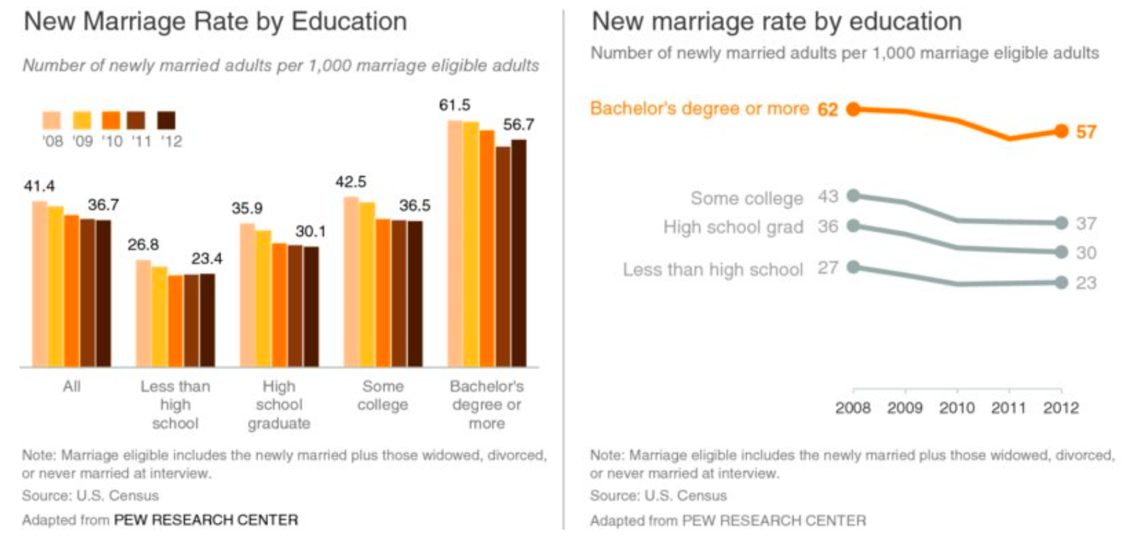
Visualization of Data, Understanding and Interpretation
Strategic Highlighting
5. Check the overall hierarchy
The highlighted element should attract attention without making the visualization difficult to interpret as a whole.

Slide 10
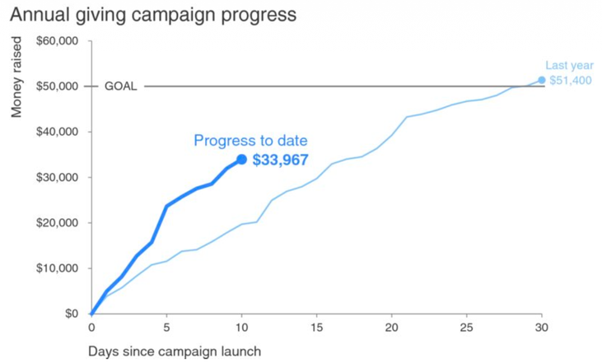
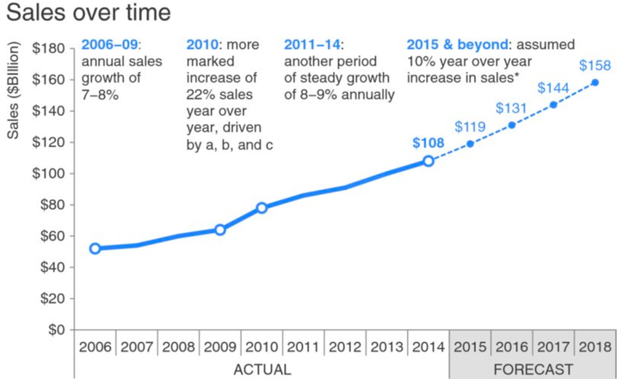
Visualization of Data, Understanding and Interpretation
Annotation as an Explanatory Layer
Annotation & Highlighting
Annotation adds information that helps the audience interpret the visualization.
Common forms include:
  Direct labels
  Data values
  Callouts
  Reference lines
  Explanatory notes
  Events or thresholds
  Sources and methodological notes
Annotations can answer:
  What is this?
  What is important here?
  Why does it matter?
  What should the viewer notice?

Slide 11
Visualization of Data, Understanding and Interpretation
Designing Effective Annotations
Principles for Effective Annotation
1. Place annotations close to their target
  Position text near the data point, trend, or region it describes.
  Minimize the visual distance between the annotation and the information being explained.
  Use connecting lines when direct placement is not practical.
2. Use concise and specific language
  State the relevant observation rather than describing the entire graph.
  Avoid vague statements such as “interesting result” or “important change.”
  Use language that identifies the actual pattern or event.
3. Establish clear visual hierarchy
  The primary annotation should receive greater emphasis than supporting notes.
  Supporting information should remain visually secondary.
  Avoid giving every annotation the same size, weight, or contrast.
4. Avoid annotation overload
  Too many labels, callouts, or explanatory notes can recreate the clutter that the annotation was intended to reduce.
  Annotate the most relevant observations, rather than every data point.

Slide 12
Visualization of Data, Understanding and Interpretation
Visual Design: Affordances and Hierarchy
Think Like a Designer
Knaflic's central principle in Chapter 5 is “form follows function”: the visual form should make it easy for the audience to perform the intended task. Design choices should therefore be evaluated by asking whether they help the audience understand and use the visualization.
Visual Affordances
Affordances are visual cues that indicate how an element should be interpreted or used.
In a data visualization, they can help the audience understand:
  Where to look first
  Which elements belong together
  What information is important
  How different elements relate to one another
  How the visual should be interpreted
For example, consistent alignment, grouping, direct labeling, and deliberate emphasis can make the intended reading of a visualization more apparent.

Slide 13
Visualization of Data, Understanding and Interpretation
Visual Design: Affordances and Hierarchy
Establishing Visual Hierarchy
A clear hierarchy creates different levels of visual importance:
Primary: Main finding or most important comparison
Secondary: Supporting data and context
Tertiary: Axes, gridlines, sources, methodological details
Hierarchy can be created through:
  Size and text weight
  Color and contrast
  Position
  Alignment
  Spacing
  Degree of detail
Knaflic emphasizes that highlighting important information, eliminating distractions, and establishing hierarchy allow a visualization to “afford understanding.”
Every visual element should have a purpose, and its visual prominence should reflect that purpose.

Slide 14
Visualization of Data, Understanding and Interpretation
Accessibility in Data Visualization
Designing for a Diverse Audience
Accessibility means designing visualizations so that they can be understood and used by people with different abilities, backgrounds, and levels of technical expertise.
Key Considerations
1. Use clear and understandable language
  Avoid unnecessary technical terminology and unexplained acronyms.
  Use descriptive titles and axis labels.
  Write labels and annotations so that the intended meaning is clear.
2. Provide sufficient context
  Clearly identify what is being measured.
  Include appropriate units, time periods, and categories.
  Do not assume that the audience already understands the data.

Slide 15
Visualization of Data, Understanding and Interpretation
Accessibility in Data Visualization
3. Make visual structure easy to interpret
  Establish a clear hierarchy between important and supporting information.
  Use alignment and spacing to show relationships between elements.
  Avoid designs that require excessive visual or cognitive effort.
4. Support different ways of perceiving information
  Important information should not depend entirely on one visual property.
  Where appropriate, combine visual distinctions with text, labels, symbols, or other redundant cues.
5. Consider the user's context
  A visualization may be viewed at different sizes, distances, or levels of attention.
  Design choices should remain effective outside the original presentation context.
Example: A technically correct graph with unexplained abbreviations, unlabeled axes, and unclear units may be accurate but inaccessible.
Not accessible:
Title: Performance Analysis
X-axis: Sem
Y-axis: Avg
No units
Uses only colors to distinguish groups
Accessible:
Title: Average Student Marks by Semester
X-axis: Semester
Y-axis: Average Marks (%)
Use labels such as CSE, AIML along with different visual markers
Clearly mention the 2025–26 academic year

Slide 16
Visualization of Data, Understanding and Interpretation
Ethical Responsibility in Visual Design
Design Choices Influence Interpretation
Ethical visualization requires more than avoiding mathematically incorrect charts.
Design decisions can influence:
  What the audience notices.
  What they consider important.
  How they interpret relationships.
  Which comparisons they make.
  What information they overlook.
Therefore, designers should be transparent about:
  Data selection and scope
  Scales and transformations
  Important exclusions
  Uncertainty and limitations
  Sources and context
Principle: A visualization should guide understanding without manipulating interpretation.

Slide 17
Visualization of Data, Understanding and Interpretation
Affordances in Visualization
Designing Cues That Guide Interpretation
An affordance is a visual cue that suggests how an element should be understood or used.
In visualization, design can provide cues about:
  Which elements are related
  Which elements are important
  Where to begin reading
  What information belongs together
  How different visual elements should be interpreted
Examples include:
  Consistent alignment
  Grouping through whitespace
  Direct labels
  Visual emphasis
  Consistent positioning
Design principle: Good visual design reduces the amount of interpretation the viewer has to perform.

Slide 18
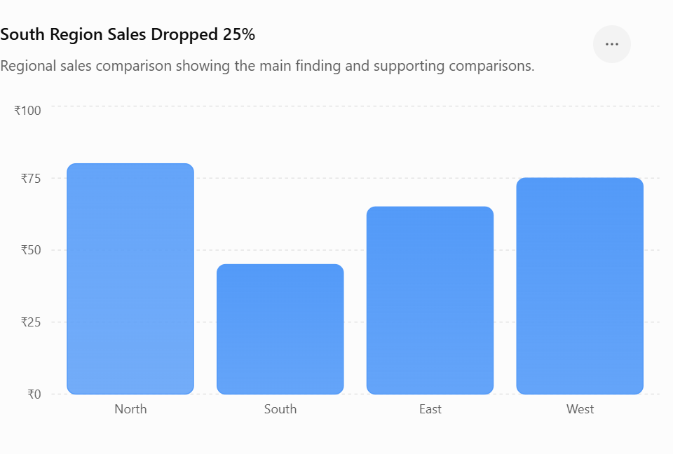
Visualization of Data, Understanding and Interpretation
Visual Hierarchy
Establishing Levels of Importance
A visualization rarely contains information of equal importance. Visual hierarchy determines the order in which elements attract attention and are interpreted. A practical hierarchy can be:
1. Primary
  Main finding
  Key comparison
  Important data point
2. Secondary
  Supporting trends
  Context
  Additional comparisons
3. Tertiary
  Axes
  Gridlines
  Sources
  Methodological details
Hierarchy can be created through:
  Size
  Weight
  Contrast
  Position
  Spacing
  Color
The purpose is to create a clear reading structure, rather than making every component equally prominent.
Level | What you focus on | Example in the graph
Primary | Main finding | South has the lowest sales
Secondary | Supporting comparison | Compare South with North, East and West
Tertiary | Supporting details | Axis, gridlines, units (₹), data source

Slide 19
Visualization of Data, Understanding and Interpretation
Alignment and Spatial Organization
Alignment is not merely an aesthetic choice. It helps viewers understand which elements belong together and how information is organized.
Use alignment to:
  Create consistent columns and rows
  Connect labels with their corresponding values
  Establish visual groups
  Make comparisons easier
  Reduce unnecessary eye movement
Common problems
  Arbitrary placement
  Misaligned labels
  Inconsistent spacing
  Elements that appear related but are not
Example: Aligning several charts to the same baseline allows the audience to compare their structure before reading individual values.
Consistent spatial organization makes relationships easier to perceive.

Slide 20
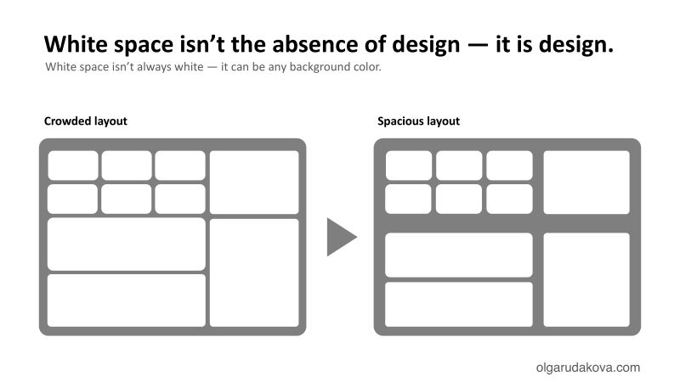
Visualization of Data, Understanding and Interpretation
Proximity and Whitespace
Space Can Encode Meaning
Whitespace is not simply “empty space.” The distance between elements can communicate their relationship.
  Small separation: elements are perceived as related
  Large separation: elements appear more independent
Use whitespace to distinguish:
  Data from annotation
  Primary from secondary information
  Different categories
  Separate sections of a dashboard or report
Avoid two extremes
  Too little space: crowded, ambiguous relationships
  Too much space: fragmented visual structure
The objective is to use spacing deliberately as part of the visual encoding.

Slide 21
Visualization of Data, Understanding and Interpretation
Words as Part of the Visualization
Text Is a Visual Encoding Channel
Text should not be treated as something added after the chart is complete. Titles, labels, annotations and captions are part of the visualization's communication system.
Use text to provide:
  Identification — What does this element represent?
  Context — What is being measured?
  Interpretation — What pattern is important?
  Action — What should the viewer consider or do?
Example
Generic title: Annual Revenue, 2018–2025
Descriptive title: Revenue increased steadily after 2021
The second title begins communicating the relevant finding before the viewer examines individual values.

Slide 22
Visualization of Data, Understanding and Interpretation
Data Labels: When and Where to Use Them
Labels Should Add Information
Data labels are useful when the exact value matters, but labeling every observation can quickly create clutter.
Use labels when:
  Exact values are important
  Only a few observations require identification
  The audience needs to locate specific values
  The chart contains a small number of categories
Avoid excessive labeling when:
  The overall pattern matters more than individual values
  Every point receives the same label
  Labels overlap with the data
  The visual becomes harder to scan
Show the pattern visually → label the important exceptions or values.

Slide 23
Visualization of Data, Understanding and Interpretation
Annotation: Identification vs. Interpretation
Annotations can perform different levels of communication:
Identification: Tells the viewer what something is
“2024”
“India”
“Product A”
Interpretation: Explains what the viewer should understand from it
“Growth accelerates after 2024”
“India becomes the largest market”
“Product A accounts for most of the increase”
Interpretive annotations are more powerful, but also require greater care because they introduce the designer's interpretation.
The more an annotation interprets the data, the more important it becomes to ensure that the interpretation is supported by the evidence.

Slide 24
Visualization of Data, Understanding and Interpretation
Annotation as a Structured Layer
Anatomy of an Annotation
A useful annotation can be considered as three components:
TARGET: What part of the visualization is being referenced?
CONNECTOR: How does the viewer know which element the text refers to?
MESSAGE: What information or interpretation is being communicated?
Example:
Target: unusual spike in a time series
Connector: marker / short leader line
Message: “Demand increased following the product launch”
Poor annotation design can fail at any of these three stages:
  Ambiguous target
  Long or crossing connector
  Vague message
This provides a more technical way to evaluate annotation quality.

Slide 25
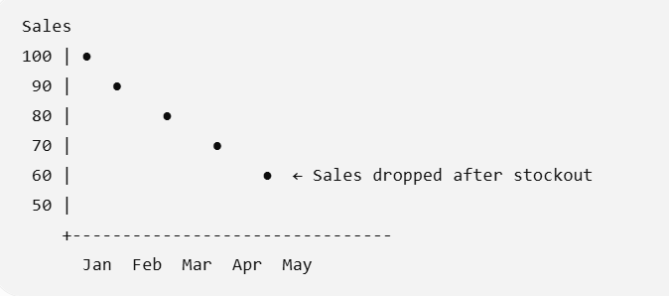
Visualization of Data, Understanding and Interpretation
Annotation Placement
Minimize the Annotation–Target Distance
The viewer must establish a relationship between the annotation and the visual element it describes.
A useful placement hierarchy is:
Directly adjacent > Short connector > Enclosure / highlighted region > Legend or distant explanation
Avoid:
  Long leader lines
  Crossing connectors
  Ambiguous endpoints
  Labels placed far from their targets
  Annotations covering important data
The closer the annotation is to its target, the less visual search is required to establish the relationship.
Here, the annotation “Sales dropped after stockout” is placed directly beside the relevant data point.

Slide 26
Visualization of Data, Understanding and Interpretation
Annotation Density and Visual Clutter
How Much Annotation Is Enough?
Annotation improves interpretation only up to a point.
  Too little → Viewer must infer the message independently.
  Appropriate amount → Key findings and necessary context are clear.
  Too much → Text competes with the data and creates clutter.
Practical strategy
  Identify the main finding.
  Annotate the most important evidence.
  Add context only where it improves interpretation.
  Remove annotations that merely repeat information already obvious from the visual.
💡Key Principle
Annotation should reduce cognitive effort, not become another source of cognitive load

Slide 27
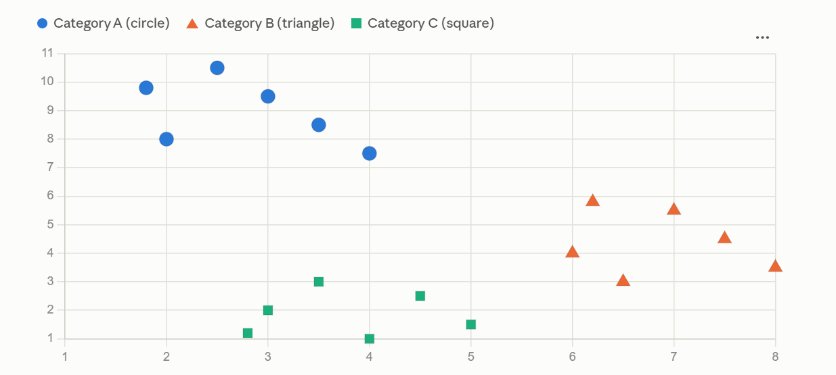
Visualization of Data, Understanding and Interpretation
Accessibility Beyond Color
Designing for Multiple Ways of Perceiving Information
A visualization should not depend on a single visual channel to communicate an important distinction.
For example, if category membership is encoded only by color, some viewers may have difficulty distinguishing the categories.
Instead, information can be encoded redundantly using:
  Color + Shape
  Color + Position
  Color + Line Style
  Color + Text Labels
  Color + Pattern / Texture
Redundant Encoding
If: Color → Category
Then add: Shape → Category
Now the same information can be recovered even if color discrimination is difficult.

Slide 28
Visualization of Data, Understanding and Interpretation
Integral vs. Separable Visual Dimensions
Choosing Visual Channels for Accessibility
Different visual dimensions can interact differently during perception.
Separable dimensions: The viewer can judge one attribute relatively independently of another.
Examples:
  Color + position
  Color + height
Integral dimensions: The attributes tend to be perceived together as a combined visual pattern.
Ware's experiments show that the choice between integral and separable dimensions affects how efficiently viewers can identify combinations of variables.
Design implication
  If users need to analyze variables separately, use relatively separable visual properties.
  If users need to recognize a combination as a whole, integral properties may be useful.
This gives a more technical basis for choosing color, shape, size, and other encodings, rather than selecting them purely for aesthetics.

Slide 29
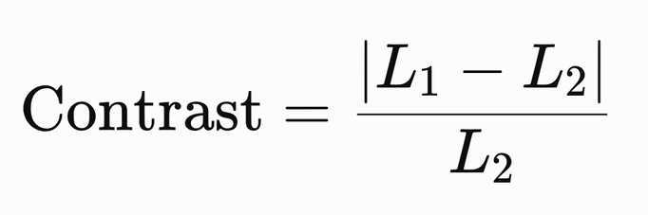
Visualization of Data, Understanding and Interpretation
Luminance Contrast
Contrast Determines Visual Distinctness
Visibility depends strongly on the difference in luminance between an object and its background, not simply on how bright the object is.
Ware describes the visual system as responding strongly to differences and edges, which makes luminance contrast an important consideration in visualization design.
A simplified contrast measure can be expressed as:
where L1​ and L2​ represent the luminance of two regions.

Slide 30
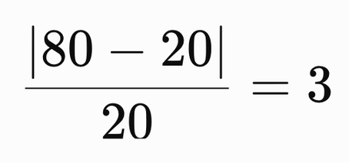
Visualization of Data, Understanding and Interpretation
Luminance Contrast
Example
Suppose:
  Foreground luminance = 80
  Background luminance = 20
the foreground's luminance isn't just "higher" than the background's — it's 3 times greater than the background luminance itself.
The foreground has a substantially greater luminance than its background and will be easier to distinguish
foreground is brighter than its background, .
Design implications
  Use sufficient contrast for important graphical elements.
  Do not assume that two different hues will remain distinguishable if their luminance is similar.
  Check contrast against the actual background, not in isolation.

Slide 31
Visualization of Data, Understanding and Interpretation
Quantitative Limits of Grayscale
Grayscale Is Not Always a Neutral Encoding
Grayscale can be useful for simple quantitative displays, but perception of neighboring gray values is affected by contrast and surrounding regions.
Ware reports an experiment in which errors in reading quantitative values from grayscale maps averaged approximately 20% of the entire scale.
Avoid using grayscale to represent more than a few (approximately 2–4) numerical values.
This is especially important when:
  Precise value comparison is required
  Adjacent regions have different backgrounds
  The visualization contains many subtle shades
  The viewer must decode values from a legend
Example: If a map uses Light → Medium-light → Medium → Dark → Very dark → Darkest
the viewer may struggle to reliably distinguish six closely spaced levels.
For categorical information, grayscale is particularly inefficient because luminance is already heavily used by the visual system for shape and structure.

Slide 32
Visualization of Data, Understanding and Interpretation
Accessibility: A Practical Design Check
Accessibility Checklist
Before finalizing a visualization, check whether the information remains available when one visual cue becomes difficult to perceive.
Visual Encoding
  Is important information dependent on color alone?
  Can categories be distinguished using shape, position, pattern, or labels?
  Is there sufficient luminance contrast?
  Are subtle shades being used to represent too many categories?
Text & Structure
  Are titles and labels understandable?
  Are units and scales clearly identified?
  Can the main message be understood without relying entirely on visual emphasis?
Perceptual Robustness
Ask: If the viewer cannot distinguish one color, see subtle differences in luminance, or view the figure at reduced size, can they still recover the important information?
Design Goal
Accessible visualization = information survives perceptual limitations.

Slide 33
Visualization of Data, Understanding and Interpretation
Accuracy vs. Interpretation
A Technically Correct Visualization Can Still Mislead
A visualization can accurately encode the underlying numbers while encouraging an inappropriate interpretation.
Consider two levels:
  Data accuracy
    Values are represented correctly.
    Calculations are correct.
    Axes and scales are mathematically valid.
  Interpretive accuracy
    The visual encourages an interpretation supported by the data.
    Important context is visible.
    Uncertainty and limitations are not hidden.
    Visual emphasis does not exaggerate the evidence.

Slide 34
Visualization of Data, Understanding and Interpretation
Accuracy vs. Interpretation
Example:
Two groups:
A = 100, B = 105
The numerical difference is only 5%.
If the design gives the two values dramatically different visual prominence, the viewer may perceive a much larger difference than the data supports.
💡Ethical visualization requires accuracy in both encoding and communication

Slide 35
Visualization of Data, Understanding and Interpretation
The Visualization as a Transformation
Data → Representation → Perception
A visualization is not the data itself. It is a sequence of transformations:
Data
Transformation
Visual Encoding
Perception
Interpretation
At each stage, information can be:
  preserved
  emphasized
  compressed
  obscured
  removed
Examples
  Data transformation: aggregation, filtering, normalization
  Visual transformation: scale, color, position, symbol size
  Perceptual transformation: some differences are easier to perceive than others
Therefore, ethical design requires examining the entire transformation pipeline, not only the final chart.

Slide 36
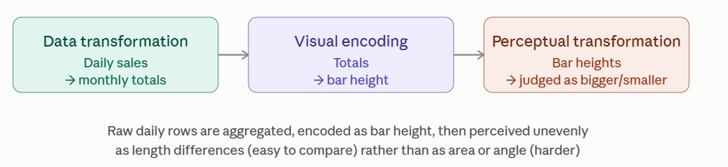
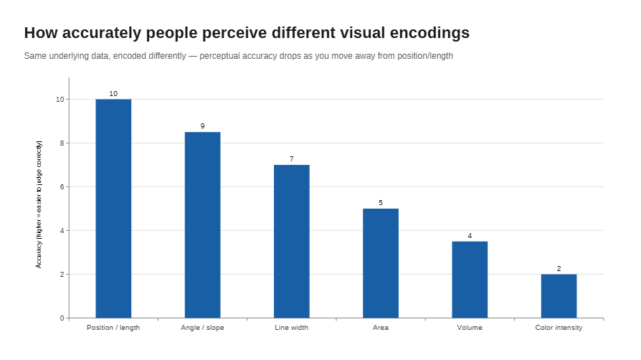

Slide 37


Visualization of Data, Understanding and Interpretation
Uncertainty Is Information
Do Not Present Estimates as Exact Values
A plotted value is often an estimate, not a perfectly known quantity.
For an estimate:
the visualization may also need to communicate its uncertainty:
Common representations include:
  Error bars
  Confidence intervals
  Confidence bands
  Distributions
  Quantile dotplots
  Multiple possible outcomes
Ethical implication
Showing only estimate = 72 may imply more certainty than estimate = 72 ± 8
The omission of uncertainty can therefore change the meaning of the visualization.

Slide 38
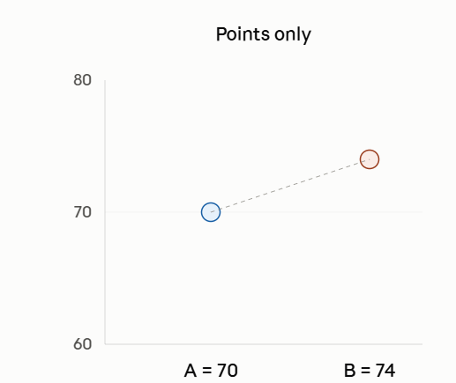
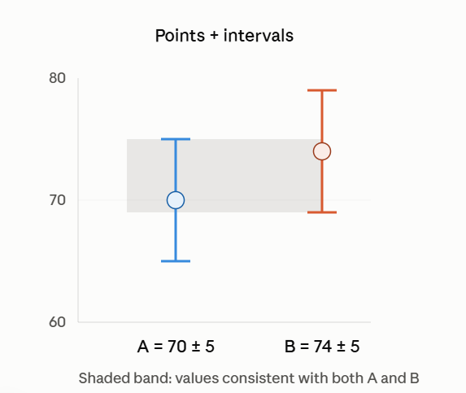
Visualization of Data, Understanding and Interpretation
Uncertainty Can Change the Decision
From Statistical Uncertainty to Decision Uncertainty
Consider two estimates:
A = 70 ± 5, B = 74 ± 5
Their point estimates differ by: 74 − 70 = 4
But the uncertainty ranges overlap substantially.
  A visualization showing only the two points may encourage: “B is clearly larger than A.”
  A visualization showing the distributions or intervals communicates: “B has a higher estimate, but the difference is uncertain.”
Conventional error bars can encourage overly binary judgments about whether two values differ, while richer uncertainty representations can produce more appropriate confidence judgments (Ware).
💡Represent uncertainty at the level required by the decision—not merely at the level that is easiest to draw
Same four numbers, same four-point difference — but only the second panel tells you how much to trust that difference.

Slide 39
Visualization of Data, Understanding and Interpretation
Scale Is a Communication Decision
The Axis Changes the Visual Argument
The same dataset can produce very different visual impressions depending on scale.
Suppose: A = 100, B = 110
Absolute Difference: Δ = 10
Relative Difference: (110-100)/100 = 10%
A broad axis may make the difference appear visually small.
A tightly focused axis may make the difference appear visually dramatic.
Ethical question
The issue is not simply: “Is the axis technically valid?”
It is: “Does the chosen scale create an appropriate visual impression of the magnitude of the difference?”
The scale should be selected according to the quantity being communicated and the comparison the audience needs to make.

Slide 40
Visualization of Data, Understanding and Interpretation
Aggregation Can Hide Structure
What Happens When Data Is Summarized?
Aggregation replaces many observations with a smaller number of summaries.
For example: {x1​,x2​,…,xn​} → xˉ
The mean is useful, but it removes information about:
  Distribution
  Outliers
  Subgroups
  Variability
  Multiple modes
Example: Two groups can have the same mean (xˉA​ = xˉ B​ = 50) while having completely different distributions. One may be tightly clustered around 50; the other may contain values near 10 and 90.
Ethical implication
A summary is not necessarily a neutral substitute for the underlying data.
The visualization should preserve enough detail to support the intended conclusion.

Slide 41
Visualization of Data, Understanding and Interpretation
Selection and Omission
What Is Not Shown Also Affects Interpretation
A visualization can influence interpretation through selection as well as representation.
Potential sources of selective presentation:
  Removing inconvenient observations
  Choosing a particular time window
  Showing only selected categories
  Excluding missing observations without explanation
  Filtering outliers
  Reporting only successful cases
Example:
Suppose a trend is: 2018→2019→2020→2021
If the visualization begins at 2020, the audience sees a very different story than if it begins at 2018.
💡A visualization should make significant data-selection decisions visible to the audience

Slide 42
Visualization of Data, Understanding and Interpretation
Annotation Is Also Rhetoric
Description vs. Interpretation
Annotation does more than explain a graph; it can frame how the audience interprets it.
Compare: “Sales increased by 12%.” vs. “Sales surged by 12%.”
The numerical information is identical. The second statement introduces an interpretation of the magnitude.
Three Levels:
  Descriptive: “Sales increased by 12%.”
  Interpretive: “Sales increased following the product launch.”
  Persuasive: “The product launch drove exceptional growth.”
The further an annotation moves toward interpretation or persuasion, the stronger the evidence required.
💡Principle: Separate what the data shows from what the designer concludes from it
Keep the chart's caption honest by separating what the numbers literally show from your own conclusion about what they mean. Don't let the label do the arguing that the evidence hasn't earned.

Slide 43
Visualization of Data, Understanding and Interpretation
Visual Rhetoric: Where Bias Enters
Bias Can Enter at Multiple Stages
Ethical problems are not limited to chart selection.
Consider the complete pipeline:
Stage | Possible Choice
Data | What observations are included?
Transformation | What is aggregated or normalized?
Encoding | What visual variables are used?
Scale | What range is shown?
Ordering | What appears first?
Annotation | What is explicitly emphasized?
Interaction | What is visible by default?

Slide 44
Visualization of Data, Understanding and Interpretation
Visual Rhetoric: Where Bias Enters
Each choice can influence the viewer's interpretation.
Important distinction
  Bias does not necessarily mean that the designer is intentionally deceptive.
  A visualization can introduce systematic framing effects simply through design decisions.
  Ethical practice requires examining design choices, not only designer intentions.

Slide 45
Visualization of Data, Understanding and Interpretation
The Ethical Visualization Audit
Before Publishing: Test the Visualization
A final visualization can be audited through five questions:
1. DATA: What was included or excluded?
2. ENCODING: Does the visual accurately represent the values?
3. SCALE: Does the scale communicate magnitude appropriately?
4. UNCERTAINTY: Does the visualization communicate how certain the evidence is?
5. FRAMING: Do titles, annotations, ordering, and emphasis encourage a conclusion stronger than the evidence supports?
A technically responsible visualization should be:
Accurate + Transparent + Interpretable + Accessible
The goal is not to remove all interpretation from visualization—interpretation is unavoidable. The goal is to ensure that the visual argument remains proportionate to the evidence.

Slide 46
Visualization of Data, Understanding and Interpretation
MCQ
Q1. A visualization contains several data series, but the designer wants the audience to focus on one particular trend while retaining the others as context. Which approach is most appropriate?
A. Remove all other data series
B. Use selective visual emphasis
C. Increase contrast across all series
D. Add labels to every data point
Answer: B

Slide 47
Visualization of Data, Understanding and Interpretation
MCQ
Q2. Why can aggregation into a single mean be problematic when visualizing a dataset?
A. It prevents numerical comparison
B. It always produces an incorrect statistic
C. It can conceal distributional structure
D. It eliminates the need for visualization
Answer: A

Slide 48
Visualization of Data, Understanding and Interpretation
MCQ
Q3. Two groups have estimated values of 70 ± 5 and 74 ± 5. What is the primary reason to display their uncertainty?
A. To increase visual complexity
B. To reveal the precision of the estimates
C. To make the values appear different
D. To eliminate statistical variation
Answer: B

Slide 49
Visualization of Data, Understanding and Interpretation
MCQ
Q4. Which situation represents a potential ethical problem even if all plotted values are numerically correct?
A. Using direct labels
B. Aligning multiple charts
C. Selectively choosing the time range
D. Including a source citation
Answer: C
Every number plotted can be 100% accurate — correct calculations, correct axis, nothing fabricated — and the chart can still mislead, simply because of which slice of time you chose to show.

Slide 50
Visualization of Data, Understanding and Interpretation
MCQ
Q5. Which design choice best supports accessibility when category membership is important?
A. Use color alone
B. Use several similar hues
C. Use color with redundant cues
D. Remove categorical distinctions
Answer: C

Slide 51
Thank You

