Slide 1

Visualization of Data, Understanding and Interpretation
Unit 2 : Advanced Visualization & Storytelling
(UE24CS342AA9)
Visualization of Data, Understanding and Interpretation
Dr.Prajwala TR (Course Instructor)
Dept. of CSE, PES University, Bangalore

Slide 2
Visualization of Data, Understanding and Interpretation
Acknowledgement
The slides are prepared from various resources from the Universities from abroad and India. Also, some material is taken from reliable resources from internet throughout this course.

Slide 3
Visualization of Data, Understanding and Interpretation
Lecture Overview
By the end of this lecture, students should be able to:
  Explain how geospatial visualizations represent location, magnitude, and regional patterns using maps, symbol maps, choropleths, and cartograms.
  Interpret and communicate uncertainty using standard deviation, standard error, confidence intervals, confidence bands, and outcome-based visualizations.
  Design and evaluate dashboards for monitoring, balancing information density, cognitive load, and rapid detection of trends or exceptions.
  Understand coordinated multiple views and how brushing, linking, and shared interaction support exploratory analysis across different visual representations.
How do I represent something big/complex in a smaller, viewable form?

Slide 4
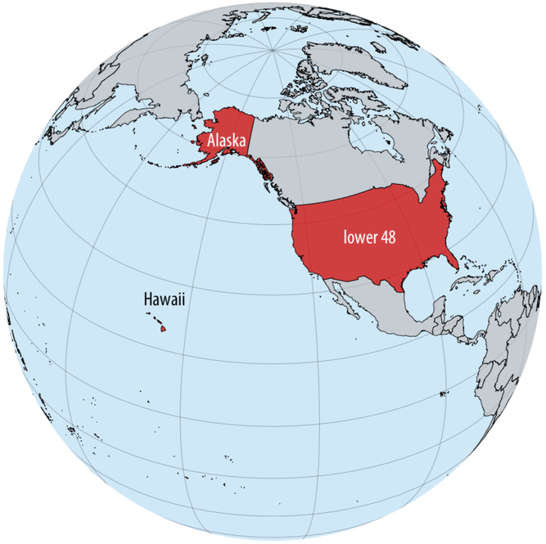
Visualization of Data, Understanding and Interpretation
Why Visualize Data Geographically? (TB 1, Ch 15)
Geospatial visualization represents data according to its location in physical or geographic space.
A map becomes useful when where something occurs is an important part of the question.
It allows us to see:
  Spatial patterns: where values concentrate or spread
  Clusters and hotspots: regions with unusually high/low values
  Regional differences: how measurements vary across locations
  Spatial relationships: proximity, distance, boundaries, and connectivity
  Geographic context: relating data to roads, terrain, cities, borders, etc.
. For example, in an ecological study, a dataset may list where specific plants or animals have been found.
socioeconomic or political context, a dataset may contain information about where people with specific attributes (such as income, age, or educational attainment) live, or where man-made objects (e.g., bridges, roads, buildings) have been constructed.

Slide 5
Visualization of Data, Understanding and Interpretation
From Location to Coordinates
To visualize geographic data, locations must first be represented numerically.
Geographic coordinates:
  Latitude:
    Position north or south of the equator
    Typically ranges from −90° to +90°
  Longitude:
    Position east or west of the prime meridian
    Typically ranges from −180° to +180°
  Altitude / elevation
    Height relative to a reference surface
Together, coordinates allow geographic locations to be represented mathematically.
💡Important Distinction!
A geographic coordinate system describes locations on the Earth's surface, while a visualization must eventually display those locations on a 2D screen or page. That creates the fundamental problem of map projection.
choropleth maps (coloring regions by data value, and why density measures work better than raw counts), and cartograms (deliberately resizing regions, e.g., by population) as ways of building on top of whichever projection you pick.
Longitude, latitude, and altitude are specified relative to a reference system called the datum. The datum specifies properties such as the shape and size of the earth, as well as the location of zero longitude, latitude, and altitude.

Slide 6
Visualization of Data, Understanding and Interpretation
The Map Projection Problem
The Earth is approximately spherical, but our displays are flat. Therefore, converting geographic coordinates into a map requires a map projection.
Every projection introduces some form of distortion.
A projection may distort:
  Shape
  Area
  Distance
  Direction
No single projection preserves all of these simultaneously.
Design principle: Choose the projection according to the purpose of the visualization.
For example:
  Preserving area → useful when comparing regional quantities
  Preserving direction → useful for navigation
  Preserving shape → useful for certain geographic analyses
So every flat map is a trade-off. The three types:
Conformal projections preserve local angles/shapes correctly, but distort area.
Equal-area projections preserve area correctly, but distort shapes/angles.
Compromise projections don't perfectly preserve either, but try to balance both for a visually pleasing whole-world map.

Slide 7
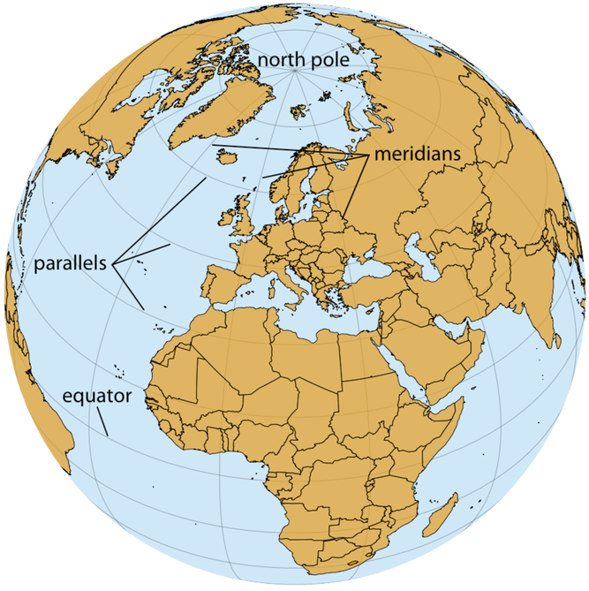
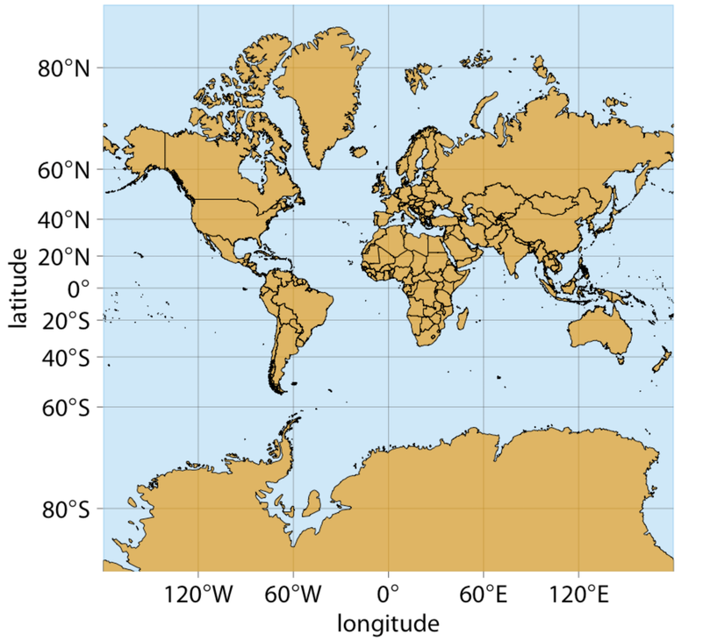
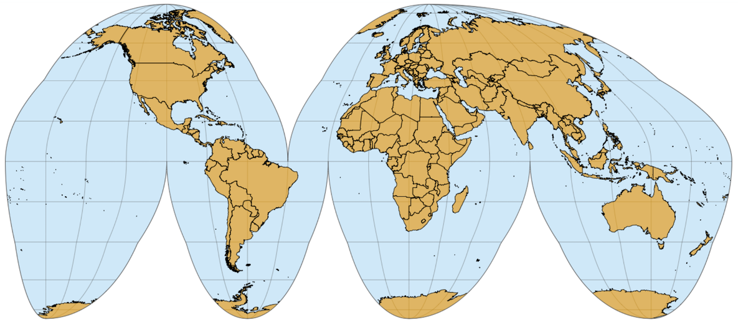
Visualization of Data, Understanding and Interpretation
The Map Projection Problem
Orthographic Projection
Orthographic Projection — this is basically how the globe looks from space (not flattened at all). It's used in the chapter to explain the underlying geometry: the lines emanating from the north pole and running south are called meridians, and the lines running orthogonal to the meridians are called parallels.
Mercator Projection
Interrupted Goode Homolosine Projection
Mercator Projection — one of the earliest map projections in use, developed in the 16th century for nautical navigation. It is a conformal projection that accurately represents shapes but introduces severe area distortions near the poles. This is why it's the classic bad example:
Interrupted Goode Homolosine — a whole-world projection that is perfectly area-preserving... usually shown in its interrupted form, which has one cut in the northern hemisphere and three cuts in the southern hemisphere, carefully chosen so they don't interrupt major land masses.

Slide 8
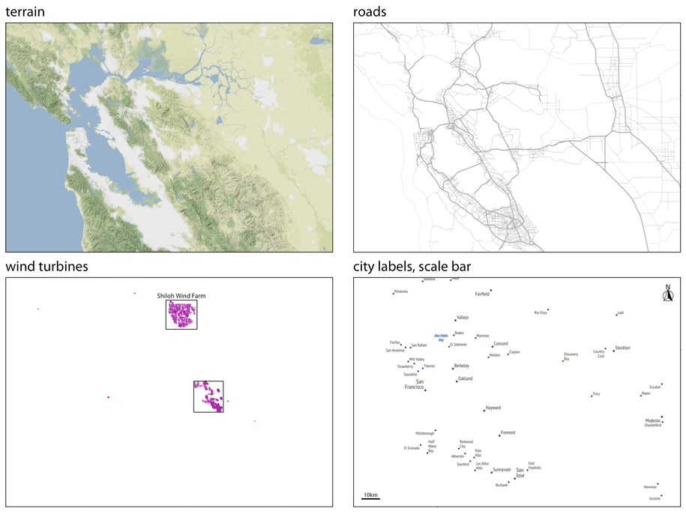
Visualization of Data, Understanding and Interpretation
Building a Map: Layers and Context
Terrain layer — shows hills, valleys, and water (the base of the map)
Roads layer — the road network, sitting on top of terrain
Data layer — the actual data points of interest (here, individual wind turbine locations), plus any highlighting elements like rectangles marking regions of interest
Labels/annotation layer — city names and locations, typically placed on top, along with map conventions like a scale bar and north arrow
A useful map rarely consists of a single visual layer.
Multiple layers can provide geographic context:
  Base layer: terrain, satellite imagery, land/water
  Reference layers: roads, boundaries, cities, administrative regions
  Data layer: observations, measurements, events, highlighted regions
💡Key design principle
  Every layer should serve the analytical task.
  Too many background layers can compete with the actual data.
A map can therefore fail through visual clutter, even when every individual layer is technically correct.
Example: for a traffic-accident map,
  Useful features: roads, accident locations, major intersections
  Potentially distracting features: unnecessary terrain, decorative satellite imagery, excessive labels
Figure 15.9: The individual layers of Figure 15.8. From bottom to top, the figure consists of a terrain layer, a roads layer, a layer showning the wind turbines, and a layer labeling cities and adding a scale bar and north arrow.

Slide 9
Visualization of Data, Understanding and Interpretation
Point Maps: Where Are the Observations?
A point map represents each geographic observation using its spatial position.
ENCODING: position → geographic location
Additional attributes can be encoded using:
  Color: category or quantitative value
  Size: magnitude
  Shape: category
  Transparency: density/overlap
Strengths
  Directly shows individual locations
  Easy to understand
  Preserves geographic relationships
  Useful for events and point observations
Limitations
  Overplotting when many observations overlap
  Difficult to compare exact quantities from size alone
  Too many visual attributes can create clutter
Example Applications:
  Earthquake locations
  Hospitals
  Crime incidents
  Sensor locations
  Wildlife observations
Dots on a crime map showing where incidents were reported
A map of coffee shop locations in a city, all marked with the same pin icon

Slide 10
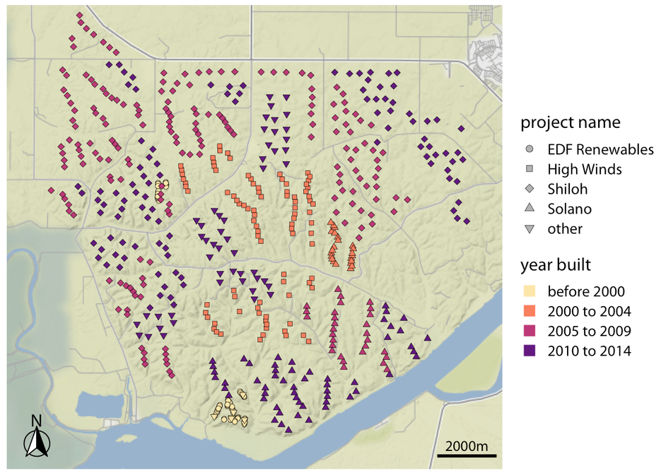
Visualization of Data, Understanding and Interpretation
Symbol Maps: Adding Another Dimension
Circles on an earthquake map sized by magnitude and colored by depth
City markers on a map sized by population (bigger circle = bigger city)
A point can carry more information than simply its location.
A symbol map uses graphical properties of symbols to encode additional attributes.
Visual Property | Possible Encoding
Position | Location
Size | Magnitude
Colour | Category/Value
Shape | Type
Orientation | Direction
A map of cities could encode:
  Location → city position
  Circle size → population
  Color → air-quality category
This produces a multivariate spatial visualization.
Figure: Location of individual wind turbines in the Shiloh Wind Farm. Each dot highlights the location of one wind turbine. Dots are colored by when the wind turbine was built, and the shape of the dots represents the various projects to which the individual wind turbines belong

Slide 11
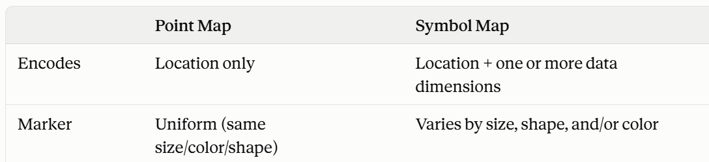
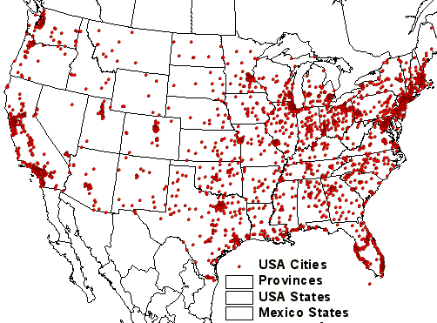
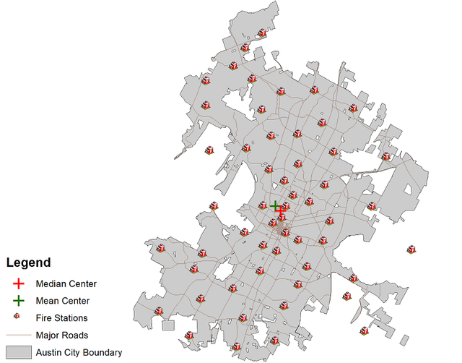
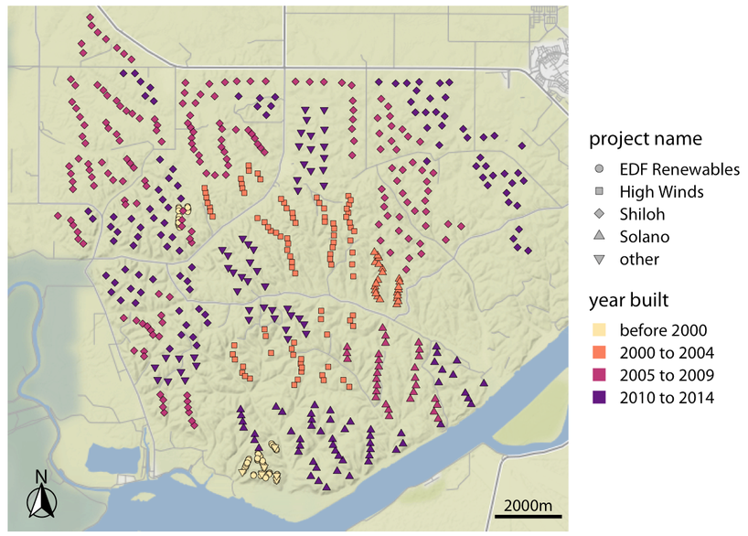
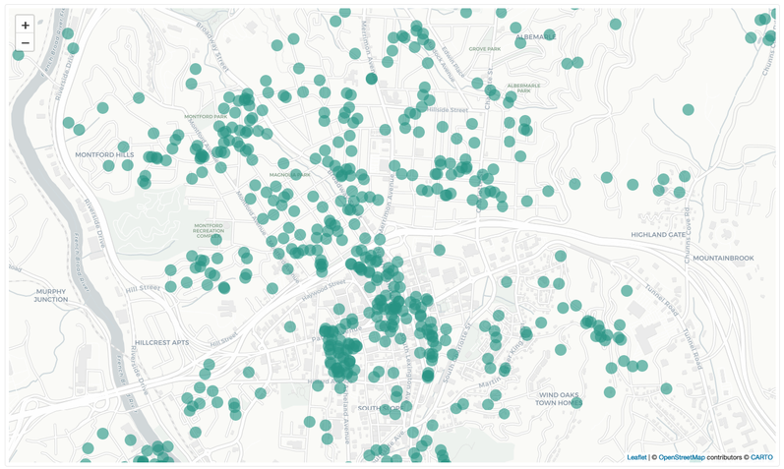
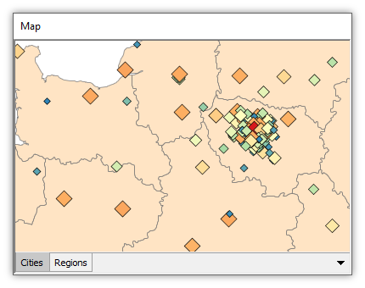
Visualization of Data, Understanding and Interpretation
Examples

Slide 12
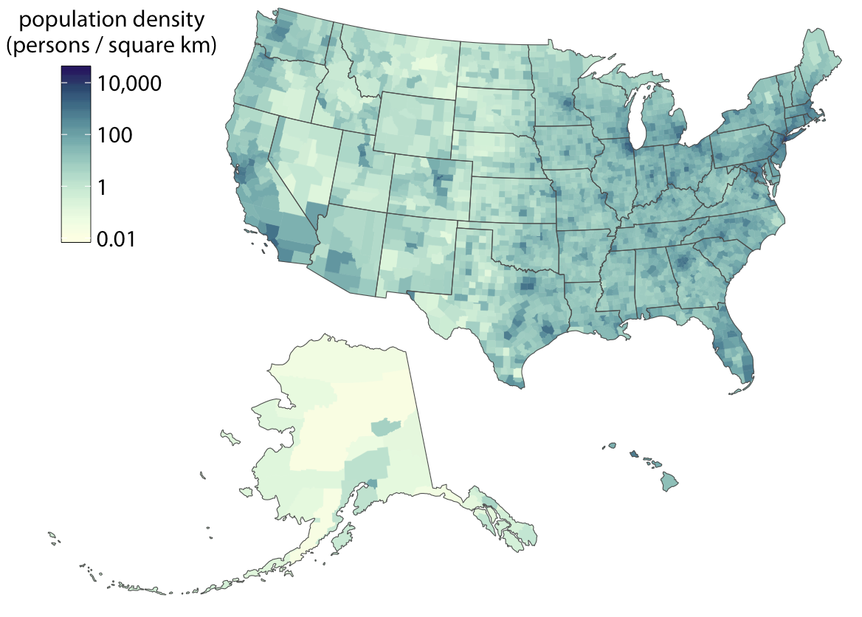
Visualization of Data, Understanding and Interpretation
Choropleth Maps
A choropleth map divides geographic space into predefined regions and uses color to represent a quantitative value.
Examples:
  population density by state
  unemployment rate by district
  rainfall by region
  disease incidence by country
ENCODING:
region → geographic area
colour → quantitative value
Why choropleths are powerful?
They allow us to see:
  regional patterns
  hotspots
  geographic clusters
  broad spatial differences
Figure: Population density in every U.S. county, shown as a choropleth map. Population density is reported as persons per square kilometer.
Continuous scale: smooth color gradient — looks pretty, but hard to read precisely (your eye can't reliably tell "0.62" from "0.58" on a gradient).
Binned scale: data grouped into ~4–6 buckets, each with a distinct color — easier to read at a glance, at the cost of some precision.

Slide 13
Visualization of Data, Understanding and Interpretation
The Choropleth Trap: Counts vs Rates
A major problem with choropleth maps is that raw counts can be misleading.
Suppose we map the number of hospitalizations by district. A district with more people will naturally tend to have more hospitalizations. But this does not necessarily mean that the district has a higher hospitalization rate. Instead, consider normalization.
For example:
Raw count: 5,000 hospitalizations
Rate: 5,000 hospitalizations / population
The second representation accounts for differences in population size.
💡General principle: when geographic regions differ substantially in population or area, consider whether the variable should be normalized
Other problems:
  Large regions can visually dominate
  Small regions may be difficult to see
  Color represents the value, not geographic area
  Regional boundaries can influence interpretation
Choropleth maps are powerful for showing "where is X high/low," but they can visually lie if you color by a raw total instead of a density — because our eyes just see "big blob of color" and assume "big number," regardless of population or scale.

Slide 14
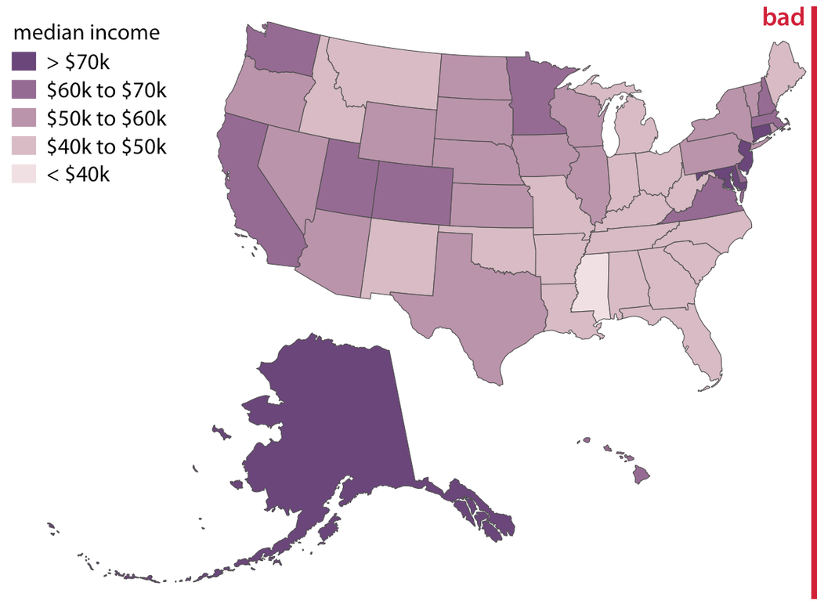
Visualization of Data, Understanding and Interpretation
The Choropleth Trap: Counts vs Rates
Example:
  The adjacent figure represents the median income in every U.S. state, shown as a choropleth map.
  This map is visually dominated by the state of Alaska, which has a high median income but very low population density.
  At the same time, the densely populated high-income states on the East Coast do not appear very prominent on this map.
  In aggregate, this map provides a poor visualization of the income distribution in the U.S., and therefore labeled “bad.”

Slide 15
Visualization of Data, Understanding and Interpretation
Cartograms: Distorting Geography to Encode Data
A cartogram deliberately changes the geographic size or shape of regions so that another variable is represented through area.
For example: A country's displayed area can be made proportional to its population rather than its geographic area.
Why use a cartogram?
  A normal map emphasizes geographic space.
  A cartogram can emphasize data magnitude.
  This can make highly populated regions visually prominent even if their physical area is small.
Trade-off
Cartograms introduce a deliberate distortion:
  Gain: Important quantitative differences become visually prominent.
  Cost: Geographic shape and location become harder to recognize or compare.
💡Key question: do we want the viewer to compare geography or the encoded quantity?

Slide 16
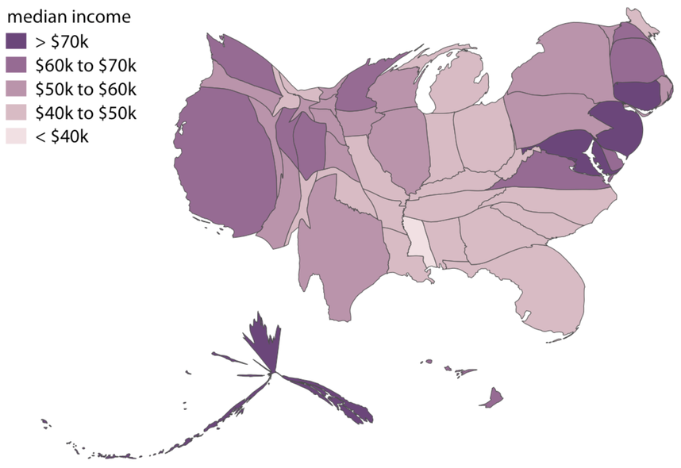
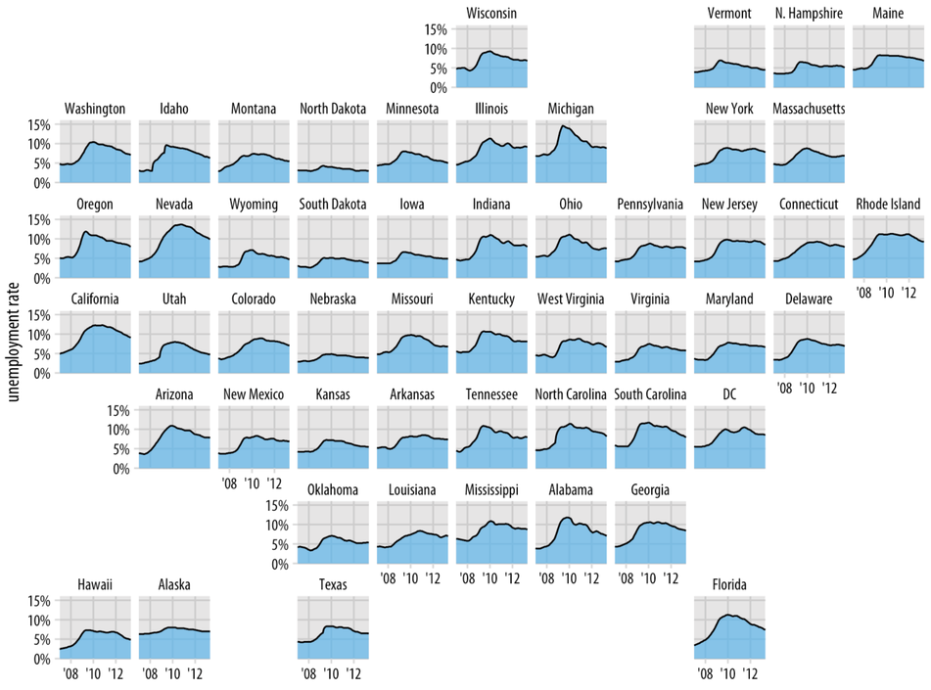
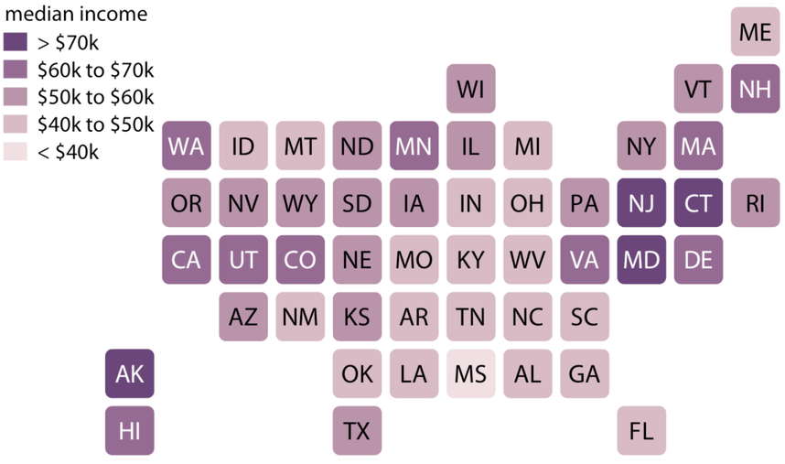
Visualization of Data, Understanding and Interpretation
Cartograms: Distorting Geography to Encode Data
Figure 1: Cartogram
State areas are resized according to population, while color represents median income, emphasizing income differences across states.
Figure 2: Cartogram Heatmap
Each state is given equal visual area and positioned approximately geographically, allowing median income to be compared without population-size distortion.
Figure 3: Geographically arranged small multiples
Each state displays its unemployment trend separately while preserving approximate geographic relationships for regional comparison.

Slide 17
Visualization of Data, Understanding and Interpretation
Choosing the Right Geospatial Visualization
1. What is the data?
  Individual locations → Point map
  Quantity by region → Choropleth
  Magnitude at locations → Symbol map
  Density of observations → Dot-density map
  Quantity should determine region size → Cartogram
2. What does the viewer need to do?
  Locate → preserve position
  Compare quantities → use effective quantitative channels
  Detect hotspots → emphasize spatial patterns
  Understand geographic context → preserve recognizable geography
3. What should not be sacrificed?
  Accurate interpretation
  Appropriate color scale
  Geographic context
  Readability
  Perceptual effectiveness

Slide 18
Visualization of Data, Understanding and Interpretation
What Is Feature Importance? (TB 3, Ch 5)
In a predictive model, different input features can contribute differently to the model's output.
Feature importance visualization communicates:
  Which features matter most
  Their relative importance
  How importance is distributed across features
  Which features deserve further investigation
Two levels of importance
  Global importance: how important is a feature across the model or dataset?
  Local importance: how important was a feature for one particular prediction?
💡Key idea: feature importance turns a high-dimensional model into a visual ranking of influential variables.
Example: House price prediction model(Global)
Say you train a model to predict house prices using features like square footage, number of bedrooms, neighborhood, age of house, and distance to school.
house price model, but for one house(Local)
Say the model predicts $850,000 for a particular house. A local explanation (like a SHAP force plot or LIME output)

Slide 19
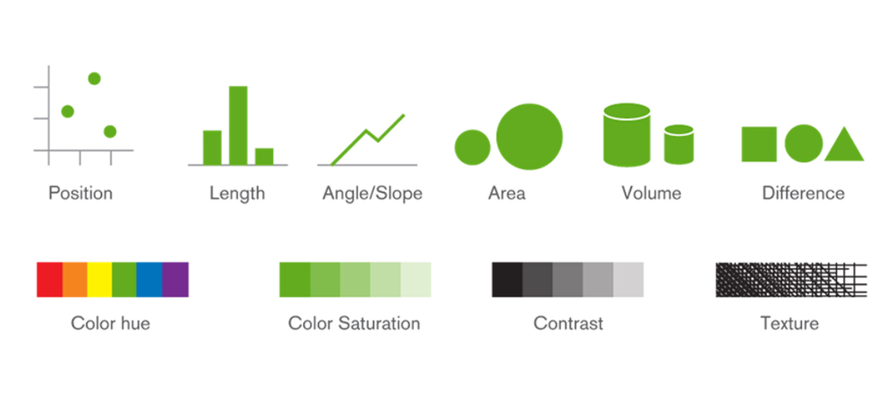
Visualization of Data, Understanding and Interpretation
From Importance to Visual Encoding
Once we know which features are important, the next question is:
How should importance be visually encoded?
For quantitative importance, stronger visual channels include:
  Position on a common scale
  Length
  Size
  Color intensity as a supporting channel
Example
Instead of:
Feature A = dark purple
Feature B = light purple
Use:
Feature A = long bar
Feature B = short bar
because length/position provides a more direct quantitative comparison.
💡Principle: match the visual channel to the type of information being represented

Slide 20
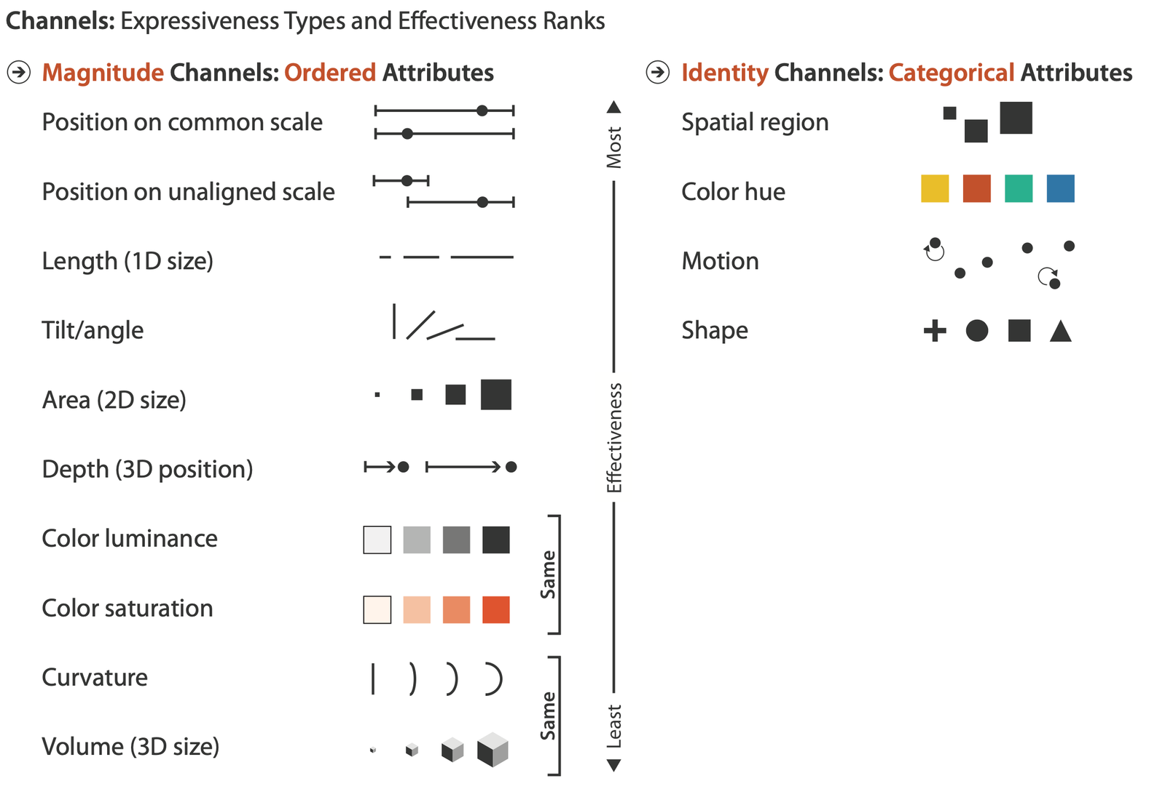
Visualization of Data, Understanding and Interpretation
From Importance to Visual Encoding
Magnitude channels → use for quantitative data, and pick from the top of the list when precision matters (position > length > angle > area > color > volume).
Identity channels → use for categorical data, where the goal isn't "how much" but "which group" — hue and shape are the classic go-tos

Slide 21
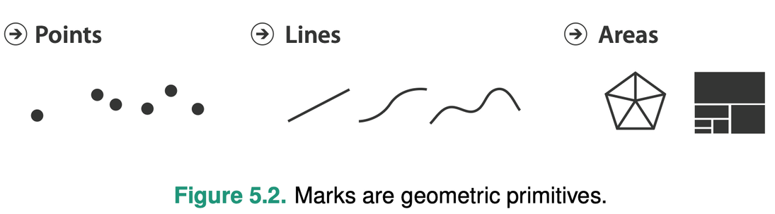
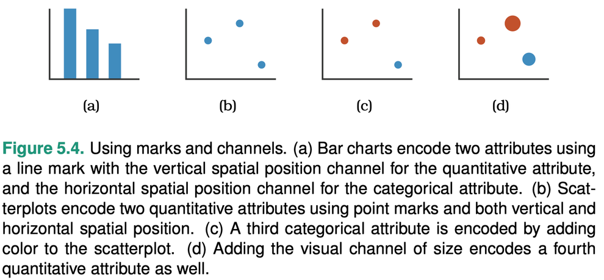
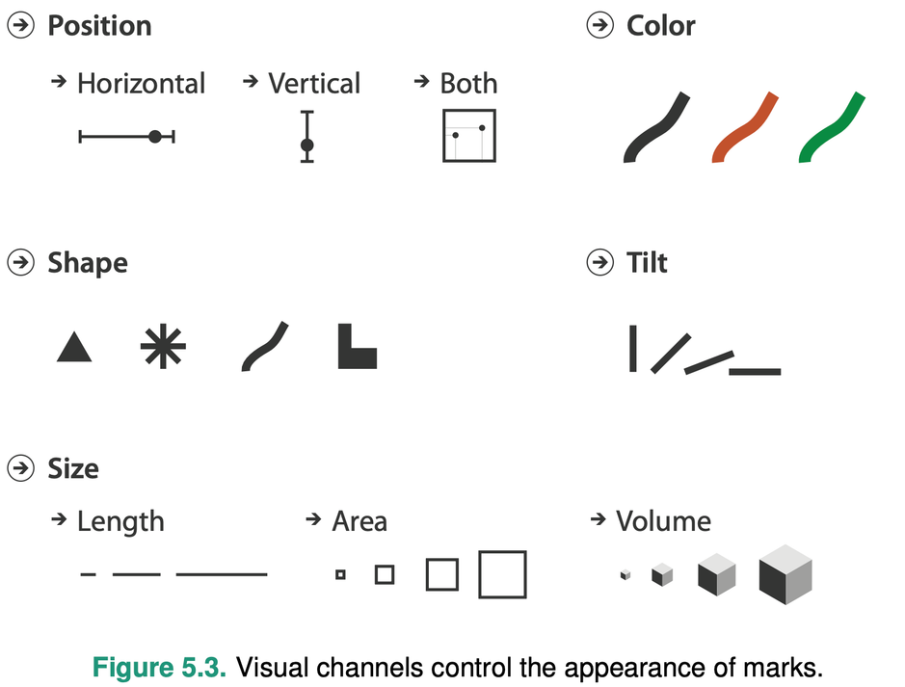
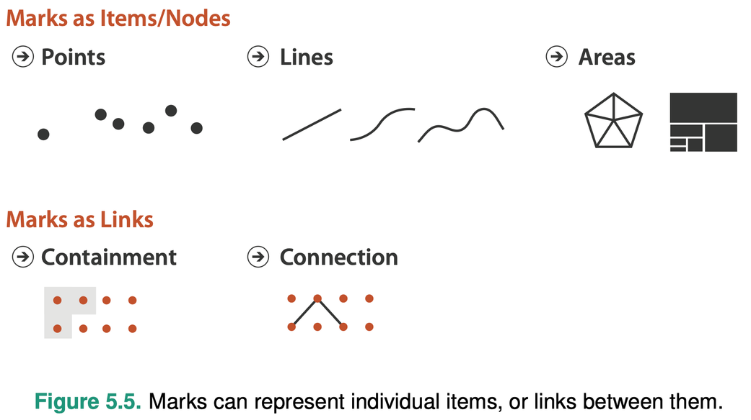
Visualization of Data, Understanding and Interpretation
From Importance to Visual Encoding
Notes:
A mark is the visual object used to represent a data item.- line point etc
A channel is the visual property of a mark that communicates information about the data.- size shape colour

Slide 22
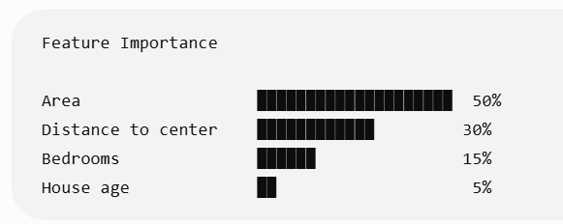
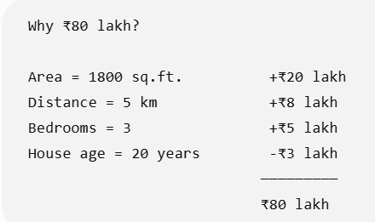
Visualization of Data, Understanding and Interpretation
Global vs Local Feature Importance
Feature importance can answer two different questions.
Global importance: which features generally influence the model?
Useful for:
  Understanding the model overall
  Feature selection
  Identifying dominant variables
  Comparing the model's reliance on different inputs
Local importance: which features influenced this particular prediction?
Useful for:
  Explaining individual decisions
  Investigating unusual predictions
  Understanding why two similar observations received different outputs
💡Global importance explains the model; local importance explains an individual decision

Slide 23
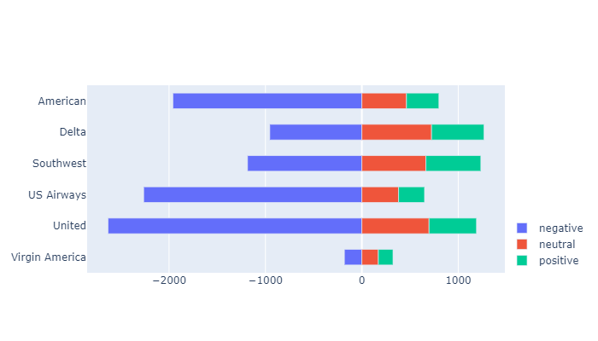
Visualization of Data, Understanding and Interpretation
Positive and Negative Contributions
A feature can influence a prediction in different directions.
For example:
  Positive contribution → pushes prediction upward
  Negative contribution → pushes prediction downward
  Near-zero contribution → little influence
Visualization: use a diverging horizontal bar chart
Why this matters?
A simple ranking such as:
Feature A = 0.8
Feature B = 0.7
doesn't necessarily communicate whether the features increase or decrease the prediction.
💡When direction matters, encode direction explicitly rather than showing magnitude alone
encoding both magnitude (how far the bar extends) and direction (which side of zero it's on)

Slide 24

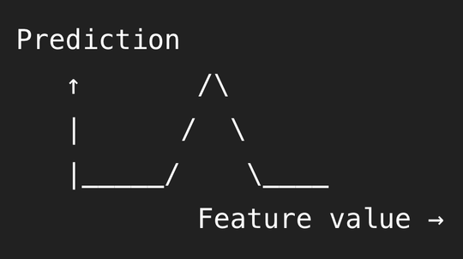
Visualization of Data, Understanding and Interpretation
Feature Importance Is Not the Same as Feature Effect
A feature can be important without having a simple relationship with the prediction.
For example:
High feature importance does not necessarily mean higher feature value → higher prediction
A model may use a feature:
  Nonlinearly
  Only within certain ranges
  In combination with other features
  Differently for different observations
Therefore:
Importance asks: how much does the model rely on this feature?
Effect asks: how does changing this feature affect the output?
A ranking tells us what matters; it does not necessarily
tell us how it behaves.
Feature Importance
Feature Effect

Slide 25
Age in a loan/insurance risk model
Say "Age" comes out as the #1 most important feature in a credit risk model (high importance score). You might assume: "okay, so higher age → higher (or lower) risk, linearly." But the actual effect could look like the tent curve on the slide:
Ages 18–25: risk is high (limited credit history) → prediction pulled up
Ages 30–55: risk is low (stable income, established history) → prediction pulled down
Ages 65+: risk rises again (fixed/reduced income) → prediction pulled up again
So Age has high importance (the model relies on it a lot to make decisions) but no simple monotonic effect (it's not "more age = more risk" or "more age = less risk" — it's a U-shape / tent-shape). A plain importance ranking would tell you Age matters most, but would completely hide this non-monotonic pattern — you'd need a feature effect plot (like a Partial Dependence Plot or a SHAP dependence plot) to actually see it.
Another quick example: Temperature in an ice-cream sales model
Importance: Temperature might rank #1 — the model relies on it heavily.
Effect: Sales rise steadily as temperature increases from 15°C to 30°C, but flatten out (or even dip slightly) above 35°C, because it's "too hot to go outside." That's a nonlinear, range-dependent effect — importance alone wouldn't reveal the flattening.

Slide 26
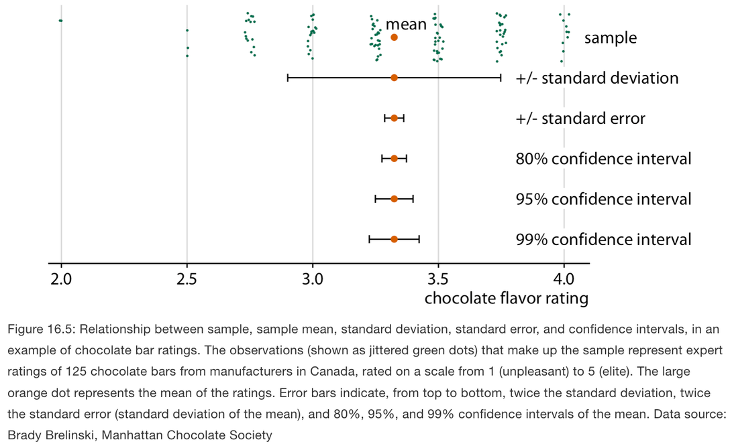
Visualization of Data, Understanding and Interpretation
Uncertainty Visualization (TB 1, Ch 16)
A plotted value is easily interpreted as precise, even when the underlying estimate is uncertain.
Uncertainty can arise from:
  Measurement limitations
  Sampling variability
  Limited data
  Model estimation
  Prediction
  Future outcomes
Why it matters
Ignoring uncertainty can make viewers:
  Overestimate precision
  Treat estimates as fixed values
  Make overly confident comparisons
  Misinterpret model outputs
💡A visualization should communicate not only the estimated value, but also how uncertain that estimate is.
all five error bars come from the same dataset and are mathematically related, but they answer different questions and look completely different in width. If you don't label which one you're showing, the reader has no way to know whether that error bar represents "individual variation" or "how confident we are in the average

Slide 27
Visualization of Data, Understanding and Interpretation
Variation, Standard Error & Confidence Intervals
Not every interval around a value represents the same thing.
Standard deviation
Describes variation among individual observations.
How much do the observations differ from each other?
Standard error
Describes precision of an estimated parameter.
How precisely have we estimated the parameter?
Confidence interval
Represents uncertainty associated with an estimate under the frequentist framework.
Standard deviation ≠ standard error ≠ confidence interval
They may look visually similar, but they communicate different statistical concepts.

Slide 28
Visualization of Data, Understanding and Interpretation
Variation, Standard Error & Confidence Intervals
1. Standard Deviation — Variation in the data
Measures how much individual observations differ from one another.
Question: How spread out are the observations?
  Large SD → observations are widely dispersed
  Small SD → observations are clustered around the mean
  It describes variation, not how precisely we estimated the mean
2. Standard Error — Precision of the estimate
Measures how precisely a sample statistic—typically the sample mean—has been estimated.
Approximately:
SE = SD / √n
where n = sample size.
Therefore:
  Larger sample → smaller SE
  Smaller sample → larger SE
  Two datasets can have the same SD but different SE
Question: How precisely have we estimated the population mean?

Slide 29
Visualization of Data, Understanding and Interpretation
Variation, Standard Error & Confidence Intervals
3. Confidence Interval — Uncertainty in the estimate
A confidence interval gives a range associated with an estimate at a specified confidence level.
For example, a 95% confidence interval is constructed so that, under repeated sampling, approximately 95% of such intervals would contain the true parameter.
Question: How does the estimate behave under repeated sampling?
Measure | What it describes
Standard deviation | Variation among observations
Standard error | Precision of the estimated parameter
Confidence interval | Range associated with the estimate at a chosen confidence level

Slide 30

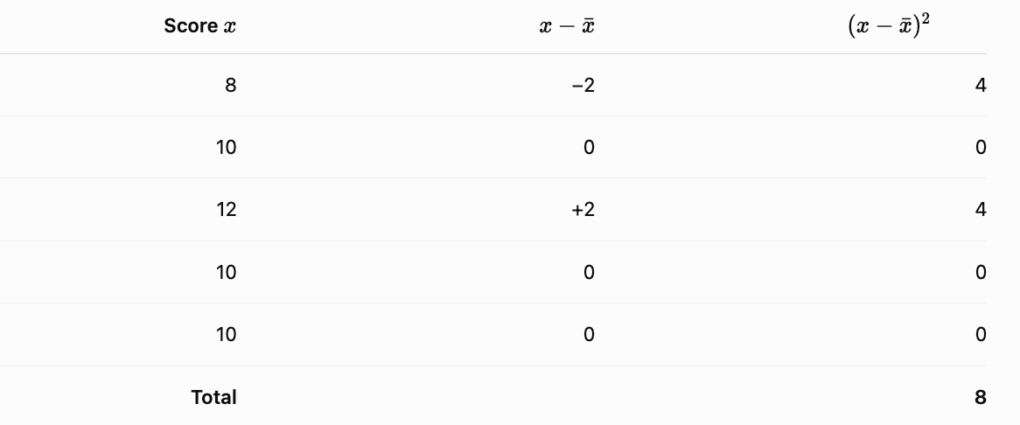
Visualization of Data, Understanding and Interpretation
Variation, Standard Error & Confidence Intervals
Calculation of SD, SE, CI:
Example: Suppose the test scores of 5 students are 8, 10, 12, 10, 10
Step 1: Calculate the mean
Mean = (8+10+12+10+10)/5 = 10
Step 2: Calculate the standard deviation
First calculate deviation from the mean

Slide 31
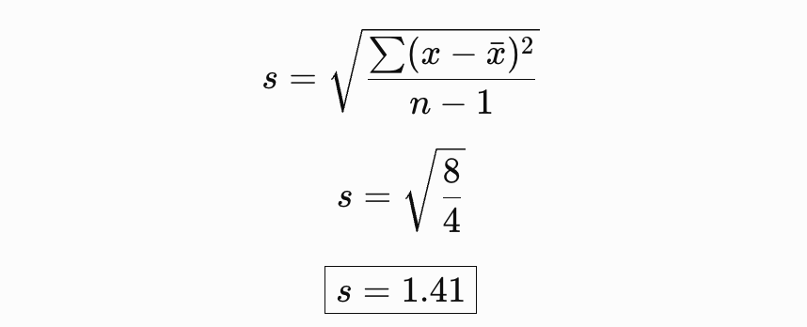
Visualization of Data, Understanding and Interpretation
Variation, Standard Error & Confidence Intervals
For a sample standard deviation:
Individual scores typically vary by about 1.41 points around the mean.

Slide 32
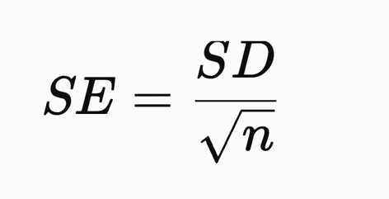
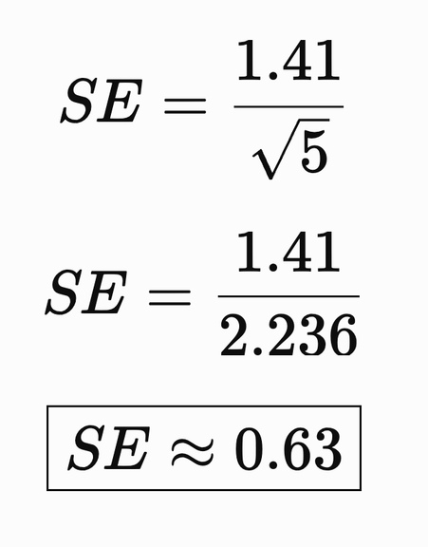
Visualization of Data, Understanding and Interpretation
Variation, Standard Error & Confidence Intervals
Step 3: Calculate Standard Error
Wilke gives the approximate relationship:
Therefore:
The estimated mean has a standard error of approximately 0.63 points.
Notice: SD = 1.41 > SE = 0.63
That's expected because SD describes variation among individual observations, whereas SE describes uncertainty in the estimated mean.
If we repeatedly took samples of 5 observations from the same population and calculated the mean each time, those sample means would typically vary by about 0.63 points around the true population mean.

Slide 33
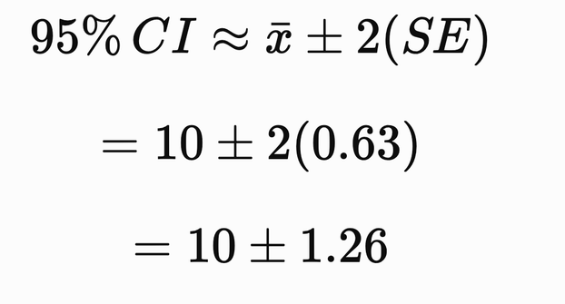
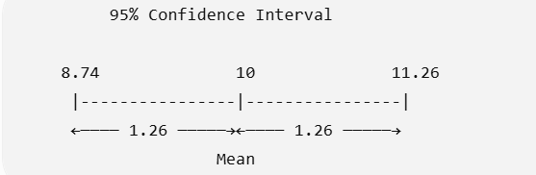
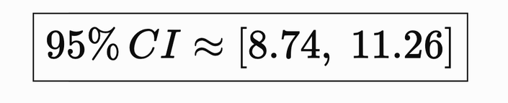
Visualization of Data, Understanding and Interpretation
Variation, Standard Error & Confidence Intervals
Step 4: Approximate 95% Confidence Interval
For a simple introductory calculation, use Wilke's approximation:
Therefore:
SD → variation in individual data
SE → uncertainty in the mean
CI → range around the mean based on that uncertainty.
The estimated mean is: 10 ± 1.26 with an approximate 95% confidence interval of: 8.74 to 11.26
This interval, [8.74, 11.26], is the range within which we're roughly 95% confident the true population mean lies (or, in strict frequentist terms: if we repeated this sampling process many times, about 95% of the intervals we calculate this way would contain the true mean)

Slide 34
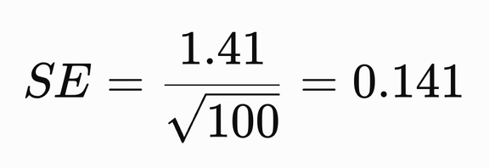
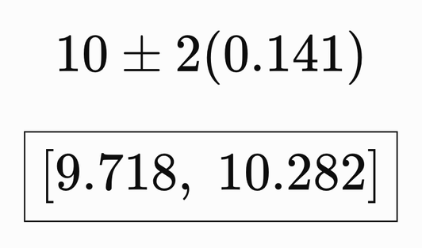
Visualization of Data, Understanding and Interpretation
Variation, Standard Error & Confidence Intervals
Note: Sample size matters!
Imagine the same SD = 1.41, but the number of students are 100 instead of 5.
Approximate 95% CI:
So the SD can remain the same, while the SE and confidence interval become much narrower as sample size increases.

Slide 35
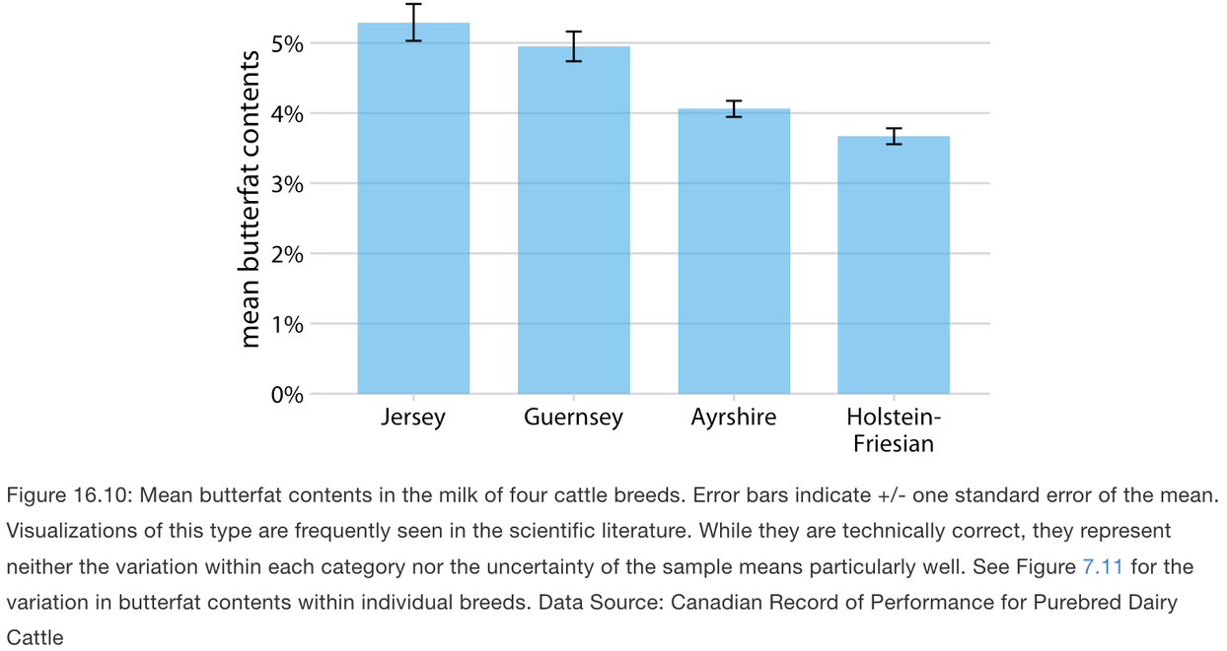
Visualization of Data, Understanding and Interpretation
Error Bars: The Basic Uncertainty Encoding
Error bars extend from an estimated value to indicate a range of uncertainty.
They can be used with:
  Bar charts
  Dot plots
  Scatter plots
  Point estimates
  Other 2D visualizations
Advantages
  Compact
  Show uncertainty for simultaneous estimates
  Easy to combine with existing charts
For example:
  ±1 SD
  ±1 SE
  95% CI

Slide 36
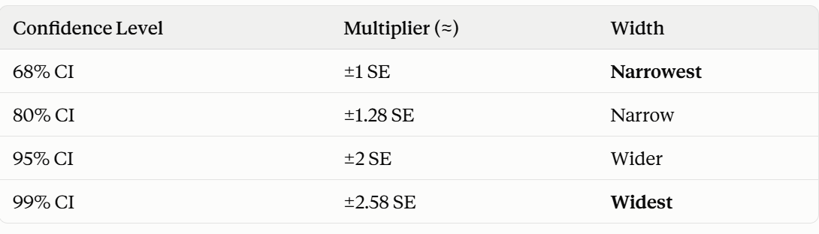
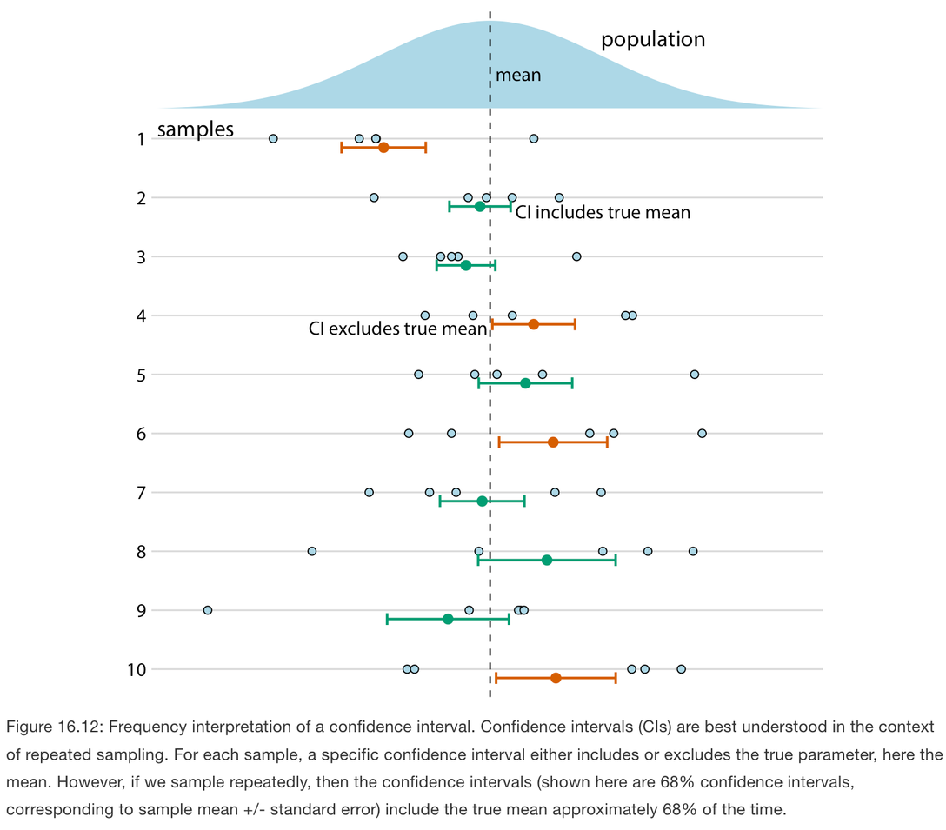
Visualization of Data, Understanding and Interpretation
Confidence Intervals(CI): Reading Uncertainty
A confidence interval gives a range associated with an estimate and a specified confidence level.
For example: 95% confidence interval means that under repeated sampling, intervals constructed using this procedure would contain the true parameter approximately 95% of the time.
💡Important!
Do not interpret a particular 95% confidence interval as:
“There is a 95% probability that the true value is inside this particular interval.”
That is not the frequentist interpretation.
Visual interpretation
  Wider CI → more uncertainty (small sample, noisy data)
  Narrower CI → more precision (larger sample, less variable data)
X`

Slide 37
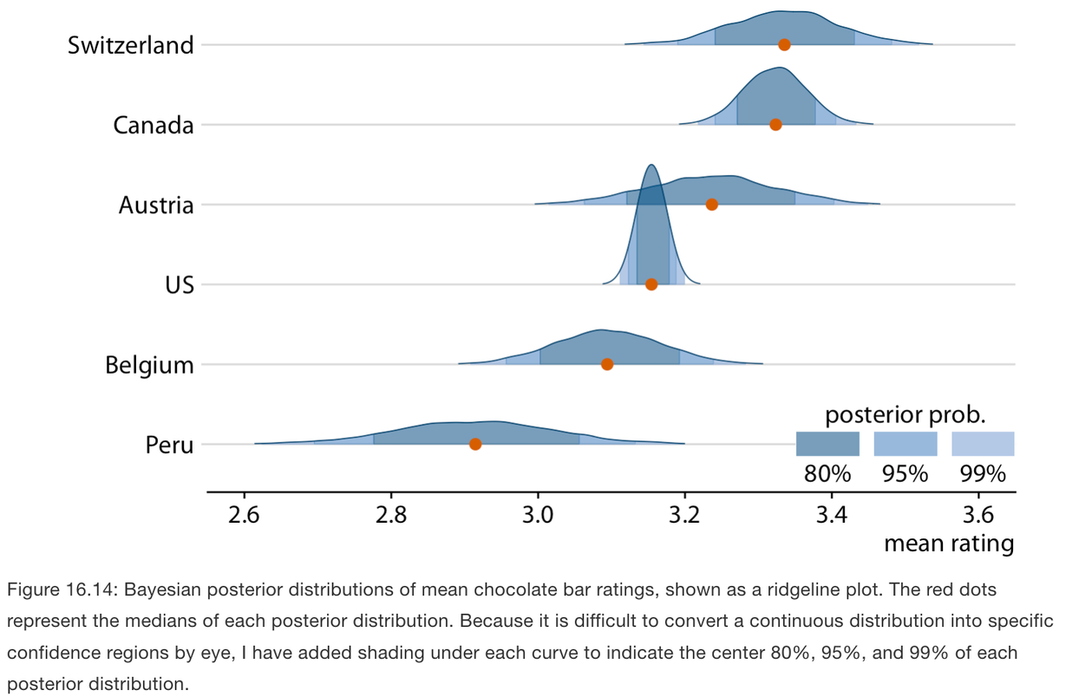
Visualization of Data, Understanding and Interpretation
Bayesian Uncertainty: Credible Intervals & Distributions
The peak of the curve = the most probable value for that country's true mean
The red dot = the median of that posterior
The shaded bands (80%, 95%, 99%) = "center X% of the posterior probability" — literally the credible intervals carved directly out of that curve
Wider/flatter curve (like Peru) → more uncertainty about the true mean
Narrower/taller curve (like US) → more confidence about the true mean
A Bayesian analysis represents uncertainty through a posterior distribution.
A credible interval describes a region of that posterior distribution.
For example: A 95% credible interval contains the central 95% of the posterior distribution.
Visualization
Rather than reducing the posterior to one interval, we can visualize the entire distribution.
Useful displays include:
  Density plots
  Violin plots
  Ridgeline plots
  Quantile dotplots
Prior = what you believed before seeing the data (your starting assumption)
Data = what you actually observed (the sample)
Posterior = your updated belief after combining the prior with the data
Notes:
Posterior probability (or posterior distribution) is the Bayesian answer to: "given the data I've observed, how likely is each possible value of the thing I'm trying to estimate?"

Slide 38
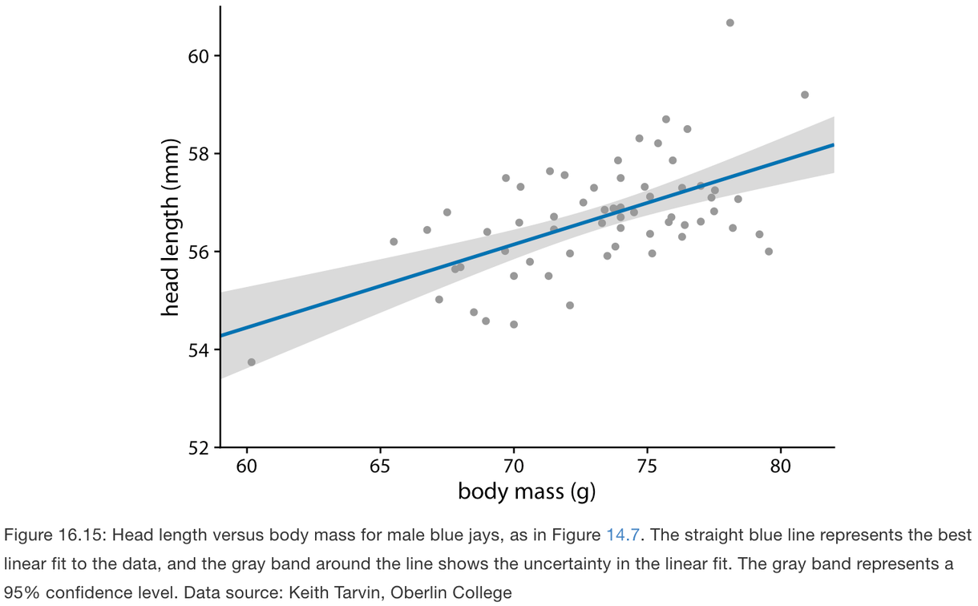
Visualization of Data, Understanding and Interpretation
Uncertainty in Trend Lines
A fitted trend is itself an estimate, so it has uncertainty.
A confidence band shows the range of plausible fitted values around a trend line.
Line → estimated trend
Band → uncertainty around the estimated trend
Why the band can curve
Even if the fitted model is a straight line, uncertainty exists in:
  Its intercept
  Its slope
Different plausible lines therefore produce an overall curved region.

Slide 39
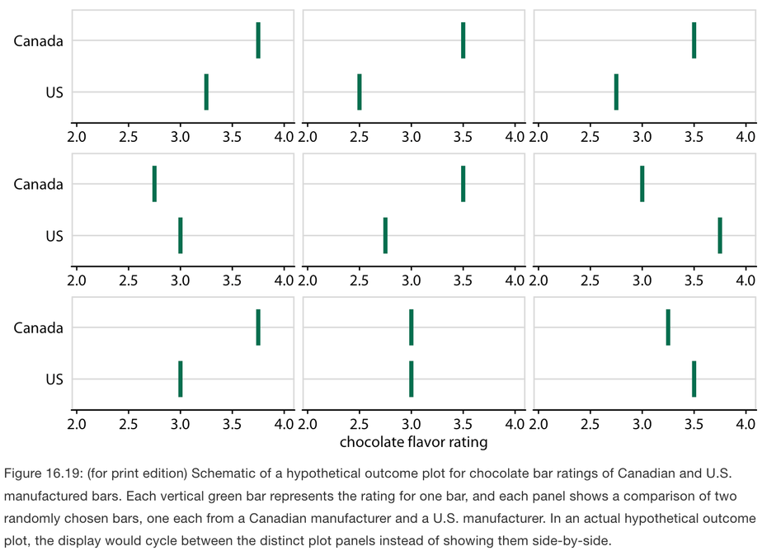
Visualization of Data, Understanding and Interpretation
Communicating Uncertainty Through Possible Outcomes
Old approach says: "Here is the range of uncertainty." (one static picture, viewer has to imagine what's inside it)
HOP approach says: "Here are many possible outcomes." (viewer directly sees multiple concrete realizations, one at a time)
Static uncertainty displays can sometimes be interpreted
as deterministic.
For example, viewers may assume:
“The value cannot go outside this error bar.”
This is a deterministic construal error.
Alternative: Hypothetical Outcome Plots (HOPs)
A HOP repeatedly shows different plausible outcomes sampled from the uncertainty distribution.
Instead of saying:
“Here is the range of uncertainty.”
the visualization effectively shows:
“Here are many possible outcomes.”
Why useful?
  Makes probability more intuitive
  Emphasizes variation between plausible outcomes
  Useful in interactive/animated environments
  Can be effective for presentations and online visualizations
If someone tells you "Canadian chocolate is rated higher than U.S. chocolate," you might assume that means every single Canadian bar beats every single U.S. bar. That's wrong — some U.S. bars are actually better than some Canadian bars. A single average number hides that messiness.
Okay, Canada seems to win more often than not, but it's not a guaranteed thing.
Notes:
Uses random sampling

Slide 40
Visualization of Data, Understanding and Interpretation
Interactive Dashboards: What Is a Dashboard? (TB 3, Ch 12)
A dashboard is a visual display designed primarily for monitoring a system or situation. It brings multiple pieces of information together so that users can maintain awareness and respond to important changes.
Typical dashboard information
  Current status
  Key metrics
  Trends
  Exceptions
  Threshold violations
  Emerging patterns
💡A dashboard is not simply a collection of charts—it is designed around a monitoring task.
Examples
  Business sales dashboard
  Factory monitoring
  Aircraft cockpit
  Healthcare monitoring
  Social-media analytics

Slide 41
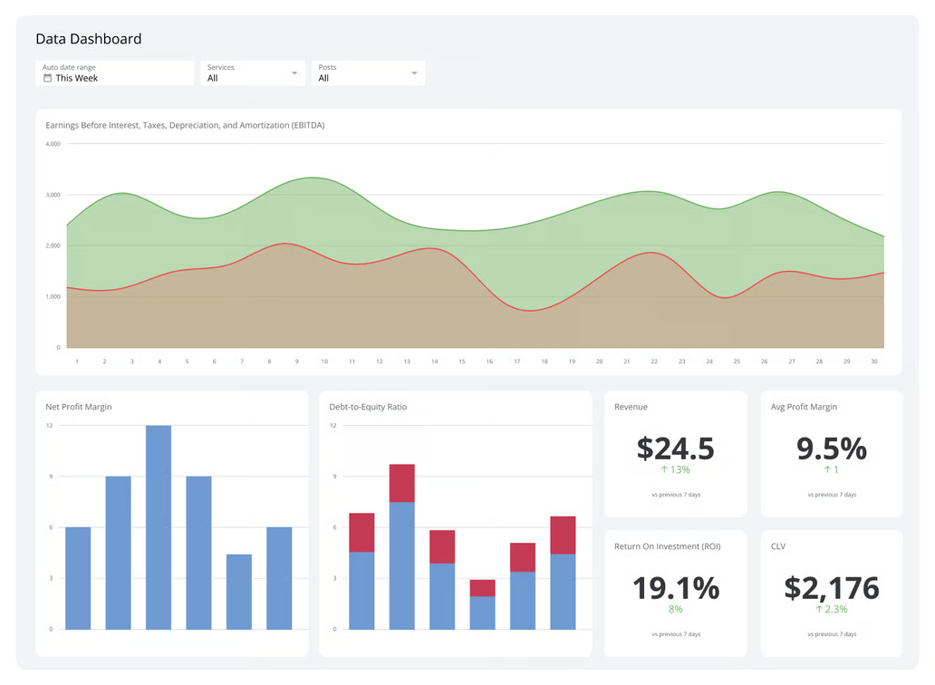

Visualization of Data, Understanding and Interpretation
Interactive Dashboards: What Is a Dashboard?
Examples:

Slide 42
Visualization of Data, Understanding and Interpretation
Designing for Monitoring: What Should the User Notice?
Monitoring differs from ordinary exploratory analysis. The user is often:
  Performing another task simultaneously
  Checking the display intermittently
  Looking for exceptions
  Watching for trends
  Responding to changes
Therefore, a monitoring display should support rapid detection of:
1. Exceptions: Something has crossed a threshold.
2. Trends: Something is changing over time.
3. Emerging patterns: Something unusual is developing.
4. Actions: The information should support an appropriate response.
Cognitive challenge
Monitoring can involve:
  Task switching
  Vigilance
  Attention management
  Missed weak signals

Slide 43
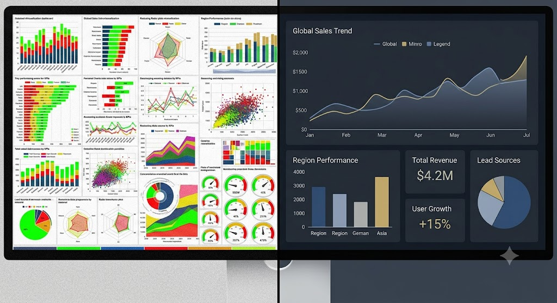
Visualization of Data, Understanding and Interpretation
Dashboard Information Density
A dashboard must balance information availability with cognitive load.
Too little information
  Important context is missing
  Users must navigate elsewhere
  Monitoring becomes inefficient
Too much information
  Visual clutter
  Competing signals
  Slower search
  Important events become harder to detect
Provide enough information to support the task without overwhelming attention.
  Group related information
  Establish clear hierarchy
  Use consistent layouts
  Keep frequently compared information close together
  Avoid decorative elements that compete with data

Slide 44
Visualization of Data, Understanding and Interpretation
Dashboards as Composite Visualizations
A dashboard can combine different visualization types because different views answer different questions.
For example:
Map → Where?
Line chart → How is it changing?
Bar chart → Which category is largest?
Table → What is the exact value?
Example analytical dashboard:
Map + Scatterplot + Time Series
The views can represent different aspects of the same underlying dataset.
A composite visualization is useful when multiple views collectively answer the analytical question better than one view alone.

Slide 45
Visualization of Data, Understanding and Interpretation
Coordinated Multiple Views
A single visualization often cannot represent all relevant dimensions effectively.
Multiple views allow us to:
  Separate different analytical questions
  Use the best visual representation for each data aspect
  Reduce clutter
  Compare different perspectives
  Preserve different types of information simultaneously
Example
A dataset about city performance might use:
Map → geographic distribution
Scatterplot → relationship between two variables
Time series → temporal change
💡Multiple views distribute the cognitive and visual workload across several coordinated displays.

Slide 46
Visualization of Data, Understanding and Interpretation
Coordinated Multiple Views
Coordinated Multiple Views (CMV) connect multiple visualizations so that interaction in one view affects the others.
Coordination can occur through:
  Shared data: All views represent the same underlying dataset.
  Shared encoding: The same variable is represented consistently across views.
  Shared navigation: Views can be explored together.
  Linked selection: Selecting an item in one view identifies the corresponding item elsewhere.
Example:
Select a state on the map → corresponding state is highlighted in the time series and scatterplot.
file:///C:/Users/prajw/Downloads/cmv_interactive_click_demo.html

Slide 47
Visualization of Data, Understanding and Interpretation
Brushing & Linking
Brushing allows the user to select a subset of data in one view.
Linking propagates that selection to other views.
Example:
A user selects several points in a scatterplot
Selected observations → highlighted on the map → corresponding observations highlighted in the time series.
Why is this useful?
Without linking, the user must mentally match:
“Which points here correspond to those points there?”
With linking, the system performs the correspondence visually. This reduces the need to hold information in working memory.
💡Interaction turns separate visualizations into one coordinated analytical system

Slide 48
Visualization of Data, Understanding and Interpretation
MCQ
Q1. A researcher maps the number of disease cases across districts. District A has 10,000 cases and District B has 5,000 cases, but District A also has four times the population of District B. Which visualization choice would most directly address the potential problem?
A. Use a different categorical color for every district
B. Normalize cases by population before using a choropleth
C. Increase the geographic size of District B
D. Replace the choropleth with a 3D map
Answer: B

Slide 49
Visualization of Data, Understanding and Interpretation
MCQ
Q2. Two studies estimate the same population mean and have approximately the same standard deviation. Study A has n=25, while Study B has n=100. Which statement is most consistent with the interpretation of standard error?
A. Study A must have the smaller standard error because it has fewer observations
B. Both studies must have identical standard errors because their SDs are similar
C. Study B have the smaller standard error because the estimate is based on more observations
D. Study B should have the larger standard error because larger samples introduce more variability
Answer: C

Slide 50
Visualization of Data, Understanding and Interpretation
MCQ
Q3. A visualization shows a fitted trend line surrounded by a 95% confidence band. Which interpretation is most appropriate?
A. The band represents the range in which 95% of individual observations must fall
B. The band represents uncertainty associated with the estimated trend
C. The band guarantees that future observations will fall within its boundaries
D. The width of the band directly represents the standard deviation of the observed data
Answer: B

Slide 51
Visualization of Data, Understanding and Interpretation
MCQ
Q4. A cartogram enlarges regions according to population while substantially distorting their geographic shapes. What is the primary trade-off introduced by this visualization?
A. It removes the need for a color scale
B. It makes geographic location completely irrelevant
C. It improves population comparison at the cost of geographic fidelity
D. It guarantees more accurate distance measurements between regions
Answer: C

Slide 52
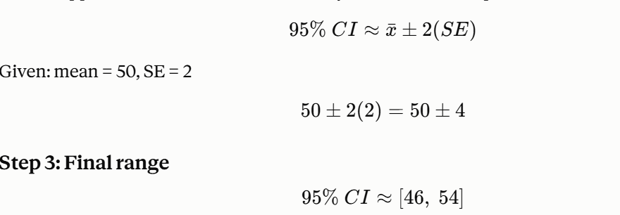
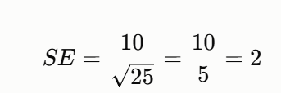
Visualization of Data, Understanding and Interpretation
MCQ
Q5. A sample contains 25 observations with a standard deviation of 10. Using the approximations provided by Wilke for SE and CI, if the sample mean is 50, what is the approximate 95% confidence interval?
A. 45 to 55
B. 48 to 52
C. 40 to 60
D. 46 to 54
Answer: D
Notes:
SE=25​10​=510​=2

Slide 53
Thank You

