Slide 1

Visualization of Data, Understanding and Interpretation
Unit 4 : AI-Assisted Visualization
(UE24CS342AA9)
Lecture 2: Natural Language & Conversational Visualization
Dr.Prajwala TR (Course Instructor)
Dept. of CSE, PES University, Bangalore

Slide 2
Visualization of Data, Understanding and Interpretation
Acknowledgement
The slides are prepared from various resources from the Universities from abroad and India. Also, some material is taken from reliable resources from internet throughout this course.

Slide 3
Visualization of Data, Understanding and Interpretation
Lecture Overview
In this lecture, we will cover:
Natural Language to Visualization (NL2Vis)
From a natural-language query to data/task abstraction to a chart
Semantic parsing of user intent and handling ambiguity
Conversational visualization systems
Multi-turn querying and refinement
Follow-up questions and context preservation
Text-to-chart generation using LLMs and LLM-generated chart specifications
Conversational chart editing
Benefits and failure modes of LLM-generated visualizations

Slide 4
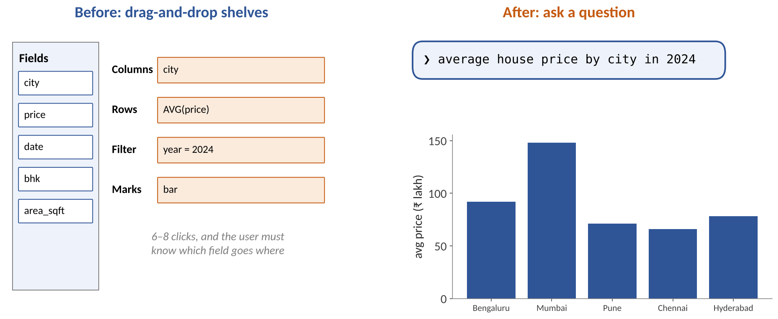
Visualization of Data, Understanding and Interpretation
From Clicks to Questions
MOTIVATION
Natural language lowers the barrier: users say what they want to know, and the system decides how to show it.
Source: Illustrative interfaces; cf. Tableau Ask Data, Power BI Q&A, Narechania et al. 2021 (NL4DV)

Slide 5
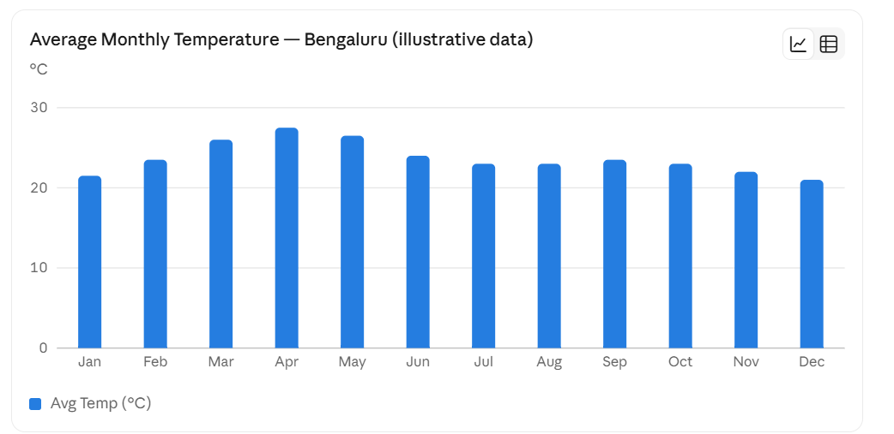
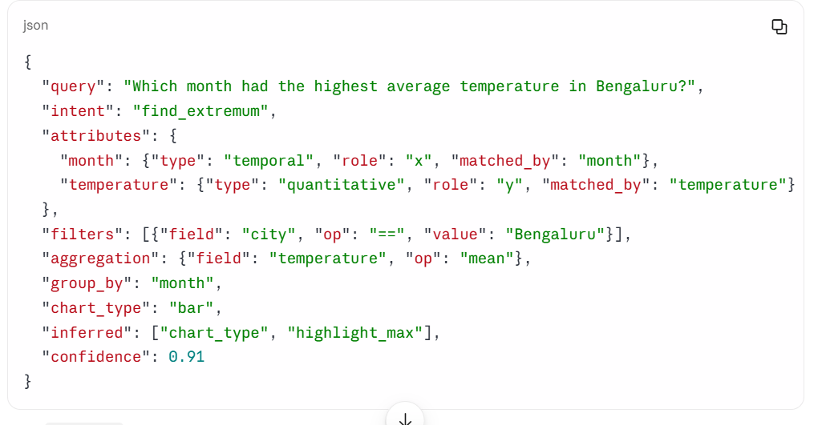
Visualization of Data, Understanding and Interpretation
What Is NL2Vis?
TOPIC 1 · NATURAL LANGUAGE TO VISUALIZATION (NL2VIS)
Definition
NL2Vis translates a natural-language question about a dataset into a visualization specification (fields, transformations, mark, encodings) and renders it.
April had the highest average temperature in Bengaluru (≈27.5 °C), followed by May (≈26.5 °C).
Input
A question in plain language
The dataset schema: column names, types, sample values
Optional: dialogue history
Which month had the highest average temperature in Bengaluru
Output
A spec (e.g. Vega-Lite JSON) or SQL + chart type
The rendered chart
Often a sentence explaining the interpretation
Intermediate interpretation (NL4DV-style JSON)
Examples
Tableau Ask Data / Pulse
Power BI Q&A and Copilot
NL4DV toolkit (Python)
ChatGPT data analysis, LIDA
Source: Narechania et al. (2021) NL4DV, IEEE TVCG; Luo et al. (2021) nvBench, SIGMOD; Munzner VAD §1.2 (p.2)

Slide 6
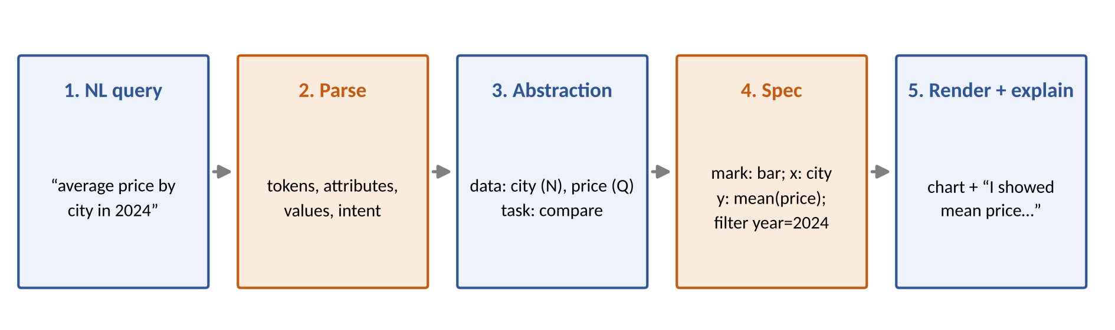
Visualization of Data, Understanding and Interpretation
The NL2Vis Pipeline
TOPIC 1 · NATURAL LANGUAGE TO VISUALIZATION (NL2VIS)
Parse
Find the attributes, values, aggregations and words that signal a task.
Abstract
Turn domain words into generic data types and an abstract task (Munzner Ch 2–3).
Specify
Choose mark and channels (Deck 1 rules), then render and explain.
Source: Synthesised from NL4DV (Narechania et al. 2021) and Munzner VAD Ch 2–3

Slide 7
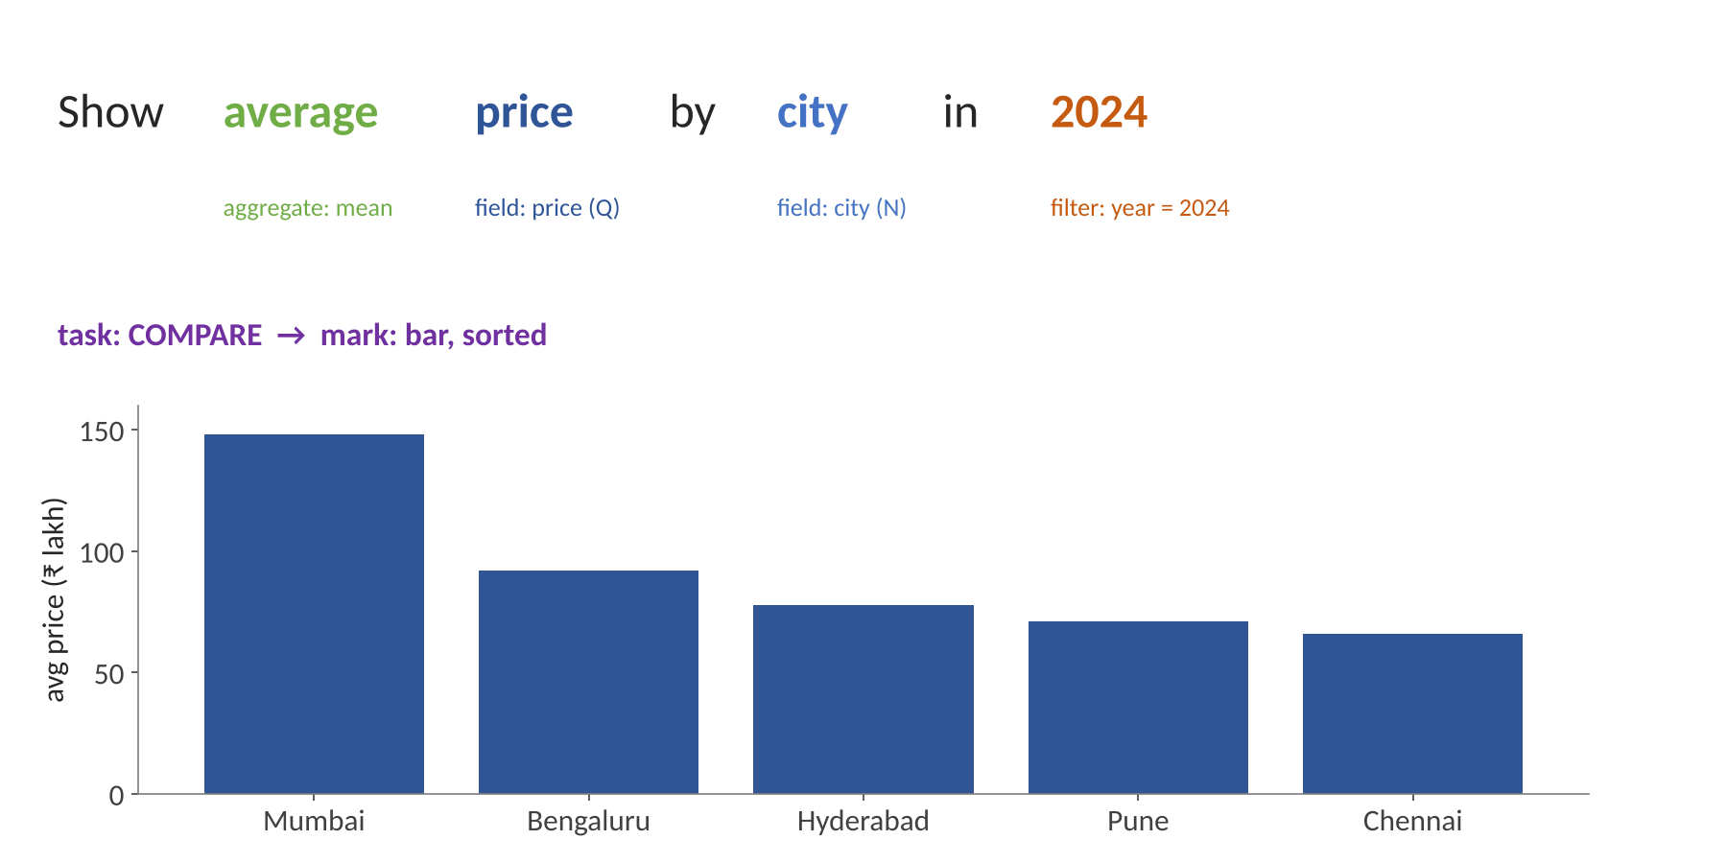
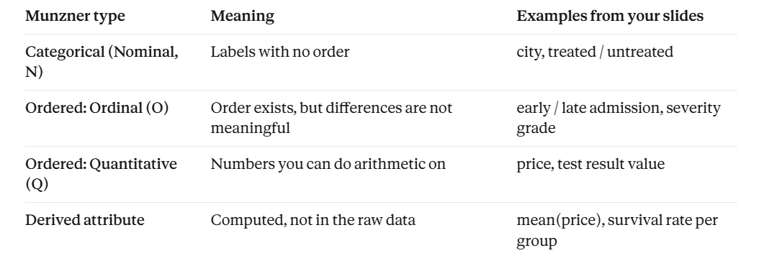
Visualization of Data, Understanding and Interpretation
Parsing a Query (Animated)
This step answers: what kind of thing is each field?
What the parser finds
average → aggregation = mean
price → quantitative attribute
city → categorical attribute
2024 → value of the year field → filter
Task (implicit): compare cities
Chart: sorted bar chart
TOPIC 1 · NATURAL LANGUAGE TO VISUALIZATION (NL2VIS)
what is the user trying to do? Munzner describes every task as an {action, target} pair.
Source: Illustrative; tagging scheme follows NL4DV's attribute / task / visualization output

Slide 8
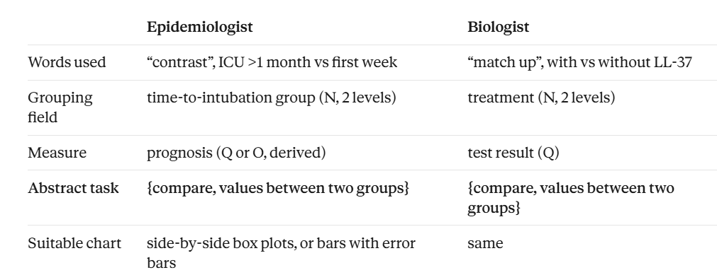
Visualization of Data, Understanding and Interpretation
Why Translate Queries into Abstract Tasks?
TOPIC 2 · QUERY → DATA/TASK ABSTRACTION → VISUALIZATION
Epidemiologist
“Contrast the prognosis of patients intubated in the ICU more than one month after exposure to patients hospitalized within the first week”
Biologist
“See if the results for the tissue samples treated with LL-37 match up with the ones without the peptide”
Same abstract task: “compare values between two groups”
“The task abstraction can and should guide the data abstraction” (§3.2): the task tells the system which fields to derive or aggregate.
NL2Vis lesson: different words (contrast, match up, vs, compared with) must map to one abstract task.

Slide 9
Visualization of Data, Understanding and Interpretation
Actions:
  Analyze: discover, present
  Search: lookup, locate, browse, explore
  Query: identify, compare, summarize
Targets:
  All data: trends, outliers
  One attribute: distribution, extremes
  Many attributes: correlation, dependency
Munzner's Task Vocabulary: Actions and Targets
TOPIC 2 · QUERY → DATA/TASK ABSTRACTION → VISUALIZATION
Level | Abstract terms | Typical words in a query
Analyze | discover (generate / verify hypothesis), present, enjoy | explore, show me, is it true that…
Search | lookup (target & location known), locate (target known), browse (location known), explore (neither known) | find, where is, look at, anything interesting
Query | identify one · compare some · summarize all | what is, compare, vs, overall, summary
Targets (all data) | trends, outliers, features | over time, trend, unusual, spikes
Targets (attributes) | one value, extremes, distribution; dependency, correlation, similarity | highest, top 5, spread, related to, correlated
Searching (§3.1): both known → lookup; target known, location unknown → locate; location known → browse; neither → explore.
Source: Munzner VAD §3.1 The big picture, Fig. 3.1 (p.43); §3.4–3.5 (p.45–57)

Slide 10
Visualization of Data, Understanding and Interpretation
From Words to Tasks to Charts
TOPIC 2 · QUERY → DATA/TASK ABSTRACTION → VISUALIZATION
Cue words in the query | Abstract task / target | Default chart (Wilke Ch 5)
over time, trend, since 2019, monthly | trend | Line chart
compare, vs, across, by <category> | compare values | Sorted bar chart
top 5, highest, lowest, best | extremes | Sorted bar, top-k highlighted
distribution, spread, range, how varied | distribution | Histogram / boxplot
related to, correlation, depends on | correlation | Scatter plot
share, percentage of, breakdown | part-to-whole | Stacked bar / pie (few parts)
unusual, outlier, anomaly, spike | outliers | Scatter / line with highlights
Knaflic Ch 2: prefer simple text, tables, lines and bars; avoid pies with many slices, 3D and secondary y-axes.
Source: Task terms: Munzner Ch 3; chart choices: Wilke TB1 Ch 5 (PDF p.40–42); Knaflic TB2 Ch 2

Slide 11
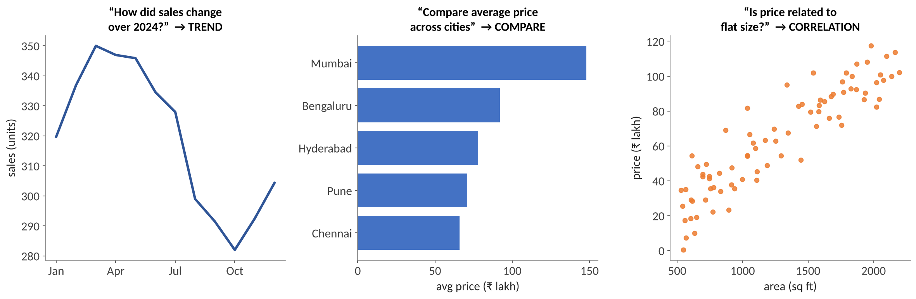
Visualization of Data, Understanding and Interpretation
Worked Example: Three Questions, Three Abstractions
TOPIC 2 · QUERY → DATA/TASK ABSTRACTION → VISUALIZATION
Query | Data abstraction | Task | Chart
How did sales change over 2024? | month (ordinal), sales (Q) | trend | line
Compare average price across cities | city (N), mean price (Q) | compare | sorted bar
Is price related to flat size? | area (Q), price (Q) | correlation | scatter
Source: Charts drawn with illustrative housing data; task mapping per Munzner Ch 3

Slide 12
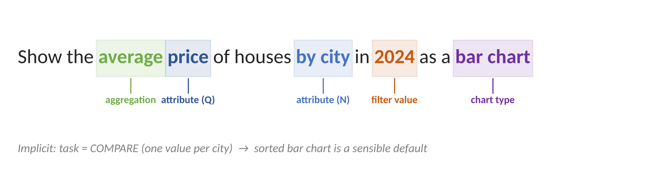
Visualization of Data, Understanding and Interpretation
Semantic Parsing: From Sentence to Specification
TOPIC 3 · SEMANTIC PARSING OF USER INTENT
Sub-tasks
Attribute detection: match words to columns (with synonyms)
Value detection: 'Pune', '2024' → filters
Aggregation: average, total, count
Task / intent: compare, trend, correlation
Explicit chart words: 'as a bar chart'
{"attributes": ["price", "city"],
"filters": [{"year": 2024}],
"aggregate": {"price": "mean"},
"task": "compare",
"vis": {"mark": "bar",
"x": "city", "y": "mean(price)"}}
Source: Narechania et al. (2021) NL4DV; Setlur et al. (2016) Eviza

Slide 13
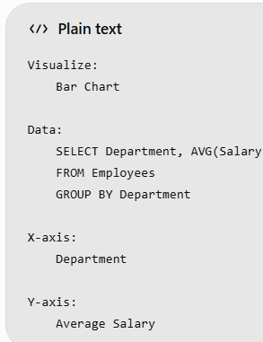
Visualization of Data, Understanding and Interpretation
Three Families of NL2Vis Parsers
TOPIC 3 · SEMANTIC PARSING OF USER INTENT
 | Rule / grammar-based | Neural (seq2seq) | LLM prompting
How it works | Lexicon + dependency parse + hand rules | Trained on (question, spec) pairs | Prompt with schema + question; LLM writes spec/code
Examples | Eviza, NL4DV, DataTone | Seq2Vis, ncNet (nvBench) | Chat2VIS, LIDA, Copilot
Strengths | Predictable, explainable, fast | Learns paraphrases | Handles open-ended, messy language
Weaknesses | Brittle to new phrasing | Needs large labelled data | Hallucinates fields; non-deterministic
Typical output | Analytic spec (JSON) | Vega-Lite / VQL-VQL is the structured representation of the user's request, not the final chart itself. | Python code or Vega-Lite
Trend: hybrid systems — LLM for language understanding, rules and validators for safe chart specs.
Source: Setlur et al. 2016 (Eviza); Narechania et al. 2021 (NL4DV); Luo et al. 2021 (nvBench, ncNet); Maddigan & Susnjak 2023 (Chat2VIS); Dibia 2023 (LIDA)

Slide 14
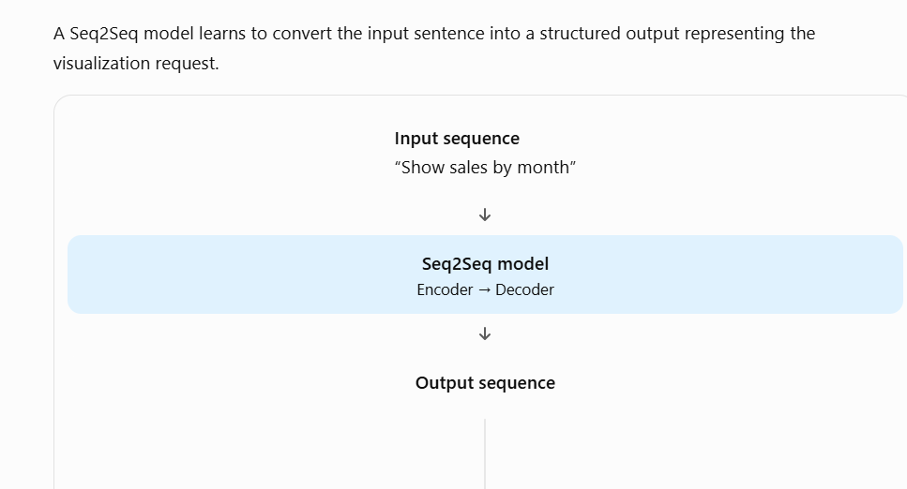
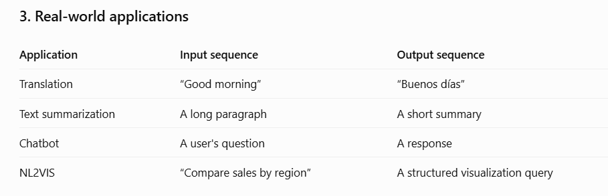
How does a Seq2Seq model work?
A traditional Seq2Seq model has two main components.
1. Encoder
Reads the input sequence and converts it into a numerical representation that captures relevant information.
Example: It identifies the concepts sales, month, and line chart.
2. Decoder
Uses the encoded information to generate the output sequence, usually one token at a time.
Example: It generates the chart type, axis fields, and data operations.

Slide 15
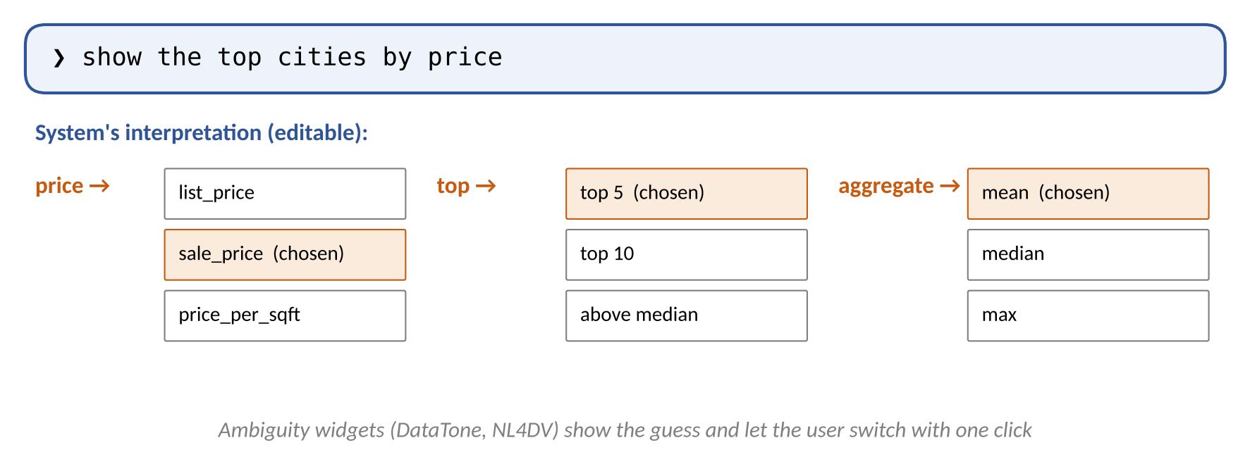
Visualization of Data, Understanding and Interpretation
Ambiguity in Natural-Language Queries
TOPIC 3 · SEMANTIC PARSING OF USER INTENT
Types of ambiguity
Data: which column is 'price'?
Value: what counts as 'top'?
Aggregation: average or total?
Task: 'show sales' → trend or compare?
Under-specified: no chart named
Strategy | How | Trade-off
Default + show interpretation | Pick most likely, state it in text | Fast; user must notice errors
Ambiguity widget | Dropdowns for each uncertain choice | Transparent; slightly more UI
Clarifying question | “Did you mean list or sale price?” | Accurate; slows the user
Source: Gao et al. (2015) DataTone, UIST; Narechania et al. (2021) NL4DV; Setlur et al. (2016) Eviza

Slide 16
Understanding the Similarity Formula
a: Word from the user's query (e.g., revnue).
b: Database column name (e.g., revenue).
d: Levenshtein distance — minimum number of insertions, deletions, or substitutions required to convert one word into the other.
len(a): Number of characters in word a.
len(b): Number of characters in word b.
max(len(a), len(b)): Length of the longer word.
Visualization of Data, Understanding and Interpretation
Numerical 1: Matching a Misspelt Attribute
TOPIC 3 · SEMANTIC PARSING OF USER INTENT
Question
Query: “show avg revnue by month”.
Columns: revenue, review, reserve, region, returns.
Similarity = 1 − d / max(len(a), len(b)), where d = Levenshtein distance.
Match the column with the highest similarity if it is ≥ 0.7.
(a) Compute d and similarity for each column.
(b) Which column is matched?
Column | Length | d(revnue, ·) | Similarity
revenue | 7 | 1 | 1 − 1/7 = 0.857
review | 6 | 3 | 1 − 3/6 = 0.500
reserve | 7 | 4 | 1 − 4/7 = 0.429
region | 6 | 4 | 1 − 4/6 = 0.333
returns | 7 | 5 | 1 − 5/7 = 0.286
(b) Only revenue (0.857 ≥ 0.7) is matched. revnue → revenue needs one insertion (the second 'e'). If no column passes, the system should ask, not guess.
Levenshtein distance is the minimum number of insertions, deletions, or substitutions required to convert one word into another.
Query term: revenue (from “avg revnue” — assuming the intended word is revenue for matching).
The formula measures how similar two words are.
Source: Levenshtein (edit) distance; similarity normalisation as used in lexical attribute matching (cf. NL4DV)

Slide 17
Visualization of Data, Understanding and Interpretation
From a Single Query to a Conversation
TOPIC 4 · CONVERSATIONAL VISUALIZATION SYSTEMS
A conversational visualization system lets users ask a sequence of related questions in natural language; each turn updates the chart using the context of earlier turns.
System | Year | Key idea
Eviza (Tableau Research) | 2016 | NL interface with pragmatics for follow-up questions; ambiguity widgets
Evizeon | 2018 | Context transitions (continue / retain / shift) across turns
Orko | 2018 | Multimodal: speech + touch on network visualizations
Tableau Pulse, Power BI Copilot | 2023+ | Chat panels in BI tools; chart + narrative answers
Data Formulator 2 | 2024+ | Iterative chart authoring with an LLM, keeps history of versions
Source: Setlur et al. 2016 (Eviza); Hoque et al. 2018 (Evizeon); Srinivasan & Stasko 2018 (Orko); Wang et al. 2024 (Data Formulator)

Slide 18
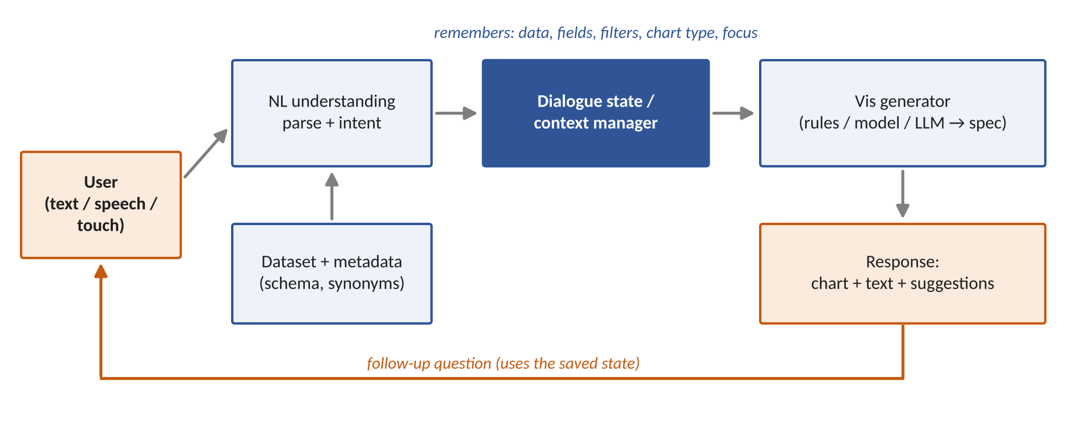
Visualization of Data, Understanding and Interpretation
Architecture of a Conversational Visualization System
TOPIC 4 · CONVERSATIONAL VISUALIZATION SYSTEMS
The key new component is the dialogue state: without it, every follow-up would be treated as a brand-new question.
Source: Synthesised from Eviza, Evizeon, Orko and LLM chat-BI tools

Slide 19
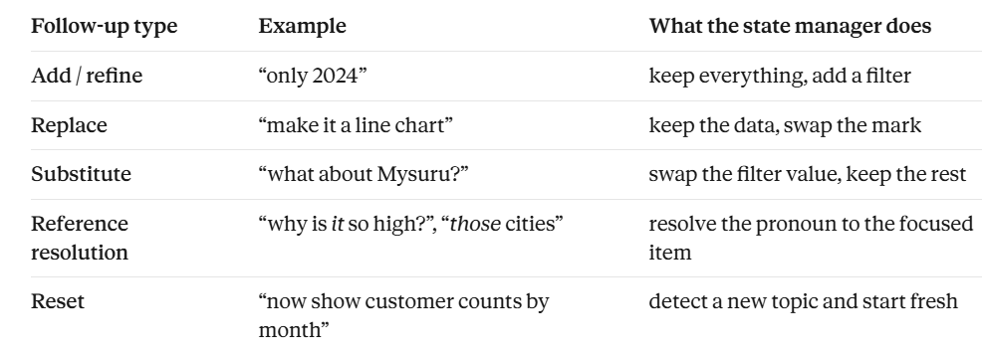
Dialogue state / context manager (the key new component)
This is the system’s memory. it remembers data, fields, filters, chart type, and focus. Its job is to merge each partial update into the current state:

Slide 20
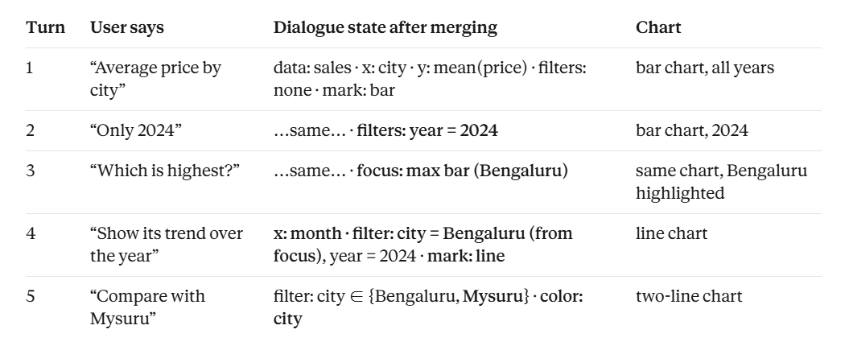

Slide 21
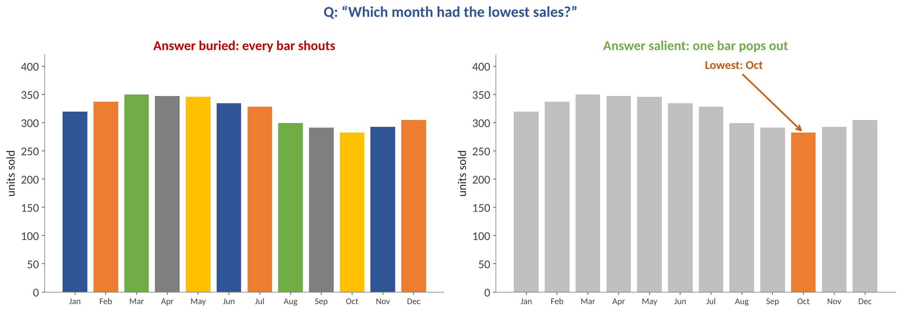
Visualization of Data, Understanding and Interpretation
Responses Must Make the Answer Salient
TOPIC 4 · CONVERSATIONAL VISUALIZATION SYSTEMS
Design rules
One accent colour for the answer, grey for context
Annotate the answer in words
Avoid rainbow palettes: every bar competes
Pre-attentive cues are found without search (Ware Ch 5)
Ware Ch 5 & 12
Pop-out features cut the cost of the viewer's visual query.
Knaflic Ch 4
Size, colour and position direct attention to the point.
Source: Ware, Information Visualization 4th ed., Ch 5 Visual salience & Ch 12; Knaflic TB2 Ch 4 Focus your audience's attention

Slide 22
Visualization of Data, Understanding and Interpretation
Kinds of Follow-Up Turns
TOPIC 5 · MULTI-TURN QUERYING AND REFINEMENT
Turn type | Example utterance | What changes in the state
Refine (filter) | “only for Pune and Mumbai” | add filter; keep fields and chart
Elaborate (add field) | “split it by property type” | add colour / facet encoding
Change aggregation | “show the median instead” | aggregate mean → median
Change view | “as a line chart” | mark bar → line
Drill down | “break March into weeks” | finer time unit + filter month
Compare | “and how does that compare with 2023?” | add year as colour / second series
Shift / reset | “now show rental yields” | new measure; drop old filters
Munzner §3.2: complex activities are “a chained sequence of tasks, where the output of one becomes the input to the next.”
Source: Hoque et al. 2018 (Evizeon); Munzner VAD §3.2 chained tasks (p.44)

Slide 23
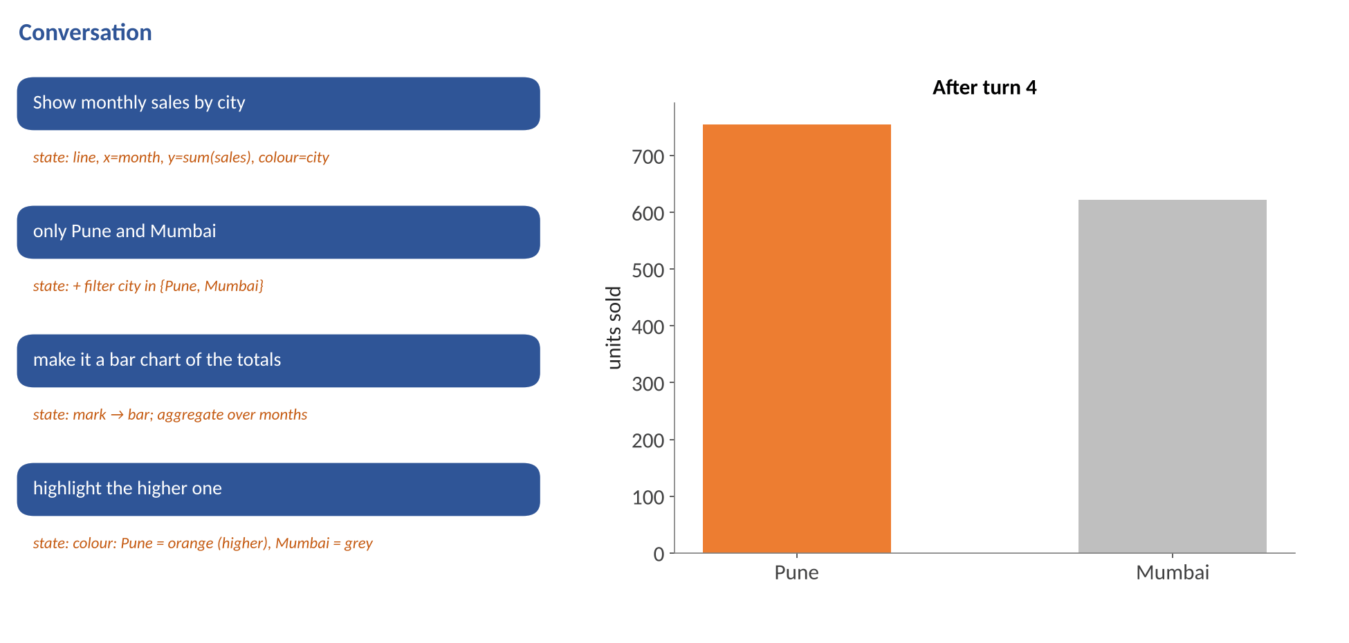
Visualization of Data, Understanding and Interpretation
Multi-Turn Refinement in Action (Animated)
TOPIC 5 · MULTI-TURN QUERYING AND REFINEMENT
Watch the state
Turn 1: new query
Turn 2: refine (filter)
Turn 3: change view + aggregate
Turn 4: emphasis (Knaflic Ch 4)
Fields and data source are never repeated by the user
Source: Illustrative conversation; state updates follow the turn types on the previous slide

Slide 24
Visualization of Data, Understanding and Interpretation
Follow-Ups Depend on Context
TOPIC 6 · FOLLOW-UP QUESTIONS AND CONTEXT PRESERVATION
Three types:
Ellipsis
“…and for 2023?”
Missing words are copied from the previous query.
Anaphora
“Sort them by price.”
'them' refers to the cities currently shown.
Deixis (pointing)
“Why is this one so high?” + tap
Refers to a selected mark (Orko).
pointing at something on screen
“Why is this one so high?” + tap on a bar
Once the system knows the follow-up depends on context, it still has to decide how much of the old context to keep. Evizeon (Hoque et al., 2018) borrowed centering theory from linguistics.
Transition (Evizeon) | Meaning | Example after “prices in Pune 2024” | Context action
Continue | same focus, more detail | “by number of bedrooms” | keep all, add field
Retain | same entities, new angle | “what about rents?” | keep filters, swap measure
Shift | new topic | “show traffic accidents by city” | reset filters and fields
Source: Hoque et al. (2018) Evizeon, IEEE TVCG (centering theory); Setlur et al. (2016) Eviza

Slide 25
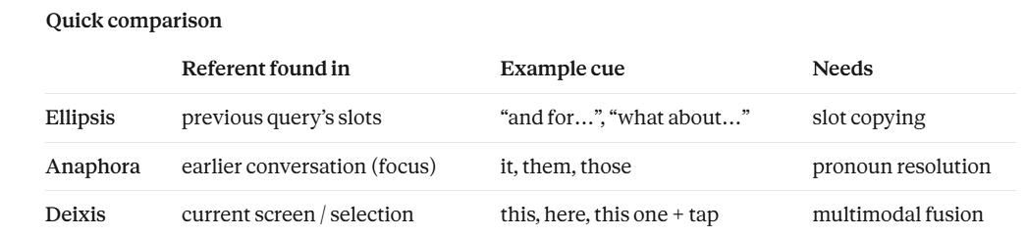
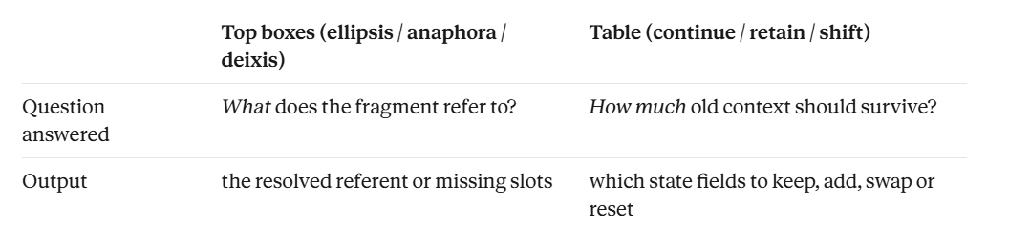

Slide 26
Visualization of Data, Understanding and Interpretation
Tracking the Dialogue State: A Worked Trace
TOPIC 6 · FOLLOW-UP QUESTIONS AND CONTEXT PRESERVATION
Turn | Utterance | Measure | Group / x | Filters | Chart
1 | “average price by city” | mean(price) | city | — | bar
2 | “only 2024” | mean(price) | city | year = 2024 | bar
3 | “show it monthly for Pune” | mean(price) | month | year = 2024, city = Pune | line
4 | “what about Chennai?” | mean(price) | month | year = 2024, city = Chennai | line
5 | “compare the two” | mean(price) | month, colour = city | year = 2024, city ∈ {Pune, Chennai} | line × 2
Inherited values (black) come from the state; only the changed slot is updated each turn. Turn 4 is ambiguous: replace Pune or add Chennai? The system should say which it chose.
Source: State fields follow the conversational architecture; illustrative trace

Slide 27
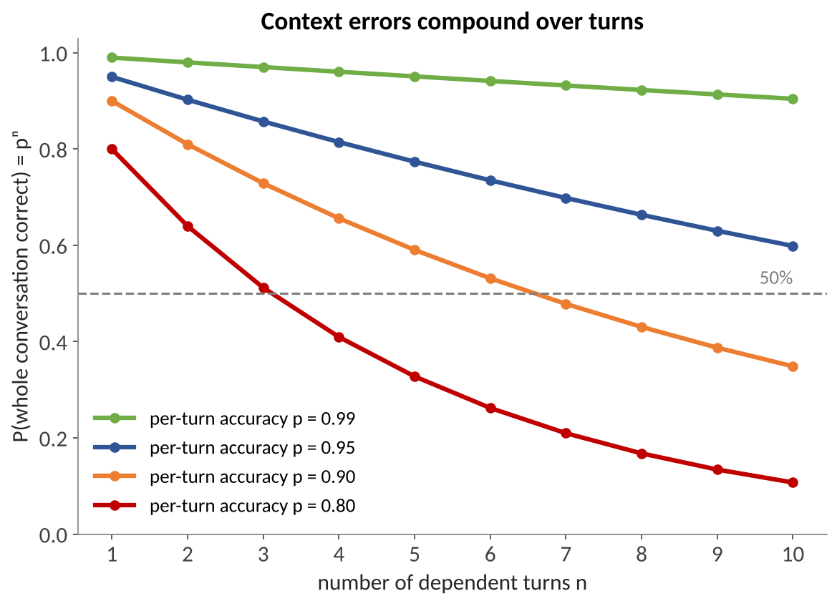

Visualization of Data, Understanding and Interpretation
Numerical 2: Why Context Errors Compound
In a conversation, each follow-up builds on the previous state. If the system gets the context wrong at turn 3 (say it keeps a filter that should have been dropped), turns 4, 5 and 6 inherit that wrong state. One mistake spoils every later turn, even if all the later turns are interpreted correctly.
So the question is not “how accurate is one turn?” but “how likely is it that the whole conversation stays correct?”
TOPIC 6 · FOLLOW-UP QUESTIONS AND CONTEXT PRESERVATION
Question & solution
A system resolves each follow-up correctly with p = 0.90. Each turn builds on the last.
(a) 5 turns: 0.90⁵ = 0.590-A system that is “90% accurate” gets a 5-turn conversation fully right only 59% of the time.
(b) 10 turns: 0.90¹⁰ = 0.349
(c) Improve to p = 0.95, 5 turns: 0.95⁵ = 0.774
Lesson: echo the interpretation every turn so the user catches an error before it spreads.
Source: Probability of independent per-turn success; illustrative accuracies

Slide 28
Visualization of Data, Understanding and Interpretation
Prompting Strategies for Text-to-Chart
TOPIC 7 · TEXT-TO-CHART GENERATION USING LLMS
Strategy | What you add to the prompt | Helps with
Zero-shot | Only schema + question | Quick; works for simple charts
Few-shot | 2–3 (question, code) examples | Consistent style and output format
Schema + samples | Column types and a few rows | Fewer hallucinated columns, correct parsing
Plan, then code | “First list fields, aggregation, chart; then code” | Reasoning you can check before running
Design rules | Knaflic/Wilke rules as bullet points | Fewer pies, 3D, unlabelled axes
Self-repair loop | Execution error + schema sent back | Code that runs; fixes typos in names
No strategy guarantees a correct chart: the output still needs validation (Topic 8).
Source: Chat2VIS (2023); LIDA (2023); common prompting practice

Slide 29
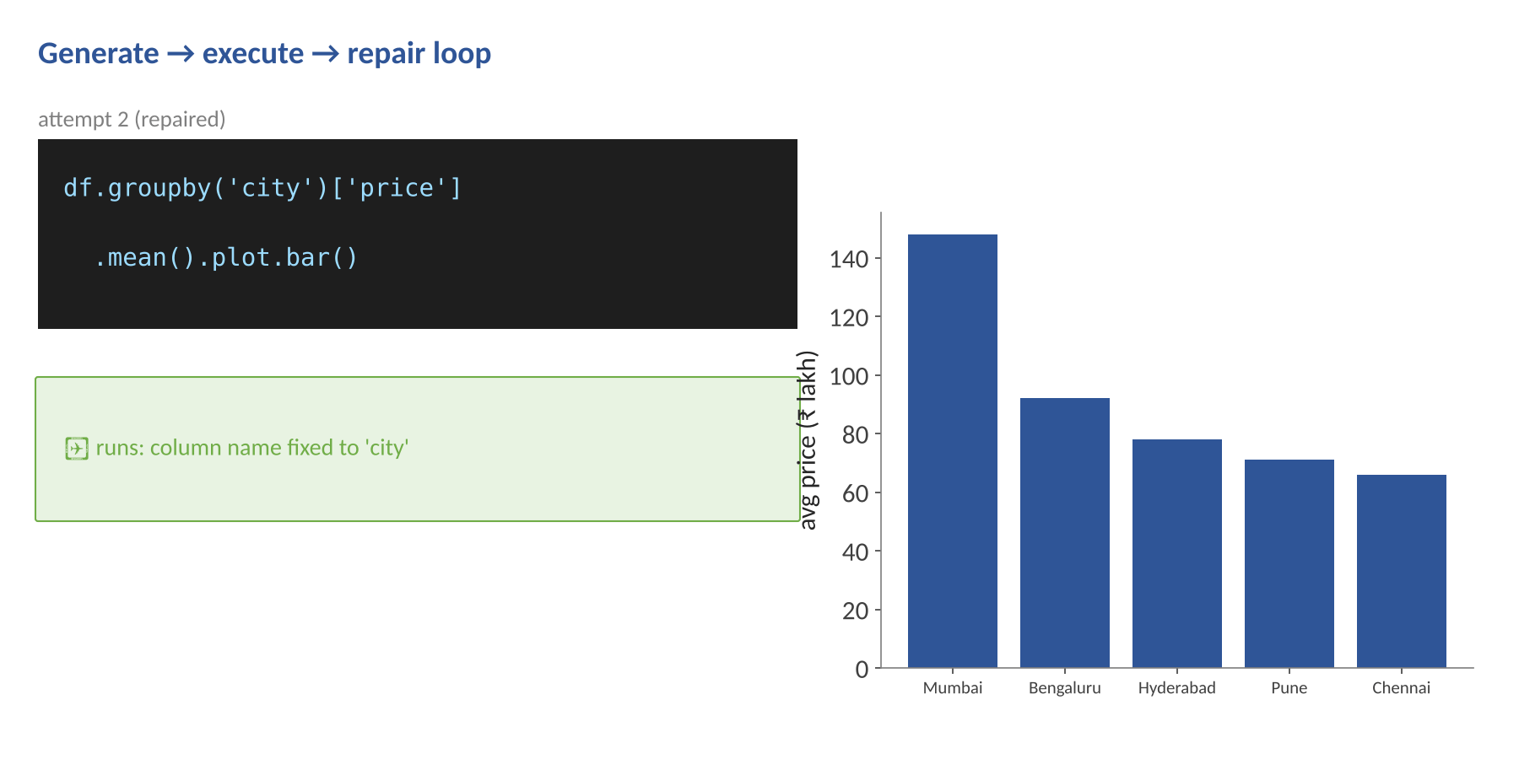
Visualization of Data, Understanding and Interpretation
The Generate → Execute → Repair Loop (Animated)
TOPIC 7 · TEXT-TO-CHART GENERATION USING LLMS
Loop steps
Generate code or spec
Execute in a sandbox
On error: send error + schema back
LLM repairs; retry (max 2–3)
Still failing: ask the user
Runs ≠ correct: a chart that runs can still answer the wrong question.
Source: Loop design as in LIDA (Dibia 2023): generation, execution, self-evaluation and repair

Slide 30
Visualization of Data, Understanding and Interpretation
NL2Vis Systems Compared
TOPIC 7 · TEXT-TO-CHART GENERATION USING LLMS
System | Input | Method | Output
NL4DV (2021) | Question + CSV | Rules + dependency parsing | Analytic spec + Vega-Lite
Data2Vis (2019) | Data rows (no question) | Seq2seq translation (LSTM) | Vega-Lite spec
ncNet / nvBench (2021) | Question + table | Transformer trained on 25k pairs | Vis query language
Chat2VIS (2023) | Question + schema | LLM prompting (GPT, Codex) | Python code
LIDA (2023) | Dataset (+ optional goal) | LLM modules + repair | Code, any library
Copilot / Pulse | Question in BI tool | LLM + BI semantic model | Native chart + narrative
Source: Narechania et al. 2021; Dibia & Demiralp 2019; Luo et al. 2021; Maddigan & Susnjak 2023; Dibia 2023

Slide 31
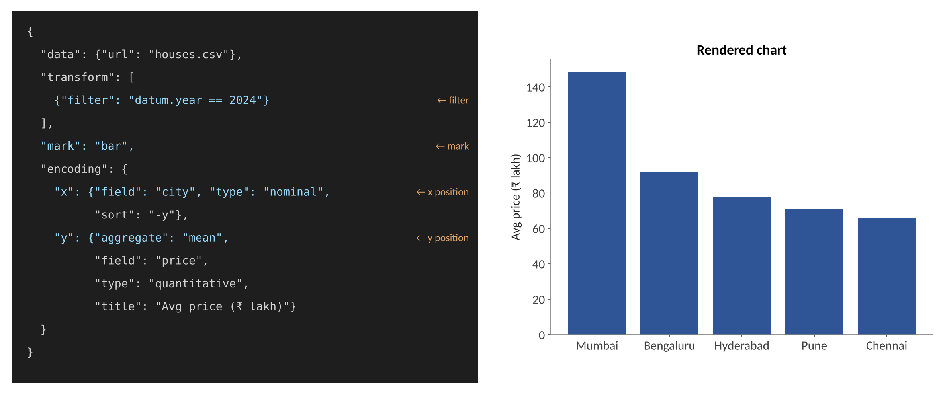
Visualization of Data, Understanding and Interpretation
Specs, Not Just Code: Vega-Lite
TOPIC 8 · LLM-GENERATED CHART SPECIFICATIONS
Spec key | Wilke Ch 2 concept
mark | graphical element
encoding.x / y / color | aesthetics (position, colour)
type: nominal / quantitative | data type → discrete / continuous scale
aggregate, filter | data transformation
Why specs are safer than code
No arbitrary code execution; easy to validate, diff and edit.
Why code is still used
More flexible: any library, custom styling, complex transforms.
Source: Satyanarayan et al. (2017) Vega-Lite, IEEE TVCG; Wilke TB1 Ch 2 (aesthetics, scales)

Slide 32
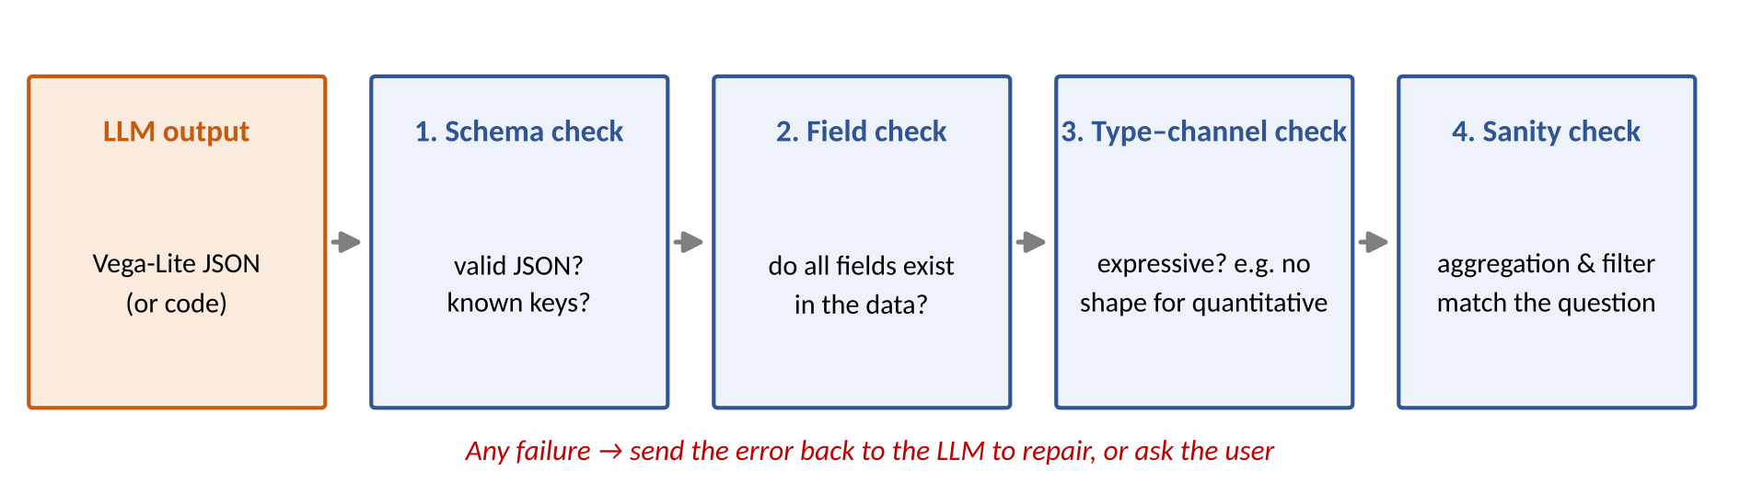
Visualization of Data, Understanding and Interpretation
Validating an LLM-Generated Spec-validation check
TOPIC 8 · LLM-GENERATED CHART SPECIFICATIONS
Check | Catches | Example
Schema | malformed JSON, unknown keys | "colour" instead of "color"
Field | hallucinated columns | "rating" not in the dataset
Type–channel | expressiveness violations | quantitative price on shape
Sanity | wrong aggregation / filter | asked average, spec says sum
Source: Expressiveness check per Munzner VAD §5.4.1; schema validation via the Vega-Lite JSON schema

Slide 33
Visualization of Data, Understanding and Interpretation
Numerical 3: Evaluating NL2Vis Outputs
TOPIC 8 · LLM-GENERATED CHART SPECIFICATIONS
Query | Chart type | x | y | Aggregation | Filter | Exact | Values right
Q1 | ✔ | ✔ | ✔ | ✔ | ✔ | ✔ | ✔
Q2 | ✔ | ✔ | ✔ | ✗ sum | ✔ | ✗ | ✗
Q3 | ✗ line | ✔ | ✔ | ✔ | ✔ | ✗ | ✔
Q4 | ✔ | ✔ | ✔ | ✔ | ✗ no 2024 | ✗ | ✗
Q5 | ✔ | ✔ | ✔ | ✔ | ✔ | ✔ | ✔
Solution
Component accuracy:
chart 4/5 = 0.8; x 1.0; y 1.0;
aggregation 0.8; filter 0.8
Exact match = 2/5 = 0.40
Execution accuracy = 3/5 = 0.60
Q3 has the right numbers but the wrong chart, so it counts for execution accuracy, not exact match.
Definitions
Exact match: every component equals the reference spec.
Execution accuracy: the plotted data values equal the reference values.
Component accuracy: share of queries with that part correct.
Source: Metric definitions follow NL2Vis benchmark practice (nvBench: exact match vs execution-based evaluation)

Slide 34
Visualization of Data, Understanding and Interpretation
Editing Charts by Talking to Them
TOPIC 9 · CONVERSATIONAL CHART EDITING
Utterance | Spec change (patch) | Design reason
“sort highest first” | x.sort = "-y" | ordered bars are easier to compare
“make the bars horizontal” | swap x and y | long city names fit on the y-axis
“highlight Pune in orange” | color = condition(city == Pune) | focus attention (Knaflic Ch 4)
“use a log scale” | y.scale.type = "log" | values span orders of magnitude
“add a title that says the point” | title = assertion text | Wilke Ch 22: title conveys the point
“start the axis at zero” | y.scale.zero = true | bars must start at zero (Wilke Ch 17)
Good editing = minimal change: alter only the requested property and keep everything else stable.
Source: Wang et al. 2024 (Data Formulator); Vega-Lite spec edits; Knaflic TB2 Ch 4

Slide 35
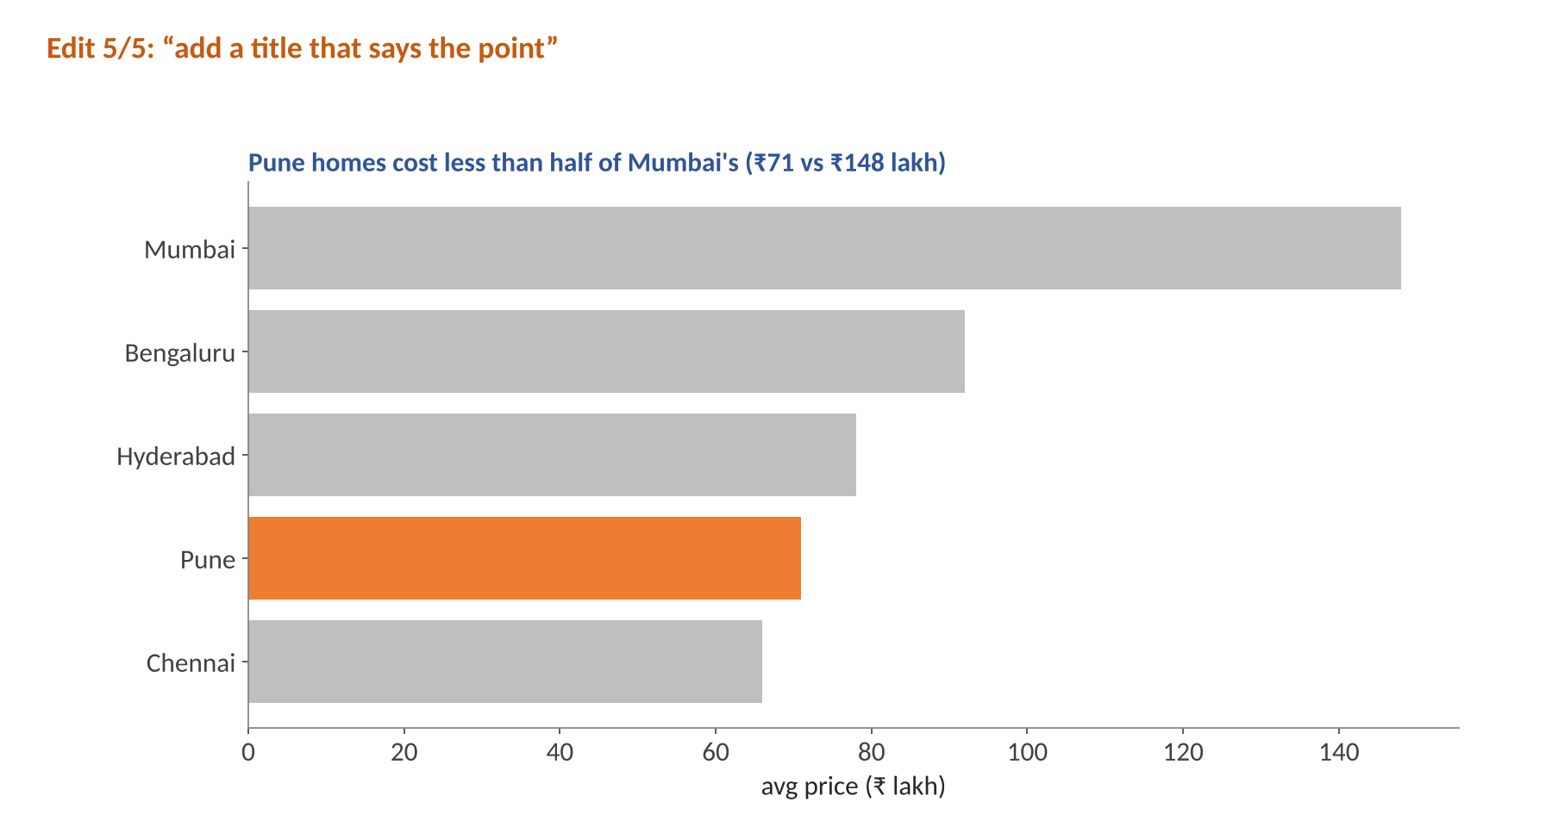
Visualization of Data, Understanding and Interpretation
Five Edits, One Better Chart (Animated)
TOPIC 9 · CONVERSATIONAL CHART EDITING
The edit sequence
1. Show the data
2. Sort for comparison
3. Horizontal for long labels
4. Highlight the focus city
5. Assertion title
Knaflic Ch 7: tell the story in steps, each building on the last.
Source: Illustrative data; edit sequence applies Knaflic TB2 Ch 4 and Wilke TB1 Ch 22

Slide 36
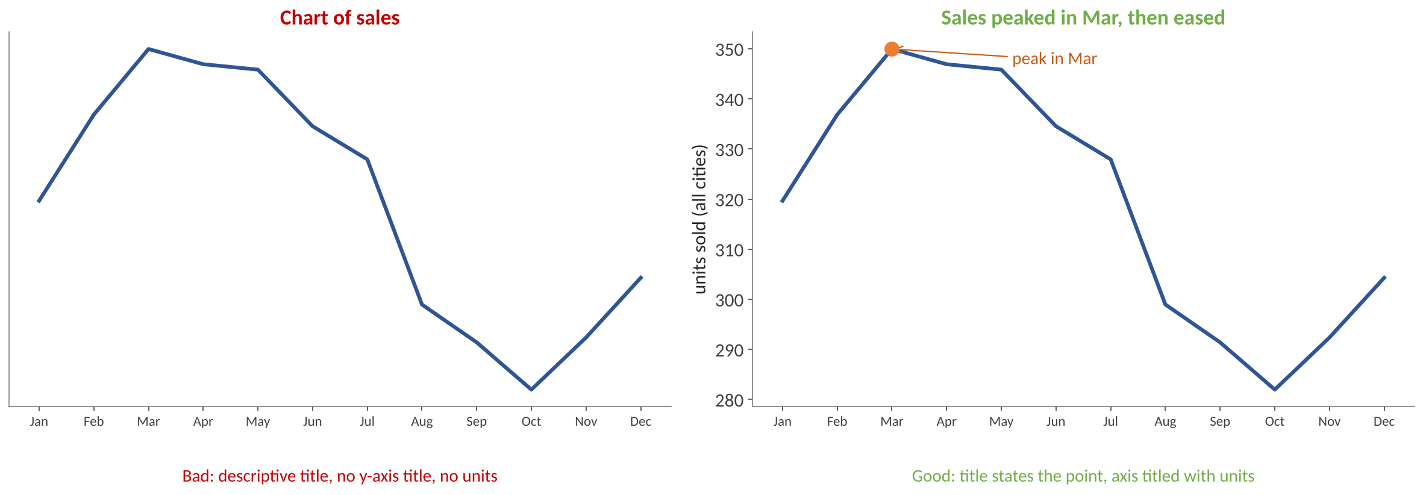
Visualization of Data, Understanding and Interpretation
What an LLM Should Write: Titles and Labels
TOPIC 9 · CONVERSATIONAL CHART EDITING
Every figure needs a title that states its point
Not “This figure shows…” — make a clear assertion
Axis and legend titles state the variable and its units
Omit titles only when labels are self-explanatory
Don't over-label (“time (years AD)” is ugly)
“The job of the title is to accurately convey to the reader what the figure is about, what point it makes.” — Wilke, Ch 22
Source: Wilke TB1 Ch 22 Titles, captions, and tables (PDF p.260–268); Knaflic TB2 Ch 7

Slide 37
Visualization of Data, Understanding and Interpretation
Benefits of LLM-Generated Visualizations
TOPIC 10 · BENEFITS AND FAILURE MODES OF LLM-GENERATED VISUALIZATIONS
Low barrier
No need to know chart grammar or a plotting library
Speed
Charts in seconds; fast what-if exploration
Flexible language
Handles paraphrases, typos and vague requests
Iterative
Refine through conversation instead of starting over
Explains itself
Can write captions, summaries and code comments
Any library
Matplotlib, Plotly, Vega-Lite, BI tools
Source: Dibia 2023; Maddigan & Susnjak 2023; Munzner VAD §1.2

Slide 38
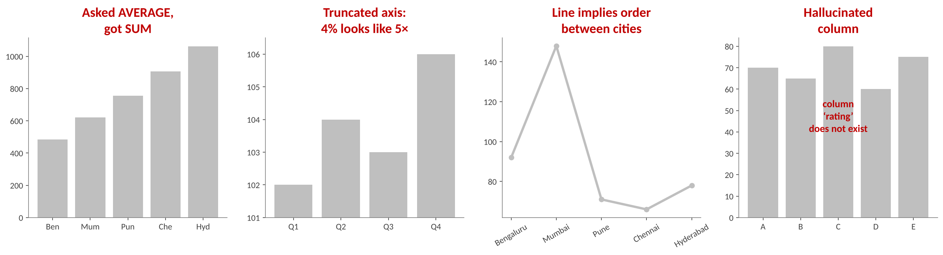
Visualization of Data, Understanding and Interpretation
Failure Modes of LLM-Generated Visualizations
TOPIC 10 · BENEFITS AND FAILURE MODES OF LLM-GENERATED VISUALIZATIONS
Failure | Example | Why it is dangerous
Hallucinated field | plots 'rating' that does not exist | crashes, or worse, plots invented data
Wrong aggregation / filter | sum instead of average; drops 2024 | runs fine, looks plausible, wrong answer
Wrong chart for the task | line across categories; 12-slice pie | misleads about order or parts
Misleading design | truncated axis, dual axes | exaggerates differences (Wilke Ch 17)
Context drift | follow-up silently drops a filter | user trusts an outdated view
Over-confident narrative | caption claims a cause | correlation presented as causation
Source: Taxonomy synthesised from Chat2VIS and LIDA evaluations; Wilke TB1 Ch 1 & Ch 17; Munzner VAD §5.4.1

Slide 39
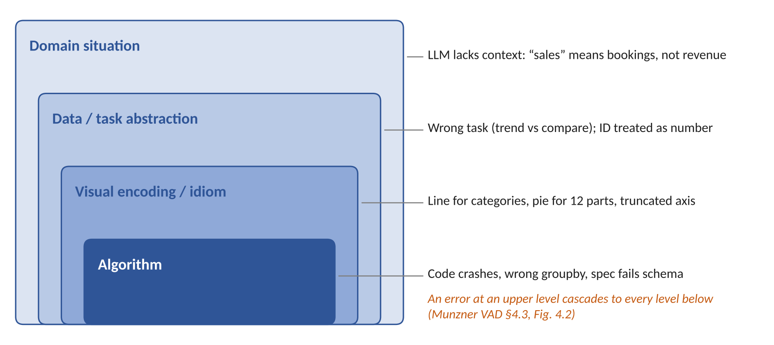
Visualization of Data, Understanding and Interpretation
Locating the Failure: Munzner's Nested Model
TOPIC 10 · BENEFITS AND FAILURE MODES OF LLM-GENERATED VISUALIZATIONS
Munzner §4.3
Four nested levels: domain → abstraction → idiom → algorithm
“Choosing the wrong block at an upstream level inevitably cascades to all downstream levels.”
Debug from the top: right question before right code
LLM-specific: most visible errors are at the algorithm level (code crashes), but the costliest are at the abstraction level (wrong task, wrong field) because they produce charts that look right.
Source: Munzner VAD Ch 4, §4.3 Four levels of design, Fig. 4.2 (p.67–69)

Slide 40
Visualization of Data, Understanding and Interpretation
Mitigations: Keeping Humans in Control
TOPIC 10 · BENEFITS AND FAILURE MODES OF LLM-GENERATED VISUALIZATIONS
Echo the interpretation
“Showing mean price by city, 2024”
Make choices editable
Widgets for field, aggregation, filter
1
2
Validate before showing
Schema, field, type–channel, sanity checks
Keep the spec / code
Reproducible and auditable (Wilke Ch 28)
3
4
Constrain the design
Prompt with Knaflic/Wilke rules
Human review for decisions
Never ship an unchecked chart to a report
5
6
Source: Munzner VAD §1.2; Heer (2019) Agency plus automation, PNAS; NL4DV ambiguity handling

Slide 41
Visualization of Data, Understanding and Interpretation
Summary
NL2Vis
question + schema → spec → chart + explanation
Abstraction
map many words to few abstract tasks (Munzner Ch 3)
Semantic parsing
attributes, values, aggregation, intent; handle ambiguity
Conversational systems
dialogue state turns single queries into analysis
Multi-turn & context
refine, elaborate, shift; errors compound as pⁿ
LLM text-to-chart
prompt with schema + rules; generate, run, repair
Specs & editing
Vega-Lite specs are checkable; edits are small patches
Failures & fixes
validate, echo, keep humans in control (nested model)

Slide 42
Visualization of Data, Understanding and Interpretation
MCQs
1. Case: A real-estate analyst types “compare flat prices in Pune and Hyderabad over the last 5 years”. Which abstract task and chart should an NL2Vis system infer?
A. Correlation → scatter of price vs year
B. Trend by group → one line per city
C. Distribution → one histogram per city
D. Part-to-whole → stacked bar per year
Answer: B
“Over the last 5 years” signals a trend over time, and two cities are groups to compare, so one line per city. 'Compare' alone could suggest bars, but the time cue dominates.

Slide 43
Visualization of Data, Understanding and Interpretation
MCQs
2. Case: A sales head asks “show sales by region”, then “what about last year?”. The system redraws sales by region for ALL years. Which capability failed?
A. Semantic parsing of the measure name “sales”
B. Choosing a chart type suited to regional data
C. Schema validation of the generated chart spec
D. Context carry-over for an elliptical query
Answer: D
The follow-up is elliptical: it should inherit 'sales by region' and add a filter for last year. Dropping the filter is a context-preservation failure, not a parsing or schema error.
In conversational visualization
Turn 1: “Show sales by region.”
Turn 2: “What about last year?”
Turn 2 by itself is incomplete: what about last year? The full meaning is:
“Show sales by region for last year.”
The part in bold is left out, and the system must copy it from Turn 1. That makes Turn 2 an elliptical query.
Elliptical describes a sentence with words left out, because the speaker expects the listener to fill them in from what was said before. The noun is ellipsis, the same word as the “…” punctuation mark, which also means “something is missing here”.

Slide 44
Visualization of Data, Understanding and Interpretation
MCQs
3. Case: A user types “show avg revnue by month”. Columns: revenue, review, reserve, region. With similarity = 1 − Levenshtein / max length and a 0.7 threshold, which column is matched?
A. revenue
B. review
C. reserve
D. None — all fall below 0.7
Answer: A
d(revnue, revenue) = 1, so similarity = 1 − 1/7 = 0.857 ≥ 0.7. review gives 1 − 3/6 = 0.50 and reserve 1 − 4/7 = 0.43, both below the threshold.

Slide 45
Visualization of Data, Understanding and Interpretation
MCQs
5. Case: A bank's chatbot answers “Which branch had the lowest NPA ratio?” with a 12-colour bar chart and no highlight. Following Ware Ch 5 and Knaflic Ch 4, the best fix is:
A. Grey all bars and colour only the answer bar
B. Switch to a pie so the smallest slice stands out
C. Add bold data labels to all twelve bars
D. Use a rainbow palette sorted by value
Answer: A
One accent colour against grey context pops out pre-attentively (Ware Ch 5) and directs attention to the answer (Knaflic Ch 4). A pie makes comparison harder; bold labels on every bar add clutter.

Slide 46
Visualization of Data, Understanding and Interpretation
MCQs
6. Case: A conversational BI assistant resolves each dependent follow-up correctly 90% of the time. A typical session has 4 dependent turns. What is the chance the whole session is correct?
A. 0.90
B. 0.60
C. 0.73
D. 0.66
Answer: D
P = 0.9⁴ = 0.6561 ≈ 0.66. 0.73 is 0.9³ (one turn short); 0.90 ignores compounding; 0.60 = 1 − 4 × 0.1 wrongly adds the error rates.

Slide 47
Visualization of Data, Understanding and Interpretation
MCQs
7. Case: An NL2Vis model is tested on 10 queries. 7 outputs plot the correct data values, but 2 of those 7 use the wrong chart type. There are no other errors. What are exact-match (EM) and execution accuracy (EA)?
A. EM = 0.7, EA = 0.5
B. EM = 0.7, EA = 0.7
C. EM = 0.5, EA = 0.7
D. EM = 0.5, EA = 0.5
Answer: C
EA counts correct values: 7/10 = 0.7. EM also needs the right chart type: 7 − 2 = 5, so 5/10 = 0.5.

Slide 48
Visualization of Data, Understanding and Interpretation
MCQs
8. Case: An LLM-generated chart is titled “This chart shows sales by quarter” and its y-axis has no title. According to Wilke Ch 22, what should change?
A. Move the title into the legend and drop axis titles
B. Assert the point in the title; add y units
C. Remove the title, as online charts need none
D. Add “time (years AD)” as the x-axis title
Answer: B
Wilke: the title states the point (not “This chart shows…”), and axes need titles with units. Over-labelling such as “time (years AD)” is called out as ugly.

Slide 49
Visualization of Data, Understanding and Interpretation
References
FURTHER READING
TB1 C. O. Wilke, Fundamentals of Data Visualization, O'Reilly, 2019 — Ch 2, Ch 5, Ch 22.
TB2 C. N. Knaflic, Storytelling with Data, Wiley, 2015 — Ch 2, Ch 4, Ch 7.
TB3 C. Ware, Information Visualization: Perception for Design, 4th ed., Morgan Kaufmann, 2020 — Ch 5, Ch 12.
Additional T. Munzner, Visualization Analysis and Design, CRC Press, 2014 — Ch 1–4.
A. Narechania, A. Srinivasan, J. Stasko, “NL4DV: a toolkit for generating analytic specifications for data visualization from NL queries,” IEEE TVCG, 2021.
V. Dibia, Ç. Demiralp, “Data2Vis: automatic generation of data visualizations using sequence-to-sequence RNNs,” IEEE CG&A, 2019.
Y. Luo et al., “Synthesizing natural language to visualization (NL2VIS) benchmarks from NL2SQL benchmarks (nvBench),” SIGMOD, 2021.
V. Setlur et al., “Eviza: a natural language interface for visual analysis,” UIST, 2016; E. Hoque et al., “Applying pragmatics principles for interaction with visual analytics (Evizeon),” IEEE TVCG, 2018.
A. Srinivasan, J. Stasko, “Orko: facilitating multimodal interaction for visual exploration and analysis of networks,” IEEE TVCG, 2018.
T. Gao et al., “DataTone: managing ambiguity in natural language interfaces for data visualization,” UIST, 2015.
P. Maddigan, T. Susnjak, “Chat2VIS: generating data visualizations via natural language using ChatGPT, Codex and GPT-3,” IEEE Access, 2023.
V. Dibia, “LIDA,” ACL Demo, 2023; C. Wang et al., “Data Formulator,” IEEE TVCG, 2024; A. Satyanarayan et al., “Vega-Lite,” IEEE TVCG, 2017.

Slide 50
Thank You

