Slide 1

Visualization of Data, Understanding and Interpretation
Unit 3 : Multimedia and Interactive Visualization
(UE24CS342AA9)
PPT 7: Interactive Visualization, Visual Analytics and Sensemaking
Dr.Prajwala TR (Course Instructor)
Dept. of CSE, PES University, Bangalore

Slide 2
Visualization of Data, Understanding and Interpretation
Acknowledgement
The slides are prepared from various resources from the Universities from abroad and India. Also, some material is taken from reliable resources from internet throughout this course.
Primary textbooks for this lecture: T. Munzner, Visualization Analysis and Design (CRC Press, 2014) and C. O. Wilke, Fundamentals of Data Visualization (O’Reilly, 2019), supported by research papers listed on the References slide.

Slide 3
Visualization of Data, Understanding and Interpretation
Lecture Overview
In this lecture, we will cover:
Interactive Visualization Concepts
Purpose Of Interaction
Visualization As An Interactive Process
Brushing
Cross-View Brushing
Linking
Coordinated Views
Filtering
Dynamic Queries
Selection
Highlighting
Zooming
Panning
Details-On-Demand
Tooltips And Inspection
Drill-Down
Focus And Context
Interaction Sequences
Overview And Details
Interactive Network Exploration
Interactive Temporal Visualization
Interactive Scientific Visualization
Visual Analytics
Human-In-The-Loop Analysis
Exploratory Analysis, Pattern Discovery, Anomaly Detection
Hypothesis Generation and Testing
Sensemaking
Information Foraging
Iterative Analytical Reasoning
Visual Analytics Workflows
Plus: 6 worked numericals with solutions • 8 MCQs
References

Slide 4
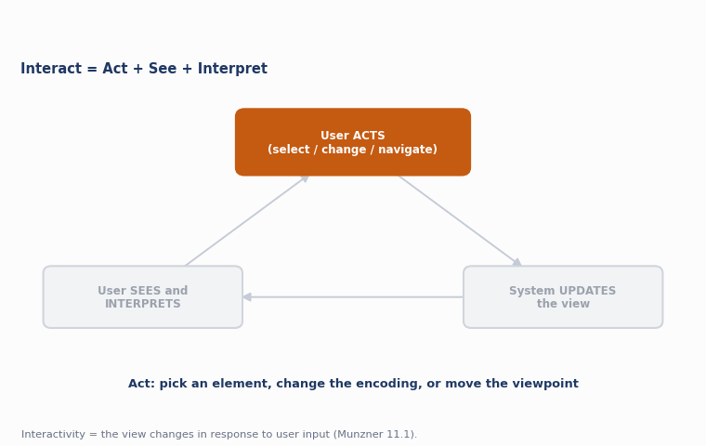
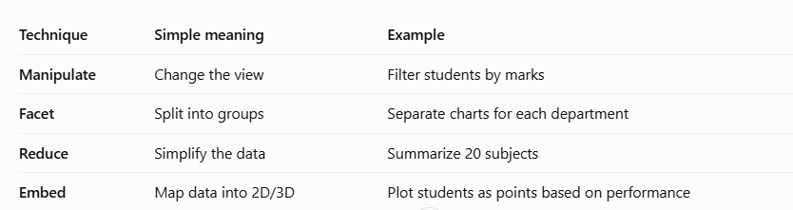
Visualization of Data, Understanding and Interpretation
Interactive Visualization Concepts
Interaction turns a static picture into a tool for exploration: the view changes over time in response to user input, instead of being fixed once drawn.
Interactivity is the key advantage of vis on a computer display over vis printed on paper — a view can dynamically respond to input.
Manipulate, Facet, Reduce, Embed — Munzner's four families of interaction idioms for changing what is shown.
Direct manipulation lets users act on visual objects directly (click, drag, brush) rather than typing commands.
Tight coupling between action and visual feedback is what makes an interface feel interactive rather than a batch query.
Key idea
A view that changes over time can dynamically respond to user input, rather than being limited to a static visual encoding — this is the most fundamental benefit of vis on a computer.
Source: Munzner, Visualization Analysis and Design (2014), §11.1–11.2, pp. 242–244

Slide 5
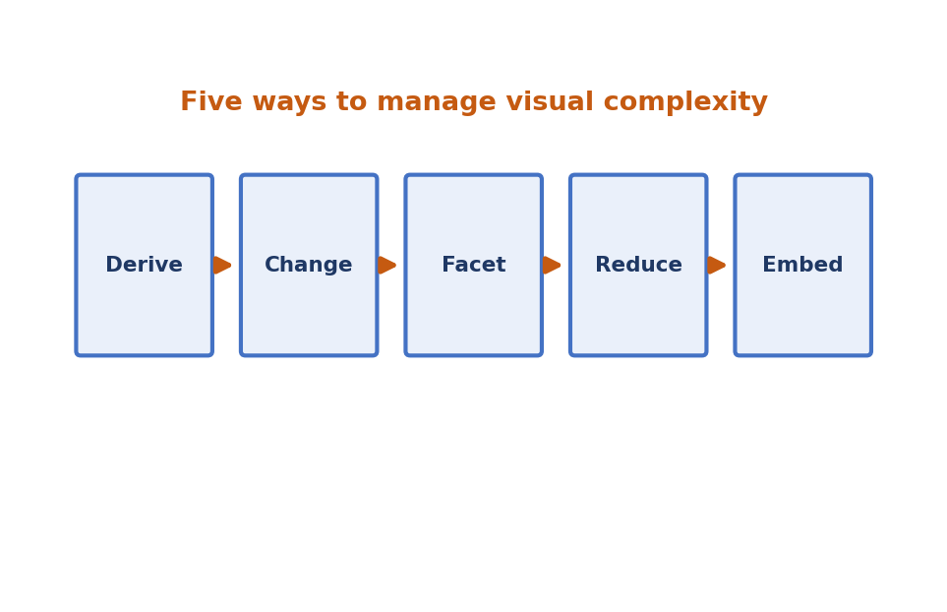
Visualization of Data, Understanding and Interpretation
Interactive Visualization Concepts: Why Change a View?
Datasets are often too large and complex to show everything at once without overwhelming visual clutter. Munzner lists five major, non-exclusive options for handling this complexity.
Derive new data (compute new attributes) before encoding it.
Change the view over time (Ch. 11) — encoding, arrangement, order, viewpoint, filter, aggregation.
Facet the data into multiple juxtaposed views or superimposed layers (Ch. 12).
Reduce the amount of data shown, by filtering or aggregating (Ch. 13).
Embed focus and context information together within a single view (Ch. 14).
Key idea
These five choices are not mutually exclusive — real systems combine several of them, and interaction is what lets the user choose which combination to apply, and when.
Source: Munzner, Visualization Analysis and Design (2014), §11.2, p. 244

Slide 6
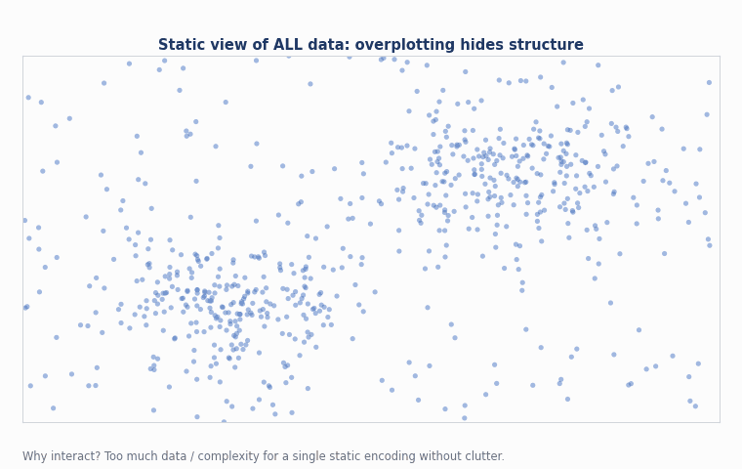
Visualization of Data, Understanding and Interpretation
Purpose Of Interaction
Interaction exists to let the analyst adapt the display to a question that could not be anticipated at design time.
Overcome display limits — screens have finite pixels; interaction lets one screen serve many views over time.
Support open-ended tasks — exploration and discovery cannot be fully scripted in advance.
Reduce cognitive load — the view does the remembering (eyes beat memory) instead of the user's working memory.
Close the loop between the analyst's evolving mental model and what the system displays.
Key idea
Comparing two views that are simultaneously visible is far easier than comparing a changing view to what was on screen a moment ago — this trade-off motivates most interaction design choices.
Source: Munzner, Visualization Analysis and Design (2014), §6.5, §12.2, p. 266

Slide 7
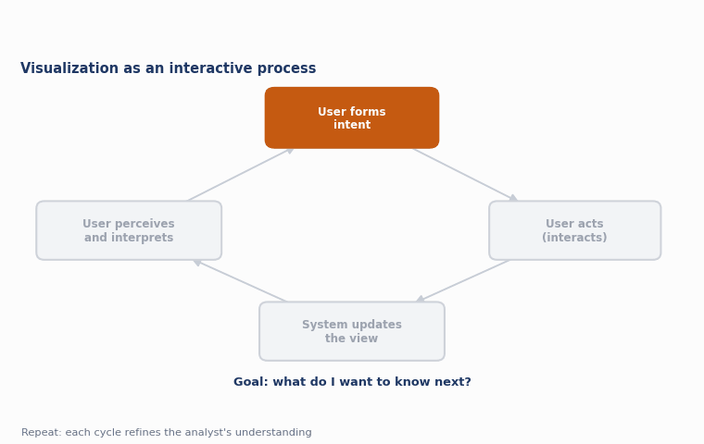
Visualization of Data, Understanding and Interpretation
Visualization As An Interactive Process
Interactive visualization is best understood as a closed loop, not a one-shot picture: the user acts, the system updates the view, and the user perceives and interprets the result before acting again.
The loop repeats continuously during an analysis session, each cycle refining the analyst's understanding.
Low latency in the loop is essential — Shneiderman's dynamic-query work showed that delayed feedback breaks the sense of direct manipulation.
Each cycle can invoke any of the manipulate / facet / reduce / embed idiom families.
Sessions chain many such cycles together into interaction sequences (see later topic).
Key idea
The output of a selection or change is very often the input to the next interaction — vis is process, not artifact.
Source: Munzner, Visualization Analysis and Design (2014), §1.14, §3.7, §11.4.3

Slide 8
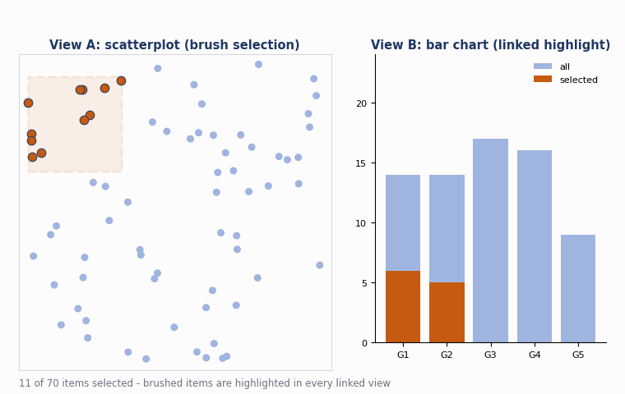
Visualization of Data, Understanding and Interpretation
Brushing
Brushing lets the user interactively paint a selection directly over a set of marks in a view, typically by dragging a rectangular or freeform region.
Origin — the term comes from Becker and Cleveland's 1987 technique of brushing scatterplots.
Mechanism — the brush is a movable region; any mark it touches becomes part of the current selection.
Feedback — brushed items are immediately highlighted, usually with a colour or outline change, in the same view.
Building block — brushing is the interaction half of the linked-highlighting idiom used across coordinated views.
Key idea
Linked highlighting is also called brushing or cross-filtering — the same underlying idiom, described from the interaction side (brushing) or the encoding side (linked highlighting).
Source: Munzner, Visualization Analysis and Design (2014), §12.3.1, p. 267 (Becker & Cleveland 1987)

Slide 9
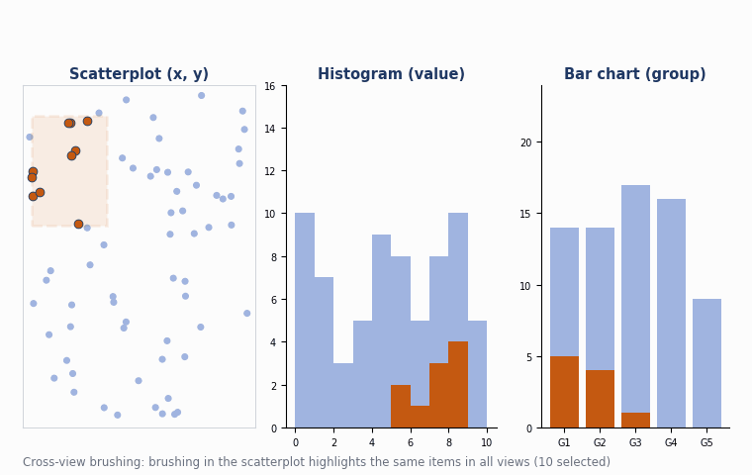
Visualization of Data, Understanding and Interpretation
Cross-View Brushing
Cross-view brushing extends brushing so that a selection painted in one view is propagated to every other coordinated view on screen.
Shows distribution — the central benefit is seeing how a region contiguous in one view is distributed within another.
Example: EDV — the Exploratory Data Visualizer links bar charts, scatterplots and a histogram of baseball statistics.
Selecting high salaries in a histogram view instantly reveals that rookies are absent in a linked 'years played' bar chart.
Requires shared identity — every view must reference the same underlying items so highlighting can be matched across encodings.
Key idea
Cross-view brushing is how analysts discover correlations that are invisible in any single view but obvious once the same items are traced across several.
Source: Munzner, Visualization Analysis and Design (2014), §12.3.1, pp. 267–269 (Wills 1995, EDV example)

Slide 10
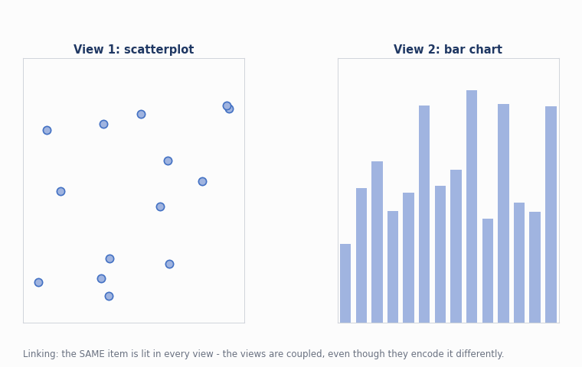
Visualization of Data, Understanding and Interpretation
Linking
Linking is the general design choice of establishing some form of connection between multiple juxtaposed views so that they behave as one coordinated system rather than independent windows.
Share encoding — same or different visual channels used consistently across views.
Share highlighting — the most common case: a selection in one view is echoed in all others (linked highlighting).
Share data — views may show all the data, a subset (overview–detail), or disjoint partitions (small multiples).
Share navigation — panning or zooming one view can move the viewpoint of another (synchronized navigation).
Key idea
Linked views, multiple views, coordinated views and coupled views are all synonyms in the literature for the same underlying idea of connecting juxtaposed views.
Source: Munzner, Visualization Analysis and Design (2014), §12.3, p. 267

Slide 11
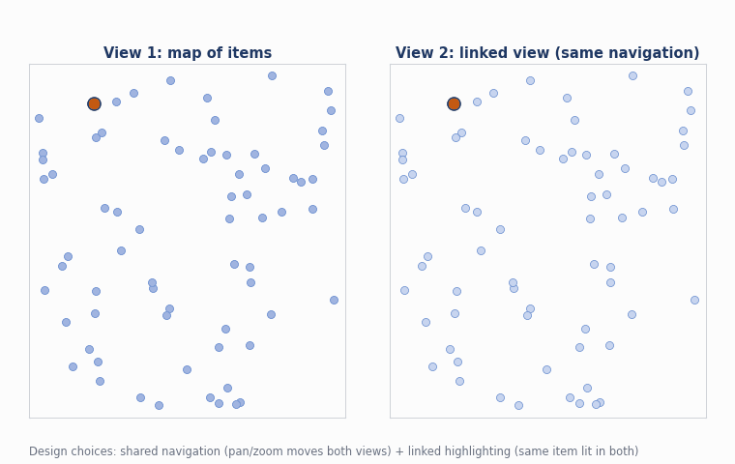
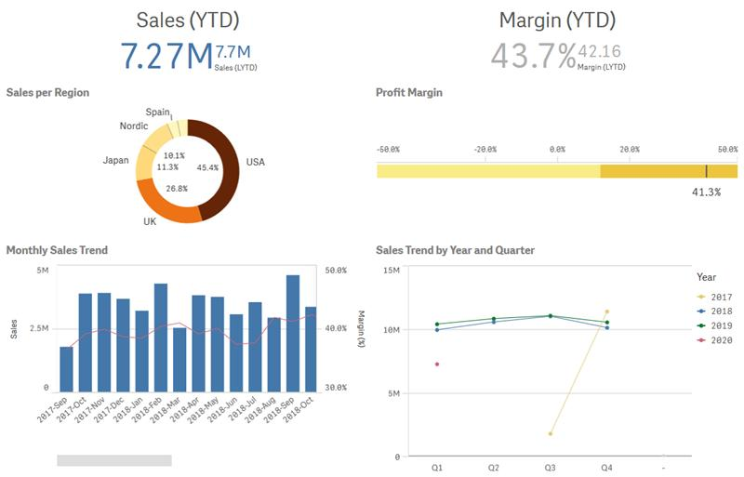
Visualization of Data, Understanding and Interpretation
Coordinated Views
Juxtaposing Views in interactive visualization means placing two or more visualizations side by side so that users can compare them easily.
Juxtaposing views side by side spreads information out in space rather than over time, so the eye can move between views instead of relying on working memory.
Design choice 1 — encoding: shared encoding (identical channels) versus multiform (different channels per view).
Design choice 2 — data: shared data, overview–detail (subset), or small multiples (disjoint partition).
Design choice 3 — navigation: synchronized or independent viewpoints.
Cost: juxtaposed views split the display area — two views each get roughly half the pixels of one.
Key idea
A multiform system is valuable because no single visual encoding is optimal for every task; several linked, differently-encoded views can support more tasks together than any one view alone.
Source: Munzner, Visualization Analysis and Design (2014), §12.3, pp. 266–267
Notes:
juk-stuh-POH-zing

Slide 12
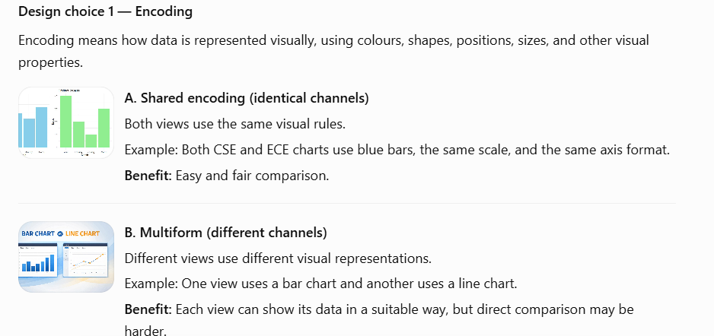
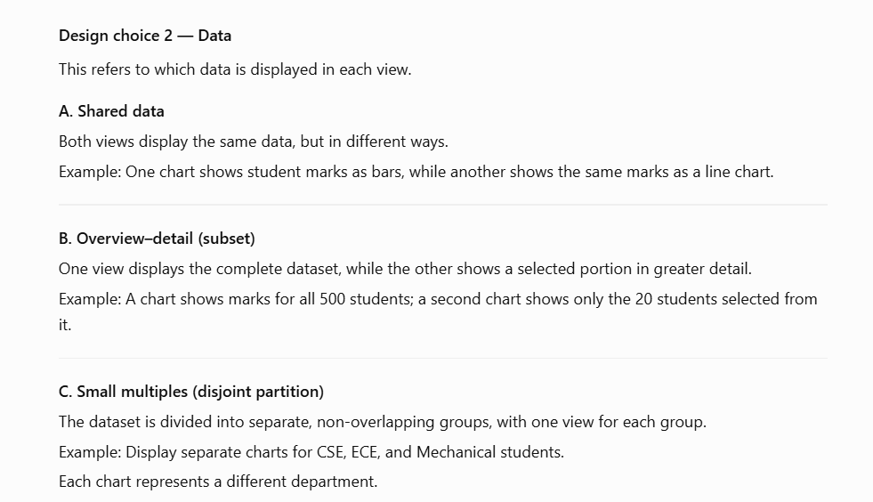
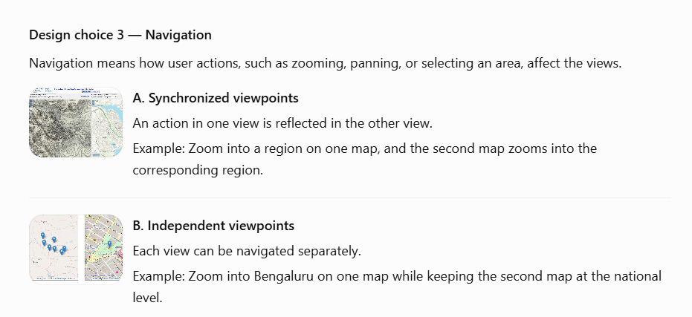

Slide 13
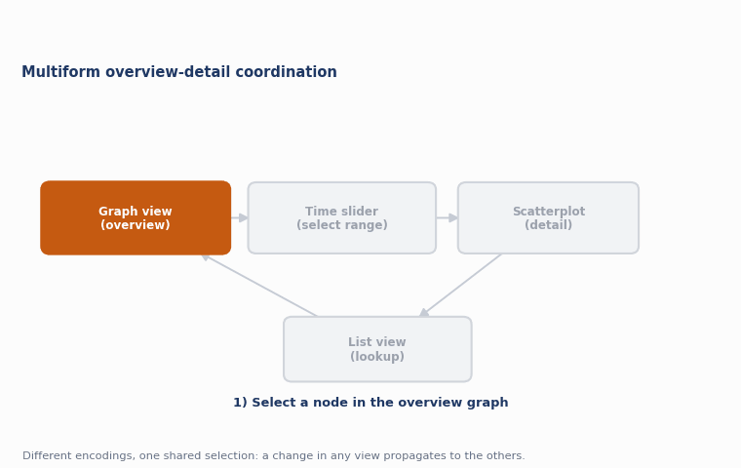
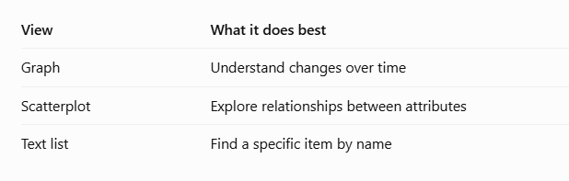
Visualization of Data, Understanding and Interpretation
Coordinated Views: A Worked Example
Multiform overview–detail systems combine several of the coordination choices at once to support complex, multi-part analysis tasks.
Microarray explorer links a graph view (time-series, overview) with a scatterplot (derived attributes, detail) and a text list.
Overview → detail filtering: dragging the time slider in the graph view sets the time window shown in the scatterplot.
Colour-coded functional groups give a shared encoding channel across the linked scatterplot view.
Even a plain list view earns its place — it supports quick lookup by name that hovering alone cannot provide.
Key idea
No single view sufficed for the five analysis tasks identified by the designers — the coordinated combination of views was necessary, not just convenient.
Source: Munzner, Visualization Analysis and Design (2014), §12.3.2, pp. 271–273 (Craig & Kennedy 2003)

Slide 14
Visualization of Data, Understanding and Interpretation
Numerical 1: Overview–Detail Zoom Scaling
Problem
A geographic overview panel is 300 × 200 px and shows a region 60 km × 40 km.
A linked detail panel is 900 × 600 px.
(a) What map scale (km per pixel) does the overview use?
(b) If the detail panel shows the same scale as the overview at zoom level 1, how many km × km does it cover?
(c) To show a 6 km × 4 km neighbourhood in the same 900 × 600 detail panel, what zoom factor (×) is required relative to the overview scale?
Solution
(a) 60 km / 300 px = 0.2 km/px (same for 40/200 = 0.2 km/px) → 0.2 km per pixel
(b) 900 px × 0.2 km/px = 180 km; 600 px × 0.2 km/px = 120 km → 180 km × 120 km
(c) Overview scale 0.2 km/px → required scale for 6 km over 900 px = 6/900 = 0.00667 km/px
Zoom factor = 0.2 / 0.00667 = 30× magnification needed
Source: Worked example applying overview–detail data-sharing concepts (Munzner §12.3.2)

Slide 15
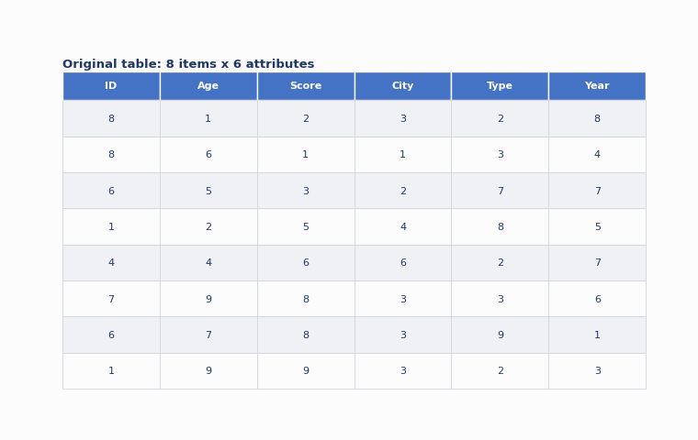
Visualization of Data, Understanding and Interpretation
Filtering
Filtering reduces the number of elements shown by simply eliminating the ones that fall outside a chosen range or condition.
Item filtering eliminates rows/items while keeping the same attributes for what remains.
Attribute filtering eliminates columns/attributes while keeping the same items.
Both can combine to reduce items and attributes shown together.
Unlike aggregation, filtering keeps full detail for what remains, but the filtered-out data is completely hidden.
Key idea
Filtering is simple to describe but hard to make usable — the challenge is designing a system where the user can explore an unfamiliar dataset without already knowing what range to type in.
Source: Munzner, Visualization Analysis and Design (2014), §13.3, §13.3.1–13.3.2, pp. 300, 303

Slide 16
Visualization of Data, Understanding and Interpretation
Filtering
Filtering reduces the number of elements shown by simply eliminating the ones that fall outside a chosen range or condition.
Item filtering eliminates rows/items while keeping the same attributes for what remains.
Attribute filtering eliminates columns/attributes while keeping the same items.
Both can combine to reduce items and attributes shown together.
Unlike aggregation, filtering keeps full detail for what remains, but the filtered-out data is completely hidden.
Key idea
Filtering is simple to describe but hard to make usable — the challenge is designing a system where the user can explore an unfamiliar dataset without already knowing what range to type in.
Source: Munzner, Visualization Analysis and Design (2014), §13.3, §13.3.1–13.3.2, pp. 300, 303

Slide 17
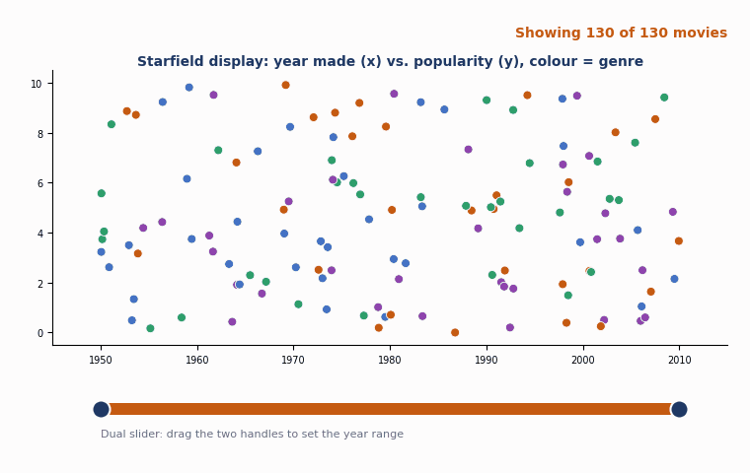
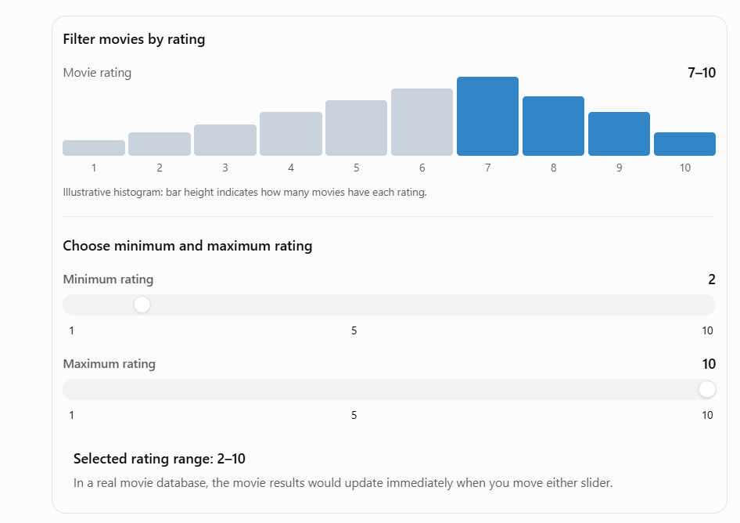
Visualization of Data, Understanding and Interpretation
Dynamic Queries
Dynamic queries create a tightly coupled loop between visual encoding and interaction, so the display updates immediately whenever the user changes a control — sliders, buttons or text fields.
FilmFinder (Ahlberg & Shneiderman 1994) filters a movie scatterplot live as the user drags sliders.
Adaptive encoding: as more items are filtered away, marks are automatically enlarged and labelled.
Dual sliders let a user pick a minimum and maximum together; alpha sliders filter by text.
Scented widgets embed small statistical graphics or icons directly into filter controls to add information scent.
Key idea
Dynamic queries replace reformulating explicit database queries with direct manipulation of widgets, starting from a full overview — well suited to browsing rather than a one-shot search.
Source: Munzner, Visualization Analysis and Design (2014), §13.3, §13.3.1, pp. 300–303 (Ahlberg & Shneiderman 1994; Willett et al. 2007; Pirolli 2007)

Slide 18
Visualization of Data, Understanding and Interpretation
Numerical 2: Dynamic Query Response-Time Budget
Problem
A dynamic-query slider must feel instantaneous: Shneiderman's guideline caps feedback at 0.1 s for it to feel 'instant'.
Filtering the full dataset costs 2 µs per item examined.
(a) What is the largest dataset (item count) that can be filtered within the 0.1 s budget?
(b) If the dataset actually has 500,000 items, what is the minimum feasible response time?
(c) How many items must be pre-indexed / skipped to bring that same 500,000-item dataset back under the 0.1 s budget?
Solution
(a) 0.1 s = 100,000 µs; 100,000 µs / 2 µs per item = 50,000 items
(b) 500,000 × 2 µs = 1,000,000 µs = 1.0 s (far above the 0.1 s target)
(c) Need to examine ≤ 50,000 of the 500,000 items → at least 450,000 items (90%) must be skipped via indexing/pre-filtering
Source: Worked example based on dynamic-query response-time guidelines (Shneiderman 1994; Munzner §13.3)

Slide 19
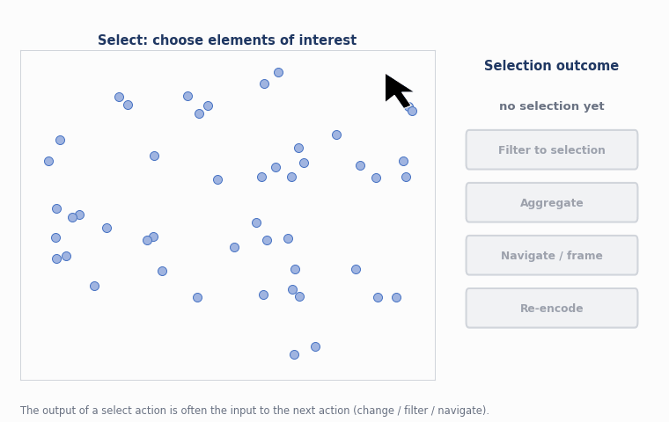
Visualization of Data, Understanding and Interpretation
Selection
Selection is the fundamental action of choosing one or more elements of interest in a view; its output is very often the input to the next interaction.
Selection targets: data items, links (for network data), attributes, or even an entire view.
How many selection types: one kind of selection (selected/not), or several (e.g. click vs. hover).
Selection-set size: exactly one, many, or zero — with primary versus secondary selection for tasks like path traversal.
Group membership can be tracked with attributes so a user can assign items to named groups, not just a binary selection.
Key idea
Selection is a fundamental action that supports nearly every other interactive idiom — the change choice usually depends on a previous select result.
Source: Munzner, Visualization Analysis and Design (2014), §11.4, §11.4.1, pp. 249–251

Slide 20
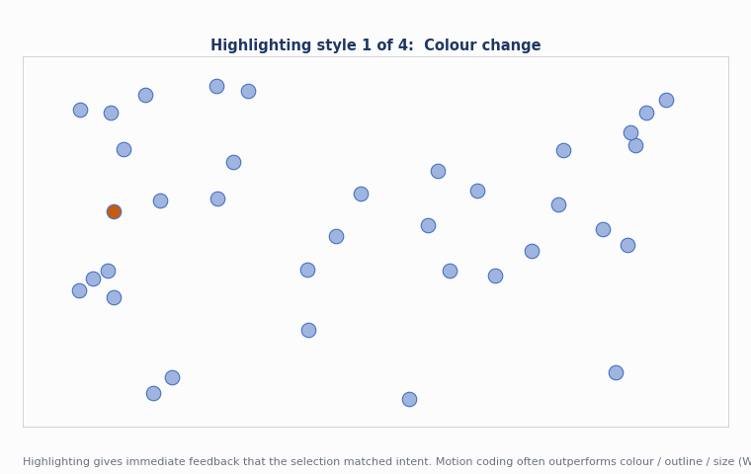
Visualization of Data, Understanding and Interpretation
Highlighting
Highlighting is the visual side of selection: chosen elements are shown with a changed appearance to confirm that the interaction matched the user's intent.
Colour change is the most common highlight, but it temporarily hides existing colour coding.
Outline change preserves existing colour coding — safer when colour already carries meaning.
Size / linewidth change increases salience, especially for small marks.
Motion coding (small oscillation) can outperform colour, outline, and size changes (Ware & Bobrow 2004).
Key idea
The highlight colour must be sufficiently different from existing colours to achieve a genuine pop-out effect — otherwise the selection feedback is not salient enough to notice.
Source: Munzner, Visualization Analysis and Design (2014), §11.4.2, pp. 251–253 (Ware & Bobrow 2004)

Slide 21
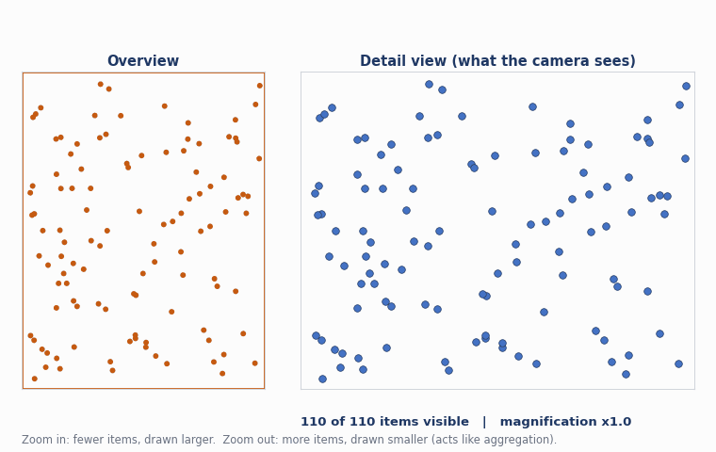
Visualization of Data, Understanding and Interpretation
Zooming
Zooming is one of the three components of navigation: it moves a virtual camera closer to or farther from the data, changing how many items are visible and how large they appear.
Geometric zooming scales appearance uniformly — matches real-world intuition of moving closer to an object.
Zooming in shows fewer items in more detail; it effectively filters based on spatial layout.
Zooming out shows more items, more coarsely; it can act as a form of aggregation, creating an overview.
Constrained zoom ranges prevent zooming out past the full scene or in past the smallest object.
Key idea
Because changing the viewpoint changes the visible set of items, the outcome of zooming is effectively filtering (zoom in) or aggregation (zoom out) — navigation and reduction are deeply linked.
Source: Munzner, Visualization Analysis and Design (2014), §11.5, §11.5.1, pp. 254–255

Slide 22
Visualization of Data, Understanding and Interpretation
Numerical 3: Semantic Zoom Pixel Budget
Problem
A LiveRAC-style stretchable grid uses semantic zoom with three representations: colour-only (needs ≥ 4 px), sparkline (needs ≥ 40 px), and full axes + multi-line chart (needs ≥ 120 px), measured as cell width in pixels.
The grid has 25 columns across a 2000 px wide panel (ignore gutters).
(a) What is the cell width, and which representation is used?
(b) The panel is resized to 4200 px wide. Which representation is now used?
(c) What is the minimum panel width (px) needed for every cell to show the full axes representation?
Solution
(a) 2000 / 25 = 80 px per cell → ≥ 40 px but < 120 px → sparkline representation
(b) 4200 / 25 = 168 px per cell → ≥ 120 px → full axes + multi-line chart representation
(c) Need 120 px × 25 columns = 3,000 px minimum panel width
Source: Worked example on semantic zoom thresholds (Munzner §11.5.2; McLachlan et al. 2008, LiveRAC)

Slide 23
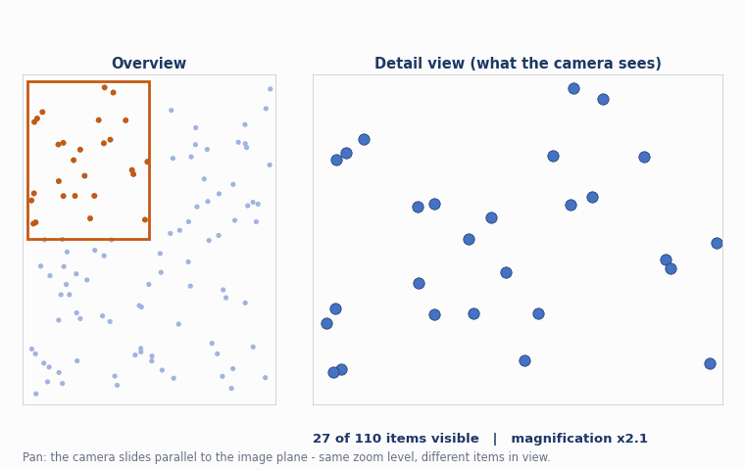
Visualization of Data, Understanding and Interpretation
Panning
Panning (also called scrolling, or trucking in cinematography) translates the camera parallel to the image plane, moving up/down or side to side while keeping the same zoom level.
Camera metaphor: a virtual camera located at a point and aimed in a direction; panning slides that camera sideways.
Distinguished from rotation, which spins the camera around its own axis — rare in 2D, much more relevant in 3D.
Unconstrained panning can leave the camera pointed at empty space — a 'reset view' control is good practice.
Often combined with zoom in the same gesture, e.g. scroll-to-zoom plus drag-to-pan interfaces.
Key idea
Pan and zoom together define the two-dimensional navigation design space; constraining both makes navigation far easier to learn than fully free 3D camera motion.
Source: Munzner, Visualization Analysis and Design (2014), §11.5, §11.5.3, pp. 254, 256–257

Slide 24
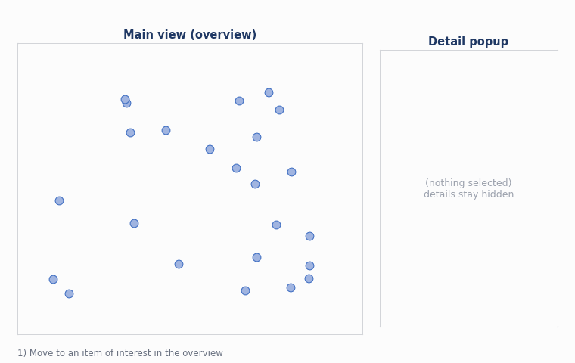
Visualization of Data, Understanding and Interpretation
Details-On-Demand
Details-on-demand is an overview–detail idiom in which a small popup or fixed panel shows extra information about one or more items selected in the main view, only when the user asks for it.
Triggered by selection, typically a click or hover on a mark in the primary view.
Keeps the main view uncluttered — detailed attributes are hidden until specifically requested.
FilmFinder example: clicking a movie mark opens a popup detail view with text and images.
A form of embedding overview and detail together, without needing a second permanent panel.
Key idea
Details-on-demand is one instance of the broader overview–detail data-sharing choice, distinguished by being popup / on-request rather than a persistent second view.
Source: Munzner, Visualization Analysis and Design (2014), §12.3.2, pp. 270–271, 301–302 (Ahlberg & Shneiderman 1994)

Slide 25
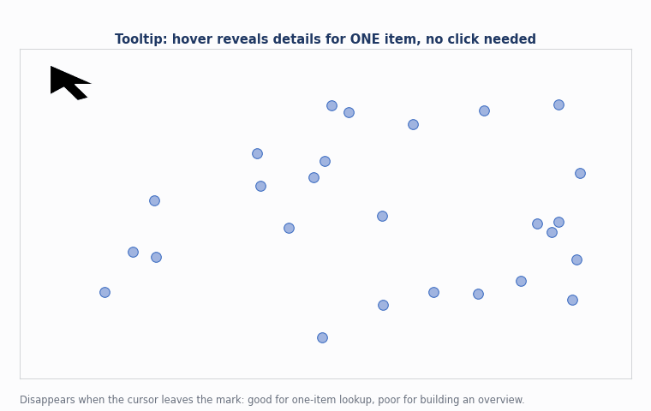
Visualization of Data, Understanding and Interpretation
Tooltips And Inspection
Tooltips are the lightest-weight details-on-demand idiom: hovering the cursor over a mark reveals a small floating label with attribute values for that single item.
Low commitment: no click needed, and the tooltip disappears as soon as the cursor moves away.
Best for single-item lookup, but a poor way to build an overview — the user cannot remember every hovered label.
Complements list views, which give the same lookup capability but as a persistent, scannable overview.
Dynamically shows the label for whatever is currently under the cursor — used in the microarray scatterplot example.
Key idea
Inspection via hovering is useful for identifying one mark, but it would be a frustrating way to get an overview of all labels — the user would have to click everywhere and remember every result.
Source: Munzner, Visualization Analysis and Design (2014), §12.3.2, p. 273

Slide 26
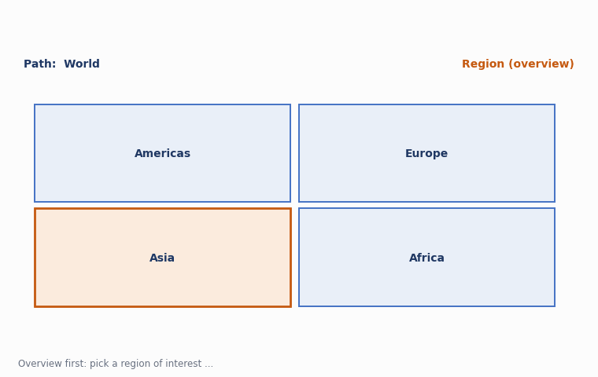
Visualization of Data, Understanding and Interpretation
Drill-Down
Drill-down is a navigation pattern that moves from a coarse, aggregated overview down through successive levels of a hierarchy to progressively finer detail.
Complements roll-up, which aggregates from detail back up to an overview.
Often driven by selection: clicking a region in an overview navigates into a more detailed sub-view.
Related to semantic zoom and to hierarchical aggregation, where structure narrows as more detail appears.
Animated transition example: a compound network shown as an adjacency matrix zooms from one hierarchy level to the next.
Key idea
Drill-down works well when the dataset has multi-level structure at discrete scales — multiple detail views act as a visual history of what the user selected at each level.
Source: Munzner, Visualization Analysis and Design (2014), §11.3, §12.3.2, §13.4.1, pp. 248–249, 270 (van Ham 2003)

Slide 27
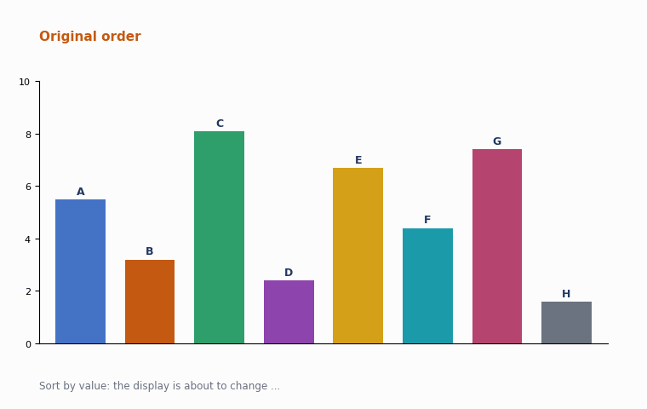
Visualization of Data, Understanding and Interpretation
Animated Transitions
An animated transition generates a smooth sequence of in-between frames to carry marks from an old state to a new one, instead of an abrupt jump cut.
Used for: reordering (e.g. LineUp), filtering (items fade in/out), re-encoding, and camera navigation between viewpoints.
Preserves object constancy: because each mark visibly glides from its old position to its new one, the viewer keeps track of “which item is which” without relying on memory.
Heer & Robertson (2007) found animated transitions improve graphical perception of change — but mainly when the amount of simultaneous change stays limited.
Contrast with a jump cut: an instant redraw forces the viewer to re-find every item from scratch — cheap to implement, costly to perceive.
Key idea
Animated transitions are the interaction-time analogue of reordering: the display changes, but the viewer's mental model of “which mark is which” survives the change.
Jump cut — sudden change
The old arrangement disappears, and the new arrangement appears immediately. The viewer must figure out where each student has moved.
Animated transition — gradual change
Each student's name visibly moves from its old position to its new position. The viewer can follow the movement and understand the change more easily.
Source: Munzner, Visualization Analysis and Design (2014), §11.3, pp. 245–246 (Heer & Robertson 2007)

Slide 28
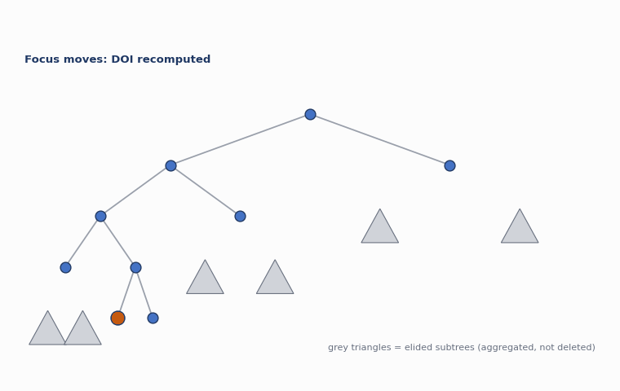
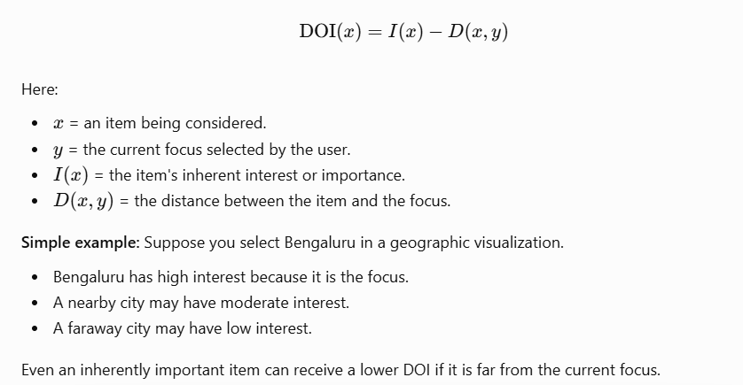
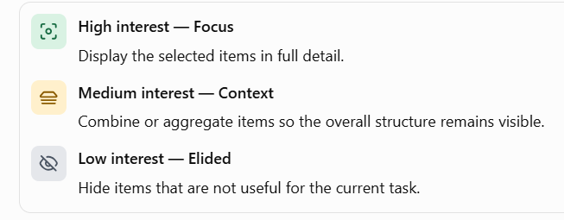
Visualization of Data, Understanding and Interpretation
Focus And Context
Focus+context idioms embed detailed information about a selected focus together with overview information about the rest of the data (the context), all within a single view.
Goal: mitigate the disorientation that comes with standard navigation such as geometric zooming.
Degree-of-interest (DOI) function: DOI = I(x) − D(x, y), combining an interest function I with distance D from the current focus y.
Elision filters out low-interest items entirely and aggregates medium-interest items for context, keeping only focus items in detail.
DOITrees Revisited uses multiple foci to show an elided view of a 600,000-node tree, using topological (hop-count) distance.
Key idea
Embedding idioms are fundamentally a synthesis of visual encoding and interaction together — the focus set changes dynamically as the user interacts, so the visual representation changes with it.
The DOI function calculates how important each item is for display.
Elision means removing or simplifying less-important information to make the important information easier to see.
Multiple foci: More than one important node can be selected.
Topological distance: Distance is measured by counting the number of edges or hops between nodes, rather than physical screen distance.
Elision: Unimportant nodes are hidden, and intermediate information may be aggregated.
Focus detail: Important nodes and their relevant structure remain visible.

Slide 29
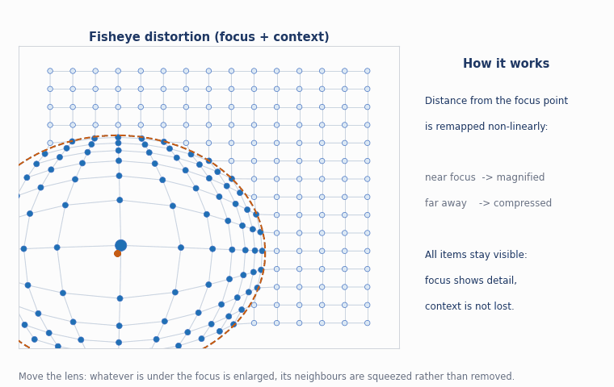
Visualization of Data, Understanding and Interpretation
Focus And Context: Distortion Techniques
A second family of focus+context idioms uses geometric distortion, compressing context regions to make room for magnified focus regions within a single unified view.
Fisheye lens: single local focus, radial shape, moveable draggable-lens interaction metaphor — like a camera lens or door peephole.
Hyperbolic geometry: a single global radial focus using non-Euclidean geometry, well suited to exponentially-growing trees.
3D perspective (Cone Trees): a single global focus using standard 3D camera transformations — intuitive but later found costly for abstract data.
Design choices: number of foci, region shape (radial / rectangular / arbitrary), extent (local / global), interaction metaphor (lens, rubber sheet, vector field).
Key idea
All distortion idioms share the same trade-off: a moveable lens preserves the global layout while still magnifying local detail, at the cost of a visually warped context region.
Source: Munzner, Visualization Analysis and Design (2014), §14.5, pp. 326–330 (Robertson et al. 1991; Lambert et al. 2010)

Slide 30
Visualization of Data, Understanding and Interpretation
Numerical 4: Fisheye Lens Magnification
Problem
A fisheye lens has focus radius r = 15 px and maximum central magnification m = 4×, falling off linearly to 1× at the lens edge.
An item sits at distance d = 6 px from the lens centre.
(a) Using magnification(d) = 1 + (m − 1) × (r − d)/r for d ≤ r, find the magnification at d = 6 px.
(b) An item's true size is 3 px. What is its displayed size under the lens at d = 6 px?
(c) At what distance d does the magnification drop to exactly 2×?
Solution
(a) magnification = 1 + (4−1) × (15−6)/15 = 1 + 3 × 0.6 = 2.8×
The item appears 2.8 times larger than its original size because it is relatively close to the focus.
(b) Displayed size = 3 px × 2.8 = 8.4 px
The item originally occupies 3 pixels, but the fisheye lens displays it across 8.4 pixels. This makes the item easier to see and examine.
(c) 2 = 1 + 3(15−d)/15 → 1 = 3(15−d)/15 → 15−d = 5 → d = 10 px
The magnification drops to exactly 2× when the item is 10 px from the centre.
Source: Worked example on fisheye distortion mathematics (Munzner §14.5, Fisheye Lens example)

Slide 31
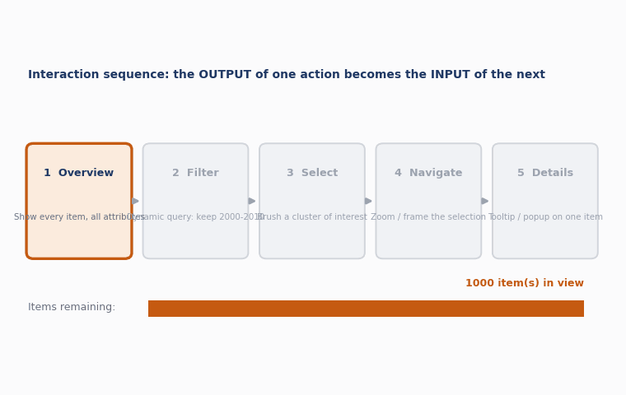
Visualization of Data, Understanding and Interpretation
Interaction Sequences
Complex analysis tasks are rarely a single interaction — they are chains of interactions, where the output of one step becomes the input to the next.
Chained tasks: select → filter → compare, or navigate → select → inspect are common sequences.
State must persist across steps so later interactions can build on earlier selections.
Undo / history support lets analysts backtrack when a sequence leads to a dead end.
Sequences are the building blocks of the higher-level exploratory workflows discussed later in this lecture (sensemaking, iterative reasoning).
Key idea
The output of a select action is often the input to the next action — nearly every major design choice for constructing idioms can accommodate a selected set of elements as its input.
Source: Munzner, Visualization Analysis and Design (2014), §1.14, §3.7, §11.4.3, p. 254

Slide 32
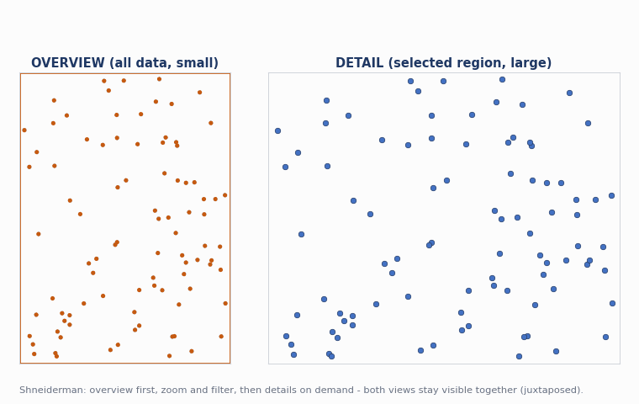
Visualization of Data, Understanding and Interpretation
Overview And Details
Ben Shneiderman's classic design mantra for interactive visualization: 'Overview first, zoom and filter, then details-on-demand.'
Overview first: let the user see the whole dataset before narrowing in, so nothing important is missed.
Zoom and filter: let the user narrow attention to a subset relevant to their current question.
Details-on-demand: only then reveal fine-grained attributes for the narrowed selection.
Bird's-eye maps are a classic overview–detail example — a small orienting overview beside a large exploration view.
Key idea
This mantra is one of the most cited rules of thumb in the whole field — most detail-on-demand, drill-down and coordinated-view idioms in this lecture are instances of it.
Source: Munzner, Visualization Analysis and Design (2014), §6.7, p. 135; §12.3.2, pp. 270–271 (Shneiderman 1996)

Slide 33
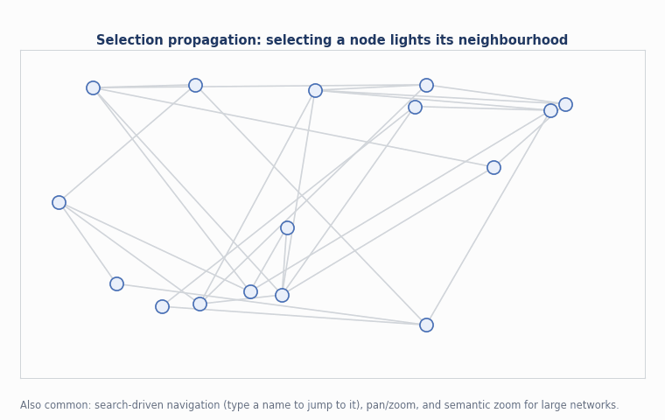
Visualization of Data, Understanding and Interpretation
Interactive Network Exploration
Networks pose special interaction challenges because layout, scale and hierarchy all interact — a node-link diagram that fits thousands of nodes can become unreadable at tens of thousands.
Navigation: pan / zoom / semantic zoom, often combined with search to jump directly to a named node.
Selection propagation: selecting a node can highlight its neighbours or an entire connected path.
Animated transitions between hierarchical aggregation levels (e.g. an adjacency-matrix view) preserve context while narrowing detail.
Context-preserving visual links route curved connection marks between related items across views while minimizing occlusion.
Key idea
For very large networks, interaction is not optional — it is the only practical way to make the structure legible, since no single static layout scales to hundreds of thousands of nodes.
Source: Munzner, Visualization Analysis and Design (2014), §9, §11.3–11.4, pp. 248–249, 253 (van Ham 2003; Steinberger et al. 2011)

Slide 34
Visualization of Data, Understanding and Interpretation
Interactive Network Exploration: Focus+Context on Graphs
Focus+context idioms are especially valuable for networks, where elision and distortion let an analyst inspect local neighbourhoods without losing the surrounding structure.
DOITrees Revisited: shows a 600,000-node tree by eliding distant subtrees into shaded aggregate triangles.
Hyperbolic browsers: map an exponentially growing tree onto a finite hyperbolic disk, focus-navigable by hyperbolic translation.
Search-driven focus: typing a node name can set the DOI function's focus point automatically, rather than requiring manual clicking.
Multiple foci let an analyst compare several neighbourhoods of interest at once within the same context.
Key idea
Interest functions typically exploit dataset structure, especially hierarchy — a good context for a set of selected subsections is usually their enclosing sections or common ancestors.
Source: Munzner, Visualization Analysis and Design (2014), §14.3, pp. 324–325 (Heer & Card 2004; Lamping, Rao & Pirolli 1995)

Slide 35
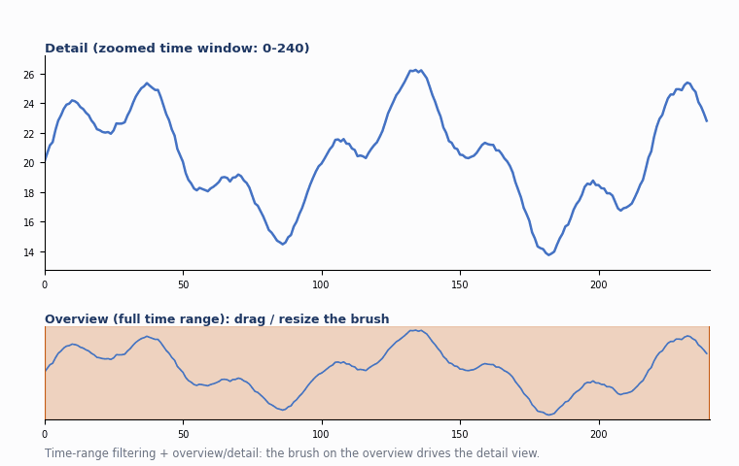
Visualization of Data, Understanding and Interpretation
Interactive Temporal Visualization
Time-varying data benefits from the same interaction idioms covered so far, applied specifically to the time dimension: zooming, filtering, and detail-on-demand along a timeline.
Time-range filtering: sliders or overview brushing select a window of interest (dynamic query on the time axis).
Scrubbing: dragging a playhead jumps directly to any time instant instead of only playing forward.
Temporal drill-down: navigating from year → month → day mirrors hierarchical drill-down in other data types.
Overview + detail on a timeline: a compressed full-range overview sits beside a zoomed detail window (see previous lecture's playback slides).
Key idea
Interaction generally beats animation alone for temporal analysis tasks: letting a user pause, scrub, filter and drill down keeps the choice of pace and focus with the analyst, not the system.
Source: Munzner, Visualization Analysis and Design (2014), §2.6.2, §6.5.2, §11.5, pp. 38–39, 132–133, 254–256

Slide 36
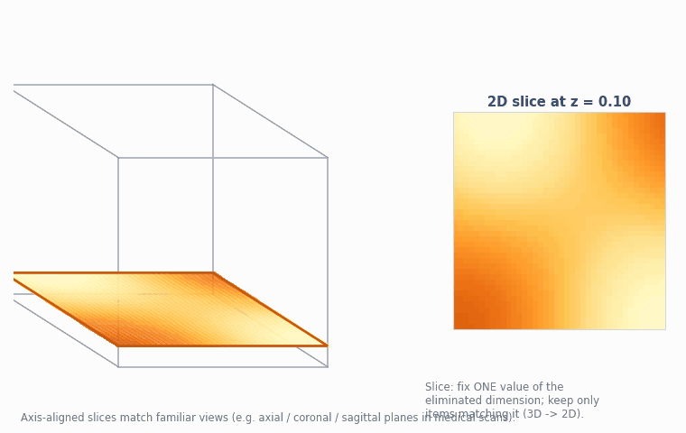
Visualization of Data, Understanding and Interpretation
Interactive Scientific Visualization
For 3D spatial and volumetric data, navigation additionally motivates three view-manipulation idioms grounded in the spatial-dimension camera metaphor.
Slice: extract a single 2D cross-section from a 3D view volume — e.g. one plane of a medical scan.
Cut: separate the volume into two parts with a plane and eliminate everything on one side.
Project: reduce the number of dimensions shown using one of many possible transformations.
Toolglass and Magic Lenses: a see-through lens superimposes a colour-coded curvature layer atop a 3D scene, revealing detail beneath the cursor only.
Key idea
The camera metaphor that motivates zoom and pan in 2D also motivates slice, cut and project in 3D — attributes are assigned to spatial dimensions, and interaction manipulates which part of that volume is visible.
Source: Munzner, Visualization Analysis and Design (2014), §11.1, §14.4, pp. 243, 326 (Bier et al. 1993)

Slide 37
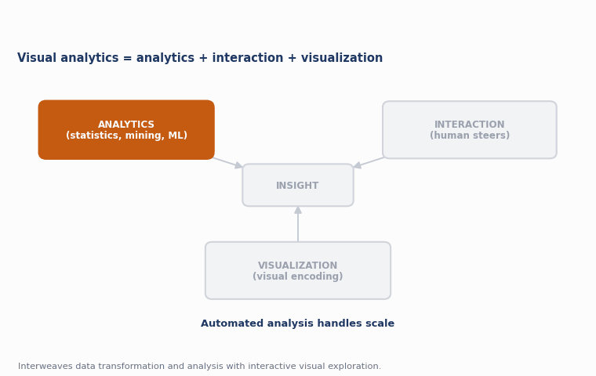
Visualization of Data, Understanding and Interpretation
Visual Analytics
Visual analytics is the science of analytical reasoning facilitated by interactive visual interfaces — it combines automated analysis with interactive visualization for effective understanding, reasoning and decision-making on very large and complex datasets.
Defining reference: Thomas & Cook, Illuminating the Path (2005), the report that popularised the term.
Interweaves data transformation and analysis (statistics, data mining, machine learning) with interactive visual exploration.
Goes beyond information visualization alone by explicitly bringing automated/computational analysis into the human's interactive loop.
Human-in-the-loop throughout, because fully automated analysis alone often misses context that only a human analyst supplies.
Key idea
Munzner's own subtitle for the field folds all three together: information visualization for abstract data, scientific visualization for spatial data, and visual analytics for interweaving data transformation and analysis with interactive visual exploration.
Source: Munzner, Visualization Analysis and Design (2014), book subtitle & preface; Thomas & Cook, Illuminating the Path (2005)

Slide 38
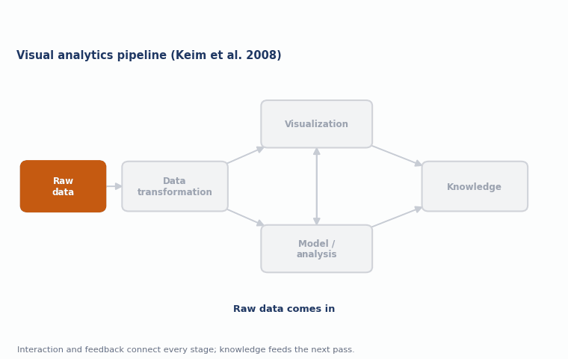
Visualization of Data, Understanding and Interpretation
Visual Analytics: The Pipeline
A widely used model (Keim et al. 2008) frames visual analytics as a pipeline in which data, visualizations, models and human judgement continuously feed back into each other.
Data transformation: raw data is cleaned and mapped into a form suitable for visualization or modelling.
Two parallel paths: a visualization path (mapping to visual encodings) and a data-mining/model path (automated pattern extraction).
Human interaction steers both paths — refining visual mappings, adjusting model parameters, and confirming or rejecting findings.
Knowledge output: the pipeline's goal is actionable insight, not just a picture or a trained model in isolation.
Key idea
Visual analytics is fundamentally iterative — knowledge gained from one pass through the pipeline informs how the data is transformed or filtered on the next pass.
Source: Keim, Andrienko, Fekete et al., Visual Analytics: Definition, Process and Challenges (2008)

Slide 39
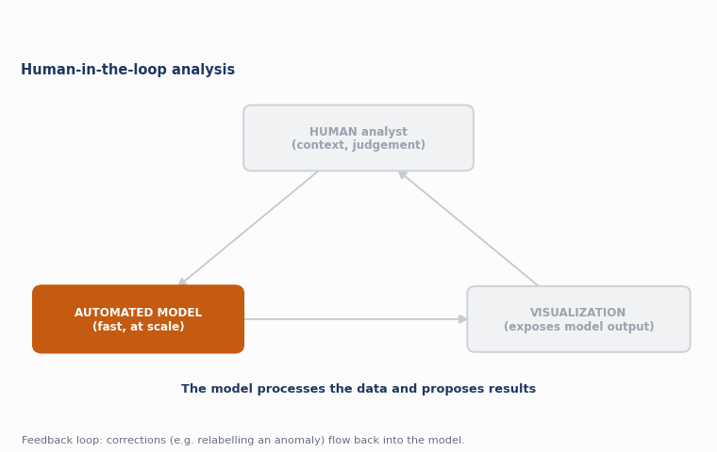
Visualization of Data, Understanding and Interpretation
Human-In-The-Loop Analysis
Human-in-the-loop analysis keeps a person actively steering the analytical process, rather than delegating decisions entirely to an automated algorithm.
Complements automation: algorithms are fast at scale, but people are better at incorporating context, domain knowledge, and judgement.
Interactive model steering: users adjust parameters (e.g. a clustering threshold) and immediately see updated visual results.
Trust and interpretability: visualization exposes what a model is doing, so a human can validate or challenge its output.
Feedback loops: user corrections (e.g. relabeling a misclassified anomaly) can feed back into retraining a model.
Key idea
Human-in-the-loop analysis is the practical realisation of Munzner's principle that interaction couples the user's evolving understanding to the system's evolving display, extended to include automated models.
Source: Keim et al. (2008); Munzner, Visualization Analysis and Design (2014), §11.4.3, p. 254

Slide 40
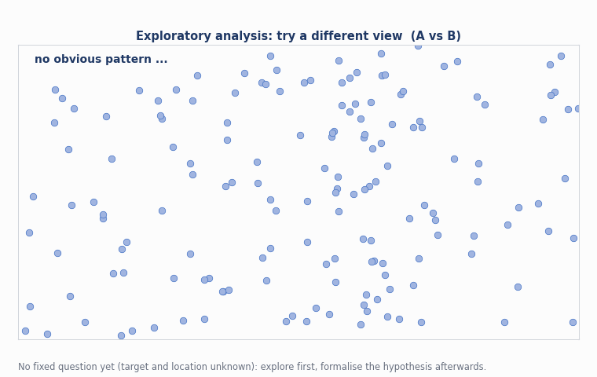
Visualization of Data, Understanding and Interpretation
Exploratory Analysis
Exploratory analysis is open-ended investigation of a dataset without a fixed, predetermined question — the goal is to discover what is interesting before deciding what to ask formally.
Contrasts with confirmatory analysis, which tests a specific, pre-registered hypothesis.
Relies heavily on overview-first, drill-down, filtering and coordinated views to let unexpected patterns surface.
Munzner's discover goal: a high-level task category for finding the unknown, as opposed to locate/identify/compare of known targets.
Often the first phase of a longer analytical workflow, feeding hypotheses into more targeted testing.
Key idea
Exploratory analysis is precisely where visual analytics earns its keep: a human can recognise 'something interesting' in a display long before that pattern could be specified as a formal query.
Source: Munzner, Visualization Analysis and Design (2014), §3 (Why: task abstraction — discover goal); Tukey, Exploratory Data Analysis (1977)

Slide 41
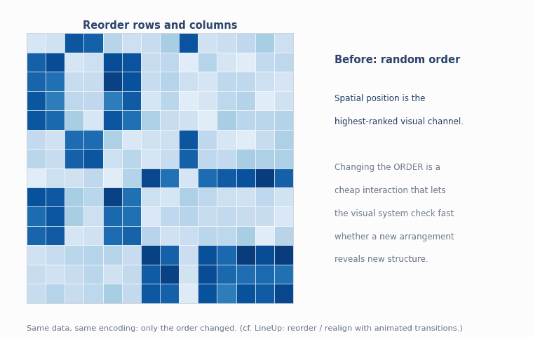
Visualization of Data, Understanding and Interpretation
Pattern Discovery
Pattern discovery is the task of finding structure — trends, clusters, correlations, periodicities — in data that was not previously known to be there.
Visual pattern-finding exploits the highest-ranked visual channel, spatial position, plus reordering and small multiples.
Reordering / sorting is one of the most powerful pattern-finding interactions — it invokes the visual system's fast pattern detection.
Coordinated views let a pattern found in one encoding be checked for correspondence in another.
Automated pattern mining (clustering, association rules) can propose candidate patterns for the analyst to inspect visually.
Key idea
Reordering data spatially invokes the pattern-finding parts of the visual system to quickly check whether a new configuration reveals new information — this is why sort/reorder interactions are so effective.
Source: Munzner, Visualization Analysis and Design (2014), §11.3, pp. 245–246 (LineUp example)

Slide 42
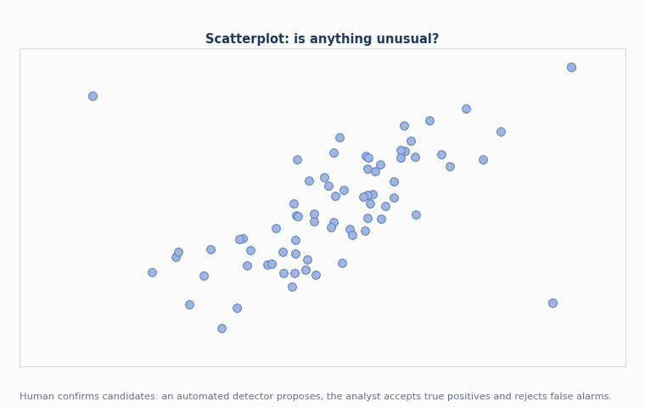
Visualization of Data, Understanding and Interpretation
Anomaly Detection
Anomaly detection is the task of finding items, events or regions that deviate substantially from the expected pattern — outliers that may signal errors, fraud, faults or rare but important events.
Visual outlier spotting: scatterplots, box plots and small multiples make deviations from a norm visually salient.
Motion / colour pop-out can be used to draw attention to a flagged anomaly the moment it appears (see motion channel, previous lecture).
Statistical + visual hybrid: an automated detector proposes candidates; the analyst visually confirms true positives and rejects false alarms.
Evaluation needs metrics: precision, recall and F1 quantify how well a detector balances catching real anomalies against raising false alarms (see Numerical 5).
Key idea
Anomaly detection is a natural visual analytics task precisely because 'unexpected' is easier for a human to recognise visually than to define algorithmically in advance.
Source: Keim et al. (2008); Munzner, Visualization Analysis and Design (2014), §5.5 (pop-out, channel salience)

Slide 43
Visualization of Data, Understanding and Interpretation
Numerical 5: Precision, Recall and F1 for Anomaly Detection
Problem
An anomaly detector is run on 100 labelled events: 50 are true anomalies, 50 are normal.
The detector flags 47 events as anomalies: of these, 42 are true anomalies (true positives) and 5 are normal (false positives).
(a) Compute precision. (b) Compute recall. (c) Compute the F1 score.
Solution
(a) Precision = TP / (TP + FP) = 42 / (42 + 5) = 42/47 ≈ 0.894 (89.4%)
(b) Recall = TP / (TP + FN); FN = 50 − 42 = 8 → Recall = 42/50 = 0.84 (84%)
(c) F1 = 2 × (Precision × Recall)/(Precision + Recall) = 2 × (0.894×0.84)/(0.894+0.84) ≈ 0.866
Source: Worked example on standard detection-quality metrics, applied to visual analytics anomaly triage

Slide 44
Visualization of Data, Understanding and Interpretation
Hypothesis Generation
Hypothesis generation is the creative step of proposing a candidate explanation for a pattern noticed during exploratory analysis.
Bottom-up from data: a visual pattern (cluster, trend, outlier) suggests a plausible underlying cause.
Informed by domain knowledge, which supplies plausible mechanisms that pure pattern-matching cannot.
Multiple competing hypotheses are normal at this stage — visualization should support comparing several explanations side by side.
Feeds directly into hypothesis testing, the next stage of the analytic reasoning cycle.
Key idea
Hypothesis generation is inherently an interactive, human task — it is where domain expertise and visual pattern discovery meet to produce a testable claim.
Source: Pirolli & Card, The Sensemaking Process and Leverage Points (2005)

Slide 45
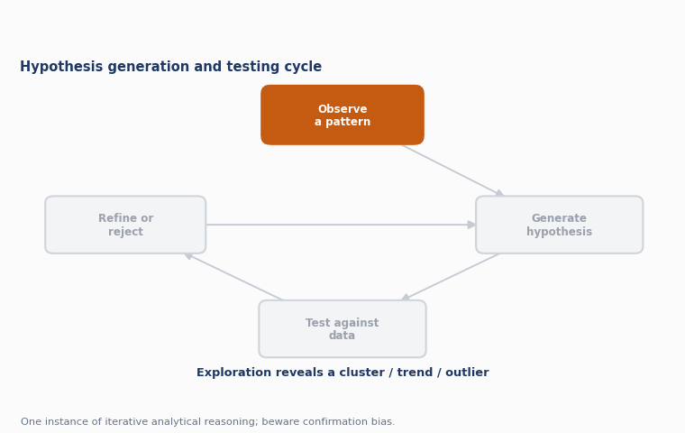
Visualization of Data, Understanding and Interpretation
Hypothesis Testing
Hypothesis testing is the step of checking a candidate explanation against evidence — visually, statistically, or both — to accept, refine or reject it.
Visual confirmation: re-encode the data to directly show whether the hypothesised pattern holds (e.g. plot the suspected correlation explicitly).
Statistical confirmation: compute a test statistic or confidence interval alongside the visual check.
Counter-example search: interactively filter to look for cases that would disprove the hypothesis, not just confirm it.
Iteration: a rejected hypothesis returns the analyst to hypothesis generation with updated understanding — this cycle is one instance of iterative analytical reasoning.
Key idea
Confirmation bias is a real risk: an interactive system should make it as easy to look for disconfirming evidence as for confirming evidence.
Source: Pirolli & Card (2005); Thomas & Cook (2005)

Slide 46
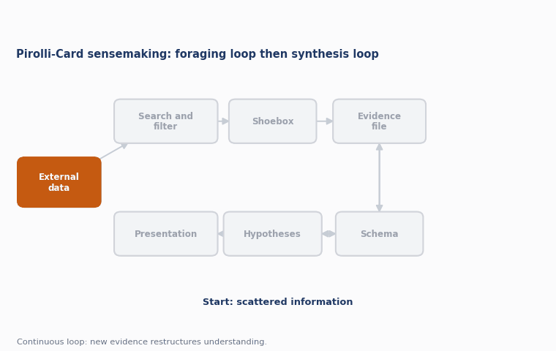
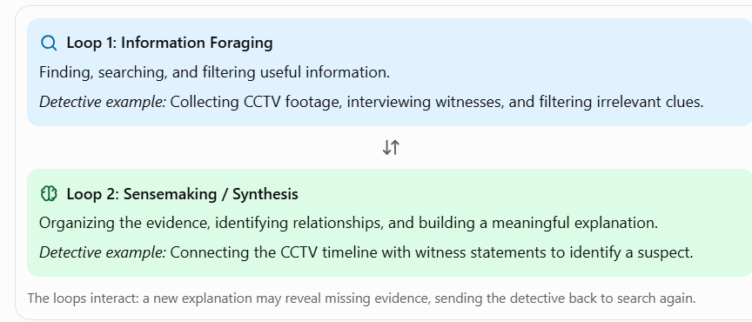
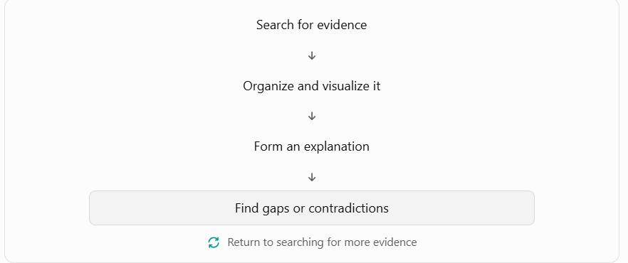
Visualization of Data, Understanding and Interpretation
Imagine a detective investigating a theft. The detective has CCTV footage, fingerprints, witness statements, and phone records. Each piece provides only partial information. The detective must connect them to understand what actually happened.
That process is called sensemaking.
Sensemaking
Sensemaking is the broader cognitive process of building an understanding of a situation from scattered evidence, of which interactive visual analysis is one crucial support tool.
Origin: sensemaking research began in organisational and cognitive science before being adapted to visual analytics.
Pirolli & Card's sensemaking loop (2005) is the reference model most used in the visual analytics literature.
Two intertwined loops: a foraging loop (finding and filtering information) and a synthesis loop (building a coherent case from it).
Externalises cognition: visualization acts as a shared 'evidence file' that offloads working memory onto the screen.
Key idea
Sensemaking is not a single step but a continuous loop of searching, structuring, and re-structuring understanding as new evidence arrives.
Source: Pirolli & Card, The Sensemaking Process and Leverage Points (2005)

Slide 47
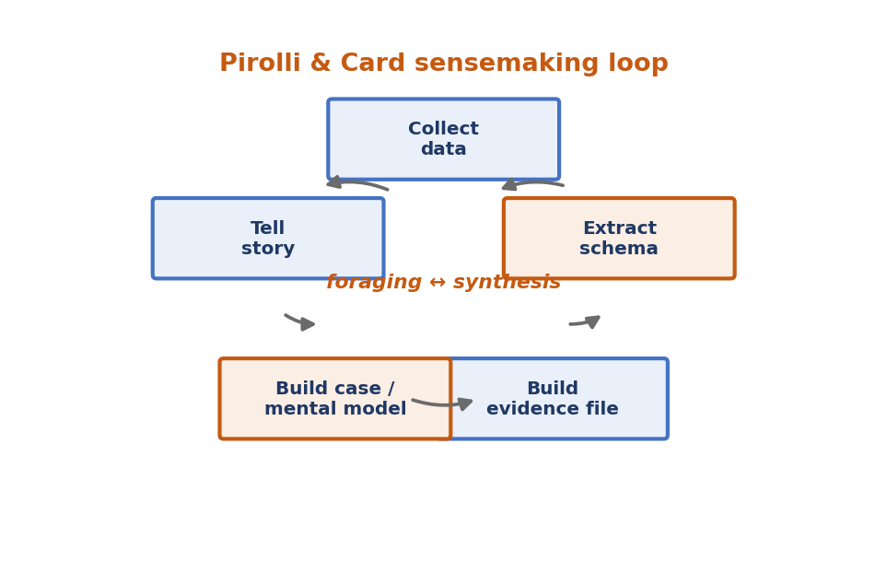
Visualization of Data, Understanding and Interpretation
Sensemaking: Foraging and Synthesis in Detail
The Pirolli–Card model breaks sensemaking into concrete stages, each of which interactive visualization can directly support.
Foraging loop: search & filter sources → read & extract → shoebox (raw collected evidence) → evidence file (organised extracts).
Synthesis loop: evidence file → schema (structured representation) → hypotheses → presentation (report or decision).
Leverage points: Pirolli & Card identify specific bottlenecks — e.g. the cost of foraging, or of re-structuring a schema — where good tool design has the biggest impact.
Visual analytics tools target these leverage points directly: coordinated views reduce foraging cost, and interactive schemas reduce restructuring cost.
Key idea
Good visual analytics tool design is often really a matter of identifying which leverage point in the sensemaking loop is the analyst's true bottleneck, and targeting that specifically.
Source: Pirolli & Card (2005)

Slide 48
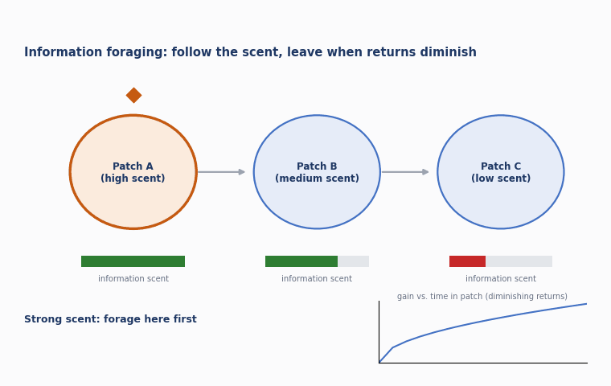
Visualization of Data, Understanding and Interpretation
Information Foraging
Information foraging theory (Pirolli 2007) models information-seeking behaviour by analogy with animal foraging for food: seekers follow 'information scent' between patches of value.
Information scent: cues that help a searcher decide whether to drill down further into a source, or look elsewhere.
Scented widgets (Willett et al. 2007) add concise visual cues — small charts, icons — directly into filter controls to convey scent cheaply.
Patch model: an information source ('patch') yields diminishing returns the longer a user stays in it, motivating a move to the next patch.
Cost/benefit trade-off: users balance the cost of navigating to a new patch against the expected gain (see Numerical 6).
Key idea
Information foraging theory explains why good affordances (clear scent) dramatically speed up analysis: users spend their limited attention on the most promising path rather than searching blindly.
Sensemaking: Building an understanding from scattered evidence.
Foraging loop: Finding and filtering information.
Synthesis loop: Connecting evidence to build an explanation.
Externalizing cognition: Using visualizations to reduce the burden on memory.
Continuous process: New evidence can change the current understanding.
Source: Pirolli, Information Foraging Theory (2007); Munzner, Visualization Analysis and Design (2014) §13.3.1, p. 303 (Willett et al. 2007)

Slide 49
Visualization of Data, Understanding and Interpretation
Numerical 6: Information Scent and Patch Value
Problem
Two information patches are available. Patch A yields value V(t) = 10√t (arbitrary units) after foraging for t seconds inside it; travel time between patches is 4 s.
(a) What is the instantaneous rate of gain dV/dt at t = 4 s within a patch?
(b) Using the average-rate criterion (Charnov's marginal value theorem: leave when instantaneous rate falls to the overall average rate including travel), estimate the optimal patch-leaving time if the overall average rate achieved is 2 units/s.
(c) If a scented widget lets the user identify a low-value patch instantly (0 s wasted) instead of after 4 s of foraging, how much time is saved per rejected patch?
Solution
(a) dV/dt = 10/(2√t); at t = 4: dV/dt = 10/(2×2) = 2.5 units/s
After exploring the patch for 4 seconds, the user is gaining information at an instantaneous rate of 2.5 units per second.
(b) Set dV/dt = 2: 10/(2√t) = 2 → √t = 2.5 → t = 6.25 s → leave the patch after ≈ 6.25 s of foraging
The user should continue exploring the patch until 6.25 seconds, then move to another patch. At that point, the additional information gained per second equals the overall average rate.
Patch: A source of information, such as a webpage, document, or group of records.
Foraging: Spending time exploring that source.
Marginal value theorem: A strategy for deciding when to stop exploring one source and move to another.
Scented widget: A visual control that provides clues about where useful information is likely to be found.
Source: Worked example applying information foraging / marginal value theorem concepts (Pirolli 2007; Charnov 1976)

Slide 50
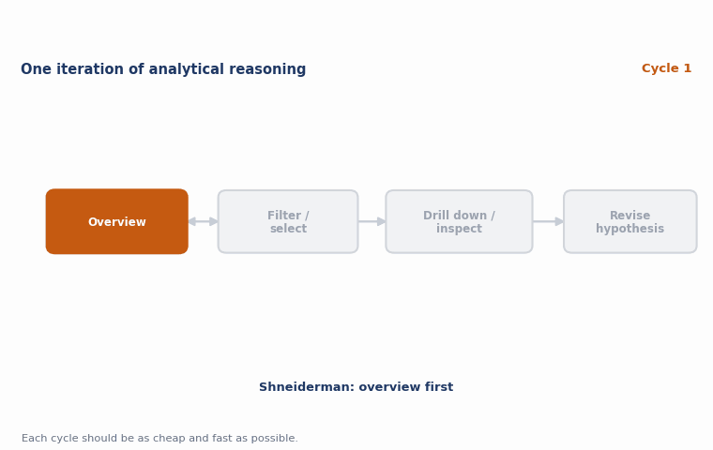
Visualization of Data, Understanding and Interpretation
Iterative Analytical Reasoning
Analytical reasoning with visual analytics tools is iterative by nature: each cycle of view, interpret and act refines the analyst's model of the data and suggests the next action.
Not linear: analysts frequently loop back to earlier stages as new evidence reframes the question.
Supported by history / provenance: recording the sequence of interactions lets an analyst retrace, justify, or resume reasoning.
Combines top-down and bottom-up: a working hypothesis guides what to look at next, while new visual patterns can override or revise that hypothesis.
Terminates when the evidence converges on an actionable, well-supported conclusion, or resources (time) run out.
Key idea
The analytic reasoning process is fundamentally cyclic, not a single pass — visual analytics tools succeed by making each cycle of the loop as cheap and fast as possible.
Source: Thomas & Cook, Illuminating the Path (2005); Pirolli & Card (2005)

Slide 51
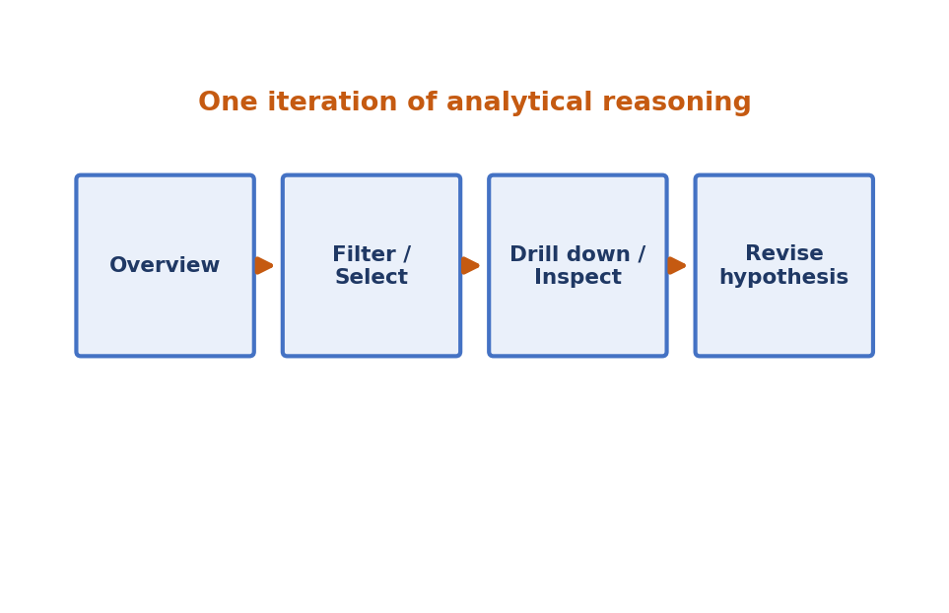
Visualization of Data, Understanding and Interpretation
Iterative Analytical Reasoning: A Worked Pattern
A typical iterative-reasoning session chains several of this lecture's idioms together, cycling through them multiple times as understanding deepens.
1. Overview: start with the full dataset (Shneiderman's mantra) to spot candidate regions of interest.
2. Filter + select: use dynamic queries or brushing to isolate a subset worth investigating.
3. Drill down / detail-on-demand: inspect individual items in the subset for supporting or disconfirming evidence.
4. Revise and repeat: update the working hypothesis and return to step 1 with a refined question.
Key idea
Each of the interaction idioms covered earlier in this lecture is a building block; iterative analytical reasoning is what happens when an analyst chains many of them together across several cycles.
Source: Synthesis based on Munzner, Visualization Analysis and Design (2014) Ch. 11–14 and Pirolli & Card (2005)

Slide 52
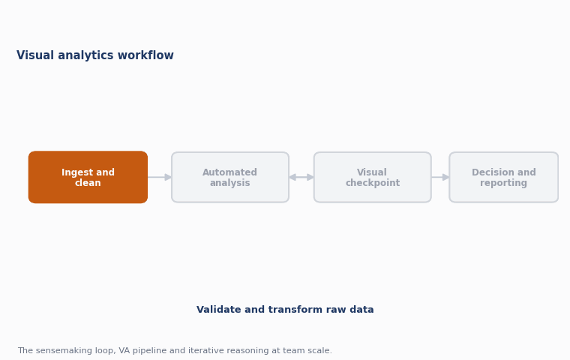
Visualization of Data, Understanding and Interpretation
Visual Analytics Workflows
A visual analytics workflow is the repeatable end-to-end path a team follows from raw data to a decision, combining automated processing stages with interactive visual checkpoints.
Ingest & clean: raw data is validated, cleaned and transformed into an analysis-ready form.
Automated analysis: statistics, clustering or machine-learning models process the data at scale.
Visual checkpoint: analysts inspect model output visually, catching errors automated metrics alone would miss.
Decision & reporting: findings are packaged (dashboard, report, alert) for stakeholders who were not part of the analysis session.
Key idea
A workflow is the sensemaking loop, the visual analytics pipeline and iterative reasoning all operating together at the scale of a team or organisation, not just one analyst's screen.
Source: Keim et al. (2008); Thomas & Cook (2005)
Notes:
ingest means to collect or bring data into a system so it can be processed and visualized.

Slide 53

Visualization of Data, Understanding and Interpretation
Visual Analytics Workflows: Case Pattern
Many operational visual analytics deployments (fraud monitoring, network security, epidemiology dashboards) follow a common case pattern built from this lecture's idioms.
Continuous monitoring view: an overview dashboard with linked, coordinated small multiples highlights emerging anomalies.
Triage via filtering: dynamic queries narrow thousands of events down to a shortlist worth human attention.
Human-in-the-loop confirmation: an analyst inspects flagged cases with details-on-demand before escalating.
Feedback to the model: confirmed and rejected cases are logged and used to retrain or recalibrate the automated detector.
Key idea
The best visual analytics workflows close the loop back to the automated model — human judgement doesn't just consume the model's output, it improves the model over time.
Source: Keim et al. (2008); synthesis of operational visual analytics practice

Slide 54
Visualization of Data, Understanding and Interpretation
Summary: Design Guidelines
1
Interaction turns a static picture into a process — begin with Munzner's manipulate / facet / reduce / embed framework for organising the design space.
2
Use brushing and linked highlighting to connect coordinated views so patterns in one view can be checked against every other view.
3
Support filtering and dynamic queries with immediate visual feedback — response time is part of the design, not an afterthought.
4
Provide details-on-demand (tooltips, popups, drill-down) instead of cluttering the main view with every attribute at once.
5
Reach for focus+context (elision or distortion) when a single view must show both fine local detail and global structure together.
6
Follow Shneiderman's mantra — overview first, zoom and filter, details-on-demand — as the default scaffolding for any interactive design.
7
Treat visual analytics as a human-in-the-loop pipeline: automated analysis proposes, interactive visualization lets the analyst confirm, refine or reject.
8
Remember that analytical reasoning and sensemaking are iterative loops, not one-shot answers — design tools that make each loop cycle cheap and fast.
Source: Munzner (2014) Ch. 11–14; Thomas & Cook (2005); Pirolli & Card (2005); Keim et al. (2008)

Slide 55
Visualization of Data, Understanding and Interpretation
Sources and References
T. Munzner, Visualization Analysis and Design, CRC Press, 2014 – §1.14, §3.7, §6.5, §6.7, §9, §11–14
J. S. Thomas & K. A. Cook (eds.), Illuminating the Path: The Research and Development Agenda for Visual Analytics, IEEE CS Press, 2005
D. Keim, G. Andrienko, J.-D. Fekete et al., “Visual Analytics: Definition, Process, and Challenges,” in Information Visualization, Springer LNCS 4950, 2008
P. Pirolli & S. Card, “The Sensemaking Process and Leverage Points for Analyst Technology,” Proc. Intl. Conf. on Intelligence Analysis, 2005
P. Pirolli, Information Foraging Theory: Adaptive Interaction with Information, Oxford University Press, 2007
B. Shneiderman, “The Eyes Have It: A Task by Data Type Taxonomy for Information Visualizations,” Proc. IEEE VL, 1996
C. Ahlberg & B. Shneiderman, “Visual Information Seeking: Tight Coupling of Dynamic Query Filters with Starfield Displays,” CHI 1994
R. A. Becker & W. S. Cleveland, “Brushing Scatterplots,” Technometrics 29(2), 1987
J. Heer & S. Card, “DOITrees Revisited: Scalable, Space-Constrained Visualization of Hierarchical Data,” AVI 2004
W. Willett, J. Heer & M. Agrawala, “Scented Widgets: Improving Navigation Cues with Embedded Visualizations,” IEEE TVCG 13(6), 2007
G. Furnas, “Generalized Fisheye Views,” CHI 1986; C. Ware & R. Bobrow, “Motion to Support Rapid Interactive Queries,” ACM TAP 1(4), 2004
J. Wills, “Visual Exploration of Large Structured Datasets,” NTTS 1995 (EDV system); van Ham, “Using Multilevel Call Matrices,” InfoVis 2003

Slide 56
Visualization of Data, Understanding and Interpretation
MCQs
1. Which of the following is NOT one of Munzner's five major ways to manage visual complexity?
A. Facet the data into multiple views
B. Reduce the data shown
C. Embed focus and context together
D. Randomize the layout on every frame
Answer: D (Randomizing layout is not one of derive / change / facet / reduce / embed.)

Slide 57
Visualization of Data, Understanding and Interpretation
MCQs
2. Linked highlighting between coordinated views is also known as:
A. Semantic zooming
B. Brushing or cross-filtering
C. Elision
D. Hyperbolic translation
Answer: B (Munzner §12.3.1 notes brushing and cross-filtering as synonyms.)

Slide 58
Visualization of Data, Understanding and Interpretation
MCQs
3. In Shneiderman's design mantra, what comes immediately after 'Overview first'?
A. Details-on-demand
B. Animate the transition
C. Zoom and filter
D. Aggregate everything
Answer: C ('Overview first, zoom and filter, then details-on-demand.')

Slide 59
Visualization of Data, Understanding and Interpretation
MCQs
4. With semantic zooming, what changes as an object's on-screen size grows?
A. Only its physical size, uniformly
B. Its representation, adapting to available pixels
C. Its position in the dataset
D. Nothing — semantic zoom only affects colour
Answer: B (Semantic zoom adapts the representation, not just the scale, unlike geometric zoom.)

Slide 60
Visualization of Data, Understanding and Interpretation
MCQs
5. The degree-of-interest (DOI) function used in focus+context idioms is defined as:
A. DOI = I(x) + D(x,y)
B. DOI = I(x) − D(x,y)
C. DOI = D(x,y) / I(x)
D. DOI = I(x) × D(x,y)
Answer: B (Furnas's DOI function subtracts distance-from-focus from an interest function.)

Slide 61
Visualization of Data, Understanding and Interpretation
MCQs
6. Which term describes the standard definition of visual analytics from Thomas & Cook (2005)?
A. Purely automated statistical modelling
B. The science of analytical reasoning facilitated by interactive visual interfaces
C. Static chart design for reports
D. A synonym for scientific visualization
Answer: B (This is the widely cited Thomas & Cook definition.)

Slide 62
Visualization of Data, Understanding and Interpretation
MCQs
7. In the Pirolli & Card sensemaking loop, the foraging loop is primarily concerned with:
A. Presenting the final report
B. Finding, filtering and extracting information
C. Testing a statistical hypothesis
D. Rendering the visual encoding
Answer: B (The foraging loop covers search, filter, read and extract, feeding the synthesis loop.)

Slide 63
Visualization of Data, Understanding and Interpretation
MCQs
8. A dynamic query interface is best characterised by:
A. A tightly coupled loop where the display updates immediately as controls change
B. Batch submission of SQL queries
C. A one-time static report generated overnight
D. Manual re-coding of the visualization for every question
Answer: A (Dynamic queries give an immediate, tightly coupled visual response to widget changes.)

Slide 64
Thank You

