Slide 1

Visualization of Data, Understanding and Interpretation
Unit 2 : Advanced Visualization & Storytelling
(UE24CS342AA9)
Visualization of Data, Understanding and Interpretation
Dr.Prajwala TR (Course Instructor)
Dept. of CSE, PES University, Bangalore

Slide 2
Visualization of Data, Understanding and Interpretation
Acknowledgement
The slides are prepared from various resources from the Universities from abroad and India. Also, some material is taken from reliable resources from internet throughout this course.

Slide 3
Visualization of Data, Understanding and Interpretation
Lecture Overview
In this lecture:
  We will understand how three-dimensional scientific data is represented and how voxels, grids, and spatial sampling support volume-based visualization.
  We will explore how scalar values can be transformed into meaningful visual structures such as slices, contours, isosurfaces, and volumetric representations.
  We will examine how direct volume rendering uses ray casting, transfer functions, opacity, color, and compositing to reveal internal structures.
  We will understand how medical imaging data such as CT and MRI can be visualized to examine anatomy and identify meaningful regions within complex volumes.
  We will study how segmentation separates anatomical structures and enables their visualization as distinct regions or three-dimensional surfaces.
  We will examine how simulation data such as fluid flow, weather, atmospheric conditions, and engineering systems can be transformed into visual representations for analysis and interpretation.

Slide 4
Visualization of Data, Understanding and Interpretation
Volume Visualization Fundamentals
Volume visualization is the visual representation of data distributed throughout a three-dimensional spatial domain.
Unlike a conventional 2D image, volumetric data contains information through depth, allowing structures inside a 3D region to be examined.
Why Volume Visualization?
  Scientific and medical systems often generate data throughout a 3D volume.
  A single 2D projection can hide structures located behind other structures.
  Volume visualization provides representations for examining internal structure, spatial relationships, and boundaries.
  Common sources include CT and MRI scans, scientific simulations, and computational models.
  Visualization techniques must determine how the values throughout the volume are converted into visible graphical information.
volume visualization turns a 3D field of values into images that show what is inside the volume, not just its outer surface.

Slide 5
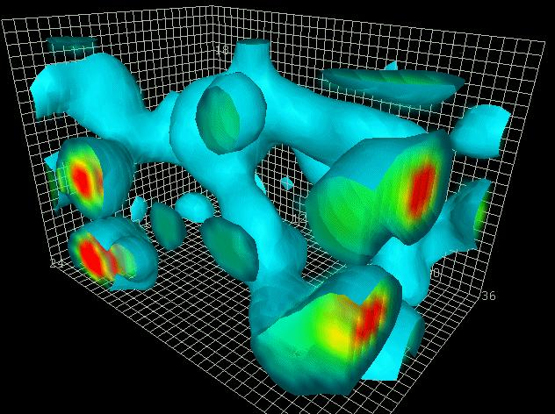
Visualization of Data, Understanding and Interpretation
Volume Visualization Fundamentals
Basic Representation
V(x, y, z) → s
where:
  x, y, z → spatial position
  s → scalar value at that position
Typical Pipeline
Volumetric Data → Visualization Method → 2D Display → Interpretation
Examples
  Medical: CT / MRI volumes
  Scientific: temperature or density fields
  Engineering: simulated stress / thermal fields
  Fluid simulation: 3D velocity and pressure data

Slide 6
Visualization of Data, Understanding and Interpretation
Volumetric Data
Volumetric data is data in which values are associated with locations throughout a three-dimensional spatial domain.
A volumetric dataset can be represented as: V(x, y, z)
where each spatial position corresponds to a measured or computed value.
Characteristics
  Contains information along three spatial dimensions.
  Usually represented using a discrete set of spatial samples.
  Each sample has a position and associated value.
  Values may represent physical measurements or simulation outputs.
  Large volumes can contain millions of spatial samples.

Slide 7
Visualization of Data, Understanding and Interpretation
Volumetric Data
Example: Medical Volume
A CT scan can be represented as a 3D array:
Nx × Ny × Nz
Each location contains an intensity-related scalar value.
For a volume of:
256 × 256 × 128,
the number of spatial samples is:
256 × 256 × 128 = 8,388,608
Thus, even a single volume can contain millions of values.
Key Concept
Volumetric data preserves information about how a quantity varies throughout 3D space.

Slide 8
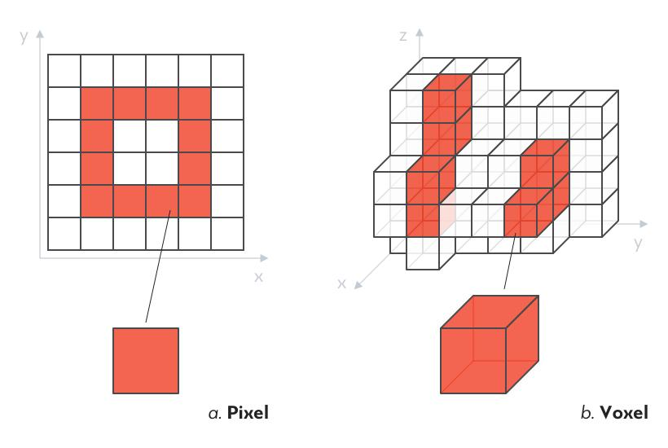
Visualization of Data, Understanding and Interpretation
Voxels
A voxel is a volumetric element representing a discrete region or sample within a three-dimensional dataset. The term is derived from volume + pixel.
Pixel vs Voxel:
Pixel | Voxel
2D image element | 3D volume element
Position: (x, y) | Position: (x,y,z)
Represents an area | Represents a volume
Example: photograph | Example: CT/MRI volume

Slide 9

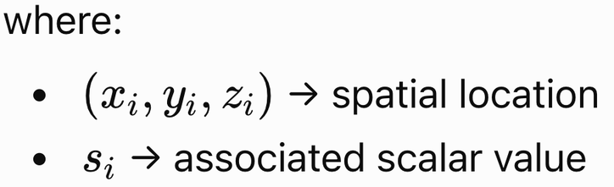

Visualization of Data, Understanding and Interpretation
Voxels
If the spacing is 0.5 × 0.5 × 1 mm, you can work out the physical size of the scanned region:
512 × 0.5 mm = 256 mm across
300 × 1 mm = 300 mm deep
voxel count tells you how many samples there are. Count × spacing tells you the real-world size of the region.
Voxel Representation
Each voxel can be described by:
Voxel Dimensions
A voxel can have physical dimensions:
These dimensions determine the spatial resolution of the volume.
Example: CT
A CT dataset may contain: 512 × 512 × 300 voxels. Each voxel contains an intensity-related value that contributes to the representation of anatomical structures.
Important Distinction
  A voxel is not simply a visual cube.
  It represents a discrete sample or spatial cell of the underlying volumetric data. The eventual visualization may represent those values using slices, surfaces, opacity, color, or other techniques.
512 samples across, 512 down, and 300 slices deep, which is 78,643,200 voxels in total. Each one stores an intensity, and high intensity corresponds to dense material such as bone.

Slide 10
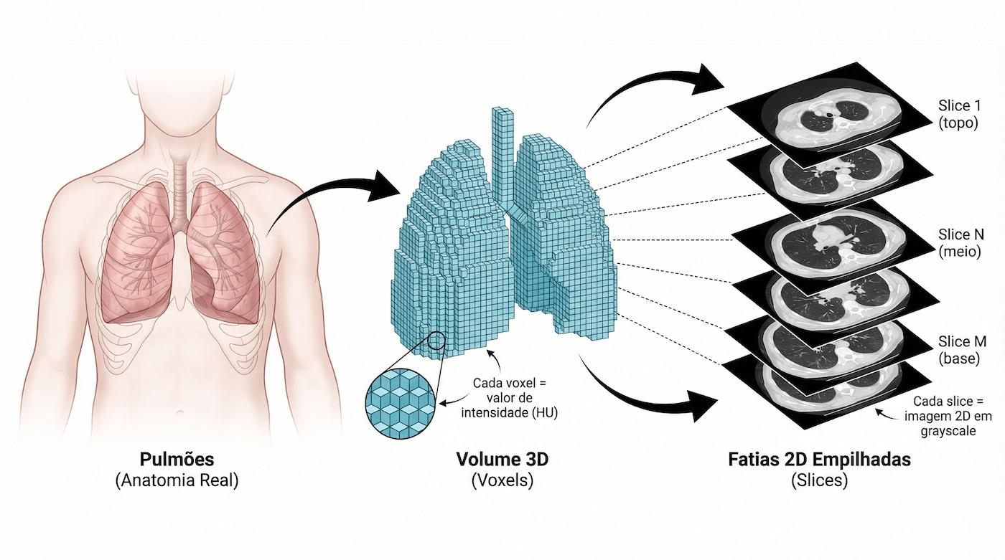
Visualization of Data, Understanding and Interpretation
Voxels
Real Anatomy
Volume 3D
(Voxels)
Scans 2D
(Slices)

Slide 11


Visualization of Data, Understanding and Interpretation
3D Grids
A 3D grid is an organized set of spatial positions used to sample and store volumetric data.
For a regular volume, the grid can be described by:
Nx × Ny × Nz
where Nx , Ny , Nz are the numbers of samples along the three spatial axes.
Regular 3D Grid
  Predictable spatial arrangement.
  Uniform or systematically defined spacing.
  Efficient indexing and storage.
  Common in image and volume datasets.
Grid And Spatial Sampling
A continuous phenomenon:
is sampled at discrete spatial positions:
The grid therefore determines where the field is represented numerically.

Slide 12
Visualization of Data, Understanding and Interpretation
3D Grids
Resolution
Higher grid resolution:
Nx , Ny , Nz ↑
generally provides more spatial detail, but also increases:
  Storage requirements
  Processing requirements
  Rendering workload
Example
A 512 × 512 × 300 volume contains 512 × 512 × 300 = 78,643,200 spatial samples.
💡Key Idea: The grid is the discrete spatial structure through which a continuous 3D field becomes computationally representable.

Slide 13
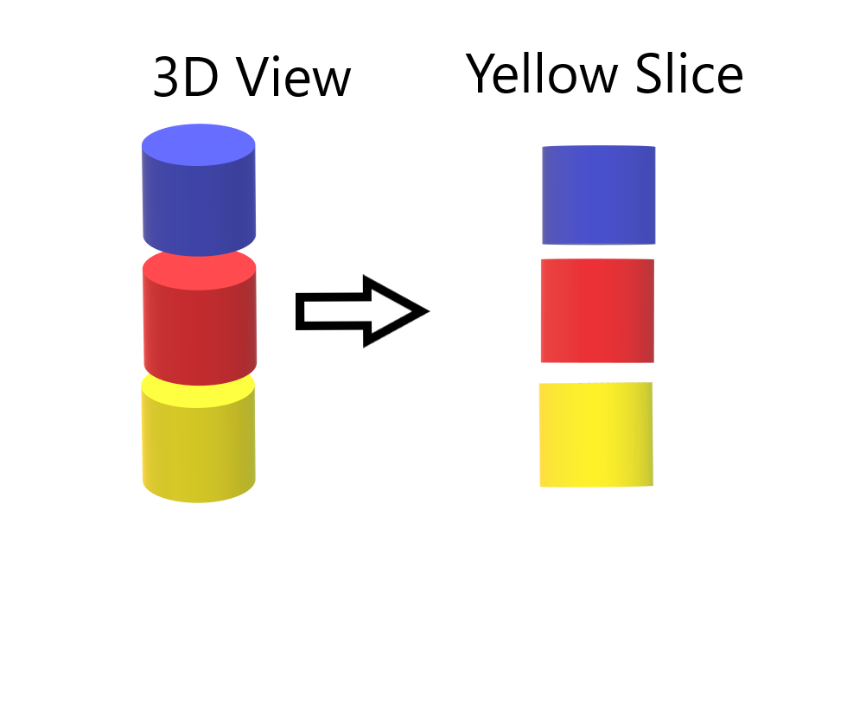
Visualization of Data, Understanding and Interpretation
Volume Slicing
Volume slicing extracts a two-dimensional cross-section from a three-dimensional volume by selecting a plane through the dataset.
For a scalar volume: V(x, y, z), a horizontal slice at z = z0 produces V(x, y, z0​)​
What Does A Slice Show?
A slice converts: 3D→2D while preserving the scalar values within the selected plane.
Advantages
  Directly exposes internal regions of a volume.
  Avoids occlusion caused by surrounding structures.
  Can display the resulting plane using a heatmap or grayscale image.
  Allows detailed inspection of local structures.
  Computationally simpler than rendering the entire volume.
Notes:
Occlusion means one visual element blocking or hiding another behind it, so part of the data can’t be seen from the current viewpoint.

Slide 14
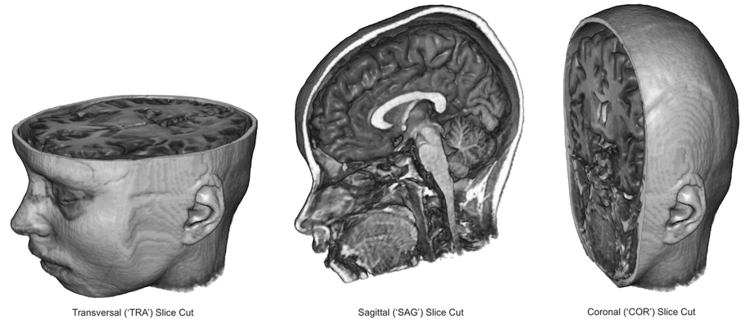
Visualization of Data, Understanding and Interpretation
Volume Slicing
Limitation
A single slice represents only one plane of the volume.
Important structures may therefore lie:
  Between slices
  Outside the selected plane
  At an orientation not aligned with the selected plane
Applications
  CT examination
  MRI analysis
  3D simulation inspection
  Temperature distribution within a solid
  Internal structure analysis
Important Visualization Principle
  Slicing does not reconstruct the entire 3D structure.
  It provides a controlled 2D view into the volume.

Slide 15
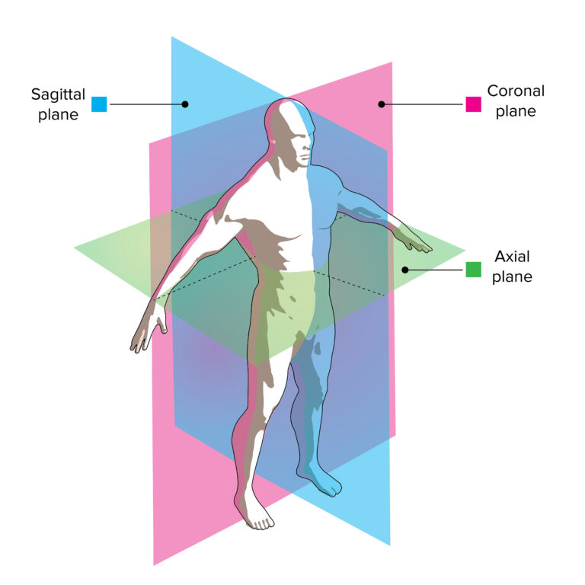
Visualization of Data, Understanding and Interpretation
Orthogonal Slices And Multiplanar Reconstruction
Orthogonal Slices
An orthogonal slice is a cross-section taken perpendicular to one of the principal spatial axes.
For a 3D medical volume, the three standard orientations are:
  Axial: z = z0 (Horizontal cross-section)
  Coronal: y = y0 (Front-to-back cross-section)
  Sagittal: x = x0 (Left-to-right cross-section)
Multiplanar Reconstruction (MPR)
Multiplanar reconstruction generates 2D views from a 3D volumetric dataset along selected planes.
Instead of examining only one orientation, multiple planes can be displayed simultaneously.

Slide 16
Visualization of Data, Understanding and Interpretation
Orthogonal Slices And Multiplanar Reconstruction
Why MPR Is Useful
  Provides complementary views of the same 3D structure.
  Makes spatial relationships easier to establish.
  Allows a structure identified in one plane to be located in other planes.
  Reduces dependence on a single viewing orientation.
  Commonly used for examining medical volume datasets.
Orthogonal vs Oblique Reconstruction
  Orthogonal: aligned with the principal axes.
  Oblique: uses a plane at an arbitrary orientation.
Oblique planes are useful when a structure does not align with the standard anatomical planes.
Key Concept
One 3D Volume → Multiple 2D Views
MPR therefore provides multiple coordinated cross-sectional views of the same volumetric data, rather than creating independent datasets.

Slide 17
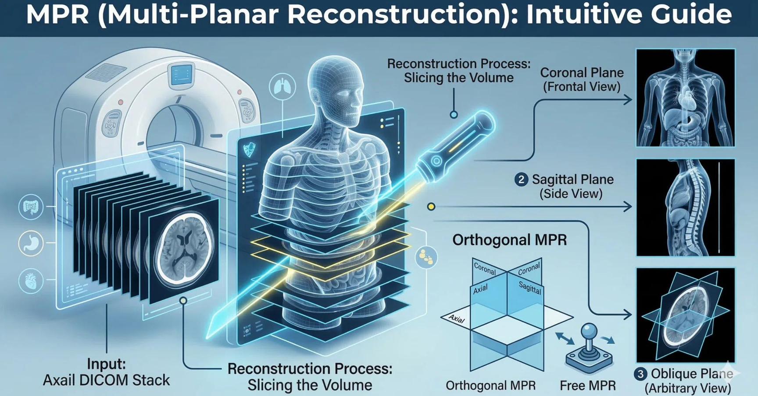
Visualization of Data, Understanding and Interpretation
Orthogonal Slices And Multiplanar Reconstruction
Notes:
A CT scanner acquires images one axial slice at a time. These are horizontal cross-sections, as if you sliced a loaf of bread perpendicular to the body's long axis. Each slice is saved as a DICOM image. The scanner's raw output is therefore just a pile of 2D axial images.

Slide 18
Visualization of Data, Understanding and Interpretation
Isosurface Visualization
An isosurface is a three-dimensional surface connecting locations within a volume where the scalar field has a constant value.
S(x, y) = c → Isocontour (2D)
V(x, y, z) = c → Isosurface (3D)
Key Characteristics
  Represents a selected scalar level as a 3D surface.
  Reveals the shape and spatial extent of regions with similar scalar values.
  Commonly used for anatomical structures, material boundaries, and simulation features.
  The selected threshold cc determines which structure is extracted.
  Unlike slicing, the representation is a 3D geometric surface rather than a 2D cross-section.

Slide 19
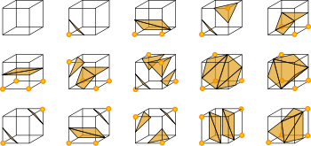
Visualization of Data, Understanding and Interpretation
Isosurface Extraction
If it's 15 °C at 6 am and 35 °C at noon, then at some moment in between it was exactly 25 °C. You may not know when, but it must have happened. Marching Cubes uses the same reasoning, and linear interpolation estimates the "when."
Isosurface extraction converts a selected scalar level within a volumetric dataset into explicit 3D surface geometry.
Basic Pipeline
Scalar Volume → Threshold c → Surface Extraction → 3D Mesh
The resulting surface is commonly represented using triangles.
Marching Cubes
Marching Cubes is a widely used algorithm for extracting an isosurface from a 3D scalar grid.
Conceptually, each voxel cell is examined to determine how the selected isosurface intersects its boundaries.
Why Triangles?
The extracted surface is represented as a polygonal mesh, commonly using triangles because triangular geometry can represent complex surfaces efficiently.
Each cube is one cell of the volume. Its 8 corners are 8 neighbouring voxels.
An orange dot on a corner means that voxel's value is ≥ c, so it is inside the surface.
A corner without a dot means its value is < c, so it is outside.
The orange shaded shapes are the triangles Marching Cubes creates in that cell. They separate the dotted corners from the undotted ones.
the surface must cut every edge that joins a dotted corner to an undotted corner,

Slide 20
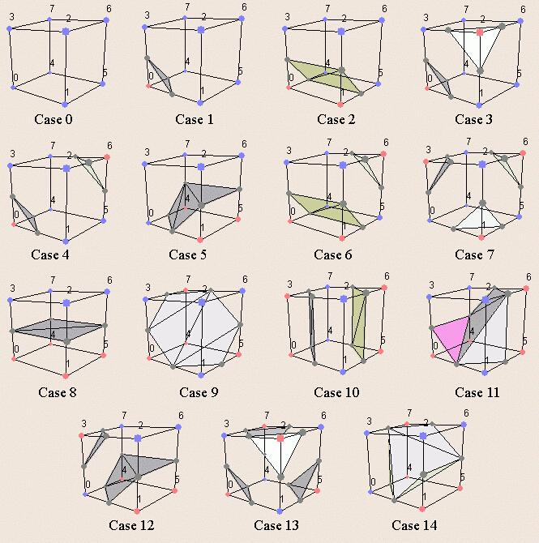
Visualization of Data, Understanding and Interpretation
Isosurface Extraction
Advantages
  Produces explicit geometric surfaces.
  Supports standard 3D rendering techniques.
  Allows rotation, lighting, shading, and measurement of extracted geometry.
  Useful when the primary analytical goal is the shape of a selected structure.
Limitation
  The chosen threshold c strongly influences the resulting geometry.
  Different values of cc can produce different surfaces from the same volume.
so there are 2⁸ = 256 possible patterns. Most of them are the same shape seen from another direction using rotation/complement etc so 15 sample are sufficient
● = voxel value ≥ c (inside); shaded = generated triangles

Slide 21
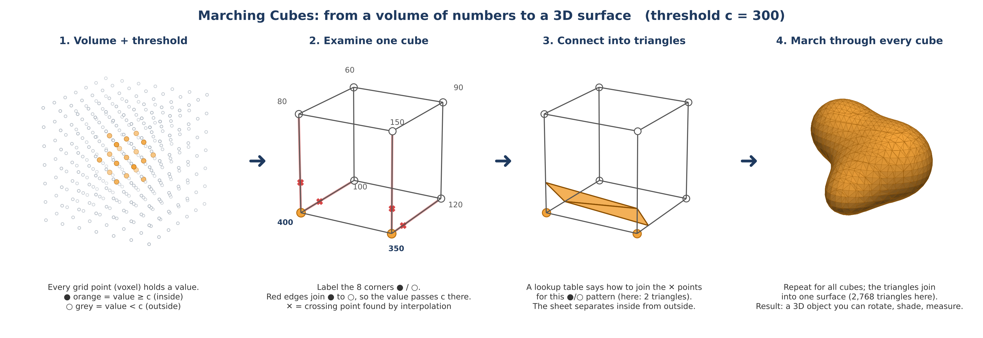

Slide 22
Analogy: imagine a block of jelly with a hidden fruit inside. You can't see the fruit, but you can poke a needle at regular points and measure "fruit or jelly?" Marching Cubes uses those pokes to trace the fruit's outer skin.
Step 0: choose the threshold c. Decide what counts as "inside." For example, "anything denser than 300 is bone."
Step 1: split the volume into tiny cubes. Each cube's 8 corners are 8 neighbouring voxels.
Step 2: for one cube, label each corner. Above c is inside (●). Below c is outside (○).
Step 3: decide whether the surface passes through this cube.
All ● or all ○: the cube is completely inside or completely outside, so there is no surface here. Skip it.
A mix of ● and ○: the boundary must pass through this cube.
Step 4: find where the boundary crosses. On every edge joining a ● to a ○, the value passes through c, so the surface crosses there. Interpolation finds the exact spot, e.g. 69% of the way along the edge.
Step 5: connect the crossing points into triangles. A ready-made lookup table (the 15-case figure) says exactly how to join them for that pattern of ● and ○. No calculation is needed; it's a lookup.
Step 6: march to the next cube and repeat. Do this for every cube in the volume. This step is where the name "Marching" comes from.
Step 7: join everything. The small triangles from all the cubes join up like tiles into one smooth, closed surface. That surface is your 3D object.

Slide 23
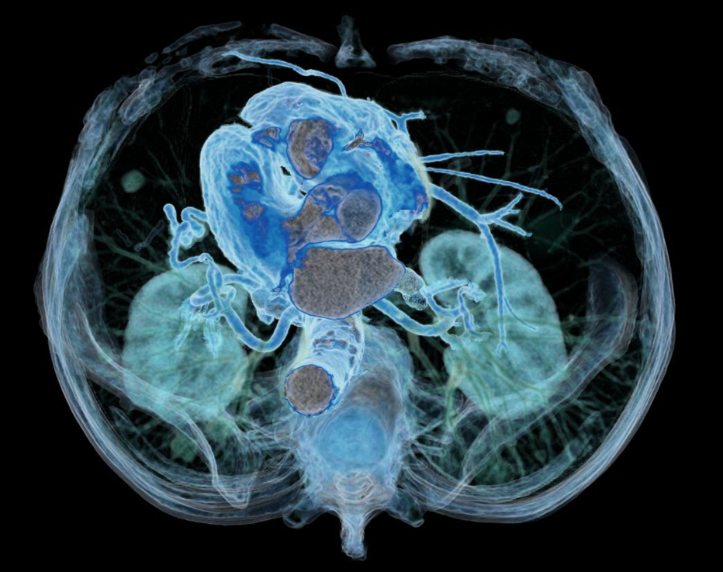
Visualization of Data, Understanding and Interpretation
Direct Volume Rendering
For every pixel, DVR sends a ray through the volume, gives each point along it a colour and a transparency, and blends them front to back. Near, solid things dominate, and faint things just tint the view.
Direct volume rendering (DVR) creates an image directly from volumetric data without first extracting explicit surface geometry.
Instead of asking: “Which voxels form a surface?”
DVR asks: “How should the values throughout the volume contribute to the final image?”
Pipeline: Volume Data → Transfer Function → Volume Rendering → Image
Key Difference
  Isosurface Rendering: Volume → Surface Extraction → 3D Geometry → Image
  Direct Volume Rendering: Volume→ Color + Opacity → Image
Why Use DVR?
  Multiple structures can contribute to the image.
  Semi-transparent regions can reveal internal structures.
  No explicit surface extraction is required.
  Useful when meaningful structures cannot be represented by a single threshold.

Slide 24
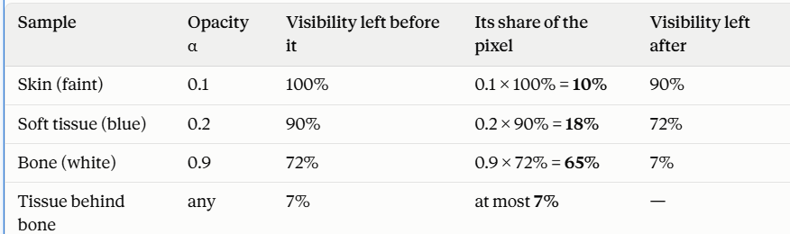
Analogy: imagine looking through a stack of tinted glass sheets. Some are almost clear, some are cloudy, and some are nearly solid. What you see is a mix: a little of the clear ones, a lot of the first cloudy one, and almost nothing from the sheets hidden behind a solid one. DVR does exactly this, once for every pixel.
Step by step
Step 1: decide the “look” of each value (the transfer function).
Before rendering, you set a rule, for example:
Air → invisible
Soft tissue → faint blue, mostly see-through
Vessels → bright blue, half see-through
Bone → white, almost solid
Step 2: shoot a ray from each pixel into the volume.
Picture a straight line going from your eye, through the pixel, through the whole body.
Step 3: take samples along the ray.
At small regular steps along the line, read the voxel value at that point.
Step 4: turn each sample into colour + opacity.
Look up the value in the transfer function. “This is soft tissue, so it’s faint blue with opacity 0.2.”
Step 5: blend the samples front to back.
Keep track of how much visibility is left, starting at 100%. Each sample:
adds its colour, weighted by its opacity × the remaining visibility, and
uses up that share of visibility for everything behind it.
Step 6: stop early when it’s solid.
Once visibility is nearly used up, nothing behind can be seen, so the ray stops.
Step 7: that blended colour is the pixel. Repeat for every pixel and you have the image.
One ray, worked with numbers
What you achieve
One image that shows many structures at once, each in its own colour.
See-through layers, so internal organs are visible inside the body without cutting it open.
Instant control by changing the transfer function. Make soft tissue opacity 0 and only the skeleton remains. Raise it and organs appear. The data never changes, only the “glasses” you look through.

Slide 25
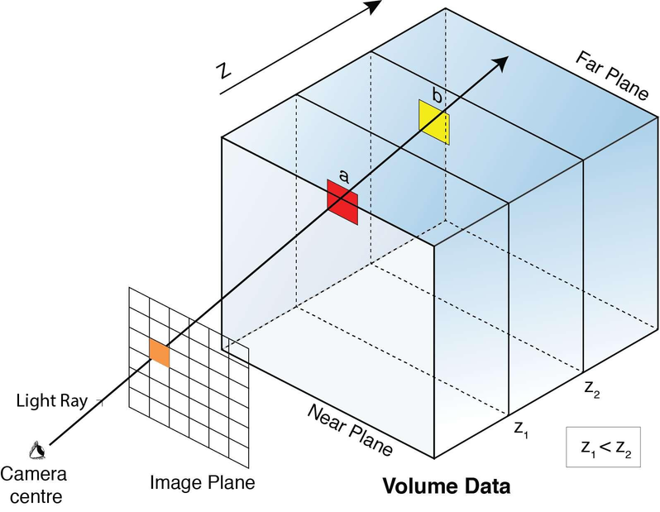

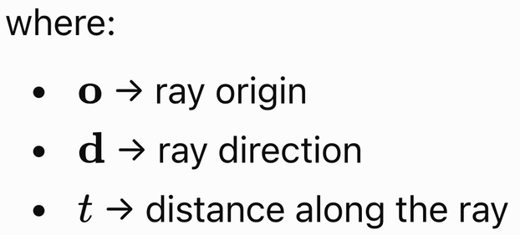
Visualization of Data, Understanding and Interpretation
Ray Casting
Ray casting is a volume-rendering approach in which rays are projected through the volume and sampled at multiple locations along their paths.
Basic Process
For each viewing ray:
  A ray enters the volume.
  The ray samples the volume at successive positions.
  Each sample obtains a scalar value.
  The scalar value is mapped to color and opacity.
  Contributions from samples are accumulated.
  The accumulated result becomes the corresponding image pixel.
A ray can be represented parametrically:

Slide 26

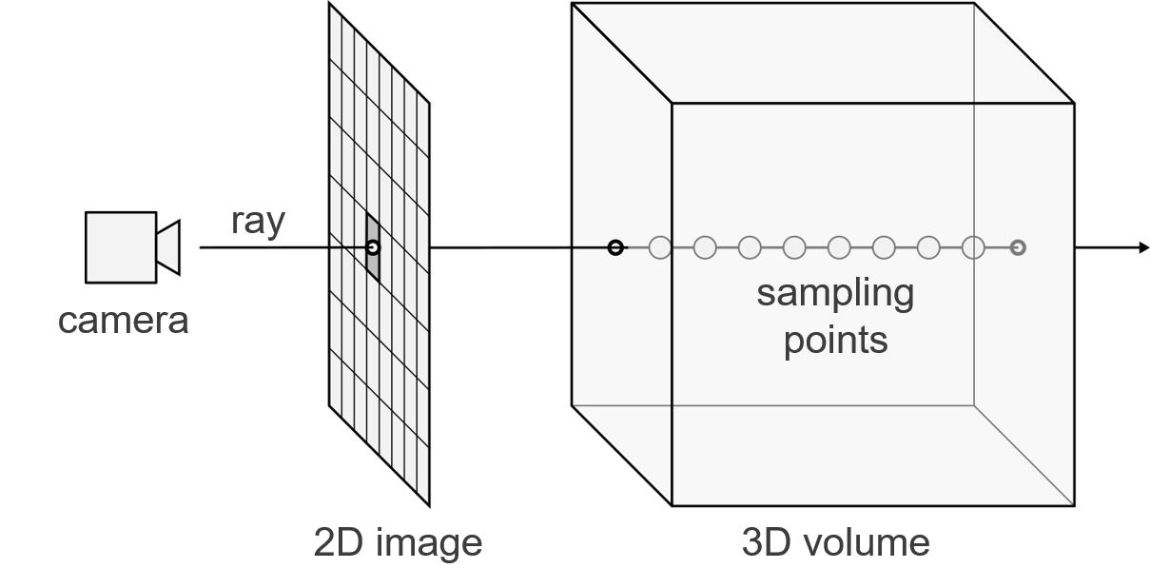
Visualization of Data, Understanding and Interpretation
Ray Casting
Sampling occurs at:
💡The final pixel does not necessarily correspond to one voxel.
Instead: Pixel = Accumulated Contribution Of Multiple Sample
DVR works by giving every voxel a colour + opacity and blending them into an image.

Slide 27
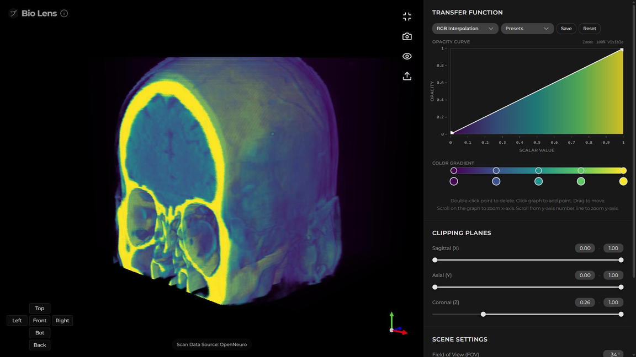
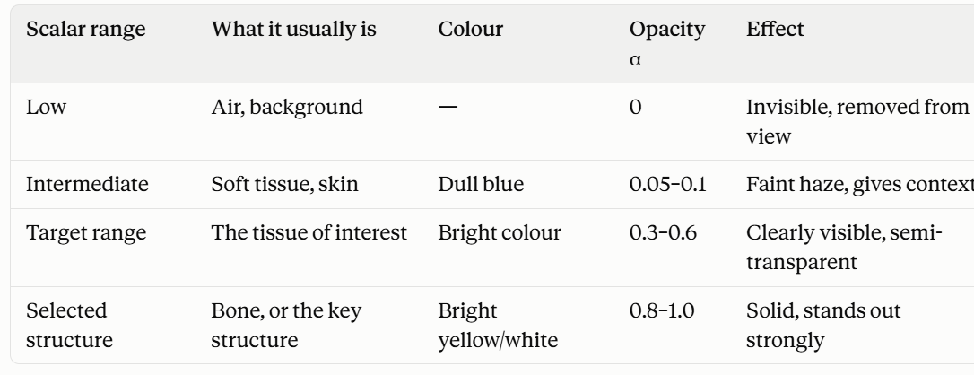
Visualization of Data, Understanding and Interpretation
Transfer Functions
A transfer function maps numerical values in volumetric data to visual properties such as color and opacity.
T(s) → (C, α) where:
  s → scalar value
  C → assigned colour
  α → assigned opacity
  from 0 (invisible) to 1 (solid)
Example
Suppose a CT volume contains several ranges of intensity:
Volume Data → Transfer Function → Volume Rendering → Image
Opacity curve (the graph): the horizontal axis is the scalar value (low → high) and the vertical axis is opacity. Here it’s a straight rising line, so the higher the value, the more solid the voxel.
explains how each voxel gets that colour and opacity. That’s the job of the transfer function, T(s) → (C, α).
Colour gradient (the bar below it): purple → blue → teal → green → yellow. Low values get purple, high values get yellow. The small circles are control points you can drag to change the colours.
Think of it as a lookup chart: “If the value is in this range, use this colour and this much solidity.

Slide 28
Visualization of Data, Understanding and Interpretation
Opacity And Color Mapping
A transfer function commonly controls two independent visual properties:
Opacity Mapping
Opacity mapping determines how transparent or opaque a voxel becomes based on its scalar value.
s → α where 0 ≤ α ≤ 1
  α = 0 → fully transparent
  α = 1 → fully opaque
Purpose
  Opacity determines visibility.
  Low opacity allows structures behind a region to remain visible.
Colour Mapping
Colour mapping assigns a color to a scalar value.
s → C
Purpose
  Color primarily communicates scalar differentiation.

Slide 29
Visualization of Data, Understanding and Interpretation
Opacity And Color Mapping
Combined Mapping
s → (C, α)
Therefore, a voxel's scalar value can determine both— what colour it has and how visible it is.
Design Consideration
Colour and opacity should have distinct analytical roles.
For example:
  Colour → differentiate tissue/material
  Opacity → reveal or suppress structures
This prevents a single visual channel from carrying too many unrelated meanings.

Slide 30

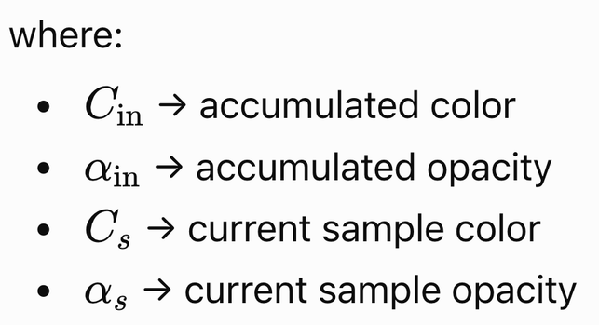

Visualization of Data, Understanding and Interpretation
Volume Compositing
Volume compositing combines the color and opacity contributions of multiple samples along a viewing ray to produce the final pixel color.
For front-to-back compositing: colour and opacity
and
Simple Interpretation
A highly opaque sample contributes strongly to the final pixel.
A transparent sample contributes little.
As opacity accumulates: α → 1, later samples contribute progressively less to the final image.
Why Compositing Matters
It allows direct volume rendering to represent:
  Semi-transparent structures
  Overlapping materials
  Internal structures
  Depth-dependent visibility
Compositing walks along the ray from front to back. Each sample adds (visibility left × its opacity) of its colour, so near, solid samples dominate, and once the ray is nearly opaque, everything behind is hidden.

Slide 31
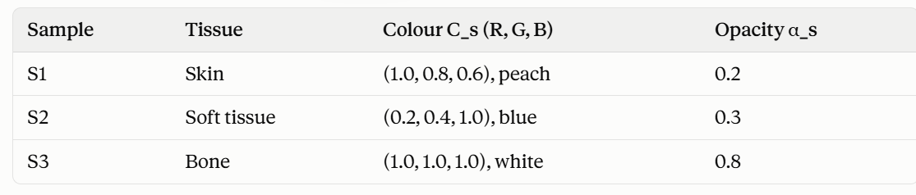
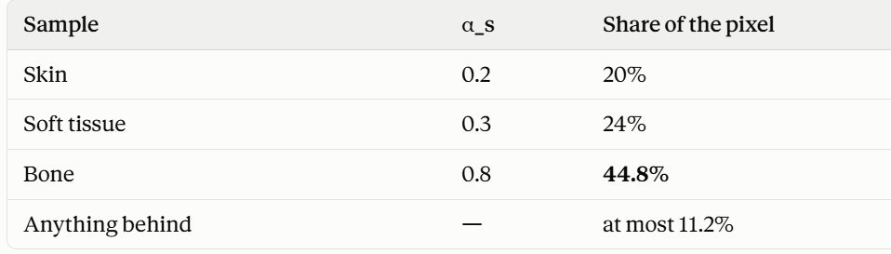
A ray passes through three samples, front to back. Colours are RGB on a 0–1 scale.
Start: C_in = (0, 0, 0), α_in = 0. Nothing has been seen yet.
Sample 1: skin
Share = (1 − 0) × 0.2 = 0.2
C_out = (0, 0, 0) + 0.2 × (1.0, 0.8, 0.6) = (0.20, 0.16, 0.12)
α_out = 0 + 0.2 = 0.20, so 80% visibility is left.
Sample 2: soft tissue
Share = (1 − 0.20) × 0.3 = 0.8 × 0.3 = 0.24
Added colour = 0.24 × (0.2, 0.4, 1.0) = (0.048, 0.096, 0.24)
C_out = (0.20, 0.16, 0.12) + (0.048, 0.096, 0.24) = (0.248, 0.256, 0.36)
α_out = 0.20 + 0.24 = 0.44, so 56% visibility is left.
Sample 3: bone
Share = (1 − 0.44) × 0.8 = 0.56 × 0.8 = 0.448
Added colour = 0.448 × (1, 1, 1) = (0.448, 0.448, 0.448)
C_out = (0.248, 0.256, 0.36) + (0.448, 0.448, 0.448) = (0.696, 0.704, 0.808)
α_out = 0.44 + 0.448 = 0.888, so only 11.2% visibility is left.
Final pixel: (0.70, 0.70, 0.81) × 255 ≈ RGB (177, 180, 206), a light bluish-white.
A highly opaque sample contributes strongly”: bone, with α = 0.8, takes the biggest share even though it is the farthest of the three.
“A transparent sample contributes little”: skin, with α = 0.2, adds only a light peach tint.
“As α → 1, later samples contribute less”: after bone, α = 0.888, so anything further back can add at most 11.2%. Once α gets close to 1 (say 0.99), the renderer stops the ray early. This is called early ray termination, and it saves computation.
Put the bone first instead:
Bone: share = 0.8
Skin: (1 − 0.8) × 0.2 = 0.04
Tissue: (1 − 0.84) × 0.3 = 0.048

Slide 32
Visualization of Data, Understanding and Interpretation
Volume Rendering Challenges
1. Occlusion
Structures closer to the viewer can obscure structures deeper inside the volume.
Front Structure → Hidden Internal Structure
2. Transfer-Function Selection
Different materials may have overlapping scalar-value ranges. Therefore, a scalar value does not lead to a unique structure. A simple transfer function may fail to separate important features.
3. Depth Perception
A 3D volume is ultimately displayed on a 2D screen.
Depth must therefore be inferred from cues such as:
  Occlusion
  Shading
  Perspective
  Motion
  Stereoscopic cues

Slide 33
Visualization of Data, Understanding and Interpretation
Volume Rendering Challenges
4. Computational Cost
Large volumes require:
  Many voxel accesses
  Many ray samples
  Transfer-function calculations
  Compositing operations
Therefore: Volume Resolution↑ ⇒ Rendering Workload↑
5. Visual Complexity
Showing too many structures simultaneously can make interpretation difficult.
The goal is therefore not to show everything but to reveal relevant structure
Overall Design Trade-off:
Detail ↔ Visibility ↔ Interpretability ↔ Computational Cost

Slide 34
Visualization of Data, Understanding and Interpretation
Medical Visualization And Imaging Data
Medical visualization represents anatomical structures, physiological measurements, and medical imaging data using visual techniques.
Major Imaging Sources
  CT: X-ray attenuation; strong for bone and density structures
  MRI: Magnetic-resonance signals; strong soft-tissue contrast
  Both produce volumetric data represented as 3D voxel grids
Visualization Techniques
  Orthogonal Slices: Axial, coronal, sagittal views
  MPR: Arbitrary cross-sectional planes
  Isosurfaces: Extract selected anatomical boundaries
  Volume Rendering: Display information throughout the volume
Key Challenge
Medical volumes are 3D, but occlusion, depth perception, and visual complexity can make internal structures difficult to interpret.

Slide 35
Visualization of Data, Understanding and Interpretation
Segmentation And Anatomical Visualization
Segmentation divides a medical volume into meaningful anatomical or pathological regions where each label represents a different structure.
Example
A CT/MRI volume can be segmented into:
  Bone
  Organs
  Blood vessels
  Tumor
  Surrounding tissue
Visualization After Segmentation
  Color overlays → highlight regions on slices(MPR)
  Surface extraction → create explicit 3D structures(marching cubes)
  Volume rendering → display multiple structures simultaneously(VDR)
  Hybrid views → combine slices, surfaces, and volume rendering
A transfer function decides colour from the value alone. But different structures often have very similar values:
Liver ≈ 55, kidney ≈ 40, spleen ≈ 50, and some tumours ≈ 40–60 (approximate CT values in HU)
In the table, the tumour (48) and the liver (55) are almost the same value.
With only a transfer function, they would get the same colour, and you couldn’t tell them apart. Likewise, no single threshold c can extract the tumour as an isosurface without pulling in the liver around it.
Segmentation solves this by using more than the value: location, shape, connectivity, texture, or a doctor’s or an AI model’s judgement. Once each voxel is labelled, you can colour the tumour red and the liver brown even though their values are almost identical.

Slide 36
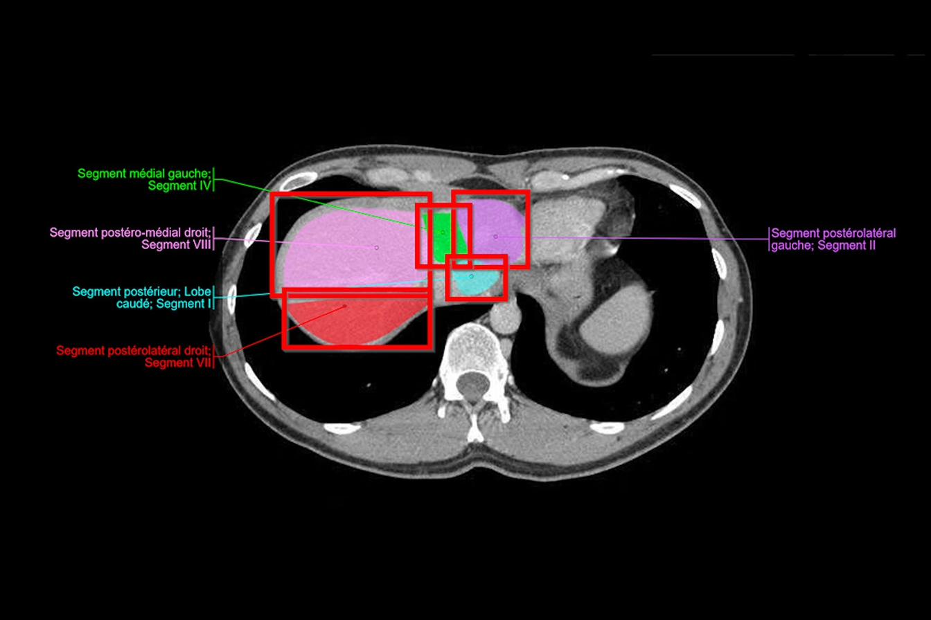
Visualization of Data, Understanding and Interpretation
Segmentation And Anatomical Visualization
How segmentation is done (brief)
Thresholding: “all voxels above 300 = bone.” This works for bone, but not for similar soft tissues.
Region growing: start from a seed point inside the organ and keep adding neighbouring voxels with similar values.
Manual or semi-automatic: a radiologist outlines the structure slice by slice.
Deep learning: models such as U-Net label every voxel automatically. This is now the most common approach.
Why It Matters
  Isolates structures from complex volumes
  Enables quantitative measurements
  Reveals spatial relationships
  Provides input for 3D reconstruction
Important Distinction:
Segmentation creates meaningful regions; visualization determines how those regions are presented.
Segmentation labels every voxel with the structure it belongs to (bone, organ, vessel, tumour), so you can show, colour, measure and render each structure separately, even when their raw values look the sa

Slide 37
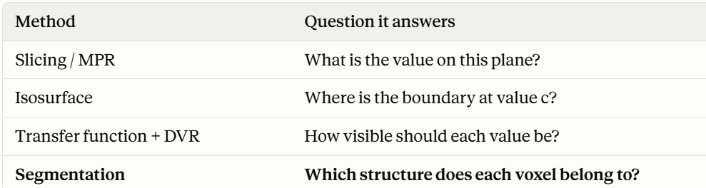

Slide 38
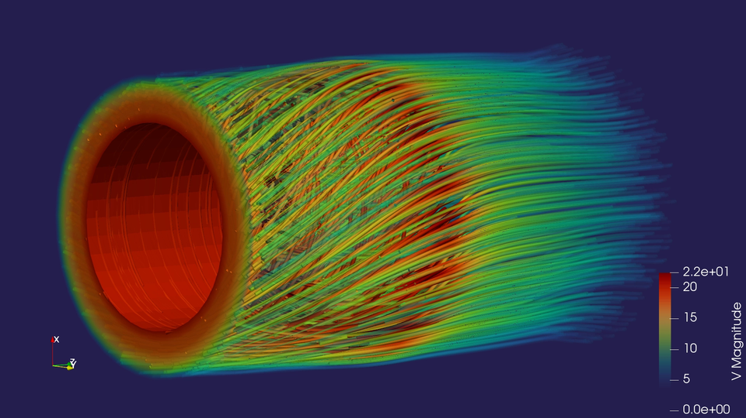
Visualization of Data, Understanding and Interpretation
Simulation Data Visualization
Simulation visualization represents computed or measured variables produced by scientific and engineering simulations.
Simulation Data
  Scalar fields → temperature, pressure, density
  Vector fields → velocity, wind direction
  Tensor fields → stress, strain, shear
  Data may vary across space, time, or both
Common Visualization Techniques
  Color Maps → scalar magnitude
  Contours / Isosurfaces → boundaries and levels
  Glyphs → vector magnitude and direction
  Streamlines → flow structure
  Volume Rendering → internal 3D distributions
  Animation → temporal evolution
Typical Pipeline: Simulation → Spatial Field → Derived Variables → Visual Encoding → Analysis

Slide 39
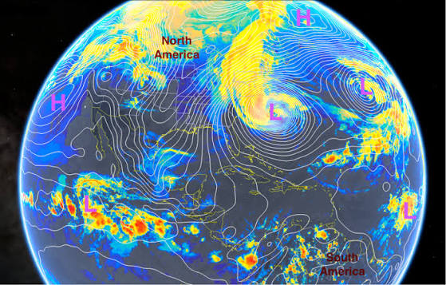
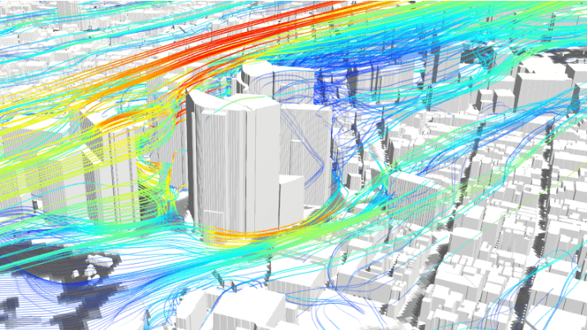
Visualization of Data, Understanding and Interpretation
Weather And Atmospheric Visualization
Data Characteristics
Weather simulations combine multiple spatial and temporal fields:
  Temperature
  Atmospheric pressure
  Wind speed
  Wind direction
  Humidity / precipitation
  Storm trajectories
Encodings
  Temperature: Color
  Pressure: Contours / Isolines
  Wind direction: Glyph Orientation
  Wind speed: Glyph Size / Density
  Flow: Streamlines / Animation
  Storm path: Trajectory

Slide 40
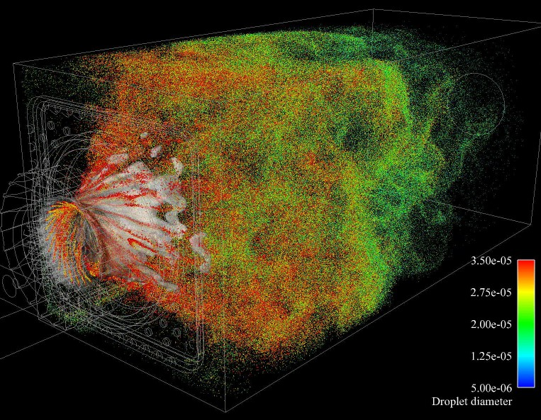
Visualization of Data, Understanding and Interpretation
Engineering And Scientific Simulation
Computational Fluid Dynamics (CFD)
CFD simulations model fluid behaviour using variables such as velocity, pressure, temperature, density, vorticity
  Velocity vectors → direction + magnitude
  Streamlines → flow paths
  Pressure contours → spatial pressure distribution
  Isosurfaces → regions at selected scalar values
  Particle/trajectory plots → movement through the flow
  Animation → evolving flow behaviour
Other Engineering Examples
  Aerodynamics: airflow around aircraft or vehicles
  Structural Simulation: stress and deformation
  Thermal Simulation: temperature distribution
  Combustion: temperature and chemical concentration
  Mechanical Systems: motion and force fields
Combustion Simulation

Slide 41
Visualization of Data, Understanding and Interpretation
MCQ
Q1. A CT volume contains multiple tissue types whose intensity ranges overlap significantly. Which visualization approach is most suitable when the goal is to reveal information throughout the volume rather than display only one tissue boundary?
A. Direct volume rendering
B. Single orthogonal slice
C. Binary isosurface extraction
D. Maximum-resolution sampling
Answer: A

Slide 42
Visualization of Data, Understanding and Interpretation
MCQ
Q2. In a medical visualization pipeline, segmentation produces a label volume where each voxel is assigned to an anatomical structure. What is the primary purpose of this intermediate representation?
A. Increase the spatial resolution of the scan
B. Separate meaningful structures for targeted visualization
C. Convert the volume directly into a perspective projection
D. Remove the need for any visualization mapping
Answer: B

Slide 43
Visualization of Data, Understanding and Interpretation
MCQ
Q3. A weather visualization maps temperature to color, pressure to contours, and wind direction to glyph orientation. What is the main advantage of this design?
A. It assigns different variables to distinct visual channels
B. It guarantees that all variables have equal perceptual accuracy
C. It converts all variables into equivalent scalar fields
D. It eliminates the need for temporal visualization
Answer: A

Slide 44
Visualization of Data, Understanding and Interpretation
MCQ
Q4. In a CFD simulation, an analyst wants to determine both the direction and spatial structure of fluid movement rather than simply locate regions of high pressure. Which visualization would be most appropriate?
A. Pressure histogram
B. Streamlines
C. Binary segmentation mask
D. Isosurface of pressure
Answer: B

Slide 45
Visualization of Data, Understanding and Interpretation
MCQ
Q5. A 3D medical visualization contains several transparent anatomical structures, but important internal regions become difficult to distinguish because multiple surfaces overlap along the viewing direction. Which issue is primarily responsible?
A. Sampling bias
B. Occlusion
C. Interpolation error
D. Quantization
Answer: B

Slide 46
Thank You

