Slide 1

Visualization of Data, Understanding and Interpretation
Unit 3 : Multimedia and Interactive Visualization
(UE24CS342AA9)
Visualization of Data, Understanding and Interpretation
Dr.Prajwala TR (Course Instructor)
Dept. of CSE, PES University, Bangalore

Slide 2
Visualization of Data, Understanding and Interpretation
Acknowledgement
The slides are prepared from various resources from the Universities from abroad and India. Also, some material is taken from reliable resources from internet throughout this course.

Slide 3
Visualization of Data, Understanding and Interpretation
Lecture Overview
In this lecture, we will cover:
  Foundations of multimedia visualization and characteristics of image, video, and audio data
  Image representation through pixels, resolution, intensity, contrast, histograms, color channels, and visual features
  Image collections, visual comparison, browsing, and rapid image search
  Video visualization through frames, frame rate, temporal sampling, keyframes, timelines, motion trajectories, and optical flow
  Audio visualization using spectrograms and time–frequency representations
  Multimedia integration, applications, design trade-offs, and visualization challenges
Wilke (TB1), Ware (TB3) Ware (TB3) Chapter/Section TB 1 Chapter 7 (Image Histograms), Chapter 27 (Bitmap and Vector Graphics) TB 3 Chapter 1-4, Chapter 6-9 (multimedia content is distributed across different sections) Other Sources: Librosa (Audio Visualization), OpenCV documentation (Optical Flow)

Slide 4
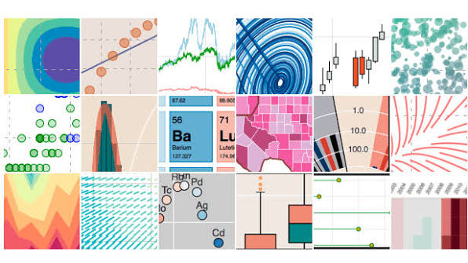
Visualization of Data, Understanding and Interpretation
Multimedia Visualization: Image, Video And Audio (TB 3, 3,4,6,8)
Multimedia Visualization
Visualizing information that exists across spatial, temporal, and sensory dimensions
  Images → spatial structure
  Video → spatial + temporal structure
  Audio → temporal + frequency structure
  Multimedia → coordinated representations across multiple modalities
Core Idea
Multimedia visualization is not simply “displaying media”; it is transforming perceptually rich media into representations that expose structure, patterns, events, and relationships.

Slide 5
Visualization of Data, Understanding and Interpretation
What Is Multimedia Visualization?
From Media To Visual Representation
A useful pipeline:
Raw Multimedia
Representation
Visual
Encoding
Perception
Interpretation
Raw data
  Pixel arrays
  Frame sequences
  Audio samples
Representation
  Intensity
  Color
  Motion
  Frequency
  Derived features
Visualization
  Images
  Timelines
  Histograms
  Trajectories
  Spectrograms
Perception
  Detect patterns
  Compare regions
  Identify objects
  Detect changes
Interpretation
  Events
  Trends
  Anomalies
  Relationships

Slide 6
Visualization of Data, Understanding and Interpretation
Why Visualize Multimedia Data?
A single photograph may contain:
  Thousands or millions of spatial samples
  Multiple color/intensity channels
  Local edges and textures
  Objects and spatial relationships
A video adds:
  Time
  Motion
  Temporal changes
  Events
Audio adds:
  Amplitude
  Frequency
  Temporal structure
  Spectral characteristics
Visualization reduces the problem.
Instead of inspecting every raw sample, visualization can expose:
Structure → Pattern → Change → Event → Meaning
Example:
A 30-minute surveillance video may contain millions of individual pixels across thousands of frames.
A visualization might reduce this to:
timeline + activity intensity + representative frames + motion trajectories
This is the central motivation for the rest of the unit.
💡Multimedia is high-dimensional

Slide 7
Visualization of Data, Understanding and Interpretation
Multimedia Data Characteristics
Modality | Primary Structure | Typical Variables
Image | Spatial | x, y, intensity, colour
Video | Spatial + Temporal | x, y, t, motion
Audio | Temporal + Spectral | t, amplitude, frequency
Multimedia | Cross-Modal | x, y, t, frequency, modality
Three Fundamental Dimensions:
Spatial
  Where is something?
  How is information distributed across an image?

Slide 8
Visualization of Data, Understanding and Interpretation
Multimedia Data Characteristics
Temporal
  When did something happen?
  How does information change?
Spectral
  Which frequencies are present?
  How is signal energy distributed across frequency?
The key challenge:
  Multimedia visualization must preserve the structure that is meaningful to the modality.
  A spatial image should not be reduced to a simple scalar summary; similarly, an audio signal cannot be adequately represented only by its overall amplitude.

Slide 9
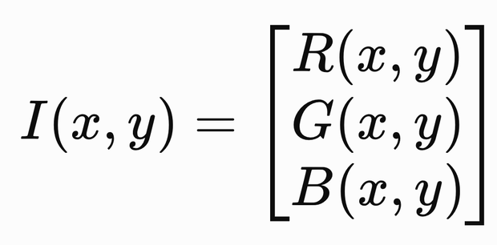
Visualization of Data, Understanding and Interpretation
Image As Data: From Pixels To Visual Representation
An Image Is A 2D Sampled Signal
Represent an image as: I(x,y)
where:
  x → horizontal spatial coordinate
  y → vertical spatial coordinate
  I → measured intensity/value
Visualization Questions
Instead of asking only:
“What does the image look like?”
Ask:
  Where are high/low intensity regions?
  Where does intensity change rapidly?
  Which colors dominate?
  Where are structures concentrated?
  Are there repeated patterns?
  Which regions are visually salient?
💡The image itself is already a visualization of underlying measurements. The task may therefore be to construct secondary visualizations of the image data.
For a colour image:

Slide 10
Visualization of Data, Understanding and Interpretation
Raster Images, Pixels And Image Resolution
Raster Representation
A raster image represents a rectangular spatial domain using a discrete grid:
where:
  W = image width in pixels
  H = image height in pixels
  W × H = total number of pixels
Spatial resolution
  Number of samples across the image
  eg: 1920 × 1080
Pixel density
  Pixels per physical distance
  eg: PPI
Display resolution
  Number of physical display pixels
Perceptual resolution
  How much spatial detail the observer can actually discriminate

Slide 11
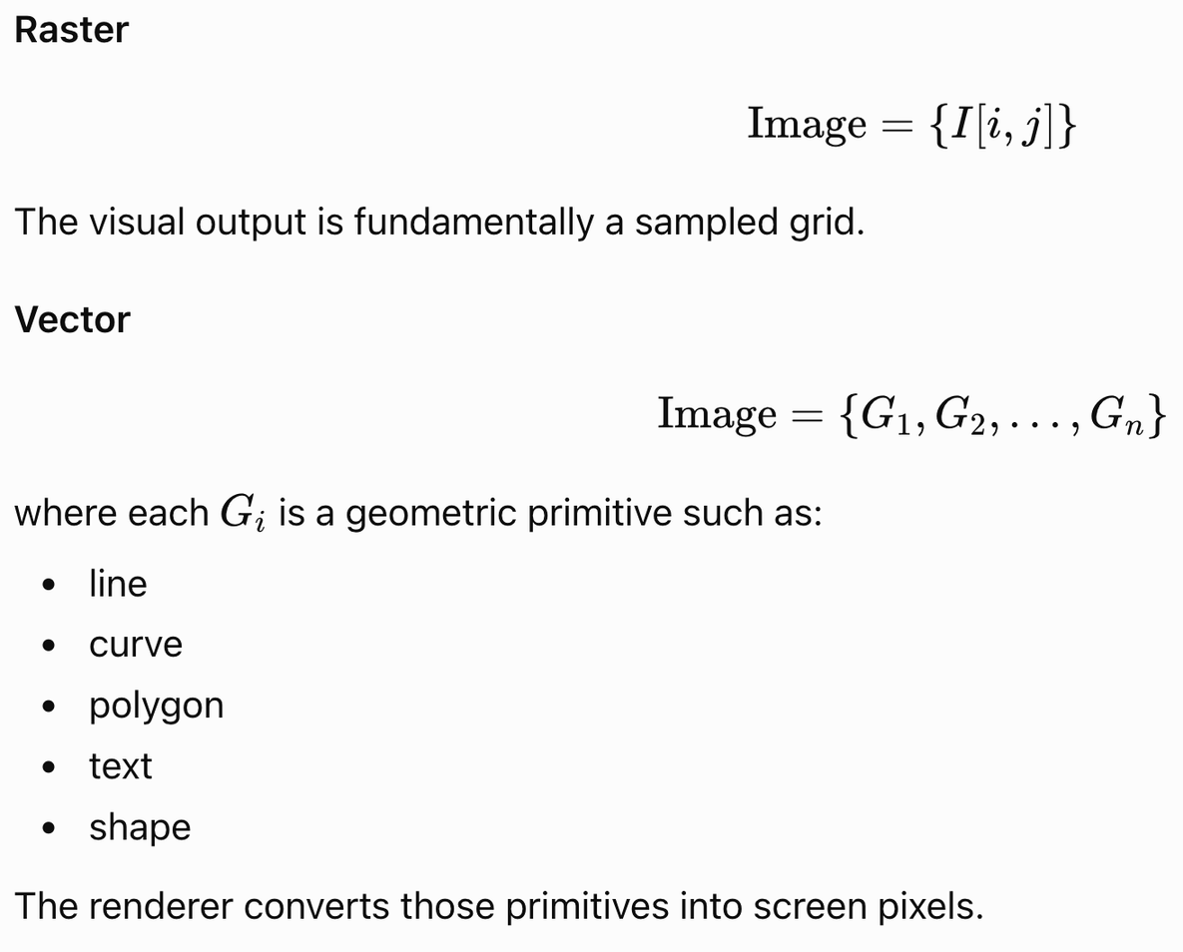
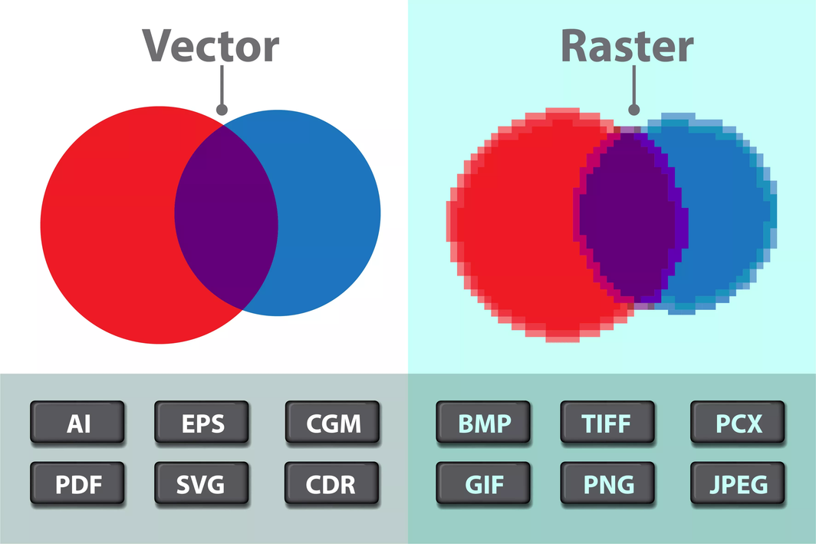
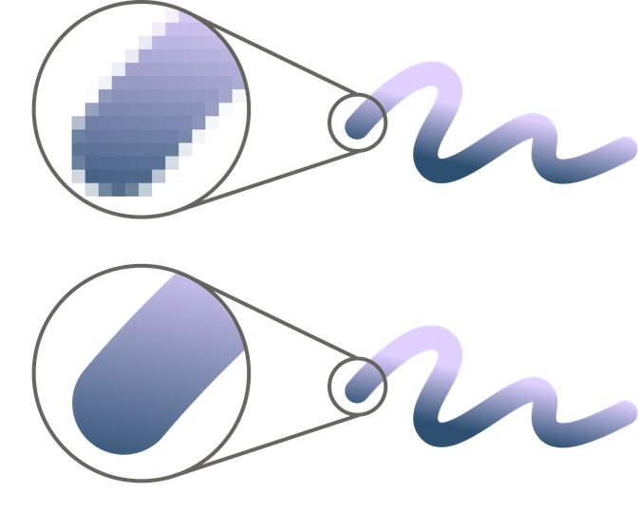
Visualization of Data, Understanding and Interpretation
Raster Versus Vector: Beyond The Basic Definition
Raster Examples: photographs, satellite images, medical images, camera images.
Why important:
Captures fine visual details, textures, colours and intensity.
Suitable when the information is naturally sampled over space.
Quality depends on resolution
Vector Examples: logos, maps, diagrams, icons, geometric drawings.
Why important:
Can be scaled up or down without inherently losing geometric precision.
Excellent for lines, boundaries, shapes and diagrams.
Often more compact when the graphic contains relatively few simple objects.

Slide 12
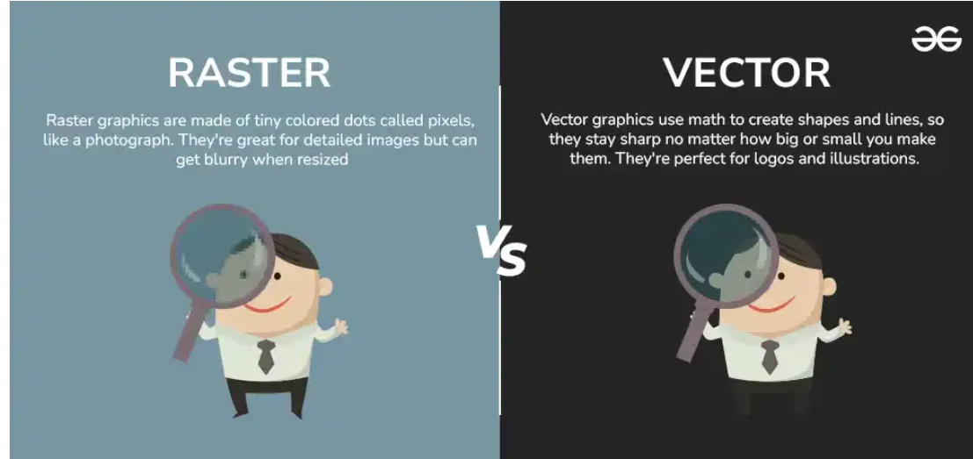
Visualization of Data, Understanding and Interpretation
Raster Versus Vector: Beyond The Basic Definition
1. Pixel:
In Computer graphics, a pixel, dot, or picture element is a physical point in a picture. A pixel is simply the smallest addressable element of a picture represented on a screen
2. Bitmap:
In computer graphics, a bitmap is a mapping from some domain (for example, a range of integers) to bits, that is, values which are zero or one. It is also called a bit array or bitmap index.
Conversions
Vector to Raster: Printers and display devices are raster devices. As a result, we need to convert vector images to raster format before they can be used i.e displayed or printed.
3.Raster Graphics
Raster images use bit maps to store information. This means a large file needs a large bitmap.
As an example, a 640 x 480 image requires information to be stored for 307,200 pixels
Eg: selfie in raster image
Vector Graphics
Making use of sequential commands or mathematical statements or programs which place lines or shapes in a 2-D or 3-D environment is referred to as Vector Graphics.
2. Raster to Vector: Image tracing in computing can be referred to as vectorization and it's simply the conversion of raster images to vector images. An interesting application of vectorization is to update images and recover work.

Slide 13
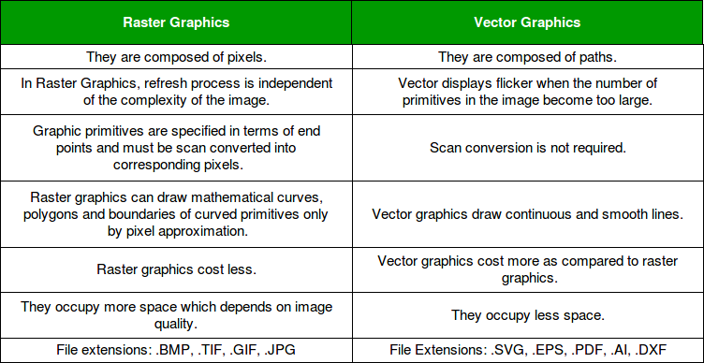
Visualization of Data, Understanding and Interpretation
Raster Versus Vector: Beyond The Basic Definition
Raster tells us "what is present at each pixel," while vector tells us "what shapes/objects exist and where they are."
Source: https://www.geeksforgeeks.org/computer-graphics/vector-vs-raster-graphics/

Slide 14
Visualization of Data, Understanding and Interpretation
Suppose the original image is:
4 × 4 pixels
and you enlarge it to:
8 × 8 pixels
The computer now needs 64 pixels, but the original image only had 16 pixels.
So it has to estimate the values of the new pixels from nearby existing pixels. This process is called interpolation.
Raster Versus Vector: Beyond The Basic Definition
Why This Matters For Visualization
When scaling a raster image: new pixels ← interpolation
Information that was never sampled cannot simply be recovered.
For vector graphics: geometry → new rasterization
Therefore, scaling does not inherently reduce geometric precision.
But there is a trade-off:
  Vector complexity can become expensive when the number of graphical primitives becomes enormous.
  Complex vector graphics can become very large and slow to render, while simple vector graphics can be more compact than equivalent bitmaps.
Takeaway: Resolution independence is a property of the representation—not a guarantee of unlimited visual detail.
For example, it may store:
Draw a circle with centre (100,100) and radius 50.
If you enlarge it, the computer doesn't have to invent new geometric information.
It simply uses the same mathematical description and renders it at the new size.
So:
Vector → resize geometry → rasterize again → display
Raster has a fixed set of sampled pixels. When enlarged, it has to estimate missing pixels. Vector stores geometry, so it can recreate the geometry at a new size. But vector is not infinitely efficient—very complex vector drawings can also become large and slow.

Slide 15

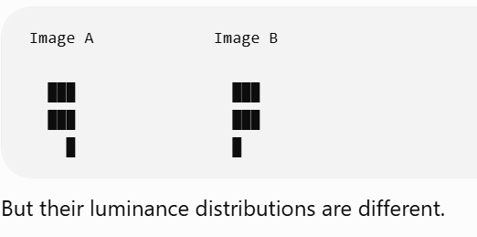
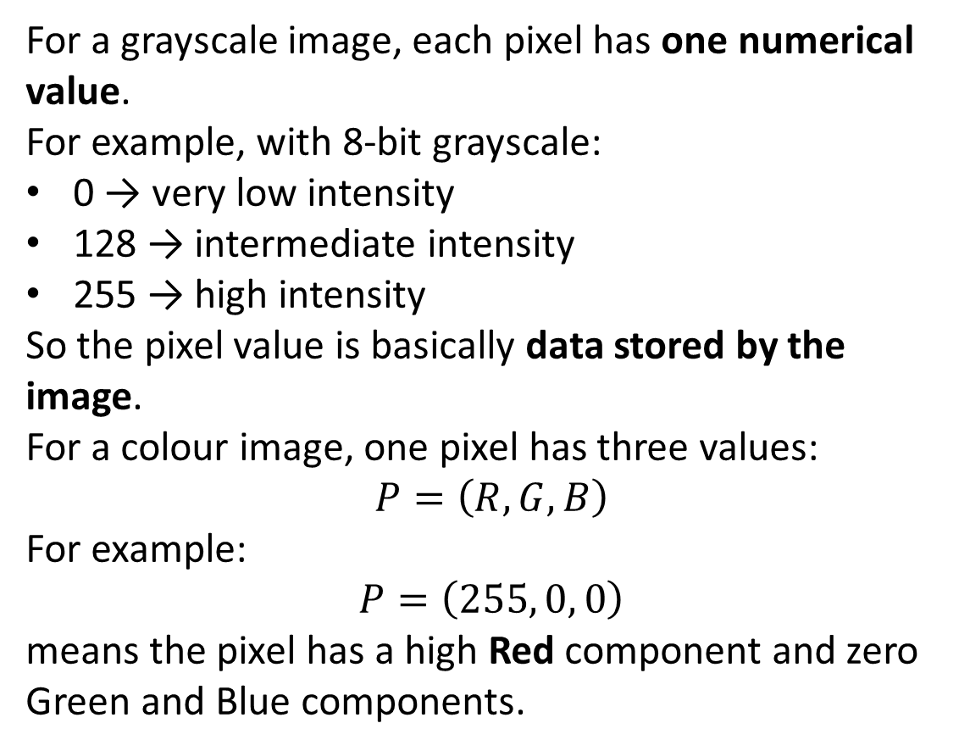
Visualization of Data, Understanding and Interpretation
Pixel Values And Image Intensity
Pixel Value ≠ Brightness
For a grayscale image, each pixel has one numerical value.
For example, with 8-bit grayscale:
0 → very low intensity
128 → intermediate intensity
255 → high intensity
So the pixel value is basically data stored by the image.
For a colour image, one pixel has three values:
$$P=\left(R , G , B\right)$$
For example:
$$P=\left(255 , 0 , 0\right)$$
means the pixel has a high Red component and zero Green and Blue components.
For a grayscale image:
The pixel value represents an encoded measurement/intensity.
For RGB: P = (R, G, B)
Each pixel contains multiple channel values.
From Pixels To Intensity
A color image can be represented through:
  Red channel
  Green channel
  Blue channel
  Luminance/intensity representation
Conceptually: RGB → luminance
💡Two images can have identical spatial structure but very different perceptual readability if their luminance distributions differ.
The pixel value is what the computer stores. Brightness is what our eyes perceive. RGB tells us the colour components, while luminance gives us information related to the light level that strongly affects visual readability.

Slide 16
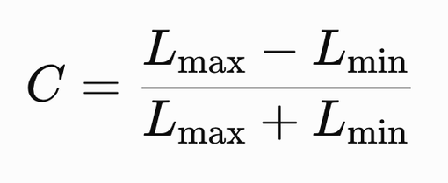
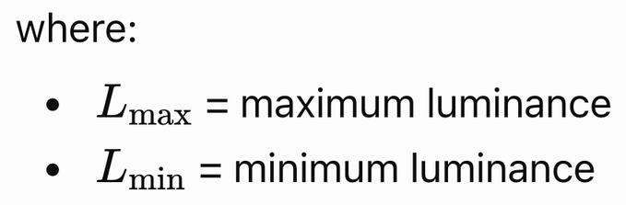
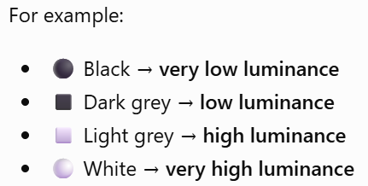
Visualization of Data, Understanding and Interpretation
Intensity, Brightness And Contrast
Intensity: A numerical property of the image signal.
Luminance: Physically/perceptually meaningful light level associated with the display.
Brightness: Perceived amount of light from a self-luminous source.
Lightness: Perceived surface property relative to its visual context.
Ware emphasizes that early visual processing responds strongly to differences, rather than simply measuring absolute light levels.
Pixel value = number stored by the computer
Luminance = light level represented by the image
Brightness = how bright we perceive it.
Contrast
A simple luminance contrast measure can be expressed as:
Contrast controls:
  Edge visibility
  Feature discrimination
  Texture perception
  Object boundaries
  Fine-detail readability
Notes:
Luminance tells us how light or dark something is, considering the colour information

Slide 17

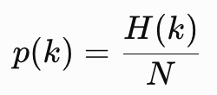
Visualization of Data, Understanding and Interpretation
Image Histograms
X-axis → Pixel intensity (brightness)
Y-axis → Number of pixels (frequency)
An image histogram is a a graph that plots the frequency of pixel intensity values in an digital image.
For an image with N pixels:
For normalized frequency:
A grayscale digital image is a grid of pixels. Each pixel has an intensity value, usually from 0 (black) to 255 (white) in an 8-bit image. An image histogram counts how many pixels have each intensity value. The x-axis is intensity and the y-axis is how often that intensity appears.
where k represents an intensity level/bin
p(k) a probability distribution: the chance that a randomly picked pixel has intensity k.
N is the total number of pixels (width × height).
  Histogram concentrated on left → predominantly dark image
  Histogram concentrated on right → predominantly bright image
  Wide distribution → broad dynamic range
  Narrow distribution → low contrast
  Two strong peaks → potentially two dominant intensity populations
  A histogram removes spatial information.
  Two completely different images can have exactly the same intensity histogram.
  Therefore: histogram = distribution of pixel values, not spatial structure.
  This is a critical distinction from ordinary statistical visualization: here, the observations are pixels generated by a spatial signal.
Normalizing lets you compare images of different sizes. A 100×100 image and a 1000×1000 image can't be compared on raw counts, but they can on p(k).
Notes:
I(x, y) is the intensity of the pixel at position (x, y).
The # symbol means "number of".
In words: H(k) is the number of pixel positions whose intensity equals k.

Slide 18
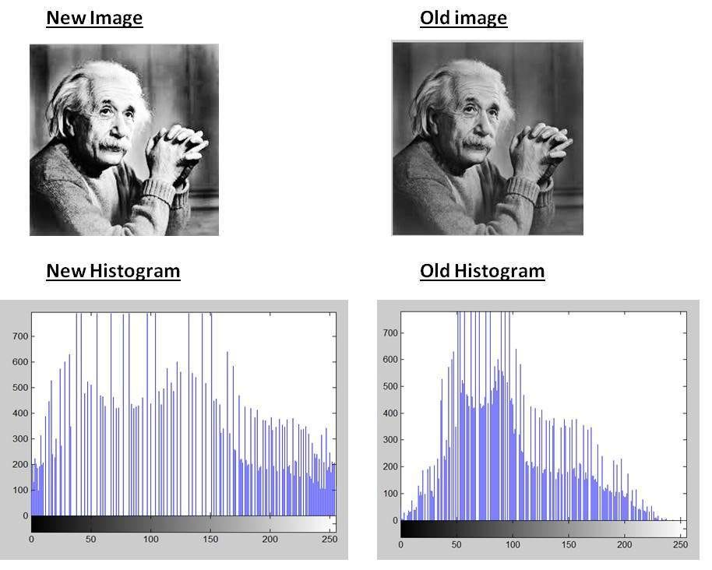
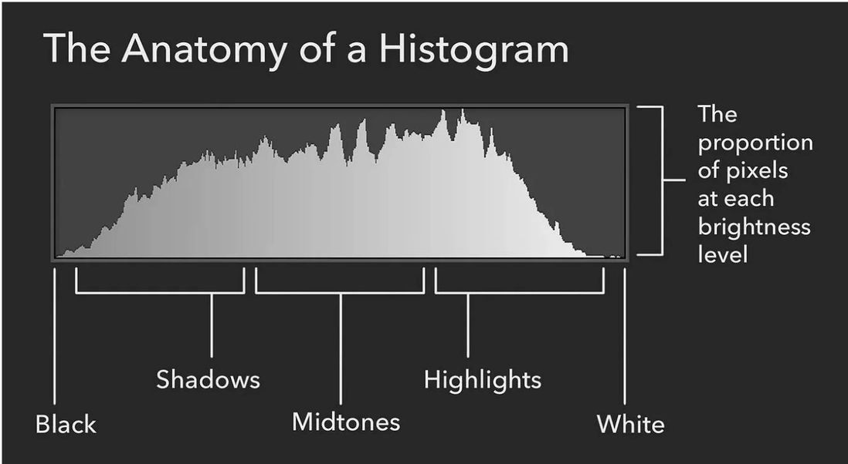
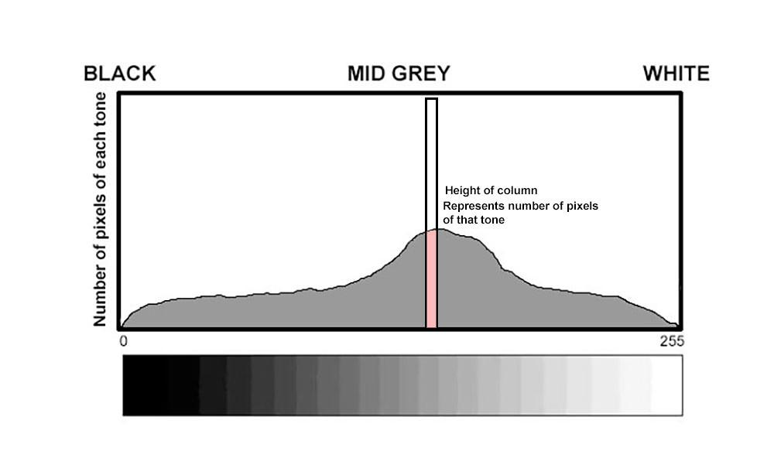
Visualization of Data, Understanding and Interpretation
Image Histograms

Slide 19
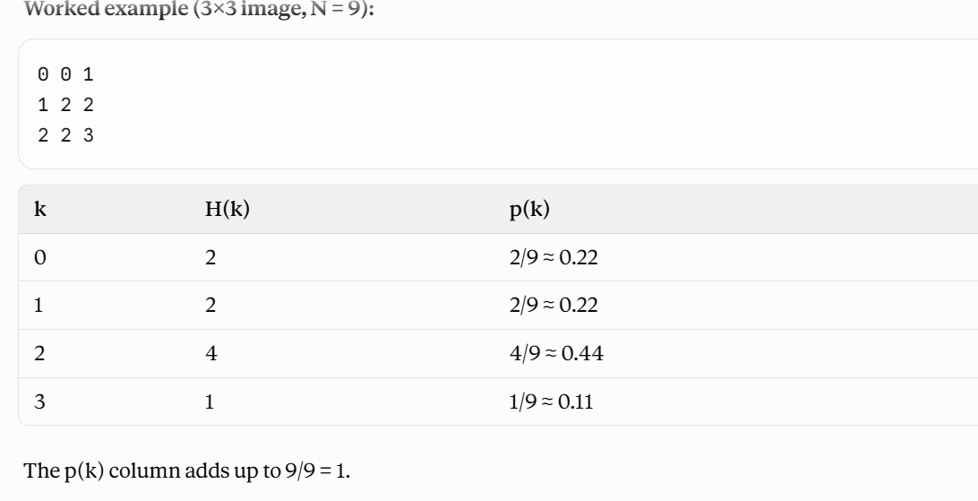
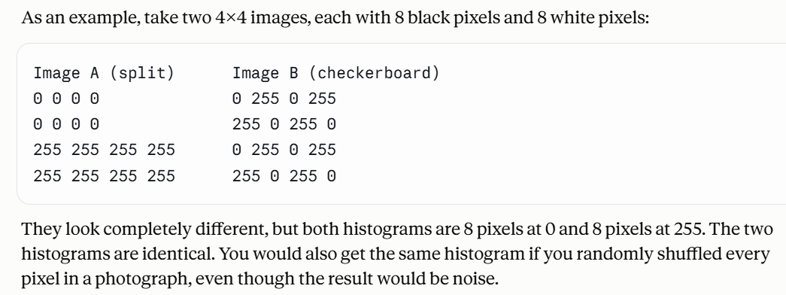

Slide 20
Visualization of Data, Understanding and Interpretation
Image Histograms
Same Histogram ≠ Same Image
Consider: Image A (bright object on dark background), Image B (dark object on bright background)
They may produce similar distributions despite radically different spatial arrangements.
What The Histogram Can Reveal
Histogram Pattern | Possible Interpretation
Narrow peak | Low intensity variation
Broad spread | Higher dynamic range
Left-skewed | Darker image
Right-skewed | Brighter image
Multiple peaks | Distinct intensity populations
Values touching limits | Possible clipping

Slide 21

Visualization of Data, Understanding and Interpretation
Color Channels And Multichannel Images
A color image can be decomposed into:
  Red channel R(x,y)
  Green channel G(x,y)
  Blue channel B(x,y)
Each channel is itself a grayscale spatial image.
Why Decompose Channels?
Channel visualization can reveal:
  Dominant color contributions
  Spatial regions emphasized by one channel
  Saturation-related structure
  Channel-specific artifacts
  Differences hidden in the composite RGB image

Slide 22
Visualization of Data, Understanding and Interpretation
Color Channels And Multichannel Images
Perceptual Consideration
RGB is convenient for display hardware, but RGB components are not perceptually equivalent dimensions.
Ware distinguishes the luminance channel from chromatic channels and notes that chromatic channels have substantially poorer spatial resolution than luminance.
Therefore:
For fine spatial detail → rely strongly on luminance/contrast
For categorical or attribute coding → color can be powerful
Ware explicitly describes color as particularly useful for coding information and attributes of visual objects.
Luminance channel — Brightness
Luminance tells us how bright or dark a pixel is.
Information | What it tells us
Luminance | Is the apple bright or dark?
Chrominance | The apple is red
Chrominance / Chromatic channels — Color
These tell us what color the pixel is, rather than how bright it is.

Slide 23
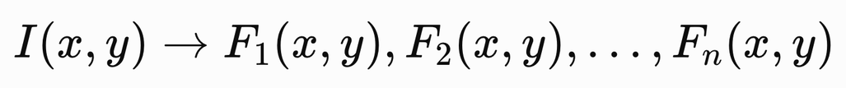
Visualization of Data, Understanding and Interpretation
Image-Based Feature Visualization
Raw Image → Derived Visual Features
Instead of visualizing only I(x,y), construct derived representations:
Examples:
  Intensity
  Color channels
  Local contrast
  Edges
  Texture
  Orientation
  Salient regions
  Object-related regions

Slide 24
Visualization of Data, Understanding and Interpretation
Image-Based Feature Visualization
Feature Visualization
Each feature can become a separate visual layer:
Original image
A raw image contains enormous amounts of information. Feature visualization allows us to ask targeted questions:
  Where is the structure?
  Where are the strongest changes?
  Which regions are visually distinctive?
  Which image regions correspond to a particular attribute?
Ware's discussion of image-based object recognition emphasizes that visual recognition can exploit 2D image information and that people can recognize pictorial images extremely rapidly.
Intensity map
Contrast/Edge Representation
Colour-Channel Representation
Feature Overlay

Slide 25
Visualization of Data, Understanding and Interpretation
  Satellite images of a lake shrinking over 20 years
  Medical scans showing a tumour's progress
  CCTV frames showing when someone entered a room
  Seasonal patterns that repeat each year
Recurring patterns become visible as repeating visual rhythms along the axis.
Image Collections, Image Search And Rapid Presentation
Visualizing Image Collections
  Thumbnail grids allow many images to be displayed simultaneously, making it easier to compare images and identify recurring visual patterns.
  Contact sheets provide a structured overview of a large collection while retaining enough visual detail for rapid inspection.
  Image timelines organize images according to their temporal order, allowing changes and recurring patterns to be identified over time.
Rapid Image Presentation
  Rapid Serial Visual Presentation (RSVP) displays images sequentially at high speed and can support rapid detection of visually meaningful targets.
  Ware discusses experiments in which people were able to recognize or detect objects in rapidly presented images at rates approaching 10 images per second.
  When two targets are presented too close together in time, an attentional blink can reduce the observer's ability to detect the second target.

Slide 26
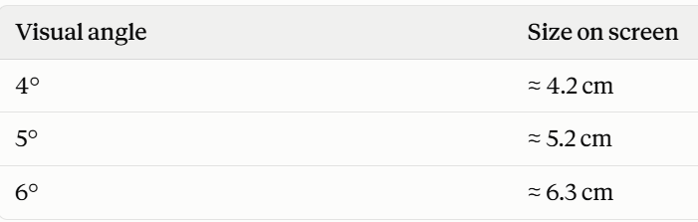
Visualization of Data, Understanding and Interpretation
Image Collections, Image Search And Rapid Presentation
Image Size And Recognition
  The appropriate display size depends on the visual complexity of the object being presented.
  Ware reports that complex objects and patterns are identified most effectively at approximately 4-6° of visual angle, whereas simpler objects can be detected at smaller visual angles.
Visualization Design Implication
  Displaying more images simultaneously increases overview but reduces the amount of detail available for each image.
  An effective image-collection visualization should therefore support a progression from browsing and detection to selection and detailed inspection.
size ≈ 2 × distance × tan(angle / 2)
Browse → Detect → Select → Inspect in detail
(grid / (spot (click / (full-size view,
RSVP) targets) mark) zoom, metadata)
Overview first, zoom and filter, then details on demand."

Slide 27
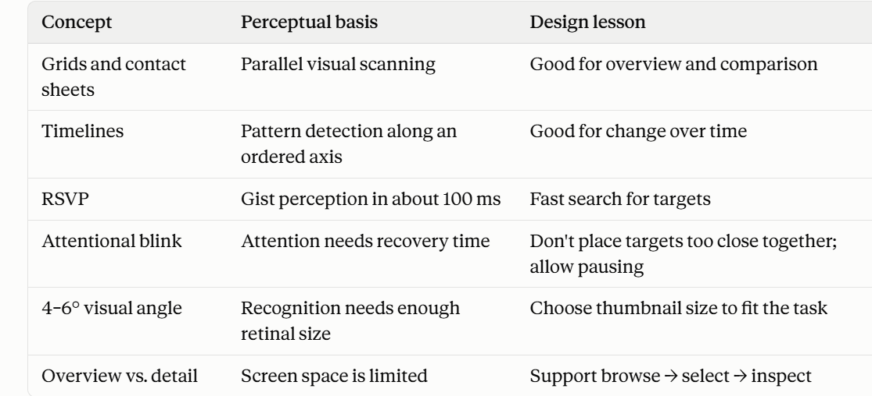

Slide 28
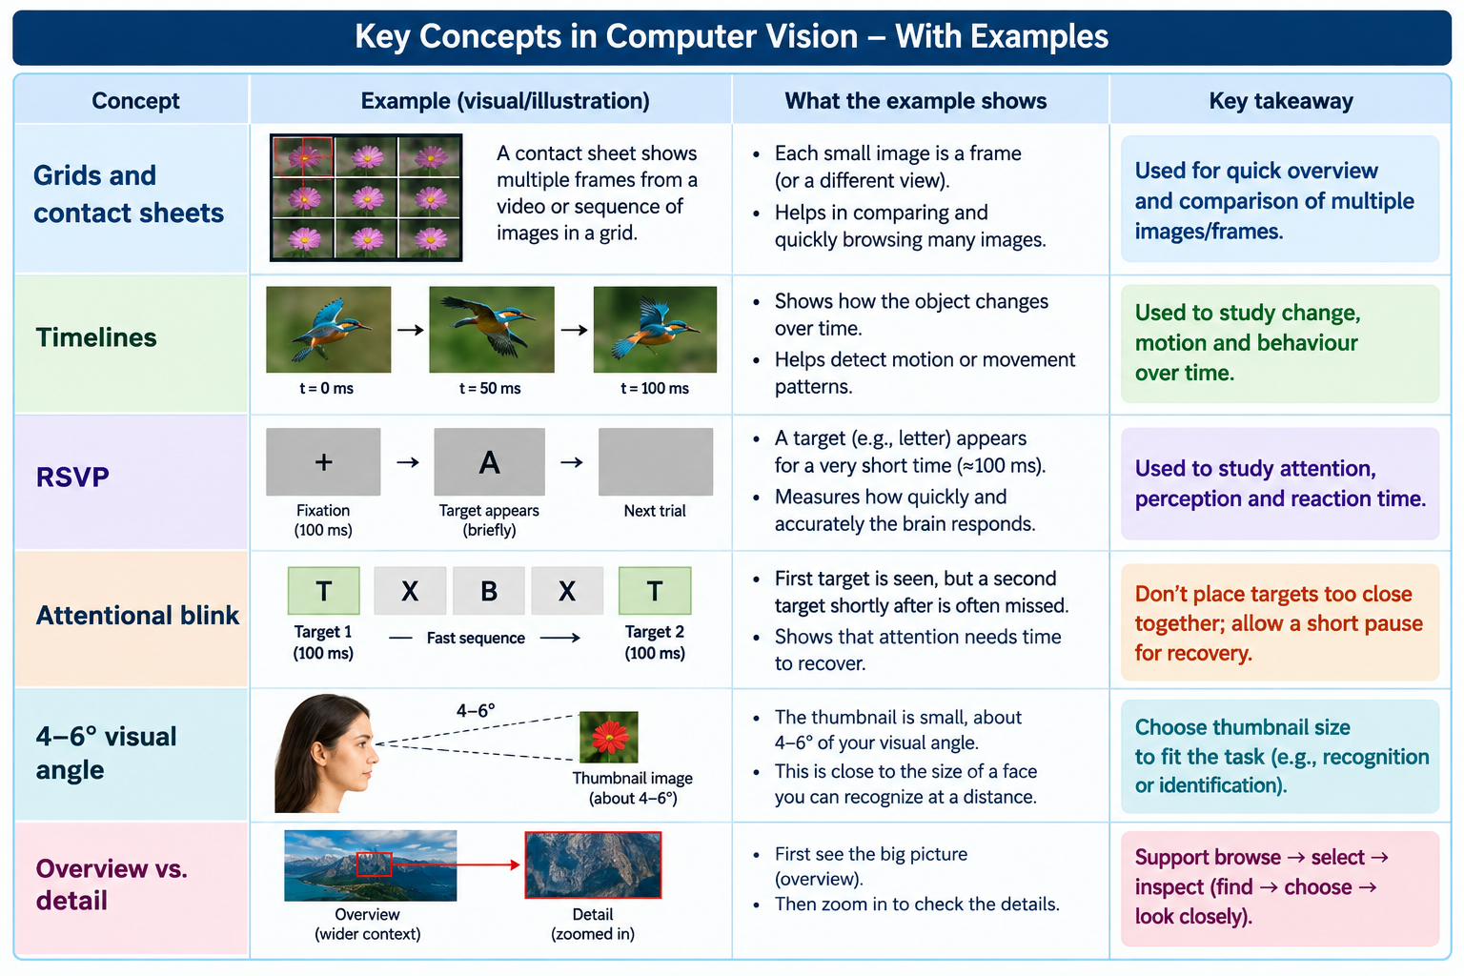

Slide 29
Visualization of Data, Understanding and Interpretation
Image Visualization: Numericals
1) Number Of Pixels In An Image
Q1: An image has a resolution of 1920 × 1080. How many pixels does it contain?
A1: N = W × H = 1920 × 1080 = 20,73,600 pixels
Q2: If the image uses 8 bits per pixel:
20,73,600 × 8 = 1,65,88,800 bits, how much data is represented?
A2: = 20,73,600 bytes ≈ 1.98 MB
Extra Questions:
Q1: A grayscale image has a resolution of 1000 × 800 pixels. Each pixel uses 8 bits. How much uncompressed storage is required?
Q2: An RGB image has a resolution of 640 × 480 pixels. Each pixel uses 24 bits. How much uncompressed storage is required?
Notes:
2,073,600 bytes ÷ 1024 = 2025 KB ÷ 1024 ≈ 1.98 MB

Slide 30
Visualization of Data, Understanding and Interpretation
Image Visualization: Numericals
Answers:
A1: N = W × H = 1000 × 800 = 8,00,000 pixels
Data = 8,00,000 × 8 = 64,00,000 bits
= 8,00,000 bytes ≈ 0.76 MB
A2: N = W × H = 640 × 480 = 3,07,200 pixels
Data = 3,07,200 × 24 = 73,72,800 bits
= 9,21,600 bytes ≈ 0.88 MB

Slide 31
Visualization of Data, Understanding and Interpretation
Image Visualization: Numericals
2) Uncompressed Image Storage
Q1: A 1920 × 1080 RGB image uses 8 bits per channel. What is its uncompressed size?
A: For an RGB image: Storage = W × H × C × B
where:
  W, H = dimensions
  C = number of channels
  B = bytes per channel
1920 × 1080 × 3 × 1 = 62,20,800 bytes ≈ 5.93 MB
Extra Questions:
Q1: A 1280 × 720 RGB image uses 8 bits per channel. What is its uncompressed size?
Q2: A 1024 × 768 grayscale image uses 8 bits per channel. What is its uncompressed size?

Slide 32
Visualization of Data, Understanding and Interpretation
Image Visualization: Numericals
Answers:
A1: 1280 × 720 × 3 × 1 = 27,64,800 bytes ≈ 2.64 MB
A2: 1024 × 768 × 1 × 1 = 7,86,432 bytes ≈ 0.75 MB

Slide 33
Visualization of Data, Understanding and Interpretation
Image Visualization: Numericals
3) Resolution Reduction / Downsampling
Q1: An image is reduced from 4000 × 3000 to 1000 × 750. What percentage of the original pixels remain?
A1: Original: 4000 × 3000 = 1,20,00,000
New: 1000 × 750 = 7,50,000
Percentage remaining: (7,50,000/1,20,00,000) × 100 = 6.25%
So 93.75% of the pixels have been removed.
Extra Questions:
Q1: An image is reduced from 2000 × 1500 to 1000 × 750. What percentage of the original pixels remain?
Q2: An image is reduced from 1600 × 1200 to 800 × 600. What percentage of the original pixels remain?

Slide 34
Visualization of Data, Understanding and Interpretation
Image Visualization: Numericals
Answers:
A1: Original: 2000 × 1500 = 30,00,000
New: 1000 × 750 = 7,50,000
Percentage remaining: (7,50,000/30,00,000) × 100 = 25%
So 25% of the pixels remain, meaning 75% have been removed.
A2: Original: 1600 × 1200 = 19,20,000
New: 800 × 600 = 4,80,000
Percentage remaining: (480,000/19,20,000) × 100 = 25%
So 25% of the pixels remain, meaning 75% have been removed.

Slide 35
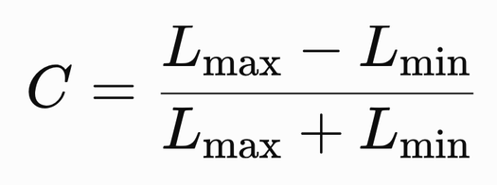
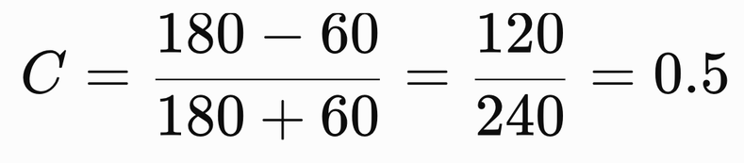
Visualization of Data, Understanding and Interpretation
Image Visualization: Numericals
4) Contrast Calculation
Q1: Suppose: Lmax ​= 180, Lmin​ = 60. What is the contrast?
A1:
Extra Questions:
Q1: Suppose: Lmax⁡ = 200, Lmin ⁡= 100. What is the contrast?
Q2: Suppose: Lmax⁡ = 150, Lmin⁡ = 50. What is the contrast?

Slide 36
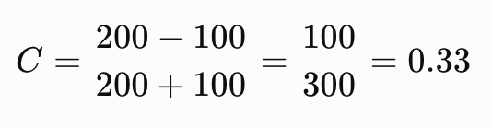
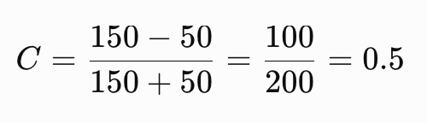
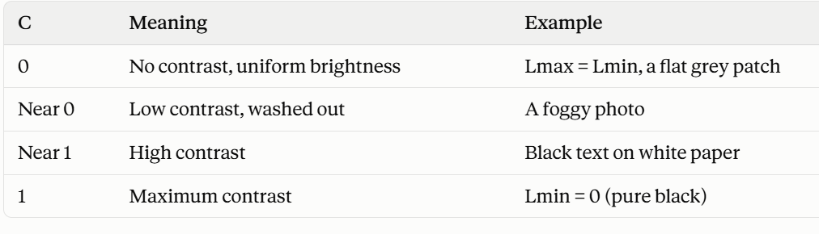
Visualization of Data, Understanding and Interpretation
Image Visualization: Numericals
Answers:
A1:
A2:

Slide 37
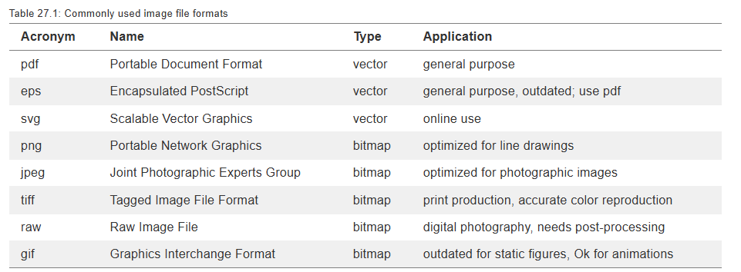
Visualization of Data, Understanding and Interpretation
Image Formats
It is therefore a good rule of thumb to always store the original image in the format that maintains maximum resolution, accuracy, and flexibility. Thus, for data visualizations, either create your figure as pdf and then convert into png or jpg when necessary, or alternatively store as high-resolution png. Similarly, for images that are only available as bitmaps, such as digital photographs, store them in a format that doesn’t use lossy compression, or if that can’t be done, compress as little as possible. Also, store the image in as high a resolution as possible, and downscale when needed.
It is generally possible to convert any image format into any other image format.

Slide 38
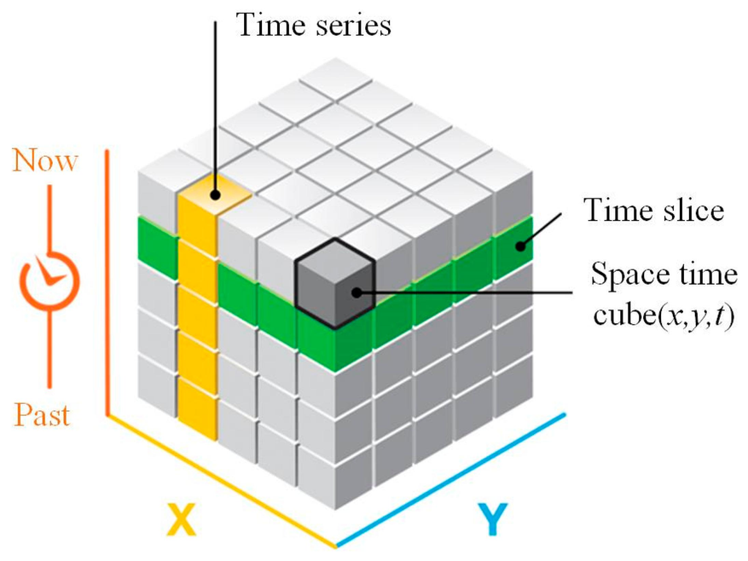
Visualization of Data, Understanding and Interpretation
Video Visualization: Video As A Sequence Of Images
Video Representation
  A digital video can be represented as an ordered sequence of two-dimensional image frames.
  Each frame contains spatial information, while the ordering of frames introduces a temporal dimension.
  A video can therefore be represented as a three-dimensional data structure: V(x,y,t), where x and y represent spatial position and t represents time.
  For a color video, each spatial position may additionally contain multiple color channels such as red, green, and blue.
  Video visualization therefore involves both spatial interpretation within individual frames and temporal interpretation across frames.
Image visualization asks:
What is present at a particular point in space?
Video visualization additionally asks:
How does that information change over time?

Slide 39
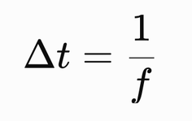
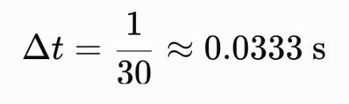
Visualization of Data, Understanding and Interpretation
Frames, Frame Rate And Temporal Sampling
Video Frames
  A frame is one discrete image sampled from a continuously changing visual scene.
  The frame rate specifies how many frames are captured or displayed during one second and is measured in frames per second (fps).
  Higher frame rates provide more temporal samples of motion, while lower frame rates provide fewer samples and can make rapid changes harder to represent accurately.
Temporal Sampling
If the frame rate is f:
where Δt is the time between consecutive frames
For a 30fps video:
Therefore, consecutive frames are separated by approximately 33.3 ms.
💡Frame rate determines the temporal resolution at which changes can be observed. A visualization of slow processes may not require a high frame rate, while rapid events require finer temporal sampling.

Slide 40
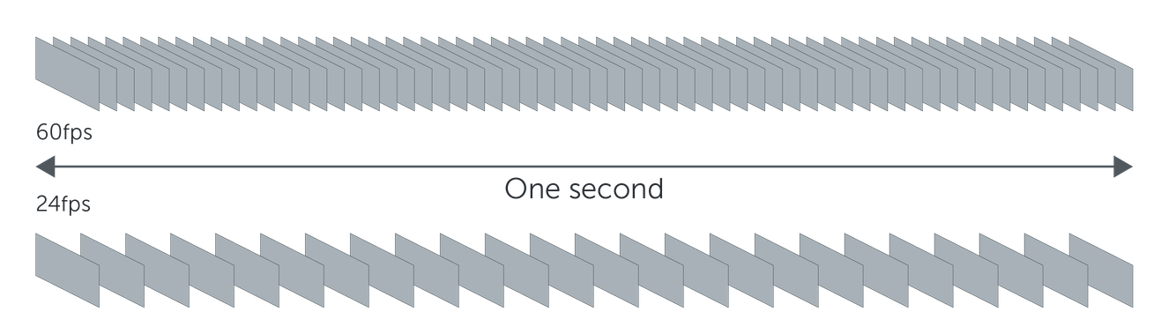
Visualization of Data, Understanding and Interpretation
Number Of Frames In A Video: Numerical
Calculating Temporal Data Volume
The number of frames in a video is: N = f × T
where:
  N = total number of frames
  f = frame rate
  T = duration in seconds
Example: A video is recorded for 2 minutes at 30 fps.
First convert the duration: 2 × 60 = 120 s
Then: N = 30 × 120 = 3600 frames​
If the same video were recorded at 60 fps:
60 × 120 = 7200 frames
The temporal sampling density has doubled.
A two-minute video may appear short to a viewer, but it already contains 3,600 individual spatial observations.
This illustrates why video visualization often requires:
  Frame sampling
  Representative frames
  Timelines
  Event detection
  Temporal aggregation

Slide 41
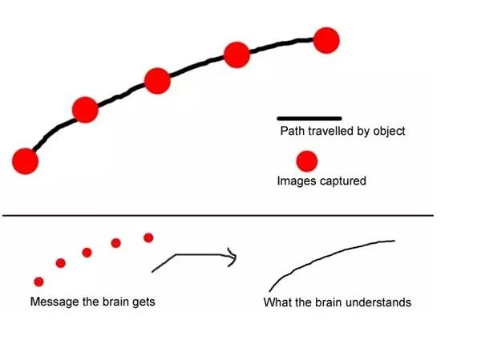
Visualization of Data, Understanding and Interpretation
From Frames To Continuous Motion
Perceived Motion
  A video does not contain continuous motion; it contains discrete spatial samples presented in temporal sequence.
  The visual system interprets sufficiently consistent changes between successive frames as motion.
  Motion perception therefore depends on both the temporal spacing of frames and the spatial displacement of objects between frames.
Correspondence Between Frames
  When an object appears in two consecutive frames, the visual system must determine that the two appearances correspond to the same moving object.
  Ware describes this as the correspondence problem.
  If identical graphical elements move too far between frames, the observer may associate an element with the wrong element in the next frame, producing ambiguous or reversed motion.

Slide 42
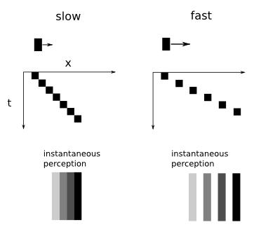
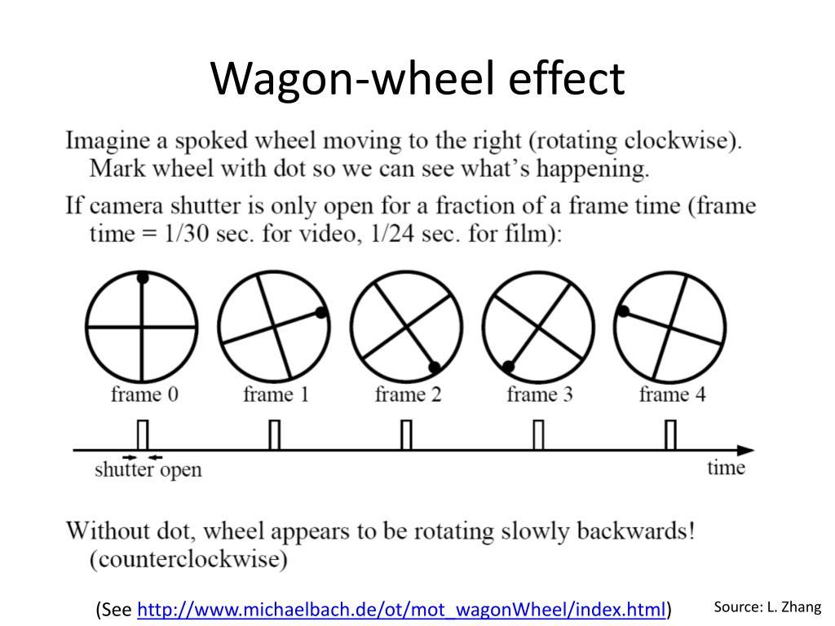
Visualization of Data, Understanding and Interpretation
From Frames To Continuous Motion
Visualization Implication
A higher frame rate is not automatically sufficient.
The visualization must also ensure that frame-to-frame displacement remains interpretable.
Slow: the dots are closely spaced in x, so consecutive samples are easy to match up correctly — the "instantaneous perception" strip below shows a smooth, correctly-ordered gradient.
Fast: the dots jump further in x between samples. The sparser spacing makes it more ambiguous which dot corresponds to which — this is the correspondence problem: the visual system has to guess which sample "belongs" to which, and with large jumps it can guess wrong (as in the wagon wheel going "backward").

Slide 43
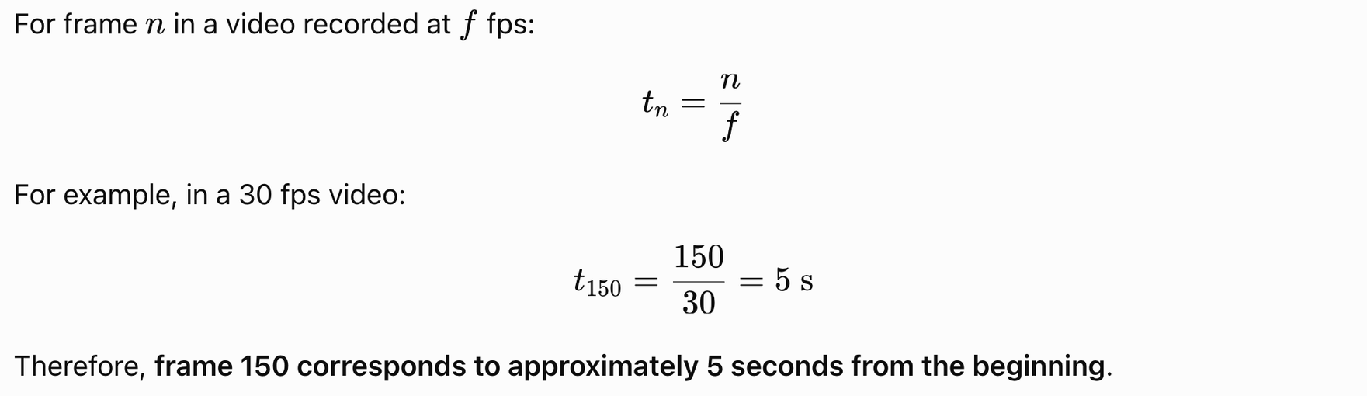
Visualization of Data, Understanding and Interpretation
Video Timelines And Temporal Navigation
Video Timeline
  A video timeline represents temporal position along a continuous sequence of frames.
  The timeline provides a spatial representation of time, allowing users to navigate directly to particular portions of a video.
  Individual frames can be indexed by their temporal position or frame number.
  A timeline can also contain markers representing events, annotations, detected changes, or important segments.
Frame–Time Relationship

Slide 44

Visualization of Data, Understanding and Interpretation
Video Timelines And Temporal Navigation
Why Timelines Matter
A timeline converts:
Large sequence of frames → Navigable temporal structure
This is especially important when the user is searching for a particular event rather than watching the video sequentially.

Slide 45
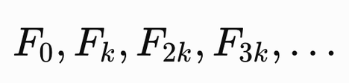
Visualization of Data, Understanding and Interpretation
Keyframes And Representative Frames
Keyframe
  A keyframe is a selected frame that represents an important visual state, event, or transition within a video.
  Keyframes can be selected manually or generated using criteria such as scene changes, motion, visual similarity, or temporal intervals.
  A sequence of representative frames can provide an overview of a video without requiring every frame to be displayed.
Uniform Sampling
For a video containing N frames, one simple strategy is to select every k-th frame:
Content-Based Selection
A more informative strategy selects frames when:
  The scene changes substantially.
  A large amount of motion occurs.
  A new object or event appears.
  The visual composition changes significantly

Slide 46
Visualization of Data, Understanding and Interpretation
Motion As A Visualization Channel
Motion As Data Encoding
  Motion can be used as a visual encoding channel in the same way that position, size, or color can encode information.
  The movement of a visual element can represent an underlying variable such as direction, change, flow, or temporal progression.
  Motion is particularly useful when the information itself describes movement or when changes need to attract attention.
Examples
  Direction → Movement direction represents the direction of a phenomenon.
  Magnitude → Movement speed can provide a qualitative indication of magnitude.
  Temporal change → Movement can represent progression through time.
  Grouping → Objects moving together can reveal related data points.
Perceptual Limitation: Ware notes that animation can communicate direction very effectively, but is comparatively poor for making precise judgments of speed.
Therefore, use motion primarily to communicate change and direction, and use another channel when precise quantitative comparison is required.

Slide 47
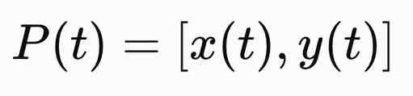
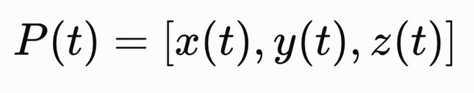
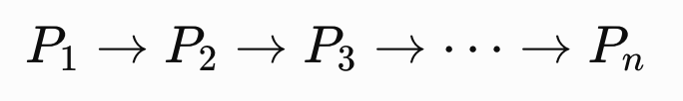
Visualization of Data, Understanding and Interpretation
Motion Trajectories
A motion trajectory represents the path followed by an object through space over time.
For a moving object (2D):
For a three-dimensional trajectory (3D):
2D Trajectory
A trajectory can be represented as a connected sequence:
This allows the viewer to examine:
  Direction
  Turning points
  Path length
  Relative movement
  Repeated movement patterns
Rather than showing an object's position at just one instant, a trajectory captures the entire path it follows

Slide 48
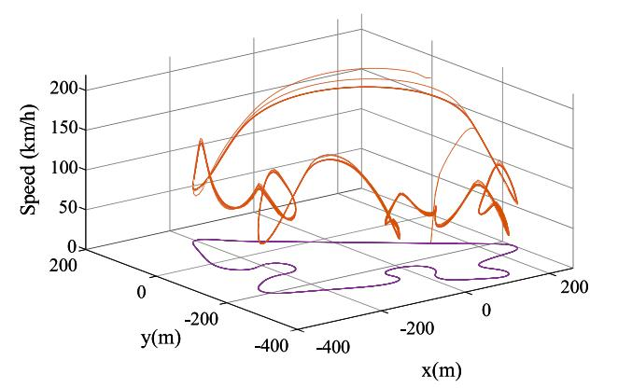
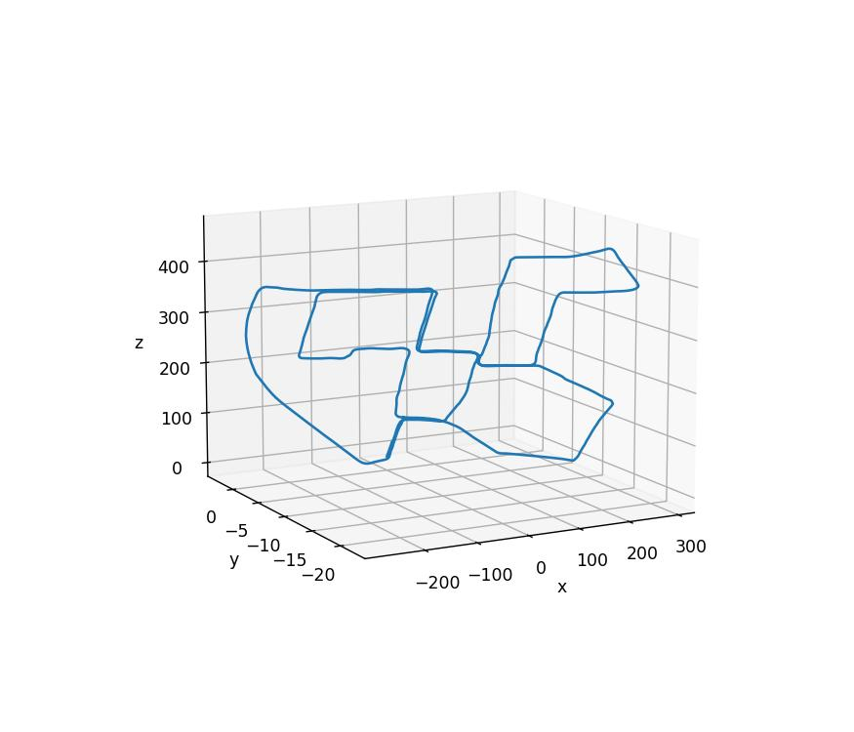
Visualization of Data, Understanding and Interpretation
Motion Trajectories
3D Trajectories
Ware discusses trajectories of particles, animals, and vehicles through space and recommends using shaded tubes or box-like extrusions with periodic bands to provide orientation cues.
Visualization Examples:
  Vehicle movement
  Aircraft trajectories
  Animal tracking
  Particle movement
  Human motion
  Geospatial movement
Notes:
Aircraft manuver detection

Slide 49
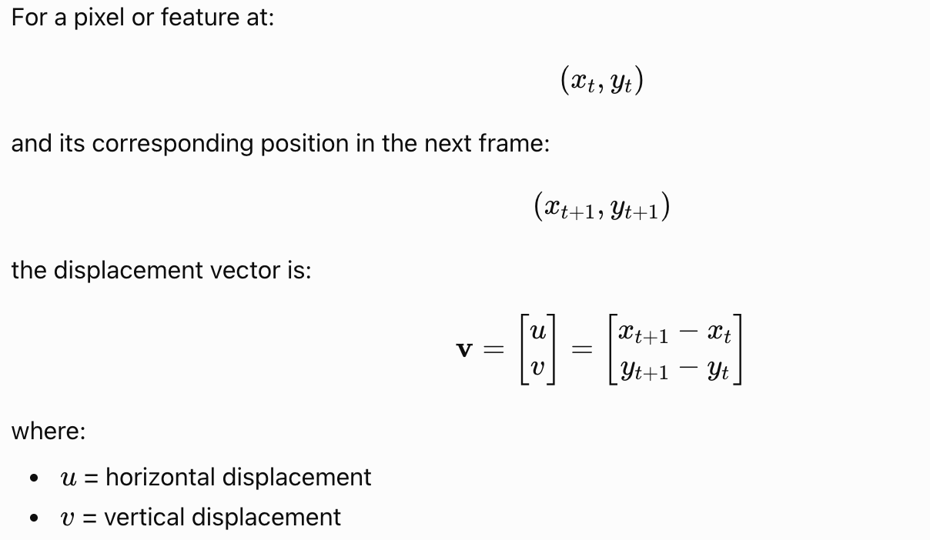
Visualization of Data, Understanding and Interpretation
Optical Flow: Concept And Motion Vectors
Optical flow describes the apparent motion of visual patterns between consecutive image frames.

Slide 50
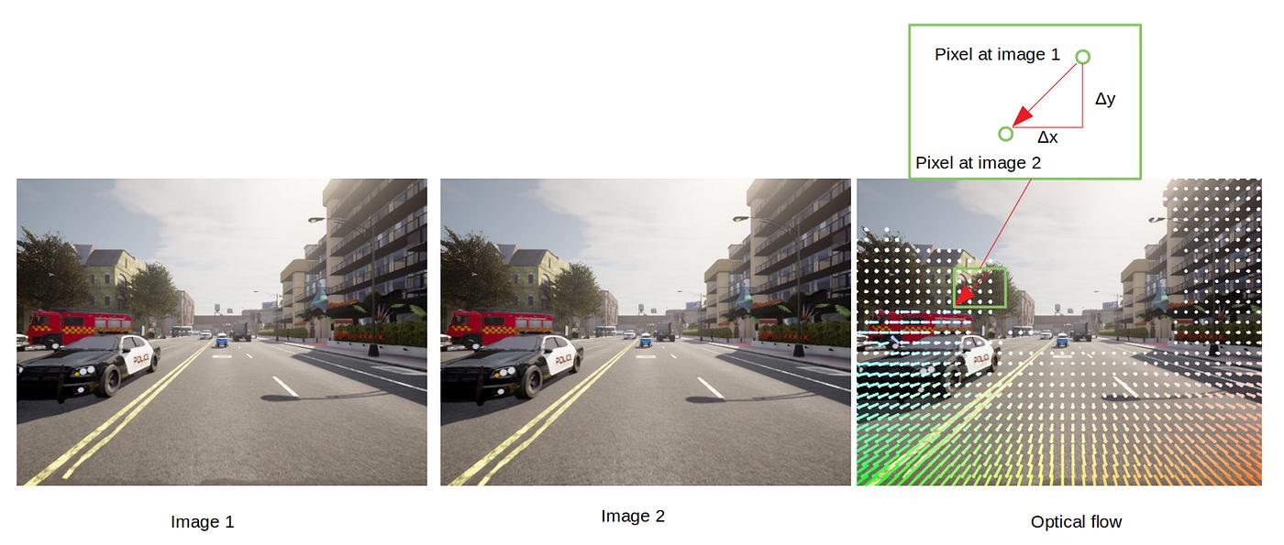

Visualization of Data, Understanding and Interpretation
Optical Flow: Concept And Motion Vectors
a way of computing and visualizing apparent motion between two consecutive frames of video
Optical Flow Visualization
A common representation uses arrows or short line segments:
  Direction → direction of apparent motion
  Length → magnitude of displacement
  Position → location of the moving pattern
Example:
If a feature moves from: (120, 80) → (126, 83)
Then: u = 126 − 120 = 6, v = 83 − 80 = 3
Therefore, the motion vector is (6, 3)
Its magnitude is:
It moved 6 pixels sideways and 3 pixels up/down
Given two frames taken a moment apart (Image 1, Image 2), optical flow estimates, for points across the image, where that point moved to in the next frame. Instead of tracking one object's path over many frames (like the trajectory slide), this computes a vector field — a motion vector at many points simultaneously, describing the instantaneous apparent motion of the whole scene.
Source: OpenCV documentation

Slide 51
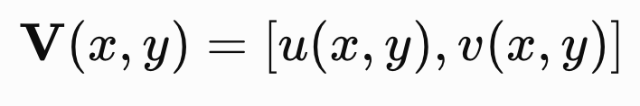
Visualization of Data, Understanding and Interpretation
Optical Flow Visualization And Video Events
Visualizing Optical Flow
An optical-flow field can be represented as:
where every spatial location may have an associated motion vector.
Common Representations
Vector field
  Arrows show direction and magnitude.
Color-coded flow
  Hue can represent direction.
  Intensity or saturation can represent magnitude.
Trajectory integration
  Consecutive flow vectors can be accumulated to estimate movement paths.

Slide 52
Visualization of Data, Understanding and Interpretation
Optical Flow Visualization And Video Events
From Motion To Events
Motion information can also be used to identify events within a video.
Examples include:
  Sudden movement
  Object entering or leaving a scene
  Collision
  Crowd formation
  Vehicle movement
  Scene transition
  Periods of inactivity
Event Visualization
Instead of presenting the entire video:
Video → Motion Analysis → Event Detection → Timeline + Representative Frames
This transforms a long sequence of frames into a structured temporal overview. Video visualization should expose temporal structure and meaningful change rather than requiring the viewer to inspect every frame.

Slide 53
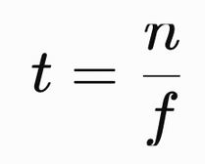

Visualization of Data, Understanding and Interpretation
Video Visualization: Numericals
1) Frame Count
Formula: N = fT
Example: 30 fps × 120 s = 3,600 frames
2) Frame–Time Conversion
Extra Questions:
1) A 5-minute video is recorded at 20 fps. How many frames must be processed if every frame is visualized?
2) A 90-second video contains 2,700 frames. What is its frame rate?
3) A visualization contains 1,500 frames sampled at 25 fps. What duration of video does this represent?
4) At 25 fps, approximately how much time has elapsed by frame 100?
5) A keyframe occurs at frame 450 in a video recorded at 30 fps. At what time does the keyframe occur?
6) A video is recorded at 60 fps. What is the time interval between consecutive frames?
7) A feature moves from (100,80) to (92,80). What is the direction of its motion?
8) A point moves from (40,50) to (43,54). What is the magnitude of its displacement?
Formula:
Example: frame 150 at 30 fps = 5 seconds
3) Motion Vector
Formula:
Example: (120, 80) → (126, 83)
∣v∣≈ 6.7 pixels/frame

Slide 54
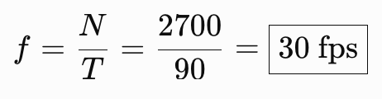
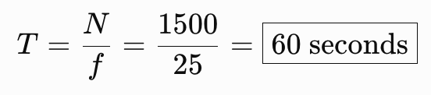
Visualization of Data, Understanding and Interpretation
Video Visualization: Numericals
Answers:
1) A 5-minute video is recorded at 20 fps. How many frames must be processed if every frame is visualized?
A: N = 20 × (5 × 60) = 6000 frames​
2) A 90-second video contains 2,700 frames. What is its frame rate?
A:
3) A visualization contains 1,500 frames sampled at 25 fps. What duration of video does this represent?
A:

Slide 55
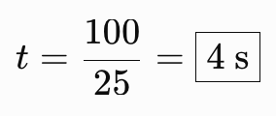
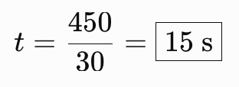

Visualization of Data, Understanding and Interpretation
Video Visualization: Numericals
4) At 25 fps, approximately how much time has elapsed by frame 100?
A:
5) A keyframe occurs at frame 450 in a video recorded at 30 fps. At what time does the keyframe occur?
A:
6) A video is recorded at 60 fps. What is the time interval between consecutive frames?
A:

Slide 56






Visualization of Data, Understanding and Interpretation
Video Visualization: Numericals
7) A feature moves from (100, 80) to (92, 80). What is the direction of its motion?
A:
The feature moves 8 pixels horizontally to the left.
8) A point moves from (40, 50) to (43, 54). What is the magnitude of its displacement?
A:

Slide 57

Visualization of Data, Understanding and Interpretation
Audio Visualization: Audio As A Time-Series Signal
Audio As A Time-Series Signal
  Digital audio represents a continuously varying sound signal as a sequence of discrete amplitude samples recorded at regular time intervals.
  The sampling rate specifies the number of samples recorded per second and determines the temporal sampling density of the signal.
  An audio signal can be represented as x[n], where each sample corresponds to a specific point in time.
  Audio visualization converts these numerical samples into visual representations that reveal temporal patterns, intensity changes, frequency content, and events.
X-axis: sample index (n), running from 0 to roughly 600,000+ — this is time, but measured in individual samples rather than seconds. If you know the sampling rate (e.g., 44,100 samples/sec), you could convert this to seconds (600,000 samples ÷ 44,100 ≈ ~13.6 sec of audio).
Y-axis: amplitude, ranging roughly from −0.8 to 0.6 — this is the instantaneous value of x[n], i.e., how far the sound wave's pressure deviates from zero (silence) at that instant. Positive and negative values represent compression and rarefaction of the sound wave.
The overall envelope (how thick/tall the band is at each point) shows loudness/intensity changes over the course of the clip
Notes:
cOlour- 2 possible signals compared

Slide 58
Visualization of Data, Understanding and Interpretation
Samples And Duration
What Is A Sample?
A sample is a single measurement of an audio signal's amplitude at a particular instant in time.
  Real-world sound is continuous. For example, when someone speaks, the air pressure around the microphone changes continuously.
  A microphone converts these physical changes into an electrical signal. However, a computer cannot store an infinitely continuous signal directly. Instead, it measures the signal at discrete points in time.
  Each measurement is a sample.
Every sample can be thought of as having:
  A time position — when the measurement was taken.
  An amplitude value — how strong the signal was at that instant.

Slide 59


Visualization of Data, Understanding and Interpretation
Samples And Duration: Numerical
Digital Audio And Sampling
  A digital audio signal is created by taking discrete measurements, called samples, from a continuous sound signal.
  The sampling rate specifies how many samples are taken every second and is measured in Hertz (Hz).
  A higher sampling rate means that the audio signal is represented using more samples over the same period of time.
  The total number of samples depends on both the sampling rate and the duration of the recording.
Relationship

Slide 60


Visualization of Data, Understanding and Interpretation
Samples And Duration: Numerical
Example:
A 2-second audio recording is sampled at 16 kHz. How many samples are recorded?
Interpretation: The computer records 32,000 amplitude measurements during the 2-second recording.

Slide 61
Visualization of Data, Understanding and Interpretation
Waveform Visualization
A waveform is a time-domain visualization that represents the amplitude of an audio signal as it changes over time.
  The horizontal axis represents time, while the vertical axis represents signal amplitude.
  Large amplitude variations can indicate louder or more energetic portions of the signal.
  Quiet regions and sudden changes in amplitude can help identify silence, transitions, and transient events.
  A waveform preserves temporal information but does not directly reveal the individual frequencies contributing to the signal.
💡Visualization Question: what happened to the signal over time?
This makes the waveform the audio equivalent of looking at an image's spatial intensity distribution before moving to more derived representations.
a waveform is to audio what a raw image's intensity/spatial distribution is to a picture

Slide 62
Visualization of Data, Understanding and Interpretation
Spectrograms
a waveform shows when and how loud, but not what frequencies. A spectrogram fixes that.
A spectrogram is a visual representation of how the frequency content of an audio signal changes over time.
  The horizontal axis represents time, while the vertical axis represents frequency.
  Color or lightness represents the magnitude or energy of the signal at each time–frequency location.
  A spectrogram is typically generated by dividing the audio signal into short segments and calculating the frequency content of each segment.
  It allows temporal events and their frequency characteristics to be examined simultaneously.
Reading A Spectrogram
  Horizontal bands indicate frequency components that persist over time.
  Short vertical patterns indicate brief events containing a range of frequencies.
  Stronger visual intensity indicates greater spectral magnitude.
  Different sounds can produce distinctive patterns across the time–frequency plane.
Visualization Perspective: Time × Frequency × Magnitude

Slide 63




Visualization of Data, Understanding and Interpretation
Spectrograms
A waveform shows how a signal changes over time, whereas a spectrogram additionally reveals how its frequency composition changes over time.

Slide 64
Visualization of Data, Understanding and Interpretation
Image–Video–Audio Integration
Multimedia Visualization
Multimedia visualization combines multiple data modalities to provide complementary views of the same event, object, or process.
  Images provide detailed spatial information about objects, scenes, and visual features.
  Video adds temporal information and allows changes and motion to be examined.
  Audio provides temporal and frequency information that may not be visible in the video.
Synchronized Visualization
Different modalities can be linked using a common temporal reference:
Image/Video Frame ↔ Time ↔ Audio Segment
For example, selecting a particular moment in a video can simultaneously display:
  The corresponding video frame
  The relevant position on the timeline
  The corresponding audio waveform or spectrogram

Slide 65
Visualization of Data, Understanding and Interpretation
Multimedia Applications And Use Cases
Surveillance And Security: Video frames, motion information, timelines, and audio can be combined to identify and review significant events within long recordings.
Medical And Scientific Imaging: Images and video can be combined with temporal measurements or other sensor data to examine changes in biological or physical systems.
Remote Sensing And Geospatial Analysis: Satellite imagery, video, terrain data, and other spatial measurements can be integrated to study geographic changes and environmental phenomena.
Human–Computer Interaction: Visual and auditory data can be analyzed together to study user behaviour, interactions, and responses.
Media And Content Analysis: Image, video, and audio features can be visualized together to explore scenes, speech, music, events, and other multimedia content.
Education And Training: Synchronized visual and auditory representations can help learners understand processes that involve both spatial and temporal information.

Slide 66
Visualization of Data, Understanding and Interpretation
Challenges, Design Trade-Offs And Key Takeaways
Data Volume And Complexity
Multimedia datasets can contain extremely large numbers of pixels, frames, samples, and derived features, making direct visualization difficult.
Temporal And Spatial Trade-Offs
Displaying more temporal information may require reducing spatial detail, while displaying more spatial detail may limit the amount of time that can be viewed simultaneously.
Information Overload
Combining multiple modalities can increase the amount of information available to the viewer while also increasing cognitive load.
Synchronization
Different modalities must be correctly aligned in time and space for relationships between them to be interpreted accurately.
Visual Encoding
Color, position, size, motion, and other visual channels must be selected according to the type of information being represented.

Slide 67
Visualization of Data, Understanding and Interpretation
MCQs
1. Which representation is most appropriate for examining how the frequency content of an audio signal changes over time?
A. Audio waveform
B. Frequency spectrum
C. Audio spectrogram
D. Amplitude histogram
Answer: C

Slide 68
Visualization of Data, Understanding and Interpretation
MCQs
2. A 30 fps video is 2 minutes long. Approximately how many frames does it contain?
A. 600 frames
B. 1,800 frames
C. 3,600 frames
D. 7,200 frames
Answer: C

Slide 69
Visualization of Data, Understanding and Interpretation
MCQs
3. An object moves from (20,30) to (24,33) between two consecutive video frames. What is the magnitude of its displacement?
A. 3 pixels/frame
B. 4 pixels/frame
C. 5 pixels/frame
D. 7 pixels/frame
Answer: C

Slide 70
Visualization of Data, Understanding and Interpretation
MCQs
4. Which statement best describes the main limitation of an image intensity histogram?
A. It cannot represent grayscale values.
B. It removes information about spatial arrangement.
C. It requires the image to contain multiple color channels.
D. It can only be computed from compressed images.
Answer: B

Slide 71
Visualization of Data, Understanding and Interpretation
MCQs
5. Why can combining video frames, audio spectrograms, and timelines improve multimedia visualization?
A. It eliminates the need for preprocessing.
B. It guarantees accurate event classification.
C. It provides complementary information across modalities.
D. It reduces every multimedia dataset to one dimension.
Answer: C

Slide 72
Thank You

