Slide 1

Visualization of Data, Understanding and Interpretation
Unit 3 : Multimedia and Interactive Visualization
(UE24CS342AA9)
PPT 5: Animation, Motion and Temporal Visualization
Dr.Prajwala TR (Course Instructor)
Dept. of CSE, PES University, Bangalore

Slide 2
Visualization of Data, Understanding and Interpretation
Acknowledgement
The slides are prepared from various resources from the Universities from abroad and India. Also, some material is taken from reliable resources from internet throughout this course.
Primary textbooks for this lecture: T. Munzner, Visualization Analysis and Design (CRC Press, 2014) and C. O. Wilke, Fundamentals of Data Visualization (O’Reilly, 2019), supported by research papers listed on the References slide.

Slide 3
Visualization of Data, Understanding and Interpretation
Lecture Overview
In this lecture, we will cover:
Animation and Visualization
Animation as a Visual Encoding
Motion as a Visual Variable
Animation Timing
Frame Rate
Temporal Sampling
Animated Transitions
Designing Good Transitions
Change Detection and Change Blindness
Animation for Trends
Animation for Spatial Data
Motion and Trajectories
Particle Animation
Temporal Visualization Fundamentals
Temporal Data and Time-Dependent Data
Continuous and Discrete Time
Events Over Time
Temporal Encoding
Time-Series Visualization
Temporal Aggregation
Temporal Filtering
Timeline Visualization
Playback and Scrubbing
Temporal Navigation
Animation Versus Static Views
Animation Versus Small Multiples
Advantages and Limitations of Animation
Cognitive Issues in Temporal Visualization
Plus: 6 worked numericals with solutions • 8 MCQs • References

Slide 4
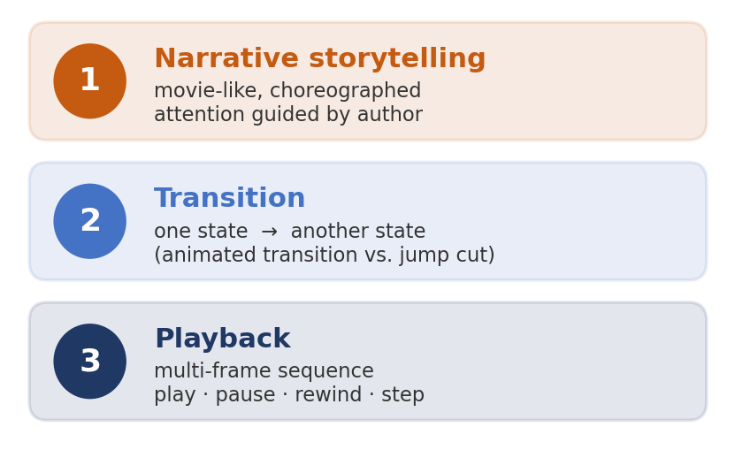
Visualization of Data, Understanding and Interpretation
Animation and Visualization
Animation = showing a sequence of images over time so that change is perceived as motion.
Munzner distinguishes three meanings:
Narrative storytelling – movie-style, choreographed by an author
Transitions – smoothly moving from one state to another
Playback – video-style multi-frame sequence (play, pause, stop, rewind, step)
Key idea
Data that changes over time does NOT have to be shown as an animation – animation is only one of many encodings of time
Movie intuition misleads: films guide the eye to one place; data animations change everywhere at once
Source: Munzner, Visualization Analysis and Design (2014), §2.6.2 & §6.5.2, pp. 38–39, 132–133

Slide 5
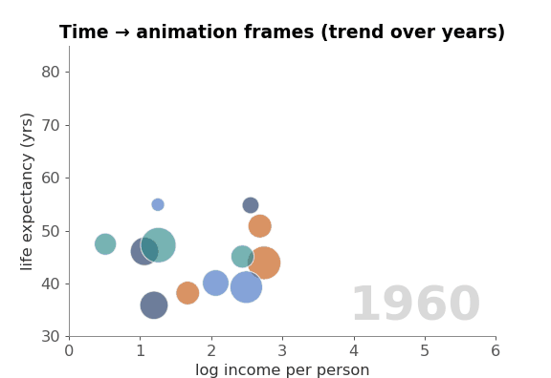
Visualization of Data, Understanding and Interpretation
Animation as a Visual Encoding
In an animated chart, the data attribute time is mapped to display time: one data time step → one (or more) frames.
Spatial channels (x, y, size, colour) still encode the other attributes in each frame
Example: Gapminder ‘Trendalyzer’ (Hans Rosling) – income vs life expectancy, one frame per year(helps people understand how countries develop over time instead of looking at separate static charts.)
Congruence principle
Animation is natural when the content itself is change over time(If you want to show how a plant grows over 30 days, animation is suitable because growth happens over time.)
Apprehension principle
It works only if viewers can perceive and understand the change – too fast or too complex and it fails
Tversky et al. found many ‘animation beats static’ studies were not fair comparisons
Even if animation is appropriate, it will not be useful if the changes happen too quickly or too many things change at once.
Principle | Simple meaning
Congruence | Use animation when the data naturally changes over time.
Apprehension | Make the animation slow and clear enough for viewers to understand.
Fair comparison | Compare animation with an equally informative static presentation before claiming it is better.
Source: Munzner, Visualization Analysis and Design (2014) §6.5; Tversky, Morrison & Bétrancourt, ‘Animation: can it facilitate?’, IJHCS 57 (2002)

Slide 6
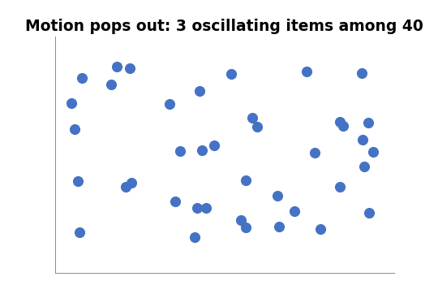
Visualization of Data, Understanding and Interpretation
Motion as a Visual Variable
Motion channels: direction of motion, velocity of motion, flicker/blink frequency.
With a fixed layout, motion is usually a small cyclic oscillation around the item’s position
Extremely salient and highly separable from static channels (colour, position)
Pops out preattentively: moving items are found almost instantly
Weakness: nearly impossible to ignore – flicker/blinking can annoy and distract
Munzner’s safe strategy
Treat motion as an identity channel with 2 levels: moves / does not move
Best use: temporary highlighting (e.g. on mouse-over, or newly added items)
Source: Munzner, Visualization Analysis and Design (2014) §10.4.5 Motion Channels, pp. 238–239; §5.5

Slide 7
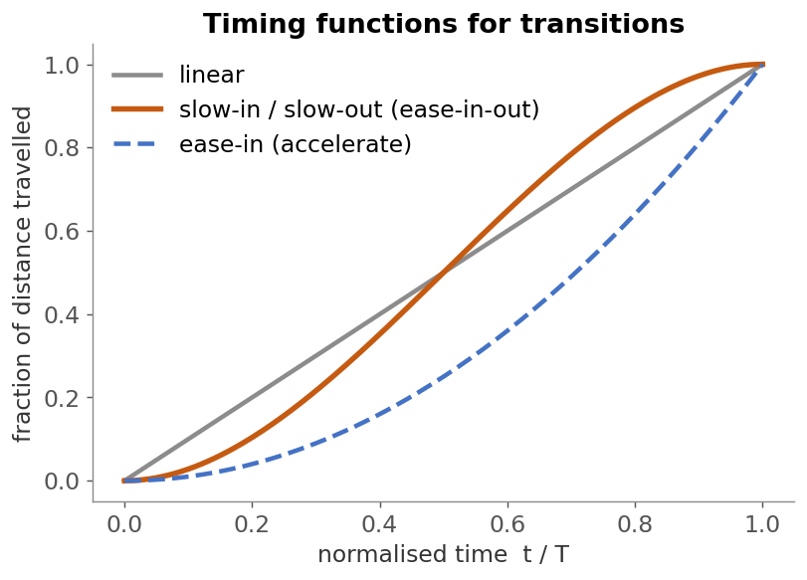
Visualization of Data, Understanding and Interpretation
Animation Timing
A perceptual cycle is the short amount of time the human visual system needs to perceive and process a visual change before processing the next one.
How long should a transition last?
Too short (< ~0.25 s): changes are missed; too long (> ~2 s): tedious
Heer & Robertson: ~1 s per stage worked well for staged chart transitions
Card et al.: ~0.1 s perceptual cycle – below this, successive frames fuse; ~1 s keeps a user’s flow of thought
Pacing / easing functions
Slow-in / slow-out (ease-in-out): start slow, speed up, end slow – helps tracking of start and end positions
Staging: break a complex change into sequential steps (e.g. first change axes, then move marks)
Hold the final state long enough to be read
Source: Heer & Robertson, IEEE TVCG 13(6) 2007; Card, Robertson & Mackinlay, CHI 1991; Dragicevic et al., CHI 2011

Slide 8
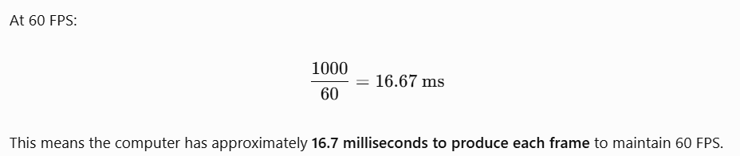
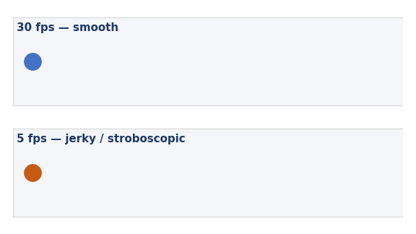
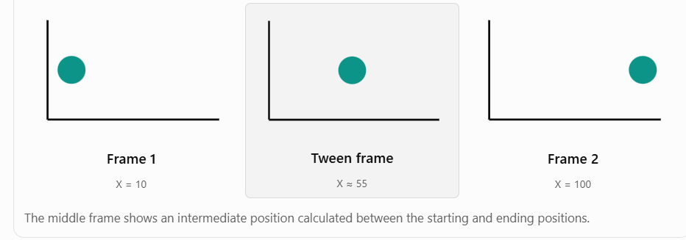
Visualization of Data, Understanding and Interpretation
Frame Rate
Frame rate (fps) = number of distinct images displayed per second.
Film ≈ 24 fps, video ≈ 25–30 fps, interactive graphics/games target 60 fps
Below ~10–12 fps motion looks jerky (stroboscopic); movement is seen as jumps
Frame time budget = 1000 ms / fps (60 fps → 16.7 ms per frame)
frame time budget is the time available to render one frame at a target frame rate.
Two different ‘rates’ in data animation
Rendering rate – how smoothly frames are drawn (fps)
Data rate – how many data time steps are shown per second (e.g. 2 years/s)
Interpolated ‘tween’ frames can keep motion smooth even when data steps are coarse
Higher FPS means less time is available to process each frame.
Source: Card, Robertson & Mackinlay, CHI 1991; general computer-graphics practice

Slide 9
Visualization of Data, Understanding and Interpretation
Numerical 1: Frame Rate and Duration
Problem
120 monthly snapshots (10 years) are animated at 24 fps, each month held for 0.5 s.
(a) Total duration? (b) Total frames? (c) Frames per month?
(d) To show all 10 years in 30 s with 6 frames per month, what fps is needed?
(e) Rendering 50,000 particles costs 0.4 µs each. Can we reach 60 fps?
Solution
(a) 120 × 0.5 s = 60 s
(b) 60 s × 24 fps = 1,440 frames
(c) 0.5 s × 24 fps = 12 frames per month
(d) 30 s / 120 = 0.25 s per month → 6 frames / 0.25 s = 24 fps
(e) 50,000 × 0.4 µs = 20 ms per frame > 16.7 ms budget for 60 fps
→ max ≈ 1000 / 20 = 50 fps; reduce particles for 60 fps
Source: Worked example based on frame-budget concepts (Card et al. 1991)

Slide 10
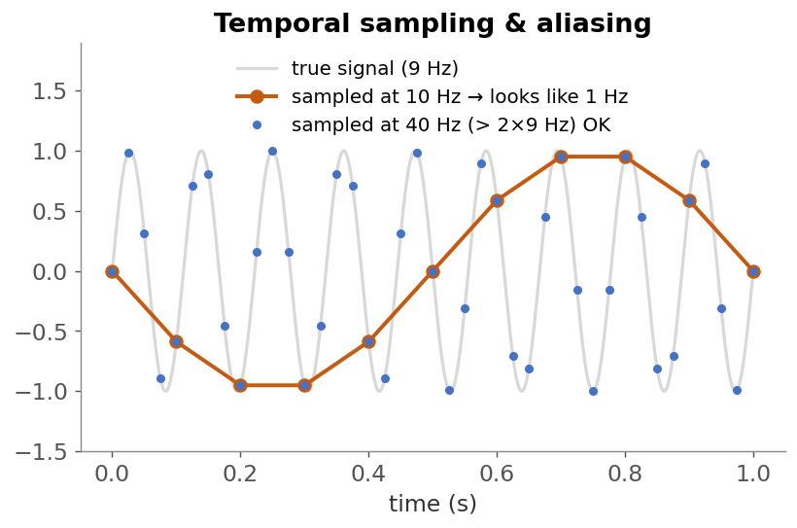
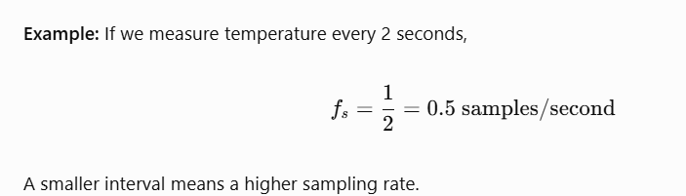
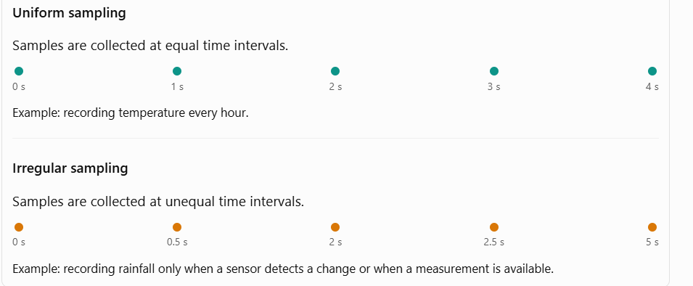
Visualization of Data, Understanding and Interpretation
Temporal sampling means deciding when to collect or display data over time. It is important in data visualization because we cannot always measure or display every instant.
Think of it like taking photographs: do you take one photo every second, every minute, or every hour?
Temporal Sampling
Temporal sampling = choosing at which instants time-varying data is measured or displayed.
Sampling interval Δt; sampling rate fs = 1/Δt
Nyquist–Shannon: to capture a cycle of frequency f, sample at f_{s} > 2f
fs = sampling rate
f = highest frequency present in the signal
Under-sampling causes aliasing: fast changes appear as slow, false patterns (e.g. ‘wagon-wheel’ effect) Aliasing occurs when we take samples too slowly to capture how something is actually changing. As a result, the data may show a false pattern.
Uniform vs irregular sampling – Munzner notes time–value pairs are often, but not always, uniformly spaced
For animation
Choose which data steps become keyframes; interpolate between them
Keyframes should be meaningful chunks, not random samples (Munzner)
Suppose a rotating wheel completes 5 rotations per second.
To capture its motion without aliasing,
the sampling rate must be greater than:
f_s>2(5)=10samples/second

Slide 11
Visualization of Data, Understanding and Interpretation
Numerical 2: Sampling and Aliasing
Problem
A traffic-sensor signal has its fastest meaningful cycle every 15 minutes.
(a) What is the minimum sampling rate and the maximum sampling interval?
(b) A 50-minute cycle is sampled once per hour. What (aliased) period is seen?
(c) 24 h of this data is replayed as a 12 s animation. What is the time compression?
Solution
(a) f_max = 1 / 0.25 = 4 cycles/hour
Nyquist: fs > 2 × 4 = 8 samples/hour
(b) f = 60/50 = 1.2 cycles/h; fs = 1 per h
aliased f = |1.2 − 1| = 0.2 cycles/h → appears as a 5-hour cycle (false!)
(c) 24 h = 86,400 s shown in 12 s → 7,200 : 1
i.e. 1 s of animation = 2 hours of data
(f) = Actual signal frequency: How fast the real-world signal repeats.
(f_s) = Sampling frequency (sampling rate): How many times per second or minute we measure that signal.
Source: Worked example applying the Nyquist–Shannon theorem

Slide 12
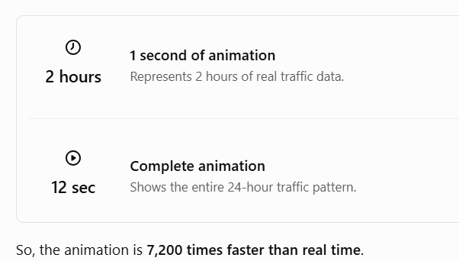
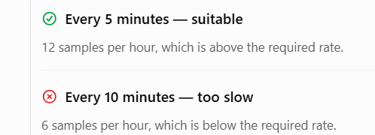
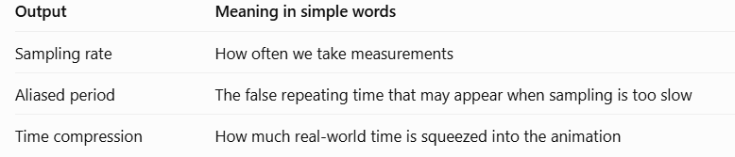
a) Sampling rate and sampling interval
The traffic signal has a cycle every 15 minutes.
We calculated:
Sampling rate: greater than 8 samples/hour
Sampling interval: less than 7.5 minutes
C Time compression = 7,200:1
B)
Actual pattern: one complete cycle every 50 minutes.
Sensor: one reading every 60 minutes.
Observed pattern: an apparent cycle every 300 minutes (5 hours).
This is called aliasing: sampling too slowly makes a fast-changing signal appear to have a different, slower pattern.
The 5-hour result assumes a regular 50-minute periodic signal and ideal sampling; it describes the apparent frequency, not a genuine change in the traffic itself.

Slide 13
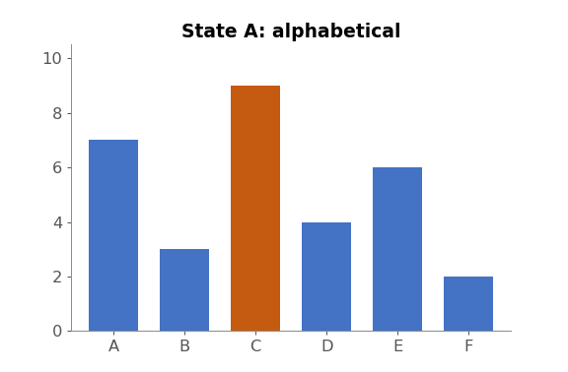
Visualization of Data, Understanding and Interpretation
Animated Transitions
A series of frames generated to move smoothly from one state to another – the alternative to a jump cut.
Used for navigation (camera viewpoint), reordering, filtering (items enter/leave), changing encoding, updating values
Benefit: keeps context – the eye tracks each item from old to new position instead of using memory
Most useful when few objects change, or groups move together
Can be broken into stages; studies show well-designed transitions improve graphical perception of change
Munzner calls this ‘one of the best-justified uses of animation’.
Source: Munzner, Visualization Analysis and Design (2014) §11.4 Example: Animated Transitions, pp. 248–249; Heer & Robertson 2007

Slide 14
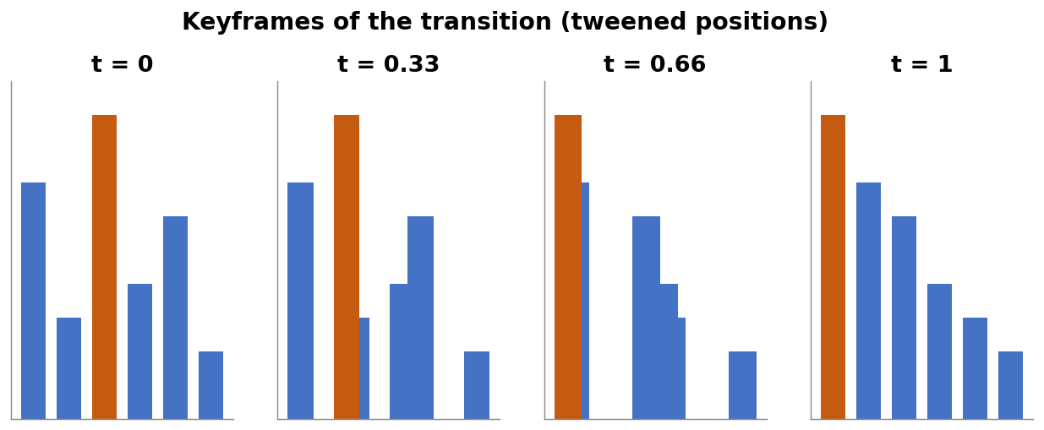
Visualization of Data, Understanding and Interpretation
Designing Good Transitions
Heer & Robertson design principles
Congruence: keep the mapping between data and marks consistent across states
Apprehension: keep transitions simple enough to follow
Staging: do one kind of change per stage (e.g. axis rescale → then mark move)
Maintain valid data graphics during the transition where possible
Avoid ambiguity: keep object identity (same mark = same data item)
Use ease-in/ease-out and keep each stage around 1 s
Jump cut vs transition
Jump cut: instant but forces viewer to re-find items using memory
Source: Heer & Robertson, ‘Animated Transitions in Statistical Data Graphics’, IEEE TVCG 13(6), 2007

Slide 15
Visualization of Data, Understanding and Interpretation
Numerical 3: Easing an Animated Transition
Problem
A bar moves from x = 100 px to x = 500 px in T = 1.0 s, rendered at 30 fps.
Compare linear motion with smoothstep easing s(u) = 3u² − 2u³, u = t/T.
(a) Position at t = 0.25 s for each. (b) Peak speed of each.
(c) Largest per-frame jump with easing.
Solution
Distance D = 500 − 100 = 400 px
(a) Linear: x = 100 + 400 × 0.25 = 200 px
Easing: s(0.25) = 3(0.0625) − 2(0.015625) = 0.15625 → x = 100 + 62.5 = 162.5 px
(b) Linear speed = 400 px/s (constant)
Easing: ds/du = 6u(1 − u), max at u = 0.5 → 1.5 → 1.5 × 400 = 600 px/s
(c) 600 px/s ÷ 30 fps = 20 px per frame (0 px/frame at start & end → easy to track)
Source: Worked example; slow-in/slow-out from Dragicevic et al. 2011, Heer & Robertson 2007

Slide 16
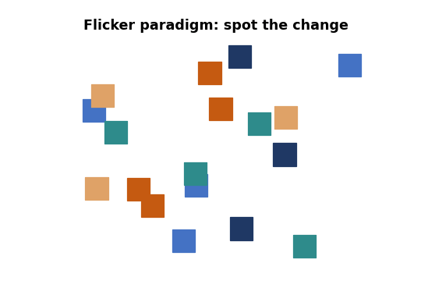
Visualization of Data, Understanding and Interpretation
Change Detection and Change Blindness
Change blindness: we fail to notice even drastic changes when attention is directed elsewhere.
Door study: a stranger asking directions was swapped for another person – most people did not notice
Flicker paradigm: A → blank → B → blank … hides the motion transient, so the change is hard to find
We don’t hold a detailed internal image of the scene; the eyes fetch information ‘just in time’
Implications for visualization
Many simultaneous changes across frames will be missed
Blink comparator: letting users flip between two frames helps spot a localized change
Highlight what changed; use transitions rather than cuts
Source: Munzner, Visualization Analysis and Design (2014) §6.5.3, pp. 133–134; Simons & Levin 1998; Rensink, O’Regan & Clark 1997

Slide 17
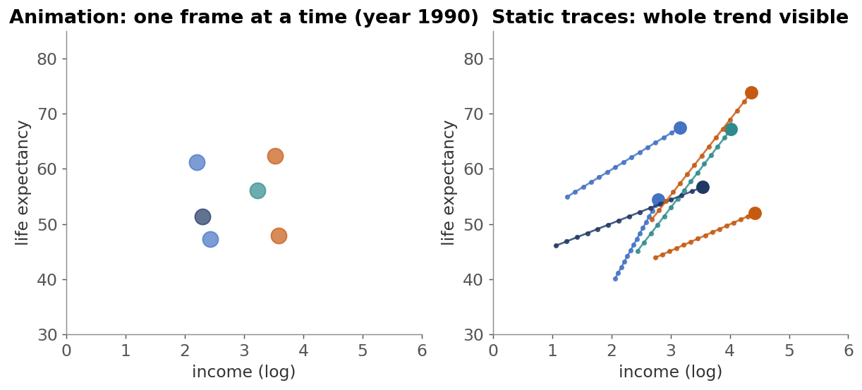
Visualization of Data, Understanding and Interpretation
Animation for Trends
Trend = direction of change over time (e.g. countries moving toward higher income).
Animated scatter plots (Gapminder) are compelling in presentations
Robertson et al. (2008) compared animation, traces and small multiples:
For analysis, animation was slowest and least accurate
For presentation, animation was engaging and liked by viewers
Static alternatives: traces (trails) show each item’s whole path in one image; line charts show trends directly
Wilke: smoothing (moving averages, LOESS) makes the underlying trend easier to see
Source: Robertson et al., ‘Effectiveness of Animation in Trend Visualization’, IEEE TVCG 14(6), 2008; Wilke, Fundamentals of Data Visualization (2019) Ch. 14

Slide 18
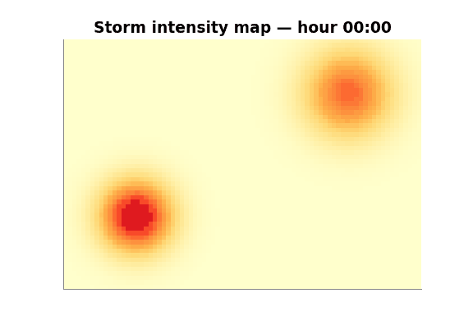
Visualization of Data, Understanding and Interpretation
Animation for Spatial Data
For geographic or spatial fields, x and y are already used by space – so time is often mapped to animation.
Examples: weather radar loops, spread of an epidemic, traffic density, ocean temperature
Munzner: time-varying spatial fields, e.g. a medical scan with keys x, y, z, t
Works well for showing movement and spread of a phenomenon
Cautions
Hard to compare values between distant frames
Keep the colour scale fixed across all frames
Offer playback control; consider small-multiple maps for key moments
Source: Munzner, Visualization Analysis and Design (2014) §2.6.2, p. 39; §8 Arrange Spatial Data

Slide 19
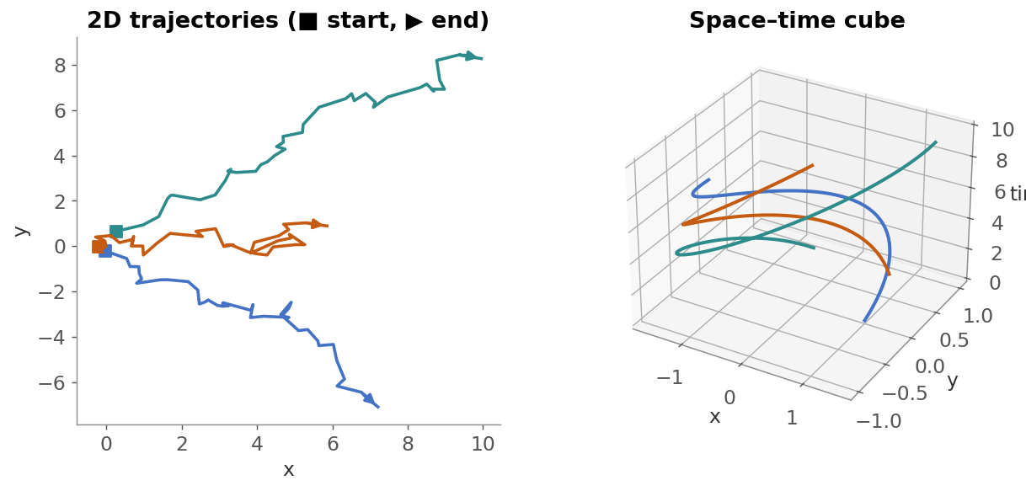
Visualization of Data, Understanding and Interpretation
Motion and Trajectories
A trajectory is the path of a moving object: a sequence of (x, y, t) positions.
Examples: GPS tracks, animal herds (Munzner’s sensor-network example), hurricanes, players on a field
Encodings:
Animated moving dots – shows speed & order but relies on memory
Static paths / trails with arrows or colour gradients for direction
Space-time cube: x, y on the base, time on the vertical axis
Direction and ordering must be shown explicitly (arrows, start/end marks, colour by time)
Source: Munzner, Visualization Analysis and Design (2014) §2.6.2.1, p. 39; Aigner et al., Visualization of Time-Oriented Data (2011)

Slide 20
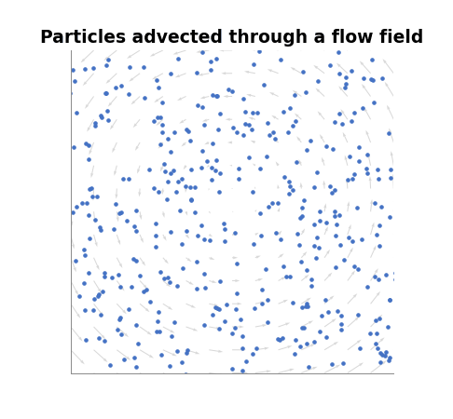
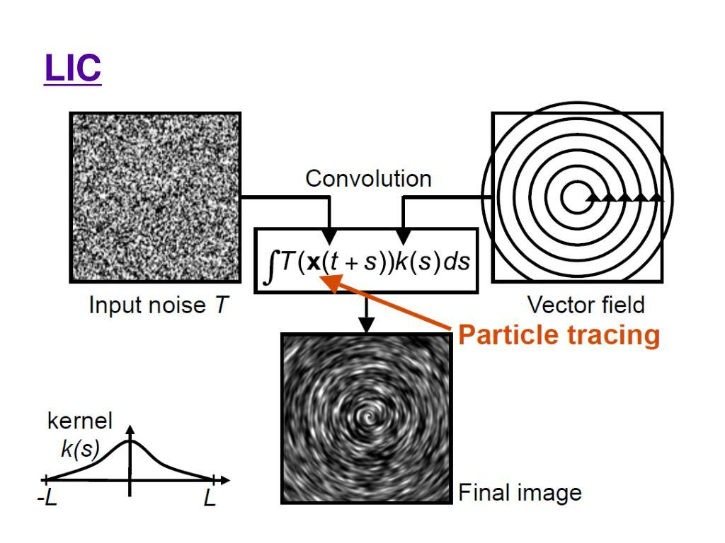
Visualization of Data, Understanding and Interpretation
Particle Animation
Particles are released in a vector (flow) field and moved along the velocity at each time step.
Geometric flow idioms trace particle trajectories:
Streamline – tangent to the velocity field at one instant
Pathline – actual route of one particle over time
Streakline – all particles released from one point (smoke trail)
Steady flow: these lines coincide; unsteady (time-varying) flow: they differ
Texture flow (LIC) uses dense particle tracing to smear a texture along flow
Particles are recycled (re-seeded) to keep density even-xample: In an animation of air flowing around an airplane, new particles are continuously introduced so the airflow remains visible instead of the screen gradually becoming empty.
Steady flow: The velocity at each location does not change with time. Streamlines, pathlines, and streaklines coincide (assuming the same flow and release setup).
Unsteady flow: The velocity changes with time. Example: If river water flows at a constant rate, the lines may coincide. If the current changes direction or speed over time, a leaf's path may differ from the flow pattern seen in a single snapshot.

Slide 21
Visualization of Data, Understanding and Interpretation
Numerical 4: Particle Advection (Euler)
Problem
Velocity field v(x, y) = (−y, x) (rotation about the origin).
A particle starts at p₀ = (1, 0). Use Euler’s method pₙ₊₁ = pₙ + Δt · v(pₙ) with Δt = 0.1.
(a) Find p₁, p₂, p₃. (b) The exact path is the unit circle – what is the error after 3 steps?
Solution
(a) v(p₀) = (0, 1) → p₁ = (1, 0) + 0.1(0, 1) = (1.000, 0.100)
v(p₁) = (−0.1, 1) → p₂ = (0.990, 0.200)
v(p₂) = (−0.2, 0.99) → p₃ = (0.970, 0.299)
(b) |p₃| = √(0.970² + 0.299²) = √1.0303 ≈ 1.015
→ the particle drifts outward by ≈ 1.5 %
Fix: smaller Δt or higher-order integrators (RK4) for accurate paths
Source: Worked example on geometric flow / particle tracing (Munzner, Visualization Analysis and Design (2014) §8.5.2)

Slide 22
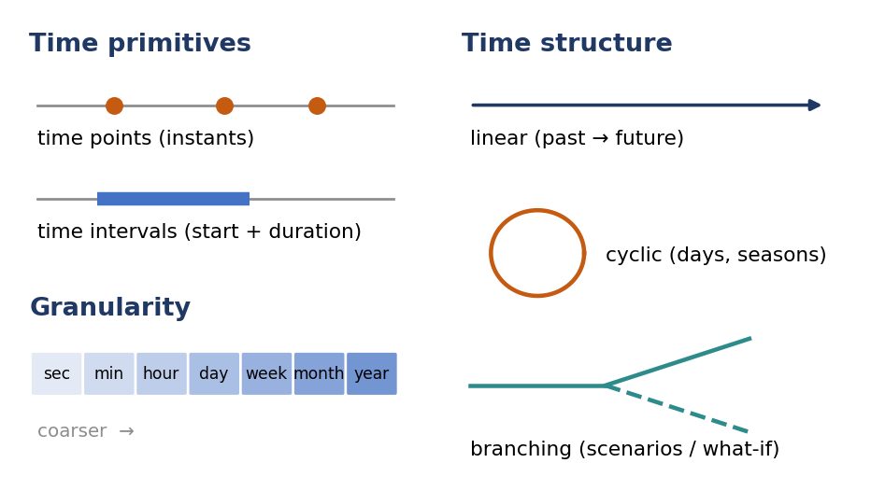
Visualization of Data, Understanding and Interpretation
Temporal Visualization Fundamentals
Time has rich structure that affects how we visualize it.
Multiscale hierarchy: nanoseconds → hours → decades → millennia
Scales don’t nest neatly: weeks do not fit into months
Periodicity: daily, weekly, seasonal cycles; finding periods is a common task
Aigner et al.’s design aspects of time
Primitives: time points vs time intervals
Structure: linear, cyclic, branching
Granularity & scale: discrete units (second, day, year) vs continuous
Source: Munzner, Visualization Analysis and Design (2014) §2.6.2 Temporal Semantics, pp. 38–39; Aigner, Miksch, Schumann & Tominski (2011)

Slide 23
Visualization of Data, Understanding and Interpretation
Temporal Data and Time-Dependent Data
Temporal attribute
Any information related to time
Can have value semantics: e.g. duration of a race, date of a transaction
Example: horse-racing data with start times and run durations – temporal, but NOT time-varying
Usually quantitative; may be treated as ordinal if gaps don’t matter
Time-dependent (time-varying) data
Time is an independent KEY attribute
Values depend on time: v = f(t)
Example: sensor network tracking each animal in a herd every second
Time-series = ordered sequence of time–value pairs (a table with time as key)
Tasks: find trends, correlations, variation at hourly, daily, weekly, seasonal scales
Key takeaway: Whether time is a key or a value needs knowledge of the dataset – it cannot be decided from the data type alone.
Simple way to remember
Temporal attribute: When did it happen, or how long did it take?
Time-dependent data: What changed as time passed?
Source: Munzner, Visualization Analysis and Design (2014) §2.6.2 & §2.6.2.1, pp. 38–40

Slide 24
Time | Horse's speed
10:00:00 | 20 km/h
10:00:01 | 25 km/h
10:00:02 | 32 km/h
10:00:03 | 28 km/h
Temporal attribute
Example: Horse racing
Imagine a horse race with the following information:
Race start time: 10:00 AM
Race end time: 10:05 AM
Race duration: 5 minutes
These are temporal attributes because they describe the time associated with the race.
Even though we have time information, we are not tracking how the horse's speed changes every second.
Key point: Time is just a piece of information in the dataset.
Time-Dependent Data (Data that changes with time)
Here, we observe how a value changes as time passes.
Example: Tracking a horse's speed
Here, the horse's speed changes every second.
Time acts as the key to identify when each measurement was taken.
Speed is the value that changes with time.
We can plot a graph to understand whether the horse is accelerating or slowing down.
Key point: We use time to study how data changes over time.
A student's date of birth is a temporal attribute, whereas the student's height measured every year is time-dependent data.

Slide 25
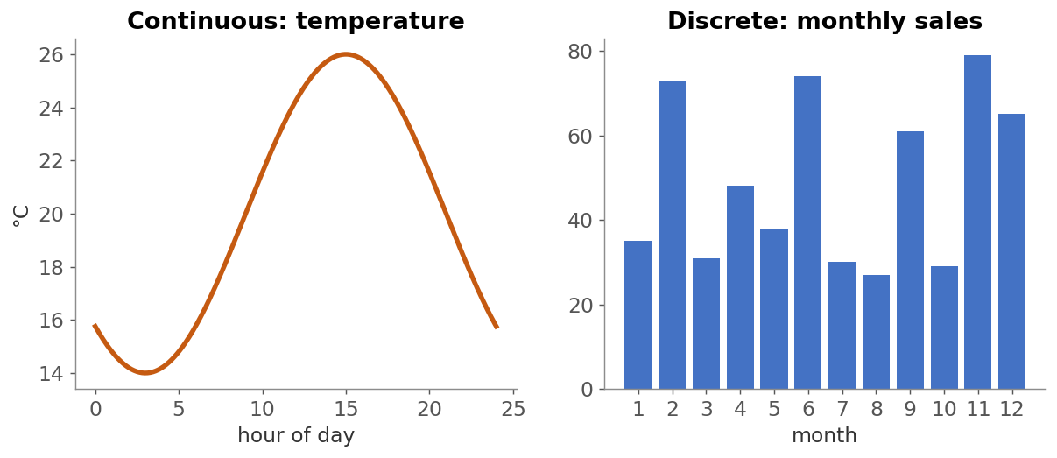
Visualization of Data, Understanding and Interpretation
Continuous and Discrete Time
Continuous time: a value exists at every instant (temperature, position); we sample it – connect points with lines
Discrete time: values exist per unit/bin (monthly sales, yearly counts) – bars or dots are appropriate
Wilke: connecting points with lines implies a continuous series; don’t draw lines for unordered categories
Source: Munzner, Visualization Analysis and Design (2014) §2.6.2; Aigner et al. (2011); Wilke, Fundamentals of Data Visualization (2019) Ch. 13

Slide 26
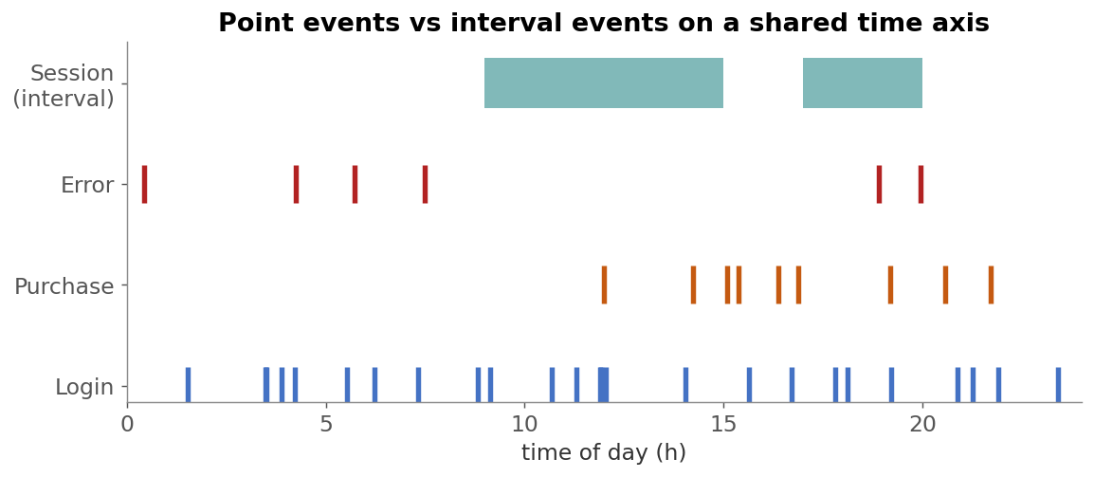
Visualization of Data, Understanding and Interpretation
Events Over Time
Event = something that happens at a time point (login, error, earthquake) or over an interval (session, illness, project task)
Visual forms: event strips / rug plots, lollipop timelines, interval bars; counts per bin → histogram over time
Tasks: find order, frequency, co-occurrence, gaps and bursts; align events to a reference (e.g. ‘time since sign-up’)
Source: Aigner et al., Visualization of Time-Oriented Data (2011); Munzner, Visualization Analysis and Design (2014) §2.6.2

Slide 27
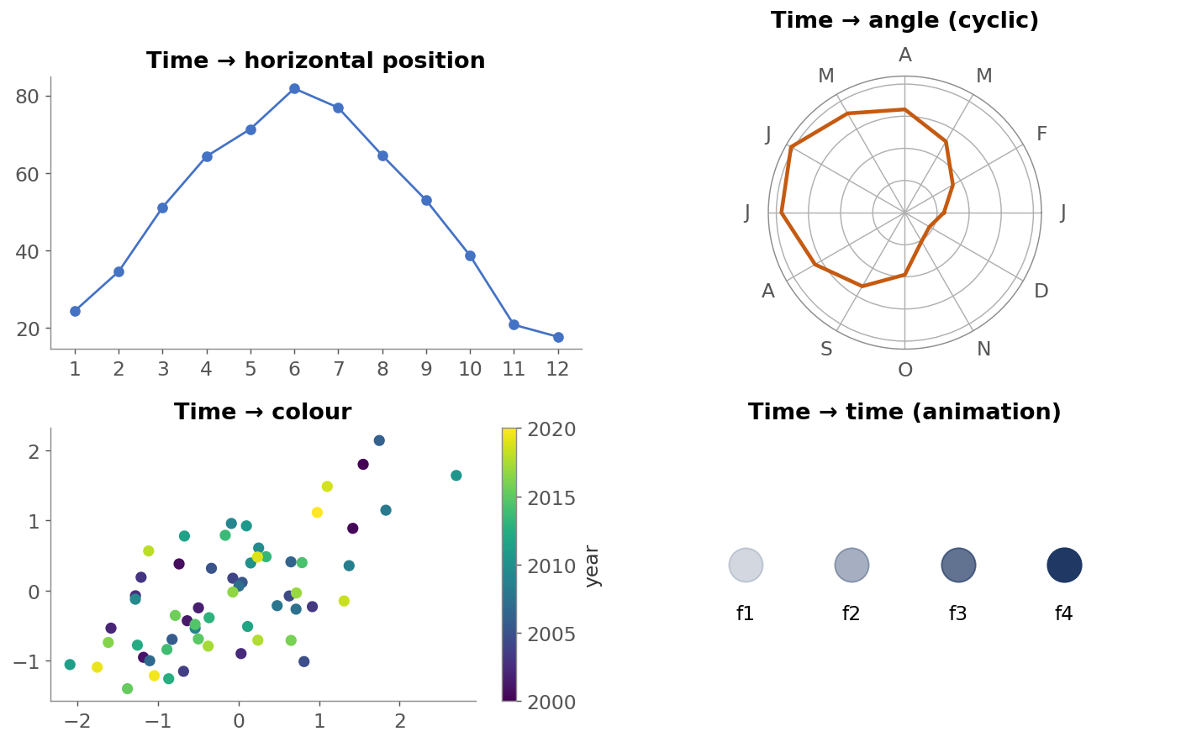
Visualization of Data, Understanding and Interpretation
Temporal Encoding
How can the time attribute be encoded?
Horizontal position (most common, most accurate) – line & bar charts
Angle / radial layout – for cyclic time (hours of day, months)
Colour – time as a sequential colour ramp in a scatter plot
Order / connection – connected scatter plots
Animation – time mapped to display time
Guideline
Position is the most effective channel (Munzner’s channel ranking); prefer it for detailed comparison over time
Source: Munzner, Visualization Analysis and Design (2014) §5.5 Channel Effectiveness & §2.6.2; Wilke, Fundamentals of Data Visualization (2019) Ch. 13

Slide 28
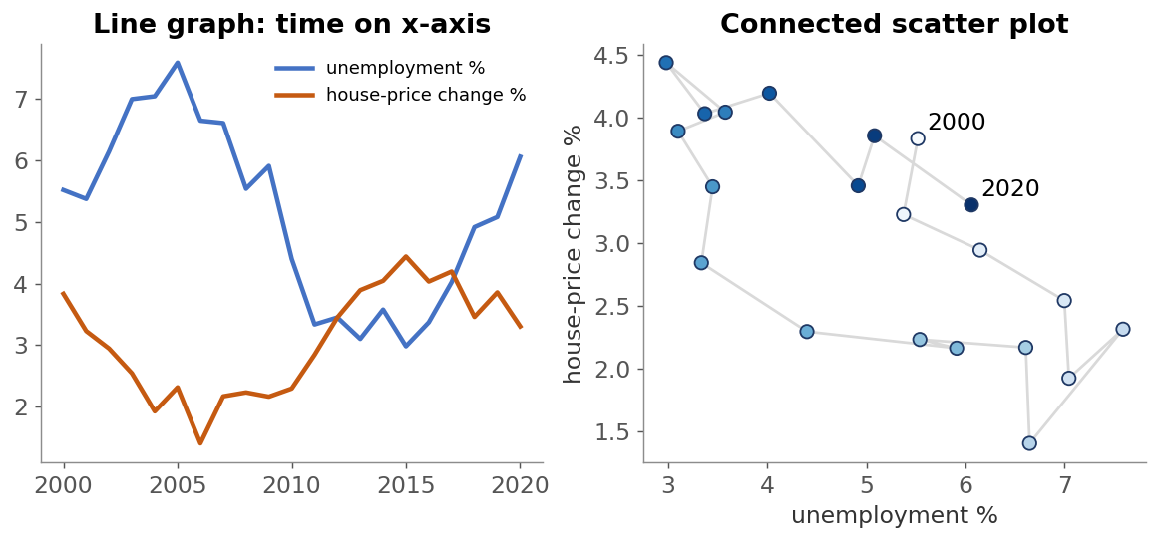
Visualization of Data, Understanding and Interpretation
Time-Series Visualization
Line graph with time on x-axis is the standard; dots + lines for sparse data, lines alone for dense data
Multiple series: direct labels instead of legends; don’t stack too many lines (use small multiples)
Connected scatter plot: two variables vs each other, points joined in time order – shows cycles; show direction & start/end
Source: Wilke, Fundamentals of Data Visualization (2019) Ch. 13 ‘Visualizing time series and other functions of an independent variable’

Slide 29
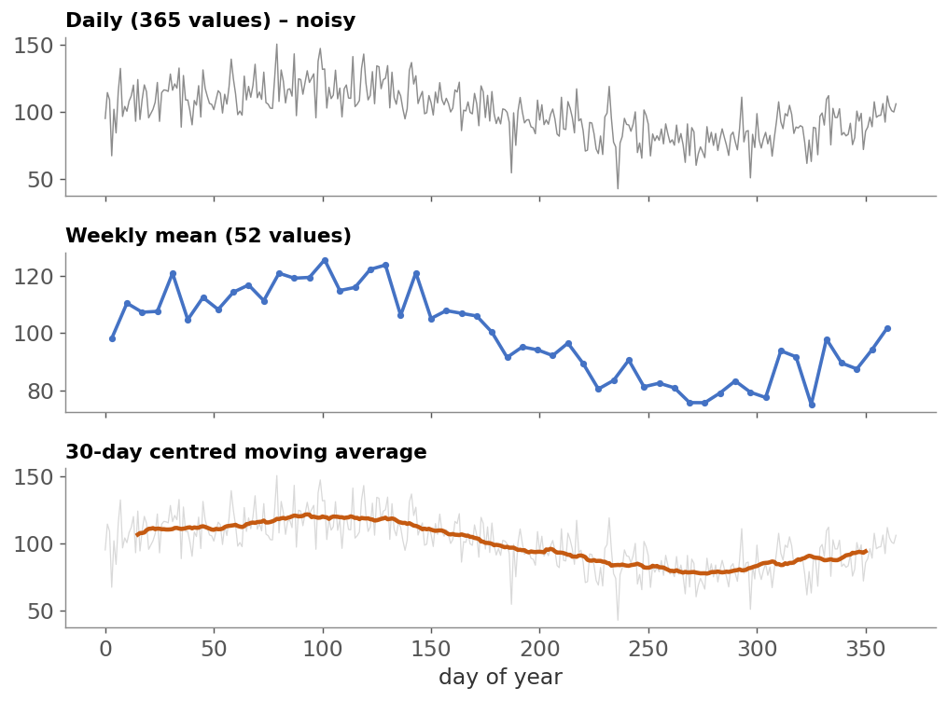
Visualization of Data, Understanding and Interpretation
Temporal Aggregation
Aggregation combines many time steps into fewer summary values.
Binning to a coarser granularity: hour → day → week → month (sum, mean, max)
Moving average over a window of k steps smooths noise (Wilke)
Larger window = smoother, but hides short events
Plot the average at the window centre to avoid lag
Munzner: aggregation is complex for time because units don’t nest (weeks vs months)
Trade-off: reduces clutter but loses detail
Source: Munzner, Visualization Analysis and Design (2014) §2.6.2 & §13.4 Aggregate; Wilke, Fundamentals of Data Visualization (2019) Ch. 14 ‘Visualizing trends’

Slide 30
Visualization of Data, Understanding and Interpretation
Numerical 5: Moving Averages
Problem
Daily sales for one week: 12, 15, 11, 18, 20, 14, 16.
(a) Compute the 3-day centred moving average. (b) Weekly total and mean.
(c) 3 years of daily data is plotted on a 900-pixel-wide chart. How many data points
per pixel for daily, weekly and monthly aggregation?
Solution
(a) Day 2: (12+15+11)/3 = 12.67 Day 3: (15+11+18)/3 = 14.67
Day 4: (11+18+20)/3 = 16.33 Day 5: (18+20+14)/3 = 17.33
Day 6: (20+14+16)/3 = 16.67 (days 1 & 7 undefined)
(b) Total = 106; mean = 106 / 7 = 15.14 per day
(c) Daily 1,095 pts → 1.22 pts/px (overplotted)
Weekly ≈ 156 pts → 5.8 px per point; Monthly 36 pts → 25 px per point
Source: Worked example; moving averages as described in Wilke, Fundamentals of Data Visualization (2019) Ch. 14

Slide 31
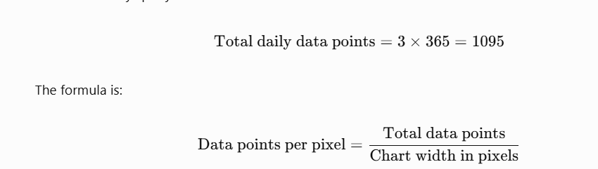
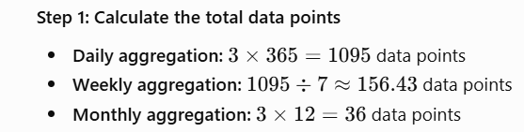
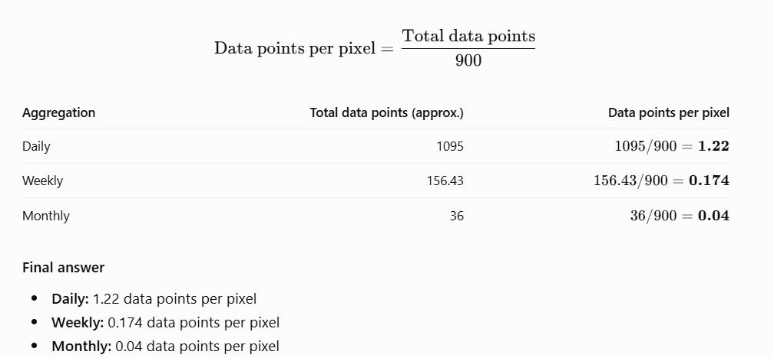
Daily data has more than one data point per pixel on average, so some points may overlap horizontally. Weekly and monthly aggregation use fewer data points per pixel, making the chart less crowded.
Notes:
3years and 12 months

Slide 32
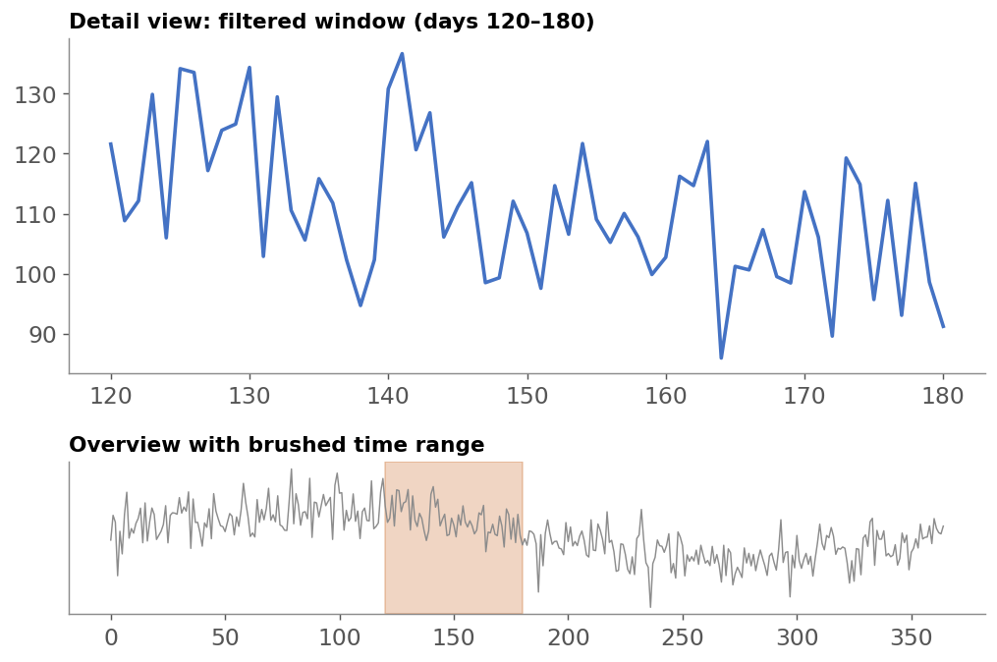
Visualization of Data, Understanding and Interpretation
Temporal Filtering
Filtering removes items outside a chosen time range or condition.
Time-range selection: sliders, brushing an overview (overview + detail)
Conditional filters: show only weekends, only peak hours, only events of type X
Dynamic queries: the view updates immediately as the range changes
Unlike aggregation, filtering keeps full detail for what remains – but the filtered-out data is hidden
Follows ‘Overview first, zoom and filter, details on demand’
Source: Munzner, Visualization Analysis and Design (2014) §13.3 Filter & §6.7 (Shneiderman’s mantra), p. 135

Slide 33
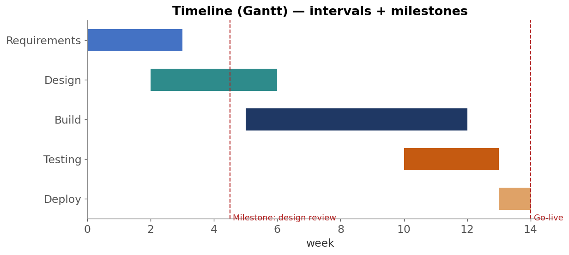
Visualization of Data, Understanding and Interpretation
Timeline Visualization
A timeline places events/intervals along a time axis: point events as marks, intervals as bars (Gantt chart)
Lanes (rows) group events by person, task or category; milestones shown as vertical reference lines
Layouts: linear (most common), radial/spiral for cyclic patterns; uses: project plans, history, patient records, logs
Source: Aigner et al., Visualization of Time-Oriented Data (2011); Munzner, Visualization Analysis and Design (2014) §2.6.2

Slide 34
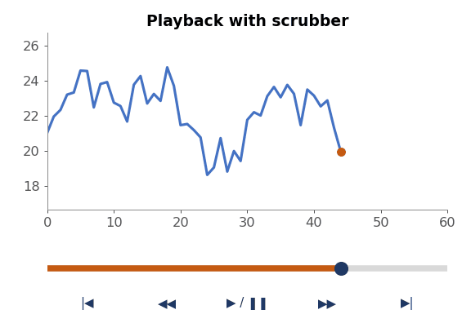
Visualization of Data, Understanding and Interpretation
Playback and Scrubbing
Playback = video-style control of an animation: play, pause, stop, rewind, step forward/back.
Scrubbing = dragging a slider (playhead) to jump to any time instantly
Speed control lets users slow down complex parts
with playback the user controls only the speed, not what happens – it is not full interactive control
Pausing and replaying is much better than seeing an animation once, but does not fully solve memory problems
Show the current time clearly (label, playhead position)
Source: Munzner, Visualization Analysis and Design (2014) §6.5.2, pp. 132–133

Slide 35
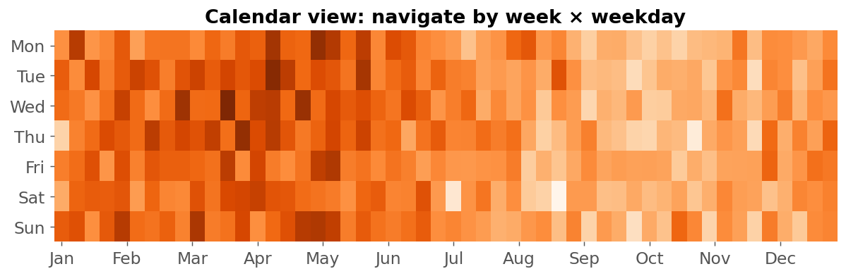
Visualization of Data, Understanding and Interpretation
Temporal Navigation
Navigate by zooming/panning the time axis, overview + detail, or jumping by calendar units (day, week, month)
Calendar views & cyclic layouts reveal weekly/seasonal patterns; semantic zoom changes granularity with zoom level
Eyes beat memory: an overview with the current window marked replaces remembering ‘where am I in time?’
Source: Munzner, Visualization Analysis and Design (2014) §11.5 Navigate & §6.5 Eyes Beat Memory; Aigner et al. (2011)

Slide 36
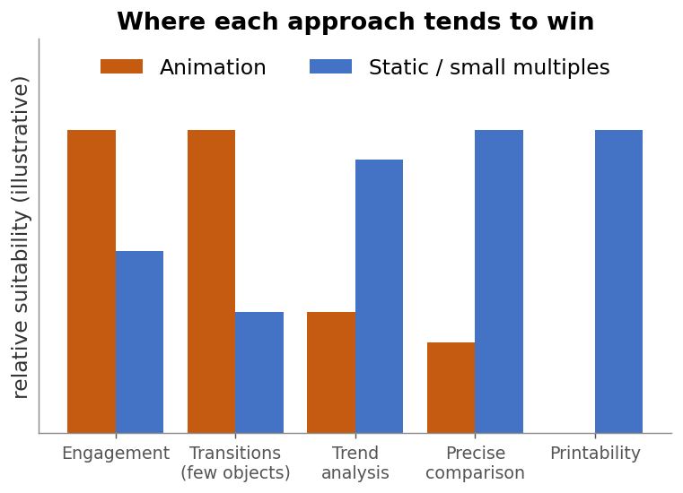
Visualization of Data, Understanding and Interpretation
Animation Versus Static Views
Animation
Time → display time
Good for transitions and showing that something moves
Engaging for storytelling and presentation
Relies on working memory to compare frames
Cannot be printed; timing controlled by viewer or author
Static views
Time → position (x-axis), colour, or multiple panels
All data visible at once – eyes can compare directly
Better for detailed analysis and precise comparison
Can be printed, annotated and re-read
May become cluttered with many time steps
Key takeaway: Munzner: ‘eyes beat memory’ – comparing visible views is cheaper than recalling earlier frames. Use animation for transitions, static views for analysis.
Source: Munzner, Visualization Analysis and Design (2014) §6.5; Tversky et al. 2002; Robertson et al. 2008

Slide 37
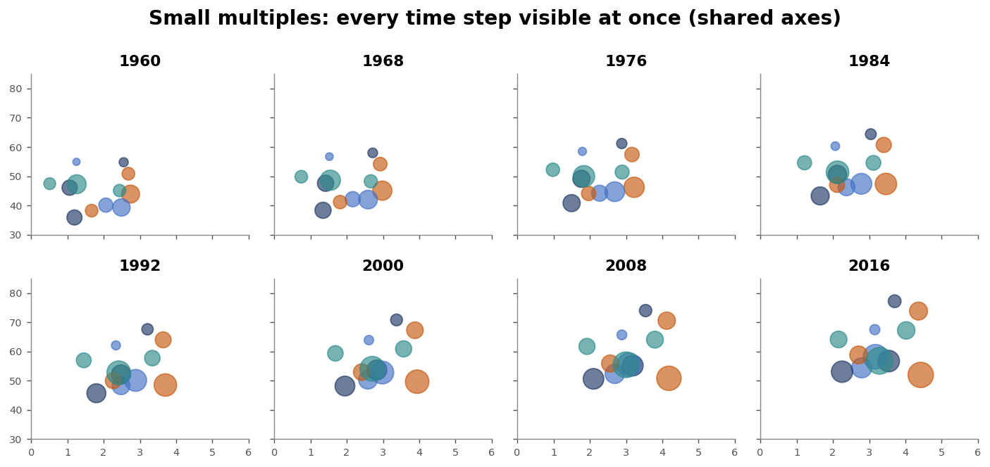
Visualization of Data, Understanding and Interpretation
Animation Versus Small Multiples
Small multiples = a grid of the same chart, one per time step, with shared axes.
Side by side, all frames can be compared with eye movements instead of memory
Works for dozens – not hundreds – of frames (display resolution limit)
Frames should be meaningful chunks, not random keyframes
Animation still better for showing continuous movement or a single transition
Wilke: multi-panel figures need consistent axes and ordering
Source: Munzner, Visualization Analysis and Design (2014) §6.5.2 & §12.3.2 Small Multiples; Wilke, Fundamentals of Data Visualization (2019) Ch. 21 ‘Multi-panel figures’; Tufte (1990)

Slide 38
Visualization of Data, Understanding and Interpretation
Numerical 6: How Many Small Multiples Fit?
Problem
A 1920 × 1080 px screen shows small multiples. Each panel needs at least 200 × 150 px
plus a 20 px in each direction.
(a) How many panels fit? (b) The data has 60 yearly time steps – does it fit? Suggest options.
(c) If instead animated at 0.5 s per year, how long is the animation?
Solution
(a) Columns = ⌊1920 / (200 + 20)⌋ = ⌊8.73⌋ = 8
Rows = ⌊1080 / (150 + 20)⌋ = ⌊6.35⌋ = 6 → 8 × 6 = 48 panels
(b) 60 > 48 → does not fit
Options: aggregate to 5-year steps (12 panels), filter to key years,
or shrink panels (loses detail)
(c) 60 × 0.5 s = 30 s of animation – viewer must remember up to 60 frames
Source: Worked example based on Munzner, Visualization Analysis and Design (2014) §6.5.2 (display-resolution limit on small multiples)

Slide 39
Visualization of Data, Understanding and Interpretation
Advantages and Limitations of Animation
Advantages
Natural (congruent) mapping for change and movement
Keeps context during transitions; tracks object identity
Motion is highly salient – good for drawing attention
Engaging for audiences and storytelling
Saves space: one view instead of many panels
Can show uncertainty via hypothetical outcome plots (Wilke)
Limitations
Heavy load on working memory
Change blindness – many simultaneous changes are missed
Hard to compare non-adjacent frames
Slower & less accurate for trend analysis
Viewer may miss the moment; needs playback control
Not printable; can be distracting or annoying (flicker)
Key takeaway: Rule of thumb: animate transitions between a few states; use static or small-multiple views for analysis tasks.
Source: Munzner, Visualization Analysis and Design (2014) §6.5, §10.4.5; Wilke, Fundamentals of Data Visualization (2019) Ch. 16; Robertson et al. 2008; Tversky et al. 2002

Slide 40
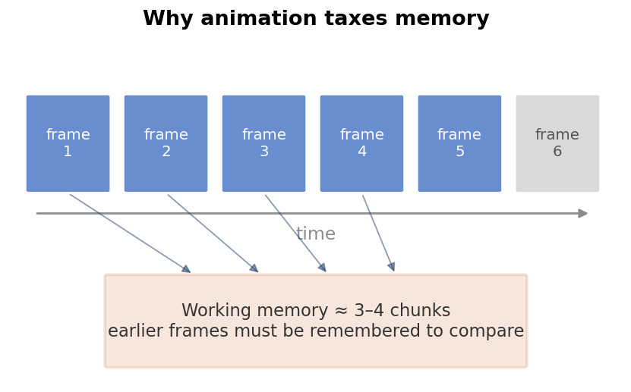
Visualization of Data, Understanding and Interpretation
Cognitive Issues in Temporal Visualization
Working memory is very limited (≈ 3–4 chunks, Cowan) and short-lived (seconds)
Attention is limited; visual search gets harder with more items; vigilance drops over time
Change blindness for changes outside the focus of attention
Motion captures attention involuntarily – distracting if overused
Confusing order and direction (e.g. in connected scatter plots – Wilke)
Mental mapping: layout must stay stable between frames
Mitigations
Few changes at a time, staging, trails, highlighting, pause & replay, small multiples
Source: Munzner, Visualization Analysis and Design (2014) §6.5.1–6.5.3, pp. 131–134; Cowan (2001); Wilke, Fundamentals of Data Visualization (2019) Ch. 13

Slide 41
Visualization of Data, Understanding and Interpretation
Summary: Design Guidelines
1
Decide first whether time needs animation at all – position (x-axis) is usually the best encoding for time
2
Use animated transitions (≈ 1 s, ease-in/out, staged) to preserve context between states
3
Use motion sparingly, mainly for highlighting; avoid flicker
4
Choose sampling and frame rate carefully: sample above 2× the fastest cycle; aim for ≥ 24 fps rendering
5
Aggregate or filter time to match the question and the available pixels
6
Give users playback, scrubbing and navigation controls; always show the current time
7
For analysis and comparison prefer static views, traces or small multiples – eyes beat memory
8
Keep scales, colours and layouts fixed across frames to support the mental map
Source: Munzner, Visualization Analysis and Design (2014) Ch. 6, 10, 11, 12, 13; Wilke, Fundamentals of Data Visualization (2019) Ch. 13, 14, 21; Heer & Robertson 2007

Slide 42
Visualization of Data, Understanding and Interpretation
Summary: Design Guidelines
1
Decide first whether time needs animation at all – position (x-axis) is usually the best encoding for time
2
Use animated transitions (≈ 1 s, ease-in/out, staged) to preserve context between states
3
Use motion sparingly, mainly for highlighting; avoid flicker
4
Choose sampling and frame rate carefully: sample above 2× the fastest cycle; aim for ≥ 24 fps rendering
5
Aggregate or filter time to match the question and the available pixels
6
Give users playback, scrubbing and navigation controls; always show the current time
7
For analysis and comparison prefer static views, traces or small multiples – eyes beat memory
8
Keep scales, colours and layouts fixed across frames to support the mental map
Source: Munzner, Visualization Analysis and Design (2014) Ch. 6, 10, 11, 12, 13; Wilke, Fundamentals of Data Visualization (2019) Ch. 13, 14, 21; Heer & Robertson 2007

Slide 43
Visualization of Data, Understanding and Interpretation
Sources and References
T. Munzner, Visualization Analysis and Design, CRC Press, 2014 – §2.6.2, §5.5, §6.5, §8.5, §10.4.5, §11.4–11.5, §12.3, §13.3–13.4
C. O. Wilke, Fundamentals of Data Visualization, O’Reilly, 2019 – Ch. 13, 14, 16, 21
J. Heer & G. Robertson, “Animated Transitions in Statistical Data Graphics,” IEEE TVCG 13(6), 2007
B. Tversky, J. B. Morrison & M. Bétrancourt, “Animation: can it facilitate?” Int. J. Human-Computer Studies 57, 2002
G. Robertson et al., “Effectiveness of Animation in Trend Visualization,” IEEE TVCG 14(6), 2008
W. Aigner, S. Miksch, H. Schumann & C. Tominski, Visualization of Time-Oriented Data, Springer, 2011
D. Simons & D. Levin, “Failure to detect changes to people during a real-world interaction,” Psychonomic Bull. & Rev., 1998
R. Rensink, J. O’Regan & J. Clark, “To see or not to see: the need for attention to perceive changes in scenes,” Psych. Science, 1997
S. Card, G. Robertson & J. Mackinlay, “The Information Visualizer,” CHI 1991; N. Cowan, “The magical number 4,” BBS, 2001
P. Dragicevic et al., “Temporal distortion for animated transitions,” CHI 2011; B. Cabral & L. Leedom, “Imaging vector fields using LIC,” SIGGRAPH 1993

Slide 44
Visualization of Data, Understanding and Interpretation
MCQs
1. According to Munzner, which use of animation is best justified in visualization?
A. Narrative storytelling with many simultaneous changes
B. Animated transitions between two states
C. Playing hundreds of frames once without controls
D. Blinking decorations to attract attention
Answer: B

Slide 45
Visualization of Data, Understanding and Interpretation
MCQs
2. Munzner classifies the motion channel as which type of channel?
A. Magnitude channel
B. Identity channel
C. Spatial position channel
D. Luminance channel
Answer: B
A. Magnitude channel: Represents quantitative values using visual properties such as length, size, or luminance intensity.
B. Identity channel: Helps distinguish or identify different objects or entities; motion can help track an object's identity over time.
C. Spatial position channel: Represents data using the location of an object along spatial axes, such as X, Y, or Z.
D. Luminance channel: Represents information through the brightness or lightness of a visual mark.

Slide 46
Visualization of Data, Understanding and Interpretation
MCQs
3. A signal’s fastest cycle has frequency 5 Hz. What is the minimum sampling rate to avoid aliasing?
A. 2.5 Hz
B. 5 Hz
C. More than 10 Hz
D. 1 Hz
Answer: C
Notes:
$$f_{s}>2f_{max}$$

Slide 47
Visualization of Data, Understanding and Interpretation
MCQs
4. Failing to notice a large change in a scene when attention is elsewhere is called:
A. Motion parallax
B. Change blindness
C. Preattentive pop-out
D. Temporal aliasing
Answer: B

Slide 48
Visualization of Data, Understanding and Interpretation
MCQs
5. How many frames are rendered for a 2-second transition at 30 fps?
A. 15
B. 30
C. 60
D. 120
Answer: C (2 s × 30 fps = 60 frames.)

Slide 49
Visualization of Data, Understanding and Interpretation
MCQs
6. Robertson et al. (2008) found that, for trend ANALYSIS, animation was:
A. Fastest and most accurate
B. Slowest and least accurate, though enjoyed by viewers
C. Identical to small multiples
D. Only useful when printed
Answer: B (Static traces/small multiples were better for analysis.)

Slide 50
Visualization of Data, Understanding and Interpretation
MCQs
7. In Munzner’s terms, a time-series dataset is:
A. A dataset where time is a value attribute only
B. An ordered sequence of time–value pairs with time as the key
C. A network of time nodes
D. An unordered set of dates
Answer: B

Slide 51
Visualization of Data, Understanding and Interpretation
MCQs
8. Increasing the window size of a moving average will:
A. Add more noise to the curve
B. Smooth more but may hide short-term events
C. Increase the number of data points
D. Convert time to a categorical axis
Answer: B

Slide 52
Thank You

