Slide 1

Visualization of Data, Understanding and Interpretation
Unit 4 : AI-Assisted Visualization
(UE24CS342AA9)
Lecture 3: LLMs for EDA & Human-in-the-Loop Visualization
Dr.Prajwala TR (Course Instructor)
Dept. of CSE, PES University, Bangalore

Slide 2
Visualization of Data, Understanding and Interpretation
Acknowledgement
The slides are prepared from various resources from the Universities from abroad and India. Also, some material is taken from reliable resources from internet throughout this course.

Slide 3
Visualization of Data, Understanding and Interpretation
Lecture Overview
In this lecture, we will cover:
Data summarization using LLMs
Automated EDA reports
LLM-generated insights and narratives
Automatic identification of trends, correlations and patterns
LLM-generated hypotheses
Data interpretation using natural language
Human-in-the-loop AI visualization: AI as assistant, not replacement
Human validation and correction of AI-generated insights
Interactive refinement of AI recommendations
Trust, verification and controllability
Human–AI division of analytical responsibility

Slide 4
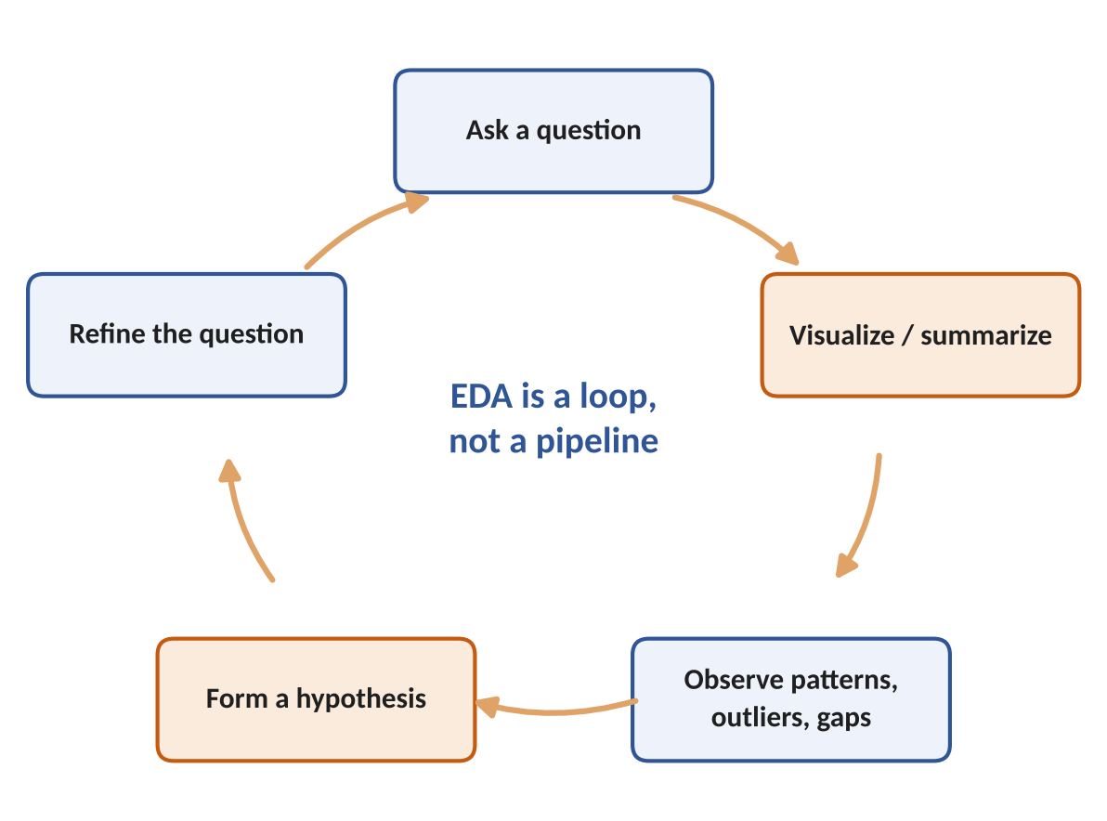
Visualization of Data, Understanding and Interpretation
Why LLMs for Exploratory Data Analysis?
What changes with an LLM assistant
EDA is iterative: Tukey's idea of exploration is to look at data from many angles before modelling. Wilke Ch 28 calls this the exploration phase, where speed of trying views matters more than polish.
Bottleneck today: each loop needs code, a chart choice and careful reading. Beginners stall at the code; experts lose time on routine profiling.
What an LLM adds: it writes profiling code, summarizes results in plain language, suggests next questions and drafts hypotheses.
What it cannot add: domain knowledge, the real question behind the request, and responsibility for the conclusion (Munzner §1.2).
Theme of this lecture: the AI speeds up every step of the loop; the human decides what each step means.
profiling means data profiling: code that gives a first overview of a dataset before any real analysis. It answers the basic “what am I working with?”

Slide 5
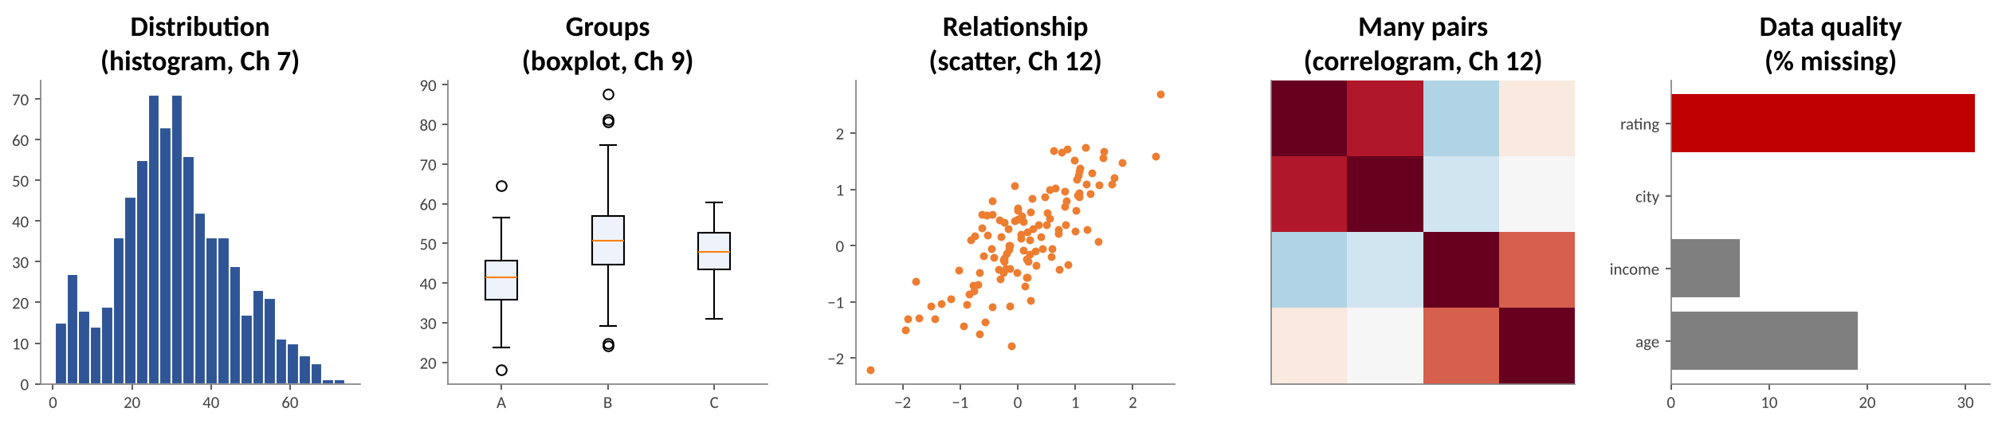
Visualization of Data, Understanding and Interpretation
Data Summarization Using LLMs: What EDA Looks For
EDA question | Statistic an AI computes | Chart to confirm it (Wilke)
How is one variable distributed? | mean, median, SD, skew, quantiles | Histogram / density (Ch 7)
How do groups differ? | group means, IQR, counts | Boxplot / violin (Ch 9)
How are two variables related? | Pearson r, Spearman ρ | Scatter plot (Ch 12)
Which of many pairs matter? | correlation matrix | Correlogram (Ch 12)
Is the data trustworthy? | % missing, duplicates, outliers | Bar of missingness, boxplot

Slide 6
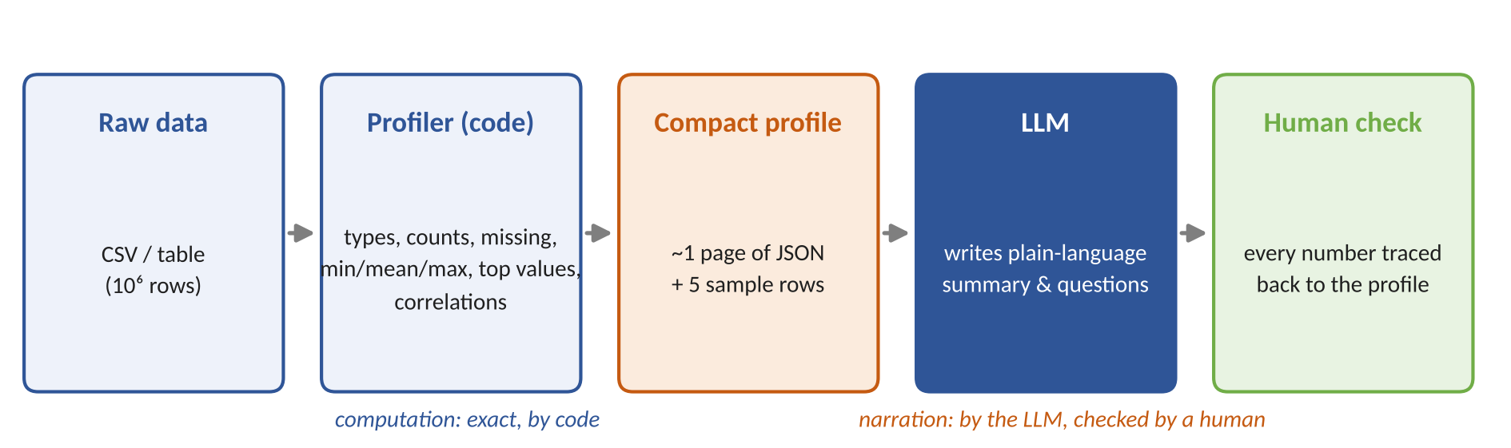
Visualization of Data, Understanding and Interpretation
The profiler is ordinary code, such as pandas or ydata-profiling
. It reads all 10⁶ rows and computes, for each column:
type: number, text, date
counts: total rows, unique values
missing: how many values are empty
min / mean / max: the range and centre of numeric columns
top values: the most frequent categories
correlations: which numeric columns move together
Data Summarization Using LLMs: How It Works
Step by step
A profiler (pandas, ydata-profiling) computes exact statistics; the LLM receives only this compact profile plus a few sample rows.
The LLM turns the profile into a readable summary, flags issues (missing values, skew, ID columns) and proposes questions to explore next.

Slide 7
Visualization of Data, Understanding and Interpretation
Example: From Profile to Plain-Language Summary
{"rows": 12480, "columns": 9,
"price_lakh": {"type": "float",
"mean": 84.2, "median": 68.5,
"skew": 3.2, "missing": 0},
"city": {"type": "category",
"unique": 6, "top": "Bengaluru"},
"rating": {"missing_pct": 31.0},
"listing_id": {"unique_pct": 100},
"corr": {"area_sqft~bhk": 0.86,
"price~area_sqft": 0.71}}
LLM summary
“The dataset has 12,480 listings across 6 cities, led by Bengaluru. Prices are right-skewed: the mean (₹84.2 lakh) is well above the median (₹68.5 lakh), so a few very expensive homes pull the average up. 31% of ratings are missing. listing_id is an identifier and should not be analysed as a number. Larger flats cost more (r = 0.71), possibly because they have more bedrooms.”
Sentence type | Status
Counts, mean, median, % missing | ✔ restates the profile
“A few expensive homes pull the average up” | ✔ correct reading of skew
“possibly because they have more bedrooms” | ⚠ hypothesis — verify

Slide 8
Visualization of Data, Understanding and Interpretation
Why Compute First, Then Narrate?
Task | LLM alone | Code + LLM
Exact mean / median of 10,000 rows | Unreliable: may approximate or invent | Exact (code), explained (LLM)
Spot an identifier column | Good: uses names and patterns | Good
Explain what skewness means here | Good | Good
Correlations across 20 columns | Unreliable without computation | Exact matrix, ranked by |r|
Fit within context window | Fails for large tables | Profile is ~1 page
Data privacy | Raw data sent to the model | Only aggregates and a few samples sent
Rule for this course: every number an AI states must come from code you can inspect.

Slide 9
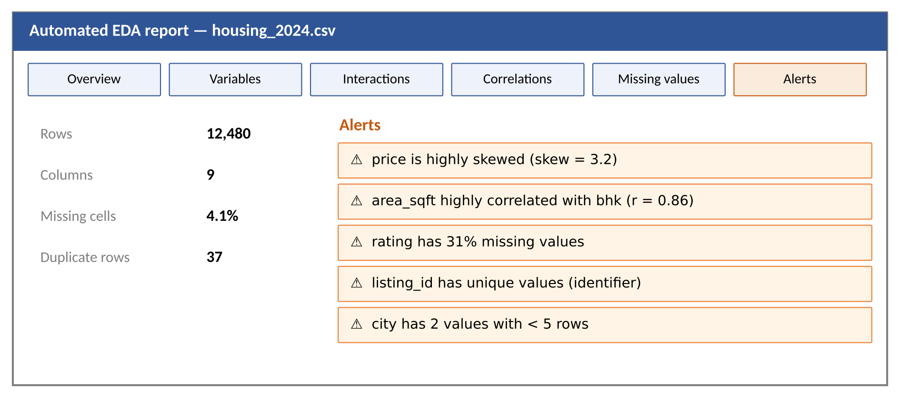
Visualization of Data, Understanding and Interpretation
Automated EDA Reports
What a report contains
Overview: rows, columns, missing cells, duplicates, memory.
Variables: type, distribution, extremes per column.
Interactions & correlations: pairwise plots, correlation matrices.
Missing values: where and how much data is absent.
Alerts: automatic warnings such as skew, high correlation, constant or unique columns.
Tools: ydata-profiling, Sweetviz, D-Tale, AutoViz, LIDA, ChatGPT data analysis.
Why it helps
Produces a full first look in seconds, so the analyst starts from questions rather than from boilerplate code.

Slide 10
Visualization of Data, Understanding and Interpretation
Reading the Alerts: From Warning to Verification Chart
Alert | What it means | Risk if ignored | Verify with (Wilke)
High skew (price) | a long right tail | mean misleads; LLM reports 'average' | Histogram / density (Ch 7)
High correlation (area ~ bhk) | two columns carry similar information | double counting in models | Scatter plot (Ch 12)
Many missing (rating 31%) | data absent for many rows | biased summaries | Missingness bar by group
Unique values (listing_id) | identifier, not a measure | meaningless 'average ID' | Check the data type (Ch 2)
Rare categories | groups with < 5 rows | unstable group means | Bar of counts per group
Duplicates | repeated rows | inflated counts | Count of duplicates by source
An alert tells you where to look; the chart tells you what is true.

Slide 11
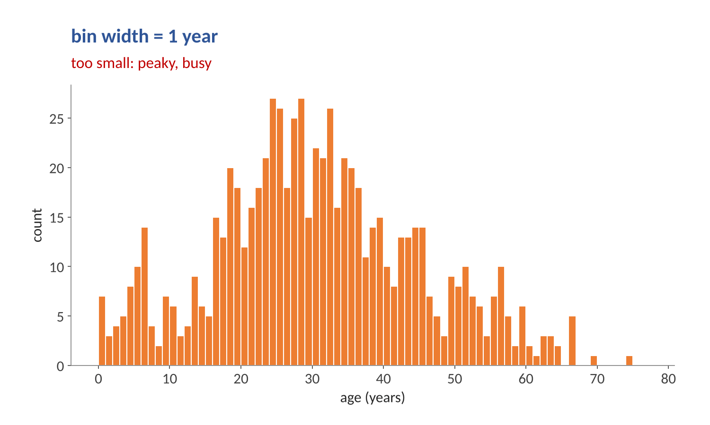
Visualization of Data, Understanding and Interpretation
Automated Reports Inherit Default Choices: Bin Width
Wilke Ch 7 on histograms
A histogram's appearance depends on the bin width, and most programs pick a default.
Too small: “overly peaky and visually busy”; the main trend is hidden.
Too large: small features such as the dip near age 10 disappear.
For the Titanic ages, 3–5 year bins work well; 1 and 15 years do not.
Implication for AI: an LLM reading a 1-year histogram may report a 'multimodal' pattern that is only noise.

Slide 12
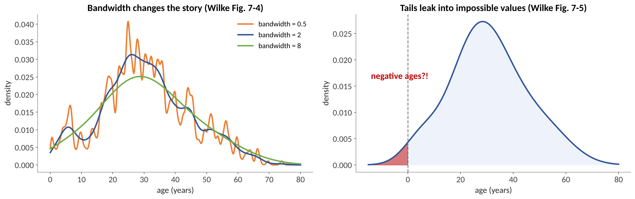
Visualization of Data, Understanding and Interpretation
Automated Reports Inherit Default Choices: Density Plots
Bandwidth
Small bandwidth = spiky curve; large bandwidth = over-smoothed. The kernel shape matters less as data size grows.
Impossible values
“Always verify that your density estimate does not predict the existence of nonsensical data values” (Wilke Ch 7).

Slide 13
Visualization of Data, Understanding and Interpretation
LLM-Generated Insights: What Counts as an Insight?
Insight type | Template | Example | Typical chart
Trend | <measure> rose/fell X% over <period> | Listings rose 18% Jan–Jun | Line
Extreme | <item> has the highest/lowest <measure> | Mumbai has the highest median price | Sorted bar
Outlier | <item> is unusually high/low | One Pune listing at ₹12 crore | Boxplot / scatter
Comparison | <A> is X% higher than <B> | Online orders 40% above store | Grouped bar
Correlation | <x> and <y> move together (r = …) | Area and price, r = 0.71 | Scatter
Composition | <part> makes up X% of <whole> | 2BHK is 46% of listings | Stacked bar
Distribution | <measure> is skewed / bimodal | Price is right-skewed | Histogram

Slide 14
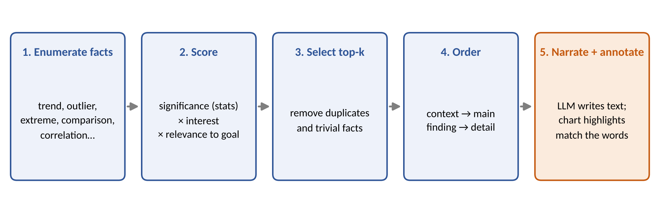
Visualization of Data, Understanding and Interpretation
From Insights to a Narrative
How the steps work
Facts are scored by statistical strength (effect size, p-value) and by relevance to the user's question; near-duplicates are removed so the story is not repetitive.
The LLM orders the chosen facts (context, main finding, supporting detail) and every claim is paired with a highlight on the chart.

Slide 15
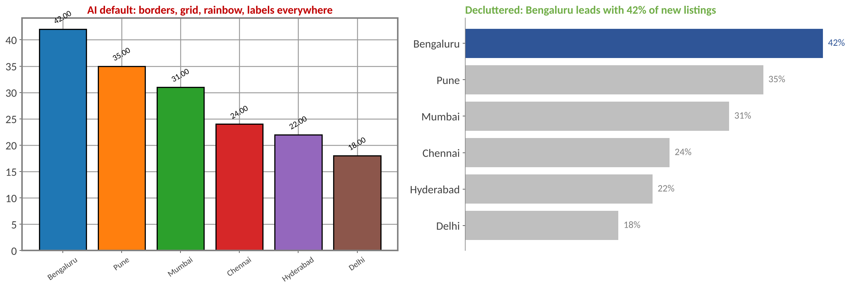
Visualization of Data, Understanding and Interpretation
AI Charts Need Decluttering (Knaflic Ch 3)
Clutter is your enemy
Borders, heavy gridlines, rainbow colours and repeated labels raise cognitive load without adding information.
Declutter steps
Remove border and gridlines → grey the context → label directly → title with the takeaway.

Slide 16
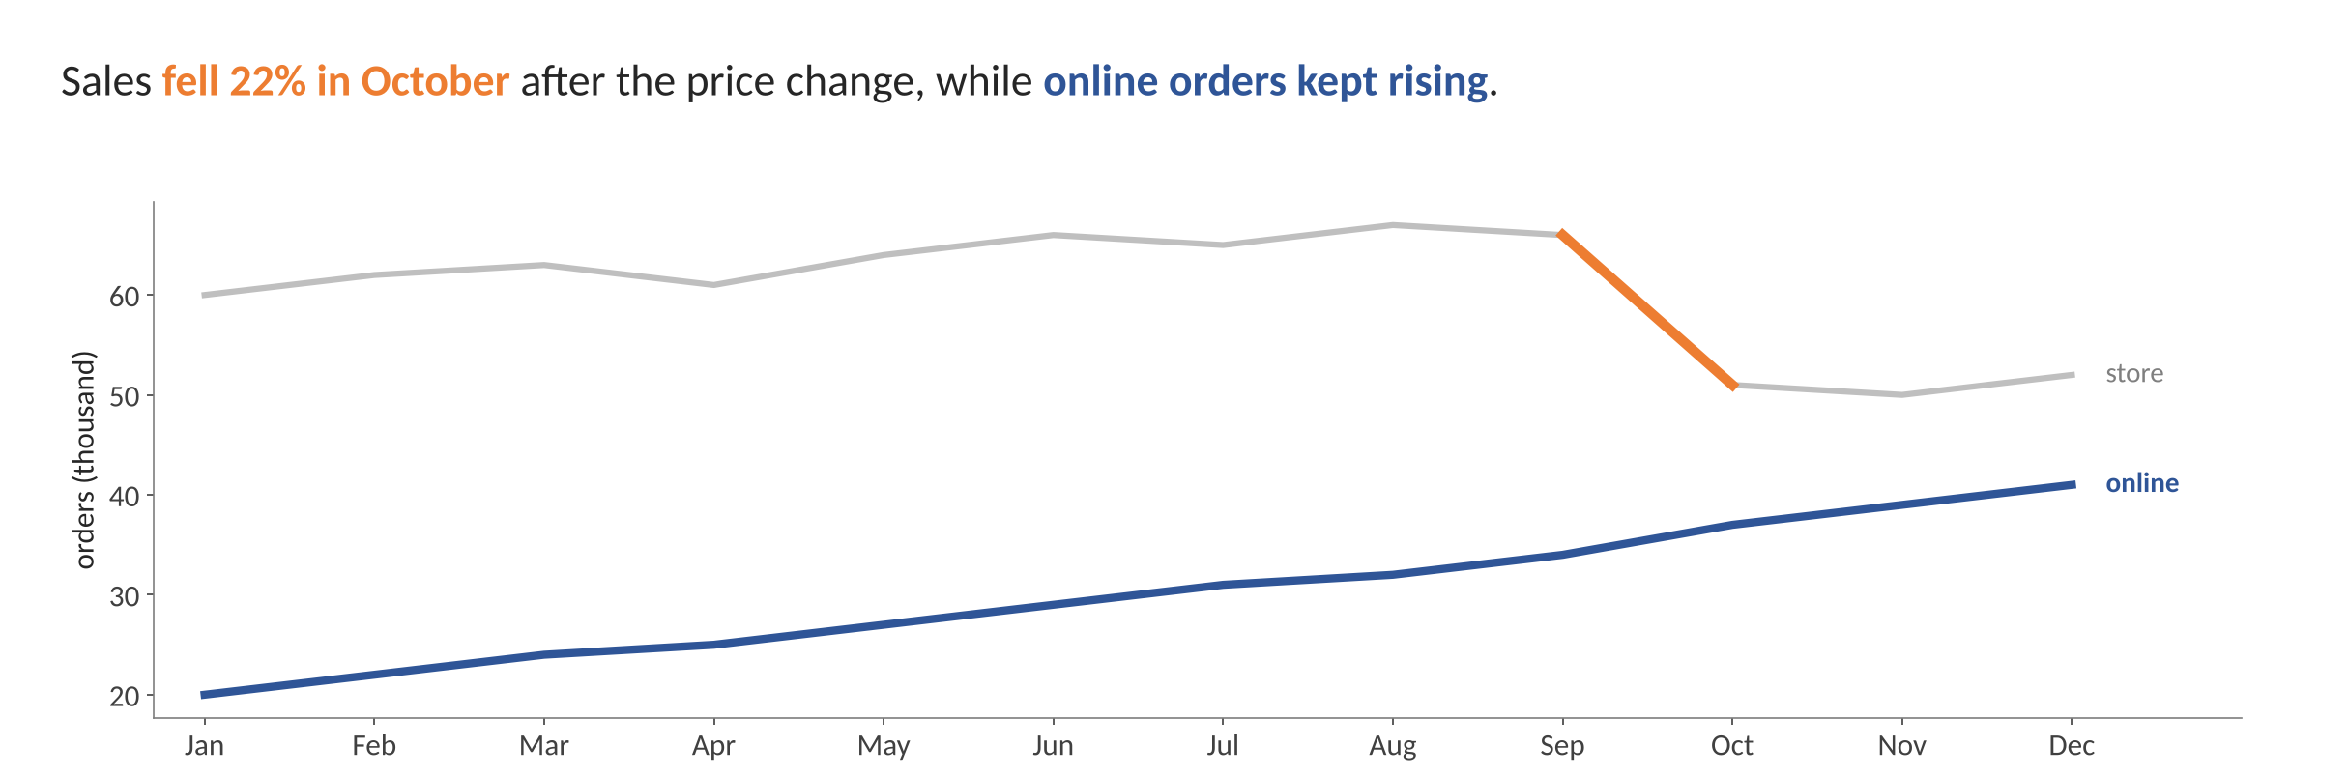
Visualization of Data, Understanding and Interpretation
Linking Narrative Words to Visual Emphasis (Knaflic Ch 4)
Design rules
Use colour sparingly: one or two accents only.
Match the colour of a phrase to the data it describes.
Grey everything that is context.
Test: where do your eyes go first? It should be the key finding.
Why it matters for AI narratives
A sentence the reader cannot find in the chart cannot be checked; colour-linking makes every AI claim verifiable at a glance.

Slide 17
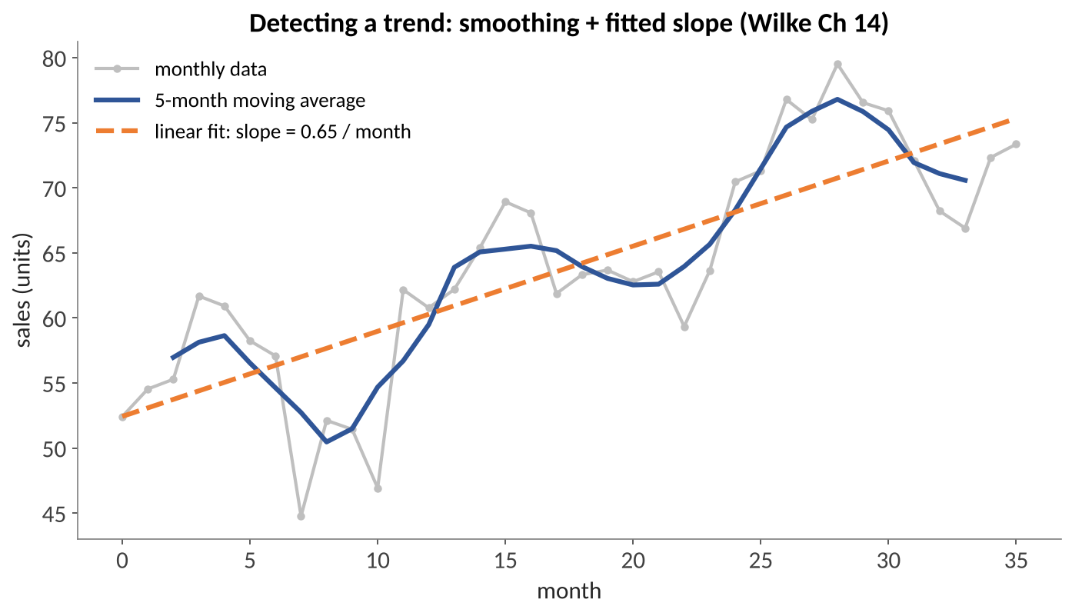
Visualization of Data, Understanding and Interpretation
Automatic Identification of Trends
How an AI detects a trend
Smooth: a moving average or LOESS removes noise and seasonality (Wilke Ch 14).
Fit: a linear regression slope gives direction and size, e.g. +0.65 units per month.
Test: is the slope distinguishable from zero? (e.g. Mann–Kendall test).
Describe: the LLM turns the numbers into a sentence.
Caution: a trend over a short or seasonal window can reverse; always show the full series.
Wilke Ch 14
Moving averages lag the data; LOESS adapts to local shape but its curve depends on the span chosen.

Slide 18
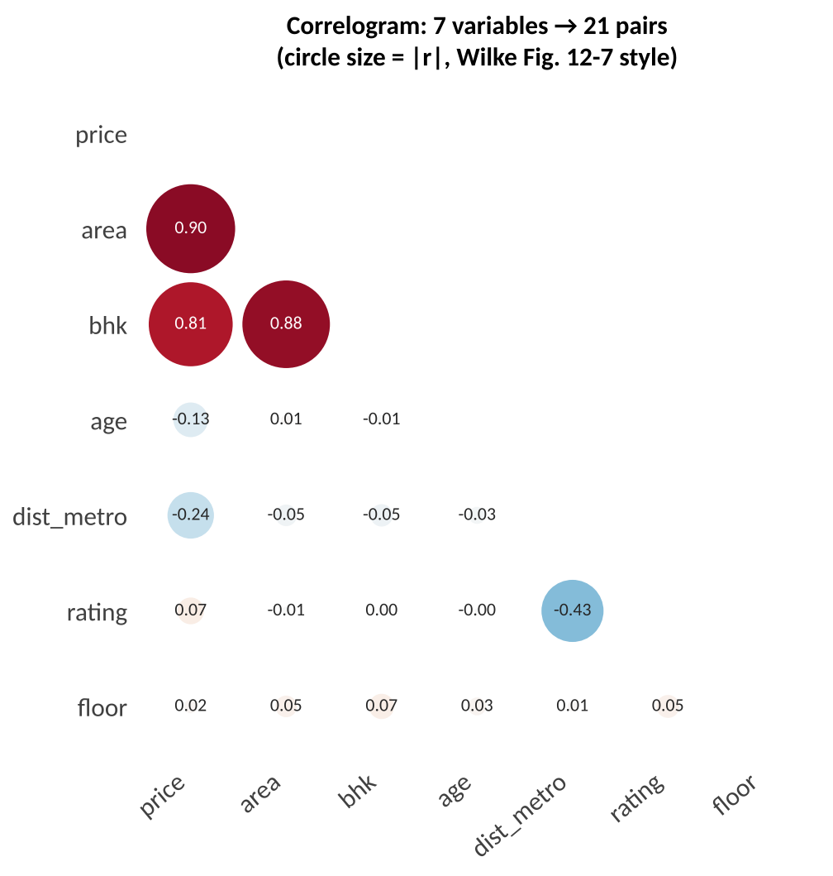
Visualization of Data, Understanding and Interpretation
Automatic Identification of Correlations
Pearson correlation coefficient (Wilke Ch 12)
r = Σ(xᵢ − x̄)(yᵢ − ȳ) / √[Σ(xᵢ − x̄)² · Σ(yᵢ − ȳ)²]
Properties and use
r lies between −1 and +1; 0 means no linear association, ±1 a perfect one.
Symmetric: r(x, y) = r(y, x). Unchanged if data are shifted (x + C) or rescaled (C·x).
n variables give n(n − 1)/2 pairs: 7 variables → 21 pairs, 20 variables → 190.
Circle size = |r| suppresses near-zero correlations (Wilke Fig. 12-7).
Wilke's warning: correlograms “hide the underlying data points and may cause us to draw incorrect conclusions.”

Slide 19
Visualization of Data, Understanding and Interpretation
Numerical 1: Computing Pearson r by Hand
Store | Ad spend x (₹ lakh) | Sales y (₹ lakh) | x − x̄ | y − ȳ | (x − x̄)(y − ȳ) | (x − x̄)² | (y − ȳ)²
A | 1 | 2 | −2 | −2 | 4 | 4 | 4
B | 2 | 4 | −1 | 0 | 0 | 1 | 0
C | 3 | 5 | 0 | 1 | 0 | 0 | 1
D | 4 | 4 | 1 | 0 | 0 | 1 | 0
E | 5 | 5 | 2 | 1 | 2 | 4 | 1
Σ / mean | x̄ = 3 | ȳ = 4 |  |  | 6 | 10 | 6
Solution
r = 6 / √(10 × 6)
= 6 / √60 = 6 / 7.746
≈ 0.775
Strong positive association.
If x is rescaled to ₹ thousand (×100), r stays 0.775 (Wilke: rescaling cancels).
With only 5 points, an AI should report this as tentative, not as a finding.
Steps
Compute the means, then the deviations from the mean.
Multiply paired deviations and sum (numerator); sum the squared deviations (denominator).

Slide 20
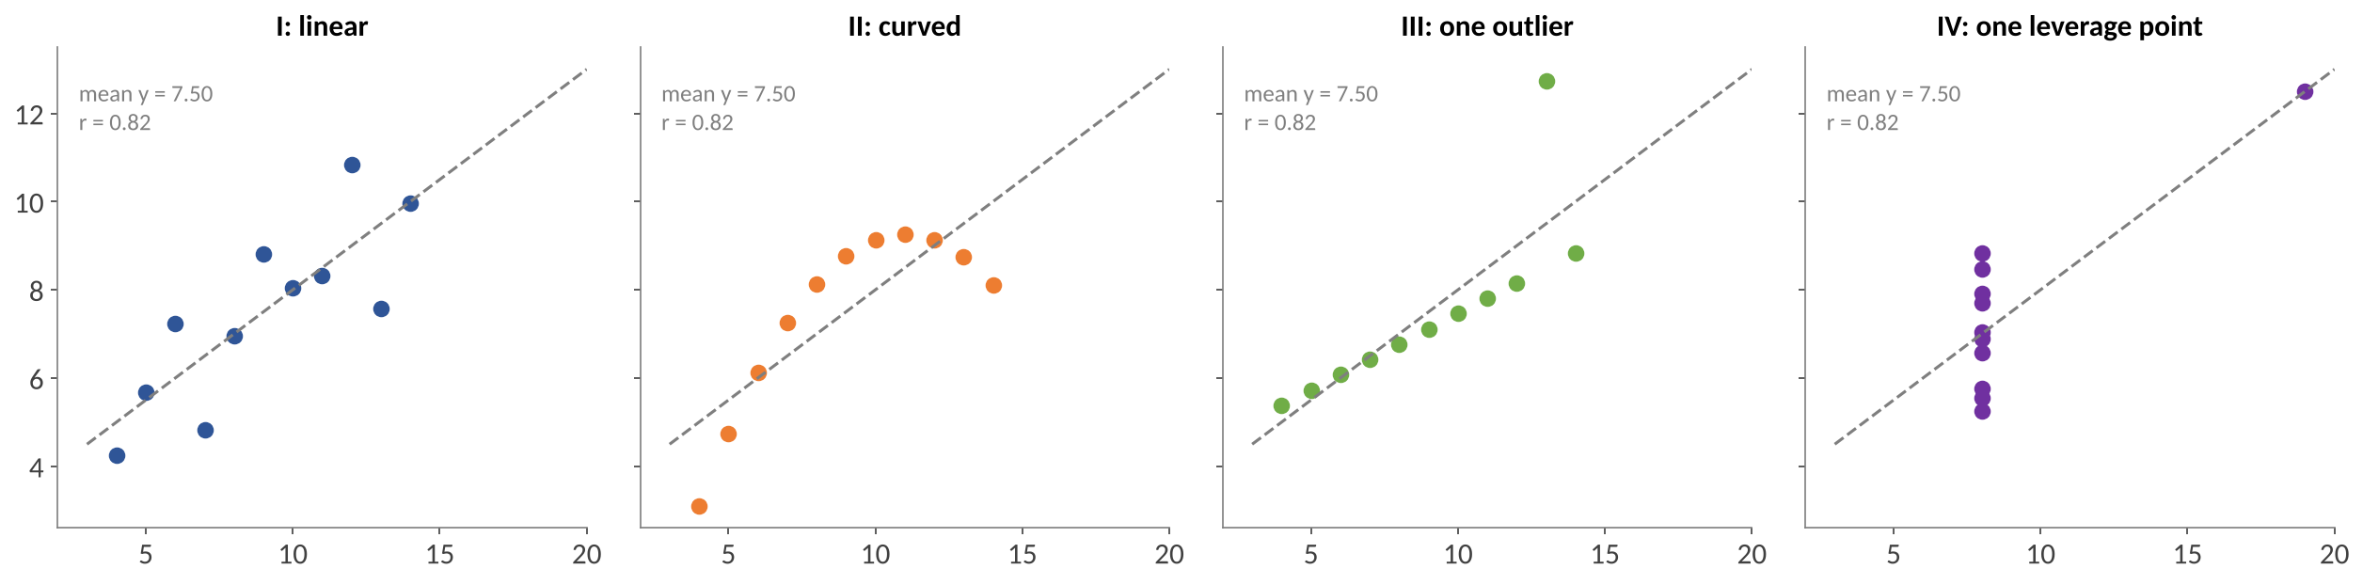
Visualization of Data, Understanding and Interpretation
Same Statistics, Different Data: Anscombe's Quartet
Anscombe’s quartet is a set of four small datasets built by the statistician Francis Anscombe in 1973. Their summary statistics are almost identical, but their graphs look completely different.
“It is always better to visualize the raw data rather than abstract, derived quantities that have been calculated from it.”
— Wilke, Ch 12
Lesson for AI-assisted EDA
Summary statistics can be identical while the data differ; require a chart for every correlation an AI reports.

Slide 21
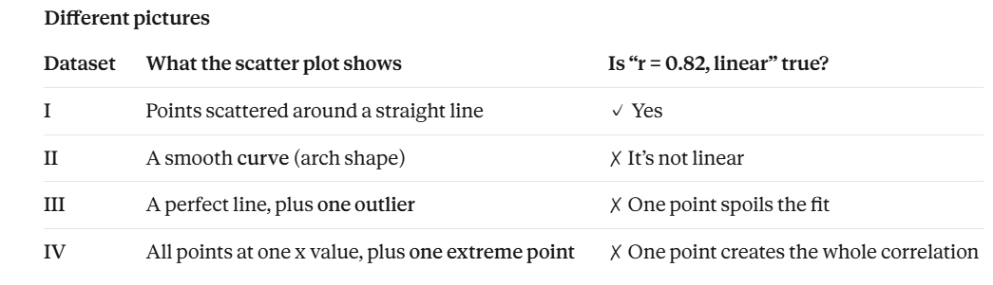

Slide 22
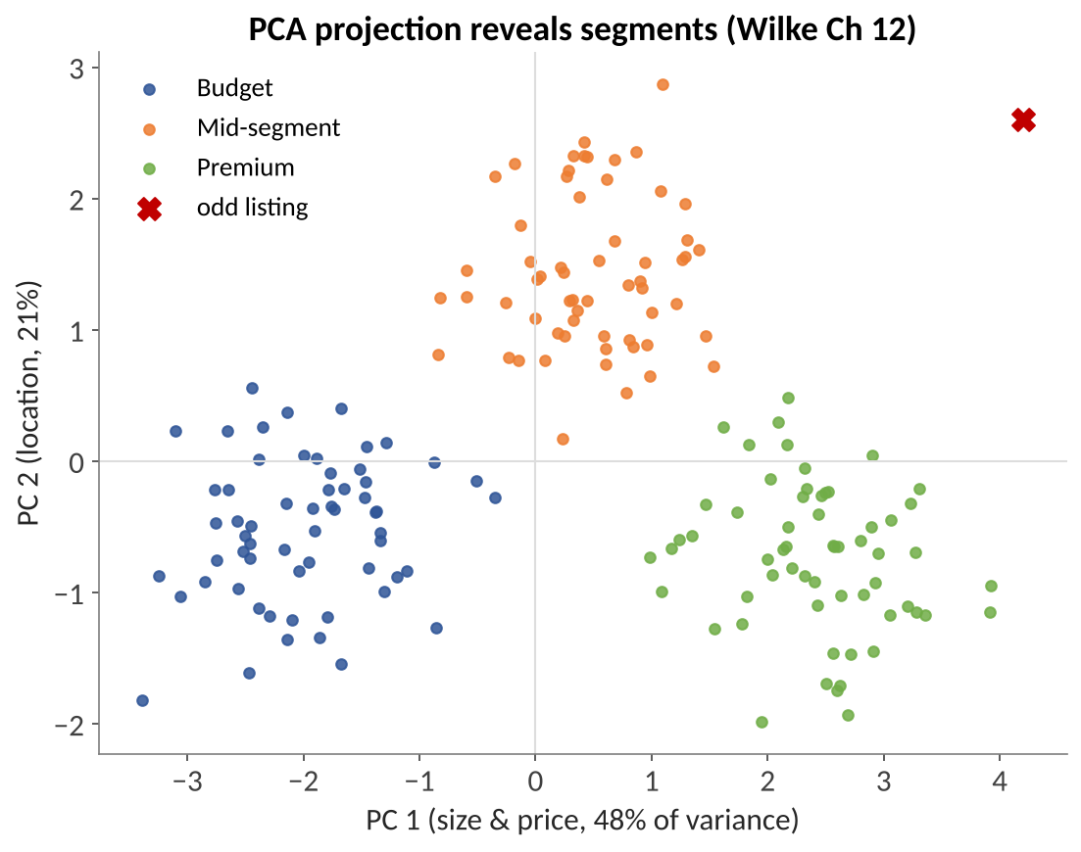
Visualization of Data, Understanding and Interpretation
Automatic Identification of Patterns: Clusters
PCA in Wilke Ch 12
High-dimensional data often contain correlated variables carrying overlapping information.
PCA standardizes variables (mean 0, variance 1) and creates principal components as linear combinations.
PCs are uncorrelated; PC 1 captures the most variation, PC 2 the next most.
Interpret two things: the composition of each PC (arrows) and where points fall.
AI role: compute PCA, propose clusters, flag the odd listing.
Human role: decide whether 'Budget / Mid / Premium' are meaningful segments or artefacts.

Slide 23
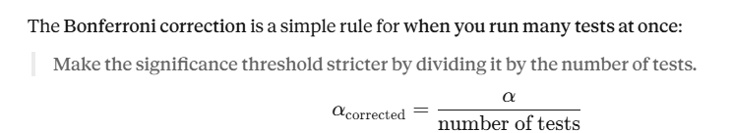
Visualization of Data, Understanding and Interpretation
Numerical 2: Scanning Many Pairs Produces False Patterns
Question
An AI assistant scans all pairs of 7 variables for correlations and calls any pair with p < 0.05 'significant'. Suppose no real correlations exist.
(a) How many pairs are tested?
(b) Expected number of false 'significant' pairs?
(c) Probability of at least one false finding?
(d) Bonferroni-corrected threshold?
Solution
(a) ⁷C₂ =7 × 6 / 2 = 21 pairs
(b) 21 × 0.05 = 1.05 false findings expected
(c) 1 − 0.95²¹ = 1 − 0.341 = 0.659
about a 2-in-3 chance of at least one false pattern
(d) 0.05 / 21 ≈ 0.0024
Lesson: an AI that reports 'the strongest correlation' from a big scan is often reporting noise. Treat scan results as hypotheses and confirm on new data.
0.0024 is the new cut-off.
The AI should call a pair of variables “related” only if its p-value is smaller than 0.0024.

Slide 24
Visualization of Data, Understanding and Interpretation
LLM-Generated Hypotheses
Generate vs verify (Munzner §3.4.1.1)
Generate: propose possible explanations for an observation; breadth matters.
Verify: test a specific hypothesis with data; rigour matters.
LLM strength: fast, broad generation using world knowledge (festivals, pricing, supply).
LLM weakness: cannot see unrecorded causes; may present guesses as facts.
Good practice: ask for several competing hypotheses and the evidence that would separate them.
Observation | LLM hypothesis | Test (chart / statistic)
Oct sales fell 22% | Price rise in Sept | Sales vs price, before/after
 | Festival shifted to Nov | Same month, previous years
 | 3 stores missing data | Row counts per store per month
Rating ~ distance to metro | Commute matters to buyers | Scatter by city; control for price
The cheapest hypothesis to rule out first is a data problem (missing rows, duplicates).

Slide 25
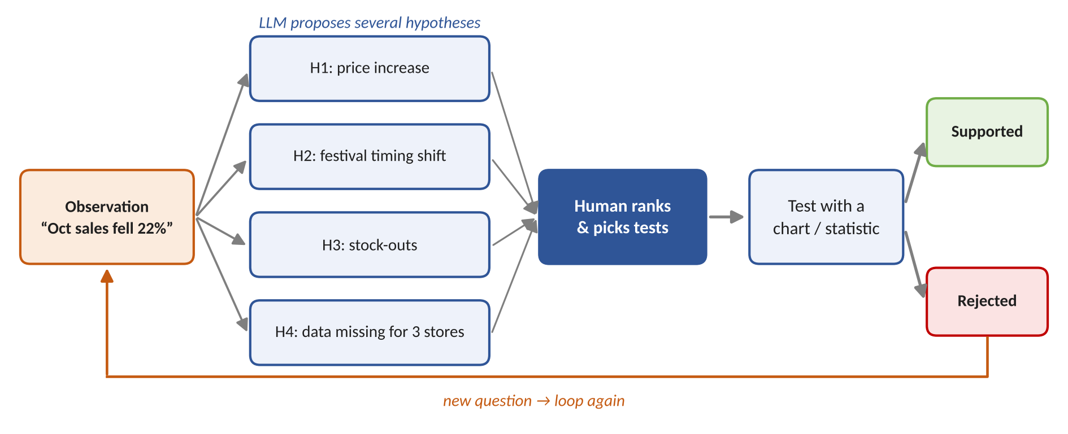
Visualization of Data, Understanding and Interpretation
A Workflow for AI-Generated Hypotheses
Key idea
The LLM widens the set of explanations; the human narrows it by choosing tests, and every outcome feeds the next question in the EDA loop.

Slide 26
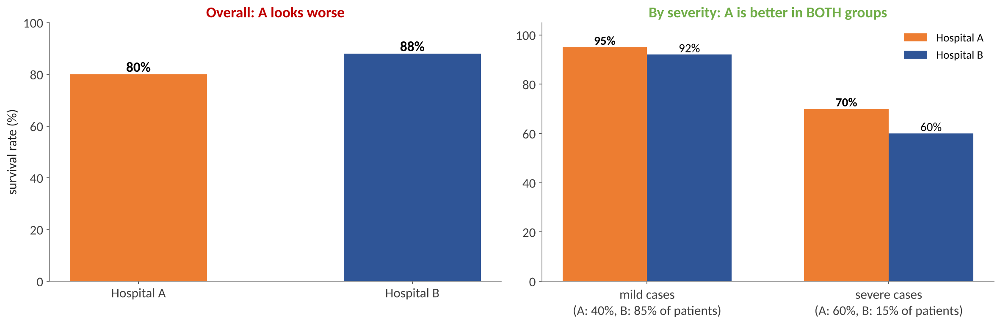
Visualization of Data, Understanding and Interpretation
When AI Hypotheses Go Wrong: Simpson's Paradox
Simpson’s paradox happens when a trend that appears in every subgroup of the data reverses, or disappears, when the groups are combined.
What happened
A lurking variable (case severity) differs between groups and reverses the overall comparison.
Human safeguard
Ask: what else differs between the groups? Split by it before accepting a causal claim.

Slide 27
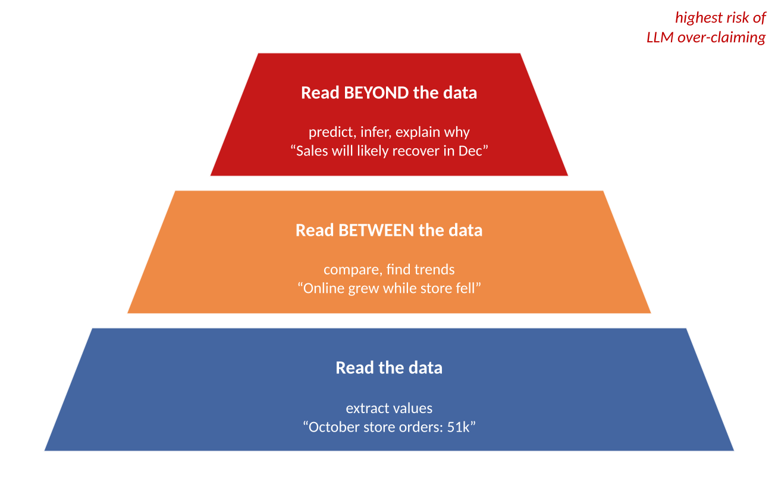
Visualization of Data, Understanding and Interpretation
Data Interpretation Using Natural Language
What an LLM can do
Chart-to-text: write captions and alt-text describing a chart.
Answer questions: “Which month was lowest?” using the underlying data.
Explain statistics: “r = 0.78 means larger flats tend to cost more, but size is not the only factor.”
Translate for audiences: technical summary for analysts, plain summary for managers.
Risk zone: predictions and causal explanations (top level) need evidence and uncertainty.
Ask the AI which level each sentence belongs to.

Slide 28
Visualization of Data, Understanding and Interpretation
Good and Poor Natural-Language Interpretations
AI statement | Problem (Wilke-style rating) | Better statement
“Ad spend causes sales to rise (r = 0.78).” | Bad: correlation stated as causation | “Stores with higher ad spend tended to have higher sales.”
“Average price is ₹84 lakh.” | Bad: mean hides strong skew | “Median price is ₹68.5 lakh; a few luxury homes raise the mean to ₹84 lakh.”
“Pune sales doubled in Q2.” | Wrong: 3 stores missing in Q1 | “For the 3 stores with data in both quarters, sales were flat.”
“Sales will recover in December.” | Bad: prediction with no uncertainty | “If the usual seasonal pattern holds, sales may rise; uncertainty is high.”
“The data show interesting variation.” | Ugly: vague, adds nothing | “Prices vary 3× across cities, from ₹66 to ₹148 lakh.”
Wilke Ch 1: ugly = aesthetic problem, bad = perception problem (unclear, misleading), wrong = mathematically incorrect.

Slide 29
Visualization of Data, Understanding and Interpretation
Human-in-the-Loop AI Visualization: Why Keep Humans?
“Vis systems are appropriate for use when your goal is to augment human capabilities, rather than completely replace the human in the loop.”
— Munzner, VAD §1.2
Ill-specified problems
People “don't know which of these many questions are the right ones in advance.”
Exploration needs human pattern detection and judgement.
When automation is enough
If a fully automatic solution is acceptable (e.g. high-frequency trading), no vis tool is needed.
Most EDA is not like this.
Vis around automation
Transitional: understand the problem before automating it.
Developers: debug the algorithm.
End users: check the ML system “is doing the right thing according to human judgement.”

Slide 30
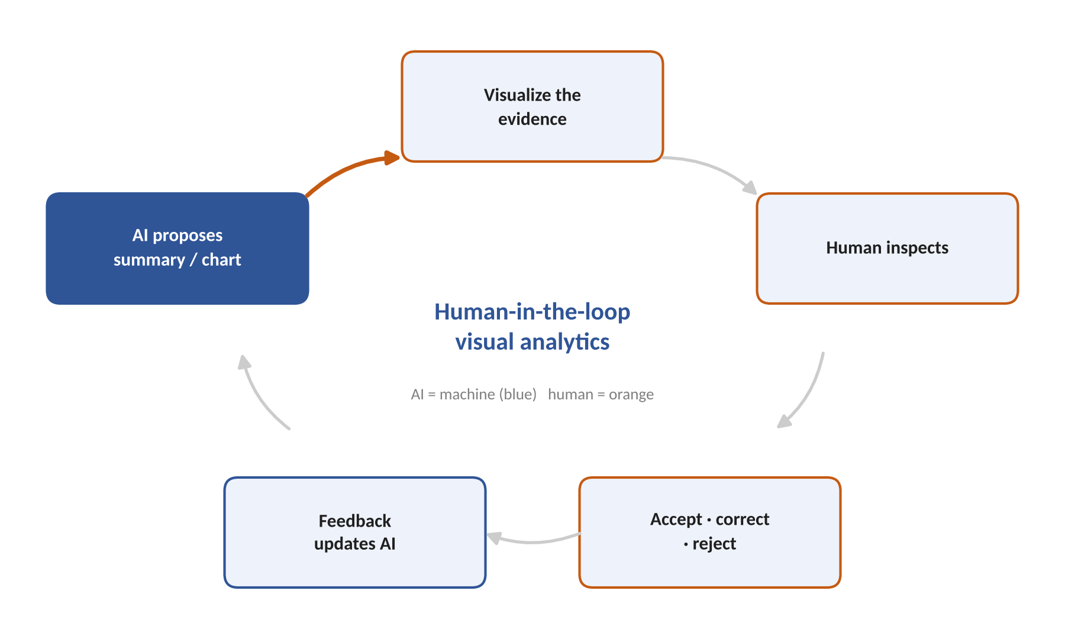
Visualization of Data, Understanding and Interpretation
The Human-in-the-Loop Cycle (Animated)
Each step
AI proposes: summary, chart or insight.
Visualize evidence: show the data behind the claim, not just the claim.
Human inspects: does it match domain knowledge and the raw data?
Decide: accept, correct (edit) or reject.
Feedback: constraints and corrections shape the next proposal.
Without step 2, the human can only trust or distrust; with it, the human can verify.

Slide 31
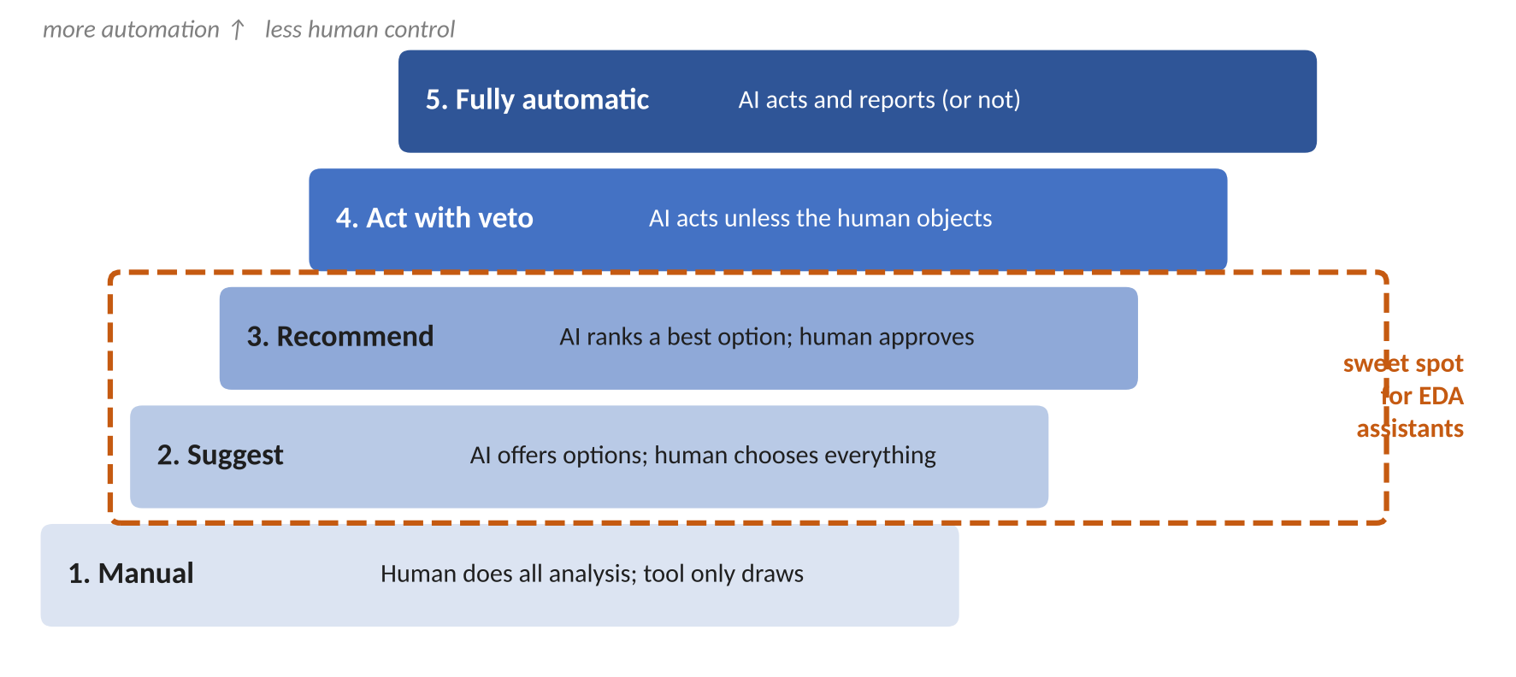
Visualization of Data, Understanding and Interpretation
AI as Assistant Rather Than Replacement
Assistant, not replacement
The AI does routine work: code, profiling, first drafts.
The human sets goals and makes judgement calls.
Every AI output is a proposal until a human accepts it.
Higher automation is fine for low-stakes, well-tested tasks.
Heer (2019): combine “agency plus automation” — AI should augment, not override, the user.
Choosing the level
Stakes and reversibility decide: a wrong exploratory chart costs minutes; a wrong board-report insight costs decisions. Raise automation only where errors are cheap and visible.

Slide 32
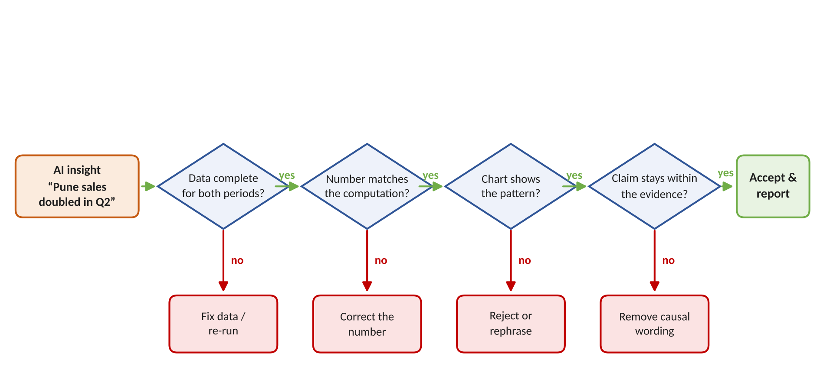
Visualization of Data, Understanding and Interpretation
Human Validation and Correction of AI Insights
Validation = is it true?
Check data completeness, recompute the number, and look at the chart the claim is based on.
Correction = make it right
Fix the data, edit the number, narrow the claim, or remove causal language; record what changed.

Slide 33
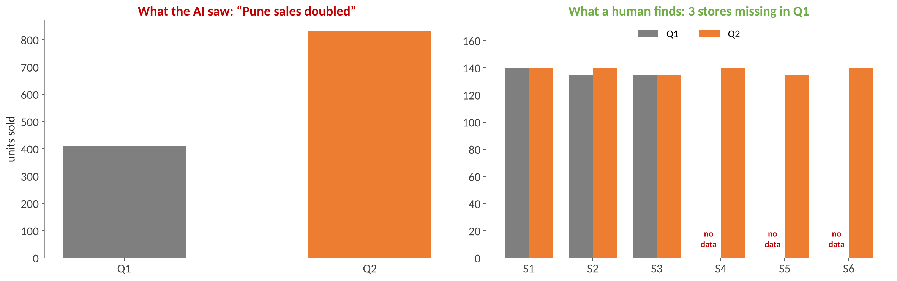
Visualization of Data, Understanding and Interpretation
Worked Case: Verifying “Pune Sales Doubled in Q2”
Step | Check | Finding
1 | Data complete? | No — stores S4–S6 have no Q1 rows (opened in Q2)
2 | Corrected computation | Like-for-like (S1–S3): 410 → 415 units, +1%
3 | Corrected insight | “Sales were flat in existing stores; 3 new stores added 415 units.”

Slide 34
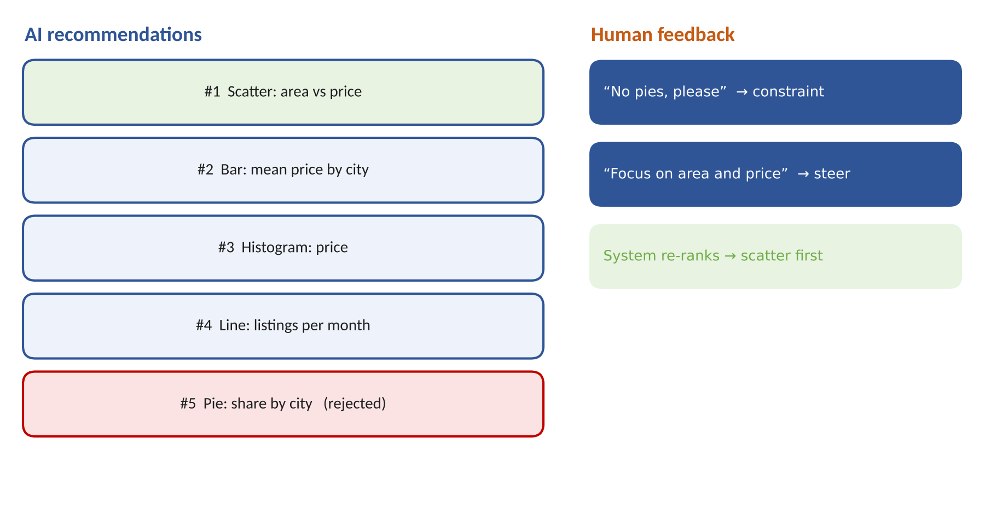
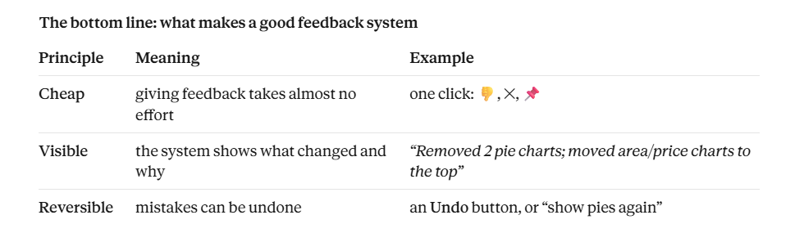
Visualization of Data, Understanding and Interpretation
Interactive Refinement of AI Recommendations
In AI-assisted EDA, the AI often suggests a list of charts to look at, ranked from most to least useful. These suggestions won’t be perfect the first time.
The five types of feedback
Feedback | Example | Effect
Reject | “not this chart” | down-weights similar charts
Constrain | “no pies” | hard rule for the session
Steer | “focus on price & area” | re-ranks by relevance
Adjust | “use 5-year bins” | changes a parameter
Pin | “keep this one” | fixed in the dashboard

Slide 35
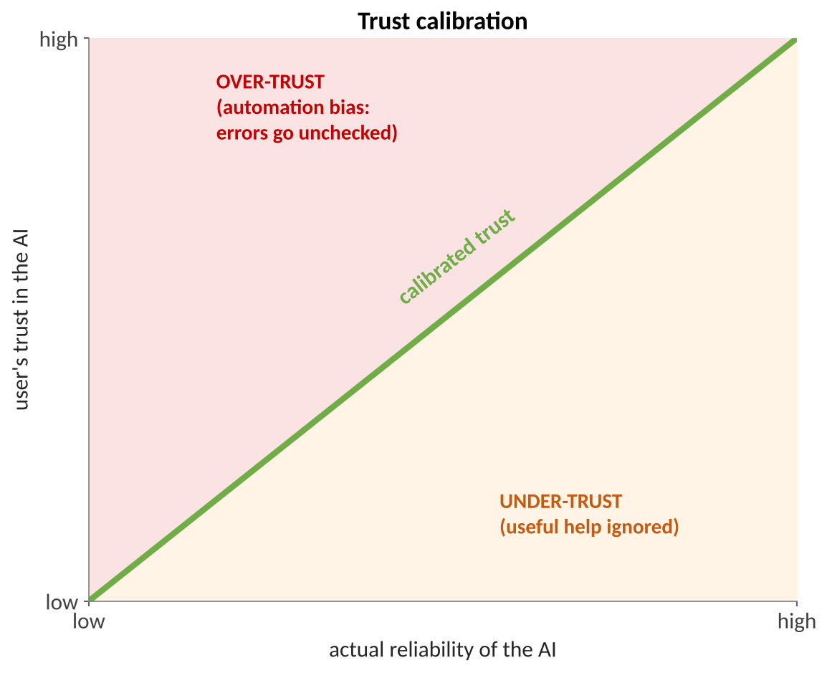
Visualization of Data, Understanding and Interpretation
Verification aids → user can CHECK the AI → catches errors → avoids over-trust
Controllability → user can FIX the AI → feels safe using it → avoids under-trust
↓
Calibrated trust (green line)
Trust, Verification and Controllability
The goal is not to make users trust the AI as much as possible. The goal is for users to trust the AI exactly as much as it deserves: trust it where it’s reliable, and check it where it isn’t. This is called calibrated trust.
Verification aids
Show the code or spec behind each chart
Link every number to its computation
Show uncertainty and sample size
Show data provenance and gaps
Controllability
Edit any choice (field, filter, bins)
Undo and version history
Override or switch off suggestions
Ask the AI to explain its choice
These are features that let users check whether the AI is right.
These are features that let users change or override the AI.

Slide 36
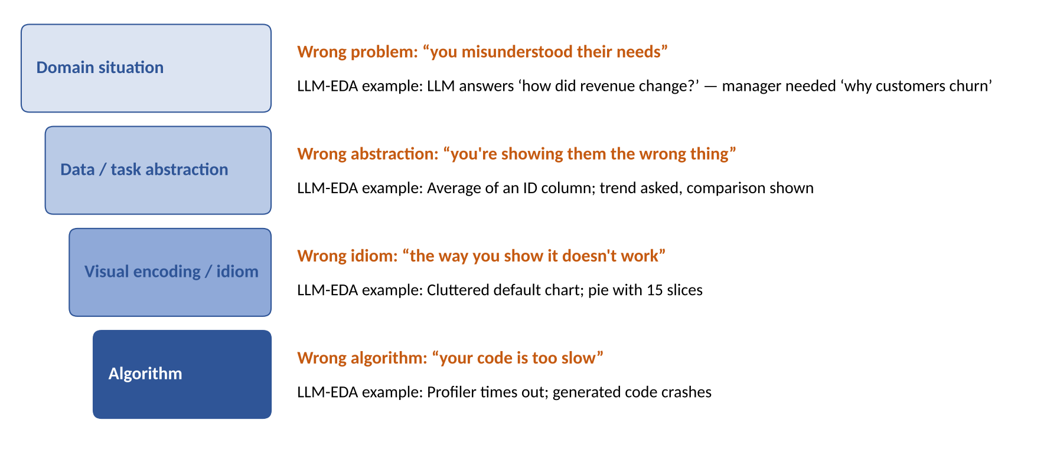
Visualization of Data, Understanding and Interpretation
Validating AI-Assisted Analysis: Munzner's Nested Model
Validation vs verification
Validation: did we build the right product? Verification: did we build the product right? (Munzner §4.5)
Cascade
An upstream error cascades: perfect code cannot rescue a misunderstood question (§4.3).

Slide 37
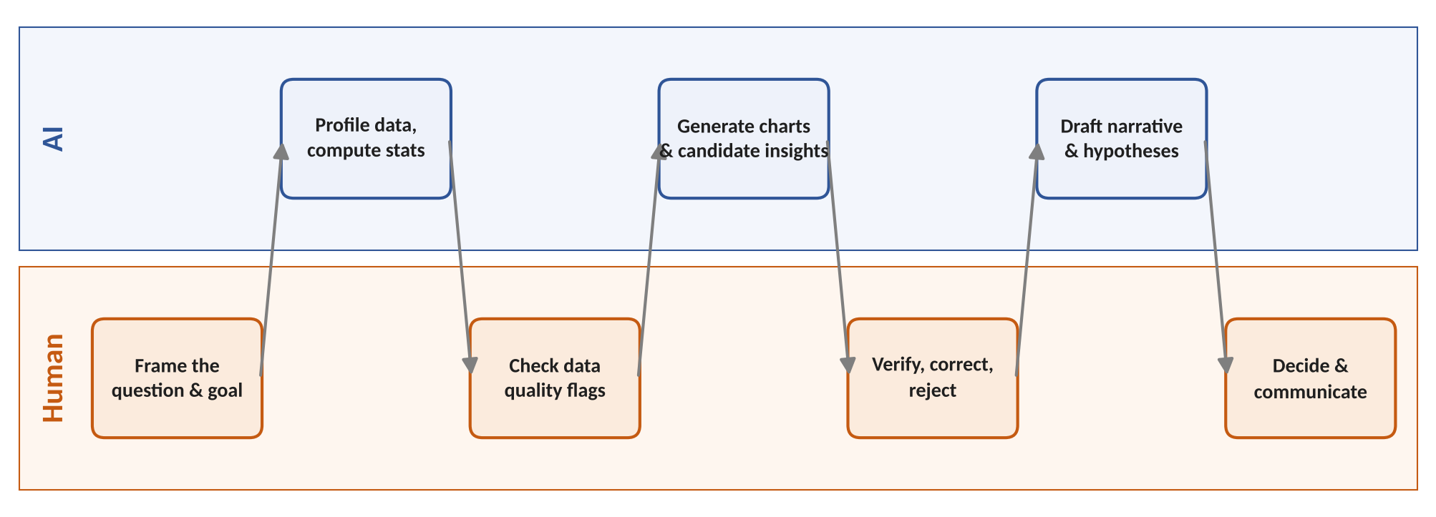
Visualization of Data, Understanding and Interpretation
Human–AI Division of Analytical Responsibility
 | AI is responsible for | Human is responsible for
Process | speed, coverage, computation, first drafts | the question, judgement, final decision
Errors | flagging its own uncertainty | catching and correcting errors
Accountability | — | the conclusion and its consequences

Slide 38
Visualization of Data, Understanding and Interpretation
Numerical 3: How Good Are the AI's Insights?
Question
An AI assistant reports 20 insights about a sales dataset. A team of analysts verifies that 14 of them are correct.
Working independently, the analysts list 25 true insights in the data; the AI's 14 correct ones are among them.
(a) Precision? (b) Recall? (c) F1 score?
(d) Each insight takes 3 minutes to verify. How long is the review, and how much of it is spent on wrong insights?
Solution
(a) Precision = 14 / 20 = 0.70
(b) Recall = 14 / 25 = 0.56
(c) F1 = 2 × 0.70 × 0.56 / (0.70 + 0.56) = 0.784 / 1.26 ≈ 0.62
(d) 20 × 3 = 60 min; 6 wrong × 3 = 18 min (30%) spent rejecting errors
Interpretation: the AI misses 44% of what experts find and 30% of its output is wrong — useful as an assistant, not as a replacement.
Notes:
18/60=30%

Slide 39
Visualization of Data, Understanding and Interpretation
Thinking Like a Designer for AI Outputs (Knaflic Ch 5)
Affordances
Highlight what matters, eliminate distractions and build a clear visual hierarchy so the reader knows how to use the chart.
Accessibility
Don't overcomplicate; text is your friend: titles, labels and annotations make the point explicit.
Aesthetics
Thoughtful use of colour, alignment and white space; people are more patient with designs they find attractive.
Acceptance
New formats need explaining; show a familiar view next to a new one and set out why the change helps.

Slide 40
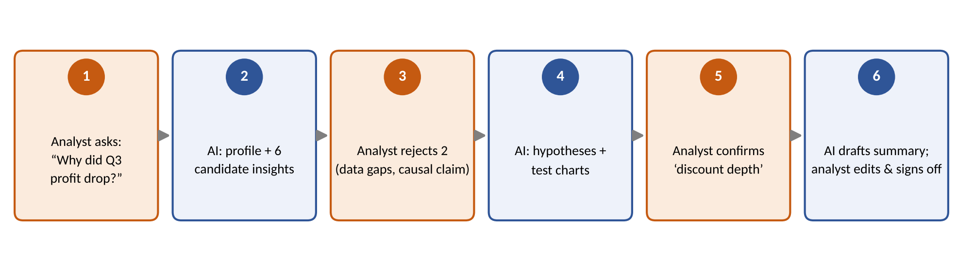
Visualization of Data, Understanding and Interpretation
End-to-End Case Study: “Why Did Q3 Profit Drop?”
AI insight | Analyst decision | Reason
“Profit fell 18% in Q3” | Accept | matches finance figures
“North region caused the drop” | Reject | causal claim; North had a 2-week data outage
“Discount depth rose from 8% to 15%” | Accept and test | chart of margin vs discount confirms it
“Customers prefer online” | Reject | outside the evidence; no customer data

Slide 41
Visualization of Data, Understanding and Interpretation
Summary
Summarize
compute with code, narrate with the LLM, trace every number
EDA reports
alerts are starting points; defaults like bin width shape the story
Insights & narrative
typed facts → score → narrate; declutter and colour-link (Knaflic)
Trends, correlations, patterns
smooth + slope, r, PCA — always plot raw data (Wilke Ch 12)
Hypotheses
AI generates many; humans choose tests; beware confounders
NL interpretation
read the data / between / beyond; over-claiming grows upwards
Human in the loop
augment, don't replace (Munzner §1.2); verify, correct, refine
Trust & responsibility
calibrate trust; AI computes and drafts, human decides and is accountable

Slide 42
Visualization of Data, Understanding and Interpretation
MCQs
1. Why should an LLM-based EDA assistant compute statistics with code and only narrate them, instead of reading all the rows itself?
A. LLM arithmetic over many rows is unreliable
B. Statistics produced by code are always unbiased
C. LLMs cannot generate text from tabular input
D. EDA reports are not allowed to include narration
Answer: A. LLM arithmetic over many rows is unreliable
LLMs generate text token by token and can approximate or invent numbers over large tables. Code computes exactly; the LLM explains. Code is not automatically unbiased (B), and LLMs can read tables (C).
Notes:
Ask students to commit to an answer before revealing (cover the green box or use an animation).

Slide 43
Visualization of Data, Understanding and Interpretation
MCQs
2. Case: An automated report shows a histogram of delivery times with 1-minute bins. It looks jagged, and the LLM reports that delivery times are ‘multimodal’. What should the analyst do first?
A. Accept it, since a histogram shows the true shape
B. Replace the histogram with a pie chart
C. Try several bin widths before concluding
D. Drop the outliers and keep the 1-minute bins
Answer: C. Try several bin widths before concluding
Wilke Ch 7: a histogram's appearance depends on bin width; too-small bins look “overly peaky and visually busy”. Always explore multiple bin widths before describing the shape.
Notes:
Ask students to commit to an answer before revealing (cover the green box or use an animation).

Slide 44
Visualization of Data, Understanding and Interpretation
MCQs
3. The Pearson correlation between ad spend (in ₹ lakh) and sales is r = 0.62. Ad spend is re-expressed in ₹ thousand (multiplied by 100). What is the new r?
A. 62.0
B. 0.62
C. 0.0062
D. It cannot be known without the data
Answer: B. 0.62
Wilke Ch 12: r is unchanged if data are rescaled (C·x) or shifted (x + C), because the constant cancels in the numerator and denominator.
Notes:
Ask students to commit to an answer before revealing (cover the green box or use an animation).

Slide 45
Visualization of Data, Understanding and Interpretation
MCQs
4. Case: An LLM summary says: “The four store datasets have identical means and r = 0.82, so they behave the same way.” What should the analyst do?
A. Report the four stores as equivalent
B. Ask the LLM for more decimal places
C. Compute a correlogram for the four stores
D. Plot the raw data for each store first
Answer: D. Plot the raw data for each store first
Anscombe's quartet shows identical summary statistics with very different data. Wilke: “it is always better to visualize the raw data rather than abstract, derived quantities.” A correlogram is itself a derived summary.
Notes:
Ask students to commit to an answer before revealing (cover the green box or use an animation).

Slide 46
Visualization of Data, Understanding and Interpretation
MCQs
5. An assistant scans all pairs of 8 variables for correlations at α = 0.05 with no correction. If no real correlations exist, how many false ‘significant’ pairs are expected?
A. 0.05
B. 0.40
C. 1.40
D. 2.80
Answer: C. 1.40
Pairs = 8 × 7 / 2 = 28. Expected false positives = 28 × 0.05 = 1.40. (2.80 uses 56 ordered pairs; 0.40 uses 8 variables instead of pairs.)
Notes:
Ask students to commit to an answer before revealing (cover the green box or use an animation).

Slide 47
Visualization of Data, Understanding and Interpretation
MCQs
6. According to Munzner (§1.2), a visualization with a human in the loop is most appropriate when:
A. The questions to ask are not known in advance
B. A trusted fully automatic solution already exists
C. Decisions are needed millions of times per second
D. The data is small enough to read row by row
Answer: A. The questions to ask are not known in advance
Munzner: many analysis problems are ill-specified — people don't know which questions are right in advance. If a fully automatic solution is acceptable (B, C), no vis tool is needed.
Notes:
Ask students to commit to an answer before revealing (cover the green box or use an animation).

Slide 48
Visualization of Data, Understanding and Interpretation
MCQs
7. Case: An LLM finds that Hospital A has a lower overall survival rate than Hospital B and concludes that A gives worse care. Split by case severity, A has the higher survival rate in every group. This is an example of:
A. Overplotting of points
B. The multiple-comparisons problem
C. A truncated y-axis
D. Simpson's paradox
Answer: D. Simpson's paradox
A confounder (severity) is distributed differently across hospitals and reverses the overall comparison. The safeguard is to split by plausible confounders before accepting a causal claim.
Notes:
Ask students to commit to an answer before revealing (cover the green box or use an animation).

Slide 49
Visualization of Data, Understanding and Interpretation
MCQs
8. In AI-assisted EDA, ‘automation bias’ refers to:
A. The AI's built-in preference for certain charts
B. Users accepting AI output without checking
C. Bias present in the model's training data
D. Systematic error in automatically computed statistics
Answer: B. Users accepting AI output without checking
Automation bias is a human over-trust problem: people accept automated output and stop verifying. It sits in the over-trust region of the trust-calibration diagram.
Notes:
Ask students to commit to an answer before revealing (cover the green box or use an animation).

Slide 50
Visualization of Data, Understanding and Interpretation
MCQs
9. An assistant reports 20 insights; experts confirm 15 are correct. The experts' full list contains 30 true insights, including those 15. What are precision and recall?
A. Precision 0.50, recall 0.75
B. Precision 0.75, recall 0.75
C. Precision 0.75, recall 0.50
D. Precision 0.67, recall 0.50
Answer: C. Precision 0.75, recall 0.50
Precision = correct reported / all reported = 15/20 = 0.75. Recall = correct reported / all true = 15/30 = 0.50.
Notes:
Ask students to commit to an answer before revealing (cover the green box or use an animation).

Slide 51
Visualization of Data, Understanding and Interpretation
MCQs
10. Case: An LLM EDA tool correctly answers “how did revenue change last quarter?”, but the manager's real need was to understand why customers stopped renewing. In Munzner's threats to validity, this is:
A. Wrong problem: the need was misunderstood
B. Wrong idiom: the chart type does not work
C. Wrong algorithm: the code runs too slowly
D. Wrong abstraction: the data types were miscoded
Answer: A. Wrong problem: the need was misunderstood
Munzner Fig. 4.4: wrong problem = “you misunderstood their needs” (domain level). The analysis was correct for the wrong question, and the error cascades down to every lower level.
Notes:
Ask students to commit to an answer before revealing (cover the green box or use an animation).

Slide 52
Visualization of Data, Understanding and Interpretation
References
TB1 C. O. Wilke, Fundamentals of Data Visualization, O'Reilly, 2019 — Ch 1, Ch 2, Ch 7, Ch 12, Ch 14.
TB2 C. N. Knaflic, Storytelling with Data, Wiley, 2015 — Ch 3, Ch 4, Ch 5.
Additional T. Munzner, Visualization Analysis and Design, CRC Press, 2014 — Ch 1 (§1.2), Ch 3 (§3.4.1), Ch 4 (§4.3–4.5).
J. W. Tukey, Exploratory Data Analysis, Addison-Wesley, 1977.
F. J. Anscombe, “Graphs in statistical analysis,” The American Statistician, 1973.
V. Dibia, “LIDA: automatic generation of grammar-agnostic visualizations and infographics using LLMs,” ACL Demo, 2023.
R. Ding et al., “QuickInsights: quick and automatic discovery of insights from multi-dimensional data,” SIGMOD, 2019.
Ç. Demiralp et al., “Foresight: recommending visual insights,” VLDB, 2017.
J. Heer, “Agency plus automation: designing artificial intelligence into interactive systems,” PNAS, 2019.
S. Amershi et al., “Guidelines for human-AI interaction,” CHI, 2019.
T. Sheridan, W. Verplank, Human and Computer Control of Undersea Teleoperators (levels of automation), MIT, 1978.
ydata-profiling documentation (formerly pandas-profiling).

Slide 53
Thank You

