Slide 2
Today …
The rendering pipeline in detail
What is OpenGL
First OpenGL program
Details about modeling

Slide 3

Basic Rendering Pipeline
Modeling Transformation
(OS -> WS)
ViewingTransformation
(WS -> CS)
Illumination
Projection
Rasterization
&
Clipping &
Display
Visibility
Culling
Database of 3D models
L
N
θ
θ
1R
Ω
1V

Slide 4
Geometric/Modeling Transformation
Goal: specify object’s position and orientations in a 3D world
Use Linear transformations that rotate and translate objects’ vertices.
Apply these transformations in matrix form

Slide 5
Modeling Transformation
Modeling Transformation
(OS -> WS)
Viewing
Transformation
(WS -> CS)
Visibility
Culling
Illumination
Projection
Rasterization
& Clipping & Display
Database of 3D models
• 3D models defined in their own model space or object space(OS)
  - Modeling of an object that consists of multiple object parts use a hierarchical structure of this modeling transformations.
• Modeling transformations orient models within a common coordinate system called world space (WS) - multiple objects in a space
• All objects, lights, and camera (viewer) is in one world space

Slide 6
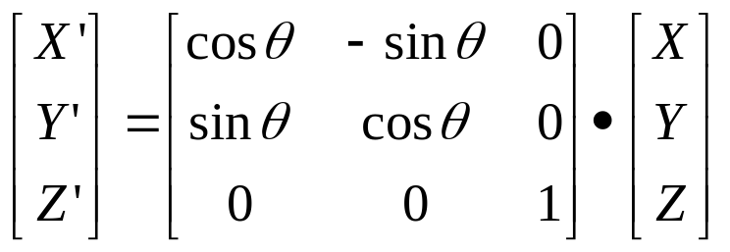
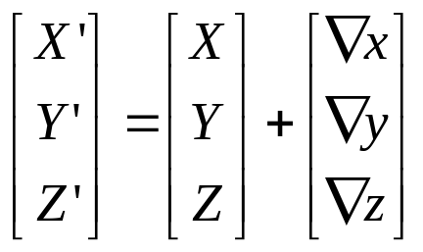
Rigid-Body Transformation
Euclidean transformation
Preserve the shape of the objects that they act on
Includes rotations and translations
rotation
translation

Slide 7
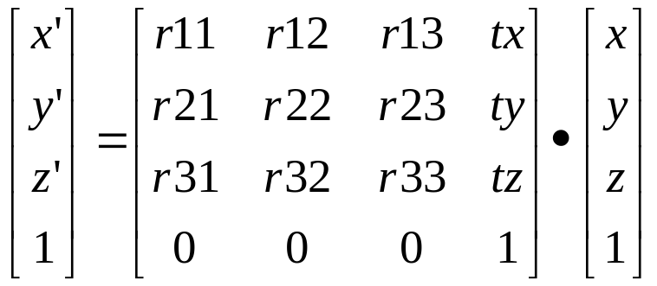
Homogeneous Coordinate System
Rotation multiplies and translation adds
  causes distingtion for every single calculation
Homogeneous system treats translation and rotation same by extending one dimension
Repeating usages, scale, skew are also fine

Slide 8
Viewing
Goal: map the visible part of a 3D world to a 2 D image
Use camera-like parameters to define a 3D view volume
Project the view voulme onto a 2D image plane
Map viewport on the image plane to the screen

Slide 9
Viewing Transformation
Modeling Transformation
(OS -> WS)
ViewingTransformation
(WS -> CS)
Visibility
Culling
Illumination
Projection
Rasterization
& Clipping
& Display
• Another change of coordinate systems
• Maps points from world space into eye (camera) space
• Eye position becomes the origin and viewing direction is oriented along some axis (z/-z)
eye
World space

Slide 10
Viewing transformation
Same with other transformation (rotation + translation)
Specially treated because camera position + viewing direction defines it.
eye

Slide 11
Visibility Culling
Modeling Transformation
(OS -> WS)
ViewingTransformation
(WS -> CS)
Visibility
Culling
Illumination
Projection
Rasterization
& Clipping & Display
Database of 3D models
• Viewing volume is defined. Objects outside viewing volume is not visible.
• This process can contribute substantial performance improvement and there are many number of techniques.

Slide 12
Clipping
Goal: cut off the part of objects outside the view volume to avoid rendering them

Slide 13
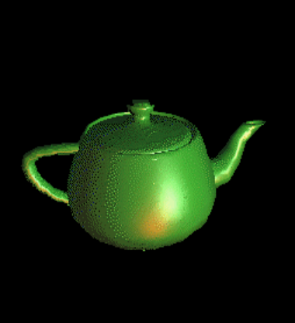
Illumination
Modeling Transformation
(OS -> WS)
ViewingTransformation
(WS -> CS)
Visibility
Culling
Illumination
Projection
Rasterization
& Clipping & Display
• Illumination needs to be done before projection since Z value does matter for shading calculation
• Shading usually refers local illumination calculated based on surface material, surface normal, view direction, and light source
• Texture map can be added here
• Global illumination adds interaction between objects, reflection, refration, BRDF, etc
L
N
θ
θ
1R
Ω
1V

Slide 14
Lighting, Shading
Lighting and shading give objects “shape”
Important effects
  shading
  shiny highlights
  reflections
  shadows
Local techniques simplify these effects to improve performance

Slide 15
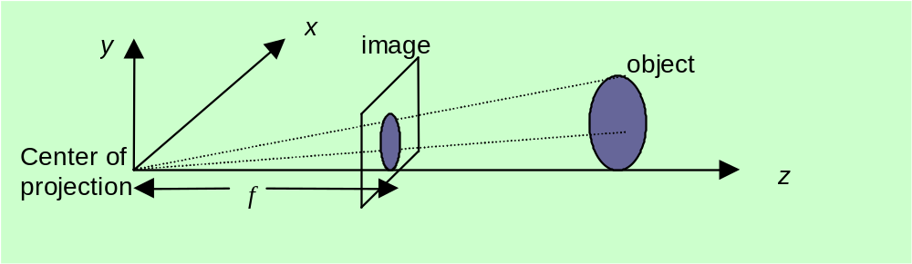
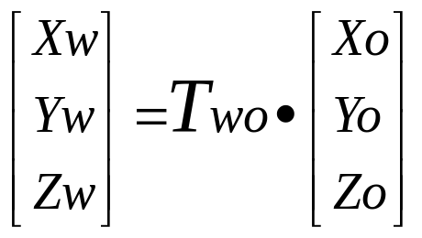
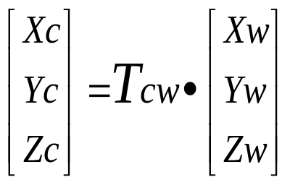
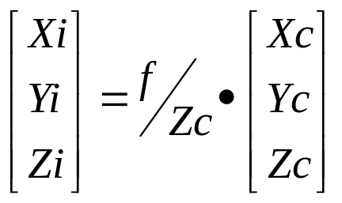
Projection
Modeling Transformation
(OS -> WS)
ViewingTransformation
(WS -> CS)
Visibility
Culling
Illumination
Projection
Rasterization
& Clipping & Display
•Another transformation from camera space to image space

Slide 16
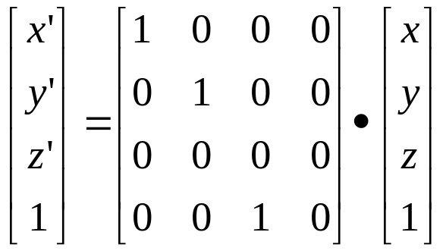
(Perspective) Projection
The projection maps all of out 3D coordinates onto our desired viewing plane, thus making 3D world into an image

Slide 17
Rasterization, Clipping, Display
Modeling Transformation
(OS -> WS)
ViewingTransformation
(WS -> CS)
Visibility
Culling
Illumination
Projection
Rasterization
& Clipping & Display
• Final transformation from image space to viewport coordinates
• Filling pixels
• Z buffer (Closer objects over write farther objects)
• Clipping cuts off objects outside of viewport
• 2D operation (filling a triangle properly)

Slide 18
OpenGL and GLUT Overview
What is OpenGL & what can it do for me?
OpenGL in windowing systems
Why GLUT
A GLUT program template
Notes:
In this section, we discuss what the OpenGL API (Application Programming Interface) is, and some of its capabilities.
As OpenGL is platform independent, we need some way to integrate OpenGL into each windowing system. Every windowing system where OpenGL is supported has additional API calls for managing OpenGL windows, colormaps, and other features. These additional APIs are platform dependent.
For the sake of simplicity, we’ll use an additional freeware library for simplifying interacting with windowing systems, GLUT. GLUT, the OpenGL Utility Toolkit is a library to make writing OpenGL programs regardless of windowing systems much easier. It’ll be the base of all of our examples in the class.
We conclude the section with a basic program template for an OpenGL program using GLUT.

Slide 19
What is a “library”.
Static
Dynamic

Slide 20
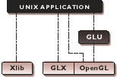
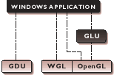
Relationship between OpenGL GLU and windowing APIs.
OpenGL applications use the window system’s window, input, and event mechanism
GLU supports quadrics, NURBS, complex polygons, matrix utilities, and more

Slide 21
What Is OpenGL?
Graphics rendering API
  high-quality color images composed of geometric and image primitives
  window system independent
  operating system independent
Notes:
OpenGL is a library for doing computer graphics. By using it, you can create interactive applications which render high-quality color images composed of 3D geometric objects and images.
OpenGL is window and operating system independent. As such, the part of your application which does rendering is platform independent. However, in order for OpenGL to be able to render, it needs a window to draw into. Generally, this is controlled by the windowing system on whatever platform you’re working on.

Slide 22
OpenGL Library Functions
GL
GL library contains all primitive and attribute functions
associated with OpenGL
GLU
GLU library builds on the GL library to include more
complex primitives (e.g. spheres) and convenience functions
GLUT (GL Utility Toolkit) includes functions to interface
with the native window system, including window creation,
management of input devices
GLUT

Slide 23
Related APIs
AGL, GLX, WGL
  glue between OpenGL and windowing systems
GLU (OpenGL Utility Library)
  part of OpenGL
  NURBS, tessellators, quadric shapes, etc.
GLUT (OpenGL Utility Toolkit)
  portable windowing API
  not officially part of OpenGL
Notes:
As mentioned, OpenGL is window and operating system independent. To integrate it into various window systems, additional libraries are used to modify a native window into an OpenGL capable window. Every window system has its own unique library and functions to do this. Some examples are:
GLX for the X Windows system, common on Unix platforms
AGL for the Apple Macintosh
WGL for Microsoft Windows
OpenGL also includes a utility library, GLU, to simplify common tasks such as: rendering quadric surfaces (i.e. spheres, cones, cylinders, etc. ), working with NURBS and curves, and concave polygon tessellation.
Finally to simplify programming and window system dependence, we’ll be using the freeware library, GLUT. GLUT, written by Mark Kilgard, is a public domain window system independent toolkit for making simple OpenGL applications. It simplifies the process of creating windows, working with events in the window system and handling animation.

Slide 24
OpenGL and Related APIs
application program
OpenGL Motif
widget or similar
GLUT
GLX, AGL
or WGL
GLU
X, Win32, Mac O/S
GL
software and/or hardware
Notes:
The above diagram illustrates the relationships of the various libraries and window system components.
Generally, applications which require more user interface support will use a library designed to support those types of features (i.e. buttons, menu and scroll bars, etc.) such as Motif or the Win32 API.
Prototype applications, or one which don’t require all the bells and whistles of a full GUI, may choose to use GLUT instead because of its simplified programming model and window system independence.

Slide 25
OpenGL Architecture
Per Vertex
Operations &
Primitive
Assembly
Polynomial
Evaluator
CPU
Display
List
Rasterization
Per Fragment
Operations
Frame
Buffer
Texture
Memory
Pixel
Operations
Notes:
This is the most important diagram you will see today, representing the flow of graphical information, as it is processed from CPU to the frame buffer.
There are two pipelines of data flow. The upper pipeline is for geometric, vertex-based primitives. The lower pipeline is for pixel-based, image primitives. Texturing combines the two types of primitives together.
There is a pull-out poster in the back of the OpenGL Reference Manual (“Blue Book”), which shows this diagram in more detail.

Slide 26
Features of OpenGL
Delivers fast and complete 3D hardware acceleration
makes real-time 3D effects possible
designed to support future innovations in software and hardware
Available on many platforms
Stable
Notes:
OpenGL delivers fast and complete 3D hardware acceleration
Today's applications and games manipulate massive amounts of data in real-time by using OpenGL hardware accelerated geometry, real-time lighting, clipping, transformations and rendering
OpenGL makes real-time 3D effects possible
OpenGL hardware acceleration adds detail & special effects to images without compromising performance. Examples include real-time fog, anti-aliasing, volume shadows, bump mapping, motion blur, transparency, reflections, 3D textures, volume rendering and more
OpenGL is designed to support future innovations in software and hardware,
The extension mechanism in OpenGL can expose radically new hardware/software features that simply never existed when OpenGL was originally conceived. So you can be confident that you will continue to get the best possible performance from your applications and games as hardware technology advances
OpenGL is on every platform
Ever wished that great Unix application would move to Windows or a great Windows game to Linux. Since OpenGL is fully cross-platform, it is realtively easy to port games or applications from one platform to be moved to another. This greatly expands the wealth of applications and games that support OpenGL.
OpenGL is stable.
High End 3D workstation & supercomputuer users have been enjoying OpenGL since 1992. Today, OpenGL is also the most popular and powerful 3D solution for Windows, Mac and Linux-based computers, for professional and consumer use.

Slide 27
OpenGL as a Renderer
Geometric primitives
  points, lines and polygons
Image Primitives
  images and bitmaps
  separate pipeline for images and geometry
    linked through texture mapping
Rendering depends on state
  colors, materials, light sources, etc.
Notes:
As mentioned, OpenGL is a library for rendering computer graphics. Generally, there are two operations that you do with OpenGL:
draw something
change the state of how OpenGL draws
OpenGL has two types of things that it can render: geometric primitives and image primitives. Geometric primitives are points, lines and polygons. Image primitives are bitmaps and graphics images (i.e. the pixels that you might extract from a JPEG image after you’ve read it into your program.) Additionally, OpenGL links image and geometric primitives together using texture mapping, which is an advanced topic we’ll discuss this afternoon.
The other common operation that you do with OpenGL is setting state. “Setting state” is the process of initializing the internal data that OpenGL uses to render your primitives. It can be as simple as setting up the size of points and color that you want a vertex to be, to initializing multiple mipmap levels for texture mapping.

Slide 28
Other issues
Rendering acceleration (rasterization, texture map, spacial subdivision, collision detection, progressive rendering, view dependent rendering, image-based rendering,…)
Color, Texture, Anti-aliasing
Animation or simulation

Slide 29
Student 007: “I am dying to see an OpenGL program !…”
Prof: Be patient, it is only few more block(diagram)s away !!

Slide 30
Block Diagram

Slide 31
Preliminaries
Headers Files
    #include <GL/gl.h>
    #include <GL/glu.h>
    #include <GL/glut.h>
Libraries
Enumerated Types
  OpenGL defines numerous types for compatibility
      GLfloat, GLint, GLenum, etc.
Notes:
All of our discussions today will be presented in the C computer language.
For C, there are a few required elements which an application must do:
Header files describe all of the function calls, their parameters and defined constant values to the compiler. OpenGL has header files for GL (the core library), GLU (the utility library), and GLUT (freeware windowing toolkit).
Note: glut.h includes gl.h and glu.h. On Microsoft Windows, including only glut.h is recommended to avoid warnings about redefining Windows macros.
Libraries are the operating system dependent implementation of OpenGL on the system you’re using. Each operating system has its own set of libraries. For Unix systems, the OpenGL library is commonly named libGL.so and for Microsoft Windows, it’s named opengl32.lib.
Finally, enumerated types are definitions for the basic types (i.e. float, double, int, etc.) which your program uses to store variables. To simplify platform independence for OpenGL programs, a complete set of enumerated types are defined. Use them to simplify transferring your programs to other operating systems.

Slide 32
GLUT Basics
Application Structure
  Configure and open window
  Initialize OpenGL state
  Register input callback functions
    render
    resize
    input: keyboard, mouse, etc.
  Enter event processing loop
Notes:
Here’s the basic structure that we’ll be using in our applications. This is generally what you’d do in your own OpenGL applications.
The steps are:
1) Choose the type of window that you need for your application and initialize it.
2) Initialize any OpenGL state that you don’t need to change every frame of your program. This might include things like the background color, light positions and texture maps.
3) Register the callback functions that you’ll need. Callbacks are routines you write that GLUT calls when a certain sequence of events occurs, like the window needing to be refreshed, or the user moving the mouse. The most important callback function is the one to render your scene, which we’ll discuss in a few slides.
4) Enter the main event processing loop. This is where your application receives events, and schedules when callback functions are called.

Slide 33
Sample Program – draw()function
void drawScene(void)
{
// Clear the rendering window
glClear(GL_COLOR_BUFFER_BIT | GL_DEPTH_BUFFER_BIT);
// Set drawing color to white
glColor3f( 1.0, 1.0, 1.0 );
// Draw triangle
glBegin(GL_TRIANGLES);
glColor3f( 1.0, 0.0, 0.0 );
glVertex2f( 1.0, 1.0 );
glVertex2f( 2.0, 1.0 );
glVertex2f( 2.0, 2.0 );
glEnd();
// Flush the pipeline. (Not usually necessary.)
glFlush();
}
Notes:
Here’s an example of the main part of a GLUT based OpenGL application. This is the model that we’ll use for most of our programs in the course.
The glutInitDisplayMode() and glutCreateWindow() functions compose the window configuration step.
We then call the init() routine, which contains our one-time initialization. Here we initialize any OpenGL state and other program variables that we might need to use during our program that remain constant throughout the program’s execution.
Next, we register the callback routines that we’re going to use during our program.
Finally, we enter the event processing loop, which interprets events and calls our respective callback routines.

Slide 34
OpenGL Command Formats
glVertex3fv( v )
Number of
components
Data Type
Vector
b - byte
ub - unsigned byte
s - short
us - unsigned short
i - int
ui - unsigned int
f - float
d - double
omit “v” for
scalar form
glVertex2f( x, y )
2 - (x,y)
3 - (x,y,z)
4 - (x,y,z,w)
Notes:
The OpenGL API calls are designed to accept almost any basic data type, which is reflected in the calls name. Knowing how the calls are structured makes it easy to determine which call should be used for a particular data format and size.
For instance, vertices from most commercial models are stored as three component floating point vectors. As such, the appropriate OpenGL command to use is glVertex3fv( coords ).
As mentioned before, OpenGL uses homogenous coordinates to specify vertices. For glVertex*() calls which don’t specify all the coordinates
( i.e. glVertex2f()), OpenGL will default z = 0.0, and w = 1.0 .

Slide 35
Specifying Geometric Primitives
Primitives are specified using
      glBegin( primType );
      glEnd();
  primType determines how vertices are combined
  GLfloat red, greed, blue;
  Glfloat coords[3];
  glBegin( primType );
  for ( i = 0; i < nVerts; ++i ) {
  glColor3f( red, green, blue );
  glVertex3fv( coords );
  }
  glEnd();
Notes:
OpenGL organizes vertices into primitives based upon which type is passed into glBegin(). The possible types are:
GL_POINTS GL_LINE_STRIP
GL_LINES GL_LINE_LOOP
GL_POLYGON GL_TRIANGLE_STRIP
GL_TRIANGLES GL_TRIANGLE_FAN
GL_QUADS GL_QUAD_STRIP

Slide 36
OpenGL Command Syntax
Function calls: glXxxxx[type] ( [args] )
  Example: glVertex2f (1.0, 2.0);
Defined constants: GL_XXXXXXXXXX
  Example: GL_COLOR_BUFFER_BIT
Type definition: GLxxxxxxx
  Example: GLfloat

Slide 37
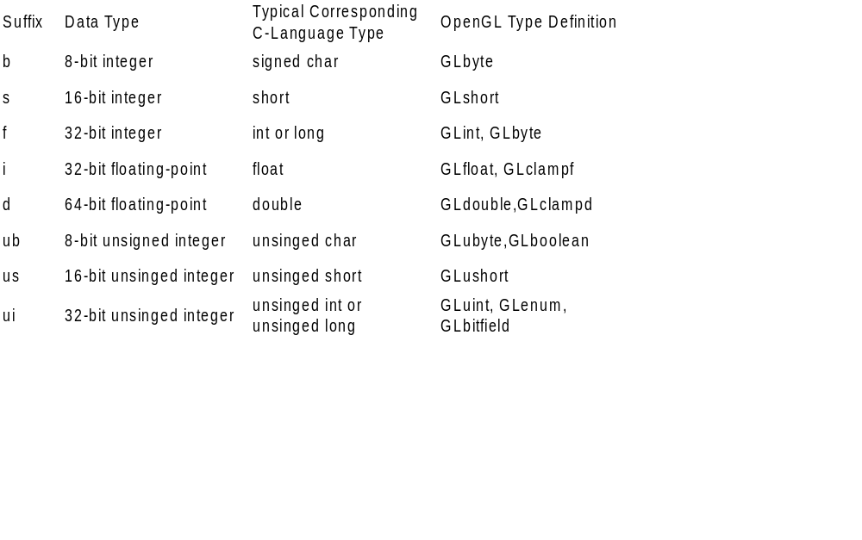
Command Suffixes/ Argument Data Types

Slide 38
Shared Namespace Model
Model
Function
Calls
Application
} Run in same process
Graphics Lib.
OS
glFlush();
unnecessary
O
I

Slide 39
Client-Server Model:
Model
Function
Calls
Application
O
Graphics
Server
Graphics Lib.
OS
OS
I
Network Protocol
glFlush();
May be necessary

Slide 40
OpenGL Architecture
Per Vertex
Operations &
Primitive
Assembly
Polynomial
Evaluator
CPU
Display
List
Rasterization
Per Fragment
Operations
Frame
Buffer
Texture
Memory
Pixel
Operations
Notes:
This is the most important diagram you will see today, representing the flow of graphical information, as it is processed from CPU to the frame buffer.
There are two pipelines of data flow. The upper pipeline is for geometric, vertex-based primitives. The lower pipeline is for pixel-based, image primitives. Texturing combines the two types of primitives together.
There is a pull-out poster in the back of the OpenGL Reference Manual (“Blue Book”), which shows this diagram in more detail.

Slide 41
State Management and Drawing in OpenGL

Slide 42
Sample Program
void main( int argc, char** argv )
{
int mode = GLUT_RGB|GLUT_DOUBLE;
glutInitDisplayMode( mode );
glutCreateWindow( argv[0] );
init();
glutDisplayFunc( display );
glutReshapeFunc( resize );
glutKeyboardFunc( key );
glutIdleFunc( idle );
glutMainLoop();
}
Notes:
Here’s an example of the main part of a GLUT based OpenGL application. This is the model that we’ll use for most of our programs in the course.
The glutInitDisplayMode() and glutCreateWindow() functions compose the window configuration step.
We then call the init() routine, which contains our one-time initialization. Here we initialize any OpenGL state and other program variables that we might need to use during our program that remain constant throughout the program’s execution.
Next, we register the callback routines that we’re going to use during our program.
Finally, we enter the event processing loop, which interprets events and calls our respective callback routines.

Slide 43
OpenGL Initialization
Set up whatever state you’re going to use
void init( void )
{
glClearColor( 0.0, 0.0, 0.0, 1.0 );
glClearDepth( 1.0 );
glEnable( GL_LIGHT0 );
glEnable( GL_LIGHTING );
glEnable( GL_DEPTH_TEST );
}
Notes:
Here’s the internals of our initialization routine, init(). Over the course of the day, you’ll learn what each of the above OpenGL calls do.

Slide 44
GLUT Callback Functions
Routine to call when something happens
  window resize or redraw
  user input
  animation
“Register” callbacks with GLUT
    glutDisplayFunc( display );
    glutIdleFunc( idle );
    glutKeyboardFunc( keyboard );
Notes:
GLUT uses a callback mechanism to do its event processing. Callbacks simplify event processing for the application developer. As compared to more traditional event driven programming, where the author must receive and process each event, and call whatever actions are necessary, callbacks simplify the process by defining what actions are supported, and automatically handling the user events. All the author must do is fill in what should happen when.
GLUT supports many different callback actions, including:
glutDisplayFunc() - called when pixels in the window need to be refreshed.
glutReshapeFunc() - called when the window changes size
glutKeyboardFunc() - called when a key is struck on the keyboard
glutMouseFunc() - called when the user presses a mouse button on the mouse
glutMotionFunc() - called when the user moves the mouse while a mouse button is pressed
glutPassiveMouseFunc() - called when the mouse is moved regardless of mouse button state
glutIdleFunc() - a callback function called when nothing else is going on. Very useful for animations.

Slide 45
A Typical Event-Driven Program
Initialization
Main Loop
Event
Handler
Background
Processing
Procedure
Input
Processing
Procedures

Slide 46
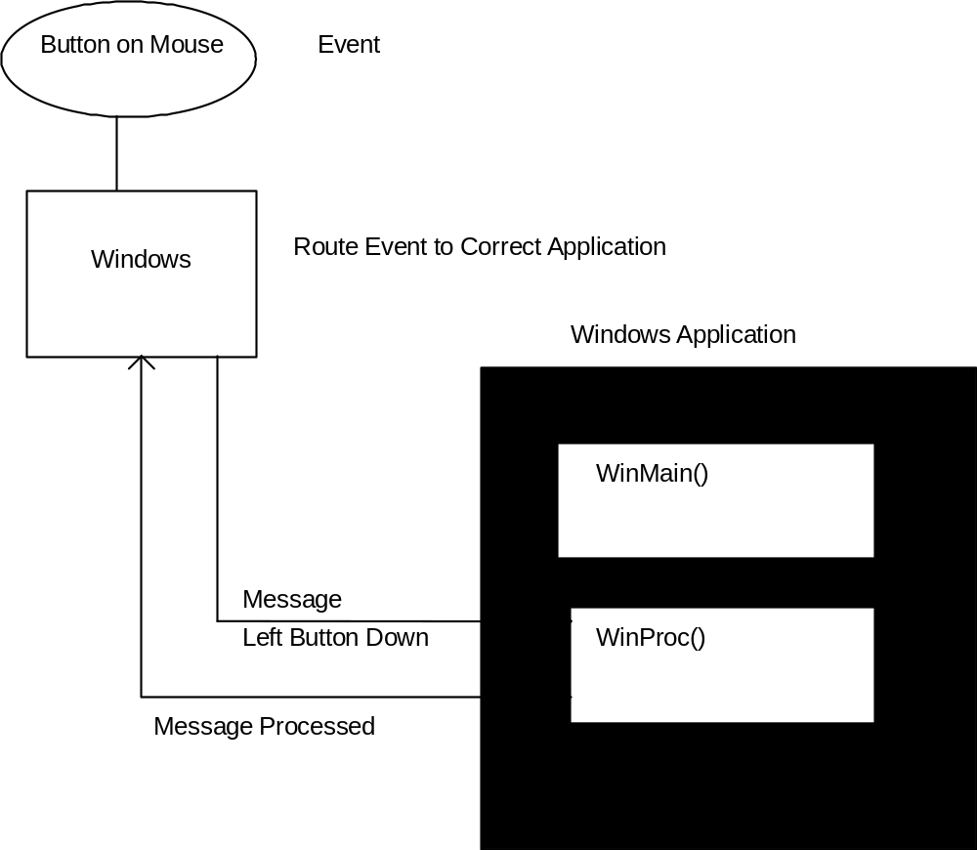
Route messages to the application

Slide 47
GLUT Event Processing
No
Event
in
Queue
Call Idle
Function
Yes
Pop Event
From Queue
Call
Function n
Call
Function n
Call
Function n
Call
Function n
Call
Function n
Call
Function n
Switch on
Event Type

Slide 48
Callbacks
Event Type
“Registered” Function
Event A
m1, m2
function_A(m1, m2)
Event B
function_B( )
Event C
function_C( )
Event D
Event E
Event F
No Event
Idle function( )
NB: Function parameters must match measures contained
in associated event.

Slide 49
Display Event
Trigger: GLUT determines that the window needs to be
redisplayed. A display event is generated when the window
is first drawn.
Callback function form:
void display();
Registration:
glutDisplayFunc(display);
A display callback function must be registered for each window.

Slide 50
GLUT Mouse Event
Trigger: Any mouse button is depressed or released.
Callback function form:
void mouse_callback_func(int button, int state,
int x, int y);
Registration:
glutMouseFunc(mouse_callback_function);

Slide 51
GLUT Defined Mouse Constants
GLUT_LEFT_BUTTON
GLUT_MIDDLE_BUTTON
GLUT_RIGHT_BUTTON
GLUT_UP
GLUT_DOWN
Systems with only one mouse button can only generate
a GLUT_LEFT_BUTTON callback.

Slide 52
GLUT Reshape Event
Trigger: Active window is resized
Callback function form:
void reshape_func(GLsizei w, GLsizei h);
Registration:
glutReshapeFunc(reshape_func);

Slide 53
GLUT Move Event
Trigger: The mouse is moved while one or more mouse
buttons are pressed.
Callback function form:
void motion_func(int x, int y);
Registration:
glutMotionFunc(motion_func);

Slide 54
GLUT Keyboard Event
Trigger: Any key is depressed.
Callback function form:
void keyboard_function(unsigned char key,
int x, int y);
Registration:
glutKeyboardFunc(keyboard_function);

Slide 55
Idle Callbacks
Use for animation and continuous update
glutIdleFunc( idle );
void idle( void )
{
t += dt;
glutPostRedisplay();
}
Notes:
Animation requires the ability to draw a sequence of images. The glutIdleFunc()is the mechanism for doing animation. You register a routine which updates your motion variables (usually global variables in your program which control how things move) and then requests that the scene be updated.
glutPostRedisplay() requests that the callback registered with glutDisplayFunc() be called as soon as possible. This is preferred over calling your rendering routine directly, since the user may have interacted with your application and user input events need to be processed.

Slide 56
Other Defined Events in GLUT
glutPassiveMotionFunc
glutVisibilityFunc
glutEntryFunc
glutSpecialFunc
glutSpaceballMotionFunc
glutSpaceballRotateFunc
glutSpaceballButtonFunc
glutButtonBoxFunc
glutDialsFunc
glutTabletMotionFunc
glutTabletButtonFunc
glutMenuStatusFunc

Slide 57
Simple GLUT Window Management Functions
glutInit(int *argc, char** argv);
Initializes a window session.
glutCreateWindow(char *name);
Creates a window with title *name.
glutInitDisplayMode(GLUT_SINGLE|GLUT_RGB);
Sets the display mode to single buffered and RGB color.
glutInitWindowSize (GLsizei h, GLsizei w);
Sets initial window size to h x w.
glutInitWindowPosition(x,y);
Sets initial window position to (x, y).

Slide 58
TA help is there, but use “Help” and try to help yourselves !!
Show simple demo program

Slide 59
OpenGL in MS Windows
GL Commands
OpenGL Lib
GDI Processor
Graphics
Hardware
GDI – Graphics Device Interface (Windows-specific)

Slide 60
Basic Program Skeleton
Header files, Global variables
Rendering initialization
Keyboard / Mouse functions
Drawing / animation
Window resizing
Idle function
main()

Slide 61
Try this …
Draw a red line in a window with black background
Try changing line thickness
Change color combination
What if you want a regular triangle as against a “filled” one
Now try drawing various figures from the library
Try modeling concave polygons

