Slide 1
An Interactive Introduction to OpenGL Programming
Dave Shreiner
Ed Angel
Vicki Shreiner

Slide 2
What You’ll See Today
General OpenGL Introduction
Rendering Primitives
Rendering Modes
Lighting
Texture Mapping
Additional Rendering Attributes
Imaging
Notes:
This course provides a general introduction and overview to the OpenGL API (Application Programming Interface) and its features. OpenGL is a rendering library available on almost any computer which supports a graphics monitor.
Today, we’ll discuss the basic elements of OpenGL: rendering points, lines, polygons and images, as well as more advanced features as lighting and texture mapping.

Slide 3
Goals for Today
Demonstrate enough OpenGL to write an interactive graphics program with
custom modeled 3D objects or imagery
lighting
texture mapping
Introduce advanced topics for future investigation
Notes:
Today we hope to demonstrate the capabilities and flexibility of OpenGL such that you’ll be able to author your own programs which can display 3D objects with lighting effects, shading, and custom texture maps.
Additionally, we’ll introduce more advanced OpenGL topics for further personal investigation.
One of OpenGL’s strengths is that its interface is easy to use for the novice, yet powerful enough to satisfy the requirement of professional applications, whether they be for flight simulation, animation, computer aided design, or scientific visualization.

Slide 4
OpenGL and GLUT Overview
Vicki Shreiner

Slide 5
OpenGL and GLUT Overview
What is OpenGL & what can it do for me?
OpenGL in windowing systems
Why GLUT
A GLUT program template
Notes:
In this section, we discuss what the OpenGL API (Application Programming Interface) is, and some of its capabilities.
As OpenGL is platform independent, we need some way to integrate OpenGL into each windowing system. Every windowing system where OpenGL is supported has additional API calls for managing OpenGL windows, colormaps, and other features. These additional APIs are platform dependent.
For the sake of simplicity, we’ll use an additional freeware library for simplifying interacting with windowing systems, GLUT. GLUT, the OpenGL Utility Toolkit is a library to make writing OpenGL programs regardless of windowing systems much easier. It’ll be the base of all of our examples in the class.
We conclude the section with a basic program template for an OpenGL program using GLUT.

Slide 6
What Is OpenGL?
Graphics rendering API
high-quality color images composed of geometric and image primitives
window system independent
operating system independent
Notes:
OpenGL is a library for doing computer graphics. By using it, you can create interactive applications which render high-quality color images composed of 3D geometric objects and images.
OpenGL is window and operating system independent. As such, the part of your application which does rendering is platform independent. However, in order for OpenGL to be able to render, it needs a window to draw into. Generally, this is controlled by the windowing system on whatever platform you’re working on.

Slide 7
OpenGL Architecture
Per Vertex
Operations &
Primitive
Assembly
Polynomial
Evaluator
CPU
Display List
Rasterization
Per Fragment
Operations
Frame
Buffer
Texture
Memory
Pixel
Operations
Notes:
This is the most important diagram you will see today, representing the flow of graphical information, as it is processed from CPU to the frame buffer.
There are two pipelines of data flow. The upper pipeline is for geometric, vertex-based primitives. The lower pipeline is for pixel-based, image primitives. Texturing combines the two types of primitives together.
There is a pull-out poster in the back of the OpenGL Reference Manual (“Blue Book”), which shows this diagram in more detail.

Slide 8
OpenGL as a Renderer
Geometric primitives
points, lines and polygons
Image Primitives
images and bitmaps
separate pipeline for images and geometry
linked through texture mapping
Rendering depends on state
colors, materials, light sources, etc.
Notes:
As mentioned, OpenGL is a library for rendering computer graphics. Generally, there are two operations that you do with OpenGL:
draw something
change the state of how OpenGL draws
OpenGL has two types of things that it can render: geometric primitives and image primitives. Geometric primitives are points, lines and polygons. Image primitives are bitmaps and graphics images (i.e. the pixels that you might extract from a JPEG image after you’ve read it into your program.) Additionally, OpenGL links image and geometric primitives together using texture mapping, which is an advanced topic we’ll discuss this afternoon.
The other common operation that you do with OpenGL is setting state. “Setting state” is the process of initializing the internal data that OpenGL uses to render your primitives. It can be as simple as setting up the size of points and color that you want a vertex to be, to initializing multiple mipmap levels for texture mapping.

Slide 9
Related APIs
AGL, GLX, WGL
glue between OpenGL and windowing systems
GLU (OpenGL Utility Library)
part of OpenGL
NURBS, tessellators, quadric shapes, etc.
GLUT (OpenGL Utility Toolkit)
portable windowing API
not officially part of OpenGL
Notes:
As mentioned, OpenGL is window and operating system independent. To integrate it into various window systems, additional libraries are used to modify a native window into an OpenGL capable window. Every window system has its own unique library and functions to do this. Some examples are:
GLX for the X Windows system, common on Unix platforms
AGL for the Apple Macintosh
WGL for Microsoft Windows
OpenGL also includes a utility library, GLU, to simplify common tasks such as: rendering quadric surfaces (i.e. spheres, cones, cylinders, etc. ), working with NURBS and curves, and concave polygon tessellation.
Finally to simplify programming and window system dependence, we’ll be using the freeware library, GLUT. GLUT, written by Mark Kilgard, is a public domain window system independent toolkit for making simple OpenGL applications. It simplifies the process of creating windows, working with events in the window system and handling animation.

Slide 10
OpenGL and Related APIs
application program
OpenGL Motif
widget or similar
GLUT
GLX, AGL or WGL
GLU
X, Win32, Mac O/S
GL
software and/or hardware
Notes:
The above diagram illustrates the relationships of the various libraries and window system components.
Generally, applications which require more user interface support will use a library designed to support those types of features (i.e. buttons, menu and scroll bars, etc.) such as Motif or the Win32 API.
Prototype applications, or one which don’t require all the bells and whistles of a full GUI, may choose to use GLUT instead because of its simplified programming model and window system independence.

Slide 11
Preliminaries
Headers Files
#include <GL/gl.h>
#include <GL/glu.h>
#include <GL/glut.h>
Libraries
Enumerated Types
OpenGL defines numerous types for compatibility
GLfloat, GLint, GLenum, etc.
Notes:
All of our discussions today will be presented in the C computer language.
For C, there are a few required elements which an application must do:
Header files describe all of the function calls, their parameters and defined constant values to the compiler. OpenGL has header files for GL (the core library), GLU (the utility library), and GLUT (freeware windowing toolkit).
Note: glut.h includes gl.h and glu.h. On Microsoft Windows, including only glut.h is recommended to avoid warnings about redefining Windows macros.
Libraries are the operating system dependent implementation of OpenGL on the system you’re using. Each operating system has its own set of libraries. For Unix systems, the OpenGL library is commonly named libGL.so and for Microsoft Windows, it’s named opengl32.lib.
Finally, enumerated types are definitions for the basic types (i.e. float, double, int, etc.) which your program uses to store variables. To simplify platform independence for OpenGL programs, a complete set of enumerated types are defined. Use them to simplify transferring your programs to other operating systems.

Slide 12
GLUT Basics
Application Structure
Configure and open window
Initialize OpenGL state
Register input callback functions
render
resize
input: keyboard, mouse, etc.
Enter event processing loop
Notes:
Here’s the basic structure that we’ll be using in our applications. This is generally what you’d do in your own OpenGL applications.
The steps are:
1) Choose the type of window that you need for your application and initialize it.
2) Initialize any OpenGL state that you don’t need to change every frame of your program. This might include things like the background color, light positions and texture maps.
3) Register the callback functions that you’ll need. Callbacks are routines you write that GLUT calls when a certain sequence of events occurs, like the window needing to be refreshed, or the user moving the mouse. The most important callback function is the one to render your scene, which we’ll discuss in a few slides.
4) Enter the main event processing loop. This is where your application receives events, and schedules when callback functions are called.

Slide 13
Sample Program
void main( int argc, char** argv )
{
int mode = GLUT_RGB|GLUT_DOUBLE;
glutInitDisplayMode( mode );
glutCreateWindow( argv[0] );
init();
glutDisplayFunc( display );
glutReshapeFunc( resize );
glutKeyboardFunc( key );
glutIdleFunc( idle );
glutMainLoop();
}
Notes:
Here’s an example of the main part of a GLUT based OpenGL application. This is the model that we’ll use for most of our programs in the course.
The glutInitDisplayMode() and glutCreateWindow() functions compose the window configuration step.
We then call the init() routine, which contains our one-time initialization. Here we initialize any OpenGL state and other program variables that we might need to use during our program that remain constant throughout the program’s execution.
Next, we register the callback routines that we’re going to use during our program.
Finally, we enter the event processing loop, which interprets events and calls our respective callback routines.

Slide 14
OpenGL Initialization
Set up whatever state you’re going to use
void init( void )
{
glClearColor( 0.0, 0.0, 0.0, 1.0 );
glClearDepth( 1.0 );
glEnable( GL_LIGHT0 );
glEnable( GL_LIGHTING );
glEnable( GL_DEPTH_TEST );
}
Notes:
Here’s the internals of our initialization routine, init(). Over the course of the day, you’ll learn what each of the above OpenGL calls do.

Slide 15
GLUT Callback Functions
Routine to call when something happens
window resize or redraw
user input
animation
“Register” callbacks with GLUT
glutDisplayFunc( display );
glutIdleFunc( idle );
glutKeyboardFunc( keyboard );
Notes:
GLUT uses a callback mechanism to do its event processing. Callbacks simplify event processing for the application developer. As compared to more traditional event driven programming, where the author must receive and process each event, and call whatever actions are necessary, callbacks simplify the process by defining what actions are supported, and automatically handling the user events. All the author must do is fill in what should happen when.
GLUT supports many different callback actions, including:
glutDisplayFunc() - called when pixels in the window need to be refreshed.
glutReshapeFunc() - called when the window changes size
glutKeyboardFunc() - called when a key is struck on the keyboard
glutMouseFunc() - called when the user presses a mouse button on the mouse
glutMotionFunc() - called when the user moves the mouse while a mouse button is pressed
glutPassiveMouseFunc() - called when the mouse is moved regardless of mouse button state
glutIdleFunc() - a callback function called when nothing else is going on. Very useful for animations.

Slide 16
Rendering Callback
Do all of your drawing here
glutDisplayFunc( display );
void display( void )
{
glClear( GL_COLOR_BUFFER_BIT );
glBegin( GL_TRIANGLE_STRIP );
glVertex3fv( v[0] );
glVertex3fv( v[1] );
glVertex3fv( v[2] );
glVertex3fv( v[3] );
glEnd();
glutSwapBuffers();
}
Notes:
One of the most important callbacks is the glutDisplayFunc() callback. This callback is called when the window needs to be refreshed. It’s here that you’d do all of your OpenGL rendering.
The above routine merely clears the window, and renders a triangle strip and then swaps the buffers for smooth animation transition. You’ll learn more about what each of these calls do during the day.

Slide 17
Idle Callbacks
Use for animation and continuous update
glutIdleFunc( idle );
void idle( void )
{
t += dt;
glutPostRedisplay();
}
Notes:
Animation requires the ability to draw a sequence of images. The glutIdleFunc()is the mechanism for doing animation. You register a routine which updates your motion variables (usually global variables in your program which control how things move) and then requests that the scene be updated.
glutPostRedisplay() requests that the callback registered with glutDisplayFunc() be called as soon as possible. This is preferred over calling your rendering routine directly, since the user may have interacted with your application and user input events need to be processed.

Slide 18
User Input Callbacks
Process user input
glutKeyboardFunc( keyboard );
void keyboard( char key, int x, int y )
{
switch( key ) {
case ‘q’ : case ‘Q’ :
exit( EXIT_SUCCESS );
break;
case ‘r’ : case ‘R’ :
rotate = GL_TRUE;
break;
}
}
Notes:
Above is a simple example of a user input callback. In this case, the routine was registered to receive keyboard input. GLUT supports user input through a number of devices including the keyboard, mouse, dial and button boxes and spaceballs.

Slide 19
Elementary Rendering
Vicki Shreiner

Slide 20
Elementary Rendering
Geometric Primitives
Managing OpenGL State
OpenGL Buffers
Notes:
In this section, we’ll be discussing the basic geometric primitives that OpenGL uses for rendering, as well as how to manage the OpenGL state which controls the appearance of those primitives.
OpenGL also supports the rendering of bitmaps and images, which is discussed in a later section.
Additionally, we’ll discuss the different types of OpenGL buffers, and what each can be used for.

Slide 21
OpenGL Geometric Primitives
All geometric primitives are specified by vertices
GL_LINES
GL_POLYGON
GL_POINTS
GL_LINE_STRIP
GL_LINE_LOOP
GL_TRIANGLES
GL_QUADS
GL_QUAD_STRIP
GL_TRIANGLE_STRIP
GL_TRIANGLE_FAN
Notes:
Every OpenGL geometric primitive is specified by its vertices, which are homogenous coordinates. Homogenous coordinates are of the form ( x, y, z, w ). Depending on how vertices are organized, OpenGL can render any of the shown primitives.

Slide 22
Simple Example
void drawRhombus( GLfloat color[] )
{
glBegin( GL_QUADS );
glColor3fv( color );
glVertex2f( 0.0, 0.0 );
glVertex2f( 1.0, 0.0 );
glVertex2f( 1.5, 1.118 );
glVertex2f( 0.5, 1.118 );
glEnd();
}
Notes:
The drawRhombus() routine causes OpenGL to render a single quadrilateral in a single color. The rhombus is planar, since the z value is automatically set to 0.0 by glVertex2f().

Slide 23
OpenGL Command Formats
glVertex3fv( v )
Number of
components
Data Type
Vector
b - byte
ub - unsigned byte
s - short
us - unsigned short
i - int
ui - unsigned int
f - float
d - double
omit “v” for
scalar form
glVertex2f( x, y )
2 - (x,y)
3 - (x,y,z)
4 - (x,y,z,w)
Notes:
The OpenGL API calls are designed to accept almost any basic data type, which is reflected in the calls name. Knowing how the calls are structured makes it easy to determine which call should be used for a particular data format and size.
For instance, vertices from most commercial models are stored as three component floating point vectors. As such, the appropriate OpenGL command to use is glVertex3fv( coords ).
As mentioned before, OpenGL uses homogenous coordinates to specify vertices. For glVertex*() calls which don’t specify all the coordinates ( i.e. glVertex2f()), OpenGL will default z = 0.0, and w = 1.0 .

Slide 24
Specifying Geometric Primitives
Primitives are specified using
glBegin( primType );
glEnd();
primType determines how vertices are combined
GLfloat red, greed, blue;
Glfloat coords[3];
glBegin( primType );
for ( i = 0; i < nVerts; ++i ) {
glColor3f( red, green, blue );
glVertex3fv( coords );
}
glEnd();
Notes:
OpenGL organizes vertices into primitives based upon which type is passed into glBegin(). The possible types are:
GL_POINTS GL_LINE_STRIP
GL_LINES GL_LINE_LOOP
GL_POLYGON GL_TRIANGLE_STRIP
GL_TRIANGLES GL_TRIANGLE_FAN
GL_QUADS GL_QUAD_STRIP

Slide 25
OpenGL Color Models
Poly.
Per
Vertex
CPU
DL
Raster
Frag
FB
Texture
Pixel
RGBA or Color Index
color index mode
Red
Green
Blue
0
1
1
Display
2
2
4
8
3
ww
16
www
ww
24
123
219
74
25
26
www
RGBA mode
Notes:
Every OpenGL implementation must support rendering in both RGBA mode, ( sometimes described as TrueColor mode ) and color index ( or colormap ) mode.
For RGBA rendering, vertex colors are specified using the glColor*() call.
For color index rendering, the vertex’s index is specified with glIndex*().
The type of window color model is requested from the windowing system. Using GLUT, the glutInitDisplayMode() call is used to specify either an RGBA window ( using GLUT_RGBA ), or a color indexed window ( using GLUT_INDEX ).

Slide 26
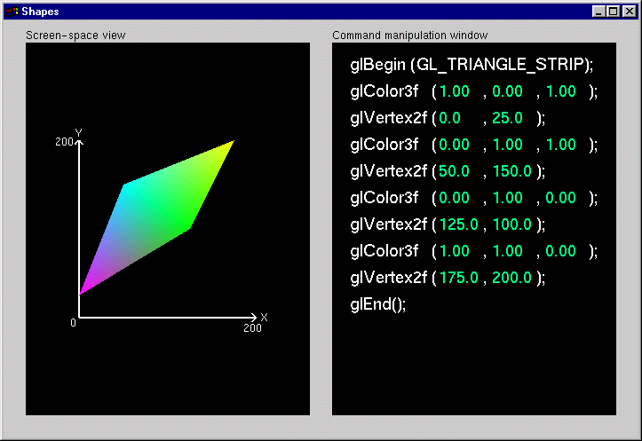
Shapes Tutorial
Notes:
This is the first of the series of Nate Robins’ tutorials. This tutorial illustrates the principles of rendering geometry, specifying both colors and vertices.
The shapes tutorial has two views: a screen-space window and a command manipulation window.
In the command manipulation window, pressing the LEFT mouse while the pointer is over the green parameter numbers allows you to move the mouse in the y-direction (up and down) and change their values. With this action, you can change the appearance of the geometric primitive in the other window. With the RIGHT mouse button, you can bring up a pop-up menu to change the primitive you are rendering. (Note that the parameters have minimum and maximum values in the tutorials, sometimes to prevent you from wandering too far. In an application, you probably don’t want to have floating-point color values less than 0.0 or greater than 1.0, but you are likely to want to position vertices at coordinates outside the boundaries of this tutorial.)
In the screen-space window, the RIGHT mouse button brings up a different pop-up menu, which has menu choices to change the appearance of the geometry in different ways.
The left and right mouse buttons will do similar operations in the other tutorials.

Slide 27
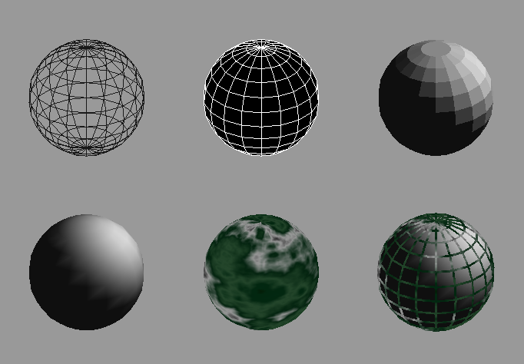
Controlling Rendering Appearance
From Wireframe to Texture Mapped
Notes:
OpenGL can render from a simple line-based wireframe to complex multi-pass texturing algorithms to simulate bump mapping or Phong lighting.

Slide 28
OpenGL’s State Machine
All rendering attributes are encapsulated in the OpenGL State
rendering styles
shading
lighting
texture mapping
Notes:
Each time OpenGL processes a vertex, it uses data stored in its internal state tables to determine how the vertex should be transformed, lit, textured or any of OpenGL’s other modes.

Slide 29
Manipulating OpenGL State
Appearance is controlled by current state
for each ( primitive to render ) {
update OpenGL state
render primitive
}
Manipulating vertex attributes is most common way to manipulate state
glColor*() / glIndex*()
glNormal*()
glTexCoord*()
Notes:
The general flow of any OpenGL rendering is to set up the required state, then pass the primitive to be rendered, and repeat for the next primitive.
In general, the most common way to manipulate OpenGL state is by setting vertex attributes, which include color, lighting normals, and texturing coordinates.

Slide 30
Controlling current state
Setting State
glPointSize( size );
glLineStipple( repeat, pattern );
glShadeModel( GL_SMOOTH );
Enabling Features
glEnable( GL_LIGHTING );
glDisable( GL_TEXTURE_2D );
Notes:
Setting OpenGL state usually includes modifying the rendering attribute, such as loading a texture map, or setting the line width. Also for some state changes, setting the OpenGL state also enables that feature ( like setting the point size or line width ).
Other features need to be turned on. This is done using glEnable(), and passing the token for the feature, like GL_LIGHT0 or GL_POLYGON_STIPPLE.

Slide 31
Transformations
Ed Angel

Slide 32
Transformations in OpenGL
Modeling
Viewing
orient camera
projection
Animation
Map to screen
Notes:
Transformations are used both by the applications programmer to move and orient objects (either statically or dynamically) and by OpenGL to implement the viewing pipeline.
Three transformations (model-view, perspective, texture) are part of the state. Their matrices can be set by application programs but the operations are carried out within the viewing pipeline.

Slide 33
Camera Analogy
3D is just like taking a photograph (lots of photographs!)
viewing
volume
camera
model
tripod
Notes:
This model has become know as the synthetic camera model.
Note that both the objects to be viewed and the camera are three-dimensional while the resulting image is two dimensional.

Slide 34
Camera Analogy and Transformations
Projection transformations
adjust the lens of the camera
Viewing transformations
tripod–define position and orientation of the viewing volume in the world
Modeling transformations
moving the model
Viewport transformations
enlarge or reduce the physical photograph
Notes:
Note that human vision and a camera lens have cone-shaped viewing volumes. OpenGL (and almost all computer graphics APIs) describe a pyramid-shaped viewing volume. Therefore, the computer will “see” differently from the natural viewpoints, especially along the edges of viewing volumes. This is particularly pronounced for wide-angle “fish-eye” camera lenses.

Slide 35
Coordinate Systems and Transformations
Steps in Forming an Image
specify geometry (world coordinates)
specify camera (camera coordinates)
project (window coordinates)
map to viewport (screen coordinates)
Each step uses transformations
Every transformation is equivalent to a change in coordinate systems (frames)
Notes:
Every transformation can be thought of as changing the representation of a vertex from one coordinate system or frame to another. Thus, initially vertices are specified in world or application coordinates. However, to view them, OpenGL must convert these representations to ones in the reference system of the camera. This change of representations is described by a transformation matrix (the model-view matrix). Similarly, the projection matrix converts from camera coordinates to window coordinates.

Slide 36
Affine Transformations
Want transformations which preserve geometry
lines, polygons, quadrics
Affine = line preserving
Rotation, translation, scaling
Projection
Concatenation (composition)
Notes:
The transformations supported by OpenGL are a special class that is important for graphical applications and for problems in science and engineering. In particular, affine transformations will not alter the type of object. A transformed line (polygon, quadric) is still a line (polygon, quadric).
Any composition of affine transformations is still affine. For example, a rotation followed by a translation followed by a projection preserves lines and polygons.

Slide 37
Homogeneous Coordinates
each vertex is a column vector
w is usually 1.0
all operations are matrix multiplications
directions (directed line segments) can be represented with w = 0.0
Notes:
A 3D vertex is represented by a 4-tuple vector (homogeneous coordinate system).
Why is a 4-tuple vector used for a 3D (x, y, z) vertex? To ensure that all matrix operations are multiplications.
If w is changed from 1.0, we can recover x, y and z by division by w. Generally, only perspective transformations change w and require this perspective division in the pipeline.

Slide 38
3D Transformations
A vertex is transformed by 4 x 4 matrices
all affine operations are matrix multiplications
all matrices are stored column-major in OpenGL
matrices are always post-multiplied
product of matrix and vector is
Notes:
Perspective projection and translation require 4th row and column, or operations would require addition, as well as multiplication.
For operations other than perspective projection, the fourth row is always (0, 0, 0, 1) which leaves w unchanged..
Because OpenGL only multiplies a matrix on the right, the programmer must remember that the last matrix specified is the first applied.

Slide 39
Specifying Transformations
Programmer has two styles of specifying transformations
specify matrices (glLoadMatrix, glMultMatrix)
specify operation (glRotate, glOrtho)
Programmer does not have to remember the exact matrices
check appendix of Red Book (Programming Guide)
Notes:
Generally, a programmer can obtain the desired matrix by a sequence of simple transformations that can be concatenated together, e.g. glRotate(), glTranslate(), and glScale().
For the basic viewing transformations, OpenGL and the Utility library have supporting functions.

Slide 40
Programming Transformations
Prior to rendering, view, locate, and orient:
eye/camera position
3D geometry
Manage the matrices
including matrix stack
Combine (composite) transformations
Notes:
Because transformation matrices are part of the state, they must be defined prior to any vertices to which they are to apply.
In modeling, we often have objects specified in their own coordinate systems and must use OpenGL transformations to bring the objects into the scene.
OpenGL provides matrix stacks for each type of supported matrix (model-view, projection, texture) to store matrices.

Slide 41
Transformation Pipeline
Poly.
Per
Vertex
CPU
DL
Raster
Frag
FB
Texture
Pixel
object
eye
clip
normalized
device
window
v
e
r
t
e
x
Modelview
Matrix
Projection
Matrix
Perspective
Division
Viewport
Transform
Modelview
Projection
other calculations here
material è color
shade model (flat)
polygon rendering mode
polygon culling
clipping
Modelview
l
l
l
Notes:
The depth of matrix stacks are implementation-dependent, but the Modelview matrix stack is guaranteed to be at least 32 matrices deep, and the Projection matrix stack is guaranteed to be at least 2 matrices deep.
The material-to-color, flat-shading, and clipping calculations take place after the Modelview matrix calculations, but before the Projection matrix. The polygon culling and rendering mode operations take place after the Viewport operations.
There is also a texture matrix stack, which is outside the scope of this course. It is an advanced texture mapping topic.

Slide 42
Matrix Operations
Specify Current Matrix Stack
glMatrixMode( GL_MODELVIEW or GL_PROJECTION )
Other Matrix or Stack Operations
glLoadIdentity() glPushMatrix()
glPopMatrix()
Viewport
usually same as window size
viewport aspect ratio should be same as projection transformation or resulting image may be distorted
glViewport( x, y, width, height )
Notes:
glLoadMatrix*() replaces the matrix on the top of the current matrix stack. glMultMatrix*(), post-multiples the matrix on the top of the current matrix stack. The matrix argument is a column-major 4 x 4 double or single precision floating point matrix.
Matrix stacks are used because it is more efficient to save and restore matrices than to calculate and multiply new matrices. Popping a matrix stack can be said to “jump back” to a previous location or orientation.
glViewport() clips the vertex or raster position. For geometric primitives, a new vertex may be created. For raster primitives, the raster position is completely clipped.
There is a per-fragment operation, the scissor test, which works in situations where viewport clipping doesn’t. The scissor operation is particularly good for fine clipping raster (bitmap or image) primitives.

Slide 43
Projection Transformation
Shape of viewing frustum
Perspective projection
gluPerspective( fovy, aspect, zNear, zFar )
glFrustum( left, right, bottom, top, zNear, zFar )
Orthographic parallel projection
glOrtho( left, right, bottom, top, zNear, zFar )
gluOrtho2D( left, right, bottom, top )
calls glOrtho with z values near zero
Notes:
For perspective projections, the viewing volume is shaped like a truncated pyramid (frustum). There is a distinct camera (eye) position, and vertexes of objects are “projected” to camera. Objects which are further from the camera appear smaller. The default camera position at (0, 0, 0), looks down the z-axis, although the camera can be moved by other transformations.
For gluPerspective(), fovy is the angle of field of view (in degrees) in the y direction. fovy must be between 0.0 and 180.0, exclusive. aspect is x/y and should be same as the viewport to avoid distortion. zNear and zFar define the distance to the near and far clipping planes.
glFrustum() is rarely used.
Warning: for gluPerspective() or glFrustum(), don’t use zero for zNear!
For glOrtho(), the viewing volume is shaped like a rectangular parallelepiped (a box). Vertexes of an object are “projected” towards infinity. Distance does not change the apparent size of an object. Orthographic projection is used for drafting and design (such as blueprints).

Slide 44
Applying Projection Transformations
Typical use (orthographic projection)
glMatrixMode( GL_PROJECTION );
glLoadIdentity();
glOrtho( left, right, bottom, top, zNear, zFar );
Notes:
Many users would follow the demonstrated sequence of commands with a glMatrixMode(GL_MODELVIEW) call to return to modelview stack.
In this example, the red line segment is inside the view volume and is projected (with parallel projectors) to the green line on the view surface. The blue line segment lies outside the volume specified by glOrtho() and is clipped.

Slide 45
Viewing Transformations
Position the camera/eye in the scene
place the tripod down; aim camera
To “fly through” a scene
change viewing transformation and redraw scene
gluLookAt( eye_{x}, eye_{y}, eye_{z}, aim_{x}, aim_{y}, aim_{z}, up_{x}, up_{y}, up_{z} )
up vector determines unique orientation
careful of degenerate positions
tripod
Notes:
gluLookAt() multiplies itself onto the current matrix, so it usually comes after glMatrixMode(GL_MODELVIEW) and glLoadIdentity().
Because of degenerate positions, gluLookAt() is not recommended for most animated fly-over applications.
An alternative is to specify a sequence of rotations and translations that are concatenated with an initial identity matrix.
Note: that the name modelview matrix is appropriate since moving objects in the model front of the camera is equivalent to moving the camera to view a set of objects.

Slide 46
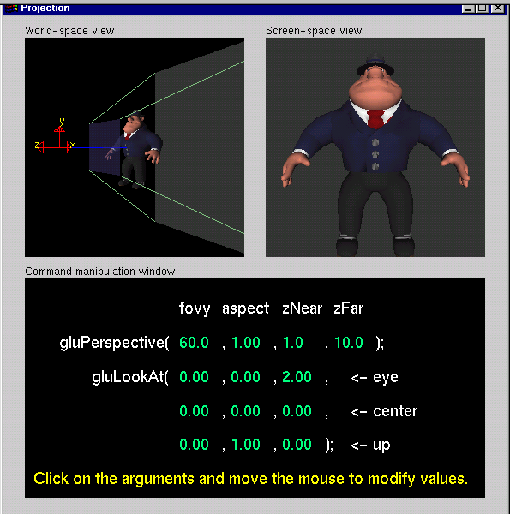
Projection Tutorial
Notes:
The RIGHT mouse button controls different menus. The screen-space view menu allows you to choose different models. The command-manipulation menu allows you to select different projection commands (including glOrtho and glFrustum).

Slide 47
Modeling Transformations
Move object
glTranslate{fd}( x, y, z )
Rotate object around arbitrary axis
glRotate{fd}( angle, x, y, z )
angle is in degrees
Dilate (stretch or shrink) or mirror object
glScale{fd}( x, y, z )
Notes:
glTranslate(), glRotate(), and glScale() multiplies itself onto the current matrix, so it usually comes after glMatrixMode(GL_MODELVIEW). There are many situations where the modeling transformation is multiplied onto a non-identity matrix.
A vertex’s distance from the origin changes the effect of glRotate() or glScale(). These operations have a fixed point for the origin. Generally, the further from the origin, the more pronounced the effect. To rotate (or scale) with a different fixed point, we must first translate, then rotate (or scale) and then undo the translation with another translation.

Slide 48
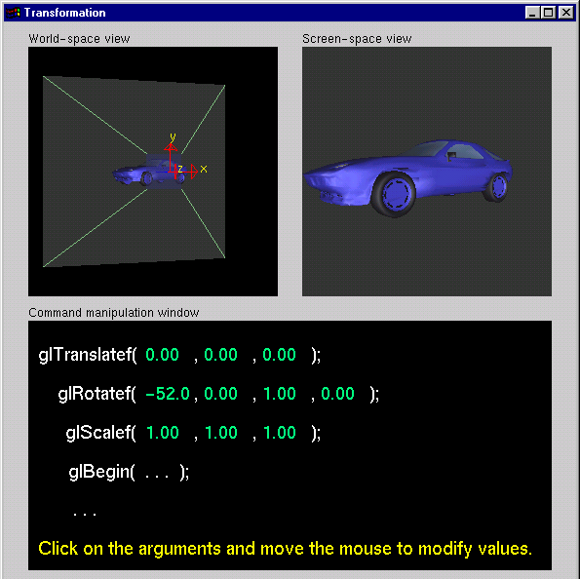
Transformation Tutorial
Notes:
For right now, concentrate on changing the effect of one command at a time. After each time that you change one command, you may want to reset the values before continuing on to the next command.
The RIGHT mouse button controls different menus. The screen-space view menu allows you to choose different models. The command-manipulation menu allows you to change the order of the glTranslatef() and glRotatef() commands. Later, we will see the effect of changing the order of modeling commands.

Slide 49
Connection: Viewing and Modeling
Moving camera is equivalent to moving every object in the world towards a stationary camera
Viewing transformations are equivalent to several modeling transformations
gluLookAt() has its own command
can make your own polar view or pilot view
Notes:
Instead of gluLookAt(, one can use the following combinations of glTranslate() and glRotate() to achieve a viewing transformation. Like gluLookAt(), these transformations should be multiplied onto the ModelView matrix, which should have an initial identity matrix.
To create a viewing transformation in which the viewer orbits an object, use this sequence (which is known as “polar view”):
glTranslated(0, 0, -distance)
glRotated(-twist, 0, 0, 1)
glRotated(-incidence, 1, 0, 0)
glRotated(azimuth, 0, 0, 1)
To create a viewing transformation which orients the viewer (roll, pitch, and heading) at position (x, y, z), use this sequence (known as “pilot view”):
glRotated(roll, 0, 0, 1)
glRotated(pitch, 0, 1, 0)
glRotated(heading, 1, 0, 0)
glTranslated(-x, -y, -z)

Slide 50
Projection is left handed
Projection transformations (gluPerspective, glOrtho) are left handed
think of zNear and zFar as distance from view point
Everything else is right handed, including the vertexes to be rendered
y
y
z+
left handed
right handed
x
x
z+
Notes:
If you get this wrong, you may see nothing in your image. Switching from right to left handed coordinates is equivalent to rotating the camera 180 degrees!
One way to think of problem is that the viewing system is left-handed so distances from the camera are measured from the camera to the object.

Slide 51
Common Transformation Usage
3 examples of resize() routine
restate projection & viewing transformations
Usually called when window resized
Registered as callback for glutReshapeFunc()
Notes:
Example: Suppose the user resizes the window. Do we see the same objects?
What if the new aspect ratio is different from the original? Can we avoid distortion of objects?
What we should do is application dependent. Hence users should write their own reshape callbacks.
Typical reshape callbacks alter the projection matrix or the viewport.

Slide 52
resize(): Perspective & LookAt
void resize( int w, int h )
{
glViewport( 0, 0, (GLsizei) w, (GLsizei) h );
glMatrixMode( GL_PROJECTION );
glLoadIdentity();
gluPerspective( 65.0, (GLfloat) w / h, 1.0, 100.0 );
glMatrixMode( GL_MODELVIEW );
glLoadIdentity();
gluLookAt( 0.0, 0.0, 5.0, 0.0, 0.0, 0.0, 0.0, 1.0, 0.0 );
}
Notes:
Using the viewport width and height as the aspect ratio for gluPerspective eliminates distortion.

Slide 53
resize(): Perspective & Translate
Same effect as previous LookAt
void resize( int w, int h )
{
glViewport( 0, 0, (GLsizei) w, (GLsizei) h );
glMatrixMode( GL_PROJECTION );
glLoadIdentity();
gluPerspective( 65.0, (GLfloat) w/h,
1.0, 100.0 );
glMatrixMode( GL_MODELVIEW );
glLoadIdentity();
glTranslatef( 0.0, 0.0, -5.0 );
}
Notes:
Moving all objects in the world five units away from you is mathematically the same as “backing up” the camera five units.

Slide 54
resize(): Ortho (part 1)
void resize( int width, int height )
{
GLdouble aspect = (GLdouble) width / height;
GLdouble left = -2.5, right = 2.5;
GLdouble bottom = -2.5, top = 2.5;
glViewport( 0, 0, (GLsizei) w, (GLsizei) h );
glMatrixMode( GL_PROJECTION );
glLoadIdentity();
… continued …
Notes:
In this routine, we first compute the aspect ratio (aspect) of the new viewing area. We’ll use this value to modify the world space values (left, right, bottom, top) of the viewing frustum depending on the new shape of the viewing volume

Slide 55
resize(): Ortho (part 2)
if ( aspect < 1.0 ) {
left /= aspect;
right /= aspect;
} else {
bottom *= aspect;
top *= aspect;
}
glOrtho( left, right, bottom, top, near, far );
glMatrixMode( GL_MODELVIEW );
glLoadIdentity();
}
Notes:
Continuing from the previous page, we determine how to modify the viewing volume based on the computed aspect ratio. After we compute the new world space values, we call glOrtho()to modify the viewing volume.

Slide 56
Compositing Modeling Transformations
Problem 1: hierarchical objects
one position depends upon a previous position
robot arm or hand; sub-assemblies
Solution 1: moving local coordinate system
modeling transformations move coordinate system
post-multiply column-major matrices
OpenGL post-multiplies matrices
Notes:
The order in which modeling transformations are performed is important because each modeling transformation is represented by a matrix, and matrix multiplication is not commutative. So a rotate followed by a translate is different from a translate followed by a rotate.

Slide 57
Compositing Modeling Transformations
Problem 2: objects move relative to absolute world origin
my object rotates around the wrong origin
make it spin around its center or something else
Solution 2: fixed coordinate system
modeling transformations move objects around fixed coordinate system
pre-multiply column-major matrices
OpenGL post-multiplies matrices
must reverse order of operations to achieve desired effect
Notes:
You’ll adjust to reading a lot of code backwards!
Typical sequence
glTranslatef(x,y,z);
glRotatef(theta, ax, ay, az);
glTranslatef(-x,-y,-z);
object();
Here (x, y, z) is the fixed point. We first (last transformation in code) move it to the origin. Then we rotate about the axis (ax, ay, az) and finally move fixed point back.

Slide 58
Additional Clipping Planes
At least 6 more clipping planes available
Good for cross-sections
Modelview matrix moves clipping plane
clipped
glEnable( GL_CLIP_PLANEi )
glClipPlane( GL_CLIP_PLANEi, GLdouble* coeff )
Notes:
Use of additional clipping places may slow rendering as they are usually implemented in software.

Slide 59
Reversing Coordinate Projection
Screen space back to world space
glGetIntegerv( GL_VIEWPORT, GLint viewport[4] )
glGetDoublev( GL_MODELVIEW_MATRIX, GLdouble mvmatrix[16] )
glGetDoublev( GL_PROJECTION_MATRIX, GLdouble projmatrix[16] )
gluUnProject( GLdouble winx, winy, winz, mvmatrix[16], projmatrix[16], GLint viewport[4], GLdouble *objx, *objy, *objz )
gluProject goes from world to screen space
Notes:
Generally, OpenGL projects 3D data onto a 2D screen. Sometimes, you need to use a 2D screen position (such as a mouse location) and figure out where in 3D it came from. If you use gluUnProject() with winz = 0 and winz = 1, you can find the 3D point at the near and far clipping planes. Then you can draw a line between those points, and you know that some point on that line was projected to your screen position.
OpenGL Release 1.2 also introduced gluUnProject4(), which also returns the transformed world-space w coordinate.

Slide 60
Animation and Depth Buffering
Vicki Shreiner

Slide 61
Animation and Depth Buffering
Discuss double buffering and animation
Discuss hidden surface removal using the depth buffer
Notes:
In this section we talk about adding the necessary steps for producing smooth interactive animations with OpenGL using double buffering. Additionally, we discuss hidden surface removal using depth buffering.

Slide 62
Double Buffering
Poly.
Per
Vertex
CPU
DL
Raster
Frag
FB
Texture
Pixel
1
2
1
2
Front
Buffer
4
4
Back
Buffer
8
8
16
16
Display
Notes:
Double buffer is a technique for tricking the eye into seeing smooth animation of rendered scenes. The color buffer is usually divided into two equal halves, called the front buffer and the back buffer.
The front buffer is displayed while the application renders into the back buffer. When the application completes rendering to the back buffer, it requests the graphics display hardware to swap the roles of the buffers, causing the back buffer to now be displayed, and the previous front buffer to become the new back buffer.

Slide 63
Animation Using Double Buffering
Request a double buffered color buffer
glutInitDisplayMode( GLUT_RGB | GLUT_DOUBLE );
Clear color buffer
glClear( GL_COLOR_BUFFER_BIT );
Render scene
Request swap of front and back buffers
glutSwapBuffers();
Repeat steps 2 - 4 for animation
Notes:
Requesting double buffering in GLUT is simple. Adding GLUT_DOUBLE to your glutInitDisplayMode() call will cause your window to be double buffered.
When your application is finished rendering its current frame, and wants to swap the front and back buffers, the glutSwapBuffers() call will request the windowing system to update the window’s color buffers.

Slide 64
Depth Buffering and Hidden Surface Removal
1
2
1
2
Color
Buffer
4
4
Depth
Buffer
8
8
16
16
Display
Notes:
Depth buffering is a technique to determine which primitives in your scene are occluded by other primitives. As each pixel in a primitive is rasterized, its distance from the eyepoint (depth value), is compared with the values stored in the depth buffer. If the pixel’s depth value is less than the stored value, the pixel’s depth value is written to the depth buffer, and its color is written to the color buffer.
The depth buffer algorithm is: if ( pixel->z < depthBuffer(x,y)->z ) { depthBuffer(x,y)->z = pixel->z; colorBuffer(x,y)->color = pixel->color; }
OpenGL depth values range from [0, 1], with one being essentially infinitely far from the eyepoint. Generally, the depth buffer is cleared to one at the start of a frame.

Slide 65
Depth Buffering Using OpenGL
Request a depth buffer
glutInitDisplayMode( GLUT_RGB | GLUT_DOUBLE | GLUT_DEPTH );
Enable depth buffering
glEnable( GL_DEPTH_TEST );
Clear color and depth buffers
glClear( GL_COLOR_BUFFER_BIT | GL_DEPTH_BUFFER_BIT );
Render scene
Swap color buffers
Notes:
Enabling depth testing in OpenGL is very straightforward.
A depth buffer must be requested for your window, once again using the glutInitDisplayMode(), and the GLUT_DEPTH bit.
Once the window is created, the depth test is enabled using glEnable( GL_DEPTH_TEST ).

Slide 66
An Updated Program Template
void main( int argc, char** argv )
{
glutInit( &argc, argv );
glutInitDisplayMode( GLUT_RGB | GLUT_DOUBLE | GLUT_DEPTH );
glutCreateWindow( “Tetrahedron” );
init();
glutIdleFunc( idle );
glutDisplayFunc( display );
glutMainLoop();
}
Notes:
In main(),
1) GLUT initializes and creates a window named “Tetrahedron”
2) set OpenGL state which is enabled through the entire life of the program in init()
3) set GLUT’s idle function, which is called when there are no user events to process.
4) enter the main event processing loop of the program.

Slide 67
An Updated Program Template (cont.)
void init( void ) { glClearColor( 0.0, 0.0, 1.0, 1.0 ); } void idle( void ) { glutPostRedisplay(); }
Notes:
In init() the basic OpenGL state to be used throughout the program is initialized. For this simple program, all we do is set the background (clear color) for the color buffer. In this case, we’ve decided that instead of the default black background, we want a blue background.
Additionally, our glutIdleFunc(), which we’ve set to the function idle() above, requests that GLUT re-render our scene again. The function glutPostRedisplay() requests that GLUT call our display function (this was set with glutDisplayFunc()) at the next convenient time. This method provides better event processing response from the application.

Slide 68
An Updated Program Template (cont.)
void drawScene( void )
{
GLfloat vertices[] = { … };
GLfloat colors[] = { … };
glClear( GL_COLOR_BUFFER_BIT | GL_DEPTH_BUFFER_BIT );
glBegin( GL_TRIANGLE_STRIP );
/* calls to glColor*() and glVertex*() */
glEnd();
glutSwapBuffers();
}
Notes:
In drawScene(),
1) the color buffer is cleared to the background color
2) a triangle strip is rendered to create a tetrahedron (use your imagination for the details!)
3) the front and back buffers are swapped.

Slide 69
Lighting
Dave Shreiner

Slide 70
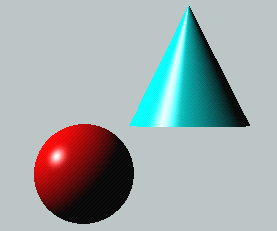
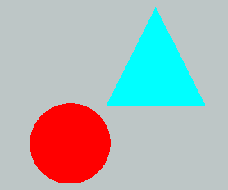
Lighting Principles
Lighting simulates how objects reflect light
material composition of object
light’s color and position
global lighting parameters
ambient light
two sided lighting
available in both color index and RGBA mode
Notes:
Lighting is an important technique in computer graphics. Without lighting, objects tend to look like they’re made out of plastic.
OpenGL divides lighting into three parts: material properties, light properties and global lighting parameters.
Lighting is available in both RGBA mode and color index mode. RGBA is more flexible and less restrictive than color index mode lighting.

Slide 71
How OpenGL Simulates Lights
Phong lighting model
Computed at vertices
Lighting contributors
Surface material properties
Light properties
Lighting model properties
Notes:
OpenGL lighting is based on the Phong lighting model. At each vertex in the primitive, a color is computed using that primitives material properties along with the light settings.
The color for the vertex is computed by adding four computed colors for the final vertex color. The four contributors to the vertex color are:
Ambient is color of the object from all the undirected light in a scene.
Diffuse is the base color of the object under current lighting. There must be a light shining on the object to get a diffuse contribution.
Specular is the contribution of the shiny highlights on the object.
Emission is the contribution added in if the object emits light (i.e. glows)

Slide 72
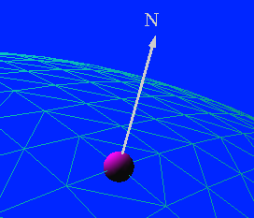
Surface Normals
Poly.
Per
Vertex
CPU
DL
Raster
Frag
FB
Texture
Pixel
Normals define how a surface reflects light
glNormal3f( x, y, z )
Current normal is used to compute vertex’s color
Use unit normals for proper lighting
scaling affects a normal’s length
glEnable( GL_NORMALIZE ) or glEnable( GL_RESCALE_NORMAL )
Notes:
The lighting normal tells OpenGL how the object reflects light around a vertex. If you imagine that there is a small mirror at the vertex, the lighting normal describes how the mirror is oriented, and consequently how light is reflected.
glNormal*() sets the current normal, which is used in the lighting computation for all vertices until a new normal is provided.
Lighting normals should be normalized to unit length for correct lighting results. glScale*() affects normals as well as vertices, which can change the normal’s length, and cause it to no longer be normalized. OpenGL can automatically normalize normals, by enabling glEnable(GL_NORMALIZE). or glEnable(GL_RESCALE_NORMAL). GL_RESCALE_NORMAL is a special mode for when your normals are uniformly scaled. If not, use GL_NORMALIZE which handles all normalization situations, but requires the computation of a square root, which can potentially lower performance
OpenGL evaluators and NURBS can provide lighting normals for generated vertices automatically.

Slide 73
Material Properties
Define the surface properties of a primitive
glMaterialfv( face, property, value );
separate materials for front and back
Notes:
Material properties describe the color and surface properties of a material (dull, shiny, etc.). OpenGL supports material properties for both the front and back of objects, as described by their vertex winding.
The OpenGL material properties are:
GL_DIFFUSE - base color of object
GL_SPECULAR - color of highlights on object
GL_AMBIENT - color of object when not directly illuminated
GL_EMISSION - color emitted from the object (think of a firefly)
GL_SHININESS - concentration of highlights on objects. Values range from 0 (very rough surface - no highlight) to 128 (very shiny)
Material properties can be set for each face separately by specifying either GL_FRONT or GL_BACK, or for both faces simultaneously using GL_FRONT_AND_BACK.

Slide 74
Light Properties
glLightfv( light, property, value );
light specifies which light
multiple lights, starting with GL_LIGHT0
glGetIntegerv( GL_MAX_LIGHTS, &n );
properties
colors
position and type
attenuation
Notes:
The glLight() call is used to set the parameters for a light. OpenGL implementations must support at least eight lights, which are named GL_LIGHT0 through GL_LIGHTn, where n is one less than the maximum number supported by an implementation.
OpenGL lights have a number of characteristics which can be changed from their default values. Color properties allow separate interactions with the different material properties. Position properties control the location and type of the light and attenuation controls the natural tendency of light to decay over distance.

Slide 75
Light Sources (cont.)
Light color properties
GL_AMBIENT
GL_DIFFUSE
GL_SPECULAR
Notes:
OpenGL lights can emit different colors for each of a materials properties. For example, a light’s GL_AMBIENT color is combined with a material’s GL_AMBIENT color to produce the ambient contribution to the color - Likewise for the diffuse and specular colors.

Slide 76
Types of Lights
OpenGL supports two types of Lights
Local (Point) light sources
Infinite (Directional) light sources
Type of light controlled by w coordinate
Notes:
OpenGL supports two types of lights: infinite (directional) and local (point) light sources. The type of light is determined by the w coordinate of the light’s position.
A light’s position is transformed by the current ModelView matrix when it is specified. As such, you can achieve different effects by when you specify the position.

Slide 77
Turning on the Lights
Flip each light’s switch
glEnable( GL_LIGHTn );
Turn on the power
glEnable( GL_LIGHTING );
Notes:
Each OpenGL light is controllable separately, using glEnable() and the respective light constant GL_LIGHTn. Additionally, global control over whether lighting will be used to compute primitive colors is controlled by passing GL_LIGHTING to glEnable(). This provides a handy way to enable and disable lighting without turning on or off all of the separate components.

Slide 78
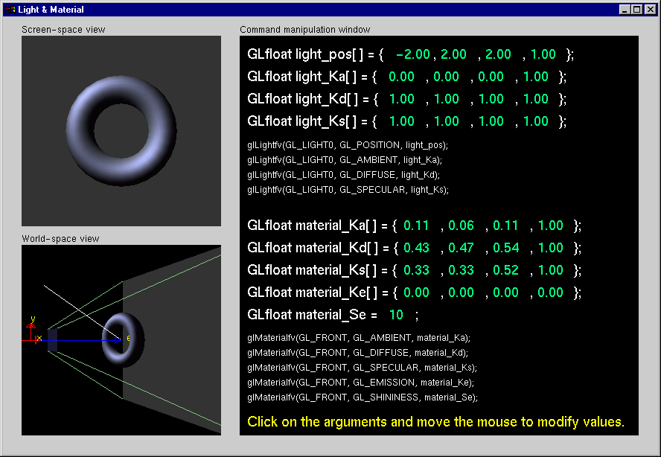
Light Material Tutorial
Notes:
In this tutorial, concentrate on noticing the affects of different material and light properties. Additionally, compare the results of using a local light versus using an infinite light.
In particular, experiment with the GL_SHININESS parameter to see its affects on highlights.

Slide 79
Controlling a Light’s Position
Modelview matrix affects a light’s position
Different effects based on when position is specified
eye coordinates
world coordinates
model coordinates
Push and pop matrices to uniquely control a light’s position
Notes:
As mentioned previously, a light’s position is transformed by the current ModelView matrix when it is specified. As such, depending on when you specify the light’s position, and what’s in the ModelView matrix, you can obtain different lighting affects.
In general, there are three coordinate systems where you can specify a light’s position/direction
1) Eye coordinates - which is represented by an identity matrix in the ModelView. In this case, when the light’s position/direction is specified, it remains fixed to the imaging plane. As such, regardless of how the objects are manipulated, the highlights remain in the same location relative to the eye.
2) World Coordinates - when only the viewing transformation is in the ModelView matrix. In this case, a light’s position/direction appears fixed in the scene, as if the light were on a lamppost.
3) Model Coordinates - any combination of viewing and modeling transformations is in the ModelView matrix. This method allows arbitrary, and even animated, position of a light using modeling transformations.

Slide 80
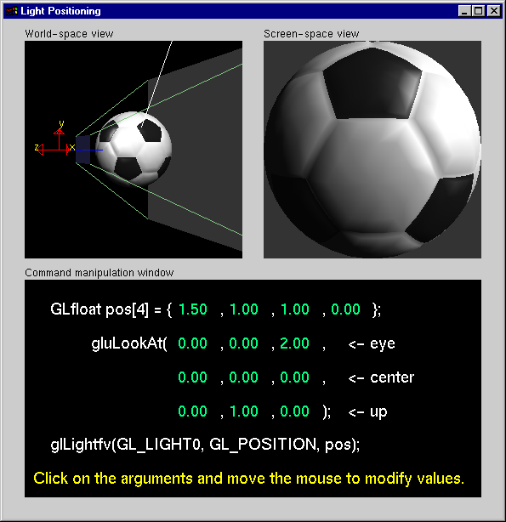
Light Position Tutorial
Notes:
This tutorial demonstrates the different lighting affects of specifying a light’s position in eye and world coordinates. Experiment with how highlights and illuminated areas change under the different lighting position specifications.

Slide 81
Advanced Lighting Features
Spotlights
localize lighting affects
GL_SPOT_DIRECTION
GL_SPOT_CUTOFF
GL_SPOT_EXPONENT
Notes:
A local light can also be converted into a spotlight. By setting the GL_SPOT_DIRECTION, GL_SPOT_CUTOFF, and GL_SPOT_EXPONENT, the local light will shine in a direction and its light will be limited to a cone centered around that direction vector.

Slide 82
Advanced Lighting Features
Light attenuation
decrease light intensity with distance
GL_CONSTANT_ATTENUATION
GL_LINEAR_ATTENUATION
GL_QUADRATIC_ATTENUATION
Notes:
Each OpenGL light source supports attenuation, which describes how light diminishes with distance. The OpenGL model supports quadratic attenuation, and utilizes the following attenuation factor, f_{i}, where d is the distance from the eyepoint to the vertex being lit:
where:
k_{c} is the GL_CONSTANT_ATTENUATION term
k_{l} is the GL_LINEAR_ATTENUATION term
k_{q} is the GL_QUADRATIC_ATTENUATION term

Slide 83
Light Model Properties
glLightModelfv( property, value );
Enabling two sided lighting
GL_LIGHT_MODEL_TWO_SIDE
Global ambient color
GL_LIGHT_MODEL_AMBIENT
Local viewer mode
GL_LIGHT_MODEL_LOCAL_VIEWER
Separate specular color
GL_LIGHT_MODEL_COLOR_CONTROL
Notes:
Properties which aren’t directly connected with materials or lights are grouped into light model properties. With OpenGL 1.2, there are four properties associated with the lighting model:
1) Two-sided lighting uses the front and back material properties for illuminating a primitive.
2) Global ambient color initializes the global ambient contribution of the lighting equation.
3) Local viewer mode disables an optimization which provides faster lighting computations. With local viewer mode on, you get better light results at a slight performance penalty.
4) Separate specular color is a mode for maintaining better specular highlights in certain texture mapped conditions. This is a new feature for OpenGL 1.2.

Slide 84
Tips for Better Lighting
Recall lighting computed only at vertices
model tessellation heavily affects lighting results
better results but more geometry to process
Use a single infinite light for fastest lighting
minimal computation per vertex
Notes:
As with all of computing, time versus space is the continual tradeoff. To get the best results from OpenGL lighting, your models should be finely tessellated to get the best specular highlights and diffuse color boundaries. This yields better results, but usually at a cost of more geometric primitives, which could slow application performance.
To achieve maximum performance for lighting in your applications, use a single infinite light source. This minimizes the amount of work that OpenGL has to do to light every vertex.

Slide 85
Imaging and Raster Primitives
Vicki Shreiner

Slide 86
Imaging and Raster Primitives
Describe OpenGL’s raster primitives: bitmaps and image rectangles
Demonstrate how to get OpenGL to read and render pixel rectangles
Notes:
OpenGL is not only a complete interface for 3D rendering, it’s also a very capable image processing engine. In this section we discuss some of the basic functions of OpenGL for rendering color-pixel rectangles and single-bit bitmaps, as well as how to read color information from the framebuffer.
OpenGL doesn’t render images, per se, since images usually are stored in some file with an image format associated with it (for example, JPEG images). OpenGL only knows how to render rectangles of pixels, not decode image files.

Slide 87
Pixel-based primitives
Bitmaps
2D array of bit masks for pixels
update pixel color based on current color
Images
2D array of pixel color information
complete color information for each pixel
OpenGL doesn’t understand image formats
Notes:
In addition to geometric primitives, OpenGL also supports pixel-based primitives. These primitives contain explicit color information for each pixel that they contain. They come in two types:
Bitmaps are single bit images, which are used as a mask to determine which pixels to update. The current color, set with glColor()is used to determine the new pixel color.
Images are blocks of pixels with complete color information for each pixel.
OpenGL, however, doesn’t understand image formats, like JPEG, PNG or GIFs. In order for OpenGL to use the information contained in those file formats, the file must be read and decoded to obtain the color information, at which point, OpenGL can rasterize the color values.

Slide 88
Pixel Pipeline
Poly.
Per
Vertex
CPU
DL
Raster
Frag
FB
Texture
Pixel
Programmable pixel storage and transfer operations
glBitmap(), glDrawPixels()
Pixel
Storage
Modes
Pixel-Transfer
Operations
(and Pixel Map)
Rasterization
(including
Pixel Zoom)
Per Fragment Operations
Frame Buffer
CPU
TextureMemory
glCopyTex*Image();
glReadPixels(), glCopyPixels()
Notes:
Just as there’s a pipeline that geometric primitives go through when they are processed, so do pixels. The pixels are read from main storage, processed to obtain the internal format which OpenGL uses, which may include color translations or byte-swapping. After this, each pixel from the image is processed by the fragment operations discussed in the last section, and finally rasterized into the framebuffer.
In addition to rendering into the framebuffer, pixels can be copied from the framebuffer back into host memory, or transferred into texture mapping memory.
For best performance, the internal representation of a pixel array should match the hardware. For example, for a 24 bit frame buffer, 8-8-8 RGB would probably be a good match, but 10-10-10 RGB could be bad. Warning: non-default values for pixel storage and transfer can be very slow.

Slide 89
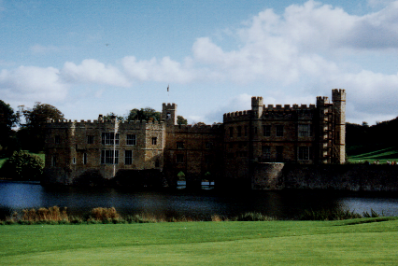
Positioning Image Primitives
glRasterPos3f( x, y, z )
raster position transformed like geometry
discarded if raster position is outside of viewport
may need to fine tune viewport for desired results
Raster Position
Notes:
Images are positioned by specifying the raster position, which maps the lower left corner of an image primitive to a point in space. Raster positions are transformed and clipped the same as vertices. If a raster position fails the clip check, no fragments are rasterized.

Slide 90
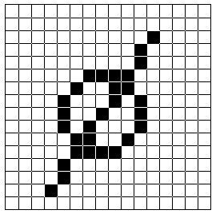
Rendering Bitmaps
glBitmap( width, height, xorig, yorig, xmove, ymove, bitmap )
render bitmap in current color at
advance raster position by after rendering
height
yorig
width
xorig
xmove
Notes:
Bitmaps are used as a mask to determine which pixels to update. A bitmap is specified as a packed array of bits in a byte array. For each value of one in the bitmap, a fragment is generated in the currently set color and processed by the fragment operations.
Bitmaps can have their own origin, which provides a relative position to the current raster position. Additionally, after the bitmap is rendered, the raster position is automatically updated by the offset provided in (xmove, ymove).
Bitmaps are particularly useful for rendering bitmapped text, which we’ll discuss in a moment.

Slide 91
Rendering Fonts using Bitmaps
OpenGL uses bitmaps for font rendering
each character is stored in a display list containing a bitmap
window system specific routines to access system fonts
glXUseXFont()
wglUseFontBitmaps()
Notes:
OpenGL uses bitmaps to do font rendering. The window system specific routines process system native font files, and create bitmaps for the different glyphs in the font. Each character is stored in a display list that is part of a set that is created when the font is processed.

Slide 92

Rendering Images
glDrawPixels( width, height, format, type, pixels )
render pixels with lower left of image at current raster position
numerous formats and data types for specifying storage in memory
best performance by using format and type that matches hardware
Notes:
Rendering images is done with the glDrawPixels()command. A block of pixels from host CPU memory is passed into OpenGL with a format and data type specified. For each pixel in the image, a fragment is generated using the color retrieved from the image, and further processed.
OpenGL supports many different formats for images including:
RGB images with an RGB triplet for every pixel
intensity images which contain only intensity for each pixel. These images are converted into greyscale RGB images internally.
depth images which are depth values written to the depth buffer, as compared to the color framebuffer. This is useful in loading the depth buffer with values and then rendering a matching color images with depth testing enabled.
stencil images which copy stencil masks in the stencil buffer. This provides an easy way to load a complicated per pixel mask.
The type of the image describes the format that the pixels stored in host memory. This could be primitive types like GL_FLOAT or GL_INT, or pixels with all color components packed into a primitive type, like GL_UNSIGNED_SHORT_5_6_5.

Slide 93
Reading Pixels
glReadPixels( x, y, width, height, format, type, pixels )
read pixels form specified (x,y) position in framebuffer
pixels automatically converted from framebuffer format into requested format and type
Framebuffer pixel copy
glCopyPixels( x, y, width, height, type )
Notes:
Just as you can send pixels to the framebuffer, you can read the pixel values back from the framebuffer to host memory for doing storage or image processing.
Pixels read from the framebuffer are processed by the pixel storage and transfer modes, as well as converting them into the format and type requested, and placing them in host memory.
Additionally, pixels can be copied from the framebuffer from one location to another using glCopyPixels(). Pixels are processed by the pixel storage and transfer modes before being returned to the framebuffer.

Slide 94

Pixel Zoom
glPixelZoom( x, y )
expand, shrink or reflect pixels around current raster position
fractional zoom supported
Raster Position
glPixelZoom(1.0, -1.0);
Notes:
OpenGL can also scale pixels as they are being rendered. glPixelZoom()will scale or shrink pixels as well as reflect them around the current raster position.

Slide 95
Storage and Transfer Modes
Storage modes control accessing memory
byte alignment in host memory
extracting a subimage
Transfer modes allow modify pixel values
scale and bias pixel component values
replace colors using pixel maps
Notes:
When pixels are read from or written to host memory, pixels can be modified by storage and transfer modes.
Storage modes control how host memory is accessed and written to, including byte swapping and addressing, and modifying how memory is accessed to read only a small subset of the original image.
Transfer modes allow pixel modifications as they are processed. This includes scaling and biasing the color component values, as well as replacing color values using color lookup tables.

Slide 96
Texture Mapping
Ed Angel

Slide 97
Texture Mapping
Poly.
Per
Vertex
CPU
DL
Raster
Frag
FB
Texture
Pixel
Apply a 1D, 2D, or 3D image to geometric primitives
Uses of Texturing
simulating materials
reducing geometric complexity
image warping
reflections
Notes:
In this section, we’ll discuss texture ( sometimes also called image ) mapping. Texture mapping augments the colors specified for a geometric primitive with the colors stored in an image. An image can be a 1D, 2D, or 3D set of colors called texels. 2D textures will be used throughout the section for demonstrations, however, the processes described are identical for 1D and 3D textures.
Some of the many uses of texture mapping include:
simulating materials like wood, bricks or granite
reducing the complexity ( number of polygons ) of a geometric object
image processing techniques like image warping and rectification, rotation and scaling
simulating reflective surfaces like mirrors or polished floors

Slide 98

Texture Mapping
y
z
x
geometry
screen
t
image
s
Notes:
Textures are images that can be thought of as continuous and be one, two, three, or four dimensional. By convention, the coordinates of the image are s, t, r and q. Thus for the two dimensional image above, a point in the image is given by its (s, t) values with (0, 0) in the lower-left corner and (1, 1) in the top-right corner.
A texture map for a two-dimensional geometric object in (x, y, z) world coordinates maps a point in (s, t) space to a corresponding point on the screen.

Slide 99
Texture Mapping and the OpenGL Pipeline
vertices
geometry pipeline
rasterizer
image
pixel pipeline
Images and geometry flow through separate pipelines that join at the rasterizer
“complex” textures do not affect geometric complexity
Notes:
The advantage of texture mapping is that visual detail is in the image, not in the geometry. Thus, the complexity of an image does not affect the geometric pipeline (transformations, clipping) in OpenGL. Texture is added during rasterization where the geometric and pixel pipelines meet.

Slide 100
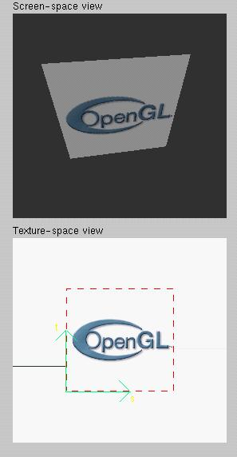
Texture Example
The texture (below) is a 256 x 256 image that has been mapped to a rectangular polygon which is viewed in perspective
Notes:
This example is from the tutorial demo.
The size of textures must be a power of two. However, we can use image manipulation routines to convert an image to the required size.
Texture can replace lighting and material effects or be used in combination with them.

Slide 101
Applying Textures I
Three steps
specify texture
read or generate image
assign to texture
assign texture coordinates to vertices
specify texture parameters
wrapping, filtering
Notes:
In the simplest approach, we must perform these three steps.
Textures reside in texture memory. When we assign an image to a texture it is copied from processor memory to texture memory where pixels are formatted differently.
Texture coordinates are actually part of the state as are other vertex attributes such as color and normals. As with colors, OpenGL interpolates texture inside geometric objects.
Because textures are really discrete and of limited extent, texture mapping is subject to aliasing errors that can be controlled through filtering.
Texture memory is a limited resource and having only a single active texture can lead to inefficient code.

Slide 102
Applying Textures II
specify textures in texture objects
set texture filter
set texture function
set texture wrap mode
set optional perspective correction hint
bind texture object
enable texturing
supply texture coordinates for vertex
coordinates can also be generated
Notes:
The general steps to enable texturing are listed above. Some steps are optional, and due to the number of combinations, complete coverage of the topic is outside the scope of this course.
Here we use the texture object approach. Using texture objects may enable your OpenGL implementation to make some optimizations behind the scenes.
As with any other OpenGL state, texture mapping requires that glEnable() be called. The tokens for texturing are:
GL_TEXTURE_1D - one dimensional texturing
GL_TEXTURE_2D - two dimensional texturing
GL_TEXTURE_3D - three dimensional texturing
2D texturing is the most commonly used. 1D texturing is useful for applying contours to objects ( like altitude contours to mountains ). 3D texturing is useful for volume rendering.

Slide 103
Texture Objects
Like display lists for texture images
one image per texture object
may be shared by several graphics contexts
Generate texture names
glGenTextures( n, *texIds );
Notes:
The first step in creating texture objects is to have OpenGL reserve some indices for your objects. glGenTextures() will request n texture ids and return those values back to you in texIds.
To begin defining a texture object, you call glBindTexture() with the id of the object you want to create. The target is one of GL_TEXTURE_{123}D(). All texturing calls become part of the object until the next glBindTexture() is called.
To have OpenGL use a particular texture object, call glBindTexture() with the target and id of the object you want to be active.
To delete texture objects, use glDeleteTextures( n, *texIds ), where texIds is an array of texture object identifiers to be deleted.

Slide 104
Texture Objects (cont.)
Create texture objects with texture data and state
glBindTexture( target, id );
Bind textures before using
glBindTexture( target, id );

Slide 105
Specify Texture Image
Poly.
Per
Vertex
CPU
DL
Raster
Frag
FB
Texture
Pixel
Define a texture image from an array of texels in CPU memory
glTexImage2D( target, level, components, w, h, border, format, type, *texels );
dimensions of image must be powers of 2
Texel colors are processed by pixel pipeline
pixel scales, biases and lookups can be done
Notes:
Specifying the texels for a texture is done using the glTexImage{123}D() call. This will transfer the texels in CPU memory to OpenGL, where they will be processed and converted into an internal format.
The array of texels sent to OpenGL with glTexImage*() must be a power of two in both directions. An optional one texel wide border may be added around the image. This is useful for certain wrapping modes.
The level parameter is used for defining how OpenGL should use this image when mapping texels to pixels. Generally, you’ll set the level to 0, unless you’re using a texturing technique called mipmapping, which we’ll discuss in a few slides.

Slide 106
Converting A Texture Image
If dimensions of image are not power of 2
gluScaleImage( format, w_in, h_in, type_in, *data_in, w_out, h_out, type_out, *data_out );
*_in is for source image
*_out is for destination image
Image interpolated and filtered during scaling
Notes:
If your image does not meet the power of two requirement for a dimension, the gluScaleImage() call will resample an image to a particular size. It uses a simple box filter to interpolate the new images pixels from the source image.
Additionally, gluScaleImage() can be used to convert from one data type ( i.e. GL_FLOAT ) to another type, which may better match the internal format in which OpenGL stores your texture.
Note that use of gluScaleImage() can also save memory.

Slide 107
Specifying a Texture: Other Methods
Use frame buffer as source of texture image
uses current buffer as source image
glCopyTexImage2D(...)
glCopyTexImage1D(...)
Modify part of a defined texture
glTexSubImage2D(...)
glTexSubImage1D(...)
Do both with glCopyTexSubImage2D(...), etc.
Notes:
glCopyTexImage*() allows textures to be defined by rendering into any of OpenGL’s buffers. The source buffer is selected using the glReadBuffer() command.
Using glTexSubImage*() to replace all or part of an existing texture often outperforms using glTexImage*() to allocate and define a new one. This can be useful for creating a “texture movie” ( sequence of textures which changes appearance on an object’s surface ).
There are some advanced techniques using glTexSubImage*() which include loading an image which doesn’t meet the power of two requirement. Additionally, several small images can be “packed” into one larger image ( which was originally created with glTexImage*() ), and loaded individually with glTexSubImage*(). Both of these techniques require the manipulation of the texture transform matrix, which is outside the scope of this course.

Slide 108
Mapping a Texture
Poly.
Per
Vertex
CPU
DL
Raster
Frag
FB
Texture
Pixel
Based on parametric texture coordinates
glTexCoord*() specified at each vertex
Texture Space
Object Space
t
1, 1
(s, t) = (0.2, 0.8)
0, 1
A
a
c
(0.4, 0.2)
b
B
C
0, 0
1, 0
s
(0.8, 0.4)
Notes:
When you want to map a texture onto a geometric primitive, you need to provide texture coordinates. The glTexCoord*() call sets the current texture coordinates. Valid texture coordinates are between 0 and 1, for each texture dimension, and the default texture coordinate is ( 0, 0, 0, 1 ). If you pass fewer texture coordinates than the currently active texture mode ( for example, using glTexCoord1d() while GL_TEXTURE_2D is enabled ), the additionally required texture coordinates take on default values.

Slide 109
Generating Texture Coordinates
Automatically generate texture coords
glTexGen{ifd}[v]()
specify a plane
generate texture coordinates based upon distance from plane
generation modes
GL_OBJECT_LINEAR
GL_EYE_LINEAR
GL_SPHERE_MAP
Notes:
You can have OpenGL automatically generate texture coordinates for vertices by using the glTexGen() and glEnable(GL_TEXTURE_GEN_{STRQ}). The coordinates are computed by determining the vertex’s distance from each of the enabled generation planes.
As with lighting positions, texture generation planes are transformed by the ModelView matrix, which allows different results based upon when the glTexGen() is issued.
There are three ways in which texture coordinates are generated:
GL_OBJECT_LINEAR - textures are fixed to the object ( like wall paper )
GL_EYE_LINEAR - texture fixed in space, and object move through texture ( like underwater light shining on a swimming fish)
GL_SPHERE_MAP - object reflects environment, as if it were made of mirrors (like the shiny guy in Terminator 2)

Slide 110
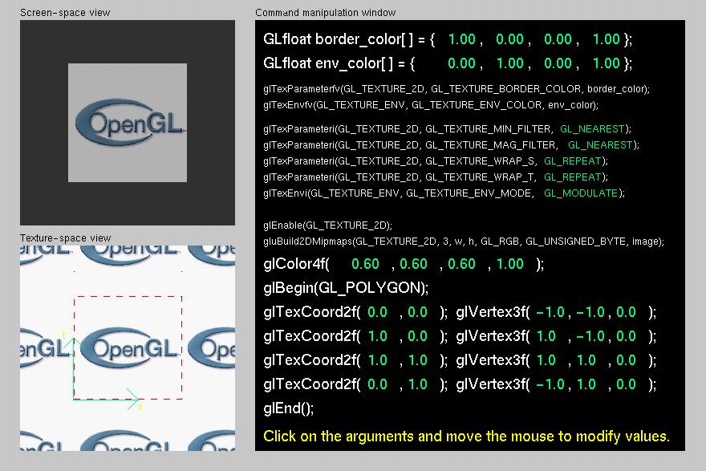
Tutorial: Texture

Slide 111
Texture Application Methods
Filter Modes
minification or magnification
special mipmap minification filters
Wrap Modes
clamping or repeating
Texture Functions
how to mix primitive’s color with texture’s color
blend, modulate or replace texels
Notes:
Textures and the objects being textured are rarely the same size ( in pixels ). Filter modes determine the methods used by how texels should be expanded ( magnification ), or shrunk ( minification ) to match a pixel’s size. An additional technique, called mipmapping is a special instance of a minification filter.
Wrap modes determine how to process texture coordinates outside of the [0,1] range. The available modes are:
GL_CLAMP - clamp any values outside the range to closest valid value, causing the edges of the texture to be “smeared” across the primitive
GL_REPEAT - use only the fractional part of the texture coordinate, causing the texture to repeat across an object
Finally, the texture environment describes how a primitives fragment colors and texel colors should be combined to produce the final framebuffer color. Depending upon the type of texture ( i.e. intensity texture vs. RGBA texture ) and the mode, pixels and texels may be simply multiplied, linearly combined, or the texel may replace the fragment’s color altogether.

Slide 112
Filter Modes
Example:
glTexParameteri( target, type, mode );
Texture
Polygon
Texture
Polygon
Magnification
Minification
Notes:
Filter modes control how pixels are minified or magnified. Generally a color is computed using the nearest texel or by a linear average of several texels.
The filter type, above is one of GL_TEXTURE_MIN_FILTER or GL_TEXTURE_MAG_FILTER.
The mode is one of GL_NEAREST, GL_LINEAR, or special modes for mipmapping. Mipmapping modes are used for minification only, and have values of: GL_NEAREST_MIPMAP_NEAREST
GL_NEAREST_MIPMAP_LINEAR
GL_LINEAR_MIPMAP_NEAREST
GL_LINEAR_MIPMAP_LINEAR
Full coverage of mipmap texture filters is outside the scope of this course.

Slide 113
Mipmapped Textures
Mipmap allows for prefiltered texture maps of decreasing resolutions
Lessens interpolation errors for smaller textured objects
Declare mipmap level during texture definition
glTexImage*D( GL_TEXTURE_*D, level, … )
GLU mipmap builder routines
gluBuild*DMipmaps( … )
OpenGL 1.2 introduces advanced LOD controls
Notes:
As primitives become smaller in screen space, a texture may appear to shimmer as the minification filters creates rougher approximations. Mipmapping is an attempt to reduce the shimmer effect by creating several approximations of the original image at lower resolutions.
Each mipmap level should have an image which is one-half the height and width of the previous level, to a minimum of one texel in either dimension. For example, level 0 could be 32 x 8 texels. Then level 1 would be 16 x 4; level 2 would be 8 x 2; level 3, 4 x 1; level 4, 2 x 1, and finally, level 5, 1 x 1.
The gluBuild*Dmipmaps() routines will automatically generate each mipmap image, and call glTexImage*D() with the appropriate level value.
OpenGL 1.2 introduces control over the minimum and maximum mipmap levels, so you don’t have to specify every mipmap level (and also add more levels, on the fly).

Slide 114
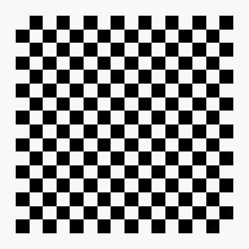
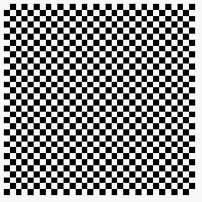

Wrapping Mode
Example:
glTexParameteri( GL_TEXTURE_2D, GL_TEXTURE_WRAP_S, GL_CLAMP )
glTexParameteri( GL_TEXTURE_2D, GL_TEXTURE_WRAP_T, GL_REPEAT )
t
s
GL_REPEAT
wrapping
GL_CLAMP
wrapping
texture
Notes:
Wrap mode determines what should happen if a texture coordinate lies outside of the [0,1] range. If the GL_REPEAT wrap mode is used, for texture coordinate values less than zero or greater than one, the integer is ignored and only the fractional value is used.
If the GL_CLAMP wrap mode is used, the texture value at the extreme (either 0 or 1) is used.

Slide 115
Texture Functions
Controls how texture is applied
glTexEnv{fi}[v]( GL_TEXTURE_ENV, prop, param )
GL_TEXTURE_ENV_MODE modes
GL_MODULATE
GL_BLEND
GL_REPLACE
Set blend color with GL_TEXTURE_ENV_COLOR
Notes:
The texture mode determines how texels and fragment colors are combined. The most common modes are:
GL_MODULATE - multiply texel and fragment color
GL_BLEND - linearly blend texel, fragment, env color
GL_REPLACE - replace fragment’s color with texel
If prop is GL_TEXTURE_ENV_COLOR, param is an array of four floating point values representing the color to be used with the GL_BLEND texture function.

Slide 116
Perspective Correction Hint
Texture coordinate and color interpolation
either linearly in screen space
or using depth/perspective values (slower)
Noticeable for polygons “on edge”
glHint( GL_PERSPECTIVE_CORRECTION_HINT, hint )
where hint is one of
GL_DONT_CARE
GL_NICEST
GL_FASTEST
Notes:
An OpenGL implementation may chose to ignore hints.

Slide 117
Is There Room for a Texture?
Query largest dimension of texture image
typically largest square texture
doesn’t consider internal format size
glGetIntegerv( GL_MAX_TEXTURE_SIZE, &size )
Texture proxy
will memory accommodate requested texture size?
no image specified; placeholder
if texture won’t fit, texture state variables set to 0
doesn’t know about other textures
only considers whether this one texture will fit all of memory
Notes:
GLint proxyComponents;
glTexImage2D(GL_PROXY_TEXTURE_2D, 0, GL_RGBA8, 64, 64, 0, GL_RGBA, GL_UNSIGNED_BYTE, NULL);
glGetTexLevelParameteriv(GL_PROXY_TEXTURE_2D, 0, GL_TEXTURE_COMPONENTS, &proxyComponents);

Slide 118
Texture Residency
Working set of textures
high-performance, usually hardware accelerated
textures must be in texture objects
a texture in the working set is resident
for residency of current texture, check GL_TEXTURE_RESIDENT state
If too many textures, not all are resident
can set priority to have some kicked out first
establish 0.0 to 1.0 priorities for texture objects
Notes:
Query for residency of an array of texture objects:
GLboolean glAreTexturesResident(GLsizei n, Gluint *texNums, GLboolean *residences)
Set priority numbers for an array of texture objects:
glPrioritizeTextures(GLsizei n, GLuint *texNums, GLclampf *priorities)
Lower priority numbers mean that, in a crunch, these texture objects will be more likely to be moved out of the working set.
One common strategy is avoid prioritization, because many implementations will automatically implement an LRU (least recently used) scheme, when removing textures from the working set.
If there is no high-performance working set, then all texture objects are considered to be resident.

Slide 119
Advanced OpenGL Topics
Dave Shreiner

Slide 120
Advanced OpenGL Topics
Display Lists and Vertex Arrays
Alpha Blending and Antialiasing
Using the Accumulation Buffer
Fog
Feedback & Selection
Fragment Tests and Operations
Using the Stencil Buffer

Slide 121
Immediate Mode versus Display Listed Rendering
Immediate Mode Graphics
Primitives are sent to pipeline and display right away
No memory of graphical entities
Display Listed Graphics
Primitives placed in display lists
Display lists kept on graphics server
Can be redisplayed with different state
Can be shared among OpenGL graphics contexts
Notes:
If display lists are shared, texture objects are also shared.
To share display lists among graphics contexts in the X Window System, use the glXCreateContext() routine.

Slide 122
Immediate Mode versus Display Lists
Immediate Mode
Per Vertex
Operations &
Primitive
Assembly
Polynomial
Evaluator
CPU
Display List
Rasterization
Per Fragment
Operations
Frame
Buffer
Display Listed
Texture
Memory
Pixel
Operations
Notes:
In immediate mode, primitives (vertices, pixels) flow through the system and produce images. These data are lost. New images are created by reexecuting the display function and regenerating the primitives.
In retained mode, the primitives are stored in a display list (in “compiled” form). Images can be recreated by “executing” the display list. Even without a network between the server and client, display lists should be more efficient than repeated executions of the display function.

Slide 123
Display Lists
Poly.
Per
Vertex
CPU
DL
Raster
Frag
FB
Texture
Pixel
Creating a display list
GLuint id;
void init( void )
{
id = glGenLists( 1 );
glNewList( id, GL_COMPILE );
/* other OpenGL routines */
glEndList();
}
Call a created list
void display( void )
{
glCallList( id );
}
Notes:
Instead of GL_COMPILE, glNewList also accepts the constant GL_COMPILE_AND_EXECUTE, which both creates and executes a display list.
If a new list is created with the same identifying number as an existing display list, the old list is replaced with the new calls. No error occurs.

Slide 124
Display Lists
Not all OpenGL routines can be stored in display lists
State changes persist, even after a display list is finished
Display lists can call other display lists
Display lists are not editable, but you can fake it
make a list (A) which calls other lists (B, C, and D)
delete and replace B, C, and D, as needed
Notes:
Some routines cannot be stored in a display list. Here are some of them:
all glGet* routines
glIs* routines (e.g., glIsEnabled, glIsList, glIsTexture)
glGenLists glDeleteLists glFeedbackBuffer
glSelectBuffer glRenderMode glVertexPointer
glNormalPointer glColorPointer glIndexPointer
glReadPixels glPixelStore glGenTextures
glTexCoordPointer glEdgeFlagPointer
glEnableClientState glDisableClientState
glDeleteTextures glAreTexturesResident
glFlush glFinish
If there is an attempt to store any of these routines in a display list, the routine is executed in immediate mode. No error occurs.

Slide 125
Display Lists and Hierarchy
Consider model of a car
Create display list for chassis
Create display list for wheel
glNewList( CAR, GL_COMPILE );
glCallList( CHASSIS );
glTranslatef( … );
glCallList( WHEEL );
glTranslatef( … );
glCallList( WHEEL );
…
glEndList();

Slide 126
Advanced Primitives
Vertex Arrays
Bernstein Polynomial Evaluators
basis for GLU NURBS
NURBS (Non-Uniform Rational B-Splines)
GLU Quadric Objects
sphere
cylinder (or cone)
disk (circle)
Notes:
In addition to specifying vertices one at a time using glVertex*(), OpenGL supports the use of arrays, which allows you to pass an array of vertices, lighting normals, colors, edge flags, or texture coordinates. This is very useful for systems where function calls are computationally expensive. Additionally, the OpenGL implementation may be able to optimize the processing of arrays.
OpenGL evaluators, which automate the evaluation of the Bernstein polynomials, allow curves and surfaces to be expressed algebraically. They are the underlying implementation of the OpenGL Utility Library’s NURBS implementation.
Finally, the OpenGL Utility Library also has calls for generating polygonal representation of quadric objects. The calls can also generate lighting normals and texture coordinates for the quadric objects.

Slide 127
Vertex Arrays
Poly.
Per
Vertex
CPU
DL
Raster
Frag
FB
Texture
Pixel
Pass arrays of vertices, colors, etc. to OpenGL in a large chunk
glVertexPointer( 3, GL_FLOAT, 0, coords )
glColorPointer( 4, GL_FLOAT, 0, colors )
glEnableClientState( GL_VERTEX_ARRAY )
glEnableClientState( GL_COLOR_ARRAY )
glDrawArrays( GL_TRIANGLE_STRIP, 0, numVerts );
All active arrays are used in rendering
Color
data
Vertex
data
Notes:
Vertex Arrays allow vertices, and their attributes to be specified in chunks, which reduces the need for sending single vertices and their attributes one call at a time. This is a useful optimization technique, as well as usually simplifying storage of polygonal models.
glInterleavedArrays() is a specialized command which substitutes for both calls to gl*Pointer() and glEnableClientState(*).
When OpenGL processes the arrays, any enabled array is used for rendering. There are three methods for rendering using vertex arrays:
One way is the glDrawArrays() routine, which will render the specified primitive type by processing numVerts consecutive data elements from the enabled arrays.
A second way is glDrawElements(), which allows indirect indexing of data elements in the enabled arrays. This allows shared data elements to be specified only once in the arrays, but be accessed numerous times.
Another way is glArrayElement(), which processes a single set of data elements from all activated arrays. As compared to the previous two commands above, glArrayElement() must appear between a glBegin() / glEnd() pair.
For more information on vertex arrays, see chapter 2 of the OpenGL Programming Guide.

Slide 128
Why use Display Lists or Vertex Arrays?
May provide better performance than immediate mode rendering
Display lists can be shared between multiple OpenGL context
reduce memory usage for multi-context applications
Vertex arrays may format data for better memory access
Notes:
Display lists and vertex arrays are principally performance enhancements. On some systems, they may provide better OpenGL performance than immediate mode because of reduced function call overhead or better data organization.
Display lists can also be used to group similar sets of OpenGL commands, like multiple calls to glMaterial() to set up the parameters for a particular object. In addition for applications which have multiple OpenGL contexts, display lists can be shared across contexts for less memory usage.

Slide 129
Alpha: the 4th Color Component
Measure of Opacity
simulate translucent objects
glass, water, etc.
composite images
antialiasing
ignored if blending is not enabled
glEnable( GL_BLEND )
Notes:
The alpha component for a color is a measure of the fragment’s opacity. As with other OpenGL color components, its value ranges from 0.0 (which represents completely transparent) to 1.0 (completely opaque).
Alpha values are important for a number of uses:
simulating translucent objects like glass, water, etc.
blending and compositing images
antialiasing geometric primitives
Blending can be enabled using glEnable(GL_BLEND).

Slide 130
Blending
Poly.
Per
Vertex
CPU
DL
Raster
Frag
FB
Texture
Pixel
Combine pixels with what’s in already in the framebuffer
glBlendFunc( src, dst )
Blending Equation
Blended Pixel
Fragment
(src)
Framebuffer Pixel
(dst)
Notes:
Blending combines fragments with pixels to produce a new pixel color. If a fragment makes it to the blending stage, the pixel is read from the framebuffer’s position, combined with the fragment’s color and then written back to the position.
The fragment and pixel each have a factor which controls their contribution to the final pixel color. These blending factors are set using glBlendFunc(), which sets the source factor, which is used to scale the incoming fragment color, and the destination blending factor, which scales the pixel read from the framebuffer. Common OpenGL blending factors are:
GL_ONE GL_ZERO
GL_SRC_ALPHA GL_ONE_MINUS_SRC_ALPHA
They are then combined using the blending equation, which is addition by default.
Blending is enabled using glEnable(GL_BLEND)
Note: If your OpenGL implementation supports the GL_ARB_imaging extension, you can modify the blending equation as well.

Slide 131
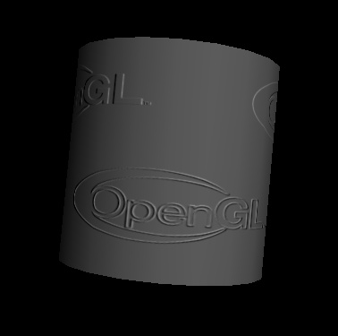
Multi-pass Rendering
Blending allows results from multiple drawing passes to be combined together
enables more complex rendering algorithms
Example of bump-mapping
done with a multi-pass
OpenGL algorithm
Notes:
OpenGL blending enables techniques which may require accumulating multiple images of the same geometry with different rendering parameters to be done.

Slide 132


Antialiasing
Removing the Jaggies
glEnable( mode )
GL_POINT_SMOOTH
GL_LINE_SMOOTH
GL_POLYGON_SMOOTH
alpha value computed by computing sub-pixel coverage
available in both RGBA and colormap modes
Notes:
Antialiasing is a process to remove the jaggies which is the common name for jagged edges of rasterized geometric primitives. OpenGL supports antialiasing of all geometric primitives by enabling both GL_BLEND and one of the constants listed above.
Antialiasing is accomplished in RGBA mode by computing an alpha value for each pixel that the primitive touches. This value is computed by subdividing the pixel into subpixels and determining the ratio used subpixels to total subpixels for that pixel. Using the computed alpha value, the fragment’s colors are blended into the existing color in the framebuffer for that pixel.
Color index mode requires a ramp of colors in the colormap to simulate the different values for each of the pixel coverage ratios.
In certain cases, GL_POLYGON_SMOOTH may not provide sufficient results, particularly if polygons share edges. As such, using the accumulation buffer for full scene antialising may be a better solution.

Slide 133
Accumulation Buffer
Problems of compositing into color buffers
limited color resolution
clamping
loss of accuracy
Accumulation buffer acts as a “floating point” color buffer
accumulate into accumulation buffer
transfer results to frame buffer
Notes:
Since most graphics hardware represents colors in the framebuffer as integer numbers, we can run into problems if we want to accumulate multiple images together.
Suppose the framebuffer has 8 bits per color component. If we want to prevent any possible overflow adding 256 8 bit per color images, we would have to divide each color component by 256 thus reducing us to 0 bits of resolution.
Many OpenGL implementations support the accumulation in software only, and as such, using the accumulation buffer may cause some slowness in rendering.

Slide 134
Accessing Accumulation Buffer
glAccum( op, value )
operations
within the accumulation buffer: GL_ADD, GL_MULT
from read buffer: GL_ACCUM, GL_LOAD
transfer back to write buffer: GL_RETURN
glAccum(GL_ACCUM, 0.5) multiplies each value in write buffer by 0.5 and adds to accumulation buffer
Notes:
If we want to average n images, we can add in each with a value of 1 and read the result with a factor of 1/n. Equivalently, we can accumulate each with a factor of 1/n and read back with a factor of 1.

Slide 135
Accumulation Buffer Applications
Compositing
Full Scene Antialiasing
Depth of Field
Filtering
Motion Blur
Notes:
Compositing, which combines several images into a single image, done with the accumulation buffer generally gives better results than blending multiple passes into the framebuffer.
Full scene antialiasing utilizes compositing in the accumulation buffer to smooth the jagged edges of all objects in the scene. Depth of field, simulates how a camera lens can focus on a single object while other objects in the view may be out of focus.
Filtering techniques, such as convolutions and blurs (from image processing) can be done easily in the accumulation buffer by rendering the same image multiple times with slight pixel offsets.
Motion blur, a technique often used in Saturday morning cartoons, simulates motion in a stationary object. We can do with the accumulation buffer by rendering the same scene multiple times, and varying the position of the object we want to appear as moving for each render pass. Compositing the results will give the impression of the object moving.

Slide 136
Full Scene Antialiasing : Jittering the view
Each time we move the viewer, the image shifts
Different aliasing artifacts in each image
Averaging images using accumulation buffer averages out these artifacts
Notes:
Full scene antialiasing, as mentioned, reduces the aliasing artifacts of objects in the scene by combining several renderings of the same scene, with each rendering done from a slightly different viewpoint. Since the viewpoint is only changed a little for each rendering pass, most of the scene looks very similar, but when all the images are composited together, the hard edges are averaged away.

Slide 137
Depth of Focus : Keeping a Plane in Focus
Jitter the viewer to keep one plane unchanged
Back Plane
Focal Plane
Front Plane
eye pos₁
eye pos₂
Notes:
Depth of field images can be produced by shifting the eyepoint around in the same parallel plane as to the focal plane. By compositing the resulting images together, objects near the center of the viewing frustum are kept in focus, while objects farther from the focal plane are composited to be a little blurry.

Slide 138
Fog
glFog( property, value )
Depth Cueing
Specify a range for a linear fog ramp
GL_FOG_LINEAR
Environmental effects
Simulate more realistic fog
GL_FOG_EXP
GL_FOG_EXP2
Notes:
Fog works in two modes:
Linear fog mode is used for depth cueing affects. In this mode, you provide OpenGL with a starting and ending distance from the eye, and between those distances, the fog color is blended into the primitive in a linear manner based on distance from the eye.
In this mode, the fog coefficient is computed as
Here’s a code snippet for setting up linear fog: glFogf(GL_FOG_MODE, GL_FOG_LINEAR); glFogf(GL_FOG_START, fogStart); glFogf(GL_FOG_END, fogEnd); glFogfv(GL_FOG_COLOR, fogColor); glEnable(GL_FOG);
Exponential fog mode is used for more natural environmental affects like fog, smog and smoke. In this mode, the fog’s density increases exponentially with the distance from the eye. For these modes, the coefficient is computed as

Slide 139
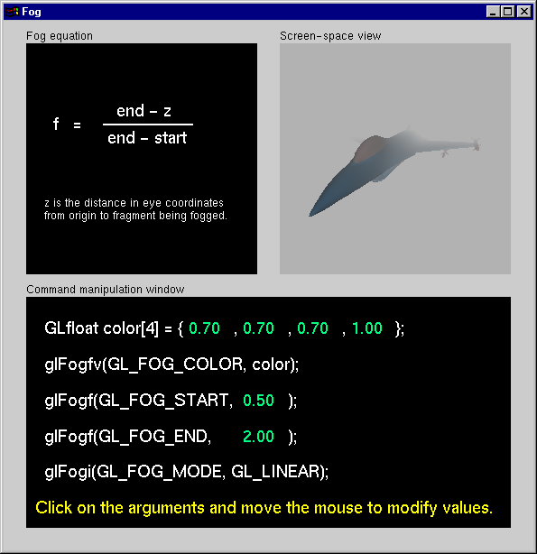
Fog Tutorial
Notes:
In this tutorial, experiment with the different fog modes, and in particular, the parameters which control either the fog density (for exponential mode) and the start and end distances (for linear mode).

Slide 140
Feedback Mode
Transformed vertex data is returned to the application, not rendered
useful to determine which primitives will make it to the screen
Need to specify a feedback buffer
glFeedbackBuffer( size, type, buffer )
Select feedback mode for rendering
glRenderMode( GL_FEEDBACK )
Notes:
Feedback mode is useful for determining which primitives will eventually be rendered, after transformation and clipping. The data returned back from feedback mode is dependant on what type of data was requested.
Possible types of values which can be returned are:
2D or 3D vertex values
3D vertex data with color
4D vertex data with color and texture
Each set of vertex data returned is delineated with a token representing what type of primitive was rendered (GL_POINT_TOKEN, GL_LINE_TOKEN, GL_POLYGON_TOKEN, GL_BITMAP_TOKEN, GL_DRAW_PIXELS_TOKEN, GL_PASS_THROUGH_TOKEN) , followed by the requested data.

Slide 141
Selection Mode
Method to determine which primitives are inside the viewing volume
Need to set up a buffer to have results returned to you
glSelectBuffer( size, buffer )
Select selection mode for rendering
glRenderMode( GL_SELECT )
Notes:
Selection mode is a way to determine which primitives fall within the viewing volume. As compared to feedback mode, where all the vertex data for a primitive is returned to you, selection mode only returns back a “name” which you assign for the primitive.

Slide 142
Selection Mode (cont.)
To identify a primitive, give it a name
“names” are just integer values, not strings
Names are stack based
allows for hierarchies of primitives
Selection Name Routines
glLoadName( name ) glPushName( name )
glInitNames()
Notes:
Selection mode uses names to identify primitives that pass the selection test. Any number of primitives can share the same name, allowing groups of primitives to be identified as a logical object.
After specifying the selection buffer, it must be initialized first by calling glPushName() . A hierarchy of names can be set up by calling glPushName() to obtain a new level in the hierarchy, and glLoadName() to uniquely name each node in the hierarchy.
glInitNames() can be used to completely clear out an existing name hierarchy.

Slide 143
Picking
Picking is a special case of selection
Programming steps
restrict “drawing” to small region near pointer
use gluPickMatrix() on projection matrix
enter selection mode; re-render scene
primitives drawn near cursor cause hits
exit selection; analyze hit records
Notes:
The picking region is usually specified in a piece of code like this:
glMatrixMode (GL_PROJECTION);
glLoadIdentity();
gluPickMatrix(x, y, width, height, viewport);
gluPerspective(...) or glOrtho(...)
The picking matrix is the rare situation where the standard projection matrix (perspective or ortho) is multiplied onto a non-identity matrix.
Each hit record contains:
number of names per hit
smallest and largest depth values
all the names

Slide 144
Picking Template
glutMouseFunc( pickMe );
void pickMe( int button, int state, int x, int y ) {
GLuint nameBuffer[256];
GLint hits;
GLint myViewport[4];
if (button != GLUT_LEFT_BUTTON ||
state != GLUT_DOWN) return;
glGetIntegerv( GL_VIEWPORT, myViewport );
glSelectBuffer( 256, nameBuffer );
(void) glRenderMode( GL_SELECT );
glInitNames();
Notes:
In this example, we specify a function to be called when a mouse button is pressed.
The routine which is called specifies the selection buffer, and switches into selection mode for retrieving which objects fall within the picking region.
The glInitNames() function resets the selection buffer to its default state.

Slide 145
Picking Template (cont.)
glMatrixMode( GL_PROJECTION );
glPushMatrix();
glLoadIdentity();
gluPickMatrix( (GLdouble) x, (GLdouble)
(myViewport[3]-y), 5.0, 5.0, myViewport );
/* gluPerspective or glOrtho or other projection */
glPushName( 1 );
/* draw something */
glLoadName( 2 );
/* draw something else … continue … */
Notes:
We continue the example by specifying the picking region using gluPickMatrix() and then specifying our normal projection transformation. Continuing, we initialize the name stack by calling glPushName() (remember, you need to do a glPushName(), and not a glLoadName() first).
Finally, we render all the objects in our scene, providing new names for the selection buffer as necessary.

Slide 146
Picking Template (cont.)
glMatrixMode( GL_PROJECTION );
glPopMatrix();
hits = glRenderMode( GL_RENDER );
/* process nameBuffer */
}
Notes:
Completing our example, we restore the projection matrix to its pre-pick matrix mode, and process our hits with the data returned back to us in the selection buffer provided previously.

Slide 147
Picking Ideas
For OpenGL Picking Mechanism
only render what is pickable (e.g., don’t clear screen!)
use an “invisible” filled rectangle, instead of text
if several primitives drawn in picking region, hard to use z values to distinguish which primitive is “on top”
Alternatives to Standard Mechanism
color or stencil tricks (for example, use glReadPixels() to obtain pixel value from back buffer)
Notes:
There are a few tricks that make picking more useful and simpler to use:
in order to make picking as fast as possible, only render what’s pickable.
Try to use simple geometry to simulate a more complex object. For example, use a filled rectangle as compared to a text string, or the bounding sphere of a complicated polygonal object.
The selection mechanism returns the depth values of objects, which can be used to sort objects based on their distance from the eyepoint.
OpenGL selection and picking methods aren’t the only ways to determine what primitives are on the screen. In some cases, it may be faster and easier to use unique colors for each object, render the scene into the back-buffer, and read the pixel or pixels which are of interest (like the hot spot on a cursor). Looking up the color may be much faster and more direct than parsing the hit list returned from selection.

Slide 148
Getting to the Framebuffer
Scissor
Test
Alpha
Test
Stencil
Test
Fragment
Depth
Test
Blending
Dithering
Logical Operations
Framebuffer
Notes:
In order for a fragment to make it to the frame buffer, it has a number of testing stages and pixel combination modes to go through.
The tests that a fragment must pass are:
scissor test - an additional clipping test
alpha test - a filtering test based on the alpha color component
stencil test - a pixel mask test
depth test - fragment occlusion test
Each of these tests is controlled by a glEnable() capability.
If a fragment passes all enabled tests, it is then blended, dithered and/or logically combined with pixels in the framebuffer. Each of these operations can be enabled and disabled.

Slide 149
Scissor Box
Additional Clipping Test
glScissor( x, y, w, h )
any fragments outside of box are clipped
useful for updating a small section of a viewport
affects glClear() operations
Notes:
The scissor test provides an additional rectangular clipping test in addition to clipping to the viewport. This is useful for clearing only particular parts of the viewport (glClear() is not bounded by the viewport clipping operation), and restricting pixel updates to a small region of the viewport.
The scissor test can be enabled with glEnable(GL_SCISSOR_TEST);

Slide 150
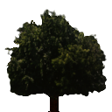
Alpha Test
Poly.
Per
Vertex
CPU
DL
Raster
Frag
FB
Texture
Pixel
Reject pixels based on their alpha value
glAlphaFunc( func, value )
glEnable( GL_ALPHA_TEST )
use alpha as a mask in textures
Notes:
Alpha values can also be used for fragment testing. glAlphaFunc() sets a value which, if glEnable(GL_ALPHA_TEST) has been called, will test every fragment’s alpha against the value set, and if the test fails, the fragment is discarded.
The functions which glAlphaFunc() can use are:
GL_NEVER GL_LESS
GL_EQUAL GL_LEQUAL
GL_GREATER GL_NOTEQUAL
GL_GEUQAL GL_ALWAYS
The default is GL_ALWAYS, which always passes fragments.
Alpha testing is particularly useful when combined with texture mapping with textures which have an alpha component. This allows your texture map to act as a localized pixel mask. This technique is commonly used for objects like trees or fences, where modeling the objects (and all of its holes) becomes prohibitive.

Slide 151

Stencil Buffer
Poly.
Per
Vertex
CPU
DL
Raster
Frag
FB
Texture
Pixel
Used to control drawing based on values in the stencil buffer
Fragments that fail the stencil test are not drawn
Example: create a mask in stencil buffer and draw only objects not in mask area
Notes:
Unlike other buffers, we do not draw into the stencil buffer. We set its values with the stencil functions. However, the rendering can alter the values in the stencil buffer depending on whether a fragment passes or fails the stencil test.

Slide 152
Controlling Stencil Buffer
glStencilFunc( func, ref, mask )
compare value in buffer with ref using func
only applied for bits in mask which are 1
func is one of standard comparison functions
glStencilOp( fail, zfail, zpass )
Allows changes in stencil buffer based on passing or failing stencil and depth tests: GL_KEEP, GL_INCR
Notes:
The two principal functions for using the stencil buffer are glStencilFunc()which controls how the bits in the stencil buffer are used to determine if a particular pixel in the framebuffer is writable.
glStencilOp()controls how the stencil buffer values are updated, based on three tests:
1) did the pixel pass the stencil test specified with glStencilFunc()
2) did the pixel fail the depth test for that pixel.
3) did the pixel pass the depth test for that pixel. This would mean that the pixel in question would have appeared in the image.

Slide 153
Creating a Mask
glInitDisplayMode( …|GLUT_STENCIL|… );
glEnable( GL_STENCIL_TEST );
glClearStencil( 0x1 );
glStencilFunc( GL_ALWAYS, 0x1, 0x1 );
glStencilOp( GL_REPLACE, GL_REPLACE, GL_REPLACE );
draw mask
Notes:
In this example, we specify a simple stencil mask. We do this by specifying that regardless of which tests the pixel passes or fails, we replace its value in the stencil buffer with the value 0x1. This permits us to render the shape of the pixel mask we want directly into the stencil buffer (in a manner of speaking).

Slide 154
Using Stencil Mask
glStencilFunc( GL_EQUAL, 0x1, 0x1 )
draw objects where stencil = 1
glStencilFunc( GL_NOT_EQUAL, 0x1, 0x1 );
glStencilOp( GL_KEEP, GL_KEEP, GL_KEEP );
draw objects where stencil != 1
Notes:
After the stencil mask is specified, we can use the mask to selectively update pixels. With the first set of commands, we only update the pixels where the stencil buffer is set to 0x01 in the stencil buffer.
In the second example, we set the stencil state up to render only to pixels where the stencil value is not 0x01.

Slide 155
Dithering
glEnable( GL_DITHER )
Dither colors for better looking results
Used to simulate more available colors
Notes:
Dithering is a technique to trick the eye into seeing a smoother color when only a few colors are available. Newspaper’s use this trick to make images look better. OpenGL will modify a fragment’s color value with a dithering table before it is written into the framebuffer.

Slide 156
Logical Operations on Pixels
Combine pixels using bitwise logical operations
glLogicOp( mode )
Common modes
GL_XOR
GL_AND
Notes:
Logical operations allows pixels to be combined with bitwise logical operations, like logical ands, ors and nots. The fragment’s color bits are combined with the pixel’s color bits using the logical operation, and then written into the framebuffer.
GL_XOR is a useful logical operation for creating “rubber banding” type techniques, where you only momentarily want to modify a pixel, and then return back to its original value.
There are several OpenGL logical operation modes:
GL_CLEAR GL_SET GL_COPY,
GL_COPY_INVERTED GL_NOOP GL_INVERT
GL_AND GL_NAND GL_OR
GL_NOR GL_XOR GL_AND_INVERTED
GL_AND_REVERSE GL_EQUIV GL_OR_REVERSE
GL_OR_INVERTED

Slide 157
Advanced Imaging
Imaging Subset
Only available if GL_ARB_imaging defined
Color matrix
Convolutions
Color tables
Histogram
MinMax
Advanced Blending
Notes:
OpenGL may also contain an advanced set of functionality referred to as the Imaging subset. This functionality is only present if your implementation supports the GL_ARB_imaging extension.
Some of the functionality included in the imaging subset is:
using a color matrix to apply linear transformation to color components
computing image convolutions
replacing colors using color tables
histogramming and computing the minimum and maximum pixel values (minmax)
advanced pixel blending modes

Slide 158
Summary / Q & A
Dave Shreiner
Ed Angel
Vicki Shreiner

Slide 159
On-Line Resources
http://www.opengl.org
start here; up to date specification and lots of sample code
news:comp.graphics.api.opengl
http://www.sgi.com/software/opengl
http://www.mesa3d.org/
Brian Paul’s Mesa 3D
http://www.cs.utah.edu/~narobins/opengl.html
very special thanks to Nate Robins for the OpenGL Tutors
source code for tutors available here!

Slide 160
Books
OpenGL Programming Guide, 3rd Edition
OpenGL Reference Manual, 3rd Edition
OpenGL Programming for the X Window System
includes many GLUT examples
Interactive Computer Graphics: A top-down approach with OpenGL, 2nd Edition

Slide 161
Thanks for Coming
Questions and Answers
Dave Shreiner shreiner@sgi.com
Ed Angel angel@cs.unm.edu
Vicki Shreiner vshreiner@sgi.com

