Slide 1
Programming with OpenGL
Part 0: 3D API

Slide 2
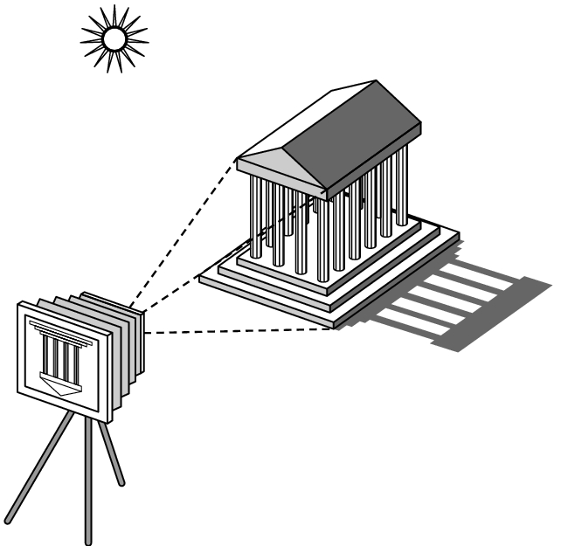
Elements of Image Formation
Objects
Viewer
Light source(s)
Attributes that govern how light interacts with the materials in the scene
Note the independence of the objects, viewer, and light source(s)

Slide 3
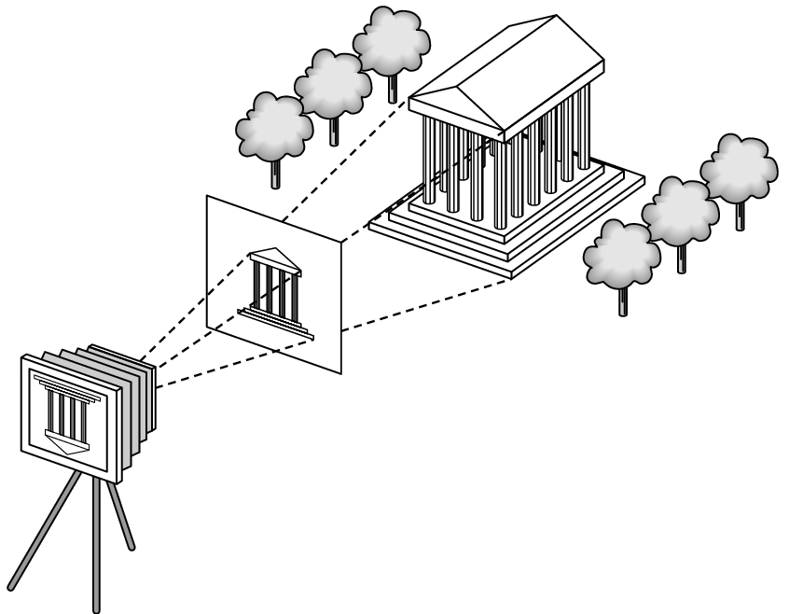
Synthetic Camera Model
projector
p
image plane
projection of p
center of projection

Slide 4
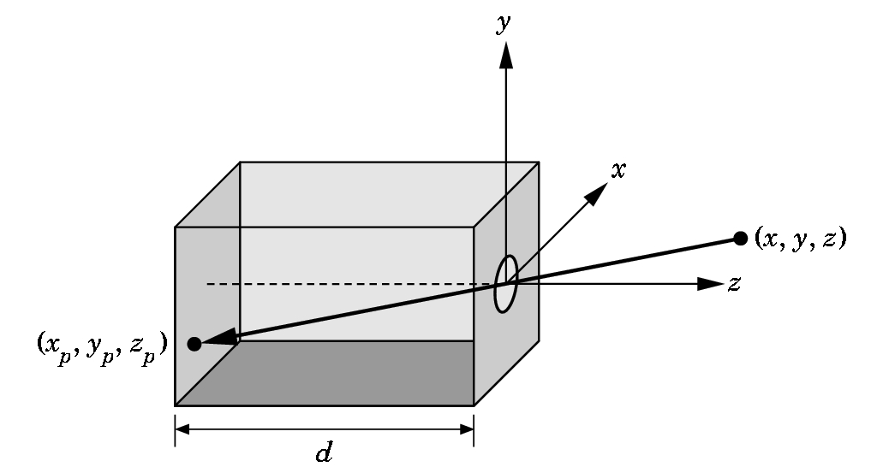
Pinhole Camera
Use trigonometry to find projection of a point
x_{p}= -x/z/d
y_{p}= -y/z/d
z_{p}= d
These are equations of simple perspective

Slide 5
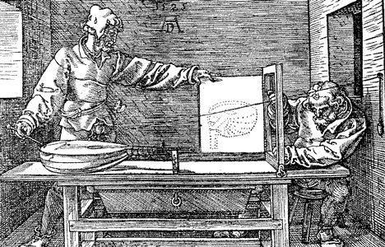
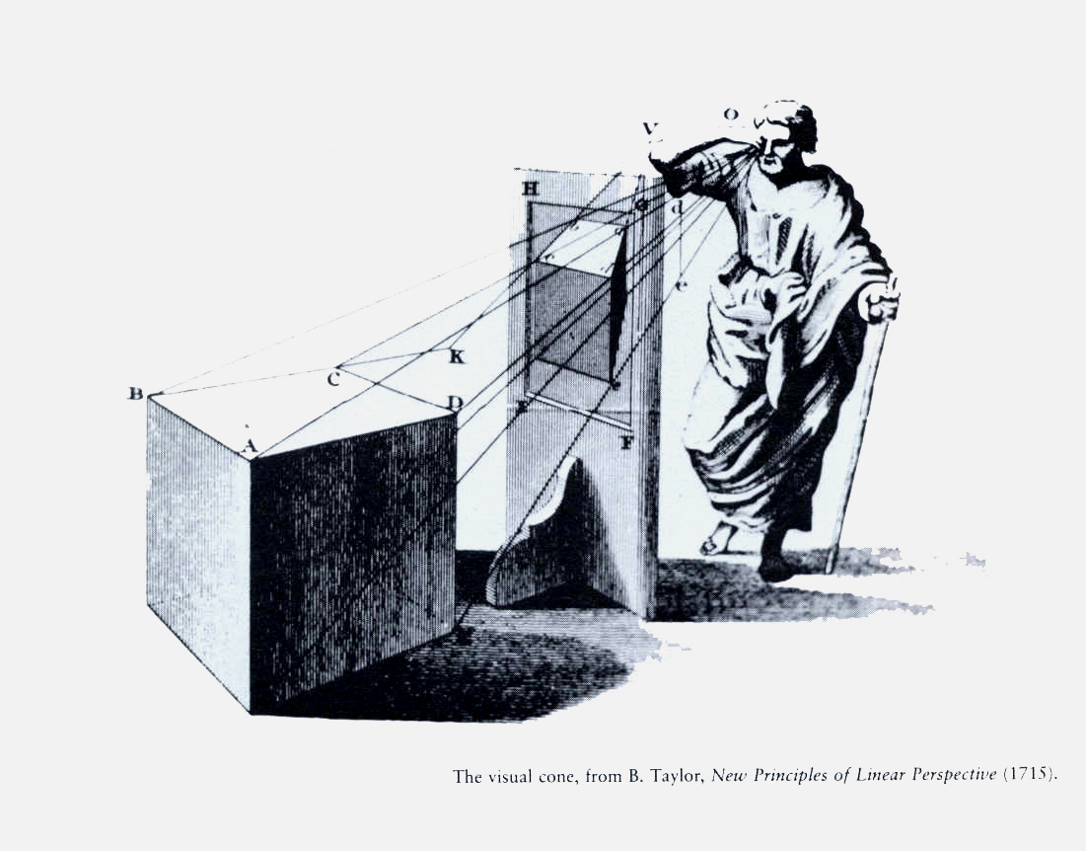

Slide 6
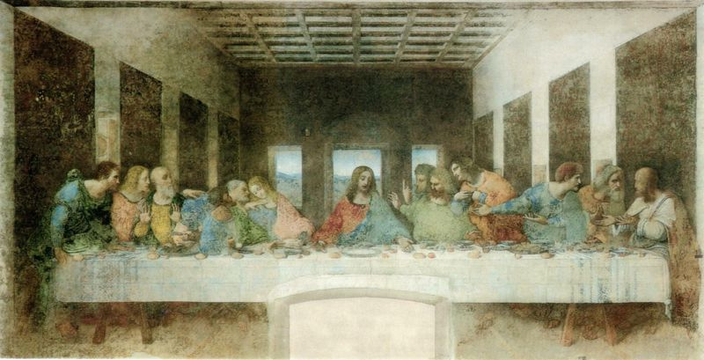

Slide 7
Programming with OpenGL
Part 1: Background

Slide 8
Advantages
Separation of objects, viewer, light sources
Two-dimensional graphics is a special case of three-dimensional graphics
Leads to simple software API
  Specify objects, lights, camera, attributes
  Let implementation determine image
Leads to fast hardware implementation

Slide 9
SGI and GL
Silicon Graphics (SGI) revolutionized the graphics workstation by implementing the pipeline in hardware (1982)
To use the system, application programmers used a library called GL
With GL, it was relatively simple to program three dimensional interactive applications

Slide 10
OpenGL
The success of GL lead to OpenGL (1992), a platform-independent API that was
  Easy to use
  Close enough to the hardware to get excellent performance
  Focus on rendering
  Omitted windowing and input to avoid window system dependencies

Slide 11
OpenGL Evolution
Originally controlled by an Architectural Review Board (ARB)
  Members included SGI, Microsoft, Nvidia, HP, 3DLabs, IBM,…….
  Now Khronos Group
  Was relatively stable (through version 2.5)
    Backward compatible
    Evolution reflected new hardware capabilities
      3D texture mapping and texture objects
      Vertex and fragment programs
  Allows platform specific features through extensions

Slide 12
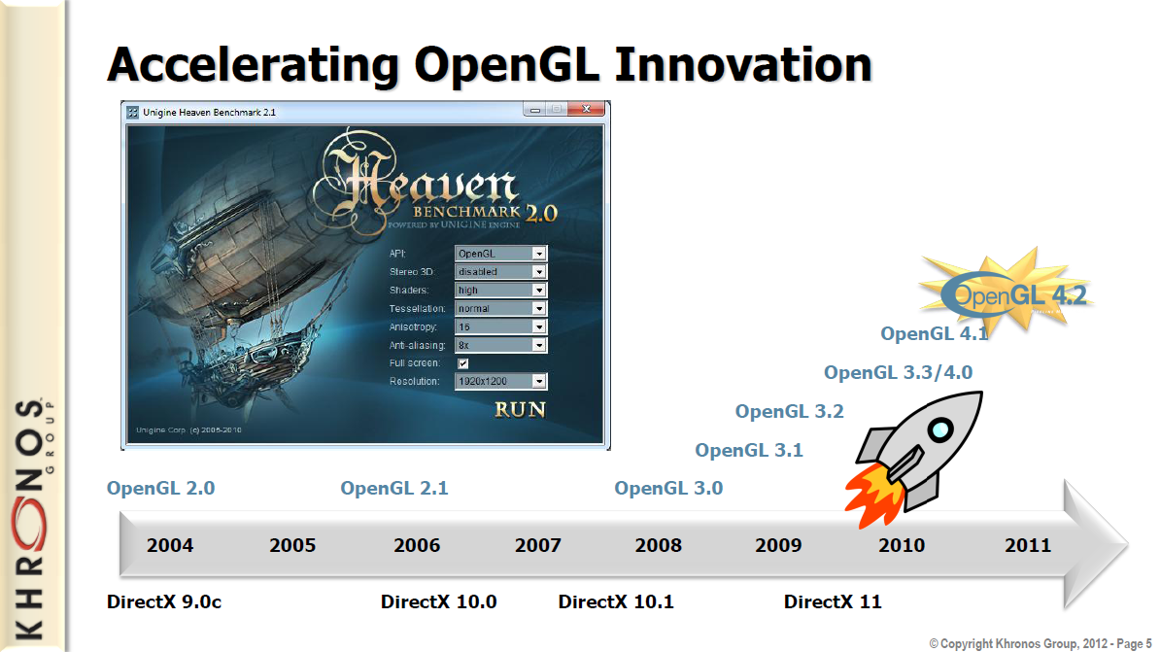
Khronos

Slide 13
OpenGL 3.1 (and Beyond)
Totally shader-based
  No default shaders
  Each application must provide both a vertex and a fragment shader
No immediate mode
Few state variables
Most OpenGL 2.5 functions deprecated
Backward compatibility not required

Slide 14
Other Versions
OpenGL ES
  Embedded systems
  Version 1.0 simplified OpenGL 2.1
  Version 2.0 simplified OpenGL 3.1
    Shader based
WebGL
  Javascript implementation of ES 2.0
  Supported on newer browsers
OpenGL 4.1 and 4.2
  Add geometry shaders and tessellator

Slide 15
Why Not Teaching OpenGL 3.1 Now?
To avoid premature exposure to shaders.
We will come back to OpenGL 3.1 (and 4.x) after we’ve learned shader programming later this semester.

Slide 16
OpenGL Libraries
OpenGL core library
  OpenGL32 on Windows
  GL on most unix/linux systems
OpenGL Utility Library (GLU)
  Provides functionality in OpenGL core but avoids having to rewrite code
Links with window system
  GLX for X window systems
  WGL for Widows
  AGL for Macintosh

Slide 17
GLUT
OpenGL Utility Library (GLUT)
  Provides functionality common to all window systems
    Open a window
    Get input from mouse and keyboard
    Menus
    Event-driven
  Code is portable but GLUT lacks the functionality of a good toolkit for a specific platform
    Slide bars

Slide 18
Software Organization
application program
OpenGL Motif
widget or similar
GLUT
GLX, AGL
or WGL
GLU
X, Win32, Mac O/S
GL
software and/or hardware

Slide 19
OpenGL Functions
Primitives
  Points
  Line Segments
  Polygons
Attributes
Transformations
  Viewing
  Modeling
Control
Input (GLUT)

Slide 20
OpenGL State
OpenGL is a state machine
OpenGL functions are of two types
  Primitive generating
    Can cause output if primitive is visible
    How vertices are processes and appearance of primitive are controlled by the state
  State changing
    Transformation functions
    Attribute functions

Slide 21
Lack of Object Orientation
OpenGL is not object oriented so that there are multiple functions for a given logical function, e.g. glVertex3f, glVertex2i, glVertex3dv,…..
Underlying storage mode is the same
Easy to create overloaded functions in C++ but issue is efficiency

Slide 22
OpenGL function format
function name
glVertex3f(x,y,z)
x,y,z are floats
belongs to GL library
glVertex3fv(p)
p is a pointer to an array

Slide 23
OpenGL #defines
Most constants are defined in the include files gl.h, glu.h and glut.h
  Note #include <glut.h> should automatically include the others
  Examples
  glBegin(GL_POLYGON)
  glClear(GL_COLOR_BUFFER_BIT)
include files also define OpenGL data types: GLfloat, GLdouble,….

Slide 24
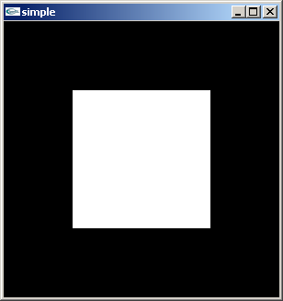
A Simple Program
Generate a square on a solid background

Slide 25
simple.c
#include <glut.h>
void mydisplay(){
glClear(GL_COLOR_BUFFER_BIT);
glBegin(GL_POLYGON);
glVertex2f(-0.5, -0.5);
glVertex2f(-0.5, 0.5);
glVertex2f(0.5, 0.5);
glVertex2f(0.5, -0.5);
glEnd();
glFlush();
}
int main(int argc, char** argv){
glutCreateWindow("simple");
glutDisplayFunc(mydisplay);
glutMainLoop();
}

Slide 26
Event Loop
Note that the program defines a display callback function named mydisplay
  Every glut program must have a display callback
  The display callback is executed whenever OpenGL decides the display must be refreshed, for example when the window is opened
  The main function ends with the program entering an event loop

Slide 27
Defaults
simple.c is too simple
Makes heavy use of state variable default values for
  Viewing
  Colors
  Window parameters
Next version will make the defaults more explicit

Slide 28
Compilation on Windows
Visual C++
  Get glut.h, glut32.lib and glut32.dll from web
  Create a console application
  Add path to find include files (GL/glut.h)
  Add opengl32.lib, glu32.lib, glut32.lib to project settings (for library linking)
  glut32.dll is used during the program execution. (Other DLL files are included in the device driver of the graphics accelerator.)

Slide 29
Programming with OpenGL
Part 2: Complete Programs

Slide 30
Objectives
Refine the first program
  Alter the default values
  Introduce a standard program structure
Simple viewing
  Two-dimensional viewing as a special case of three-dimensional viewing
Fundamental OpenGL primitives
Attributes

Slide 31
Program Structure
Most OpenGL programs have a similar structure that consists of the following functions
  main():
    defines the callback functions
    opens one or more windows with the required properties
    enters event loop (last executable statement)
  init(): sets the state variables
    viewing
    Attributes
  callbacks
    Display function
    Input and window functions

Slide 32
Simple.c revisited
In this version, we will see the same output but have defined all the relevant state values through function calls with the default values
In particular, we set
  Colors
  Viewing conditions
  Window properties

Slide 33
main.c
#include <GL/glut.h>
int main(int argc, char** argv)
{
glutInit(&argc,argv);
glutInitDisplayMode(GLUT_SINGLE|GLUT_RGB);
glutInitWindowSize(500,500);
glutInitWindowPosition(0,0);
glutCreateWindow("simple");
glutDisplayFunc(mydisplay);
init();
glutMainLoop();
}
includes gl.h
define window properties
display callback
set OpenGL state
enter event loop

Slide 34
GLUT functions
glutInit allows application to get command line arguments and initializes system
gluInitDisplayMode requests properties of the window (the rendering context)
  RGB color
  Single buffering
  Properties logically ORed together
glutWindowSize in pixels
glutWindowPosition from top-left corner of display
glutCreateWindow create window with title “simple”
glutDisplayFunc display callback
glutMainLoop enter infinite event loop

Slide 35
init.c
void init()
{
glClearColor (0.0, 0.0, 0.0, 1.0);
glColor3f(1.0, 1.0, 1.0);
glMatrixMode (GL_PROJECTION);
glLoadIdentity ();
glOrtho(-1.0, 1.0, -1.0, 1.0, -1.0, 1.0);
}
black clear color
opaque window
fill with white
viewing volume

Slide 36
Coordinate Systems
The units of in glVertex are determined by the application and are called world or problem coordinates
The viewing specifications are also in world coordinates and it is the size of the viewing volume that determines what will appear in the image
Internally, OpenGL will convert to camera coordinates and later to screen coordinates

Slide 37
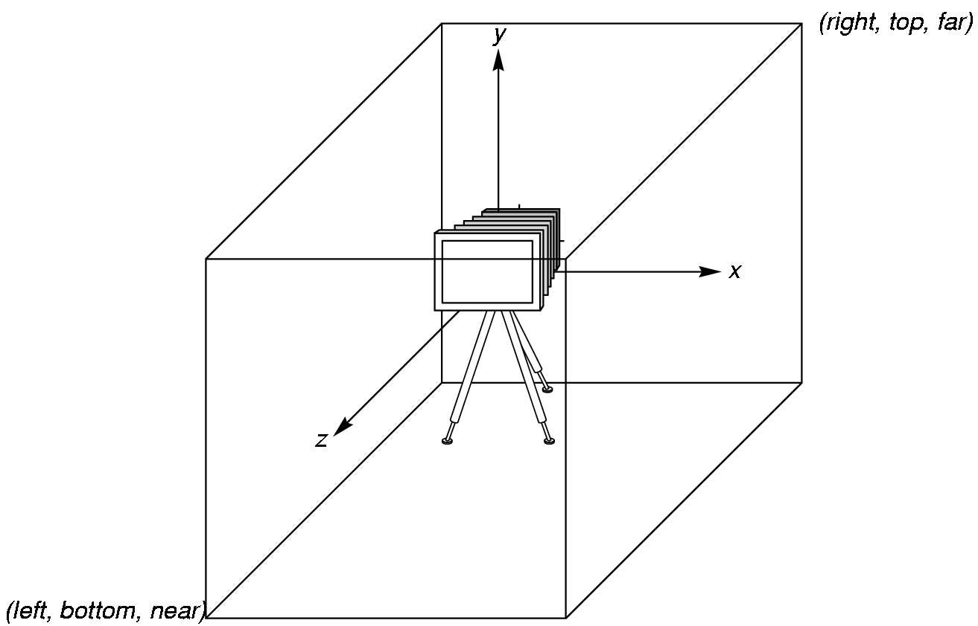
OpenGL Camera
OpenGL places a camera at the origin pointing in the negative z direction
The default viewing volume is a
box centered at the
origin with a side of
length 2

Slide 38
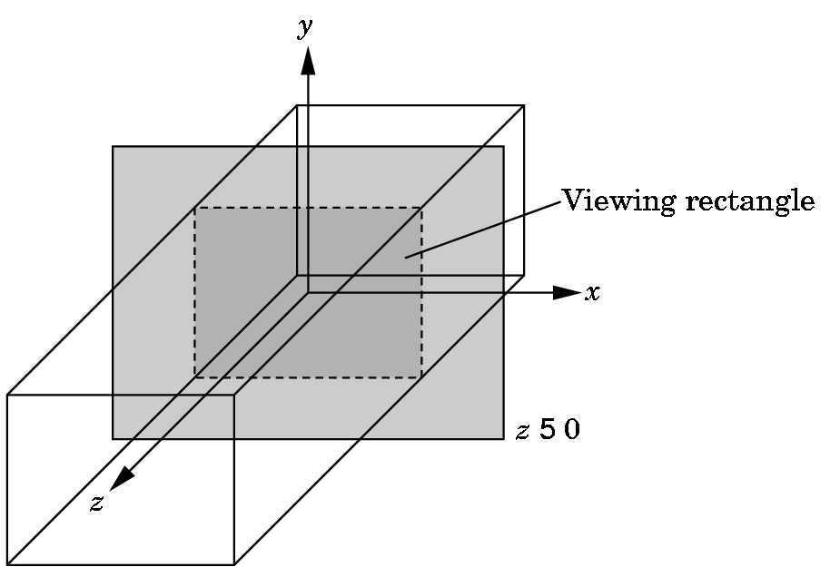
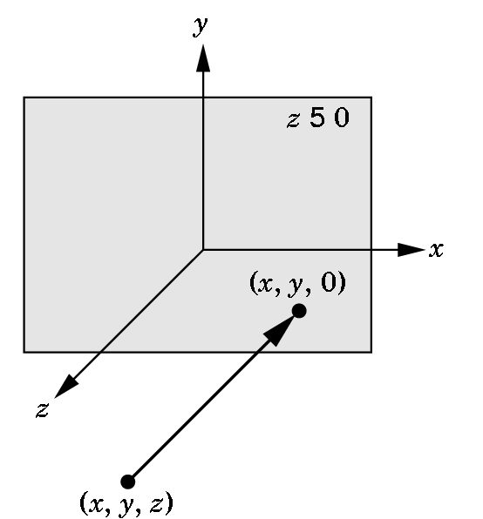
Orthographic Viewing
In the default orthographic view, points are
projected forward along the z axis onto the
plane z=0
z=0
z=0

Slide 39
Transformations and Viewing
In OpenGL, the projection is carried out by a projection matrix (transformation)
There is only one set of transformation functions so we must set the matrix mode first
glMatrixMode (GL_PROJECTION)
Transformation functions are incremental so we start with an identity matrix and alter it with a projection matrix that gives the view volume
glLoadIdentity ();
glOrtho(-1.0, 1.0, -1.0, 1.0, -1.0, 1.0);

Slide 40
Two- and three-dimensional viewing
In glOrtho(left, right, bottom, top, near, far) the near and far distances are measured from the camera
Two-dimensional vertex commands place all vertices in the plane z=0
If the application is in two dimensions, we can use the function
gluOrtho2D(left, right, bottom, top)
In two dimensions, the view or clipping volume becomes a clipping window

Slide 41
mydisplay.c
void mydisplay()
{
glClear(GL_COLOR_BUFFER_BIT);
glBegin(GL_POLYGON);
glVertex2f(-0.5, -0.5);
glVertex2f(-0.5, 0.5);
glVertex2f(0.5, 0.5);
glVertex2f(0.5, -0.5);
glEnd();
glFlush();
}

Slide 42
OpenGL Primitives
GL_POINTS
GL_POLYGON
GL_LINES
GL_LINE_STRIP
GL_LINE_LOOP
GL_TRIANGLES
GL_QUAD_STRIP
GL_TRIANGLE_STRIP
GL_TRIANGLE_FAN

Slide 43
Polygon Issues
OpenGL will only display polygons correctly that are
  Simple: edges cannot cross
  Convex: All points on line segment between two points in a polygon are also in the polygon
  Flat: all vertices are in the same plane
User program must check if above true
Triangles satisfy all conditions
nonsimple polygon
nonconvex polygon

Slide 44
Attributes
Attributes are part of the OpenGL and determine the appearance of objects
  Color (points, lines, polygons)
  Size and width (points, lines)
  Stipple pattern (lines, polygons)
  Polygon mode
    Display as filled: solid color or stipple pattern
    Display edges

Slide 45
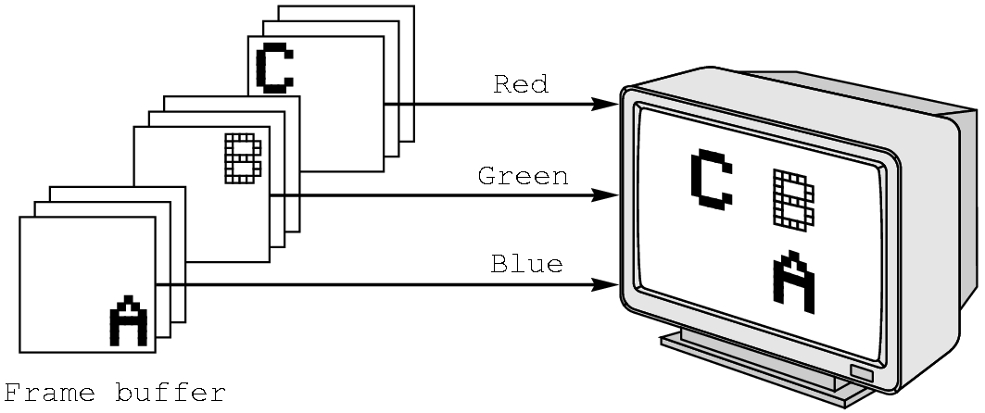
RGB color
Each color component stored separately in the frame buffer
Usually 8 bits per component in buffer
Note in glColor3f the color values range from 0.0 (none) to 1.0 (all), while in glColor3ub the values range from 0 to 255

Slide 46
Color and State
The color as set by glColor becomes part of the state and will be used until changed
  Colors and other attributes are not part of the object but are assigned when the object is rendered
We can create conceptual vertex colors by code such as
glColor
glVertex
glColor
glVertex

Slide 47
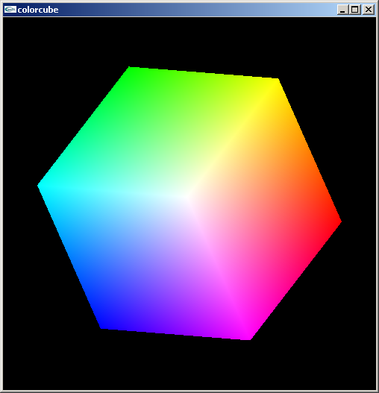
Smooth Color
Default is smooth shading
  OpenGL interpolates vertex colors across visible polygons
Alternative is flat shading
  Color of first vertex
  determines fill color
glShadeModel
  (GL_SMOOTH)
  or GL_FLAT

Slide 48
Programming with OpenGL
Part 3: OpenGL Callbacks and GLUT

Slide 49
Three-dimensional Applications
In OpenGL, two-dimensional applications are a special case of three-dimensional graphics
  Not much changes
  Use glVertex3*( )
  Have to worry about the order in which polygons are drawn or use hidden-surface removal
  Polygons should be simple, convex, flat

Slide 50
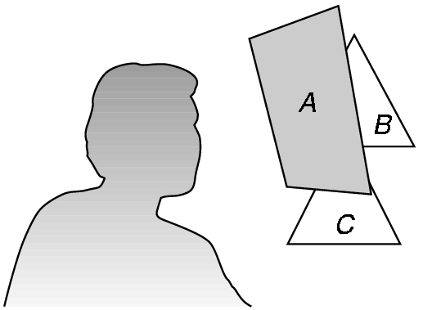
Hidden-Surface Removal
We want to see only those surfaces in front of other surfaces
OpenGL uses a hidden-surface method called the z-buffer algorithm that saves depth information as objects are rendered so that only the front objects appear in the image

Slide 51
Using the z-buffer algorithm
The algorithm uses an extra buffer, the z-buffer, to store depth information as geometry travels down the pipeline
It must be
  Requested in main.c
    glutInitDisplayMode
    (GLUT_SINGLE | GLUT_RGB | GLUT_DEPTH)
  Enabled in init.c
    glEnable(GL_DEPTH_TEST)
  Cleared in the display callback
    glClear(GL_COLOR_BUFFER_BIT |
    GL_DEPTH_BUFFER_BIT)

Slide 52
Input Modes
Input devices contain a trigger which can be used to send a signal to the operating system
  Button on mouse
  Pressing or releasing a key
When triggered, input devices return information (their measure) to the system
  Mouse returns position information
  Keyboard returns ASCII code

Slide 53
Event Types
Window: resize, expose, iconify
Mouse: click one or more buttons
Motion: move mouse
Keyboard: press or release a key
Idle: nonevent
  Define what should be done if no other event is in queue

Slide 54
Callbacks
Programming interface for event-driven input
Define a callback function for each type of event the graphics system recognizes
This user-supplied function is executed when the event occurs
GLUT example: glutMouseFunc(mymouse)
mouse callback function

Slide 55
GLUT callbacks
GLUT recognizes a subset of the events recognized by any particular window system (Windows, X, Macintosh)
  glutDisplayFunc
  glutMouseFunc
  glutReshapeFunc
  glutKeyFunc
  glutIdleFunc
  glutMotionFunc, glutPassiveMotionFunc

Slide 56
GLUT Event Loop
Remember that the last line in main.c for a program using GLUT must be
  glutMainLoop();
which puts the program in an infinite event loop
In each pass through the event loop, GLUT
  looks at the events in the queue
  for each event in the queue, GLUT executes the appropriate callback function if one is defined
  if no callback is defined for the event, the event is ignored

Slide 57
The display callback
The display callback is executed whenever GLUT determines that the window should be refreshed, for example
  When the window is first opened
  When the window is reshaped
  When a window is exposed
  When the user program decides it wants to change the display
In main.c
  glutDisplayFunc(mydisplay) identifies the function to be executed
  Every GLUT program must have a display callback

Slide 58
Posting redisplays
Many events may invoke the display callback function
  Can lead to multiple executions of the display callback on a single pass through the event loop
We can avoid this problem by instead using
    glutPostRedisplay();
which sets a flag.
GLUT checks to see if the flag is set at the end of the event loop
If set then the display callback function is executed

Slide 59
Animating a Display
When we redraw the display through the display callback, we usually start by clearing the window
  glClear()
then draw the altered display
Problem: the drawing of information in the frame buffer is decoupled from the display of its contents
  Graphics systems use dual ported memory
Hence we can see partially drawn display
  See the program single_double.c for an example with a rotating cube

Slide 60
Double Buffering
Instead of one color buffer, we use two
  Front Buffer: one that is displayed but not written to
  Back Buffer: one that is written to but not altered
Program then requests a double buffer in main.c
  glutInitDisplayMode(GL_RGB | GL_DOUBLE)
  At the end of the display callback buffers are swapped
void mydisplay()
{
glClear()
.
/* draw graphics here */
.
glutSwapBuffers()
}

Slide 61
Using the idle callback
The idle callback is executed whenever there are no events in the event queue
  glutIdleFunc(myidle)
  Useful for animations
void myidle() {
/* change something */
t += dt
glutPostRedisplay();
}
Void mydisplay() {
glClear();
/* draw something that depends on t */
glutSwapBuffers();
}

Slide 62
Using globals
The form of all GLUT callbacks is fixed
  void mydisplay()
  void mymouse(GLint button, GLint state, GLint x, GLint y)
Must use globals to pass information to callbacks
float t; /*global */
void mydisplay()
{
/* draw something that depends on t
}

Slide 63
The mouse callback
glutMouseFunc(mymouse)
void mymouse(GLint button, GLint state, GLint x, GLint y)
Returns
  which button (GLUT_LEFT_BUTTON, GLUT_MIDDLE_BUTTON, GLUT_RIGHT_BUTTON) caused event
  state of that button (GL_UP, GLUT_DOWN)
  Position in window

Slide 64
Positioning
The position in the screen window is usually measured in pixels with the origin at the top-left corner
  Consequence of refresh done from top to bottom
OpenGL uses a world coordinate system with origin at the bottom left
  Must invert y coordinate returned by callback by height of window
  y = h – y;
(0,0)
h
w

Slide 65
Obtaining the window size
To invert the y position we need the window height
  Height can change during program execution
  Track with a global variable
  New height returned to reshape callback that we will look at in detail soon
  Can also use enquiry functions
    glGetIntv
    glGetFloatv
  to obtain any value that is part of the state

Slide 66
Terminating a program
In our original programs, there was no way to terminate them through OpenGL
We can use the simple mouse callback
void mouse(int btn, int state, int x, int y)
{
if(btn==GLUT_RIGHT_BUTTON && state==GLUT_DOWN)
exit(0);
}

Slide 67
Using the mouse position
In the next example, we draw a small square at the location of the mouse each time the left mouse button is clicked
This example does not use the display callback but one is required by GLUT; We can use the empty display callback function
  mydisplay(){}

Slide 68
Drawing squares at cursor location
void mymouse(int btn, int state, int x, int y)
{
if(btn==GLUT_RIGHT_BUTTON && state==GLUT_DOWN)
exit(0);
if(btn==GLUT_LEFT_BUTTON && state==GLUT_DOWN)
drawSquare(x, y);
}
void drawSquare(int x, int y)
{
y=w-y; /* invert y position */
glColor3ub( (char) rand()%256, (char) rand )%256, (char) rand()%256); /* a random color */
glBegin(GL_POLYGON);
glVertex2f(x+size, y+size);
glVertex2f(x-size, y+size);
glVertex2f(x-size, y-size);
glVertex2f(x+size, y-size);
glEnd();
}

Slide 69
Using the motion callback
We can draw squares (or anything else) continuously as long as a mouse button is depressed by using the motion callback
  glutMotionFunc(drawSquare)
We can draw squares without depressing a button using the passive motion callback
  glutPassiveMotionFunc(drawSquare)

Slide 70
Using the keyboard
glutKeyboardFunc(mykey)
Void mykey(unsigned char key,
int x, int y)
  Returns ASCII code of key depressed and mouse location
  Note GLUT does not recognize key release as an event
void mykey(unsigned char key, int x, int y)
{
if(key == ‘Q’ || key == ‘q’)
exit(0);
}

Slide 71
Reshaping the window
We can reshape and resize the OpenGL display window by pulling the corner of the window
What happens to the display?
  Must redraw from application
  Two possibilities
    Display part of world
    Display whole world but force to fit in new window
      Can alter aspect ratio

Slide 72
Reshape possiblities
original
reshaped

Slide 73
The Reshape callback
glutReshapeFunc(myreshape)
void myreshape( int w, int h)
  Returns width and height of new window (in pixels)
  A redisplay is posted automatically at end of execution of the callback
  GLUT has a default reshape callback but you probably want to define your own
The reshape callback is good place to put camera functions because it is invoked when the window is first opened

Slide 74
Example Reshape
This reshape preserves shapes by making the viewport and world window have the same aspect ratio
void myReshape(int w, int h)
{
glViewport(0, 0, w, h);
glMatrixMode(GL_PROJECTION); /* switch matrix mode */
glLoadIdentity();
if (w <= h)
gluOrtho2D(-2.0, 2.0, -2.0 * (GLfloat) h / (GLfloat) w,
2.0 * (GLfloat) h / (GLfloat) w);
else gluOrtho2D(-2.0 * (GLfloat) w / (GLfloat) h, 2.0 *
(GLfloat) w / (GLfloat) h, -2.0, 2.0);
glMatrixMode(GL_MODELVIEW); /* return to modelview mode */
}

Slide 75
Programming with OpenGL
Part 4: 3D Object File Format

Slide 76
3D Modeling Programs
Autodesk (commercial)
  AutoCAD: for engineering plotting
  3D Studio MAX: for 3D modeling
  Maya: for animation
  Revit Architecture
Blender 3D (free)

Slide 77
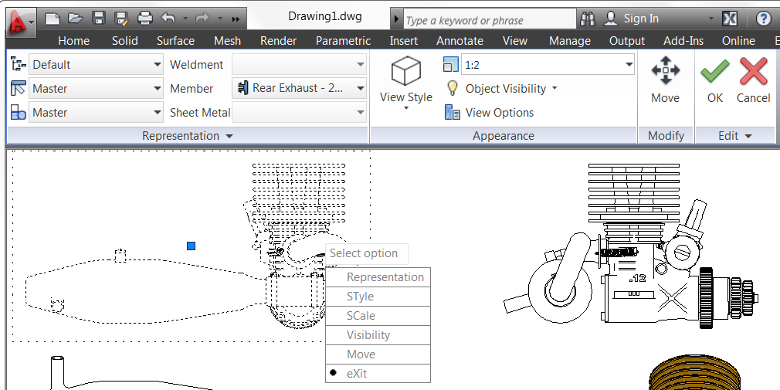
AutoCAD

Slide 78
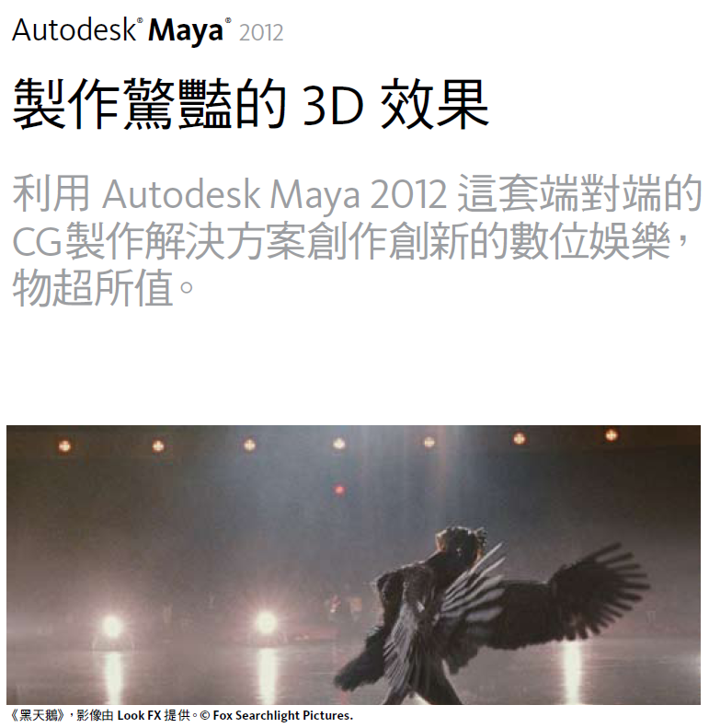
Maya

Slide 79
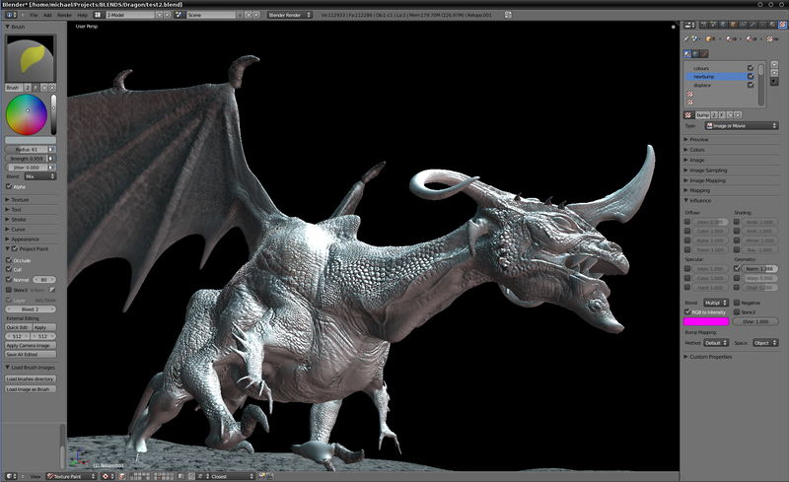
Blender

Slide 80
3D Contents
Geometry
  Vertices
  Triangles or polygons
  Curves
Materials
  Colors
  Textures (images and bumps)
Scene description & transformation

Slide 81
Drawing cube from faces
void polygon(int a, int b, int c , int d) {
glBegin(GL_POLYGON);
glVertex3fv(vertices[a]);
glVertex3fv(vertices[b]);
glVertex3fv(vertices[c]);
glVertex3fv(vertices[d]);
glEnd(); }
void colorcube(void) {
polygon(0,3,2,1);
polygon(2,3,7,6);
polygon(0,4,7,3);
polygon(1,2,6,5);
polygon(4,5,6,7);
polygon(0,1,5,4); }
5
6
2
1
7
4
0
3

Slide 82
Cube Revisted
Question #1: What is the size of the data file?
  How many vertices?
  How about the “topology” or connectivity between vertices?
Question #2: How many times did we call glVertex3fv()?

Slide 83
x₀ y₀ z₀
x₁ y₁ z₁
x₂ y₂ z₂
x₃ y₃ z₃
x₄ y₄ z₄
x₅ y₅ z_{5.}
x₆ y₆ z₆
x₇ y₇ z₇
v₀
v₃
v₂
v₁
P0
P1
P2
P3
P4
P5
v₂
v₃
v₇
v₆
topology
geometry

Slide 84
A Simple Example -- OBJ
v -0.5 -0.5 -0.6
v 0.5 -0.5 -0.6
v -0.5 -0.5 0.4
v 0.5 -0.5 0.4
v -0.5 0.5 -0.6
v 0.5 0.5 -0.6
v -0.5 0.5 0.4
v 0.5 0.5 0.4
# 8 vertices
Array of vertices
Array of polygons
Optional:
  Normals
  Textures
  Groups
f 1 3 4
f 4 2 1
f 5 6 8
f 8 7 5
f 1 2 6
f 6 5 1
f 2 4 8
f 8 6 2
f 4 3 7
f 7 8 4
f 3 1 5
f 5 7 3
# 12 faces

Slide 85
GLm
Programming interface (data types, functions) defined in glm.h
glmReadOBJ( char* filename );
struct GLMmodel
  vertices
  triangles

Slide 86
typedef struct {
GLuint vindices[3]; /* array of triangle vertex indices */
GLuint nindices[3]; /* array of triangle normal indices */
GLuint tindices[3]; /* array of triangle texcoord indices*/
GLuint findex; /* index of triangle facet normal */
} GLMtriangle;
typedef struct {
...
GLuint numvertices; /* number of vertices in model */
GLfloat* vertices; /* array of vertices */
...
GLuint numtriangles; /* number of triangles in model */
GLMtriangle* triangles; /* array of triangles */
...
} GLMmodel;

Slide 87
v -0.5 -0.5 -0.6
v 0.5 -0.5 -0.6
v -0.5 -0.5 0.4
v 0.5 -0.5 0.4
v -0.5 0.5 -0.6
v 0.5 0.5 -0.6
v -0.5 0.5 0.4
v 0.5 0.5 0.4
# 8 vertices
f 1 3 4
f 4 2 1
f 5 6 8
f 8 7 5
f 1 2 6
f 6 5 1
f 2 4 8
f 8 6 2
f 4 3 7
f 7 8 4
f 3 1 5
f 5 7 3
# 12 faces
vertex #1 coordinates is
GLMmodel::vertices[1]
vertex #3 coordinates is
GLMmodel::vertices[3]
A triangle made of vertices #1, #3, #4:
GLMmodel::triangles[i].vindices[] contains {1,3,4}

Slide 88
Your Own Format?
Triangle soup! Even simpler than OBJ
Vertex count
List of vertices
Triangle count
List of triangles

