Slide 1
YACC
Yet Another Compiler-Compiler
Tutorial 7 for SEG2101 (2005W)

Slide 2
1. How It Works
A parser generator
YACC source program
“test.y”
YACC Compiler
“y.tab.c”
“y.tab.c”
C Compiler
exe
input
exe
output

Slide 3
2.YACC Structure
A YACC source program has 3 parts:
declarations
%%
translation rules
%%
support C code

Slide 4
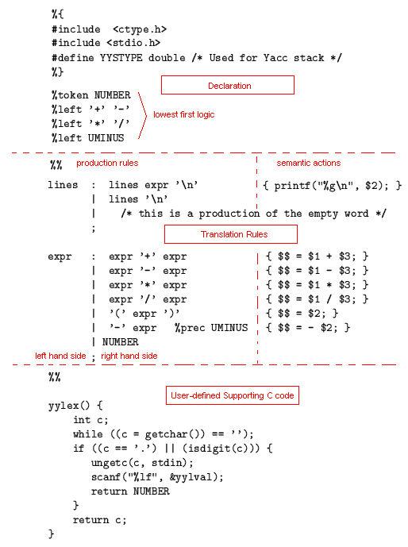

Slide 5
3. LEX & YACC
LEX: a tool for automatically generating a lexer or scanner given a lex specification (.l file); A lexer or scanner is used to perform lexical analysis, or the breaking up of an input stream into meaningful units, or tokens.
YACC: a tool for automatically generating a parser given a grammar written in a yacc specification (.y file); A grammar specifies a set of production rules, which define a language, and corresponding actions to perform the semantics.

