Slide 1
Parallel computing and message-passing in Java
Bryan Carpenter
NPAC at Syracuse University
Syracuse, NY 13244
dbc@npac.syr.edu

Slide 2
Goals of this lecture
Survey approaches to parallel computing in Java.
Describe a Java binding of MPI developed in the HPJava project at Syracuse.
Discuss ongoing activities related to message-passing in the Java Grande Forum—MPJ.

Slide 3
Contents of Lecture
Survey of parallel computing in Java
Overview of mpiJava
  API and Implementation
  Benchmarks and demos
  Object Serialization in mpiJava
Message-passing activities in Java Grande
  Thoughts on a Java Reference Implementation for MPJ

Slide 4
Survey of Parallel Computing in Java
Sung Hoon Ko
NPAC at Syracuse University
Syracuse, NY 13244
shko@npac.syr.edu

Slide 5
Java for High-Performance Computing
Java is potentially an excellent platform for developing large-scale science and engineering applications
Java has advantages.
  Java is descendant of C++.
  Java omits various features of C and C++ that are considered difficult - e.g pointer.
  Java comes with built-in multithreading.
  Java is portable.
  Java has advantages in visualisation and user interfaces .

Slide 6
The Java Grande Forum
Java has some problems that hinder its use for Grande applications.
Java Grande Forum created to make Java a better platform for Grande applications.
Currently two working groups are exist.
  Numeric Working Group
    complex and floating-point arithmetic, mulitidimensional arrays, operator overloading, etc.
  Concurrency/Applications Working Group
    performance of RMI and object serialization, benchmarking, computing portals, etc.

Slide 7
Approaches to Parallelism in Java
Automatic parallelization of sequential code.
JVM for SMP can be schedule the threads of a multi-threaded Java code.
Language extensions or directive akin to HPF or provision of libraries

Slide 8
Message Passing with Java
Java sockets
  unattractive to scientific parallel programming
Java RMI
  It is restrictive and overhead is high.
  (un)marshaling of data is costly than socket.
Message passing libraries in Java
  Java as wrapper for existing libraries
  Use only pure Java libraries

Slide 9
Java Based Frameworks
Use Java as wrapper for existing frameworks.
  (mpiJava, Java/DSM, JavaPVM)
Use pure Java libraries.
  (MPJ, DOGMA, JPVM, JavaNOW)
Extend Java language with new keywords.
  Use preprocessor or own compiler to create
  Java(byte) code. (HPJava, Manta, JavaParty, Titanium)
Web oriented and use Java applets to excute parallel task. (WebFlow, IceT, Javelin)

Slide 10
Use Java as wrapper for existing frameworks. (I)
JavaMPI : U. of Westminster
  Java wrapper to MPI
  Wrappers are automatically generated from the C MPI header using Java-to-C interface generator(JCI).
  Close to C binding, Not Object-oriented.
JavaPVM(jPVM) : Georgia Tech.
  Java wrapper to PVM

Slide 11
Use Java as wrapper for existing frameworks. (II)
Java/DSM : Rice U.
  Heterogeneous computing system.
  Implements a JVM on top of a TreadMarks Distributed Shared Memory(DSM) system.
  One JVM on each machine. All objects are allocated in the shared memory region.
  Provides Transparency : Java/DSM combination hides the hardware differences from the programmer.
  Since communication is handled by the underlying DSM, no explicit communication is necessary.

Slide 12
Use pure Java libraries(I)
JPVM : U. of Virginia
  A pure Java implementation of PVM.
  Based on communication over TCP sockets.
  Performance is very poor compared to JavaPVM.
jmpi : Baskent U.
  A pure Java implementation of MPI built on top of JPVM.
  Due to additional wrapper layer to JPVM routines, its performance is poor compared to JPVM. (JavaPVM < JPVM < jmpi)

Slide 13
Use pure Java libraries(II)
MPIJ : Brigham Young U.
  A pure Java based subset of MPI developed as part of the Distributed Object Group Meta-computing Architecture(DOGMA)
  Hard to use.
JMPI : MPI Software Technology
  Develop a commercial message-passing framework and parallel support environment for Java.
  Targets to build a pure Java version of MPI-2 standard specialized for commercial applications.

Slide 14
Use pure Java libraries(III)
JavaNOW : Illinois Institute Tech.
  Shared memory based system and experimental message passing framework.
  Creates a virtual parallel machine like PVM.
  Provides
    implicit multi-threading
    implicit synchronization
    distributed associative shared memory similar to Linda.
  Currently available as standalone software and must be used with a remote (or secure) shell tool in order to run on a network of workstations.

Slide 15
Extend Java Language(I)
Use pre-processor to create Java code.
Own compiler to create Java Byte code or executable code that loose portability of Java.
Manta : Vrije University
  Compiler-based high-performance Java system.
  Uses native compiler for aggressive optimisations.
  Has optimised RMI protocol(Manta RMI).

Slide 16
Extend Java Language(II)
Titanium : UC Berkeley
  Java based language for high-performance parallel scientific computing.
  Titanium compiler translates Titanium into C.
  Extends Java with additional features like
    immutable classes which behave like existing Java primitive types or C structs.
    multidimensional arrays
    an explicitly parallel SPMD model of computation with a global address space
    a mechanism for programmer to control memory management.

Slide 17
Extend Java Language(III)
JavaParty : University of Karlsruhe
  Provides a mechanism for parallel programming on distributed memory machines.
  Compiler generates the appropriate Java code plus RMI hooks.
  The remote keywords is used to identify which objects can be called remotely.

Slide 18
Web oriented
IceT : Emory University
  Enables users to share JVMs across a network.
  A user can upload a class to another virtual machine using a PVM-like interface.
  By explicitly calling send and receive statements, work can be distributed among multiple JVMs.
Javelin : UC Santa Barbara
  Internet-based parallel computing using Java by running Java applets in web browsers.
  Communication latencies are high since web browsers use RMIs over TCP/IP, typically over slow Ethernets.

Slide 19
Object Serialization and RMI
Object Serialization
  Provides a program the ability to read or write a whole object to and from a raw byte stream.
  An essential feature needed by RMI implementation when method arguments are passed by copy.
RMI
  Provides easy access to objects existing on remote virtual machines.
  Designed for Client-Server applications over unstable and slow networks.
  Fast remote method invocations with low latency and high bandwidth are required for high performance computing.

Slide 20
Performance Problems of Object Serialization
Does not handle float and double types efficiently.
  The type cast which is implemented in the JNI, requires various time consuming operations for check-pointing and state recovery.
  float arrays invokes the above mentioned JNI routine for every single array element.
Costly encoding of type information
  For every type of serialized object, all fields of the type are described verbosely.
Object creation takes too long.
  Object output and input should be overlapped to reduce latency.

Slide 21
Efficient Object Serialization(I)
UKA-serialization (as part of JavaParty)
  Slim Encoding type information
    Approach : When objects are being communicated, it can be assumed that all JVMs that collaborate on a parallel applications use the same file system(NSF).
    It is much shorter to textually send the name of the class including package prefix.
  Uses explicit (un)marshaling instead of reflection (by writeObject)
    For regular users of object serialization, programmers do not implement (un)marshaling, instead they rely on Java’s reflection.

Slide 22
Efficient Object Serialization(II)
UKA-serialization (as part of JavaParty)(cont.)
  Better buffer handling and less copying to achieve better performance.
    JDK External Buffering problems
      On the recipient side, JDK-serialization uses buffered stream implementation that does not know byte representation of objects.
      User can not directly write into External Buffer, instead use special write routines.
    UKA-serialization handles the buffering Internally and Public.
      By making the buffer Public, explicit marshaling routines can write their data immediately into the buffer.
With Manta: The serialization code is generated by the compiler
  This makes it possible to avoid the overhead of dynamic inspection of the object structure.

Slide 23
mpiJava: A Java Interface to MPI
Mark Baker, Bryan Carpenter, Geoffrey Fox, Guansong Zhang.
www.npac.syr.edu/projects/pcrc/HPJava/mpiJava.html

Slide 24
The mpiJava wrapper
Implements a Java API for MPI suggested in late ‘97.
Builds on work on Java wrappers for MPI started at NPAC about a year earlier.
People: Bryan Carpenter, Yuh-Jye Chang, Xinying Li, Sung Hoon Ko, Guansong Zhang, Mark Baker, Sang Lim.

Slide 25
mpiJava features.
Fully featured Java interface to MPI 1.1
Object-oriented API based on MPI 2 standard C++ interface
Initial implementation through JNI to native MPI
Comprehensive test suite translated from IBM MPI suite
Available for Solaris, Windows NT and other platforms

Slide 26
Class hierarchy
MPI
Group
Cartcomm
Intracomm
Comm
Graphcomm
Package mpi
Intercomm
Datatype
Status
Request
Prequest

Slide 27
Minimal mpiJava program
import mpi.*
class Hello {
static public void main(String[] args) {
MPI.Init(args) ;
int myrank = MPI.COMM_WORLD.Rank() ;
if(myrank == 0) {
char[] message = “Hello, there”.toCharArray() ;
MPI.COMM_WORLD.Send(message, 0, message.length, MPI.CHAR, 1, 99) ;
}
else {
char[] message = new char [20] ;
MPI.COMM_WORLD.Recv(message, 0, 20, MPI.CHAR, 0, 99) ;
System.out.println(“received:” + new String(message) + “:”) ;
}
MPI.Finalize() ;
}
}

Slide 28
MPI datatypes
Send and receive members of Comm:
void send(Object buf, int offset, int count,
Datatype type, int dst, int tag) ;
Status recv(Object buf, int offset, int count,
Datatype type, int src, int tag) ;
buf must be an array. offset is the element where message starts. Datatype class describes type of elements.

Slide 29
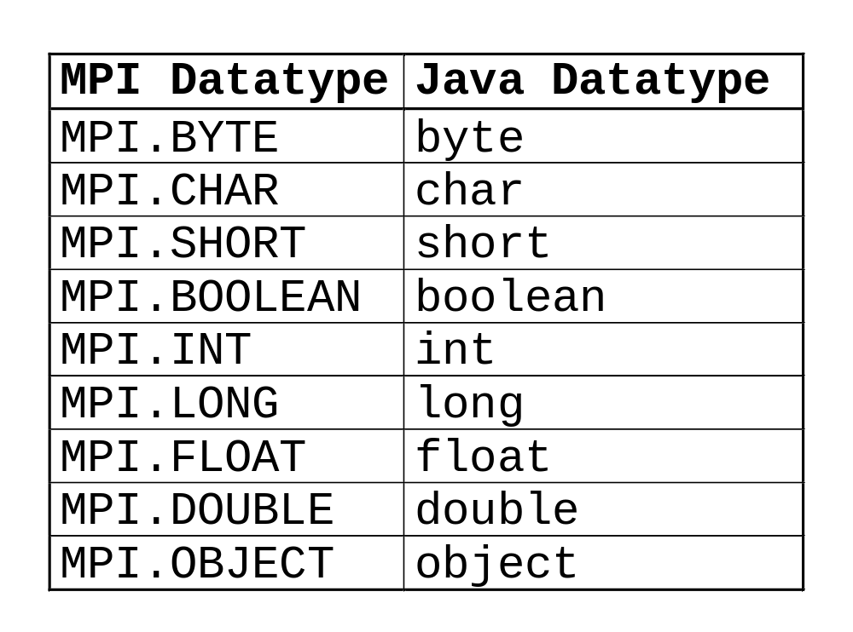
Basic Datatypes

Slide 30
mpiJava implementation issues
mpiJava is currently implemented as Java interface to an underlying MPI implementation - such as MPICH or some other native MPI implementation.
The interface between mpiJava and the underlying MPI implementation is via the Java Native Interface (JNI).

Slide 31
mpiJava - Software Layers
MPIprog.java
Import mpi.*;
JNI C Interface
Native Library (MPI)

Slide 32
mpiJava implementation issues
Interfacing Java to MPI not always trivial, e.g., see low-level conflicts between the Java runtime and interrupts in MPI.
Situation improving as JDK matures - 1.2
Now reliable on Solaris MPI (SunHPC, MPICH), shared memory, NT (WMPI).
Linux - Blackdown JDK 1.2 beta just out and seems OK - other ports in progress.

Slide 33
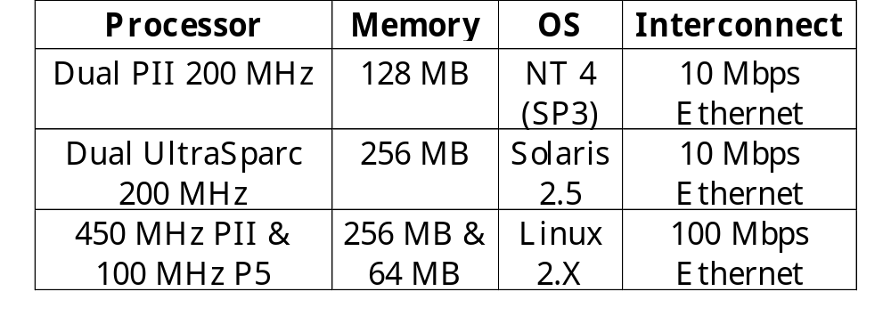
mpiJava - Test Machines

Slide 34
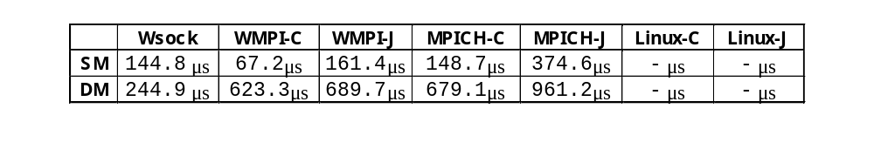
mpiJava performance

Slide 35
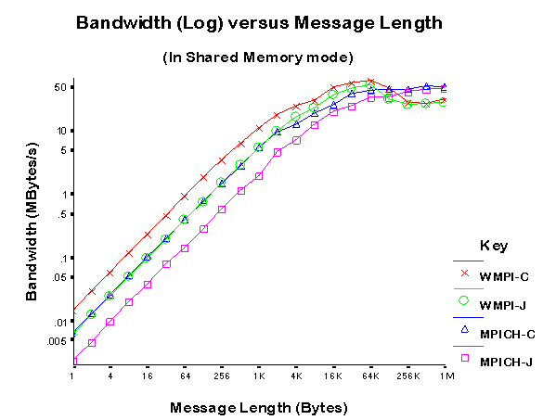
mpiJava performance
1. Shared memory mode

Slide 36
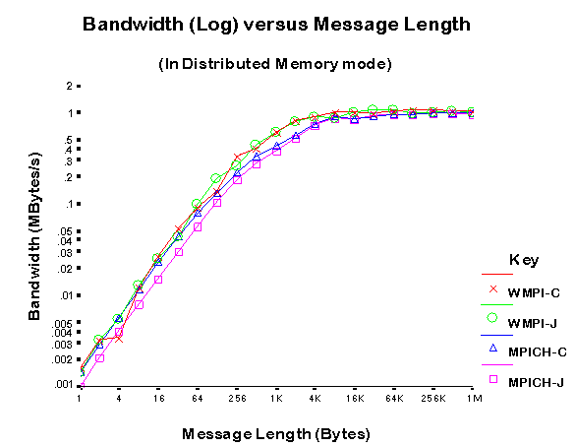
mpiJava performance
2. Distributed memory

Slide 37
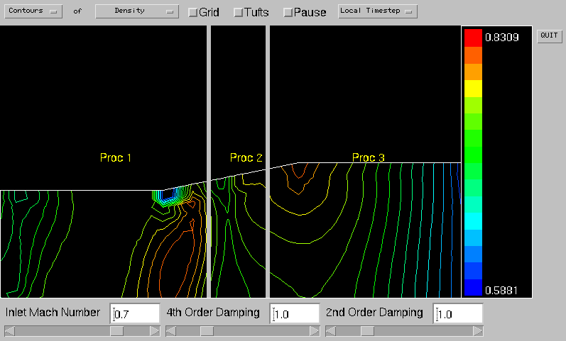
mpiJava demos
1. CFD: inviscid flow

Slide 38
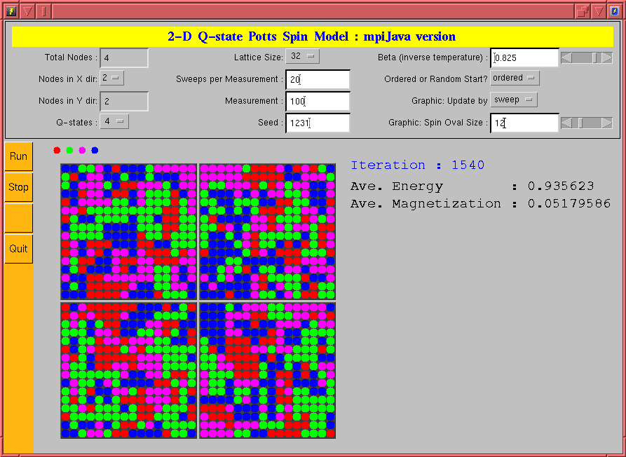
mpiJava demos
2. Q-state Potts model

Slide 39
Object Serialization in mpiJava
Bryan Carpenter, Geoffrey Fox, Sung-Hoon Ko, and Sang Lim
www.npac.syr.edu/projects/pcrc/HPJava/mpiJava.html

Slide 40
Some issues in design of a Java API for MPI
Class hierarchy. MPI is already object-based. “Standard” class hierarchy exists for C++.
Detailed argument lists for methods. Properties of Java language imply various superficial changes from C/C++.
Mechanisms for representing message buffers.

Slide 41
Representing Message Buffers
Two natural options:
Follow the MPI standard route: derived datatypes describe buffers consisting of mixed primitive fields scattered in local memory.
Follow the Java standard route: automatic marshalling of complex structures through object serialization.

Slide 42
Overview of this part of lecture
Discuss incorporation of derived datatypes in the Java API, and limitations.
Adding object serialization at the API level.
Describe implementation using JDK serialization.
Benchmarks for naïve implementation.
Optimizing serialization.

Slide 43
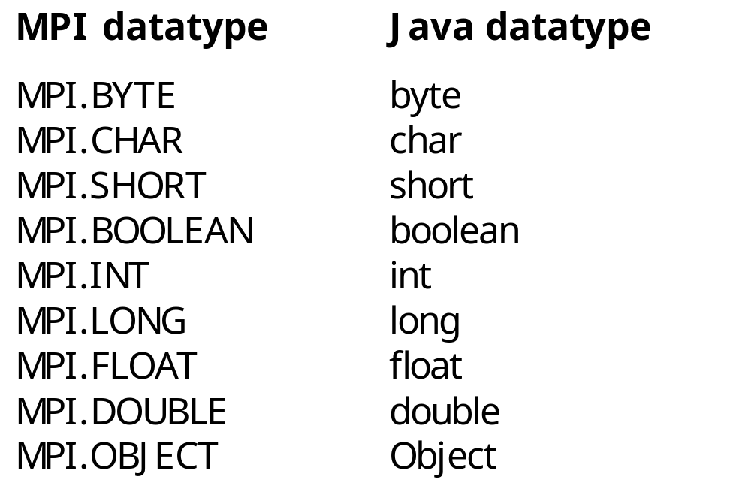
Basic Datatypes

Slide 44
Derived datatypes
MPI derived datatypes have two roles:
Non-contiguous data can be transmitted in one message.
MPI_TYPE_STRUCT allows mixed primitive types in one message.
Java binding doesn’t support second role. All data come from a homogeneous array of elements (no MPI_Address).

Slide 45
Restricted model
A derived datatype consists of
A base type. One of the 9 basic types.
A displacement sequence. A relocatable pattern of integer displacements in the buffer array:
{disp , disp , . . . , disp }
0 1 n-1

Slide 46
Limitations
Can’t mix primitive types or fields from different objects.
Displacements only operate within 1d arrays. Can’t use MPI_TYPE_VECTOR to describe sections of multidimensional arrays.

Slide 47
Object datatypes
If type argument is MPI.OBJECT, buf should be an array of objects.
Allows to send fields of mixed primitive types, and fields from different objects, in one message.
Allows to send multidimensional arrays, because they are arrays of arrays (and arrays are effectively objects).

Slide 48
Automatic serialization
Send buf should be an array of objects implementing Serializable.
Receive buf should be an array of compatible reference types (may be null).
Java serialization paradigm applied:
  Output objects (and objects referenced through them) converted to a byte stream. Object graph reconstructed at the receiving end.

Slide 49
Implementation issues for Object datatypes
Initial implementation in mpiJava used ObjectOutputStream and ObjectInputStream classes from JDK.
Data serialized and sent as a byte vector, using MPI.
Length of byte data not known in advance. Encoded in a separate header so space can be allocated dynamically in receiver.

Slide 50
Modifications to mpiJava
All mpiJava communications, including non-blocking modes and collective operations, now allow objects as base types.
Header + data decomposition complicates, eg, wait and test family.
Derived datatypes complicated.
Collective comms involve two phases if base type is OBJECT.

Slide 51
Benchmarking mpiJava with naive serialization
Assume in “Grande” applications, critical case is arrays of primitive element.
Consider N x N arrays:
float [] [] buf = new float [N] [N] ;
MPI.COMM_WORLD.send(buf, 0, N, MPI.OBJECT,
dst, tag) ;
float [] [] buf = new float [N] [] ;
MPI.COMM_WORLD.recv(buf, 0, N, MPI.OBJECT,
src, tag) ;

Slide 52
Platform
Cluster of 2-processor, 200 Mhz Ultrasparc nodes
SunATM-155/MMF network
Sun MPI 3.0
“non-shared memory” = inter-node comms
“shared memory” = intra-node comms

Slide 53
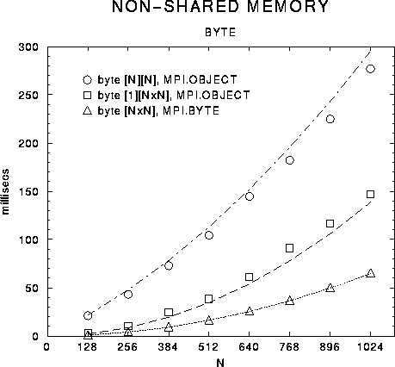
Non-shared memory: byte

Slide 54
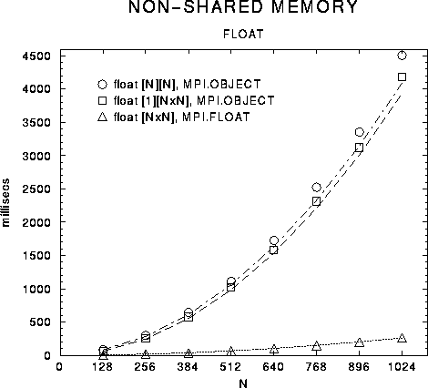
Non-shared memory: float

Slide 55
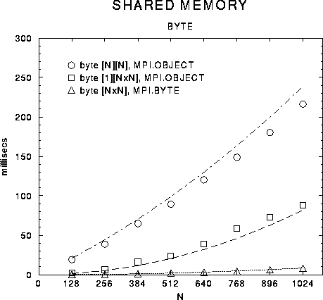
Shared memory: byte

Slide 56
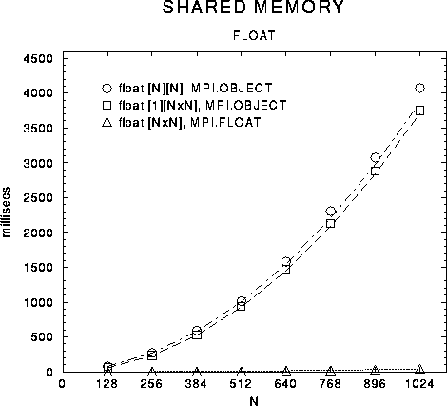
Shared memory: float

Slide 57
Parameters in timing model (microseconds)
byte float
t = 0.043 t = 2.1
ser ser
byte float
t = 0.027 t = 1.4
unser unser
byte float
t = 0.062 t = 0.25 (non-shared)
com com
byte float
t = 0.008 t = 0.038 (shared)
com com

Slide 58
Benchmark lessons
Cost of serializing and unserializing an individual float one to two orders of magnitude greater than communication!
Serializing subarrays also expensive:
vec vec
t = 100 t = 53
ser unser

Slide 59
Improving serialization
Sources of ObjectOutputStream, ObjectInputStream are available, and format of serialized stream is documented.
By overriding performance-critical methods in classes, and modifying critical aspects of the stream format, can hope to solve immediate problems.

Slide 60
Eliminating overheads of element serialization
Customized ObjectOutputStream replaces primitive arrays with short ArrayProxy object. Separate Vector holding the Java arrays is produced.
“Data-less” byte stream sent as header.
New ObjectInputStream yields Vector of allocated arrays, not writing elements.
Elements then sent in one comm using MPI_TYPE_STRUCT from vector info.

Slide 61
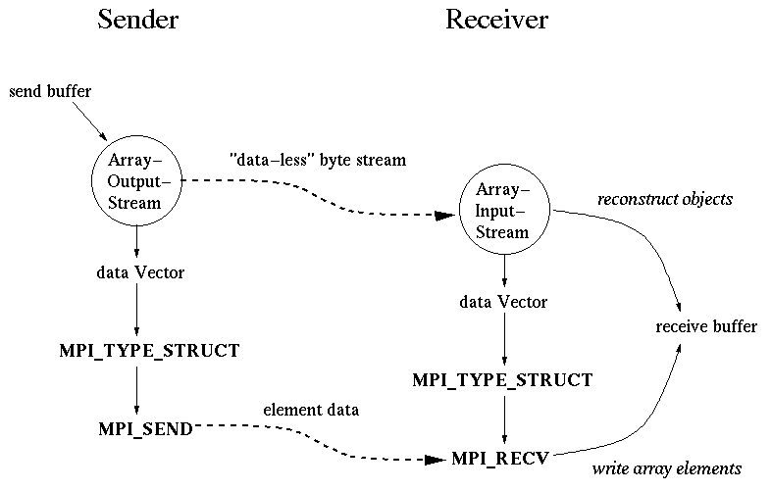
Improved protocol

Slide 62
Customized output stream class
In experimental implementation, use inheritance from standard stream class, ObjectOutputStream.
Class ArrayOutputStream extends ObjectOutputStream, and defines method replaceObject.
This method tests if argument is a primitive array. If it is, reference to the array is stored in the dataVector, and a small proxy object is placed in the output stream.

Slide 63
Customized input stream class
Similarly, class ArrayInputStream extends ObjectInputStream, and defines method resolveObject.
This method tests if argument is an array proxy. If it is, a primitive array of the appropriate size and type is created and stored in the dataVector.

Slide 64
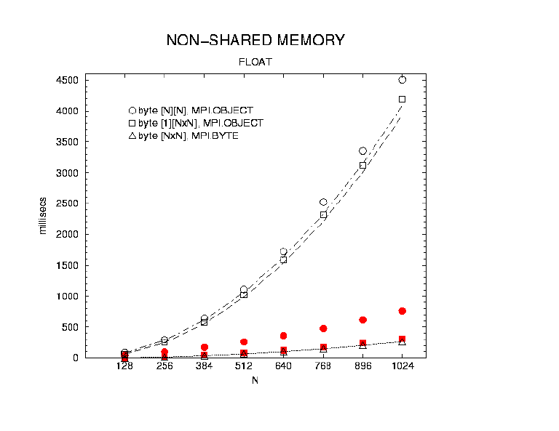
Non-shared memory: float (optimized in red)

Slide 65
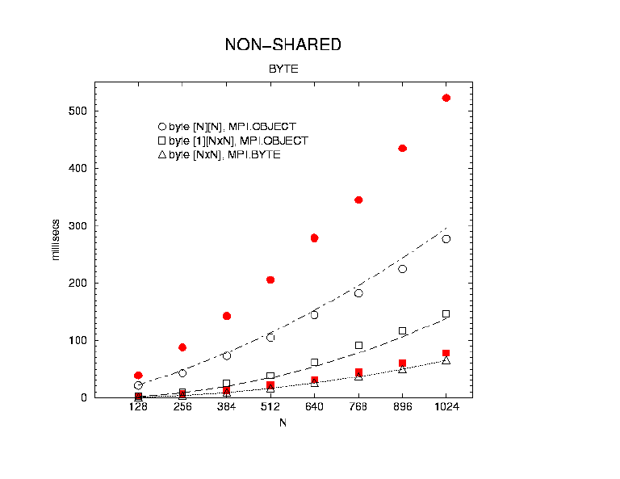
Non-shared memory: byte
(optimized in red)

Slide 66
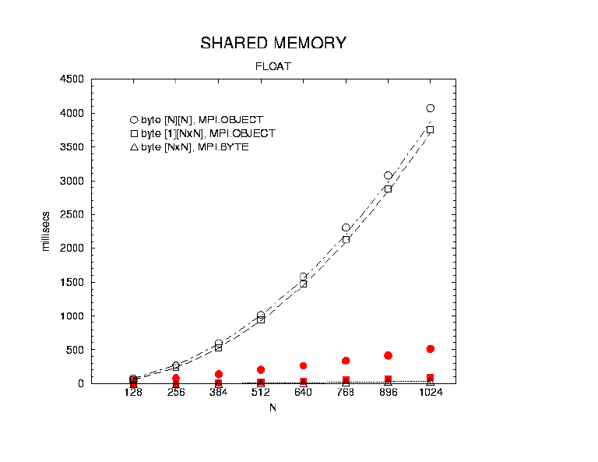
Shared memory: float
(optimized in red)

Slide 67
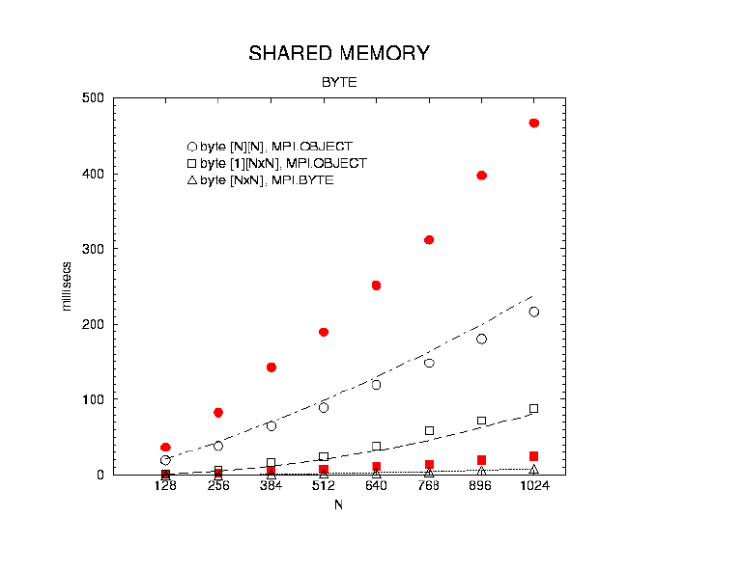
Shared memory: byte
(optimized in red)

Slide 68
Comments
Relatively easy to get dramatic improvements.
Have only truly optimized one dimensional arrays embedded in stream.
Later work looked at direct optimizations for rectangular multi-dimensional arrays---replace wholesale in stream.

Slide 69
Conclusions on object serialization
Derived datatypes workable for Java, but slightly limited.
Object basic types attractive on grounds of simplicity and generality.
Naïve implementation too slow for bulk data transfer.
Optimizations should bring asymptotic performance in line with C/Fortran MPI.

Slide 70
Message-passing in Java Grande.
http://www.javagrande.org

Slide 71
Projects related to MPI and Java
mpiJava (Syracuse)
JavaMPI (Getov et al, Westminster)
JMPI (MPI Software Technology)
MPIJ (Judd et al, Brigham Young)
jmpi (Dincer et al)

Slide 72
1. DOGMA MPIJ
Completely Java-based implementation of a large subset of MPI.
Part of Distributed Object Group Metacomputing Architecture.
Uses native marshalling of primitive Java types for performance.
Judd, Clement and Snell, 1998.

Slide 73
2. Automatic wrapper generation
JCI Java-to-C interface generator takes input C header and generates stub functions for JNI Java interface.
JavaMPI bindings generated in this way resemble the C interface to MPI.
Getov and Mintchev, 1997.

Slide 74
3. JMPI™ environment
Commercial message-passing environment for Java announced by MPI Software Technology.
Crawford, Dandass and Skjellum, 1997

Slide 75
4. jmpi instrumented MPI
100% Java implementation of an MPI subset.
Layered on JPVM.
Instrumented for performance analysis and visualization.
Dincer and Kadriy, 1998.

Slide 76
Standardization?
Currently all implementations of MPI for Java have different APIs.
An “official” Java binding for MPI (complementing Fortran, C, C++ bindings) would help.
Position paper and draft API: Carpenter, Getov, Judd, Skjellum and Fox, 1998.

Slide 77
Java Grande Forum
Level of interest in message-passing for Java healthy, but not enough to expect MPI forum to reconvene.
More promising to work within the Java Grande Forum. Message-Passing Working Group formed (as a subset of the existing Concurrency and Applications working group).
To avoid conflicts with MPIF, Java effort renamed to MPJ.

Slide 78
MPJ
Group of enthusiasts, informally chaired by Vladimir Getov.
Meetings in last year in San Francisco (Java ‘99), Syracuse, and Portland (SC ‘99).
Regular attendance by members of SunHPC group, amongst others.

Slide 79
Thoughts on a Java Reference Implementation for MPJ
Mark Baker, Bryan Carpenter

Slide 80
Benefits of a pure Java implementation of MPJ
Highly portable. Assumes only a Java development environment.
Performance: moderate. May need JNI inserts for marshalling arrays. Network speed limited by Java sockets.
Good for education/evaluation. Vendors provide wrappers to native MPI for ultimate performance?

Slide 81
Resource discovery
Technically, Jini discovery and lookup seems an obvious choice. Daemons register with lookup services.
A “hosts file” may still guide the search for hosts, if preferred.

Slide 82
Communication base
Maybe, some day, Java VIA?? For now sockets are the only portable option. RMI surely too slow.

Slide 83
Handling “Partial Failures”
A useable MPI implementation must deal with unexpected process termination or network failure, without leaving orphan processes, or leaking other resources.
Could reinvent protocols to deal with these situations, but Jini provides a ready-made framework (or, at least, a set of concepts).

Slide 84
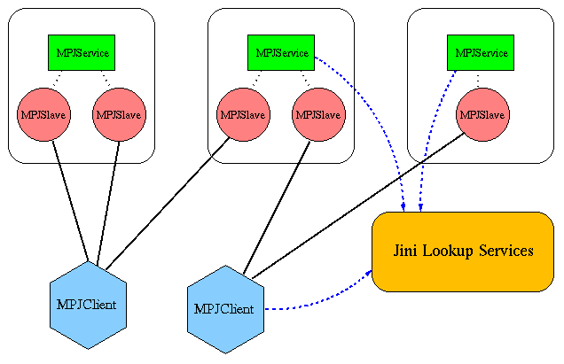
Acquiring compute slaves through Jini

Slide 85
Handling failures with Jini
If any slave dies, client generates a Jini distributed event, MPIAbort. All slaves are notified and all processes killed.
In case of other failures (network failure, death of client, death of controlling daemon, …) client leases on slaves expire in a fixed time, and processes are killed.

Slide 86
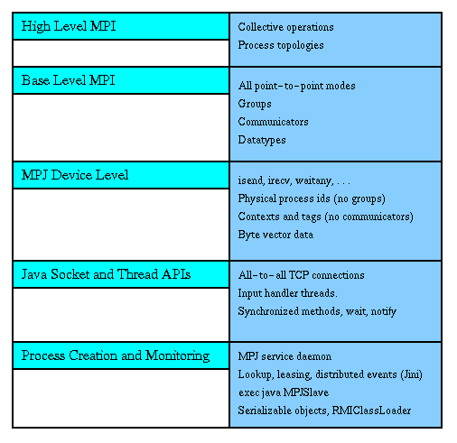
Higher layers

Slide 87
Integration of Jini and MPI
Geoffrey C. Fox
NPAC at Syracuse University
Syracuse, NY 13244
gcf@npac.syr.edu

Slide 88
Integration of Jini and MPI
Provide a natural Java framework for parallel computing with the powerful fault tolerance and dynamic characteristics of Jini combined with proven parallel computing functionality and performance of MPI

Slide 89
JiniMPI Architecture
RMI
PC is Parallel Computing
is MPI Transport Layer
SPMD
Program
SPMD
Program
SPMD
Program
SPMD
Program
Jini PC
Embryo
Jini PC
Embryo
Jini PC
Embryo
Jini PC
Embryo
Jini Lookup
Service
PC Proxy
PC Proxy
PC Proxy
PC Proxy
PC Control
and Services
Middle Tier

Slide 90
Remarks on JiniMPI I
This architecture is more general than that needed to support MPI like parallel computing
  It includes ideas present in systems like Condor and Javelin
The diagram only shows server (bottom) and service (top) layers. There is of course a client layer which communicates directly with “Parallel Computing (PC) Control and Services module”
We assume that each workstation has a “Jini client” called here a “Jini Parallel Computing (PC) Embryo” which registers the availability of that workstation to run either particular or generic applications
  The Jini embryo can represent the machine (I.e. ability to run general applications) or particular software
The Gateway or “Parallel Computing (PC) Control and Services module” queries Jini lookup server to find appropriate service computers to run a particular MPI job
  It could of course use this mechanism “just” to be able to run a single job or to set up a farm of independent workers

Slide 91
Remarks on JiniMPI II
The standard Jini mechanism is applied for each chosen embryo. This effectively establishes an RMI link from Gateway to (SPMD) node which corresponds to creating a Java proxy (corresponding to RMI stub) for the node program which can be any language (Java, Fortran, C++ etc.)
This Gateway--Embryo exchange should also supply to the Gateway any needed data (such as specification of needed parameters and how to input them) for user client layer
This strategy separates control and data transfer
  It supports Jini (registration, lookup and invocation) and advanced services such as load balancing and fault tolerance on control layer
  and MPI style data messages on fast transport layer
  The Jini embryo is only used to initiate process. It is not involved in the actual “execution” phase
One could build a JavaSpace at the Control layer as the basis of a powerful management environment
  This is very different from using Linda (JavaSpaces) in execution layer as in Control layer one represents each executing node program by a proxy and normal performance problems with Linda are irrelevant

