Slide 1
mpiJava
Mark.Baker@Computer.Org

Slide 2
Related projects
mpiJava (Syracuse)
JavaMPI (Getov et al, Westminster)
JMPI (MPI Software Technology)
MPIJ (Judd et al, Brigham Young)
jmpi (Dincer et al)

Slide 3
The mpiJava wrapper
Implements a Java API for MPI suggested in late ‘97.
Good Performance on large data transfers
Tied to native mpi C implementation

Slide 4
mpiJava features.
Fully featured Java interface to MPI 1.1
Object-oriented API based on MPI 2 standard C++ interface
Initial implementation through JNI to native MPI
Comprehensive test suite translated from IBM MPI suite

Slide 5
mpiJava - Software Layers
MPIprog.java
Import mpi.*;
JNI C Interface
Native Library (MPI)

Slide 6
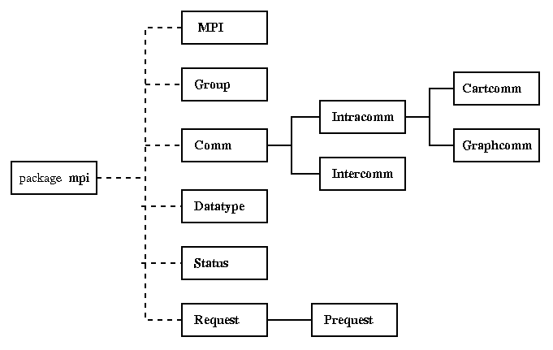
Class hierarchy

Slide 7
Minimal mpiJava program
import mpi.*
class Hello {
static public void main(String[] args) {
MPI.Init(args) ;
int myrank = MPI.COMM_WORLD.Rank() ;
if(myrank == 0) {
char[] message = “Hello, there”.toCharArray() ;
MPI.COMM_WORLD.Send(message, 0, message.length, MPI.CHAR, 1, 99) ;
}
else {
char[] message = new char [20] ;
MPI.COMM_WORLD.Recv(message, 0, 20, MPI.CHAR, 0, 99) ;
System.out.println(“received:” + new String(message) + “:”) ;
}
MPI.Finalize() ;
}
}

Slide 8
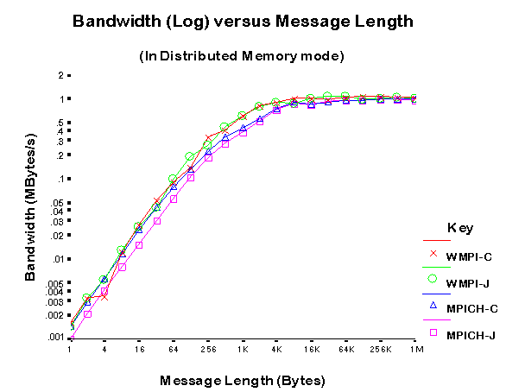
mpiJava performance

Slide 9
MPI datatypes
Send and receive members of Comm:
void send(Object buf, int offset, int count,
Datatype type, int dst, int tag) ;
Status recv(Object buf, int offset, int count,
Datatype type, int src, int tag) ;
buf must be an array. offset is the element where message starts. Datatype class describes type of elements.

Slide 10
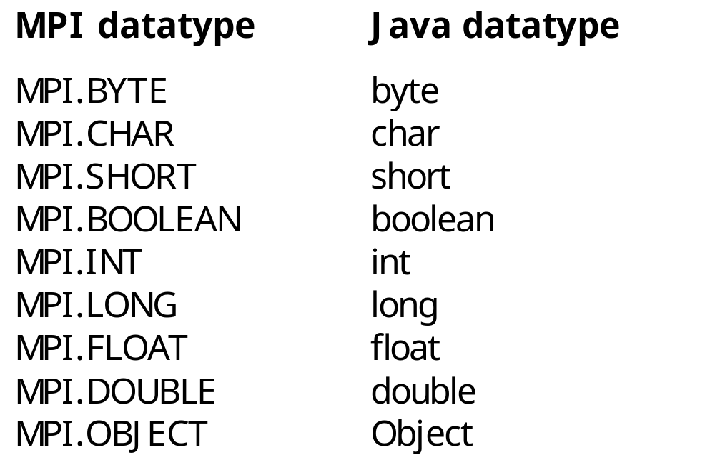
Basic Datatypes

