Slide 1
Lisp and Scheme I

Slide 2
Versions of LISP
LISP is an acronym for LISt Processing language
Lisp (b. 1958) is an old language with many variants
  Fortran is only older language still in wide use
  Lisp is alive and well today
Most modern versions are based on Common Lisp
Scheme is one of the major variants
  We’ll use Scheme, not Lisp, in this class
  Scheme is used for CS 101 in some universities
The essentials haven’t changed much

Slide 3
Why Study Lisp?
It’s a simple, elegant yet powerful language
You will learn a lot about PLs from studying it
We’ll look at how to implement a Scheme interpreter in Scheme and Python
Many features, once unique to Lisp, are now in “mainstream” PLs: python, javascript, perl …
It will expand your notion of what a PL can be
Lisp is considered hip and esoteric among computer scientists

Slide 4
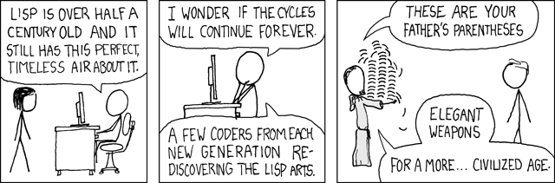
I've just received word that the Emperor has dissolved the MIT computer science program permanently.

Slide 5
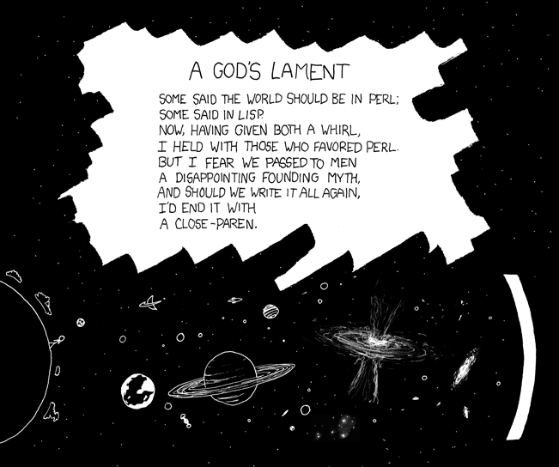
Some say the world will end in fire; some say in segfaults.

Slide 6
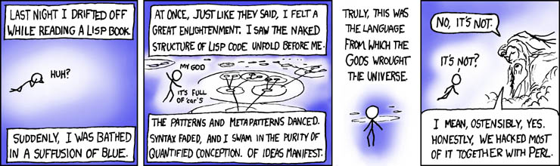
We lost the documentation on quantum mechanics. You'll have to decode the regexes yourself.

Slide 7
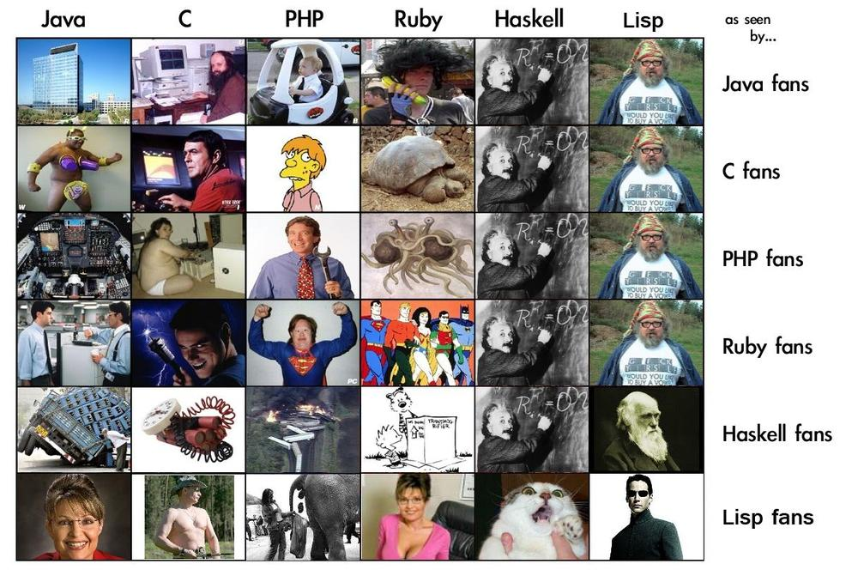
How Programming Language Fanboys See Each Others’ Languages

Slide 8
LISP Features
S-expression as the universal data type – either at atom (e.g., number, symbol) or a list of atoms or sublists
Functional Programming Style – computation done by applying functions to arguments, functions are first class objects, minimal use of side-effects
Uniform Representation of Data & Code – (A B C D) can be interpreted as data (i.e., a list of four elements) or code (calling function ‘A’ to the three parameters B, C, and D)
Reliance on Recursion – iteration is provided too, but recursion is considered more natural and elegant
Garbage Collection – frees programmer’s explicit memory management

Slide 9
What’s Functional Programming?
The FP paradigm: computation is applying functions to data
Imperative or procedural programming: a program is a set of steps to be done in order
FP eliminates or minimizes side effects and mutable objects that create/modify state
  E.g., consider f1( f2(a), f2(b))
FP treats functions as objects that can stored, passed as arguments, composed, etc.

Slide 10
Pure Lisp and Common Lisp
Lisp has a small and elegant conceptual core that has not changed much in almost 50 years.
McCarthy’s original Lisp paper defined all of Lisp using just seven primitive functions
Common Lisp, developed in the 1980s as an ANSI standard, is large (>800 builtin functions), has most modern data-types, good program-ming environments, and good compilers

Slide 11
_x0013_Scheme
Scheme is a dialect of Lisp that is favored by people who teach and study programming languages
Why?
  It’s simpler and more elegant than Lisp
  It’s pioneered many new programming language ideas (e.g., continuations, call/cc)
  It’s influenced Lisp (e.g., lexical scoping of variables)
  It’s still evolving, so it’s a good vehicle for new ideas

Slide 12
But I want to learn Lisp!
Lisp is used in many practical systems, but Scheme is not
Learning Scheme is a good introduction to Lisp
We can only give you a brief introduction to either language, and at the core, Scheme and Lisp are the same
We’ll point out some differences along the way

Slide 13

But I want to learn Clojure!
Clojure is a new Lisp dialect that compiles to the Java Virtual Machine
It offers advantages of both Lisp (dynamic typing, functional programming, closures, etc.) and Java (multi-threading, fast execution)
We’ll look at Clojure briefly later

Slide 14

DrScheme and MzScheme
We’ll use the PLT Scheme system developed by a group of academics (Brown, Northeastern, Chicago, Utah)
It’s most used for teaching introductory CS courses
MzScheme is the basic scheme engine and can be called from the command line and assumes a terminal style interface
DrScheme is a graphical programming environ-ment for Scheme

Slide 15
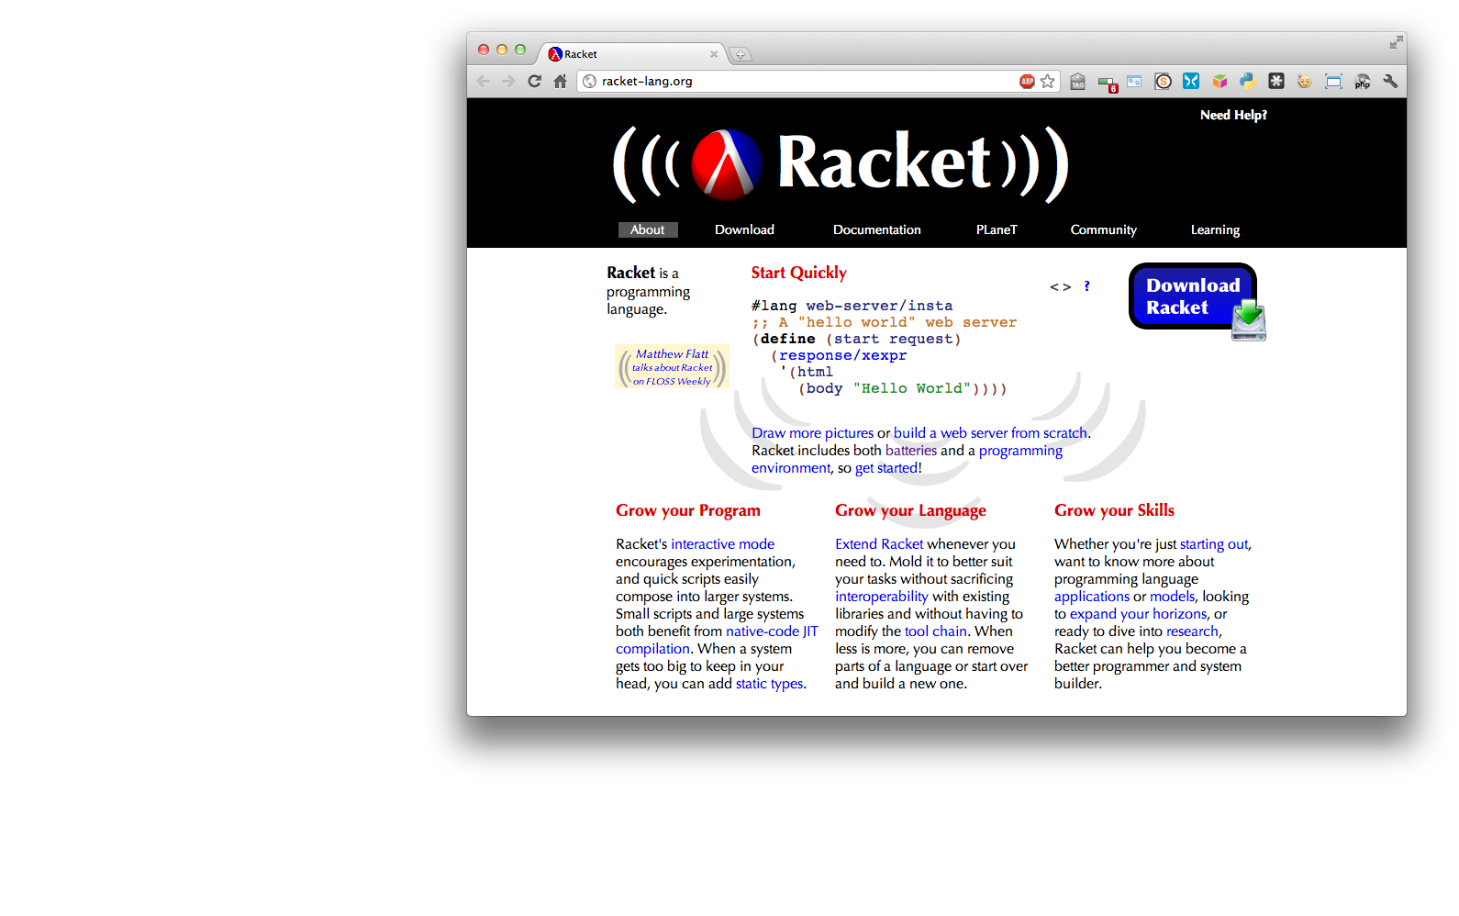

Slide 16
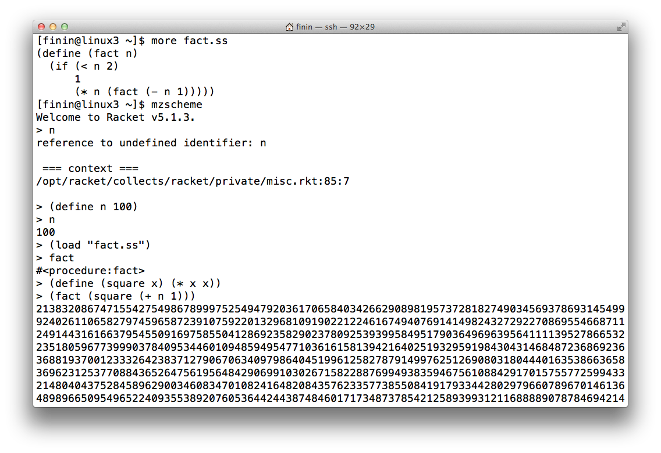
Mzscheme on gl.umbc.edu

Slide 17
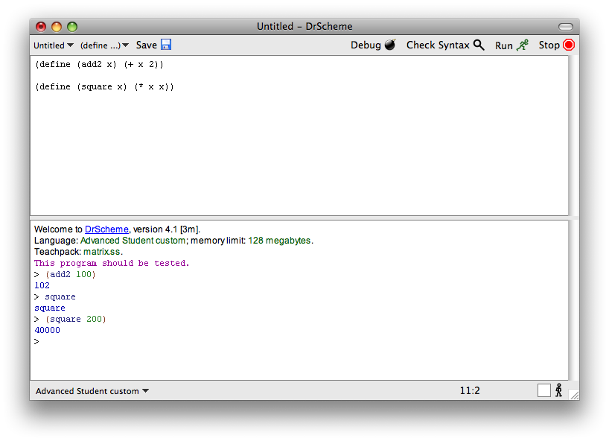
DrScheme

Slide 18
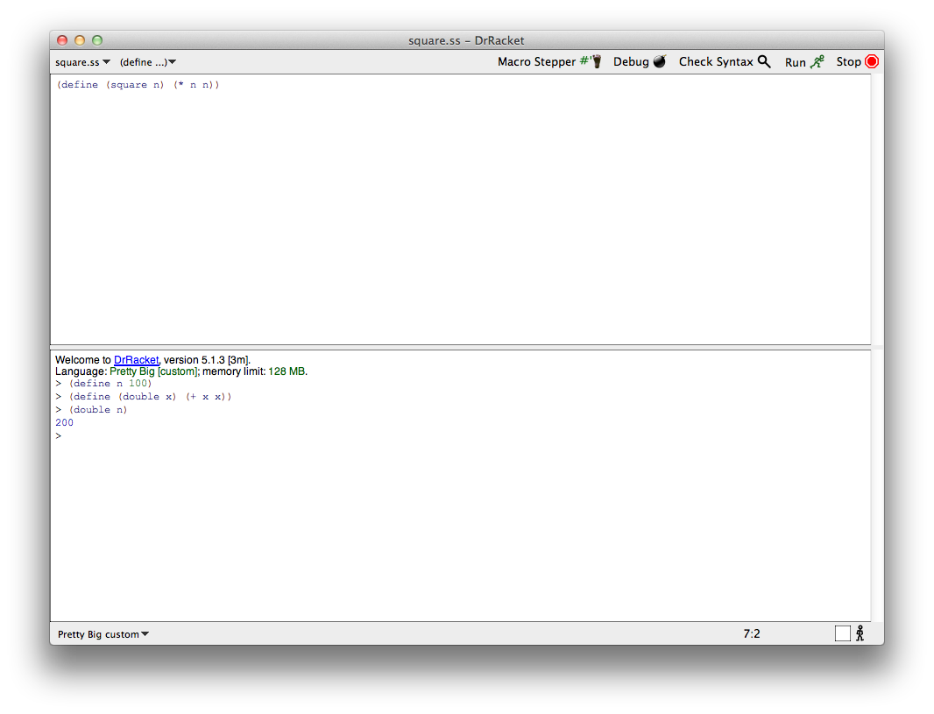
DrRacket

Slide 19
Informal Scheme/Lisp Syntax
An atom is either an integer or an identifier
A list is a left parenthesis, followed by zero or more S-expressions, followed by a right parenthesis
An S-expression is an atom or a list
Example: ()
(A (B 3) (C) ( ( ) ) )

Slide 20
Hello World
(define (helloWorld)
;; prints and returns the message.
(printf "Hello World\n"))

Slide 21
Square
> (define (square n)
;; returns square of a numeric argument
(* n n))
> (square 10)
100

Slide 22
REPL
Lisp and Scheme are interactive and use what is known as the “read, eval, print loop”
  While true
    Read one expression from the open input
    Evaluate the expression
    Print its returned value
(define (repl) (print (eval (read))) (repl))

Slide 23
What is evaluation?
We evaluate an expression producing a value
  Evaluating “2 + sqrt(100)” produces 12
Scheme has a set of rules specifying how to evaluate an s-expression
We will get to these very soon
  There are only a few rules
  Creating an interpreter for scheme means writing a program to
    read scheme expressions,
    apply the evaluation rules, and
    print the result

Slide 24
Built-in Scheme Datatypes
Basic Datatypes
Booleans
Numbers
Strings
Procedures
Symbols
Pairs and Lists
The Rest
Bytes & Byte Strings
Keywords
Characters
Vectors
Hash Tables
Boxes
Void and Undefined

Slide 25
Lisp: T and NIL
Since 1958, Lisp has used two special symbols: NIL and T
NIL is the name of the empty list, ( )
As a boolean, NIL means “false”
T is usually used to mean “true,” but…
…anything that isn’t NIL is “true”
NIL is both an atom and a list
  it’s defined this way, so just accept it

Slide 26
Scheme: #t, #f, and ‘()
Scheme cleaned this up a bit
Scheme’s boolean datatype includes #t and #f
#t is a special symbol that represents true
#f represents false
In practice, anything that’s not #f is true
Booleans evaluate to themselves
Scheme represents empty lists as the literal ( ) which is also the value of the symbol null
  (define null ‘())

Slide 27
Numbers
Numbers evaluate to themselves
Scheme has a rich collection of number types including the following
  Integers (42)
  Floats (3.14)
  Rationals: (/ 1 3) => 1/3
  Complex numbers: (* 2+2i -2-2i) => 0-8i
  Infinite precision integers: (expt 99 99) => 369…99 (contains 198 digits!)
  And more…

Slide 28
Strings
Strings are fixed length arrays of characters
  "foo"
  "foo bar\n"
  "foo \"bar\"”
Strings are immutable
Strings evaluate to themselves

Slide 29
Predicates
A predicate (in any computer language) is a function that returns a boolean value
In Lisp and Scheme predicates returns either #f or often something else that might be useful as a true value
  The member function returns true iff it’s 1st argument is in the list that is it’s 2nd
  (member 3 (list 1 2 3 4 5 6)) => (3 4 5 6))

Slide 30
Function calls and data
A function call is written as a list
  the first element is the name of the function
  remaining elements are the arguments
Example: (F A B)
  calls function F with arguments A and B
Data is written as atoms or lists
Example: (F A B) is a list of three elements
  Do you see a problem here?

Slide 31
Simple evaluation rules
Numbers evaluate to themselves
#t and #f evaluate to themselves
Any other atoms (e.g., foo) represents variables and evaluate to their values
A list of n elements represents a function call
  e.g., (add1 a)
  Evaluate each of the n elements (e.g., add1->a procedure, a->100)
  Apply function to arguments and return value

Slide 32
Example
(define a 100)
> a
100
> add1
#<procedure:add1>
> (add1 (add1 a))
102
> (if (> a 0) (+ a 1)(- a 1))
103
define is a special form that doesn’t follow the regular evaluation rules
  Scheme only has a few of these
Define doesn’t evaluate its first argument
if is another special form
  What do you think is special about if?

Slide 33
Quoting
Is (F A B) a call to F, or is it just data?
All literal data must be quoted (atoms, too)
(QUOTE (F A B)) is the list (F A B)
  QUOTE is not a function, but a special form
  Arguments to a special form aren’t evaluated or are evaluated in some special manner
'(F A B) is another way to quote data
  There is just one single quote at the beginning
  It quotes one S-expression

Slide 34
Symbols
Symbols are atomic names
  > ’foo
  foo
  > (symbol? ‘foo)
  #t
Symbols are used as names of variables and procedures
  (define foo 100)
  (define (fact x) (if (= x 1) 1 (* x (fact (- x 1)))))

Slide 35
Basic Functions
car returns the head of a list
    (car ‘(1 2 3)) => 1
    (first ‘(1 2 3)) => 1 ;; for people who don’t like car
cdr returns the tail of a list
    (cdr ‘(1 2 3)) => (2 3)
    (rest ‘(1 2 3)) => (2 3) ;; for people who don’t like cdr
cons constructs a new listbeginning with it’s first arg and continuing with it’s second
    (cons 1 ‘(2 3)) => (1 2 3)

Slide 36
CAR, CDR and CONS
These names date back to 1958
  Before lower case characters were invented
CONS = CONStruct
CAR and CDR were each implemented by a single hardware instruction on the IBM 704
  CAR: Contents of Address Register
  CDR: Contents of Data Register

Slide 37
More Basic Functions
eq? compares two atoms for equality
  (eq? ‘foo ‘foo) => #t
  (eq? ‘foo ‘bar) => #f
  Note: eq? is just a pointer test, like Java’s ‘=‘
equal? tests two list structures
  (equal? ‘(a b c) ‘(a b c)) =#t
  (equal? ‘(a b) ‘((a b))) => #f
  Note: equal? compares two complex objects, like a Java object’s equal method

Slide 38
Comment on Names
Lisp used the convention (inconsistently) of ending predicate functions with a P
  E.g., MEMBERP, EVENP
Scheme uses the more sensible convention to use ? at the end such functions
  e.g., eq?, even?
Even Scheme is not completely consistent in using this convention
  E.g., the test for list membership is member and not member?

Slide 39
Other useful Functions
(null? S) tests if S is the empty list
  (null? ‘(1 2 3) => #f
  (null? ‘()) => #t
(list? S) tests if S is a list
  (list? ‘(1 2 3)) =>#t
  (list? ‘3) => #f

Slide 40
More useful Functions
list makes a list of its arguments
  (list 'A '(B C) 'D) => (A (B C) D)
  (list (cdr '(A B)) 'C) => ((B) C)
Note that the parenthesized prefix notation makes it easy to define functions that take a varying number or arguments.
  (list ‘A) => (A)
  (list) => ( )
Lisp dialects use this flexibility a lot

Slide 41
More useful Functions
append concatenates two lists
  (append ‘(1 2) ‘(3 4)) => (1 2 3 4)
  (append '(A B) '((X) Y)) => (A B (X) Y)
  (append ‘( ) ‘(1 2 3)) => (1 2 3)
append takes any number of arguments
  (append ‘(1) ‘(2 3) ‘(4 5 6)) => (1 2 3 4 5 6)
  (append ‘(1 2)) => (1 2)
  (append) => null
  (append null null null) => null

Slide 42
If then else
In addition to cond, Lisp and Scheme have an if special form that does much the same thing
(if <test> <then> <else>)
  (if (< 4 6) ‘foo ‘bar) => foo
  (if (< 4 2) ‘foo ‘bar) => bar
  (define (min x y) (if (< x y) x y))
In Lisp, the then clause is optional and defaults to null, but in Scheme it’s required

Slide 43
Cond
cond (short for conditional) is a special form that implements the if ... then ... elseif ... then ... elseif ... then ... control structure
(COND
(condition1 result1 )
(condition2 result2 )
. . .
(#t resultN ) )
a clause

Slide 44
Cond Example
(cond ((not (number? x))
0)
((< x 0) 0)
((< x 10) x)
(#t 10))
(if (not (number? x))
0
(if (<x 0)
0
(if (< x 10)
x
10)))

Slide 45
Cond is superfluous, but loved
Any cond can be written using nested is expressions
But once you get used to the full form, it’s very useful
  It subsumes the conditional and switch statements
One example:
  (cond ((test1 a)
  (do1 a)(do2 a)(value1 a))
  ((test2 a)))
Note: If no clause is selected, then cond returns #<void>
It’s as if every cond had a final clause like
(#t (void))

Slide 46
Defining Functions
(DEFINE (function_name . parameter_list)
. function_body )
Examples:
  ;; Square a number
  (definf (square n) (* n n))
  ;; absolute difference between two numbers.
  (define (diff x y) (if (> x y) (- x y) (- y x)))

Slide 47
Example: member
member is a built-in function, but here’s how we’d define it
  (define (member x lst)
  ;; x is a top-level member of a list if it is the first
  ;; element or if it is a member of the rest of the list
  (cond ((null lst) #f)
  ((equal x (car lst)) list)
  (#t (member x (cdr lst)))))

Slide 48
Example: member
We can also define it using if:
  (define (member x lst)
  (if (null> lst)
  null
  (if (equal x (car lst))
  list
  (member x (cdr lst)))))
We could also define it using not, and & or
  (define (member x lst)
  (and (not (null lst))
  (or (equal x (car lst))
  (member x (cdr lst)))))

Slide 49
Append concatenate lists
> (append '(1 2) '(a b c))
(1 2 a b c)
> (append '(1 2) '())
(1 2)
> (append '() '() '())
()
> (append '(1 2 3))
(1 2 3)
> (append '(1 2) '(2 3) '(4 5))
(1 2 2 3 4 5)
> (append)
()
Lists are immutable
Append constructs new lists

Slide 50
Example: define append
(append ‘(1 2 3) ‘(a b)) => (1 2 3 a b)
Here are two versions, using if and cond:
  (define (append l1 l2)
  (if (null l1)
  l2
  (cons (car l1) (append (cdr l1) l2)))))
  (define (append l1 l2)
  (cond ((null l1) l2)
  (#t (cons (car l1) (append (cdr l1) l2)))))

Slide 51
Example: SETS
Implement sets and set operations: union, intersection, difference
Represent a set as a list and implement the operations to enforce uniqueness of membership
Here is set-add
  (define (set-add thing set)
  ;; returns a set formed by adding THING to set SET
  (if (member thing set) set (cons thing set)))

Slide 52
Example: SETS
Union is only slightly more complicated
  (define (set-union S1 S2)
  ;; returns the union of sets S1 and S2
  (if (null? S1)
  S2
  (add-set (car S1)
  (set-union (cdr S1) S2)))

Slide 53
Example: SETS
Intersection is also simple
  (define (set-intersection S1 S2)
  ;; returns the intersection of sets S1 and S2
  (cond ((null s1) nil)
  ((member (car s1) s2)
  (set-intersection (cdr s1) s2))
  (#t (cons (car s1)
  (set-intersection (cdr s1) s2)))))

Slide 54
Reverse
Reverse is another common operation on Lists
It reverses the “top-level” elements of a list
  Speaking more carefully, it constructs a new list equal to it’s argument with the top level elements in reverse order.
(reverse ‘(a b (c d) e)) => (e (c d) b a)
  (define (reverse L)
  (if (null? L)
  null
  (append (reverse (cdr L)) (list (car L))))

Slide 55
Reverse is Naïve
The previous version is often called naïve reverse because it’s so inefficient
What’s wrong with it?
It has two problems
  The kind of recursion it does grows the stack when it does not need to
  It ends up making lots of needless copies of parts of the list

Slide 56
Tail Recursive Reverse
The way to fix the first problem is to employ tail recursion
The way to fix the second problem is to avoid append.
So, here is a better reverse:
  (define (reverse2 L) (reverse-sub L null))
  (define (reverse-sub L answer)
  (if (null? L)
  answer
  (reverse-sub (cdr L) (cons (car L) answer))))

Slide 57
Still more useful functions
(LENGTH L) returns the length of list L
  The “length” is the number of top-level elements in the list
(RANDOM N) , where N is an integer, returns a random integer >= 0 and < N
EQUAL tests if two S-expressions are equal
  If you know both arguments are atoms, use EQ instead

Slide 58
Programs on file
Use any text editor to create your program
Save your program on a file with the extension .ss
(Load “foo.ss”) loads foo.ss
(load “foo.bar”) loads foo.bar
Each s-exprssion in the file is read and evaluated.

Slide 59
Comments
In Lisp, a comment begins with a semicolon (;) and continues to the end of the line
Conventions for ;;; and ;; and ;
Function document strings:
  (defun square (x)
  “(square x) returns x*x”
  (* x x))

Slide 60
Read – eval - print
Lisp’s interpreter essentially does:
  (loop (print (eval (read)))
i.e.,
  Read an expression
  Evaluate it
  Print the resulting value
  Goto 1
Understanding the rules for evaluating an expression is key to understanding lisp.
  Reading and printing, while a bit complicated, are conceptually simple.
Read an Expression
Evaluate the Expression
Print the result

Slide 61
When an error happens
On an error
Read an Expression
Read an Expression
Evaluate the Expression
Evaluate the Expression
Return from error
Print the result
Print the result

Slide 62
Eval(S)
If S is an atom, then call evalatom(A)
If S is a list, then call evallist(S)

Slide 63
EvalAtom(S)
Numbers eval to themselves
T evals to T
NIL evals to NIL
Atomic symbol are treated as variables, so look up the current value of symbol

Slide 64
EvalList(S)
Assume S is (S1 S2 …Sn)
  If S1 is an atom representing a special form (e.g., quote, defun) handle it as a special case
  If S1 is an atom naming a regular function
    Evaluate the arguments S2 S3 .. Sn
    Apply the function named by S1 to the resulting values
  If S1 is a list … more on this later …

Slide 65
Variables
[9]> (set! 'a 100)
100
[10]> a
100
[11]> (set 'a (+ a a))
200
[12]> a
200
[13]> b
*** - EVAL: variable B has no value
1. Break [14]> ^D
[15]> (set 'b a)
200
[16]> b
200
[17]> (set 'a 0)
0
[18]> a
0
[19]> b
200
[20]>
Atoms, in the right context, as assumed to be variables.
The traditional way to assign a value to an atom is with the SET function (a special form)
More on this later

Slide 66
Input
(read) reads and returns one s-expression from the current open input stream.
    [1]> (read)
    foo
    FOO
    [2]> (read)
    (a b
    (1 2))
    (A B (1 2))
[3]> (read)
3.1415
3.1415
[4]> (read)
-3.000
-3.0

Slide 67
Output
[1]> (print '(foo bar))
(FOO BAR)
(FOO BAR)
[2]> (setq *print-length* 3 )
3
[3]> (print '(1 2 3 4 5 6 7 8))
(1 2 3 ...)
(1 2 3 ...)
[4]> (format t "The sum of one and one is ~s.~%"
(+ 1 1))
The sum of one and one is 2.
NIL

Slide 68
Let
(let <vars><s1><s2>…<sn>)
  <vars> = (<var1>…<varn>)
  <var1> = <name> or (<name>) or (<name> <value>)
Creates environment with local variables v1..vn, initializes them in parallel & evaluates the <si>.
Example:
  >(let (x (y)(z (+ 1 2))) (print (list x y z)))
  (NIL NIL 3)
  (NIL NIL 3)

Slide 69
Iteration - DO
(do ((x 1 (1+ x))
(y 100 (1- y)))
((> x y)(+ x y))
(princ “Doing “)
(princ (list x y))
(terpri))

