Slide 1
IMPLEMENTATION OF VFS ON REACTOS
GUIDED BY: FEMINA MISS
MAHESH M.

Slide 2
OVERVIEW
Current approach in ReactOS.
VFS approach in Linux.
How VFS can be ported.
Features that can be implemented.

Slide 3
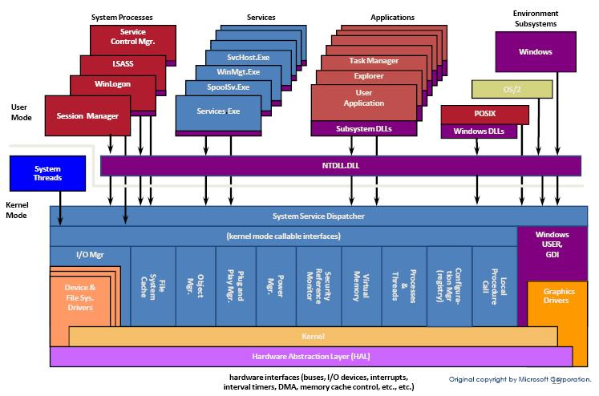
NT KERNEL

Slide 4
FEATURES OF REACTOS
Compatible
Secure
Light weight

Slide 5
REACTOS SUBSYSTEMS
The Executive
HAL
Device drivers
Communication
Kernel
System services
Protected subsystem

Slide 6
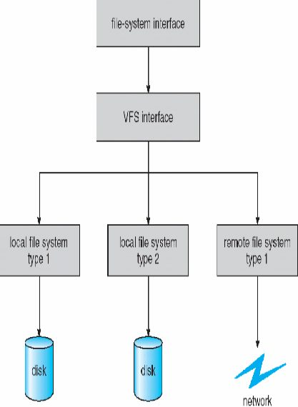
VIRTUAL FILESYSTEM

Slide 7
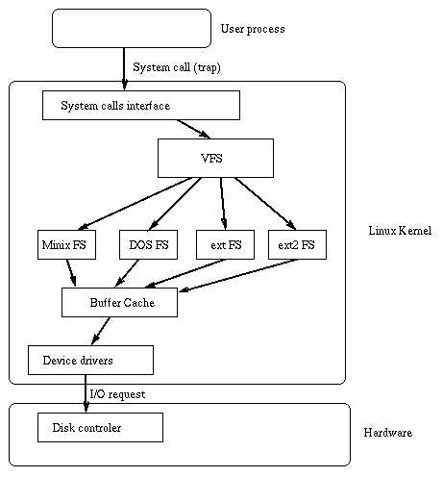

Slide 8
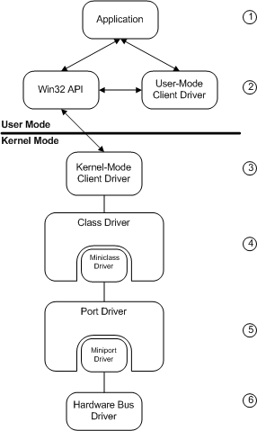
LAYERED ARCHITECTURE IN REACTOS

Slide 9
HOW IS IT PORTED

Slide 10
FUTURE ENHANCEMENTS
Heavy testing
Porting more file system
Change in the kernel?

Slide 11
REFERENCES
ReactOS source code.
Http://www.reactos.org/deoxygen/
NT Kernel Internels.

