Slide 1
Driver Drowsiness Detection

Slide 2
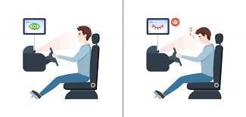
Introduction
Drowsy Driving is a deadly combination of driving and sleepiness. The number of road accidents due to Drowsy Driving is increasing at an alarming rate worldwide.
Not having a proper sleep, sleep disorders, medication, alcohol consumption, or driving during night shifts are some of the reasons drowsiness while driving.
So,we developed a driver drowsiness detection system that uses real-time video feeds to accurately detect driver drowsiness or fatigue by alerting
the driver and notify the loved ones through email.

Slide 3
Methodology
It involves the following:
Data Collection & Pre-processing
Model development & Training
Realtime detection

Slide 4
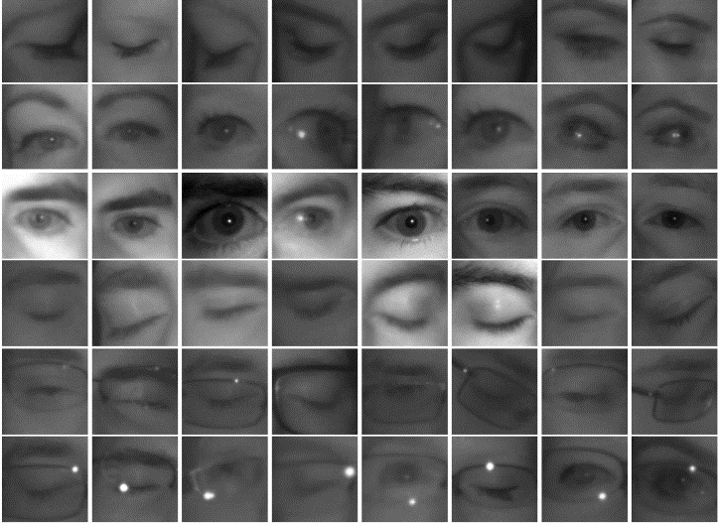
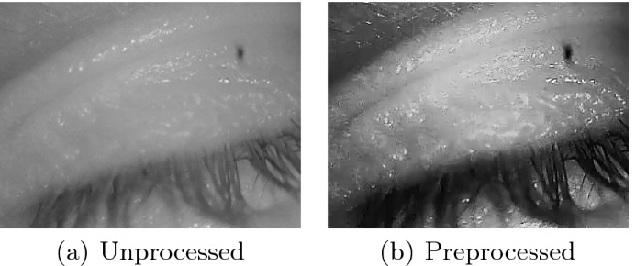
Data Collection & Pre-processing
The dataset comprises of images representing both drowsy and awake states as open eyes and close eyes, dataset is diverse and accurately reflects the target scenarios.
Preprocessing is done to enhance image quality and extract relevant features using techniques such as resizing, normalization, and grayscale conversion. Also it ensures that the input data is in a suitable format for training the model.

Slide 5
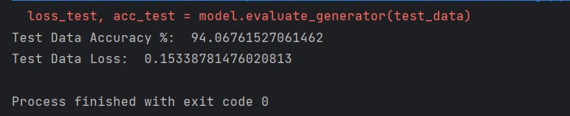
Model development & Training
The drowsiness detection model is built using Keras, a high-level deep learning library that operates on top of TensorFlow. Convolutional neural networks (CNNs) are employed to extract meaningful features from the input images.(for example: we used Inception V3 CNN )
The dataset is divided into training and testing sets and the model is trained on the training set, optimizing its parameters to minimize the loss function. The model's performance is evaluated using the testing set.

Slide 6
.
Realtime detection
The pre-trained model that we have created is used to detect drowsiness in real-time using a webcam along with OpenCV, a widely-used computer vision library is employed for video frame capture and processing.
We have used haar cascade classifier to detect frontal face and eyes of a person.
Once the drowsiness is detected an alarm alerts the driver and an email notification is sent to concerned people(usually realtives or loved ones).

Slide 7
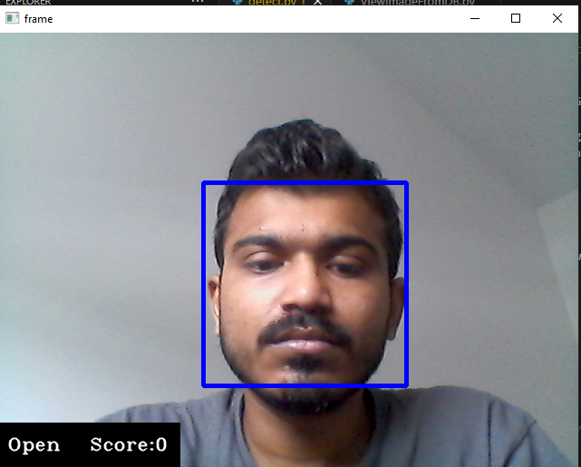
Results: Face Detection
Model h5 is used to predict the driver drowsiness
Code to predict the drowsiness, send notification to concerned person and store the data in MongoDB is in detect.py
First starts video capturing and converts frames to gray scale

Slide 8
Results: Eye Detection
eye = frame[y:y + h, x:x + w] # Region of interest in frame
eye = cv2.resize(eye, (80, 80)) # Resizing to fixed size
eye = eye / 255 # Normalizing pixel values [0, 1]
eye = eye.reshape(80, 80, 3) # image reshaped to a 3D array
eye = np.expand_dims(eye, axis=0) #Expanded by adding batch size

Slide 9
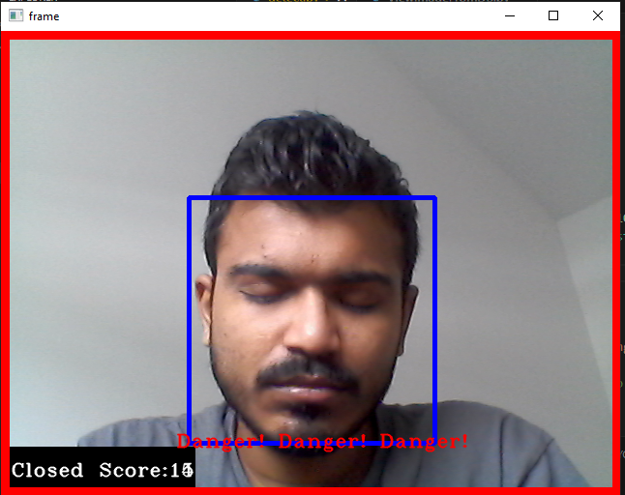
Results: Drowsiness Prediction
If eyes are closed more than 70 percent the score increases if score is more than 10 alerts driver plays alarm
If the person opens eye and if score is less than 10 then it comes to normal

Slide 10
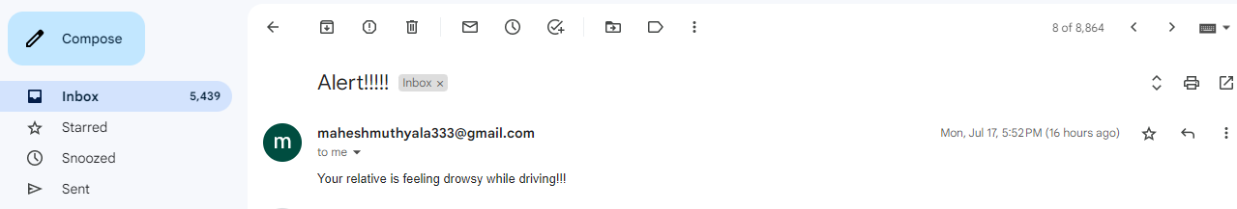
Results: Sends Email
SMTP (Simple Mail Transfer Protocol) object is created

Slide 11
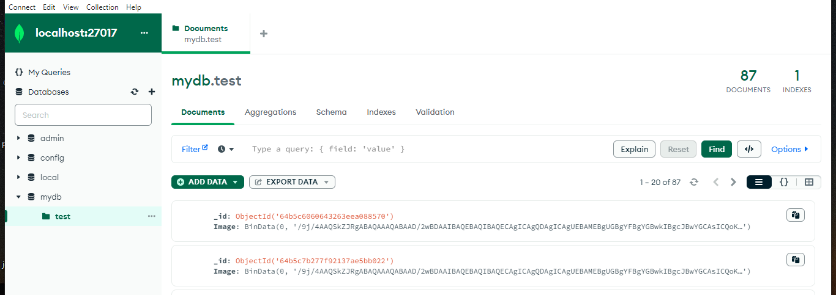
Results: Inserts in MongoDB
Uses MongoDB
Inserts image in binary format

Slide 12
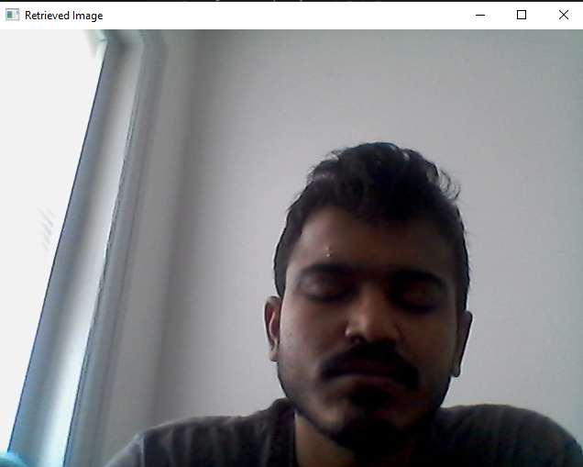
Results: Retreving image from MongoDB
This is a sample image stored in MongoDB
Image array (binary image data) and convert it into a 3-dimensional Numpy array
The image is read in color

Slide 13
Discussion
The accuracy of the drowsiness detection model may rely on the quality of the video feed.
The model trained gives 94 percent accuracy
Only Email notification is sent
Used MongoDB local host

Slide 14
Contributions
Muthyala Mahesh (16337397): Final Image Detection, MongoDB connection and storing image and PPT preparation
Preetam Reddy Patelu (16341736): Model training and Email notification and Project report preparation
Chandrashekar Oguri (16336589): Data collection, preparation, model training and project report.

Slide 15
THANK YOU

