Slide 1
Analysis of Imputation Methods on
Datasets
Challengers:
Amarnadh Peapalla
Muthyala Mahesh
Tata Rajesh
Nellutla Alekya

Slide 2
What to do when we have empty entries?
Delete the rows with empty entries
Fill the values manually
Fill the values with existing functions or create a new function

Slide 3

How to fill the missing/empty values in the numeric dataset
Do we have any existing methods?
What are they?
Which one is the best among them?

Slide 4
Data sets
4 DATA SETS
UCI Machine Learning Repository 961 instances and 6 attributes
Data World Repository cancerdatahp/lung-cancer-data 1000 instances and 26 attributes. (no missing values)
Kaggle Rice type Classification (Gonen & Jasmine) 18185 entries 12 attributes (no missing values)
Kaggle Paris Housing Price Prediction 10000 instances 17 attributes

Slide 5
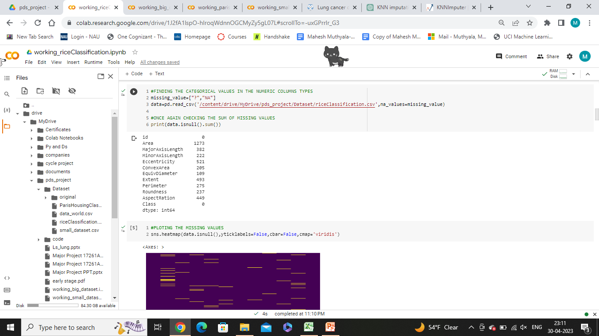
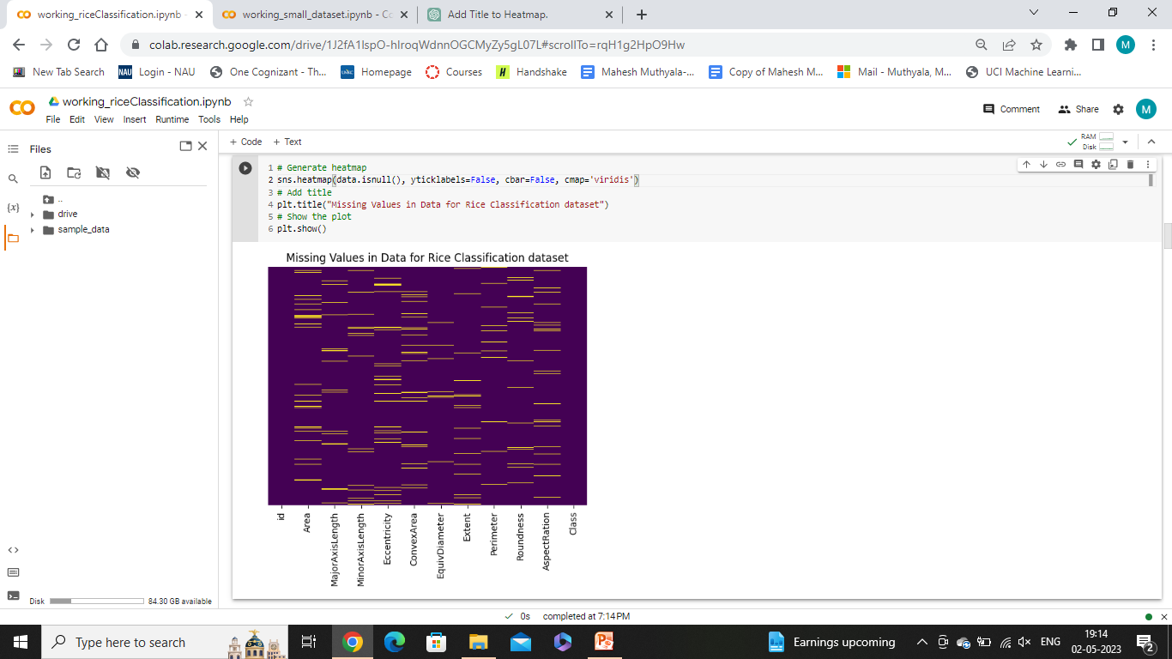
Checking empty values

Slide 6
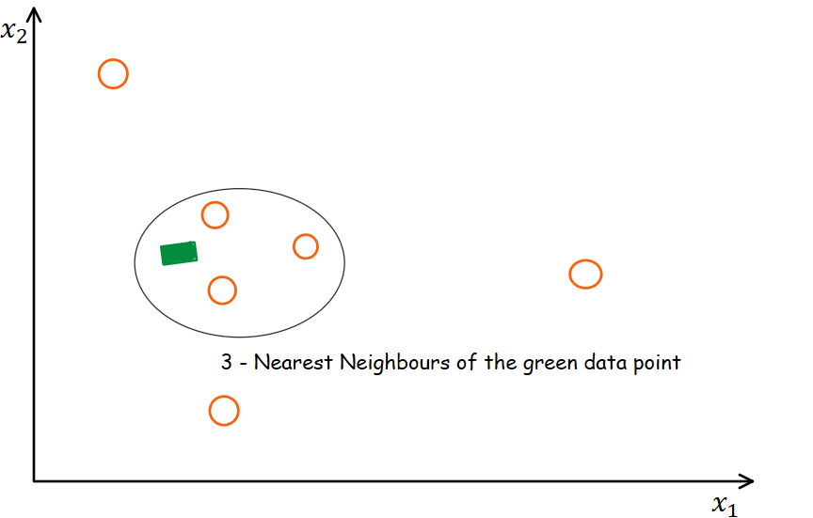
Imputation Methods
Statistical Methods
Mean, Median, Most_frequent (Mode)
KNN Imputation Method
KNN Imputation (KNNImputer(n_neighbors=10))

Slide 7
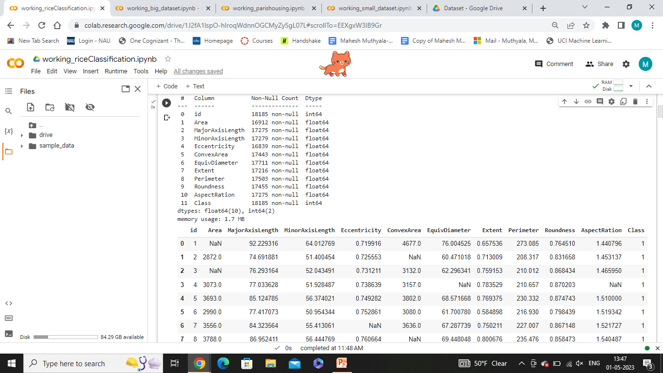
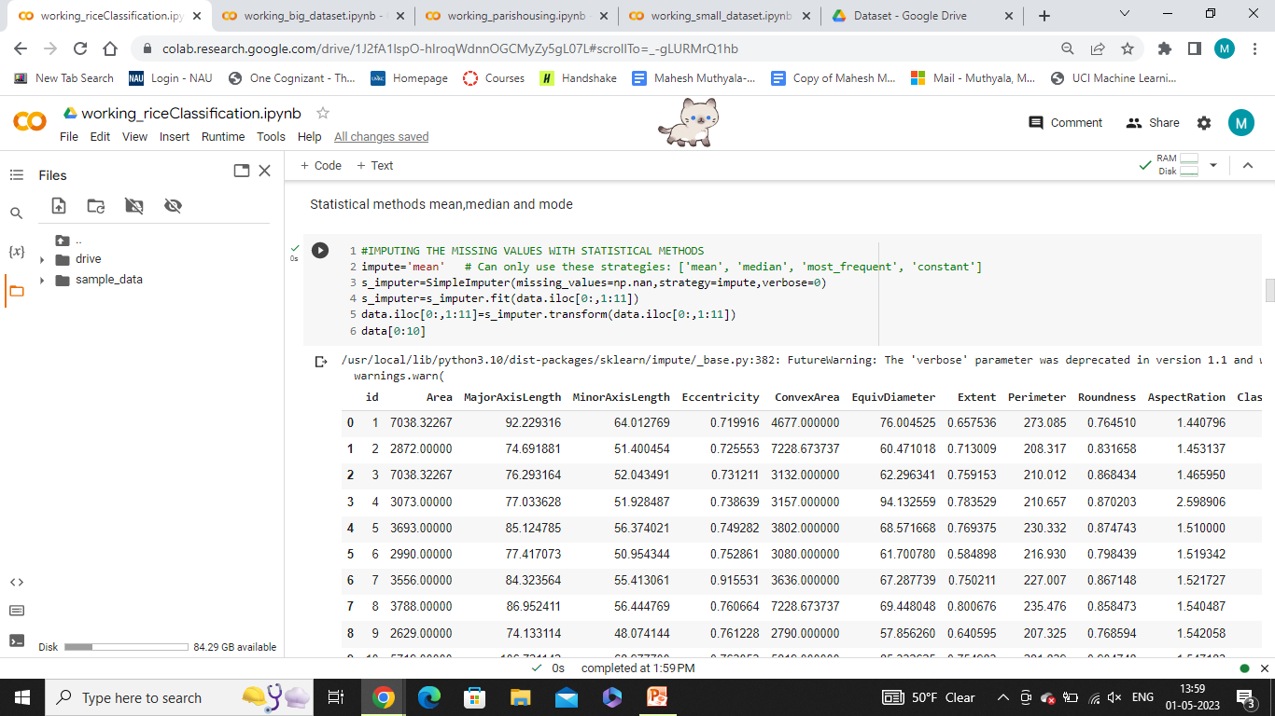
Imputation Methods
Statistical Methods DATA SETS
impute='mean' # Can only use these strategies: ['mean', 'median', 'most_frequent']
s_imputer=SimpleImputer(missing_values=np.nan,strategy=impute,verbose=0)
Original Dataset
Mean Imputation

Slide 8
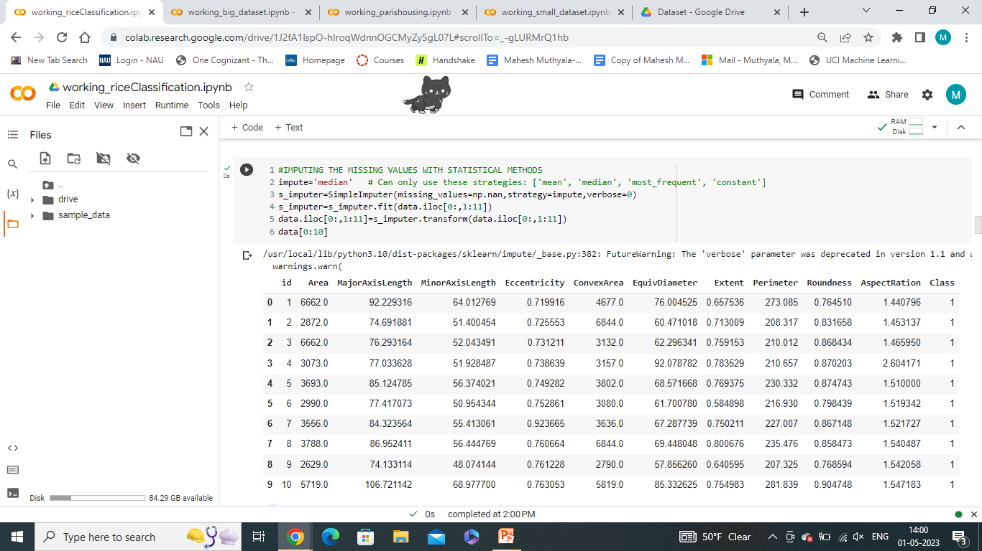
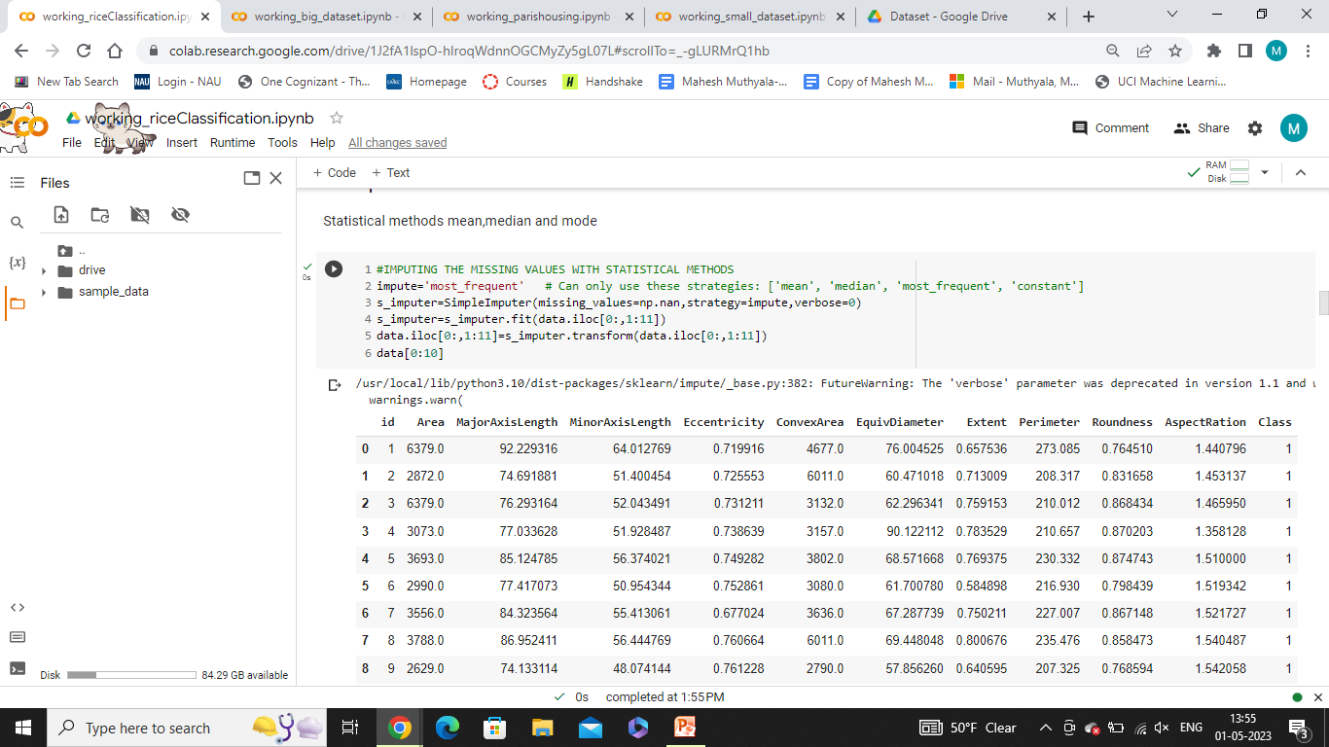
Imputation Of Column ‘Area’ in Rice Classification Dataset
Median Imputation
Original Dataset
Mode Imputation

Slide 9
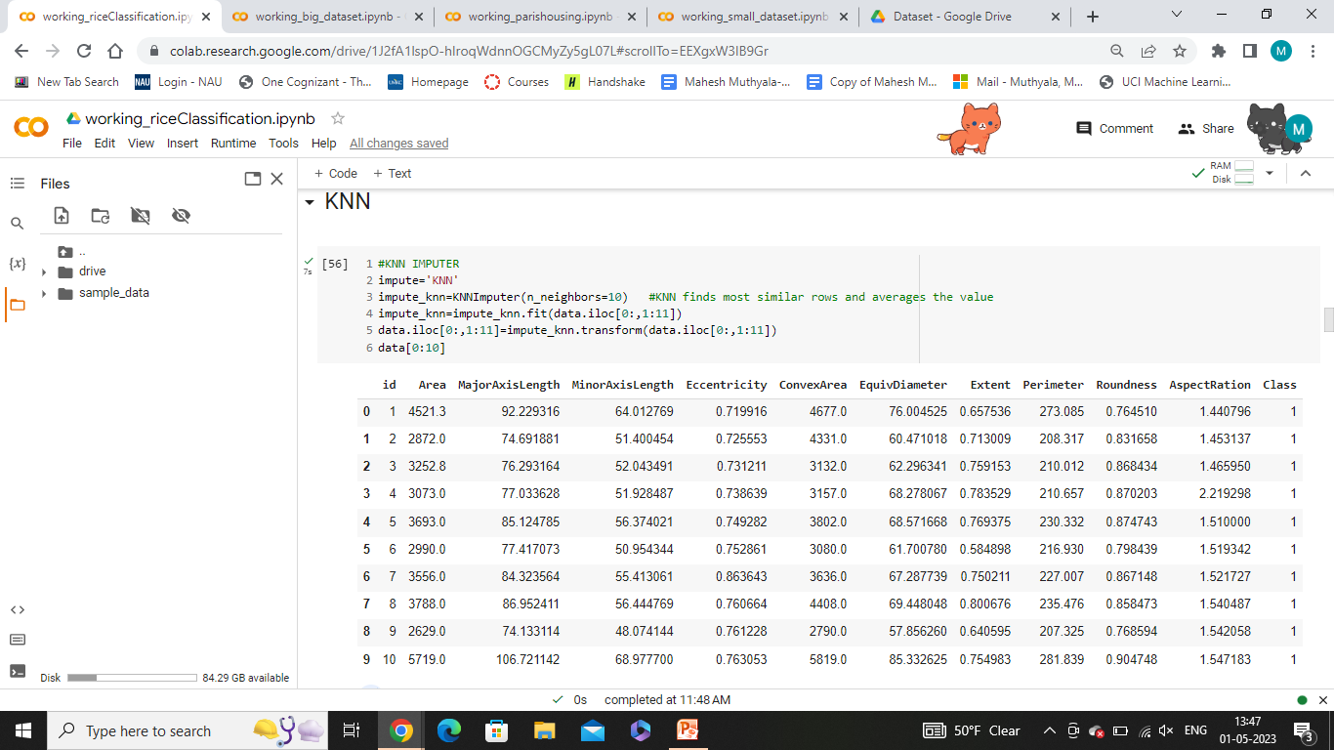
Imputation Of Column ‘Area’ in Rice Classification Dataset
Original Dataset
KNN Imputation Method
impute_knn=KNNImputer(n_neighbors=10)
Identifies the missing values in the dataset.
Calculates the distance between each pair of instances (Euclidean distance)
Algorithm identifies the K-nearest neighbors to each missing value calculates average of the nearest instances
KNN Imputation

Slide 10
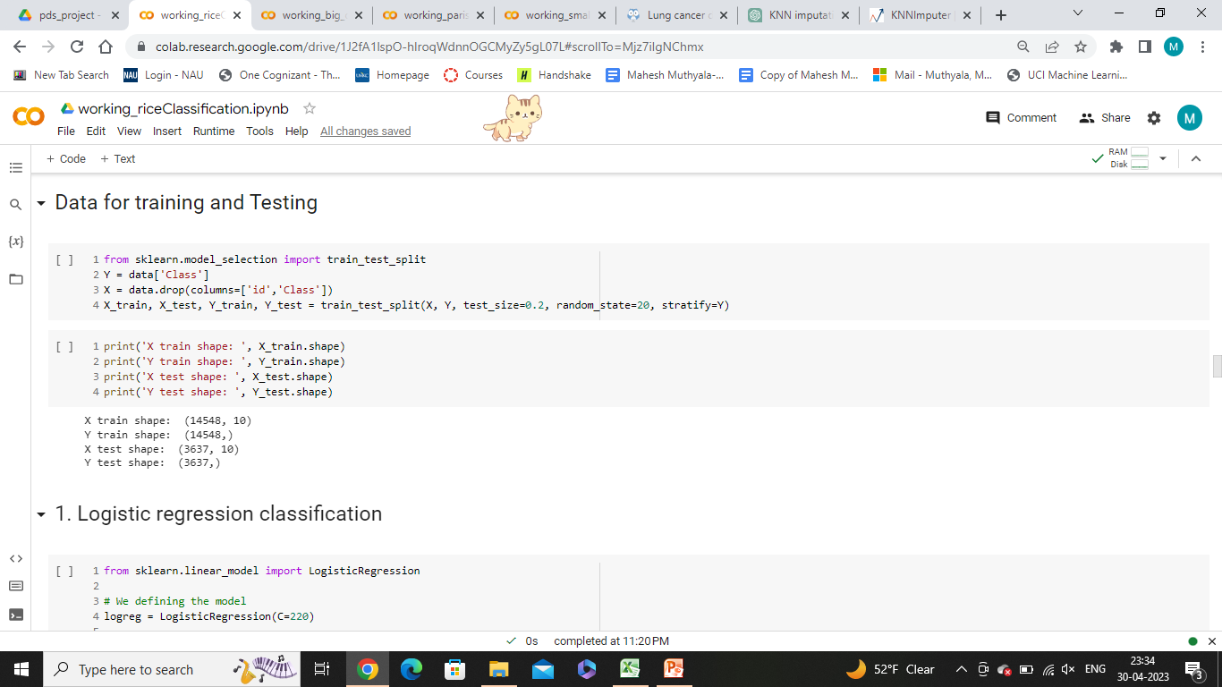
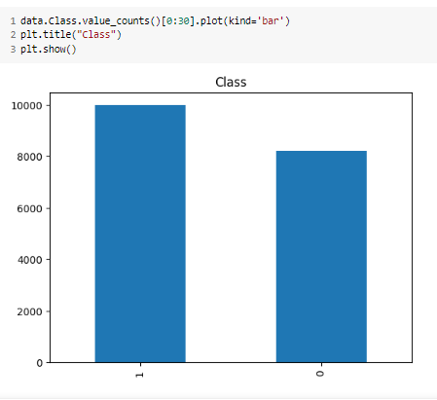
Splitting the dataset
Splitting dataset into 80:20 ratio and random state is fixed to 20.
Making sure ‘Class’ is divided equally into train and test using ‘stratify=y”.

Slide 11
Machine learning Algorithms
Machine Learning algorithms are used train and test the data after imputation and their accuracies are noted.
4 Machine Learning algorithms are used.
Logistic Regression
Support vector machine
Naive Bayes Classification
Decision tree classification

Slide 12
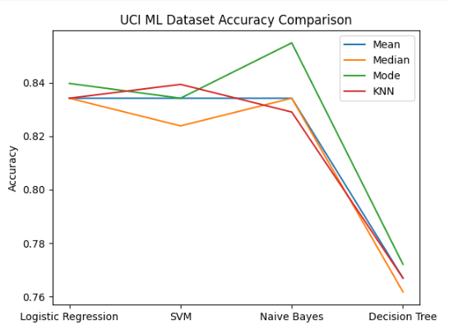
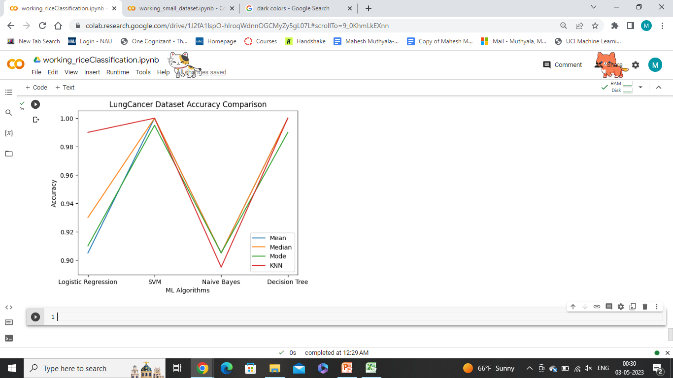
Dataset 1: UCI Machine Learning Repository
Notes:
Mode is good

Slide 13
Dataset 2: Data World Repository Lung Cancer dataset
Notes:
KNN is good

Slide 14
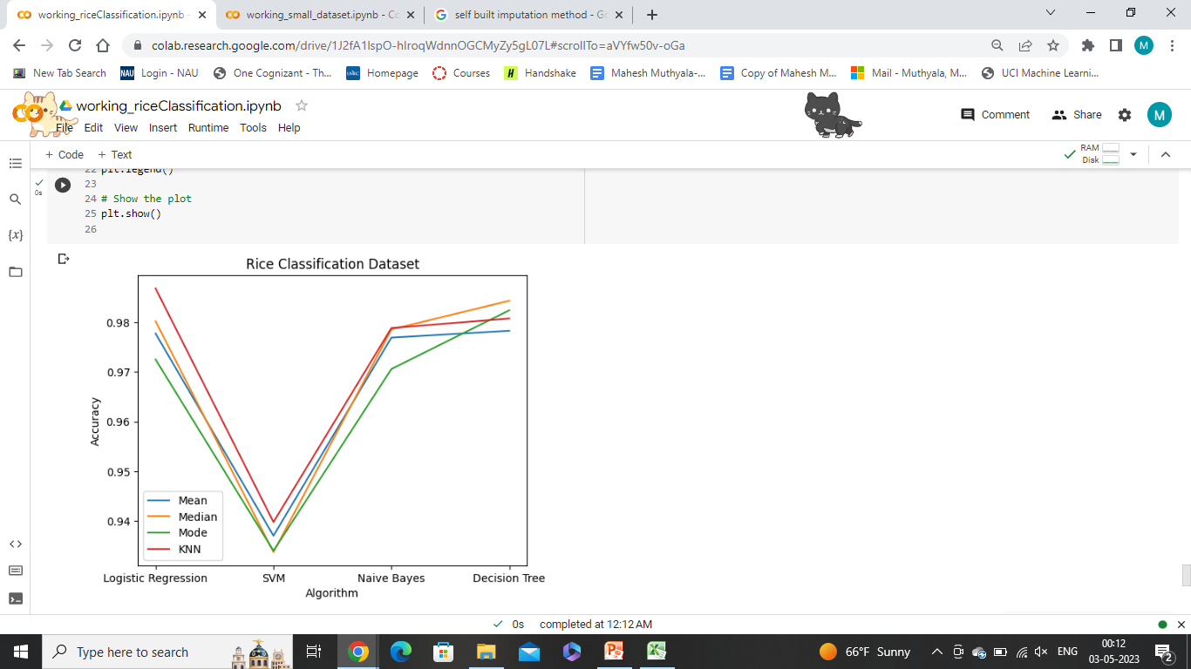
Dataset 3: Kaggle Rice Classification
Notes:
KNN is good, Mode is bad

Slide 15
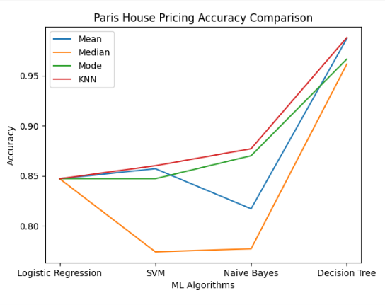
Dataset 4: Kaggle Paris House pricing
Notes:
KNN is good, mode is bad

Slide 16
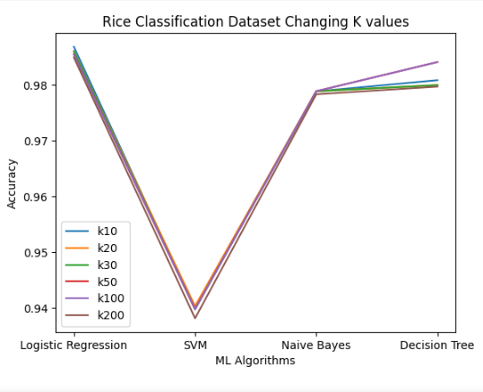
KNN Imputation value Rice Classification dataset
Notes:
We changes the KNN neighbors values but no use

Slide 17
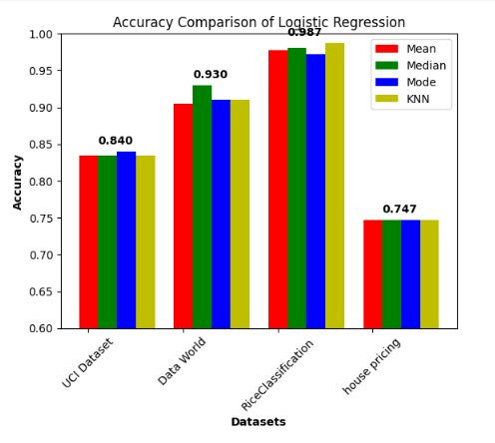
comparison of imputation methods algorithm specific
Notes:
Algorithm specific: Median

Slide 18
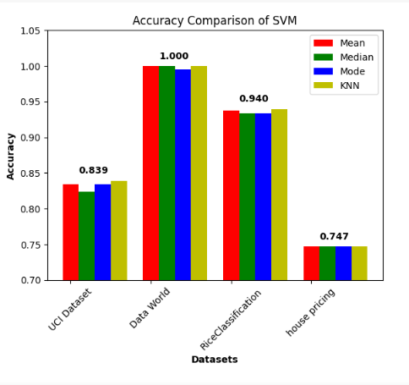
Notes:
Mean and KNN are good

Slide 19
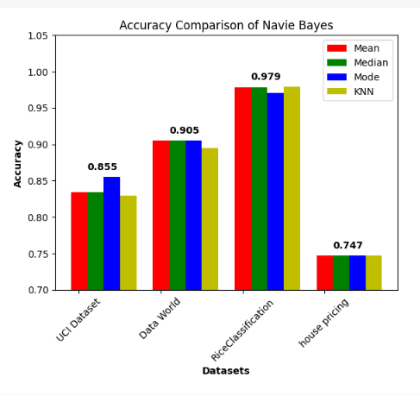
Notes:
Mean Median

Slide 20
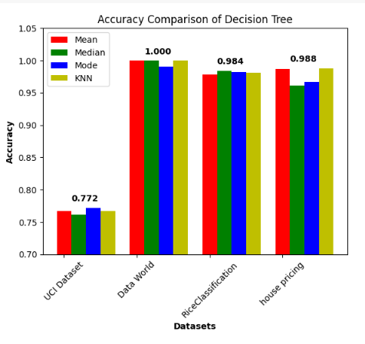
Notes:
Mean KNN

Slide 21
CONCLUSION
KNN and Mean are good for imputation
Decision Tree Working Good
Handles non-linear data effectively. It does not require normalization of data.

