Slide 1
Analysis of Imputation Methods
Challengers:
Peapalla Amarnadh
Muthyala Mahesh
Tata Rajesh
Nellutla Alekya

Slide 2
What to do when we have empty entries?
Delete the rows with empty entries
Fill the values manually
Fill the values with existing functions or create a new function

Slide 3

How to fill the missing/empty values in the numeric dataset
Do we have any existing methods?
What are they?
Which one is the best among them?

Slide 4
Data sets
4 DATA SETS
UCI Machine Learning Repository 961 instances and 6 attributes.
Data World Repository cancerdatahp/lung-cancer-data 1000 instances and 26 attributes.
Kaggle Rice type Classification (Gonen & Jasmine) 18185 entries 12 attributes.
Kaggle Paris Housing Price Prediction 10000 instances 17 attributes.

Slide 5
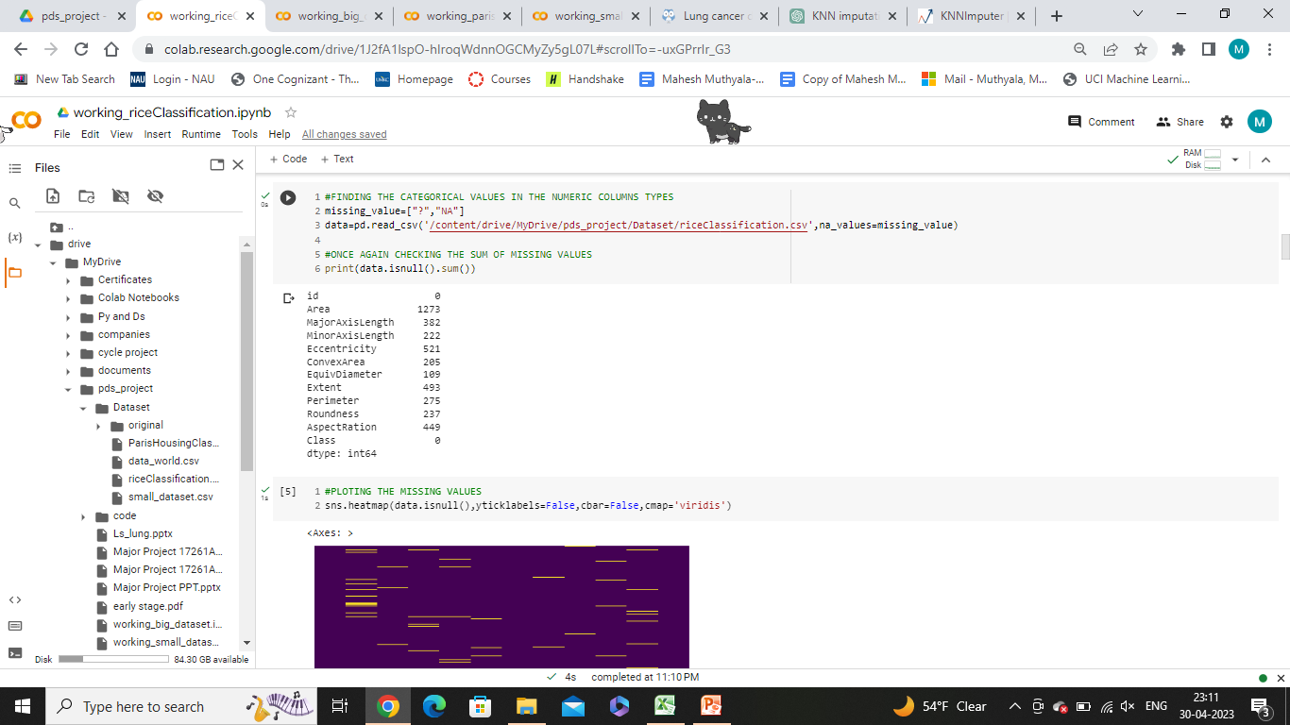
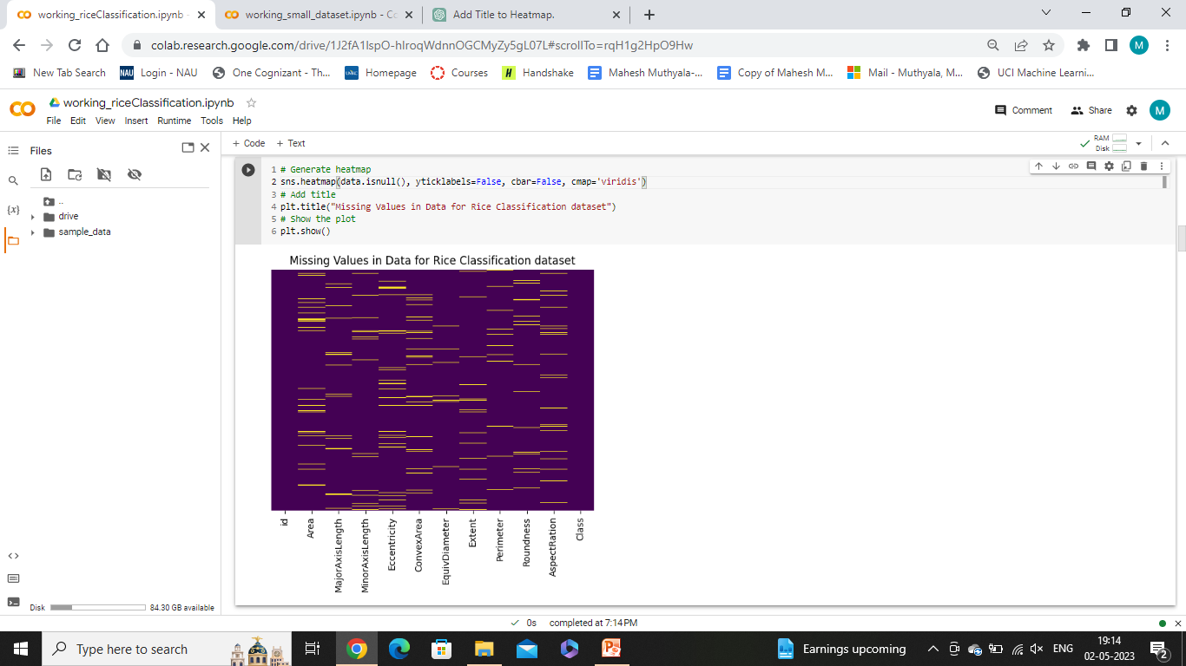
Checking empty values

Slide 6
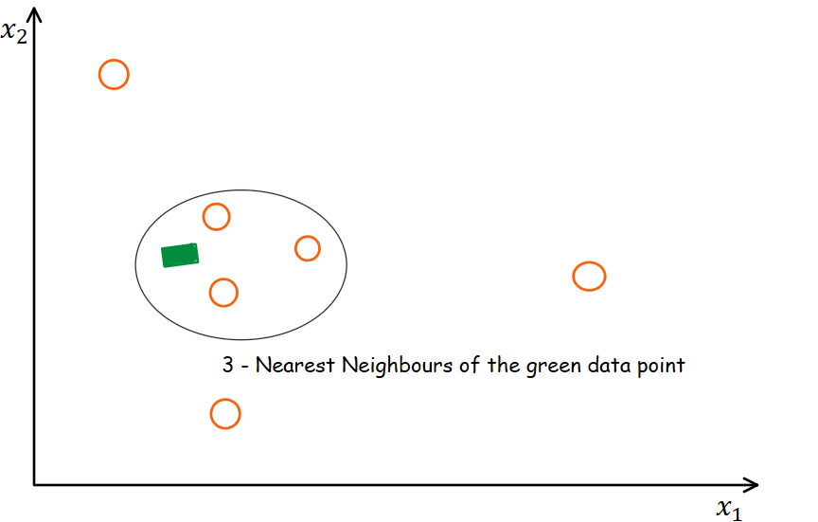
Imputation Methods
Statistical Methods
Mean, Median, Most_frequent (Mode)
KNN Imputation Method
KNN Imputation (KNNImputer(n_neighbors=10))

Slide 7
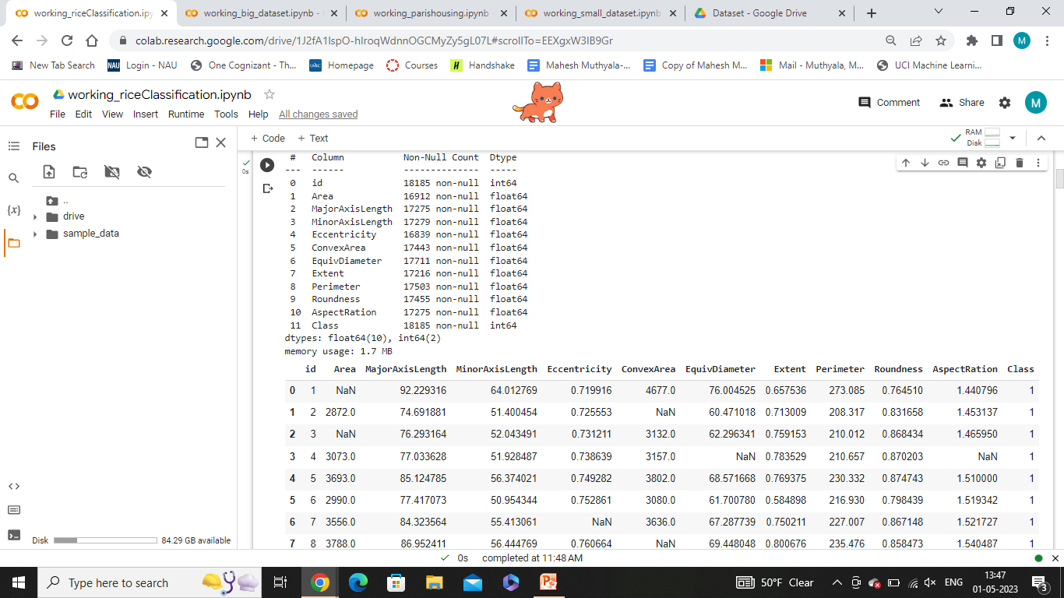
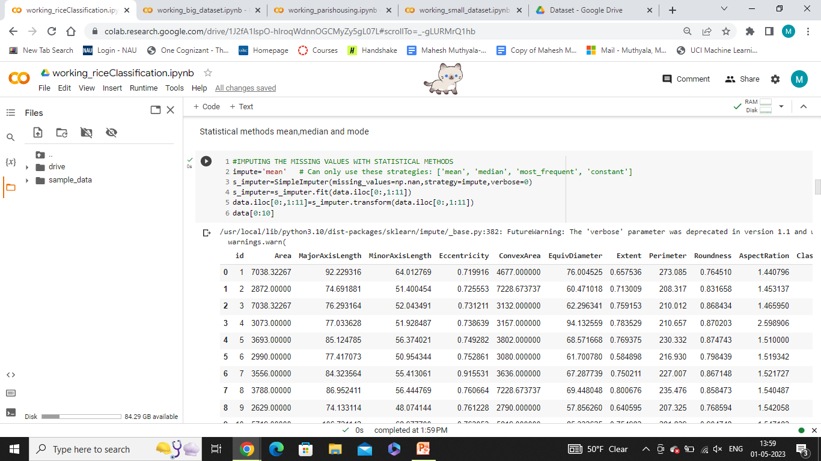
Imputation Methods
Statistical Methods
impute='mean' #Can use these strategies['mean', 'median', 'most_frequent']
s_imputer=SimpleImputer(missing_values=np.nan,strategy=impute)
Original Dataset
Mean Imputation

Slide 8
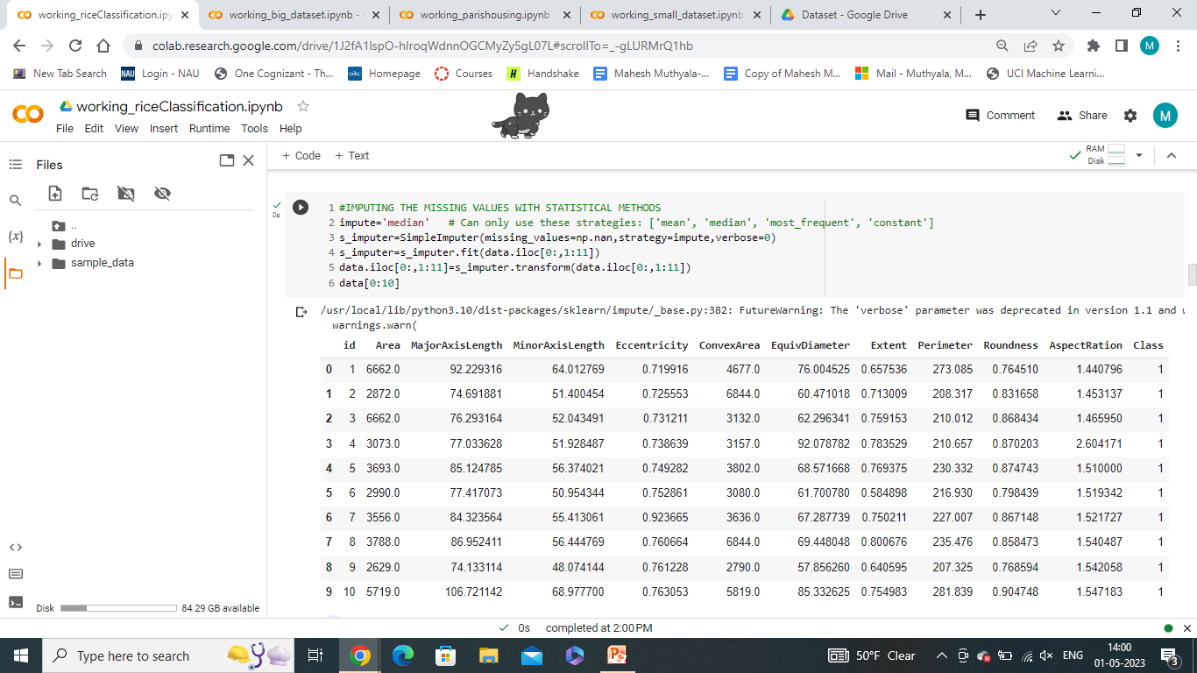
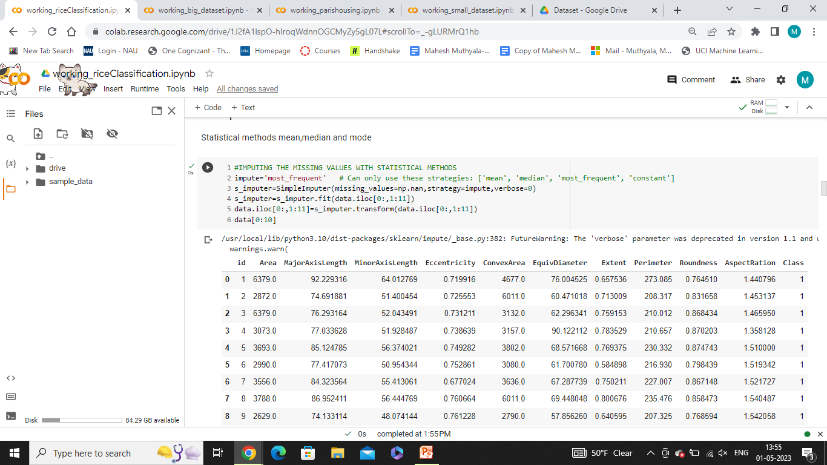
Imputation Of Column ‘Area’ in Rice Classification Dataset
Median Imputation
Original Dataset
Mode Imputation

Slide 9
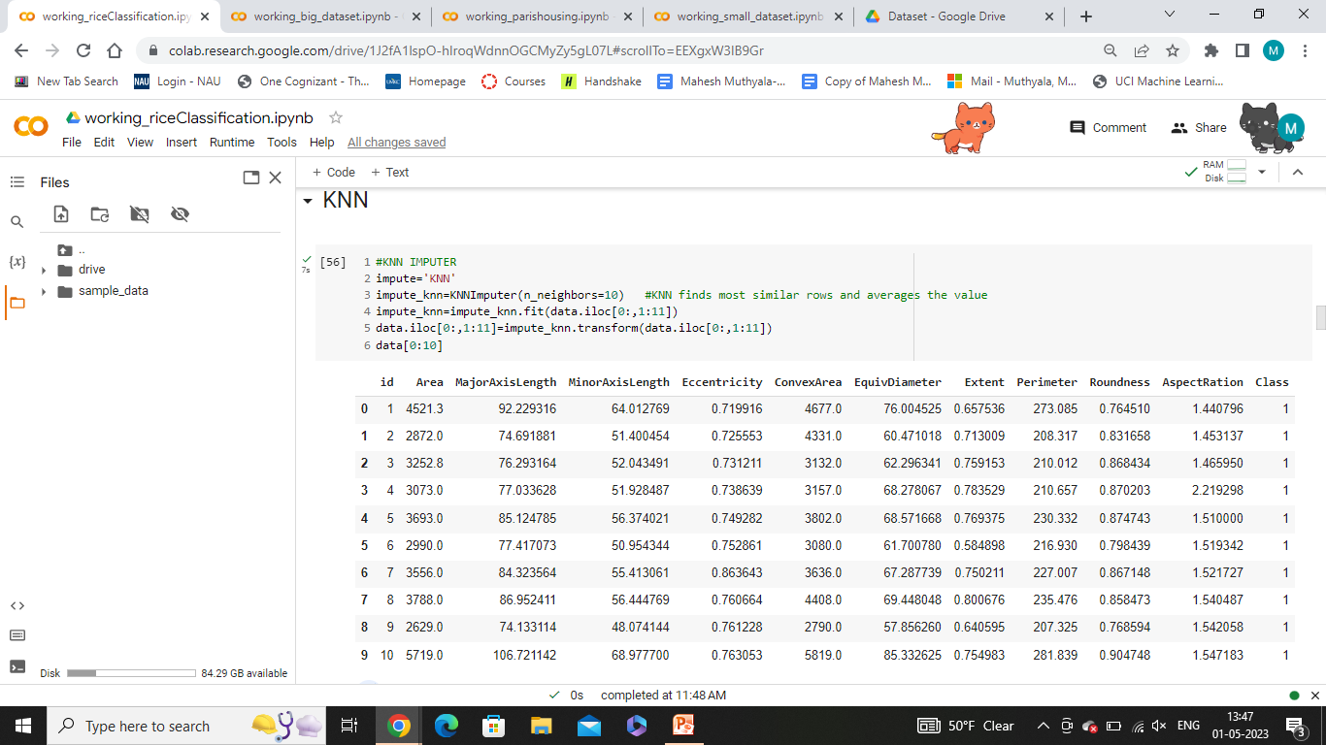
Imputation Of Column ‘Area’ in Rice Classification Dataset
Original Dataset
KNN Imputation Method
impute_knn=KNNImputer(n_neighbors=10)
Identifies the missing values in the dataset and creates a separate dataset that contains only the complete cases
Calculates the distance between each pair of instances (Euclidean distance)
Algorithm identifies the K-nearest neighbors to each missing value, calculates average of the nearest instances.
KNN Imputation

Slide 10
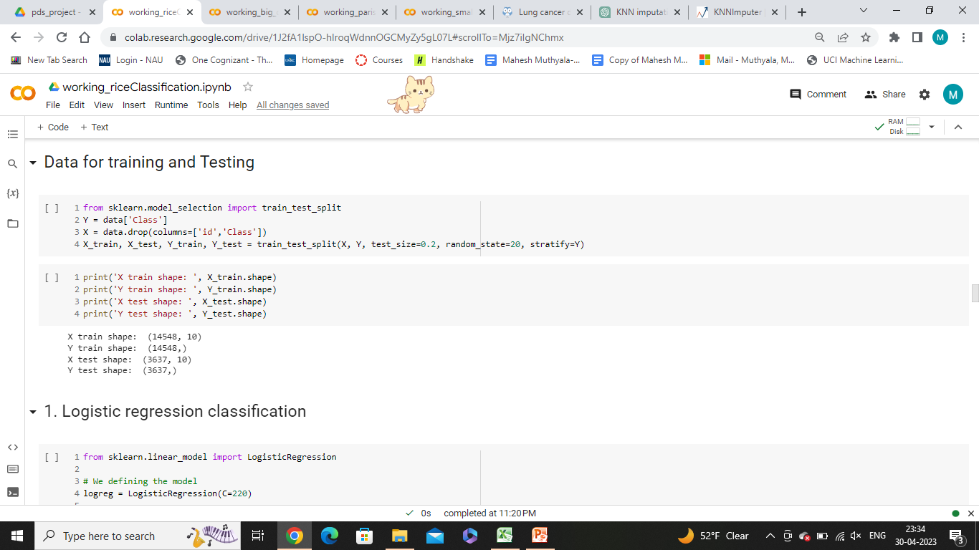
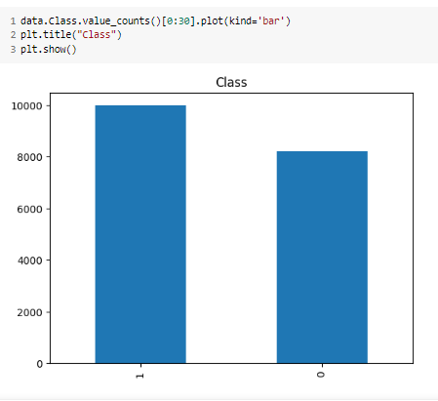
Splitting the dataset
Splitting dataset into 80:20 ratio and random state is fixed to 20.
Making sure ‘Class’ is divided equally into train and test using ‘stratify=y”.

Slide 11
Machine learning Algorithms
Machine Learning algorithms are used train and test the data after imputation and their accuracies are noted.
4 Machine Learning algorithms are used.
Logistic Regression
Support vector machine
Naive Bayes Classification
Decision tree classification

Slide 12
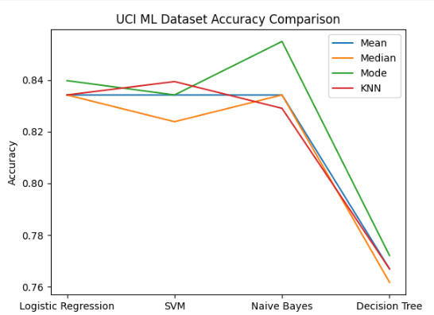
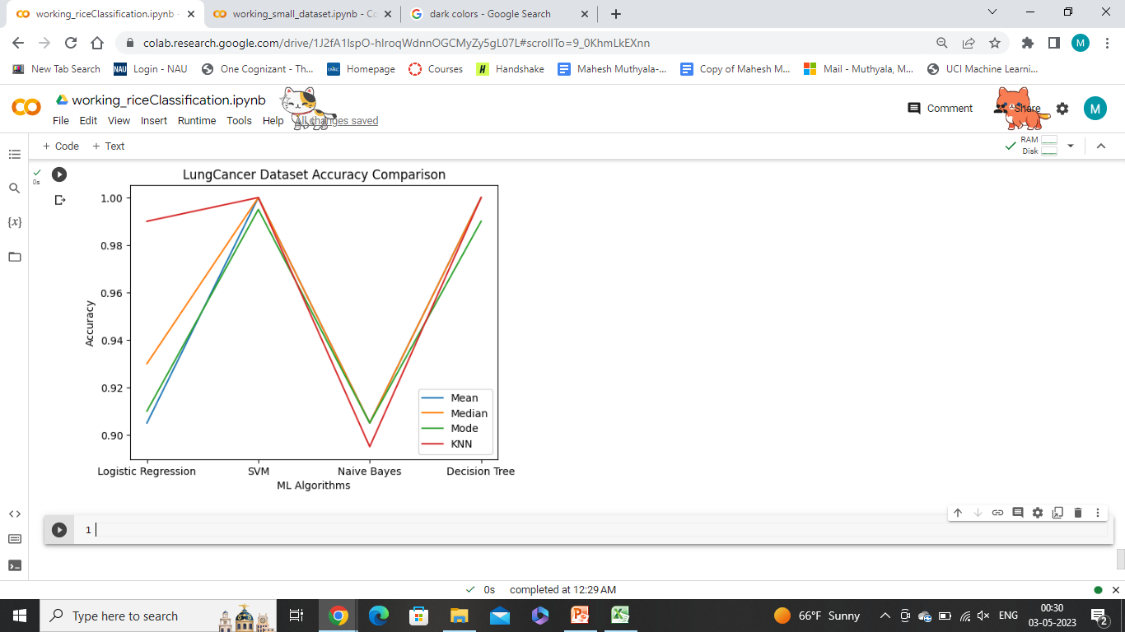
Dataset 1: UCI Machine Learning Repository
Notes:
Mode is good, median is bad

Slide 13
Dataset 2: Data World Repository Lung Cancer dataset
Notes:
KNN is good, mode is bad

Slide 14
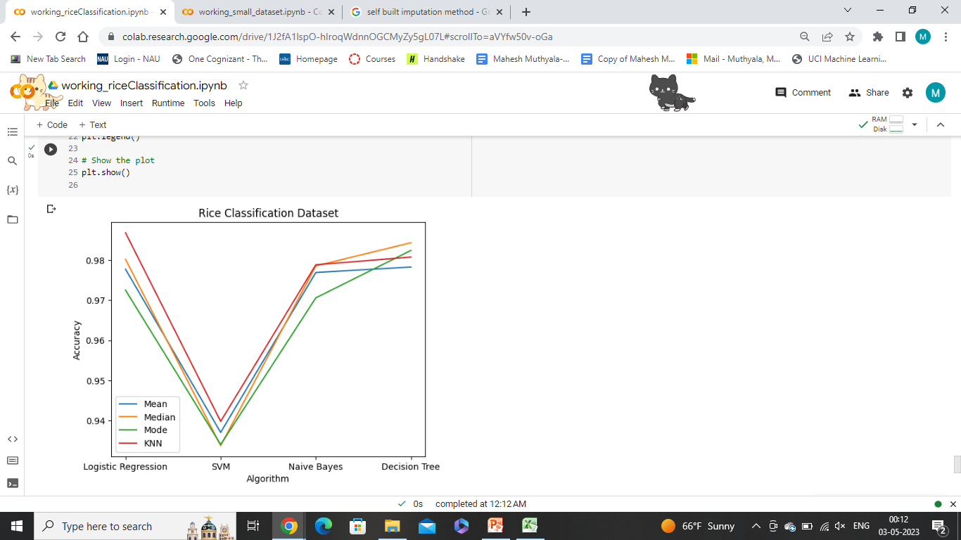
Dataset 3: Kaggle Rice Classification
Notes:
KNN is good, Mode is bad

Slide 15
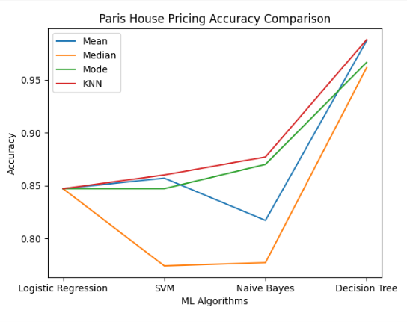
Dataset 4: Kaggle Paris House pricing
Notes:
KNN is good, mode is bad

Slide 16
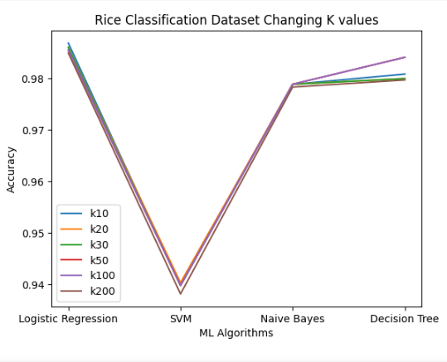
KNN Imputation value
Notes:
We changes the KNN neighbors values but no use

Slide 17
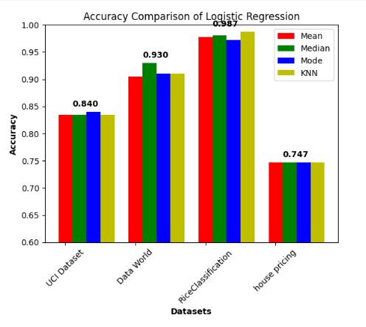
comparison of imputation methods algorithm specific
Notes:
Algorithm specific: Median

Slide 18
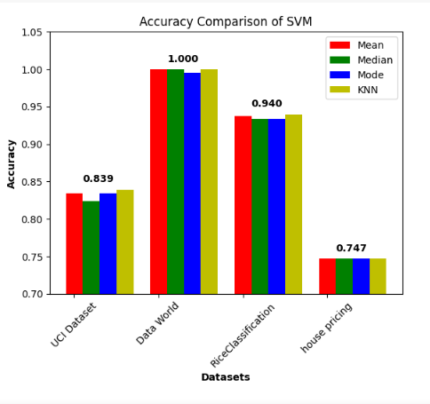
Notes:
Mean and KNN are good

Slide 19
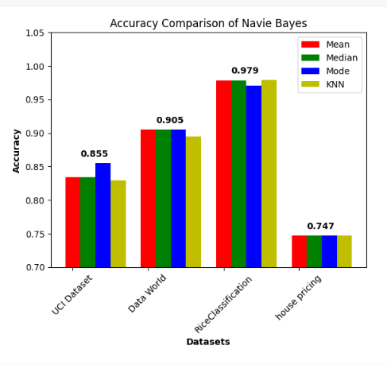
Notes:
Mean

Slide 20
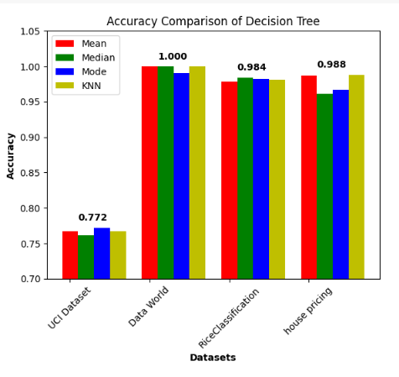
Notes:
Mean KNN

Slide 21
CONCLUSION
To conclude, the different strategies for dealing with missing data make it possible to limit the impact of the absence of information. They provide most needed help to the use of the data set and thus the quality of the analysis.
KNN and Mean are good for imputation
Decision Tree Working Good
Handles non-linear data effectively. It does not require normalization of data.
- Thank you

