Slide 1
Deep Learning- Theory and Practices Project Interpolation between Residual and Non-Residual Networks
Team 5
Maheswara Rao(2018101107)
Sandeep(2018101032)
Tharun(2018101045)
Koushik(2018101102)

Slide 2
Abstract
In this paper, we are going to present a novel ODE model by adding a damping term.
This proposed model also recover both a Resnet and CNN ( Non-Residual CNN’s) by just adjusting the interpolation coefficient.
This provides a unified framework for the interpretation of both residual and Non-Residual networks.

Slide 3
By analysis using Lyapunov analysis it reveals better stability of the proposed model and thus yields robustness improvement on the learned model
Experiments on the number of image classification benchmarks show that the proposed model substantially improves the accuracy of ResNet and ResNext over the perturbed inputs from both stochastic and adversarial attack methods.
The loss landscape analysis demonstrated the improved robustness of our method along the attack direction.

Slide 4
Introduction
In this paper we present a new ordinary differential equation that interpolates non residual and residual CNN’s.
Here the ODE is controlled by an interpolation parameter λ which ranges from 0 to infinity
It is equivalent to Residual Network if λ is zero.
On the contrary the ODE model amounts to Non-Residual network when λ approaches infinity.

Slide 5
Compared with Non-Residual networks our ODE is much easier to optimize, especially for deep architectures.
Compared with Residual networks we use Lyapunov analysis to show that the interpolation results in improved robustness.

Slide 6
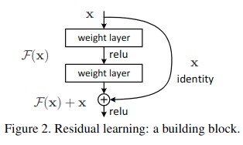
Residual learning
The core idea of ResNet is “identity shortcut connection” that skips one or more layers, as shown in figure

Slide 7
Methodology
In the next slides we discuss about following topics:-
The background of relationship between ODE and ResNets.
The proposed ODE model.
Interpolated Network Design
Interpolated Network Improves Robustness

Slide 8


Background
Considering the ordinary differential equation:
where x : [0, T ] → R^{d} represents the state of the system. Given the discretization step ∆t
and define t_{n} = n ∆t , then by forward Euler method of Eq. (1) becomes :

Slide 9

Here, f_{n} is the n-th layer operation in ResNets. Thus, the output of network is equivalent to the evolution of the state variable at terminal time T , i.e. x(T ) = x _{N} is the output of last layer in a ResNet if assuming N = T /∆t.
From Eq. (1), the skip connection from the current step x _{n} to the next
step estimation x _{n+1} always exists no matter which kind of discretization
is applied.

Slide 10


The Proposed ODE Model
Based on the ODE formulation , we add a damping term to the above model and leads to the following model:
Proposition:-The solution of the ODE(4) for any T>0 is:
(5)

Slide 11


Proof:-
By multiplying the eq(4) both sides by e ^{λt} and by taking differentiation on both sides, it become:
Now by Integrating within [0, T ] on both sides it become:
Now by adding both sides with x(0) and multiplying both sides with e^{-λt} it become
Hence, proved it.

Slide 12



Now by using the above result the iterative formula now by taking t:[t_{n},t_{n+1}]
Let assume f(x(t),t)=f(x_{n}, t_{n}) ∀ t∈[tn,tn+1),the above eq reduces to:-
Here fn(xn)=f(x(tn),tn) is the convolutions in n-th layer. Now by using above eqn and by taking appropriate weight function ρ(λ). When the weight function ρ(λ) satisfies
ρ(λ) → 1, λ → 0 + and ρ(λ) ∼ λ, λ → +∞
The above eqn recovers ResNets when the interpolation parameter λ approaches 0 and the non-residual CNNs when it approaches +∞.

Slide 13

Interpolated Network Design
Based on the unified ODE model shown above, two types of ρ(λ) are chosen and the corresponding network architectures are proposed.
Considering the case when λ is small, we choose ρ(λ) = 1 and substitute the damping factor e −λ∆t by its first order approximation:
The iterative formula derived above is

Slide 14
Now substituting the first order approximation in the above equation we get
To guarantee the positiveness of λ, we add the ReLU function to the interpolation parameter λ and absorb the ∆t into it. Thus the n-th layer of the network is
The second choice of the weight function is ρ(λ) = λ +1.
Substituting the same approximation iterative equation , the output of the nth layer becomes

Slide 15
Similar as the first choice, the second interpolated network is given by
It is easy to know that the two interpolated networks derived above recover a non-residual CNN if λn = 1 and a Residual network if λn = 0

Slide 16
Interpolated Network Improves Robustness
In this section, we show the improvment of the proposed interpolated networks over ResNets.
The added damping term in our model weakens the amplitude of the solution of the original ODE.
As a result, adding a damping term to the ODE model damps the error propagation process of ResNet, which improves model robustness.
In the following context, we show that robustness improvement of our proposed networks by using the stability analysis of the ODE.

Slide 17
Definition: Let x* be an equilibrium point of the ODE model . Then x* is called asymptotically locally stable if there exists δ > 0 such that limt→+∞ ||xt − x *|| = 0 for all starting points x0 within
||x0 − x|| ≤ δ.
Therefore, the perturbation around equilibrium x* does not change the output the network if x* is asymptotically locally stable.
The next proposition Lyapunov's proposition presents a classical method that checks the stability of nonlinear system around the equilibrium when f is time invariant.
Proposition : The equilibrium x* of the ODE model ( dx/dt = f(x(t)) is asymptotically locally stable if and only if Re(ν) < 0 where ν is the eigenvalue of ∂xf(x* ) which is the Jacobi matrix of f at x* .

Slide 18

Considering the damped ODE
The Jacobi matrix at the equilibrium x* is
Then, the eigenvalues νˆ of Jλ(x* ) are ρ(λ)ν − λ ,where ν is the eigenvalue of ∂xf(x* ).
When ρ(λ) = 1, we get

Slide 19
By choosing positive λ properly, we know the ODE in Eq is asymptotically locally stable at x* .
The above analysis shows that the stationary point of our proposed damped ODE model is more likely to be locally stable, and thus improve the its robustness when the input has be perturbed.

Slide 20
Architecture and Experiments

Slide 21
Models
110 Layer Networks
ResNet-110
In-ResNet-110
Lambda-In-ResNet-110
164 Layer Networks
ResNet-164
In-ResNet-164
Lambda-In-Resnet-164
Resnext Models
ResNext-29, 8 × 64d
In-ResNext-29,8*64d
Lambda-In-ResNext-29,8*64d

Slide 22
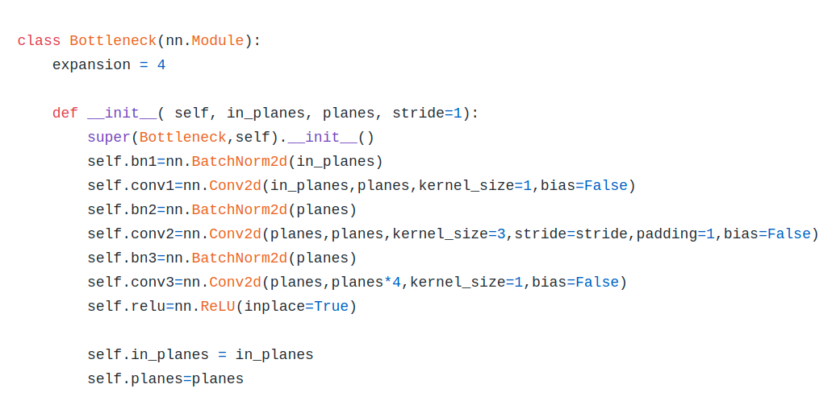
Bottleneck-3 conv2d layers Basic block –2-conv2d layers

Slide 23
Resnet-110
-Image-3*32*32
Conv2d-Kernel size-3*3,padding-1,Filters-16
Outputshape-16*32*32,layers-1 –till here
-18 basic block layers of Conv2d
Output shape-16*32*32;layers-37-till here
Down sample-Using convolution and stride-2
Output-32*16*16;layers-37-till here
18 basic block layers of Conv2d
Output shape-32*16*16;layers-73-till here

Slide 24
Contd..
Down sampling - Using stride 2
Output shape-64*8*8;layers-73-till here
18 Basic block layers of
Output shape-64*8*8;layers-109-till her
Average pooling
Output shape-64*1*1
Linear layer;layers-total-110 till here
Outputshape-10

Slide 25
Resnet-164
-Image-3*32*32
1-Conv2d-Kernel size-3*3,padding-1,Filters-64
Outputshape-64*32*32,layers-1 –till here
18 Bottleneck layers
Output shape-64*32*32;layers-55-till here
Down sample-Using and stride-2 and 128filters
Output-128*16*16;layers-37-till here
18 Bottlenecklayers
Output shape-128*16*16;layers-109-till here

Slide 26
Contd..
Down sample-Using stride 2
Output shape-256*8*8;layers-73-till here
18bottleneck layers
Output shape-256*8*8;layers-163-till here
Average pooling
Output shape-256*1*1
Linear layer;layers-total-164 till here
Outputshape-10-total-164 till here

Slide 27
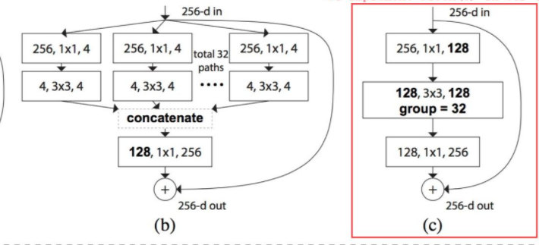
Resnext-29-8*64d
29 is number of layers will be 29,it will be same as previous architectures
Image we are showing is Resnext-32*4d
Note ,ours is 8*64d,so total paths in our will be 8 and ours is 64d which means 64 repeats in block so out channels in our case will be 8*64=512 .

Slide 28


In-Resnet?
General Residual Block is given by
Our In-Resnet is modified version of resnet and given by

Slide 29

Lambda-In-Resnet ?
General Residual Block is given by
Our lambda-In-Resnet is modified version of resnet and given by

Slide 30
Experiments
We used CIFAR-10 and CIFAR-100 datasets ,CIFAR-10 will be having 10classes and CIFAR-100 will be having 100 classes
We have totally 9 different architectures and 2 different datasets ,so totally there will be 18models
We use SGD optimizer with batch size = 128.
We train for 160 epochs for the CIFAR-10 benchmark and
For CIFAR-100 benchmark we trained for 300epoches

Slide 31
Contd..
learning rate starts we started with 0.1 and is divided it by 10 at epoch number 80 and again by 10 at epoch number 150 and again 225 epochs momentum 0.9.
The parameters lambda-n of our interpolation models are initialized by randomly sampling from U[0.2, 0.25] (reason because of previous proof). The initialization of other parameters we follow Resnet, Res-next paper
For optimization difficulty, we test our model on the CIFAR testing dataset. For model robustness, we evaluate the accuracy of our model over the perturbed inputs, details of which are given in the next section.

Slide 32
Measuring Robustness
Here we introduce the two types of perturbation methods that we use: stochastic noise perturbations and adversarial attacks.
The four groups of stochastic noise are impulse noise, speckle noise, Gaussian noise, and shot noise. We can get the noise the datasets corrupted from CIFAR-10-C,CIFAR-100-C,where C means corrupted dataset
For adversarial attacks, we consider three classical methods: Fast Gradient Sign Method (FGSM), Iterated Fast Gradient Sign Method (IFGSM), and Projected Gradient Descent (PGD).

Slide 33


For a given data point (x, y):
FGSM induces the adversarial example x' by moving with step size of at each component of the gradient descent direction, namely
IFGSM performs FGSM with step size of α, and clips the perturbed images within [x − ∈, x +∈ ] iteratively, namely
PGD attack is the same with IFGSM, except that the

Slide 34

Results

Slide 35
Table 2. Accuracy over CIFAR-10 and CIFAR-100 testing data, representing optimization difficulty of each model.
Model | CIFAR-10 | CIFAR-100
ResNet-110 | 93.48 | 73.05
In-ResNet-110 | 92.31 | 70.08
λ-In-ResNet-110 | 92.17 | 69.66
ResNet-164 | 94.3 | 76.6
In-ResNet-164 | 92.9 | 74.6
λ-In-ResNet-164 | 92.4 | 73.02
ResNeXt | 92.7 | 65
In-ResNeXt | 91.9 | 75.7
λ-In-ResNeXt | 91.94 | 75.9

Slide 36
Optimization difficulty
Optimization difficulty Table 2 shows the results of InResNet-110 and In-ResNet-164 as well as the baselines over CIFAR-10 and CIFAR-100 testing set.
On one hand, it can be seen that (λ-)In-ResNet-110 and (λ-)In-ResNet164, there is accuracy drop within 3to4 percent compared with the ResNet baselines .
This agrees with the fact that the interpolation model are be harder to optimize than ResNet. However, the performance of the interpolation models are still much better than that of the deep non-residual CNN models

Slide 37
Benchmark | Model | Impulse | Speckle | Gaussian | Shot
CIFAR-10 | ResNet-110 | 58 | 57.99 | 42.46 | 54.29
 | IN-ResNet-110 | 65.57 | 74.27 | 67.62 | 73.74
 | λ-In-ResNet-110 | 66.42 | 76.36 | 70.40 | 76.07
 | ResNet-164 | 58.2 | 60.6 | 44.1 | 56.4
 | IN-ResNet-164 | 69.11 | 79.05 | 74.38 | 78.8
 | λ-In-ResNet-164 | 67.7 | 76.9 | 70.9 | 76.7
 | ResNext | 55.7 | 58.7 | 39.2 | 52.0
 | IN-ResNext | 55.3 | 59.7 | 39.6 | 54.8
 | λ-In-ResNext | 50.3 | 57.7 | 37.5 | 51.8
CIFAR-100 | ResNet-110 | 23.47 | 28.87 | 18.80 | 27.22
 | IN-ResNet-110 | 33.23 | 40.43 | 32.32 | 39.83
 | λ-In-ResNet-110 | 33.16 | 39.74 | 31.6 | 39.09
 | ResNet-164 | 28.98 | 31.48 | 20.38 | 28.5
 | IN-ResNet-164 | 32.2 | 35.5 | 25.5 | 34.02
 | λ-In-ResNet-164 | 33.5 | 39.8 | 29.3 | 38.4
 | ResNext | 26.9 | 28.8 | 17.5 | 25.7
 | In-ResNext | 24.6 | 29.1 | 17.8 | 20.0
 | λ-In-ResNext | 27.6 | 29.1 | 27 | 20

Slide 38
Robustness against stochastic noise
Table1-Acuracies of all models over the perturbed CIFAR-10 and CIFAR-100 images from four types of stochastic noise.
Our In-ResNet-110 and In-ResNet-164 models achieve substantial improvement over the ResNet-110 and ResNet-164 baselines.
For perturbed CIFAR-10 images, accuracy of (λ-)In-ResNet-110 and (λ-)In-ResNet-164 are over 15 % higher than ResNet-110 and ResNet-164 baselines on average.
For perturbed CIFAR-100 images, accuracy of (λ- )In-ResNet-110 and (λ-)In-ResNet-164 are higher than ResNet-110 and ResNet-164 baselines on average. In-Res-Next models improves the accuracy of the perturbed images over Res-Next as well.

Slide 39
Contd..
For perturbed CIFAR-100 images, accuracy of (λ- )In-ResNet-110 and (λ-)In-ResNet-164 are over 5% higher than ResNet-110 and ResNet-164 baselines on average.
In Res-Next models improves the accuracy of the perturbed images over Res-Next as well.
We will explain using our Lyapunov analysis in next section which answers which answers the question why accuracies of Interpolated networks are higher than general Resnet architectures

Slide 40
Benchmark | Model | FGSM |  |  | IFGSM |  |  | PGD
 |  | 1/255 | 2/255 | 3/255 | 1/255 | 2/255 | 3/255 | 1/255 | 2/255 | 3/255
CIFAR-10 | ResNet-110 | 53.41 | 35 | 24.48 | 30.46 | 2.52 | 0.01 | 29.76 | 2.28 | 0.01
 | IN-ResNet-110 | 66.2 | 47.7 | 32.55 | 59.76 | 28 | 1.99 | 62.67 | 27.4 | 2.98
 | λ-In-ResNet-110 | 65.73 | 45.5 | 27.91 | 57.7 | 24.18 | 1.1 | 57.41 | 19.81 | 1.07
 | ResNet-164 | 58.67 | 39.3 | 26.8 | 38.39 | 4.44 | 0.02 | 37.75 | 4.11 | 0.01
 | IN-ResNet-164 | 67.6 | 47.4 | 28.5 | 19.8 | 2.55 | 0.16 | 60.13 | 22.78 | 1.45
 | λ-In-ResNet-164 | 66.9 | 44.8 | 25.8 | 59.05 | 19.55 | 0.75 | 58.9 | 19.2 | 0.7
CIFAR-100 | ResNet-110 | 24.01 | 15.5 | 11.44 | 10.35 | 1.01 | 0.13 | 9.99 | 0.98 | 0.12
 | IN-ResNet-110 | 28.91 | 15.1 | 8.49 | 19.35 | 3.27 | 0.26 | 19.28 | 3.04 | 0.25
 | λ-In-ResNet-110 | 29.1 | 14.8 | 8.03 | 19.83 | 3.25 | 0.31 | 19.61 | 3.22 | 0.29
 | ResNet-164 | 34.5 | 23.4 | 18.01 | 23.4 | 4.01 | 0.23 | 21.0 | 3.99 | 0.2
 | IN-ResNet-164 | 32.6 | 19.3 | 12.3 | 19.8 | 2.55 | 0.16 | 19.72 | 2.34 | 0.16
 | λ-In-ResNet-164 | 34.8 | 20.0 | 11.6 | 25.1 | 5.7 | 0.6 | 23.83 | 4.17 | 0.34

Slide 41
Robustness against adversarial attack
Table 3 shows the accuracies of all models over the perturbed CIFAR-10 and CIFAR-100 images from FGSM, IFGSM, and PGD attacks at different attack radii of 1/255, 2/255, and 4/255.
Most of the robustness results of our (λ-)In-ResNet-110 and (λ- )In-ResNet-164 models are higher than those of the ResNet110 and ResNet-164 models, which is empirically consistent with our Lyapunov analysis.
Especially on CIFAR-10 benchmark, our In-ResNet-110 and In-ResNet-164 models obtain significant robustness improvement against the strong IFGSM and PGD attacks at the radii of 1/255 and 2/255

Slide 42
Loss Landscape Analysis
In Lyapunov analysis, the robustness improvement is theoretically provided in that the damped models enjoy more locally stable points than the original ones
To further verify this, we visualize the loss landscapes of In-ResNet-110 and ResNet-110 models trained on CIFAR-10 benchmark along the attack direction

Slide 43
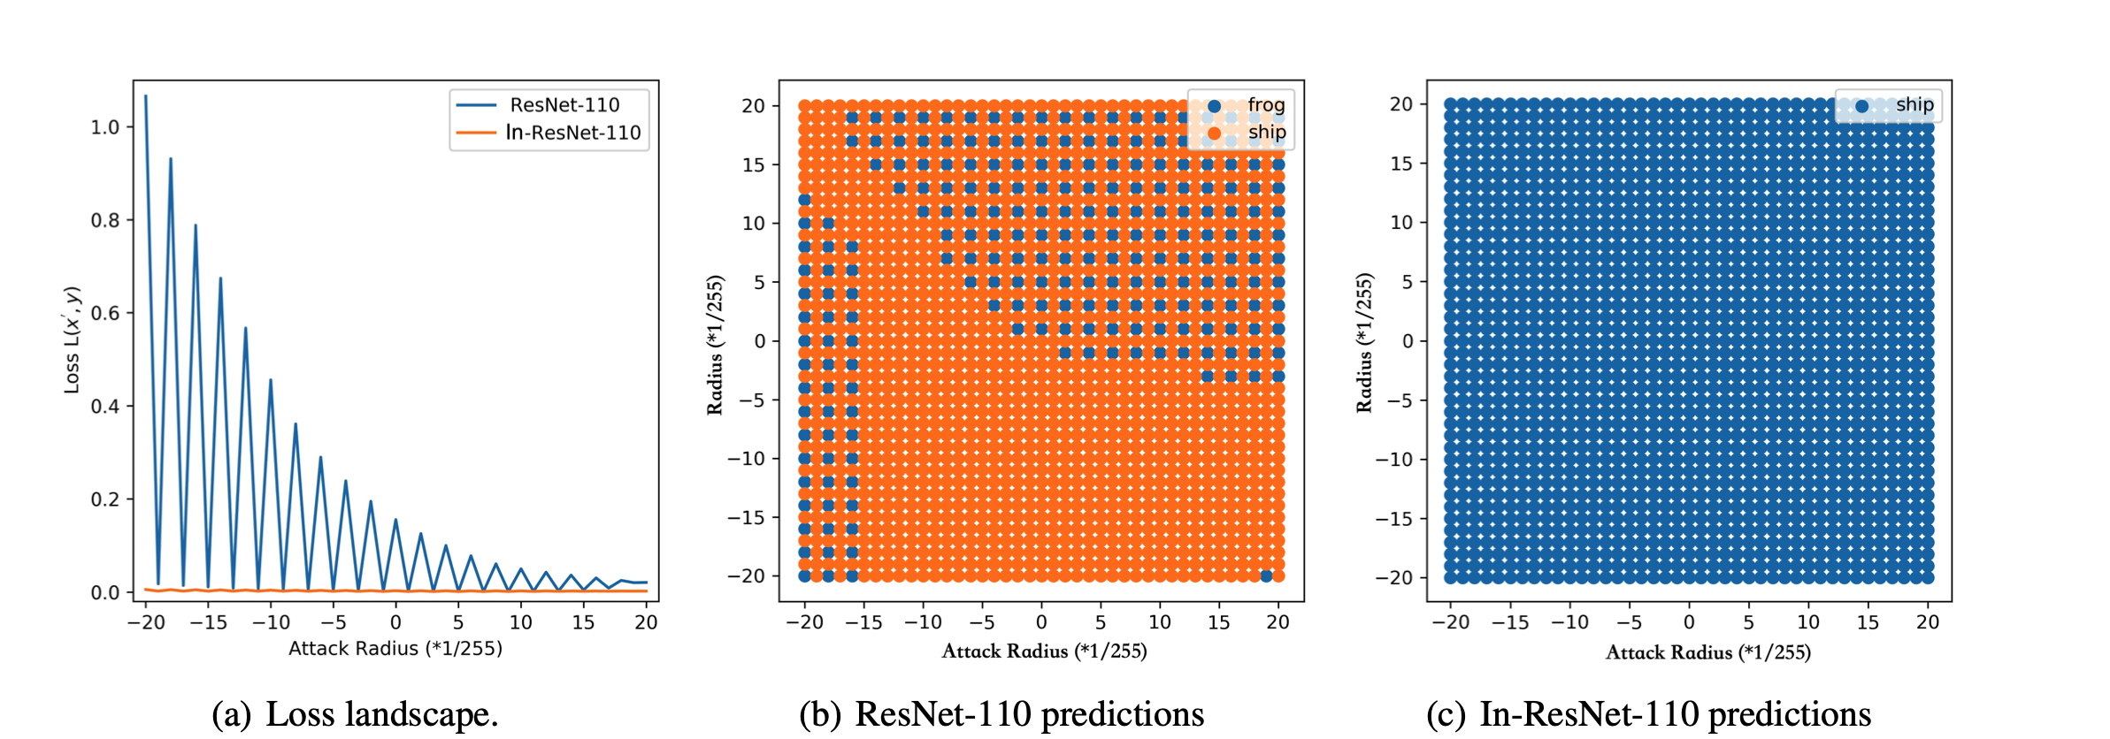

Slide 44
Conclusion
While the relation between ODE’s and Non-Residual networks remain unclear, In this paper we present a novel ODE model by adding a damping term .
Just by adjusting the interpolation quotient. The proposed model unifies both residual and Non-Residual networks.
Lyapunov analysis and experimental results on CIFAR-10 and CIFAR-100 benchmarks reveal better robustness of the proposed interpolated network’s against both stochastic and adversarial networks methods.

Slide 45
Furthermore, here it shows that proposed model is sensitive to the initializing of interpolation quotient
The significance of the design of the interpolated network is shown by comparing several model variants.
Further we know that ensemble model is more robust when compared to single model. Performing model ensembling over 5 different runs of baseline and our model increases the robustness.

