Slide 1


NEXT GEN EMPLOYABILITY PROGRAM
CREATING A FUTURE-READY WORKFORCE
Student Name :
Mahesh Walmik Narule
Student ID :
STU65dee7645c9d31709107044
Mobile No:
7666971534
Mail ID:
maheshnarule143@gmail.com
College Name :
S. B. Jain Institute of Technology, Management And Research, Nagpur

Slide 2
Project Title
Health Care Data Driven Decisions using Power BI (DA)
Abstract | Problem Statement | Project Overview | Proposed Solution | Technology Used | Modelling & Results | Conclusion | Q&A

Slide 3
Abstract
1
Introduction to Power BI as a powerful tool for data analysis and visualization.
2
Importance of data cleansing to ensure accuracy and reliability of analysis results.
3
Techniques for data cleaning and preparation within Power BI, including handling missing values and outliers.
4
Utilization of Power BI's visualization tools to create insightful dashboards and reports.

Slide 4


Problem Statement
Total number of patients treated within a specified time frame.
Patient demographics including age, gender, and location.
Disease prevalence across different demographics.
Integrating and cleansing disparate healthcare data sources for accurate analysis.
Generating actionable insights to improve patient care and operational efficiency.

Slide 5

Project Overview
Data collection, Importing, Pre Processing
DAX Function: New columns, New measures, Visualization
Dashboard, Formatted, Tested, Saved & Shared

Slide 6
Proposed Solution
Integrate data into Power BI using Power Query Editor for cleansing and transformation.
Develop interactive dashboards in Power BI showcasing key healthcare metrics.
Implementation of DAX functions to calculate descriptive statistics such as total patients, average age, and gender distribution.
Example:
TotalPatients = COUNTROWS(Patients)
AverageAge = AVERAGE(Patients[Age])
Use DAX to generate actionable insights and recommendations based on analytics findings.

Slide 7
Technology used
Power BI

Slide 8
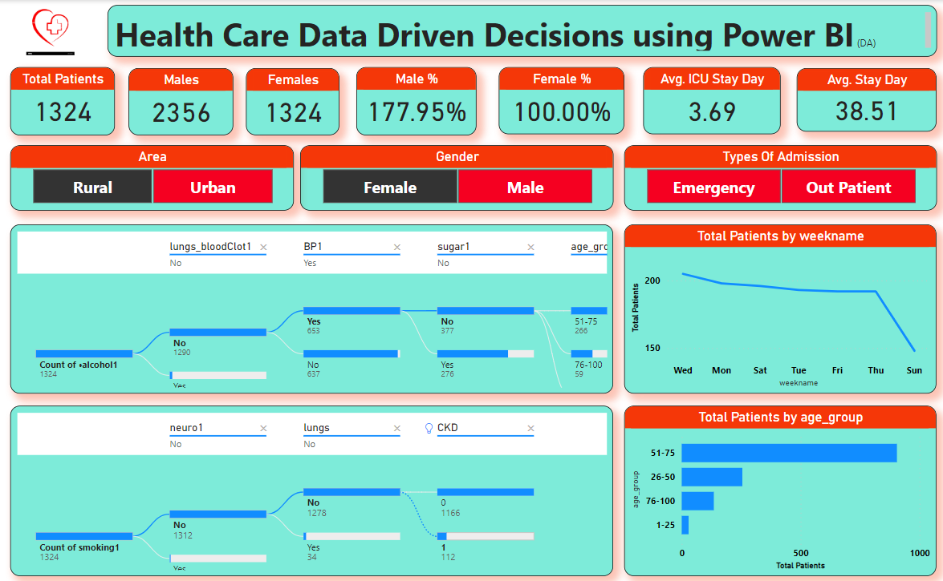
Dashboard 1

Slide 9
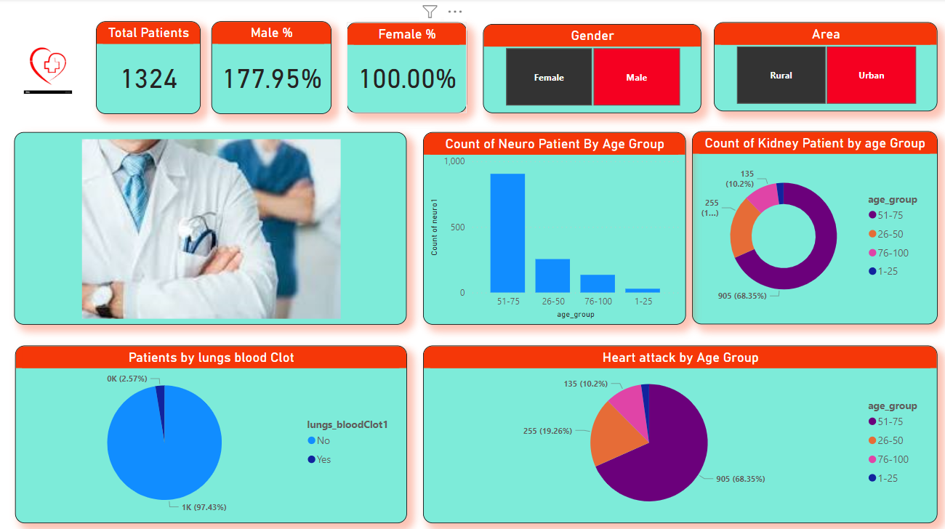
Dashboard 2

Slide 10

Conclusion
The adoption of Power BI for healthcare data-driven decision-making holds immense potential to drive innovation, improve efficiency, and ultimately enhance the quality of patient care. By harnessing the power of data, healthcare organizations can navigate complex challenges, optimize resources, and achieve better outcomes for patients and communities served.

Slide 11


Notes:
Thank You !!

