Slide 1

Credit card Approval Prediction
Mentorness
April 2024
By Mahesh Walmik Narule

Slide 2
Introduction
Credit card approval is a crucial process in the financial sector, shaping individuals' access to credit and financial services. With the rise of machine learning and data analytics, predictive modeling has become instrumental in assessing creditworthiness and automating approval decisions. This introduction delves into the realm of credit card approval prediction, exploring the methodologies and technologies that drive efficient and accurate decision-making in this domain.

Slide 3
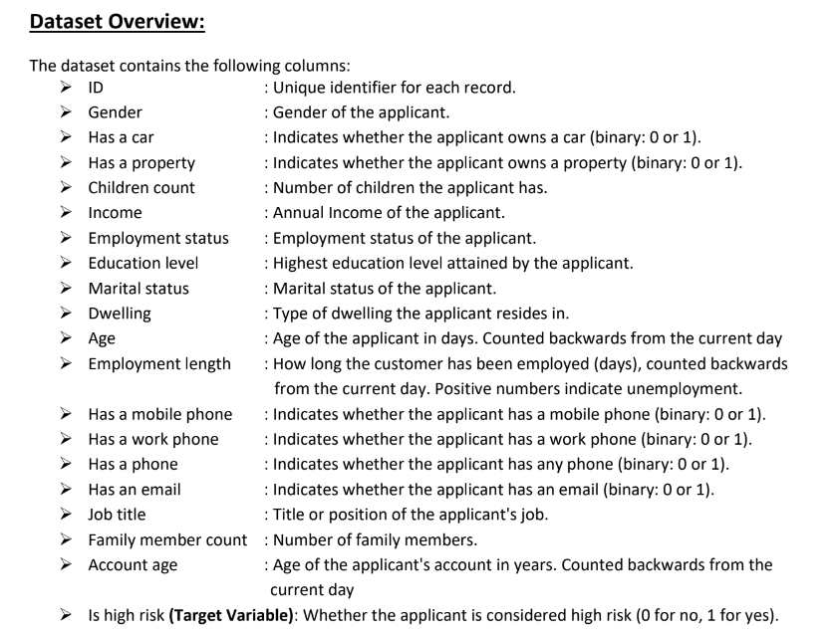
Dataset

Slide 4
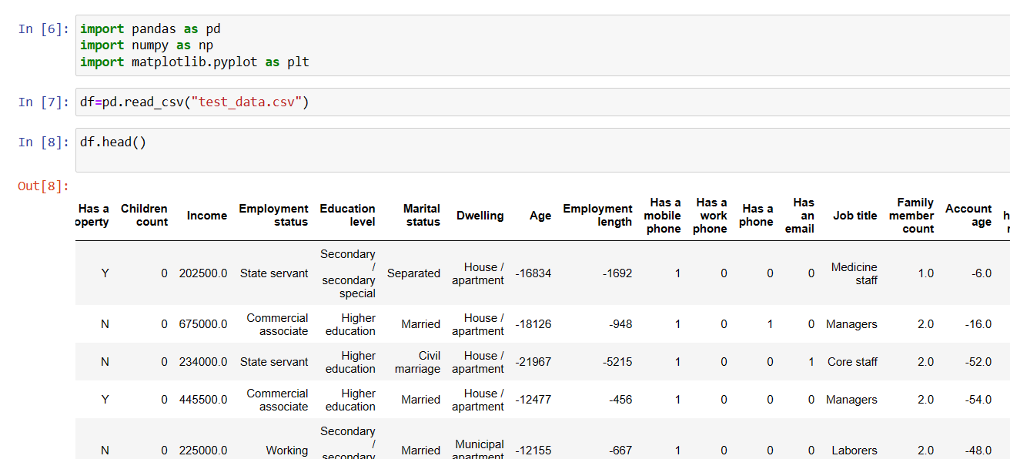
Import necessary libraries and load the dataset

Slide 5
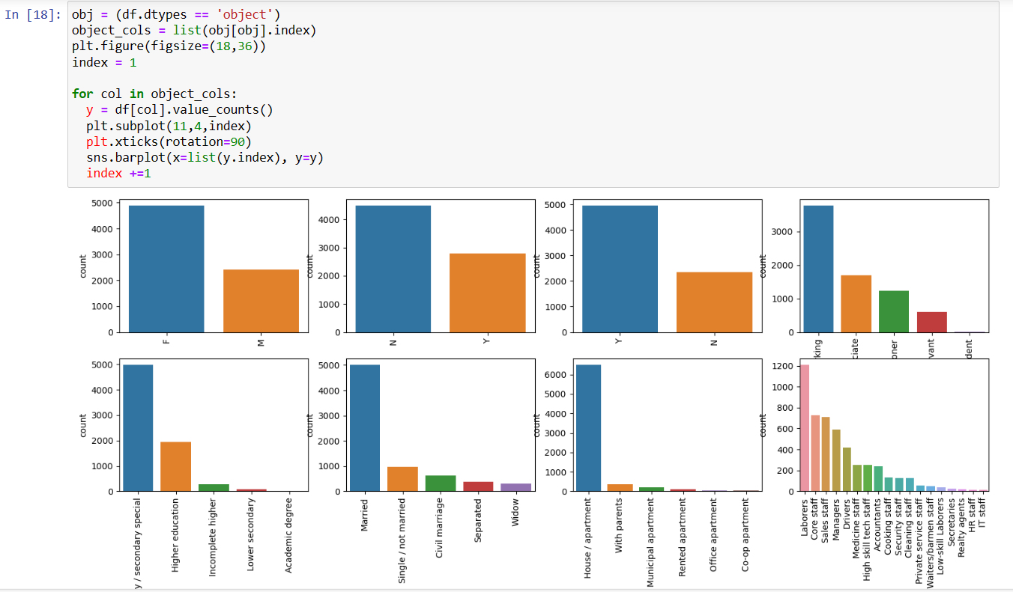
Import necessary libraries and load the dataset

Slide 6
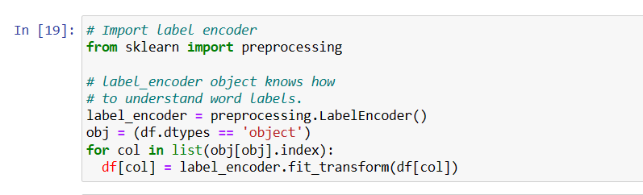
Label encoder

Slide 7
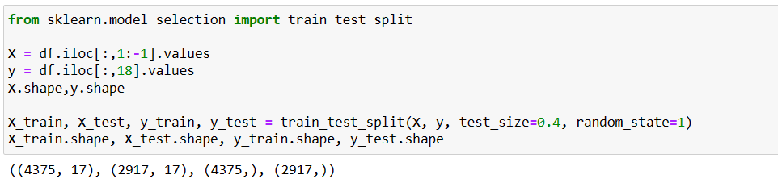
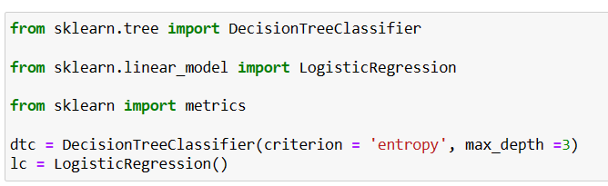
Split the dataset for training and testing
Apply Machine Learning Algorithm for prediction

Slide 8
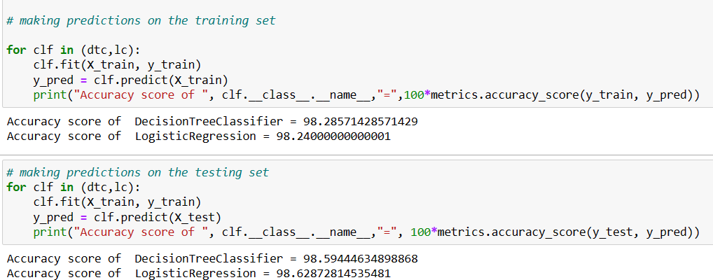
Accuracy of training and testing

Slide 9
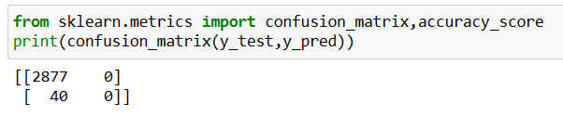
Accuracy of training and testing

Slide 10
Conclusion
In the realm of credit card approval prediction, the fusion of data analytics and machine learning empowers financial institutions to make smarter, more efficient credit decisions. While challenges like data quality and model interpretability persist, ongoing advancements in technology and ethical frameworks promise a future of fair, transparent, and customer-centric credit assessments.

Slide 11
THANK YOU!

