Slide 1

Furniture Sales Forecasting
Mentorness
April 2024
By Mahesh Walmik Narule

Slide 2
Introduction
Forecasting furniture sales involves collecting and preprocessing historical sales data, analyzing market trends and economic indicators, and selecting appropriate forecasting methods such as time series analysis or machine learning algorithms. By developing accurate forecasting models and integrating them into business processes, furniture retailers and manufacturers can optimize inventory management, plan marketing strategies, and make informed decisions to meet customer demand effectively. Continuous monitoring and refinement of forecasting models are essential for improving accuracy and adapting to changing market dynamics..

Slide 3
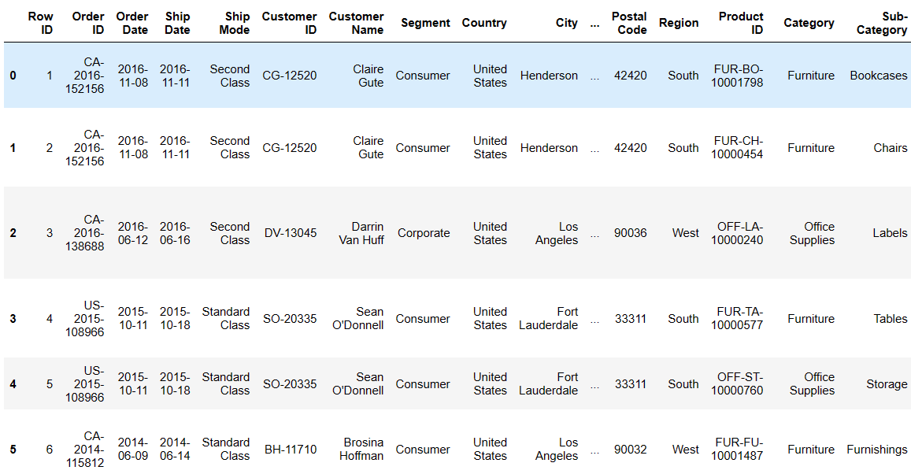
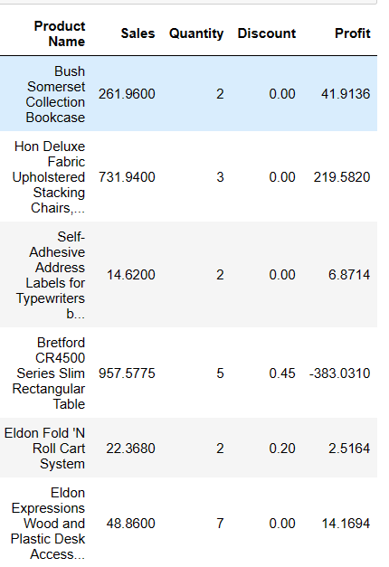
Dataset

Slide 4
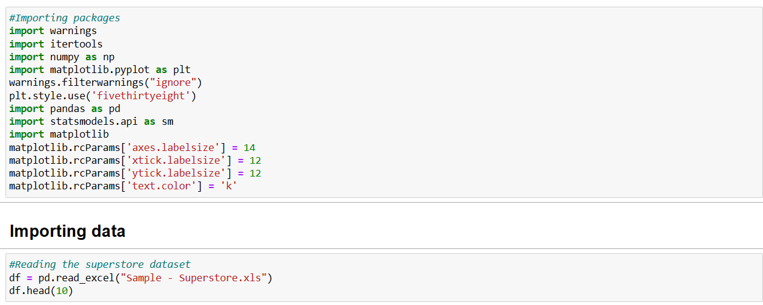
Import necessary libraries and load the dataset

Slide 5
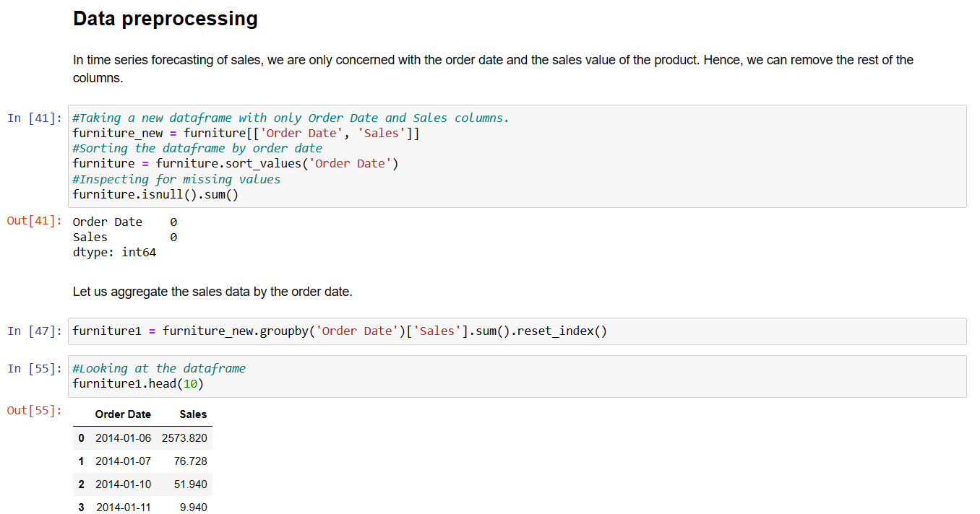
Import necessary libraries and load the dataset

Slide 6
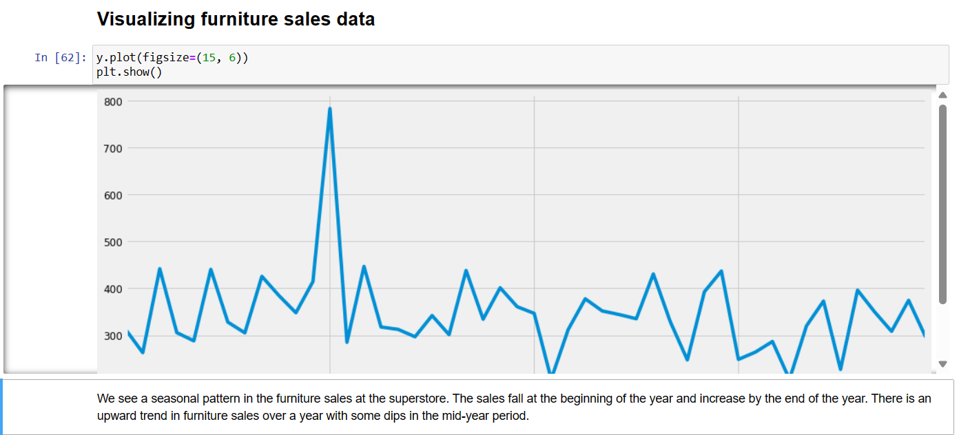
Visualization of Sales

Slide 7
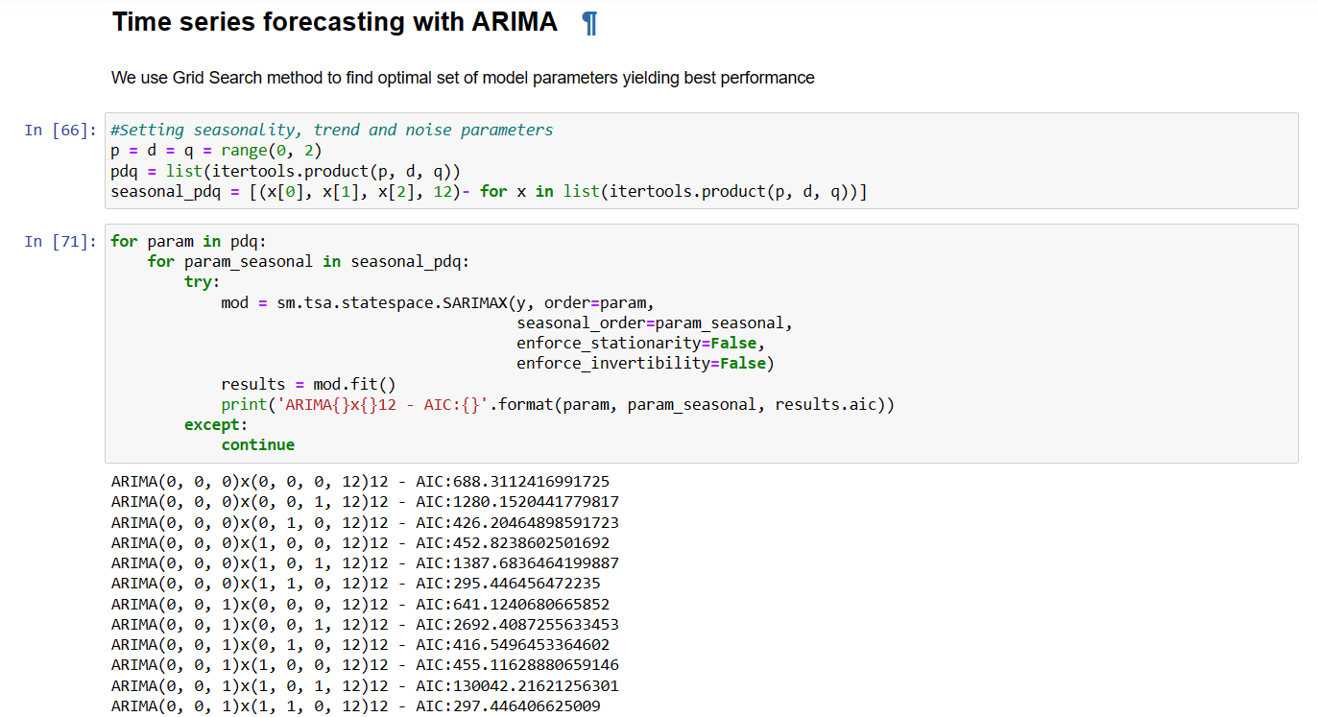
Split the dataset for training and testing
Apply Machine Learning Algorithm for prediction

Slide 8
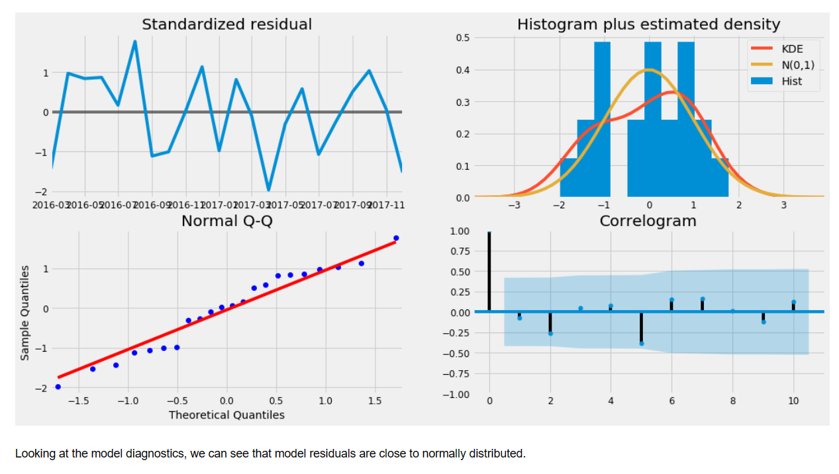
Split the dataset for training and testing
Apply Machine Learning Algorithm for prediction

Slide 9
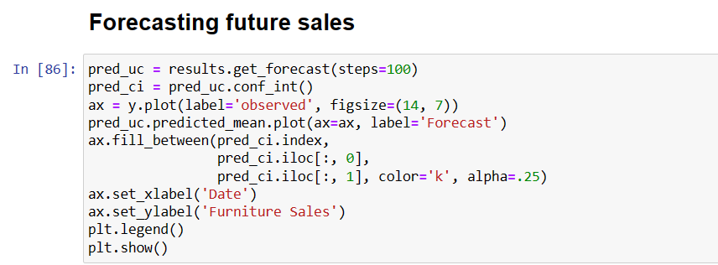
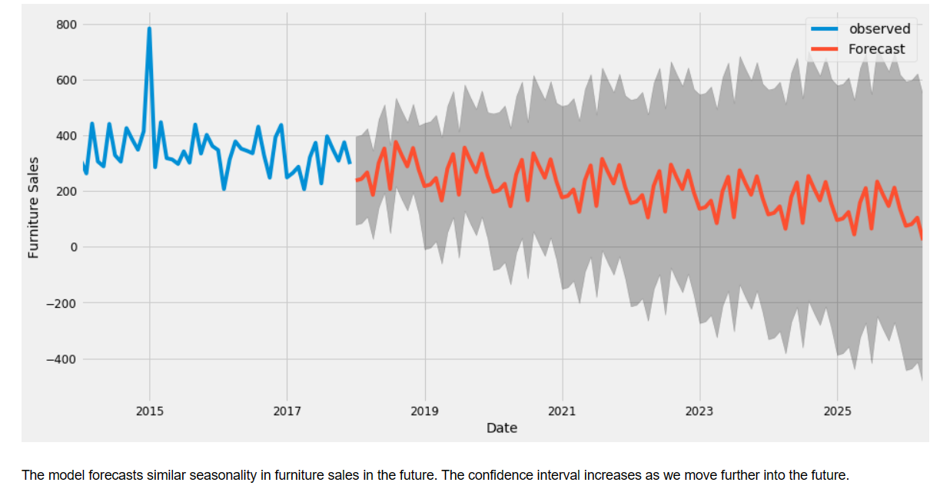
Forecasting in furniture Sales

Slide 10
Conclusion
After completing the furniture sales forecasting project, it's crucial to evaluate the performance of the forecasting models and their integration into business operations. Conducting a thorough analysis of forecast accuracy compared to actual sales, assessing the impact on inventory management and marketing strategies, and gathering feedback from stakeholders will provide valuable insights for future improvements. Continuous refinement of the forecasting models based on real-time data and market feedback is essential to maintain competitiveness and adaptability in the dynamic furniture industry..

Slide 11
THANK YOU!

