Slide 1
AUTONOMOUS ELECTRIC VEHICLE (AEV) // DRIVE-BY-WIRE EMBEDDED SYSTEM
Low-Level Embedded Controller Architecture
Deterministic 100 Hz Motion Control, Auto-Polarity Calibration & Ground Station Telemetry on STM32H723ZG
CORE CLOCK
550 MHz
ARM Cortex-M7 with DP-FPU
CONTROL LOOP
100 Hz
Hardware TIM6 10.0 ms Loop
SAFETY WATCHDOG
200 ms
Automatic Failsafe Throttle Cut
STEERING CONTROL
EKF-PID
Derivative-on-Measurement
Executive Engineering Scope
• Drive-by-Wire Hardware Abstraction: Seamlessly translates high-level autonomy commands (ROS 2 / NVIDIA Jetson) into physical steering torque, pure analog traction voltage, and electronic braking.
• Fault-Tolerant Calibration: Self-discovers rack travel limits, detects electrical motor polarity mathematically, and eliminates positive-feedback runaway without requiring physical limit switches.
• Multi-Layer Safety Supervisor: Integrates an 8-layer defense-in-depth safety matrix with non-blocking LED diagnostic codes, electronic endstop current clamps, and 50 Hz circular DMA telemetry.

Slide 2
// HARDWARE & INTERCONNECT
Drive-by-Wire System Topology & Physical Signal Flow
End-to-end signal pipeline from NVIDIA Jetson autonomy stack down to powertrain and steering actuators.
AUTONOMY COMPUTE LAYER (HOST)
NVIDIA Jetson Orin / ROS 2 / Python Ground Station
Transmits 24-byte control frames (MsgID 0x01) at 50 Hz containing gear direction, steering angle target, throttle %, brake mode, and E-Stop over 115200 8N1 serial.
Microcontroller Hardware Signal Allocation (NUCLEO-H723ZG)
PA0 (A0) | STEERING SENSOR | 16-Bit Circular DMA (0.15–3.15V)
PA4 (A2) | TRACTION THROTTLE | 12-Bit Analog Voltage (0.0–3.3V)
PA5 (A3) | ELECTRIC BRAKE | 12-Bit Analog Voltage (0.0–3.3V)
PC6 (D9) | STEERING PWM SPEED | 550 Hz PWM (0% to 60% Effort Limit)
PD14 (D10) | STEERING DIR PIN | Digital Level (0 = Left, 1 = Right)
PD8 | AUTONOMY UART RX | Circular DMA Buffer (Zero CPU Overhead)
PD9 | AUTONOMY UART TX | DMA Streamed Telemetry @ 50 Hz
PB0 (LD1) | SYSTEM STATUS LED | Green: 1Hz Heartbeat / 5Hz Calibrating
PE1 (LD2) | COMM LINK LED | Yellow: 10Hz Flash on Active Packets
PB14 (LD3) | SYSTEM FAULT LED | Red: Repeating Diagnostic Blink Codes
PC13 (B1) | RECAL BUTTON | Blue Pushbutton: Trigger Recalibration
LOW-LEVEL CONTROLLER (STM32H723ZG)
Real-Time Embedded Firmware @ 550 MHz Cortex-M7
Deterministic 100 Hz TIM6 scheduler. Runs 2-state recursive EKF, derivative-on-measurement PID, circular DMA UART, 8-layer safety watchdog, and master live monitor struct.
VEHICLE ACTUATORS & PLANT
Traction Motor Controller, Cytron Driver & Rack Potentiometer
Dual 12-bit DACs deliver 0–3.3V analog signals to main traction controller & brake actuator. TIM3 PWM & DIR pin drive Cytron MDD10A H-bridge steering motor.

Slide 3
// REAL-TIME EXECUTIVE (APPCORE)
Deterministic 100 Hz Supervisory State Machine
TIM6 hardware interrupt scheduler guaranteeing hard real-time latency and thread-safe execution.
STATE 0: INIT
Power-On Bootstrapping
Initializes ADC DMA oversampling, DAC hardware channels, PWM timers, circular UART receiver, PID structs, and EKF matrices. Immediately transitions to STATE_CALIBRATING.
STATE 1: CALIBRATING
Self-Discovering Endstops
Steering motor executes authoritative ±45% sweep. Identifies physical endstop voltages, calculates center & scale, and confirms motor polarity. Throttle locked to 0V. Green LED strobes at 5 Hz.
STATE 2: ACTIVE
Autonomous Closed-Loop Control
PID steering active with EKF feedback. Open-loop DAC throttle active (0–3.3V) when acceleration > 0%. Watchdog actively supervised within 200ms. Green LED gentle 1 Hz heartbeat.
STATE 3: FAULT
Critical Safety Interlock
Asserts immediate failsafe: Throttle DAC = 0.0V, Steering PWM = 0%, Full Emergency Brake = 3.3V. Red LED blinks diagnostic error code. Recalibration request required to reset.
100 Hz Execution Sequence Inside TIM6 ISR (App_Step_100Hz)
1. Deferred Recalibration Check: Thread-safe reset triggered from Blue Button EXTI / Debugger.
2. Circular DMA UART Ingestion: Parses incoming bytes, verifies CRC-16, feeds 200ms watchdog.
3. 16-Bit ADC Block Update: Reads 64-sample DMA buffer, computes EMA filtered potentiometer voltage.
4. State Machine Branching: Executes calibration state or closed-loop EKF-PID steering & DAC drive.
5. End-Stop Soft Limit Clamps: Checks ±40mV boundary buffer and zeroes pushing effort if near limits.
6. Master Live Monitor Refresh: Synchronously updates 'aev_live' struct for STM32CubeIDE.
7. 50 Hz Telemetry Dispatch: Binary transmits 26-byte status packet (MsgID 0x81) every 20ms.
Deterministic Watchdog Rules
• Serial Timeout (>=200ms): Immediate throttle cut to 0.0V, safe partial brake (1.65V), relaxes steering motor.
• Hardware E-Stop (estop != 0): Latches emergency brake (3.3V) and cuts motor drive within <= 10 ms.
• Sensor Bounds Check: Trip fault if pot voltage < 0.15V or > 3.15V (detects open ground or short to VCC).
• Safe Idle Relax: Motor effort is zeroed whenever communication is offline, preventing static stall drain.

Slide 4
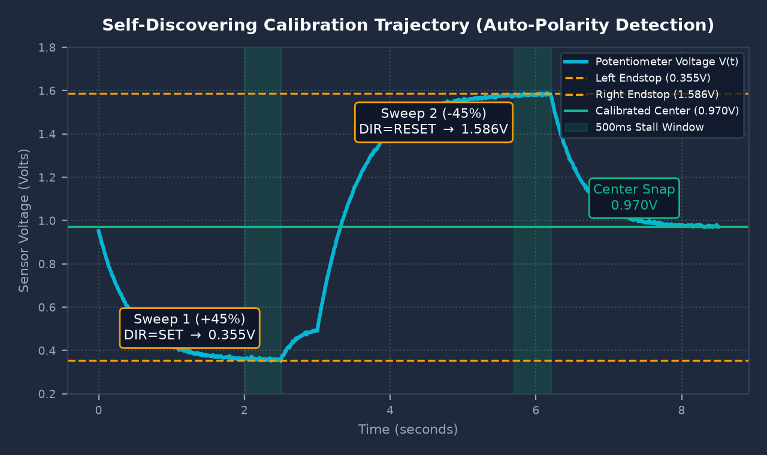
// MOTION CONTROL // CALIBRATION
Self-Discovering Steering Calibration & Polarity Detection
Authoritative ±45% torque sweep with windowed stall detection and automatic mathematical polarity inversion.
1. Windowed Stall Detection (500ms Stillness)
• 45% Sweep Effort: High torque ensures complete rack sweep through tire friction.
• 600ms Startup Grace Period: Motor static inertia is ignored during initial acceleration.
• 100ms Sliding Window Filter: ΔV > 5mV confirms active movement; stillness for 500ms confirms physical mechanical end-stop.
2. Auto-Polarity Detection (Eliminating Runaway)
• Hardware Variance: Wiring or gear linkages can make +effort decrease or increase voltage.
• Automatic Computation: polarity_sign = (limit_1 > limit_2) ? +1 : -1.
• Runtime Auto-Inversion: Runtime PID automatically multiplies effort by polarity_sign, guaranteeing negative feedback and eliminating violent endstop slamming.
3. End-Stop Soft Limits & Stall Protection
• Problem: DC motors pinned against hardstops draw locked-rotor stall currents (15A–30A+).
• Electronic Buffer: If rack is within 40mV of either stop, pushing effort is clamped to 0.0f.
• Safe Centering: Proportional snap smoothly centers wheels to 0.970V within 30mV.

Slide 5
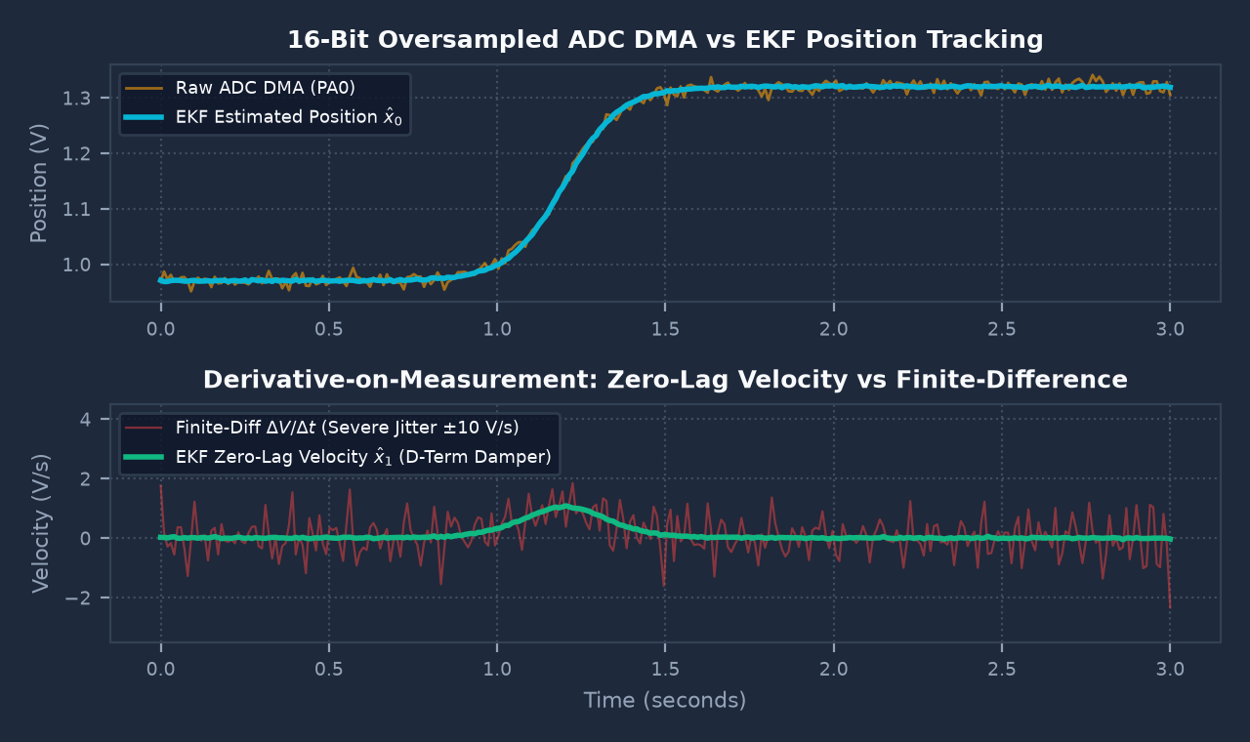
// STATE ESTIMATION & CONTROL
Recursive Extended Kalman Filter & Velocity-Damped PID
Dual-state estimator eliminates finite-difference noise while feedforward open-loop DAC drives traction.
1. Why Finite Difference Fails at 100 Hz
• Noise Amplification: Computing derivative as ΔV/Δt at 100 Hz multiplies electrical switching noise by 100x, causing severe D-term jitter and motor overheating.
• EKF Model Prediction: Combines physical motor effort model with 16-bit ADC measurements to produce zero-lag velocity estimates.
2. Derivative-on-Measurement PID Formulation
• Control Law: u(t) = Kp · e(t) + Ki ∫ e(t) dt - Kd · x̂₁_EKF(t).
• Anti-Derivative Kick: D-term is damped strictly by measured vehicle velocity rather than error derivative, allowing instant setpoint jumps without current spikes.
• Anti-Windup Clamping: Integrator is bounded to ±0.25 to prevent overshoot.
3. Open-Loop Traction Drive (No Acceleration PID)
• Direct Feedforward: Electric vehicle motor controllers operate in internal torque/speed loops. Throttle maps linearly: V_dac = (acceleration / 100) × 3.3V.
• Auto-Forward Default: Automatically engages forward drive when acceleration > 0% to streamline bench testing and avoid neutral lockouts.

Slide 6
// SAFETY & INTEGRITY SUPERVISOR
8-Layer Hardware Failsafe & Defense-in-Depth Matrix
Multi-tier protection guaranteeing zero uncontrolled acceleration, mechanical over-travel, or thermal overload.
Layer 1: Power-On Safe State [0 ms (Boot)]
Trigger: Boot / Reset
Action: All DAC outputs held at 0.0V, PWM compare register 0, DIR pin low.
Layer 5: Endstop Current Clamping [<= 10 ms]
Trigger: Rack within 40mV of stops
Action: Clamps pushing effort to 0.0f; prevents high locked-rotor stall current (15A–30A).
Layer 2: Communication Watchdog [<= 200 ms]
Trigger: Link Timeout > 200ms
Action: Immediate throttle cut to 0.0V, safe partial brake (1.65V), relax steering motor.
Layer 6: Direction Polarity Protection [Calibration]
Trigger: Inverted pot or motor
Action: Auto-polarity sign detection mathematically guarantees negative feedback loop.
Layer 3: Autonomous E-Stop [<= 10 ms]
Trigger: Payload estop != 0
Action: Full mechanical brake (3.3V) applied, throttle cut, safe latched state.
Layer 7: Actuator Saturation Clamp [Instant]
Trigger: High step angle error
Action: Output effort clamped to safe max ±60%; integrator clamped to prevent windup.
Layer 4: Sensor Bounds Supervisor [<= 10 ms]
Trigger: Pot V < 0.15V or > 3.15V
Action: Detects ground disconnect or power short; zeroes throttle & reports fault code.
Layer 8: Calibration Sweep Timeout [10.0 s]
Trigger: Motor stalled > 10.0s
Action: Enters STATE_FAULT, cuts motor PWM to protect windings and driver FETs.
Visual LED Diagnostics: 🟢 PB0: 1Hz Heartbeat / 5Hz Calibrating | 🟡 PE1: 10Hz Flash on Active Packets | 🔴 PB14: Error Blink Codes

Slide 7
// GROUND STATION & TELEMETRY
Python Ground Station GUI & Binary Protocol Framing
Real-time 50 Hz bidirectional telemetry dashboard with zero-CPU circular DMA reception.
Strict Binary Framing (CRC-16-CCITT)
Binary Frame Layout:
+-----------+--------+--------+--------+-------------+---------+-----------+
| SOF (2B) | MSG_ID | SEQ | LEN | PAYLOAD (N) | CRC-16 | EOF (2B) |
| 0xAA 0x55 | 1 Byte | 1 Byte | 1 Byte | Little-End | 2 Bytes | 0x55 0xAA |
+-----------+--------+--------+--------+-------------+---------+-----------+
Command Payload (MsgID 0x01, 16 Bytes, Jetson -> STM32):
• drive_direction (uint8): 0 = Neutral, 1 = Forward, 2 = Reverse
• steer_direction (int8): -1 = Left, 0 = Center, +1 = Right
• steer_angle (float32): Target steering angle in degrees (-30° to +30°)
• acceleration (float32): Traction throttle percentage (0.0 to 100.0%)
• brake (uint8): 0 = Off, 1 = Partial Braking, 2 = Emergency
• estop (uint8): 0 = Normal Operation, 1 = Immediate E-Stop
• timestamp_ms (uint32): Host millisecond synchronization timestamp
Telemetry Payload (MsgID 0x81, 26 Bytes, STM32 -> Jetson @ 50 Hz):
• system_state (uint8): 0=INIT, 1=CALIB, 2=ACTIVE, 3=FAULT
• actual_steer_angle (f32): EKF-estimated steering angle in degrees
• steering_pot_v (float32): Raw potentiometer sensor voltage (0–3.3V)
• applied_steer_effort (f32): Cytron PWM effort command (-1.0 to +1.0)
• applied_throttle_v (f32): DAC1 CH1 output voltage (PA4)
• applied_brake_v (f32): DAC1 CH2 output voltage (PA5)
• link_alive (uint8): 1 = Watchdog active, 0 = Link timed out
Python Diagnostic Ground Station (aev_diagnostic_gui.py)
• Side-by-Side Dual Deck Layout: Combines full transmission control and real-time telemetry meters in an intuitive dark-themed workstation.
• Auto-Forward Transmission: Defaults to Forward gear on startup. Sliding throttle automatically selects Forward gear, preventing accidental neutral lockouts.
• 50 Hz Watchdog Streaming: One-click 'Start 50 Hz Streaming' loop satisfies the STM32's 200ms watchdog with real-time heartbeat synchronization.
• Big Red Reactor E-STOP: Prominent emergency stop button instantly broadcasts emergency brake and zeroes throttle output.
• Live Packet Hex Console: Color-coded inspection terminal showing sent commands (TX in blue), incoming telemetry (RX in cyan), and system events.
• Interactive Protocol Visualizer: Second tab with embedded architectural documentation, byte maps, and diagnostic troubleshooting.

Slide 8
// EXPERIMENTAL VALIDATION
Real-World Hardware Verification & STM32 Live Monitoring
Empirical validation on vehicle chassis, STM32CubeIDE live expressions, and GitHub deployment.
Vehicle Bench Calibration Results
• is_calibrated: true
(Routine completed successfully)
• left_limit_volts: 0.35478 V
(Left physical end-stop)
• right_limit_volts: 1.58600 V
(Right physical end-stop)
• center_volts: 0.97039 V
(Exact calculated midpoint)
• degrees_per_volt: 48.732 deg/V
(Scaling: 60.0° / 1.231V span)
• polarity_sign: -1
(Auto-inverted to prevent runaway)
• settling_error: < 0.030 V
(Within 30mV centering deadband)
Unified Live Expressions (aev_live)
• aev_live.command:
Real-time host commands: drive_direction, steer_angle, acceleration, brake, estop, timestamp_ms.
• aev_live.steering:
Closed-loop feedback: target_angle_deg, actual_angle_deg, angle_error_deg, pot_volts, motor_effort, dir_pin, pwm_duty_pct.
• aev_live.drivetrain:
Hardware DAC registers: throttle_pct, throttle_volts, throttle_dac_raw, brake_volts, brake_dac_raw.
• aev_live.calibration:
Physical endstop map: is_calibrated, center_volts, left_limit_volts, right_limit_volts.
• aev_live.safety:
Diagnostics: system_state, link_alive, watchdog_left_ms, active_error_code, uptime_seconds.
Deployment & Repository Access
• GitHub Repository:
https://github.com/maheshnatham/
AEV_LowLevel_Controller
• Firmware Binary:
Debug/AEV_LowLevel_ControllerV1.elf
Compiled with 0 errors, 0 warnings.
• Ground Station GUI:
python App/Testing/aev_diagnostic_gui.py
• 1-Click GitHub Push:
.\push_to_github.bat
Cached Windows credentials enabled.
• Onboard Blue Button:
PC13 EXTI triggers thread-safe recalibration on demand.

