Slide 1
IMPLEMENTING SVM BASED POS TAGGER
PROJECT ID: 1
Presented by:
Raj kumar Kandala,
Mahesh Natkari,
RGUKT IIIT Basar.

Slide 2
DESCRIPTION
Implementation on Hindi, Telugu and Bengali ILCI datasets and finding which set of features performed the best.
SVMTool
- SVMTlearn
- SVMTagger
- SVMTeval

Slide 3
IMPLEMENTATION
Pre-processing data.
Generation of feature vectors of words using Word2Vec.
Training model using python sklearn’s SVM classifier.
Testing the model with telugu test dataset.

Slide 4
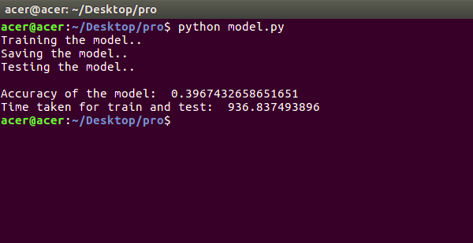
RESULT

