Slide 1
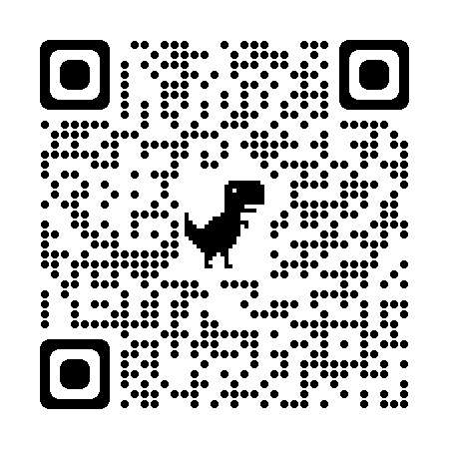
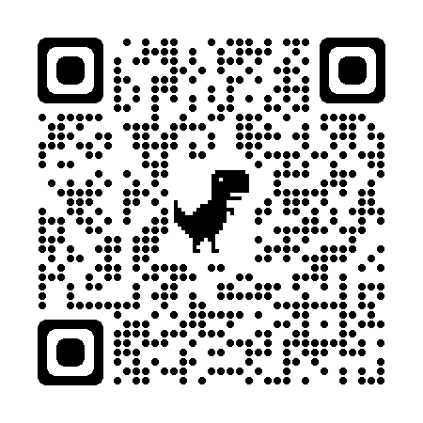
DEV II Role 5 – 8 years Experience Full Stack
DEV III Role 13 Years and above Full Stack
Only soft copies of Resumes will be accepted for the drive and its part of Go green initiative

