Slide 1
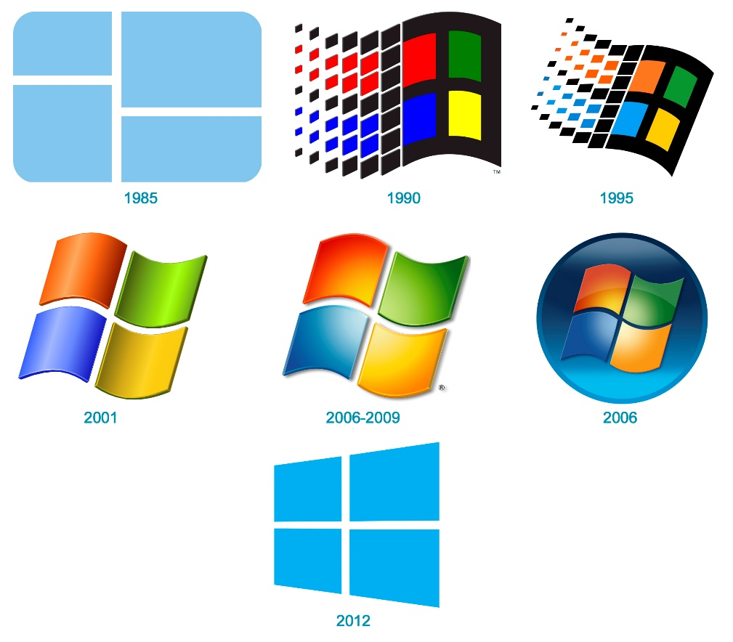

Sysmon
Mahesh Pavaskar

Slide 2
Content
What is Sysmon?
Purpose of Sysmon / why?
Understand Sysmon few EventID
Download Sysmon
Installation of Sysmon
Check logs of sysmon in EventViewer
Swiftonsecurity - Sysmon config file
Update sysmon configuration

Slide 3
What is Sysmon?
URL : https://learn.microsoft.com/en-us/sysinternals/downloads/sysmon
System Monitor (Sysmon) is a Windows system service and device driver that, once installed on a system, remains resident across system reboots to monitor and log system activity to the Windows event log. It provides detailed information about process creations, network connections, and changes to file creation time.
OR
Sysmon (short for System Monitor) is part of the Sysinternals software package, a set of free tools intended to troubleshoot, diagnose, manage and monitor Windows environments.

Slide 4
Purpose of Sysmon / why?
Extends Windows Logging Capabilities
Detect Indicators of Compromise
Sysmon Provides a Breadcrumb Trail
IMP URL : https://www.blumira.com/sysmon-benefits/

Slide 5
Understand Sysmon few EventID
Event ID 1: Process creation
Event ID 2: A process changed a file creation time
Event ID 3: Network connection
Event ID 4: Sysmon service state changed
Event ID 5: Process terminated
Event ID 6: Driver loaded
Event ID 7: Image loaded
Event ID 11: FileCreate
Event ID 21: WmiEvent (WmiEventConsumerToFilter activity detected)
Event ID 22: DNSEvent (DNS query)
Event ID 23: FileDelete (File Delete archived)

Slide 6
Download Sysmon
https://learn.microsoft.com/en-us/sysinternals/downloads/sysmon

Slide 7
Installation of Sysmon
Install with default settings (process images hashed with SHA1
and no network monitoring)
# sysmon64.exe -accepteula –i

Slide 8
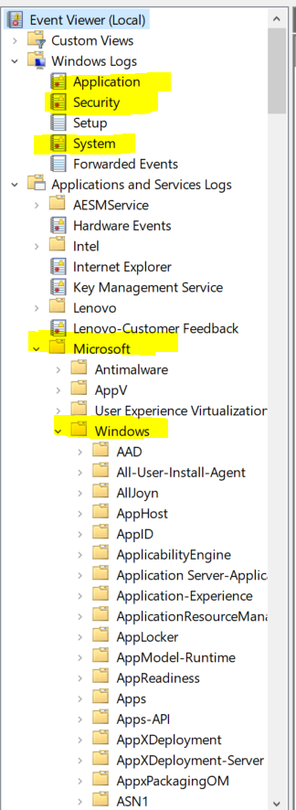
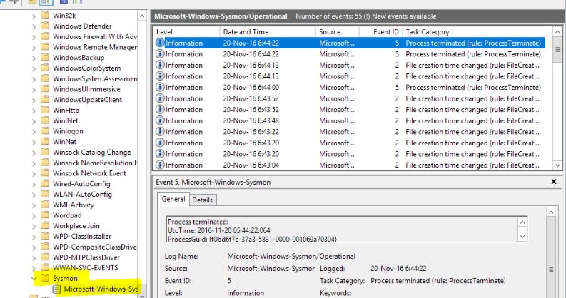
Check logs of sysmon in EventViewer

Slide 9
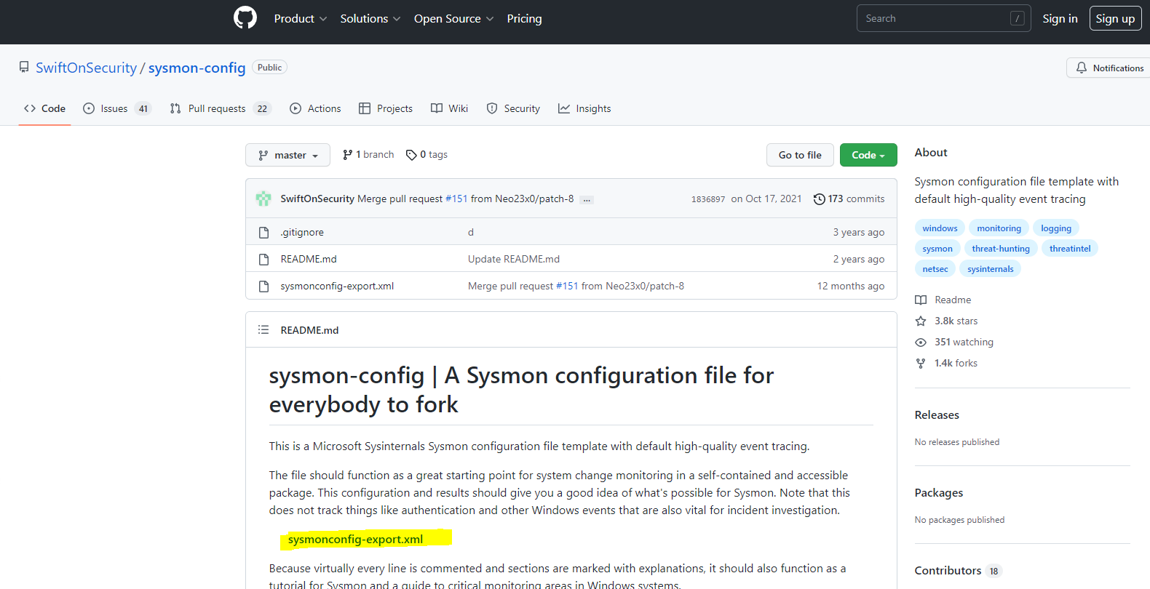
Swiftonsecurity - Sysmon config file
https://github.com/SwiftOnSecurity/sysmon-config

Slide 10
sysmon.exe -accepteula -i sysmonconfig-export.xml
Update sysmon configuration
sysmon.exe -accepteula -i sysmonconfig-export.xml
t.xml

Slide 11
Thank you

