Slide 1
Mahesh Perla
Sr. Member Technical

Slide 2
Importance of
JAVASCRIPT
Today

Slide 3
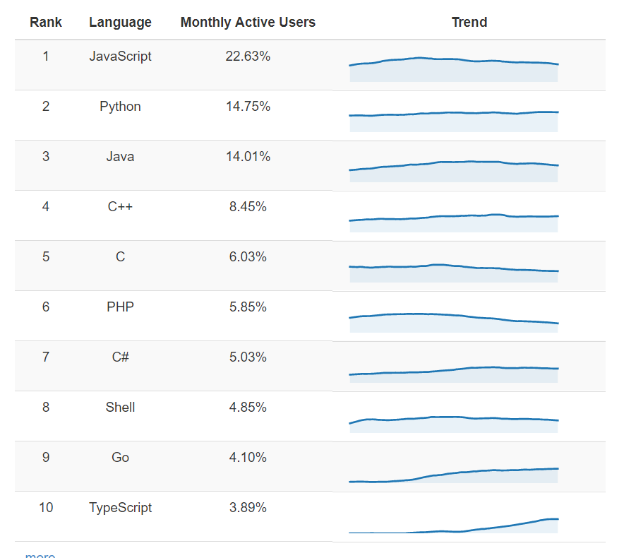
POPULAR LANGUAGES
Source: https://www.benfrederickson.com/ranking-programming-languages-by-github-users/

Slide 4
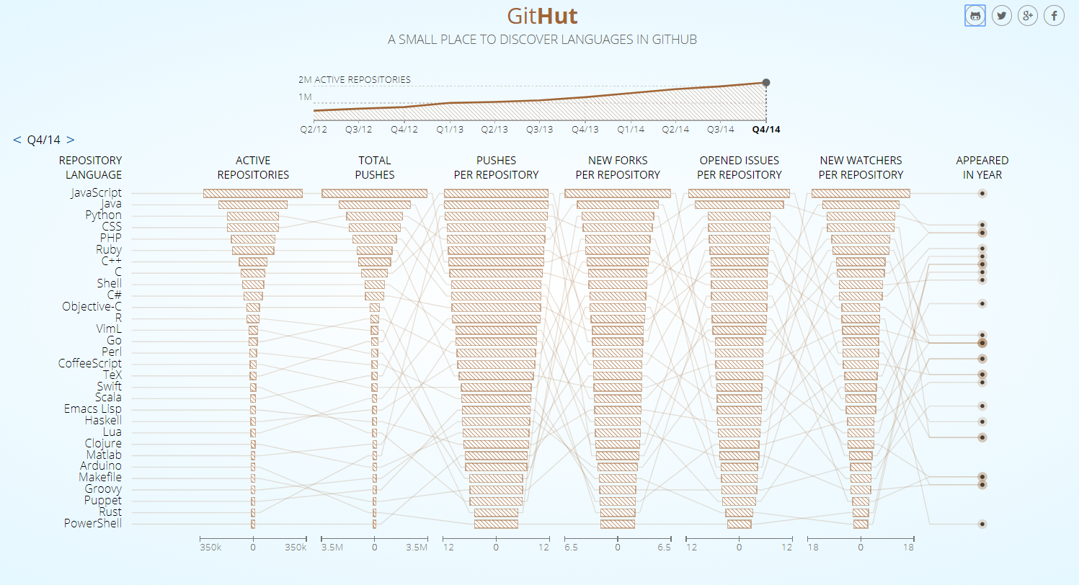
Trendzzz in REPO’s
http://githut.info/

Slide 5
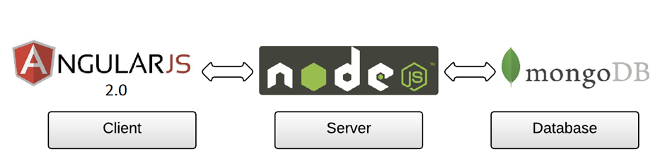
Building an APP

Slide 6
Domains
Domain | Frameworks
Client-side Scripting | Angular, React , Vue
Server-side Scripting | Node
Mobile Development | React Native, Ionic
Augmented Reality | A-Frame, AR Studio
Web Components | Polymer
Artificial Intelligence & Machine Learning | Tensorflow
Crypto Currency | Block Chain
Bundlers | Grunt, Gulp, Webpack
Webserver | Webpack-dev-server, lite-server
Command Line Interface(CLI) | Ember, angular-cli, react-cli

Slide 7
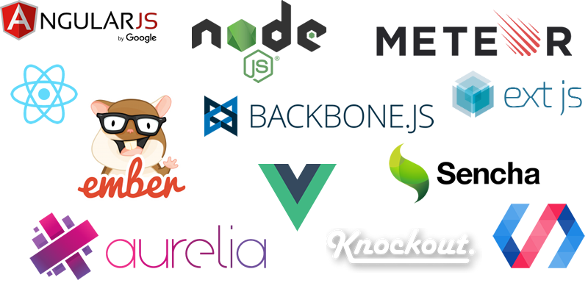

Slide 8
THANK
YOU!

