Slide 1
Unit -5 Structures, Unions and Files

Slide 2
1. Structure in C Programming
Structure is a user-defined data type in C language.
Structure is a group of variables of different data types represented by a single name.
The, struct keyword is used to define the structure.

Slide 3
Syntax of structure
struct structure_name
{
data_type member1;
data_type member2;
.
.
data_type memeberN;
};

Slide 4
Example for structure
struct employee
{ int id;
char name[10];
float salary;
};

Slide 5
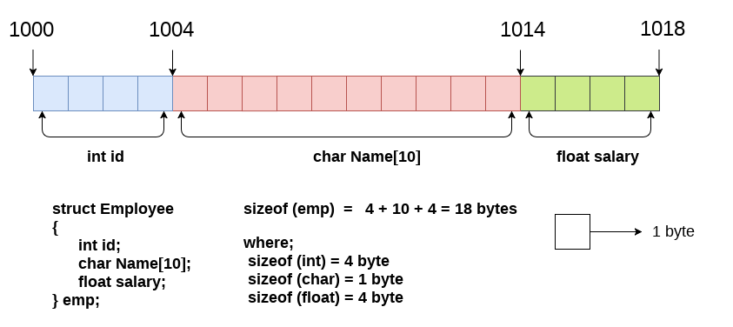
memory allocation of the structure employee

Slide 6
Declaring Structure Variables
Declaring structure variable separately:
struct Student
{
char name[30];
int age;
char branch[10]
char gender;
};
struct Student s1, s2;

Slide 7
2. Declaring structure variable with structure definition:
struct Student
{
char name[30];
int age;
char branch[10]
char gender;
}s1, s2;

Slide 8
Accessing members of the structure
There are two ways to access structure members:
By . (member or dot operator)
By -> (structure pointer operator)

Slide 9
#include<stdio.h>
struct Student{
int id;
char name[20];
int age;
};
int main() {
struct Student stud;
printf("Enter the Student details:\n");
printf("Enter the Student id:\n");
scanf("%d",&stud.id );
printf("Enter the Student Name:\n");
scanf("%s",&stud.name);
printf("Enter the Student age:\n");
scanf("%d",&stud.age);
printf("Student Name is: %s", stud.name);
printf("\nStudent Id is: %d", stud.id);
printf("\nStudent Age is: %d", stud.age);
}

Slide 10
Output:
Enter the Student details:
Enter the Student id: 007
Enter the Student Name: Suresh
Enter the Student age: 20
Student Name is: Suresh
Student id is: 7
Student age is: 20

Slide 11
2. Nested Structures
Nesting of structures, is also permitted in C language. Nested structures means, that one structure has another stucture.
Structure with in another structure.

Slide 12
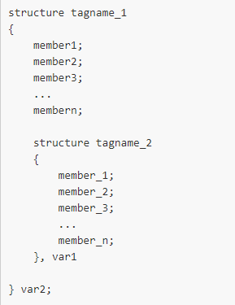
syntax

Slide 13
example
struct salary {
int id;
char name[30];
float basic;
struct allowance {
int TA;
int DA;
int HRA;
}allo;
}emp;

Slide 14
#include<stdio.h>
struct salary {
int id;
char name[30];
float basic;
struct allowance {
int TA;
int DA;
int HRA;
}allo;
}emp;
int main()
{
printf("Enter the Salary details:\n");
printf("Enter the Employee id:\n");
scanf("%d",&emp.id );
printf("Enter the Employee Name:\n");
scanf("%s",&emp.name);

Slide 15
printf("Enter the Employee Basic salary:\n");
scanf("%f",&emp.basic);
printf("Enter the DA: ");
scanf("%d",&emp.allo.DA);
printf("Enter the HRA: ");
scanf("%d",&emp.allo.HRA);
printf("Enter the TA: ");
scanf("%d",&emp.allo.TA);
emp.basic = emp.basic+emp.allo.DA+emp.allo.HRA+emp.allo.TA;
printf("Employee Name is: %s", emp.name);
printf("\nEmployee Id is: %d", emp.id);
printf("\nEmployee salary is: %f", emp.basic);
return 0;
}

Slide 16
Output:
Enter the Salary details:
Enter the Employee id: 007
Enter the Employee Name: Suresh
Enter the Employee Basic salary: 40000
Enter the DA: 4000
Enter the HRA: 3000
Enter the TA: 5000
Employee Name is: Suresh
Employee Id is: 7
Employee salary is: 52000.000000

Slide 17
3. Array of Structure
We can also declare an array of structure variables.
in which each element of the array will represent a structure variable.
Example : struct employee emp[5];

Slide 18
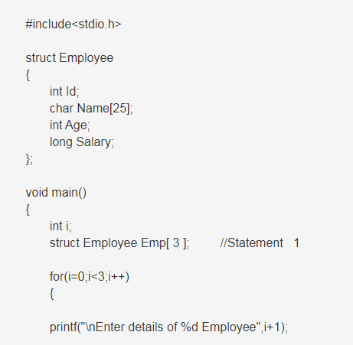

Slide 19
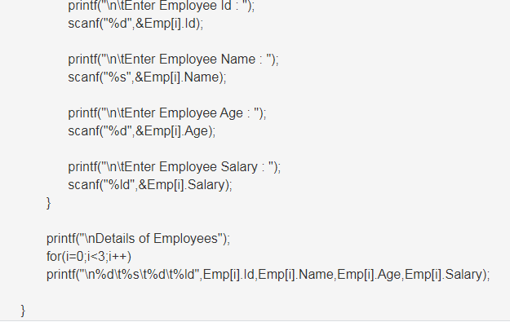

Slide 20
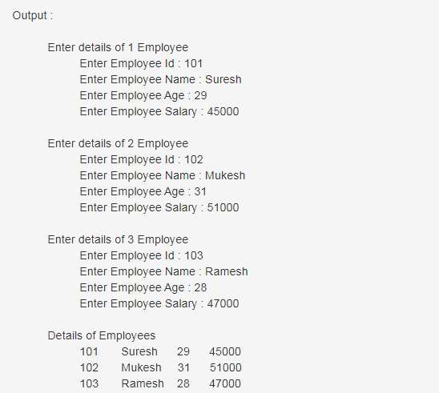

Slide 21
4. Structure as Function Arguments
We can pass a structure as a function argument just like we pass any other variable or an array as a function argument.

Slide 22
#include <stdio.h>
struct student {
char name[50];
int age;
};
void display(struct student s);
int main() {
struct student s1;
printf("Enter name: ");
scanf(“%c", s1.name);
printf("Enter age: ");
scanf("%d", &s1.age);
display(s1);
return 0;
}

Slide 23
void display(struct student s)
{
printf("\nDisplaying information\n");
printf("Name: %s", s.name);
printf("\nAge: %d", s.age);
}
Output:
Enter name: Mahesh
Enter age: 22
Displaying information
Name: Mahesh
Age: 22

Slide 24
5. Self Referential Structures
Self Referential structures are those structures that have one or more pointers which point to the same type of structure, as their member.
In other words, structures pointing to the same type of structures are self-referential

Slide 25
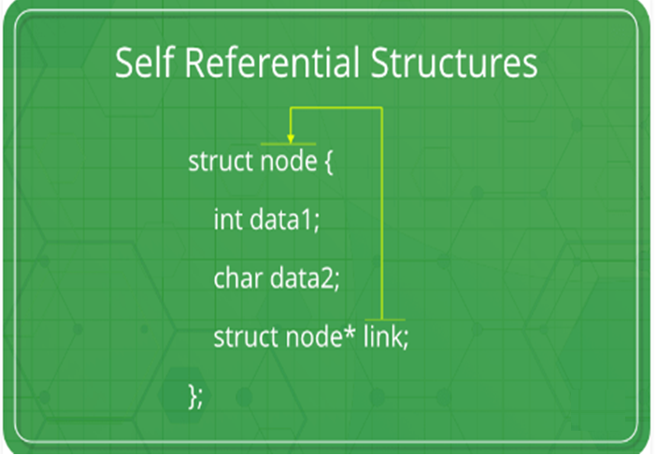

Slide 26
Example Program
struct node {
int data1;
char data2;
struct node* link;
};
int main()
{
struct node ob;
return 0;
}

Slide 27
Types of Self Referential Structures
Self Referential Structure with Single Link
Self Referential Structure with Multiple Links

Slide 28
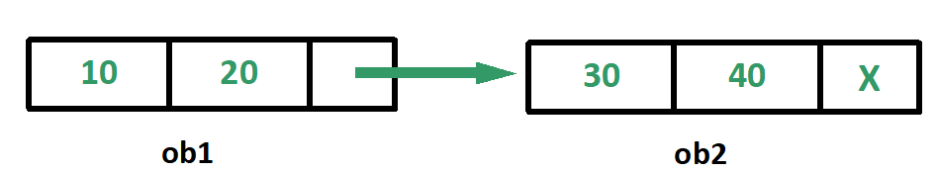
a. Self Referential Structure with Single Link
These structures can have only one self-pointer as their member.

Slide 29
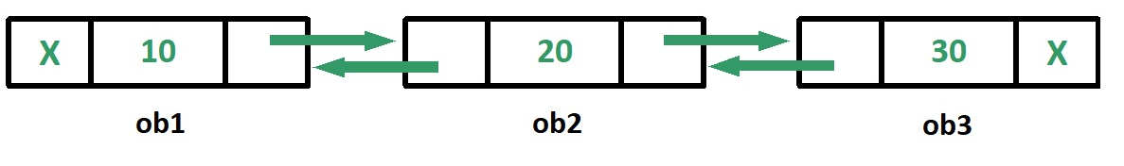
b. Self Referential Structure with Multiple Links
Self referential structures with multiple links can have more than one self-pointers.

Slide 30
Applications
Self referential structures are very useful in creation of other complex data structures like:
Linked Lists
Stacks
Queues
Trees
Graphs etc.

Slide 31
6. Unions in C Programming
Like structure, Union in c language is a user-defined data type that is used to store the different type of elements.
A union is a special data type available in C that allows to store different data types in the same memory location.

Slide 32
Unions in C Programming Cont...
At once, only one member of the union can occupy the memory.
In other words, we can say that the size of the union in any instance is equal to the size of its largest element.

Slide 33
Defining a Union
Syntax:
union union_name {
data_type member1;
data_type member2;
:
:
data_type memeberN;
} [one or more union variables];

Slide 34
Example
union employee {
int id;
char name[50];
float salary;
};

Slide 35
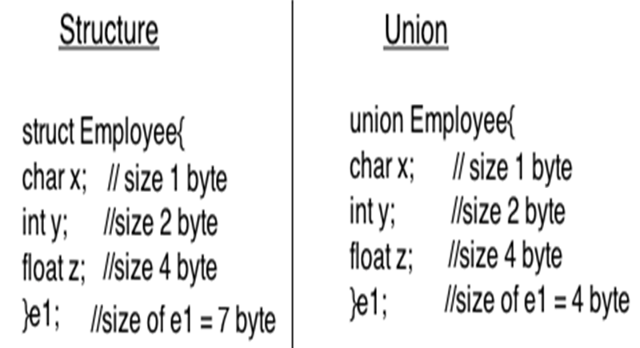

Slide 36
Advantage of union over structure:
It occupies less memory because it occupies the size of the largest member only.
Disadvantage of union over structure:
Only the last entered data can be stored in the union.
It means, it overwrites the data previously stored in the union.

Slide 37
#include<stdio.h>
int main()
{
union test {
int x;
char name[20];
float y;
};
union test t;
printf(" Memory size of Union - test is : %d", sizeof(t));
return 0;
}

Slide 38
Output:
Memory size of Union - test is : 20

Slide 39
7. Enumeration (or enum) in C
The enum in C is also known as the enumerated type.
It is a user-defined data type that consists of integer values, and it provides meaningful names to these values.
The use of enum in C makes the program easy to understand and maintain.
The enum is defined by using the enum keyword.

Slide 40
Syntax:
enum flag{integer_const1, integer_const2,....., integter_constN};
For example:
enum fruits{mango, apple, strawberry, papaya};
enum fruits { mango=2, apple=1, strawberry=5, papaya=7 };

Slide 41
Enumerated type declaration
enum status {false, true};

Slide 42
#include <stdio.h>
enum week {Mon, Tue, Wed, Thur, Fri, Sat, Sun};
int main()
{
enum week day;
day = Wed;
printf("%d", day);
return 0;
}
Output: 2

Slide 43
#include<stdio.h>
enum year { Jan, Feb, Mar, Apr, May, Jun, Jul, Aug, Sep, Oct, Nov, Dec};
int main()
{
int i;
for (i=Jan; i<=Dec; i++)
printf("%d ", i);
return 0;
}
Output:
0 1 2 3 4 5 6 7 8 9 10 11

Slide 44
8. typedef in C
The typedef is a keyword used in C programming to provide some meaningful names to the already existing variable in the C program.
In short, we can say that this keyword is used to redefine the name of an already existing variable.

Slide 45
Syntax of typedef
typedef <existing_name> <alias_name>
In the above syntax, 'existing_name' is the name of an already existing variable while 'alias name' is another name given to the existing variable.

Slide 46
#include <stdio.h>
int main()
{
typedef unsigned int unit;
unit i,j;
i=10;
j=20;
printf("Value of i is :%d",i);
printf("\nValue of j is :%d",j);
return 0;
}
Output
Value of i is :10
Value of j is :20

Slide 47
9. Bit Fields
In C programming language we can specify size (in bits) of structure and union members.
The idea is to use memory efficiently when we know that the value of a field or group of fields will never exceed a limit or is within a small range.

Slide 48
#include <stdio.h>
struct test1 {
unsigned int width;
unsigned int height;
};
struct test2 {
unsigned int width : 5;
unsigned int height : 8;
};
int main()
{
printf("Size of test1 is %lu bytes\n", sizeof(struct test1));
printf("Size of test2 is %lu bytes\n", sizeof(struct test2));
return 0;
}

Slide 49
Output:
Size of test1 is 8 bytes
Size of test2 is 4 bytes

Slide 50
Files in C

Slide 51
Introduction to files
File handling in C enables us to create, update, read, and delete the files stored on the local file system.
Types of Files
There are two types of files :
Text files
Binary files

Slide 52
1. Text files
Text files are the normal ”.txt” files.
You can easily create text files using any simple text editors such as Notepad.
2. Binary files
Binary files are mostly the “.bin” files in your computer.
Instead of storing data in plain text, they store it in the binary form (0's and 1's).

Slide 53
Using files in C
To use files in c ,we must follow the steps:
1. Declare a file pointer
2. Open the file
3. Process the file
4. Close the file

Slide 54
Using files in C
To use files in c ,we must follow the steps:
1. Declare a file pointer
2. Open the file
3. Process the file
4. Close the file

Slide 55
1.Declare a file pointer
There can be a number of files in the disk.
In order to access a particular file, you must specify the file path.
This is accomplished by file pointer variable.
Syntax:
FILE *file_pointer_name;
Ex:
FILE *fp;
Here fp is declared as a file ponter.

Slide 56
2.Open the file
A file must first opened before data can be read from it or written to it.
To open a file we use fopen() function.
Opening a file is performed using the fopen() function defined in the stdio.h header file.

Slide 57
Opening an existing file
The syntax for opening a file in standard I/O is:
ptr = fopen("filename.extension","mode");
For example:
fopen("E:\\cprogram\\newprogram.txt","w");
fopen("E:\\cprogram\\oldprogram.bin","rb");

Slide 58
The file name should be string. If the file is stored at some specific location, then we must mention the path at which the file is stored. For example, a file name can be
like "c://some_folder/some_file.ext".
The mode in which the file is to be opened. It is a string.

Slide 59
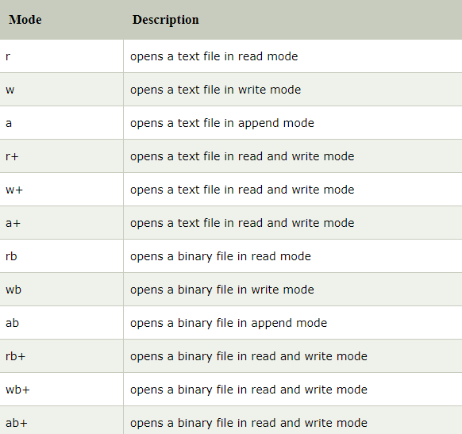

Slide 61
#include <stdio.h>
#include <stdlib.h>
int main()
{
int num;
FILE *fptr;
fptr = fopen("D:\\program.txt","w");
if(fptr == NULL)
{
printf("Error!");
exit(1);
}
printf("Enter num: ");
scanf("%d",&num);
fprintf(fptr,"%d",num);
fclose(fptr);
return 0;
}

Slide 62
Closing File: fclose()
The fclose() function is used to close a file.
The file must be closed after performing all the operations on it.
Sy: fclose( FILE *fp );
Ex: fclose(fptr);

Slide 63
Reading from text files
C provides following set of functions to read data from a file.
fscanf()
fgets()
fgetc()
fread()
fgetw()

Slide 64
fscanf ()
Reading a block of data from a file.
fscanf() function is used to read formatted data from a file.
Declaration:
fscanf(file pointer, “control strings”, list of var);
Ex:
fscanf (fp, “%d”, &age);
fscanf (fp, “%d%d%s”, &id,&age,&name);

Slide 65
Example program
#include <stdio.h>
main(){
FILE *fp;
char buff[255]; //creating char array to store data of file
fp = fopen("file.txt", "r");
while(fscanf(fp, "%s", buff)!=EOF){
printf("%s ", buff );
}
fclose(fp);
}
Output: Hello file by fprintf...

Slide 66
fgets()
fgets function is used to read a file line by line in a C program.
Declaration:
char *fgets(char *string, int n, FILE *fp);
Ex:
fgets (info, size, fp);
Where info –to put the file content, size – size of the info, and fp – file pointer

Slide 67
Read from a given file using fgets()
#include<stdio.h>
int main()
{
char string[20];
FILE *fp;
fp=fopen("file.txt","r");
fgets(string,20,fp);
printf("The string is: %s",string);
fclose(fp);
return 0;
}

Slide 68
fgetc()
used to read a character from a file.
It reads single character at a time and moves the file pointer position to the next address/location to read the next character.
Declaration:
int fgets(FILE *fp);
Ex: fgets(fp);

Slide 69
#include<stdio.h>
#include<conio.h>
void main(){
FILE *fp;
char c;
clrscr();
fp=fopen("myfile.txt","r");
while((c=fgetc(fp))!=EOF){
printf("%c",c);
}
fclose(fp);
getch();
}
myfile.txt
this is simple text message

Slide 70
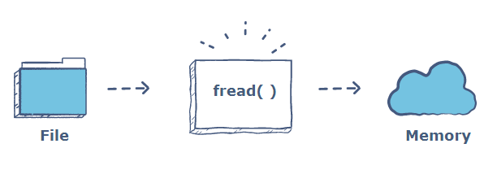
fread()
In C, the fread() function is used to read data from a file and store it in a buffer.

Slide 71
Syntax:
size_t fread(void *ptr, size_t size, size_t n, FILE *fp);
Ex:
int val;
fread(&val, sizeof(int), 1, fp);

Slide 72
fgetw()
getw function reads an integer value from a file pointed by fp.
In a C program, we can read integer value from a file as below.
Declaration:
int fgetw(FILE *fp);
Ex:
fgetw(fp);

Slide 73
C provides the following set of functions to write data into file:
fprintf()
fputs()
fputc()
fwrite()
fputw()

Slide 74
fprintf()
The fprintf() function is used to write set of characters into file. It sends formatted output to a stream.
Syntax:
int fprintf(FILE *stream,“control strings”, list of var);

Slide 75
Example
#include <stdio.h>
main(){
FILE *fp;
fp = fopen("file.txt", "w");
fprintf(fp, " %s ", "Hello file by fprintf...\n");
fclose(fp);
}

Slide 76
fputs()
The fputs() function writes a line of characters into file. It outputs string to a stream.
Syntax:
int fputs(const char *s, FILE *stream) ;

Slide 77
example
#include<stdio.h>
#include<conio.h>
void main()
{
FILE *fp;
clrscr();
fp=fopen("myfile2.txt","w");
fputs("hello c programming",fp);
fclose(fp);
getch();
}
myfile2.txt
hello c programming

Slide 78
fputc()
The fputc() function is used to write a single character into file. It outputs a character to a stream.
Syntax:
int fputc(char c, FILE *stream) ;

Slide 79
example
#include <stdio.h>
main(){
FILE *fp;
fp = fopen("file1.txt", "w");//opening file
fputc('a',fp);//writing single character into file
fclose(fp);
}
Output:
file1.txt
a

Slide 80
fwrite()
fread() and fwrite() functions are commonly used to read and write binary data to and from the file respectively.
Syntax:
size_t fwrite(const void *ptr, size_t size, size_t nmemb, FILE *stream);

Slide 81
fputw()
The putw() function is used to write integers to the file.
Syntax of fputw() function
fputw(int number, FILE *fp);

Slide 82
Random file access
There is no need to read each record sequentially, if we want to access a particular record.
C supports these functions for random access file processing.
fseek()
ftell()
rewind()

Slide 83
i. fseek()
This function is used for seeking the pointer position in the file at the specified byte.
Syntax:
fseek( file pointer, displacement, pointer position);
Where file pointer ---- It is the pointer which points to the file. displacement ---- It is positive or negative.

Slide 84
Ex:
fseek( p,10L,0)
0 means pointer position is on beginning of the file, from this statement pointer position is skipped 10 bytes from the beginning of the file.
fseek( p,5L,1)
1 means current position of the pointer position. From this statement pointer position is skipped 5 bytes forward from the current position.
3) fseek( p,8L,2)
2 means End file position. From this statement pointer position is skipped 8 bytes forward from the current position.

Slide 85
ii. ftell()
This function returns the value of the current pointer position in the file.
The value is count from the beginning of the file.
Syntax:
ftell(fptr);
Where fptr is a file pointer.

Slide 86
iii. rewind()
This function is used to move the file pointer to the beginning of the given position.
Syntax:
rewind( fptr); Where fptr is a file pointer.

Slide 87
Write a program to read last ‘n’ characters of the file using appropriate file functions(Here we need fseek() and fgetc()).
#include<stdio.h>
void main()
{
FILE *fp;
char ch;
fp=fopen("file1.c", "r");
if(fp==NULL)
printf("file cannot be opened");

Slide 88
else
{
printf("Enter value of n to read last ‘n’ characters");
scanf("%d",&n);
fseek(fp,-n,2);
while((ch=fgetc(fp))!=EOF)
{
printf("%c\t",ch);
}
}
fclose(fp);
}

Slide 89
#include <stdio.h>
#include<conio.h>
void main ()
{
FILE *f;
int len;
f = fopen("one.txt", "r");
if(f == NULL) {
printf(“Error opening file”);
return(-1);
}
fseek(f, 0, 2);
len = ftell(f);
fclose(f);
printf("Size of file: %d bytes", len);
getch();
}

Slide 90
#include <stdio.h>
int main ()
{
char str[] = "This is tutorialspoint.com";
FILE *fp;
int ch;
fp = fopen( "file.txt" , "w" );
fwrite(str , 1 , sizeof(str) , fp );
fclose(fp);
fp = fopen( "file.txt" , "r" );
while(1)
{
ch = fgetc(fp);
if( feof(fp) )
{
break ;
}
printf("%c", ch);
}

Slide 91
rewind(fp);
printf("\n");
while(1) {
ch = fgetc(fp);
if( feof(fp) )
{
break ;
}
printf("%c", ch);
}
fclose(fp);
return(0);
}

Slide 92
End of the Unit 5

