Slide 1
Pocket Farm

Slide 2

Hello!
I Nandakrishnan Nair
Exam no. 57
Im here to present my Project on E Farming

Slide 3
1.
Visit the Farm
Let’s start with the first set of slides

Slide 4
“Get Closer than ever to your customers. So close that you can tell them what they need well before they realize it themselves”
-Steve Jobs

Slide 5
We will Cover...
Problem Satement
Purpose, Scope and Objective
Working
Documentation
Modules
Conclusion

Slide 6
Big concept
We bring the Farmers and Customers closer than ever before…

Slide 7
Problem Statement
Problem Statement is on the basis of both our Users - Farmers and Customers
Farmers
Farmers don’t get the Price for their crops worth the hardwork they put in.
Buyers are under limited reach due to geographical conditions.
Customers
Customers get the products at three to four times higher price .
Customers don’t get farm fresh products with minimal artificial processing.

Slide 8
Purpose, Scope & Objective
Purpose
To bring Farmers and Customers close.
To let Farmers meet their price demands
To let customers have products at cheaper Prices
Scope
Farmer can post an auction on their products
Customers can Choose amongst the products to bid for.
Objective
To provide complete transparency between Farmer and Customer
To make Farmer and customer reachable despite of geographical conditions

Slide 9
Software Requirements
Functional Requirements
Logins and Registrations
View profiles
View by category, product name,season.
Search by keyword, farmer name, category, product name
Password recovery
Start and End Bid
Apply for the Bid
Provide Review /add comments
Non Functional Requirements
Transparency between buyer and seller
Easy to use User Interface
Recoverability
Response time

Slide 10

Working

Slide 11

Working

Slide 12
Working

Slide 13

Working

Slide 14


Working

Slide 15
Working

Slide 16
DFD Use Case diagam ER Diagram Database design

Slide 17
Limitations
Not all the farmers might be able to use the website due to the language constraint.
The website doesn’t deal with smaller quantity purchase demands.
The customer doesn’t have the option of paying the price in installments.

Slide 18
Future Enhancements
Payment Gateway can be used to carry out the transactions.
Transport facility can be made available for the products to reach the customers.
Customer and Farmer interaction can be made possible by using on website messaging.

Slide 19
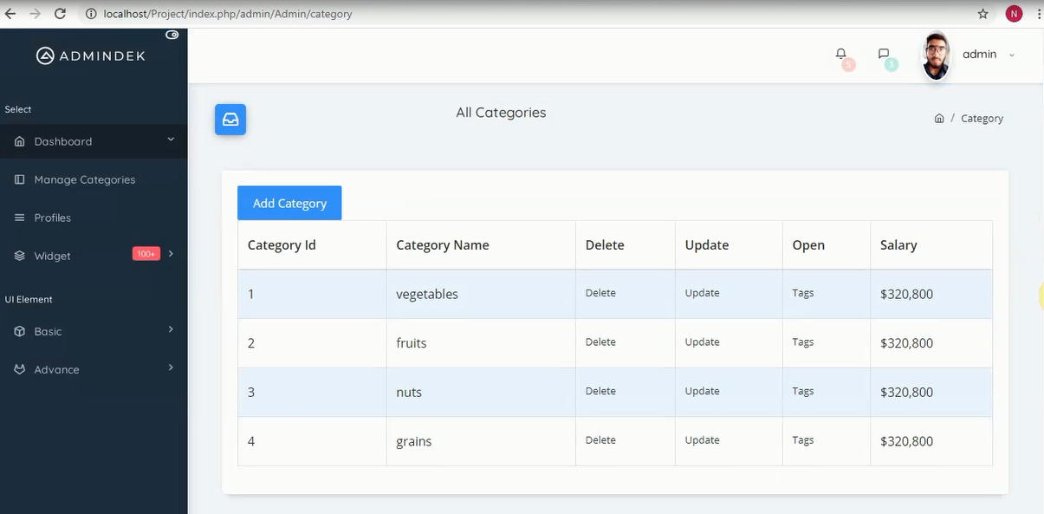
Admin Home
Admin can manage categories and tags
Place your screenshot here

Slide 20
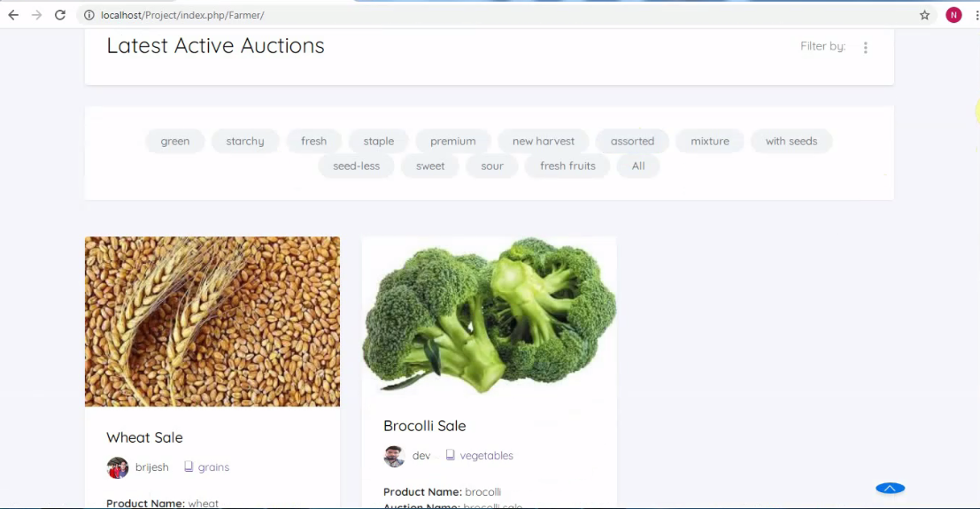
Auction Display
Active auctions displayed
Place your screenshot here

Slide 21
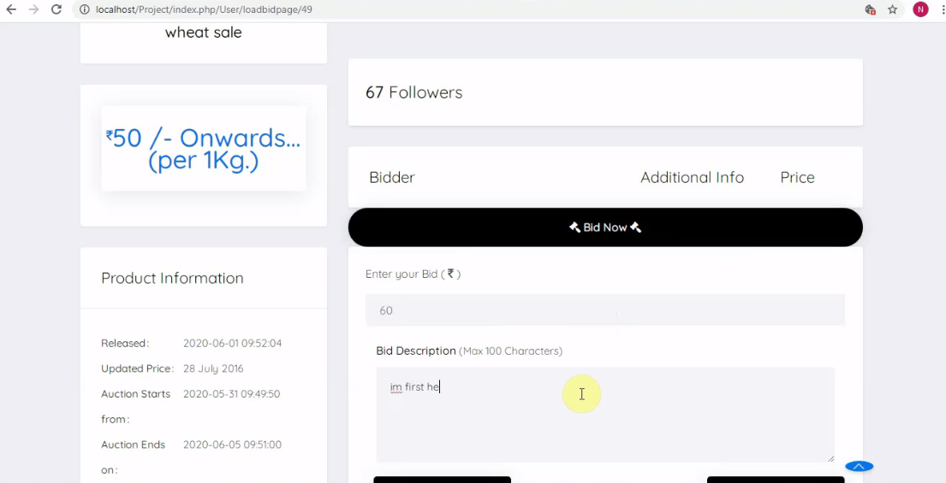
Customer can place bids
Bid Page
Place your screenshot here

Slide 22
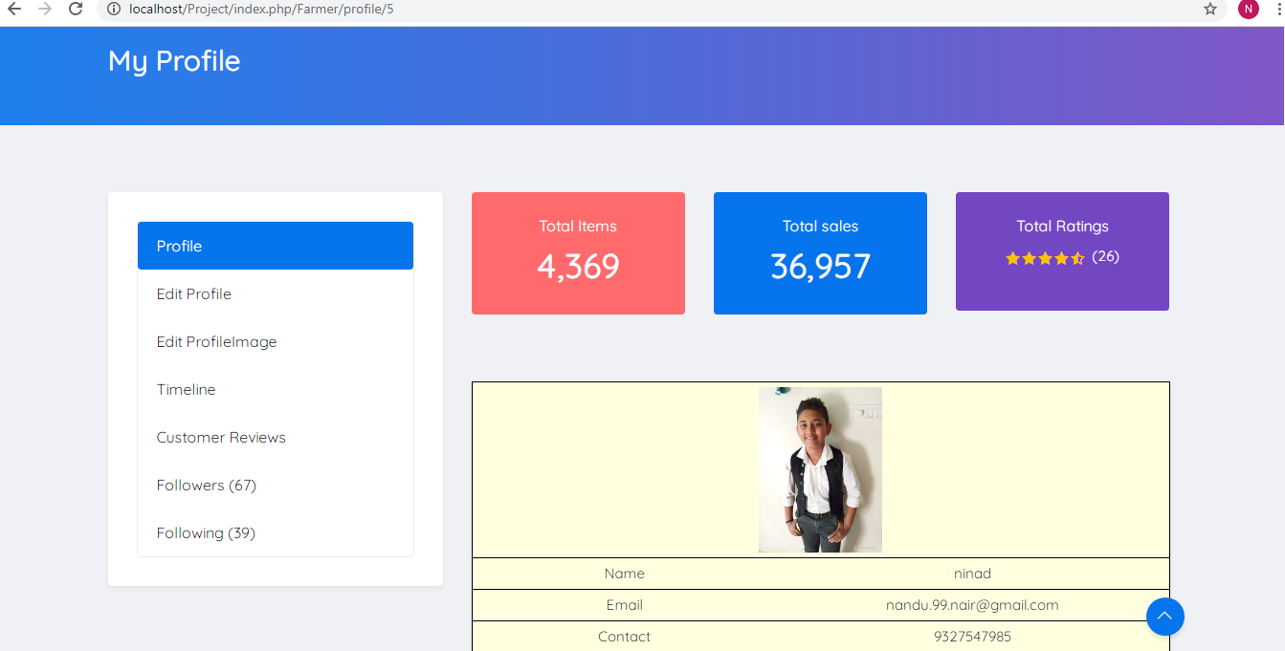
Manage Profile
Users can edit their profile
Place your screenshot here

Slide 23
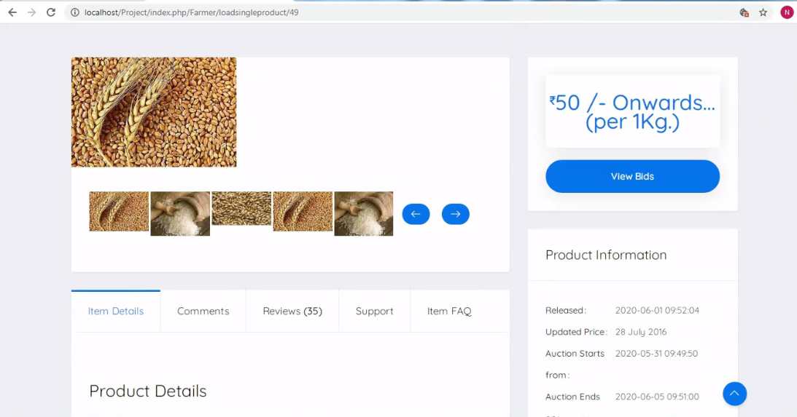
Single product info
Individual product information
Place your screenshot here

Slide 24
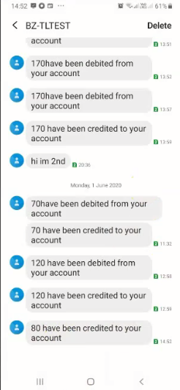
Transact-ion Message
Transaction message sent on successful transaction
Place your screenshot here

Slide 25
Thanks!
You can find me at

