Slide 1

{ }
C++ PROGRAMMING INTERNSHIP
Internship Report | Thiranex — Skill Development & Future Tech
Mahesh Pathlavath
Roll No: 2410030765 | B.Tech CSE, IILM University
Duration: 07 Aug 2026 – 06 Sept 2026

Slide 2

ORGANIZATION PROFILE
About the Organization
Thiranex is a skill development and future technology-focused organization offering structured internship and training programs.
Its programs are designed to bridge the gap between academic learning and industry expectations through practical, project-based training in programming, software development, and emerging technologies.
The internship is recognized under the Ministry of MSME, Government of India, and includes a verified certificate of completion for every intern.
Thiranex
Skill Development &
Future Tech
C++ Programming Internship | Thiranex
2

Slide 3


BACKGROUND
Introduction & Problem Statement
Introduction
Problem Statement
A one-month internship in C++ Programming at Thiranex, from 07 Aug to 06 Sept 2026, providing hands-on exposure to the language and industry-relevant coding practices. A representative console-based application, a Student Result Management System, was built to apply the concepts learned.
Many students hold theoretical programming knowledge but lack practical experience applying it. A structured, guided environment was needed to practice fundamental and object-oriented C++ concepts through real coding exercises and a small end-to-end application.
C++ Programming Internship | Thiranex
3

Slide 4

GOALS
Objectives of the Internship
Strengthen fundamental and advanced concepts of C++ programming.
Gain hands-on experience writing, debugging, and optimizing C++ code.
Apply object-oriented programming (OOP) principles in a practical application.
Design and implement a functional console-based system using C++.
Build a foundation for further learning in software development and data structures.
C++ Programming Internship | Thiranex
4

Slide 5
BOUNDARIES
Scope of the Project
In Scope
Out of Scope
Core C++ language fundamentals
Object-oriented design (classes, inheritance, polymorphism)
File handling for basic data persistence
Elementary use of the Standard Template Library (STL)
Graphical user interfaces (GUI)
Networking and client-server communication
Database connectivity
Advanced/multithreaded systems
C++ Programming Internship | Thiranex
5

Slide 6
TECH STACK
Technologies & Tools Used
Language
IDE / Compiler
Concepts
C++ (C++11/14 Standard)
GNU G++, Code::Blocks, VS Code
OOP, STL, File Handling
Version Control
Operating System
Core Practice
Git & GitHub
Windows
Console-based Application Design
C++ Programming Internship | Thiranex
6

Slide 7

STUDENT RESULT MANAGEMENT SYSTEM
System Architecture
Input / Output Layer
Handles interaction with the user through the console menu.
Business Logic Layer
Classes encapsulating student records, marks calculation, and grading logic using OOP principles.
Data Storage Layer
File handling module that reads from and writes student records to a data file for persistence.
C++ Programming Internship | Thiranex
7

Slide 8
FOUR-WEEK LEARNING PLAN
Methodology
Week 1
Week 3
C++ fundamentals — syntax, data types, control structures, and functions.
Arrays, strings, pointers, dynamic memory, and an introduction to STL.
1
2
3
4
Week 2
Week 4
Object-oriented programming — classes, objects, inheritance, and polymorphism.
Design & development of the Student Result Management System; testing and debugging.
C++ Programming Internship | Thiranex
8

Slide 9

RESULTS
Expected Outcomes & Learning
A working console-based application demonstrating core C++ and OOP concepts.
Improved proficiency in writing clean, efficient, well-structured C++ code.
Enhanced logical thinking, debugging ability, and problem-solving skills.
A stronger foundation for future coursework in data structures and software development.
C++ Programming Internship | Thiranex
9

Slide 10
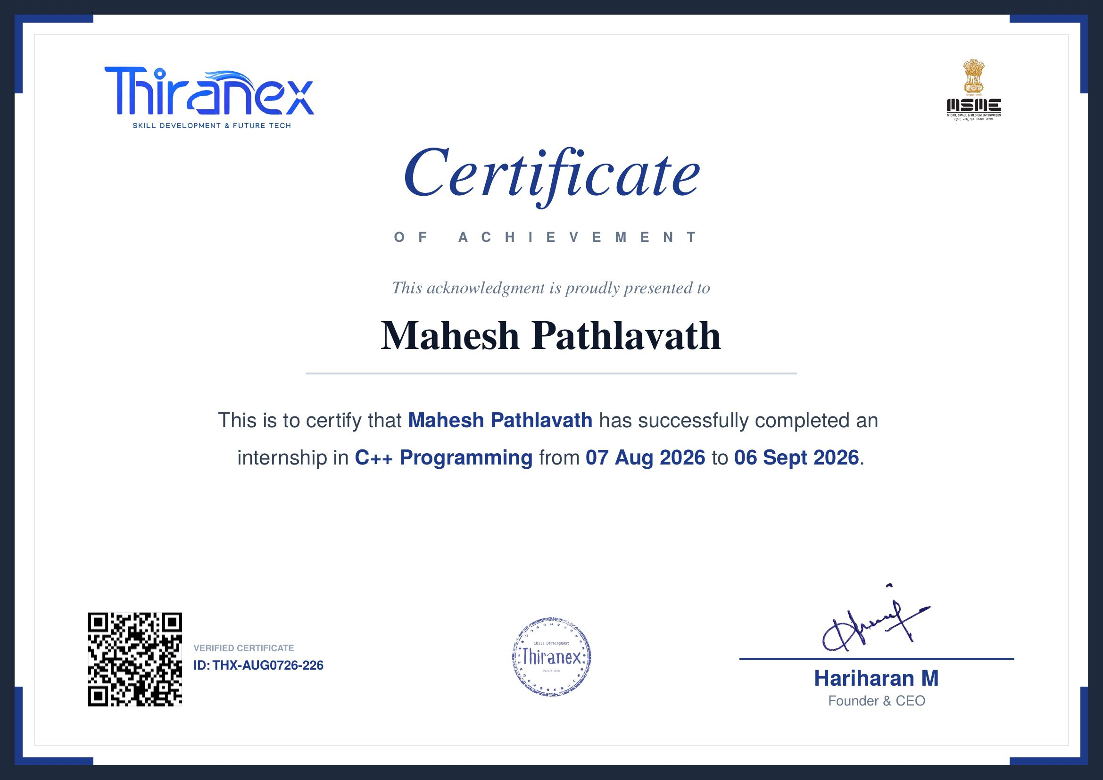
VERIFIED ACHIEVEMENT
Internship Completion Certificate
C++ Programming Internship | Thiranex
10

Slide 11
{ }
Conclusion
The internship in C++ Programming at Thiranex strengthened both theoretical knowledge and practical programming skills, building a strong foundation in C++ and OOP for future academic projects and a career in software development.
Mahesh Pathlavath
Roll No: 2410030765
Certificate ID: THX-AUG0726-226
Thank You

