Slide 1
Cloud Virtual Internship
AWS
AICTE - EduSkills | Curriculum by AWS Academy
Mahesh Pathlavath
Roll No: 2410030765 | Section: 3CSE19
B.Tech CSE, IILM University, Greater Noida

Slide 2
Internship at a Glance
8
Aug-Oct
AWS
O
Weeks
2026
Academy curriculum
Outstanding grade
Offered by EduSkills with AICTE, Ministry of Education, via the National Internship Portal.
Mahesh Pathlavath | 2410030765 | 3CSE19

Slide 3
Organization and Objectives
Objectives
EduSkills
Works with AICTE to build industry-ready skills under the vision "Nation Building Through Skills".
Runs virtual internships in cloud, AI and cybersecurity with industry partners; this one uses the AWS Academy curriculum.
Understand cloud computing concepts and models
Learn core AWS compute, storage, database and networking services
Understand security and the shared responsibility model
Learn scalability, availability and cost management
Mahesh Pathlavath | 2410030765 | 3CSE19

Slide 4
Technologies and Tools
EC2
S3
RDS
VPC
IAM
Compute
Storage
Databases
Networking
Security
Cloud platform: Amazon Web Services (AWS) | Curriculum: AWS Academy Cloud Foundations | Access: AWS Management Console on Windows
Mahesh Pathlavath | 2410030765 | 3CSE19

Slide 5
Cloud Architecture Studied
Compute Layer
Virtual servers running applications (Amazon EC2)
Storage and Database Layer
Object storage and managed databases (S3, RDS)
Networking and Security Layer
Virtual networks and access controls (VPC, IAM)
Separating compute, data and security makes solutions easier to scale and secure.

Slide 6
Methodology: 8-Week Plan
1
2
3
4
Weeks 1-2
Weeks 3-4
Weeks 5-6
Weeks 7-8
Cloud basics, service and deployment models, AWS global infrastructure
Core services: compute, storage and databases
Networking, security, IAM, shared responsibility
Architecture, availability, pricing, assessment
Mahesh Pathlavath | 2410030765 | 3CSE19

Slide 7
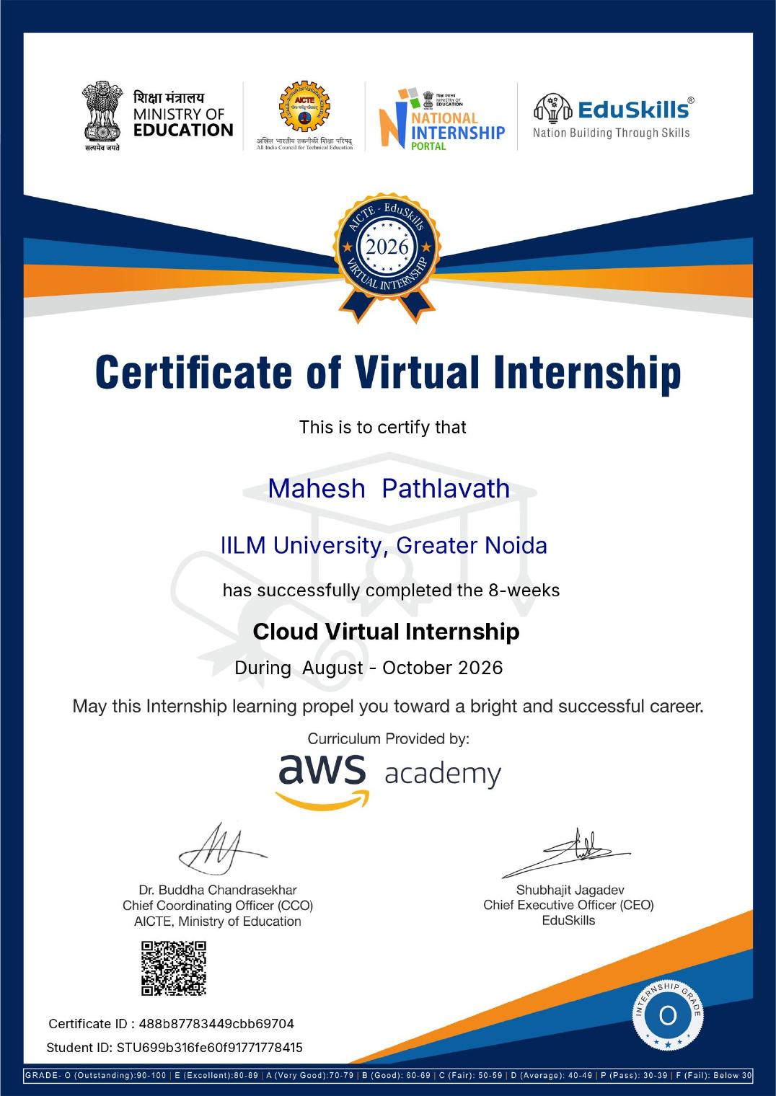
Outcomes and Certificate
Clear understanding of cloud computing and the AWS ecosystem
Familiarity with core AWS services and use cases
Awareness of cloud security, scalability and cost management
Foundation for future cloud certifications and projects
Completed with Outstanding (O) grade
Certificate ID: 488b87783449cbb69704

Slide 8
Thank You
Mahesh Pathlavath | 2410030765 | 3CSE19

