Slide 1
OLIST E-COMMERCE STORE ANALYSIS
TEAM MEMBERS :
MENTORS :
Ms. Sakshi Vijay Wagh
Ms. Tanavi Sandip Daware
Mr. Prashant Punamchand Jadhav
Mr. Akshay Sanjiv Kamble
Mr. Maheshkumar Hanamantrao Patil
Mr. Akash Kumar Kushwaha
Mr. Shubham Kabre
Mr. Sivakumar Rajasekaran
DATE :
24-06-2023

Slide 2
OBJECTIVE AND DATASET
OBJECTIVE :
Our objective as an e-commerce data analyst is to leverage data to drive informed decisions. We optimize product performance, pricing, and marketing strategies based on data insights. By understanding customer behavior, we enhance customer targeting and acquisition. Additionally, we identify operational inefficiencies and streamline processes for improved efficiency. Our goal is to contribute to the success and growth of the e-commerce store through data-driven decision-making.
ABOUT DATASETS :
Domain : E-Commerce
Project Name: Olist Store Analysis
Dataset Name: Total 9 files
Dataset Type: CSV Data

Slide 3
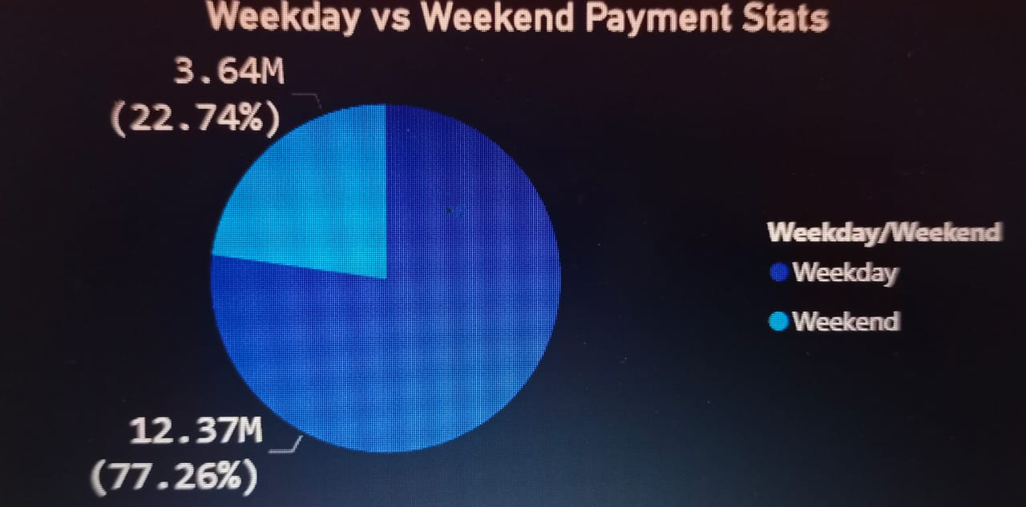
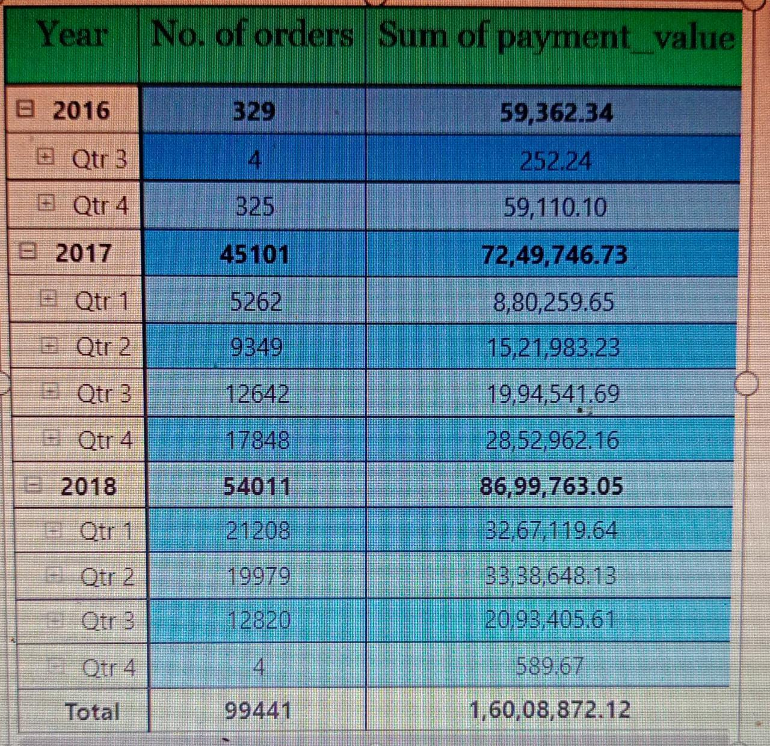
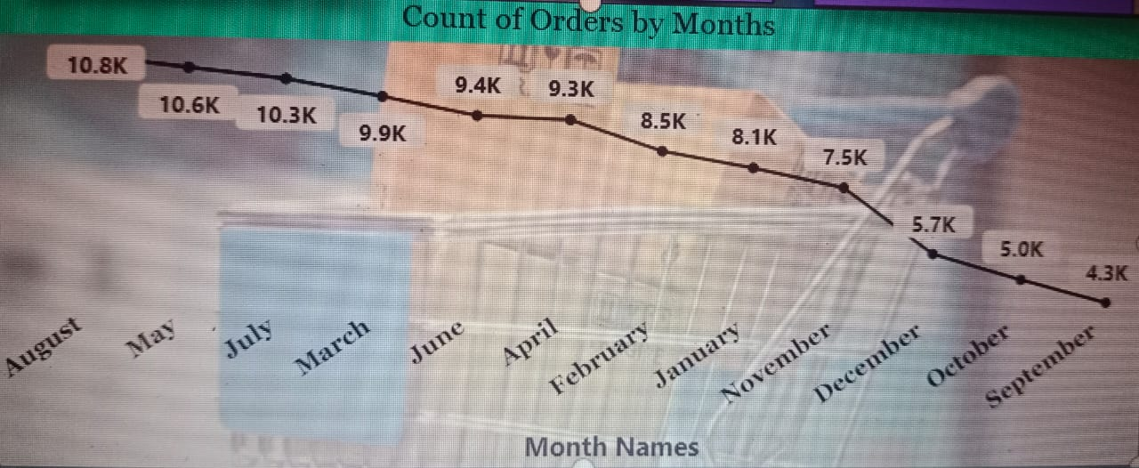
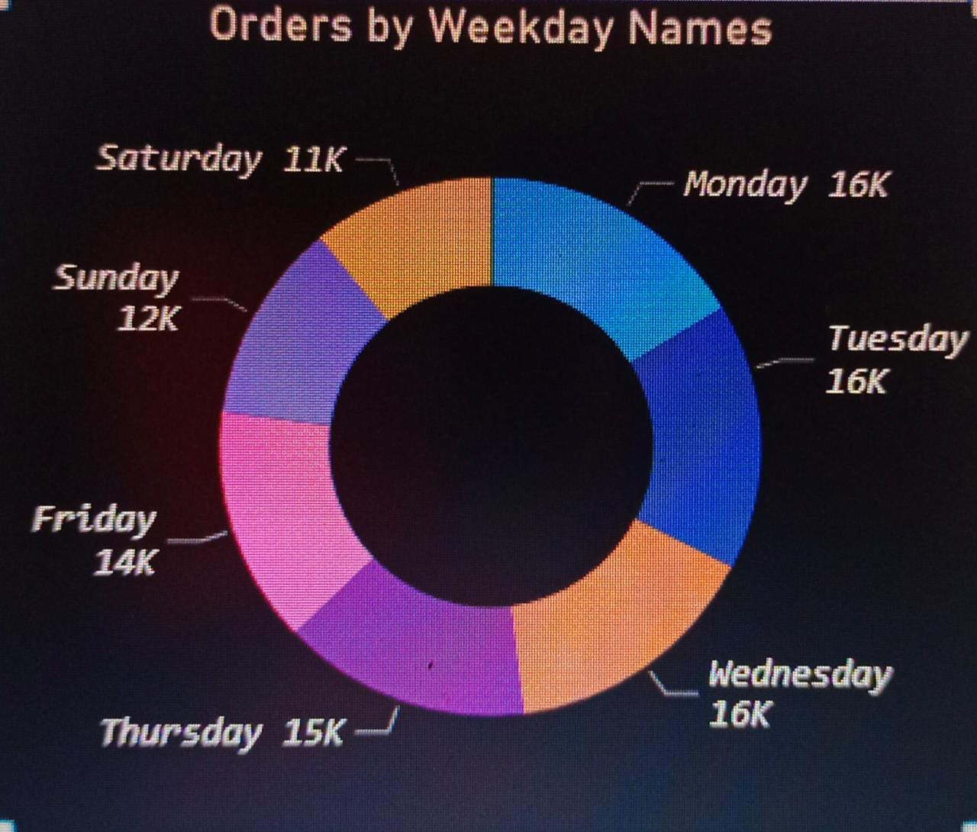
KPI-1:Weekday Vs Weekend (Order_purchase_timestamp) Payment Statistics
Key Points:
Weekday : 12.37M
Weekend : 3.64M
payment Type: Credit Card
Decrease in orders in September
No of orders increases from year 2016 to 2018
Lowest payment value is in 2016 year.
Specifically orders on weekday are much higher than orders on weekend
This could be due to a variety of factors, such as people being more likely to shop during their lunch breaks or after work on weekdays.

Slide 4
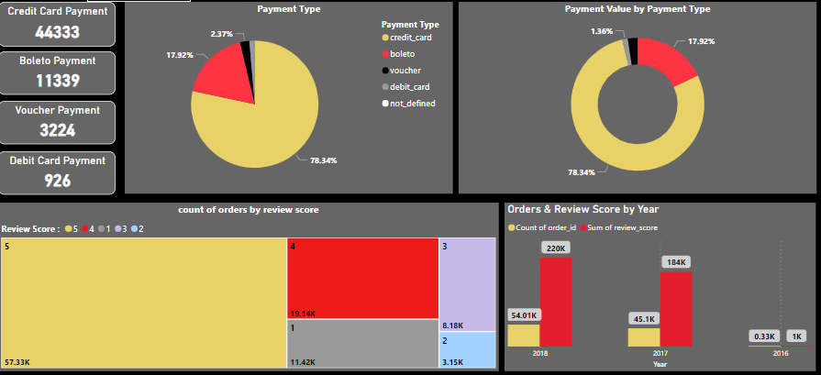
KPI-2: Number Of Orders With Review Score 5 And Payment Type As Credit Card
Key Points:
Credit card payment:44333
Boleto payment: 11339
Voucher payment: 3224
Debit card payment: 926
customer’s prefer credit card for payment, as it has highest percentage (i.e. 78.34) among all other payment types.
57.33K customers gives 5 revies score and 19.14k customers gives 4 review score.
Count of orders increases gradually from 2016 to 2018. In 2016, it was 0.33k orders, in 2017 it was 45.1k and in 2018 it was 54k.
Also sum of review score increases gradually from 2016 to 2018. it is highest in 2018 (220k).

Slide 5
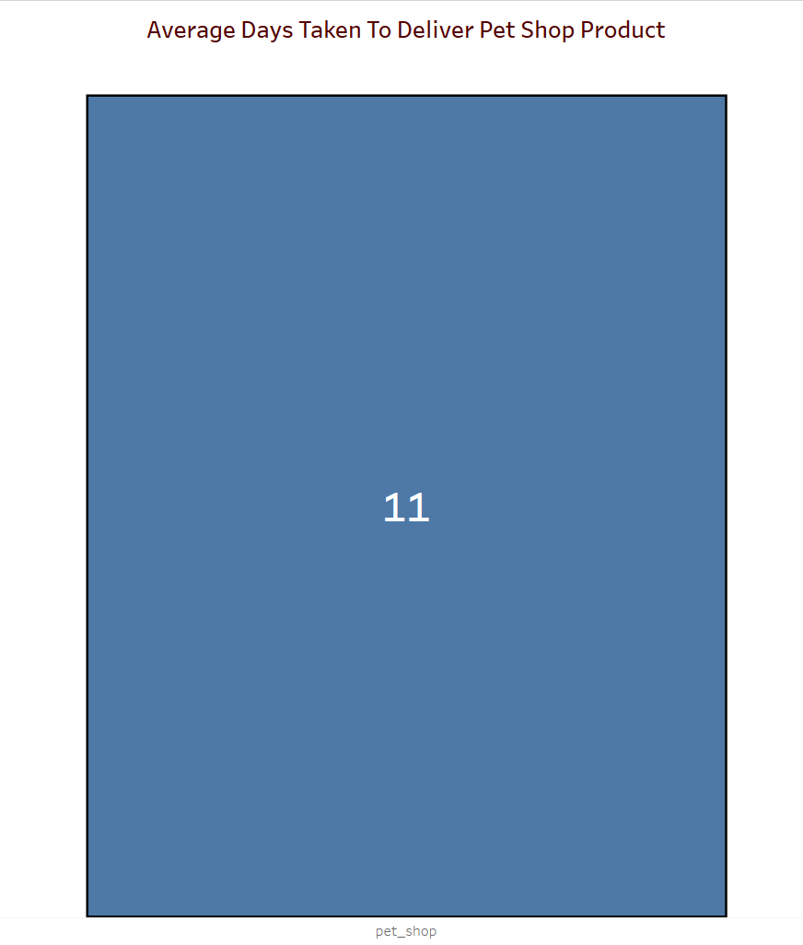
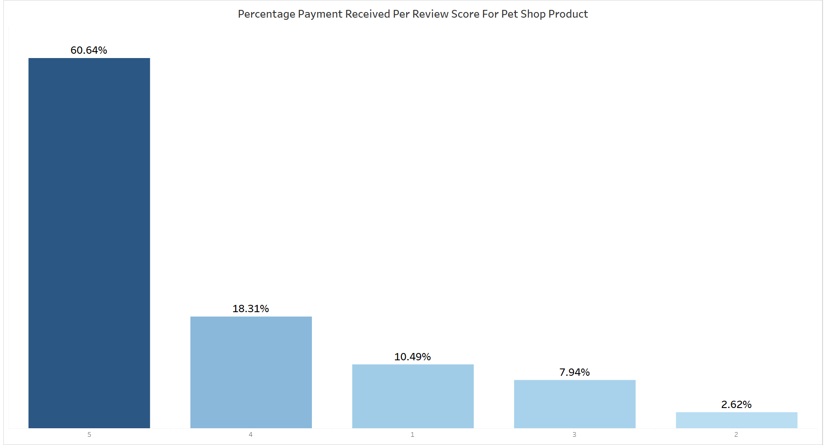
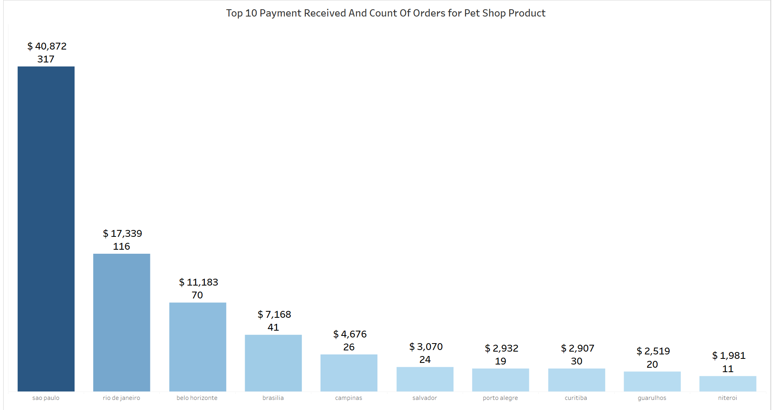
KPI 3-Average Days Taken To Deliver Pet Shop Product
Key Points:
The average time for OLIST to deliver pet shop products is 11 days.
The most often ordered goods with a rating of five and credit card payment are Cama Mesa Bano, Bleza Saude, Isporte Lazer, Moveis Decoracao, and Informetica Accessories.
The money collected by the 5 and 4 review score is around 71.39%.
We must improve our delivery service since longer delivery times have an adverse effect on our company's reputation and customer service.

Slide 6
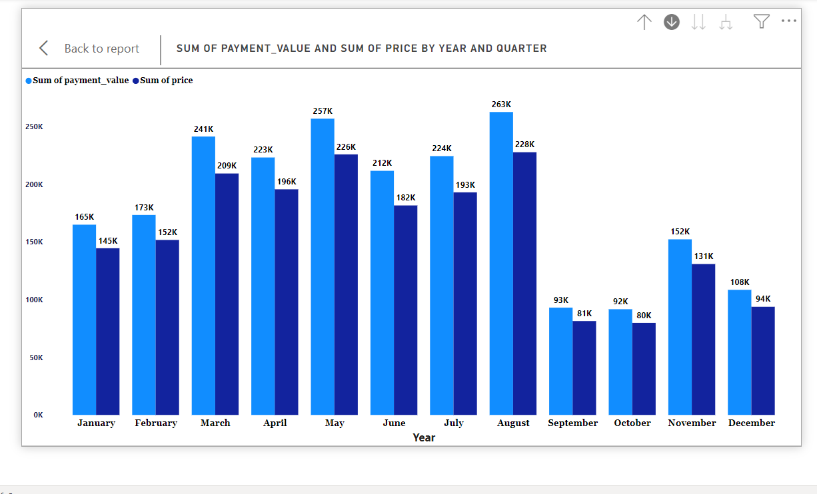
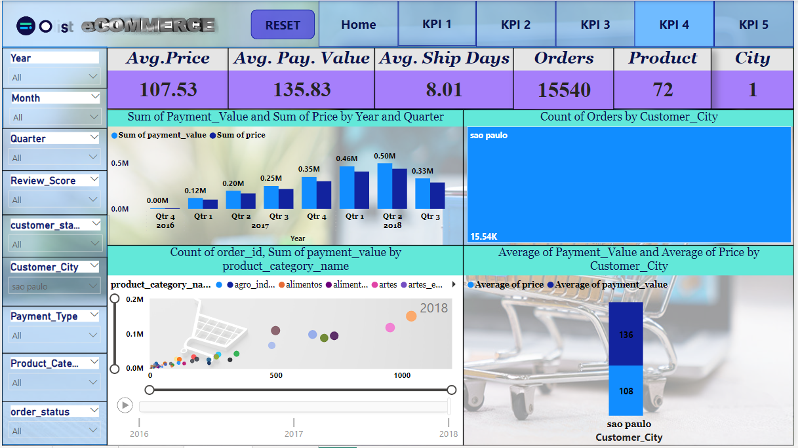
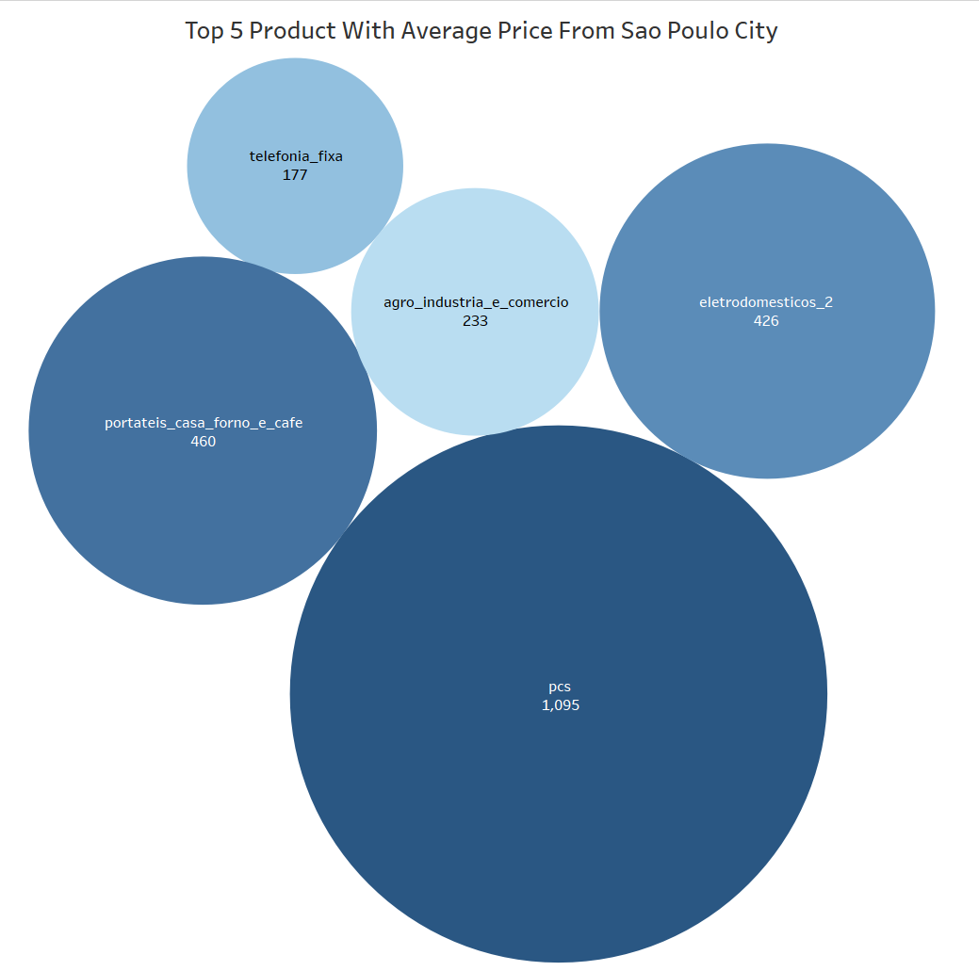
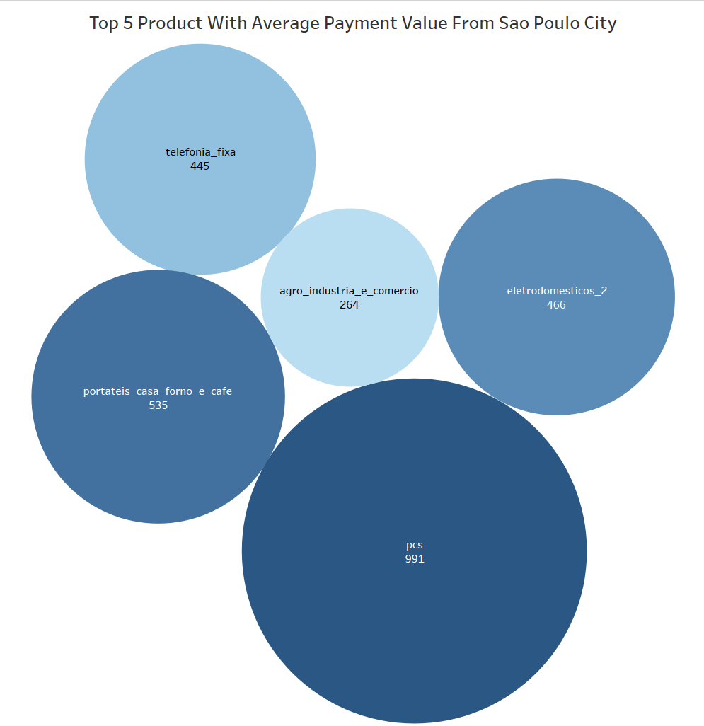
KPI 4-Average Price And Payment Values From Customers Of Sao Paulo City
Key Points:
Avg. Payment_Value : 135.83
Avg.Price : 107.53
Customers_City: Sao Paulo
September and October witnessed a decrease in the total payment values when analyzed on a monthly basis.
The top 5 items with the highest average price and payment value are agro_industria_e_comercio, pcs, telefonia_fixa, electrodomesticos, and portateis_casa_forno_e_cafe.
The only city that is making a decent profit and above the target line, according to the research on cities, is Sao Paulo. As a result, we need to examine the other cities that are having an influence on the industry and strive to improve them.

Slide 7
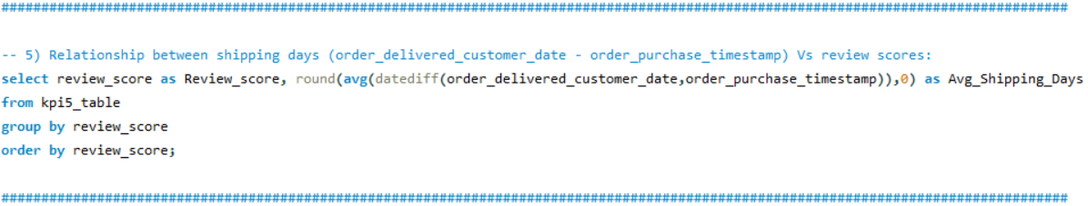
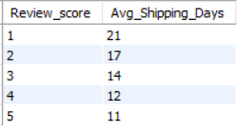
KPI-5: Relationship between Shipping Days Vs Review Scores
| Key Points |
Query:
Shipping Days
Review
Improve Delivery
Services.
Review score decreases when more shipping Days is taken.
Need better delivery Services.
Customers review increases when products are delivered fast.
OUTPUT:

Slide 8
Conclusion
We may work on delivery days so that the review score will rise in a positive way, and we can give fantastic deals for various forms of payment so that they rise in comparison to credit card payments.
Given that the average delivery time for items from pet shops is now 11 days, we must reduce this time and may do so by entering into a contract with additional local vendors. This will result in a shorter delivery time and higher customer satisfaction.
Sao Paulo City has higher average costs and payment values than other cities, the survey claims. It is essential to evaluate price and payment values between cities in order to identify potential development locations and encourage industrial expansion.
According to studies, delivery days and review scores are correlated, thus we must focus on shipping days in order to improve our review scores.
Thank You

