Slide 1





HR AI Shortlisting and
Recruitment
Team ID - CU_CP_Team_10574
Kenil Lad (Team Leader)
Mahesh Kumawat
Under the mentorship of,
Mentor Name: Palwinder Singh Sir
Notes:
Slide Duration: 5 min
Objective: To get an insight about Design Thinking
Procedure:
Explanation:
Introduce the topic "Design Thinking"
Design thinking is a creative approach to problem-solving that puts people at the center.
It starts with understanding the needs of those who will use what you're designing.
Then, it involves brainstorming ideas, prototyping solutions, and testing them to see what works best.
It's about being open-minded, collaborative, and willing to try new things to come up with innovative solutions that really fit people's needs.
Learning outcome: Students will be introduced to the topic Design Thinking.

Slide 2


Project Objectives
Problem Statement
Project Overview – Introduction
End Users
Wow Factor in Project
Modelling/Block Diagram/Flow of Project
Result/outcomes
Conclusion
Future Perspective
Notes:
Slide duration: 5 min
Objective: To know the content of the lesson.
Procedure:
Tell students what they are going to learn today.
Discuss each topics given in the slide.
Learning Outcome: Students will get to know the content of today's lesson.

Slide 3

Problem Statement
Many organizations receive a large number of job applications, making it difficult and time-consuming for HR teams to manually review each resume. This manual screening process often leads to delays, human bias, and inefficiencies in identifying the most suitable candidates.
There is a need for an automated system that can quickly analyze candidate resumes, evaluate their qualifications and skills, and shortlist candidates based on objective criteria.
This Photo by Unknown Author is licensed under CC BY
Notes:
Total duration: 5mins
Learning Objective: In this slide, the trainer will explain the students what they will learn and be able to apply in the real life situations.
Procedure: Discuss the above as the outcome of the session
Learning outcome: Students will understand the learning outcome in this slide.

Slide 4

Project overview - Introduction
The system is an AI-based recruitment solution that automates resume screening and candidate shortlisting.
Using n8n, the workflow collects candidate data, analyzes resumes with the Google Gemini AI model, and generates a score based on skills, education, and experience.
Candidates are automatically classified as Shortlisted or Rejected, and email notifications are sent using the Gmail node.
All data is stored in Google Sheets and visualized through an AppSheet dashboard, enabling efficient and unbiased hiring.
Notes:
Total duration: 5mins
Learning Objective: In this slide, the trainer will explain the students what they will learn and be able to apply in the real life situations.
Procedure: Discuss the above as the outcome of the session
Learning outcome: Students will understand the learning outcome in this slide.

Slide 5

End User
Job applicants (indirect beneficiaries)
HR Managers
Recruiters
Companies conducting bulk hiring
TECHNOLOGY USED
Workflow Automation: n8n
Artificial Intelligence: Google Gemini API
Database/Storage: Google Sheets and Google Drive
Email Automation: Gmail
This Photo by Unknown Author is licensed under CC BY
Notes:
Total duration: 5mins
Learning Objective: In this slide, the trainer will explain the students what they will learn and be able to apply in the real life situations.
Procedure: Discuss the above as the outcome of the session
Learning outcome: Students will understand the learning outcome in this slide.

Slide 6
Wow factor
End-to-End Automation – Entire recruitment process from resume upload to shortlisting is fully automated using n8n.
AI-Powered Resume Analysis – Uses Google Gemini to intelligently analyze resumes and extract key information.
Instant Candidate Scoring – Generates AI-based scores in seconds, eliminating manual screening effort.
Smart Shortlisting – Automatically classifies candidates as shortlisted or rejected using predefined logic.
Automated Communication – Sends real-time email notifications to both candidates and HR.
Live HR Dashboard – AppSheet dashboard for real-time tracking, filtering, and management of candidates.
Time-Saving & Scalable – Reduces hiring time drastically and can handle multiple candidates efficiently.
Unbiased Evaluation – AI-driven decisions reduce human bias in resume screening.
Notes:
Total duration: 5mins
Learning Objective: In this slide, the trainer will explain the students what they will learn and be able to apply in the real life situations.
Procedure: Discuss the above as the outcome of the session
Learning outcome: Students will understand the learning outcome in this slide.

Slide 7
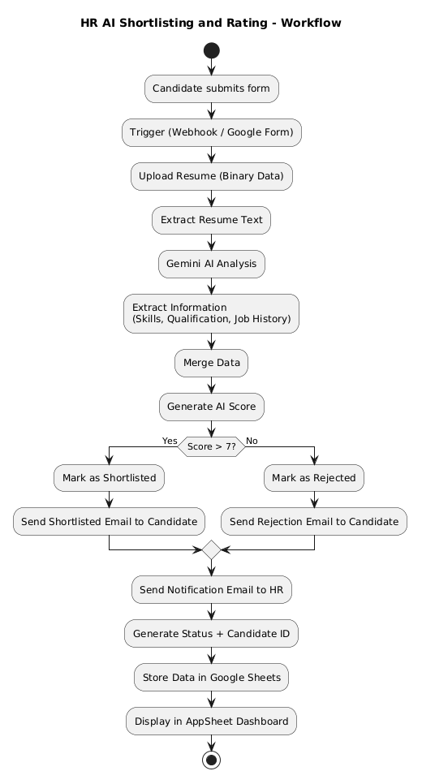
Modelling – ACTIVITY DIAGRAM
Notes:
Total duration: 5mins
Learning Objective: In this slide, the trainer will explain the students what they will learn and be able to apply in the real life situations.
Procedure: Discuss the above as the outcome of the session
Learning outcome: Students will understand the learning outcome in this slide.

Slide 8
Result / Outcomes
Successfully automated the resume screening and shortlisting process using n8n.
Reduced manual effort required by HR for initial candidate evaluation.
Achieved faster candidate processing with AI-based resume analysis.
Generated accurate and consistent candidate scoring using Google Gemini AI.
Enabled automatic classification of candidates into shortlisted and rejected categories.
Implemented real-time email notifications for both candidates and HR.
Stored and managed candidate data efficiently using Google Sheets.
Developed a HR dashboard using AppSheet for easy monitoring and filtering.
Improved efficiency, scalability, and consistency in the recruitment process.
​
Notes:
Total duration: 5mins
Learning Objective: In this slide, the trainer will explain the students what they will learn and be able to apply in the real life situations.
Procedure: Discuss the above as the outcome of the session
Learning outcome: Students will understand the learning outcome in this slide.

Slide 9
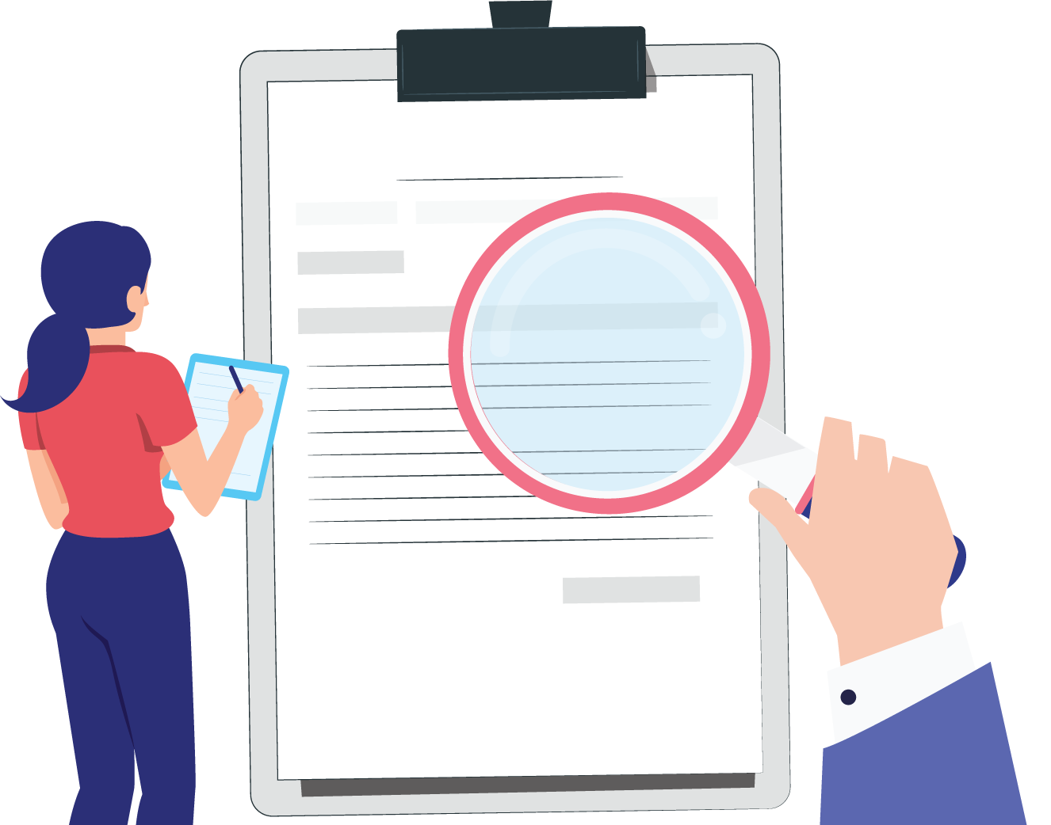
Automated AI-based resume screening system
Faster and more efficient hiring process
Reduces manual effort and bias
Real-time data management and dashboard
Scalable solution for modern recruitment
Conclusion
Source
https://www.freepik.com/
Notes:
Slide duration: 5 min
Objective: To get clarity about the lesson is well received among students.
Procedure:
Ask: What did you learn from the lesson?
What is your takeaways from the lesson?
How this lesson is going to help you in your personal and professional life.
How are you going to implement this lesson?

Slide 10
Future Perspective
Extend to full recruitment lifecycle, from onboarding to final interview scheduling using Cal.com.
Implement an AI voice agent for candidate interaction, initial screening, and communication.
Add multi-round interview management (technical & HR) with automated tracking.
Introduce JD vs Resume matching score for better evaluation.
Develop a candidate ranking system to highlight top candidates.
Integrate calendar scheduling with automated interview invites and reminders.
Build an advanced analytics dashboard (selection rate, hiring trends, performance metrics).
Enable WhatsApp/SMS notifications for faster communication.
Add role-based access control for HR teams and recruiters.
Improve AI with custom scoring models based on job roles.
Notes:
Total duration: 5mins
Learning Objective: In this slide, the trainer will explain the students what they will learn and be able to apply in the real life situations.
Procedure: Discuss the above as the outcome of the session
Learning outcome: Students will understand the learning outcome in this slide.

Slide 11
Google Gemini API Documentation
n8n Documentation
AppSheet Documentation
Google Sheets Integration Guide
REFERENCES:

Slide 12
Thank You
Notes:
Time: 25 to 30 Sec

