Slide 1


Slide 2
Setup Hadoop Core components

Slide 3

Agenda
Overview
HDFS Architecture
Setup HDFS
Map Reduce
MRv1 Architecture
Setup MRv1 or Classic
Challenges with MRv1
YARN Architecture
Setup MRv2 or YARN
Running jobs

Slide 4
Overview
In this session we will set up Hadoop Core Components using Cloudera Manager and Cloudera Distribution of Hadoop

Slide 5
HDFS Architecture
HDFS – Hadoop Distributed File System (Storage)
Daemon Processes
Slaves: Datanodes
Masters: Namenode(s) and Secondary Namenode
Parameter Files
core-site.xml
hdfs-site.xml
Apache Web Interfaces
Namenode WUI
Datanode WUI
Log Files

Slide 6
HDFS
What is HDFS?
Hadoop Distributed File System
It is all about storage
Logical file system
Distributed
Resilient
Fault Tolerant

Slide 7
Setup HDFS
Configure Slaves and Masters
Datanodes
Namenode(s) and/or Secondary Namenode
Configuration Files
core-site.xml
hdfs-site.xml
Validation
Files and Blocks
Important configuration parameters
Rack awareness
Verify logs and browse the file system
Understand Hadoop command line interface

Slide 8
Configure Slaves and Masters
Slaves
Datanodes for storage
Most of the nodes in Hadoop cluster are slaves and they will have datanodes running
Masters
Namenode
Secondary Namenode
Heartbeat
Datanodes sends heartbeat to Namenode at frequent and regular intervals.
As part of heartbeat additional information about available storage will be sent to Namenode

Slide 9
Configuration files
hadoop-env.sh is for environment variables
core-site.xml will have parameters that are used by HDFS and Map Reduce
hdfs-site.xml will have parameters that are used by HDFS
Modifying parameters
Understanding Final

Slide 10
Validation
Using WI (Namenode and Datanode)
Using OS commands
Using Cloudera Manager
Verify logs

Slide 11
Namenode Recovery and Secondary Namenode
Editlogs
FSImage
Secondary Namenode
A helper process which merges latest edit log with last snapshot of FSImage and create new one

Slide 12
Important Configuration Parameters
Namenode IP
Block Size
Replication Factor
Namenode directories for fsimage and editlogs
Datanode directories
Namenode WI and Datanode WI IPs and Ports

Slide 13
HDFS - Important parameters (Hadoop cluster with one name node)
File Name | Parameter Name | Parameter value | Description
core-site.xml | fs.defaultFS/fs.default.name | hdfs://<namenode_ip>:8020 | Namenode ip address or nameservice (HA config)
hdfs-site.xml | dfs.block.size, dfs.blocksize | 128 MB | Block size at which files will be stored physically.
hdfs-site.xml | dfs.replication | 3 | Number of copies per block of a file for fault tolerance
hdfs-site.xml | dfs.namenode.http-address | 0.0.0.0:50070 | Namenode Web UI. By default it might use ip address of namenode.
hdfs-site.xml | dfs.datanode.http.address | 0.0.0.0:50075 | Datanode Web UI
hdfs-site.xml | dfs.name.dir, dfs.namenode.name.dir | <directory_location> | Directory location for FS Image and edit logs on name node
hdfs-site.xml | dfs.data.dir, dfs.datanode.data.dir | <directory_location> | Directory location for storing blocks on data nodes
hdfs-site.xml | fs.checkpoint.dir, dfs.namenode.checkpoint.dir | <directory_location> | Directory location which will be used by secondary namenode for checkpoint.
hdfs-site.xml | fs.checkpoint.period, dfs.namenode.checkpoint.period | 1 hour | Checkpoint (merging edit logs with current fs image to create new fs image) interval.
hdfs-site.xml | dfs.namenode.checkpoint.txns | 1000000 | Checkpoint (merging edit logs with current fs image to create new fs image) transactions.

Slide 14
Verify logs and browse file system
hdfs fsck command
Map HDFS file with blocks and locations using hdfs fsck command
Understand how files are distributed PHYSICALLY?

Slide 15
Understand Hadoop command line interface
hadoop fs
hdfs dfs
Important commands
-mkdir
-copyFromLocal
-put
-copyToLocal
-get
-mv
-cat
-tail
Many more

Slide 16
HDFS Namenode HA
Namenode is typically single point of failure
It will have Secondary Namenode to help merging FS Image and Edit logs
In HA we will
Not have Secondary Namenode
Active and passive namenodes
Journalnodes to push and apply editlogs in real time.
It requires Zookeeper – a co-ordination service

Slide 17
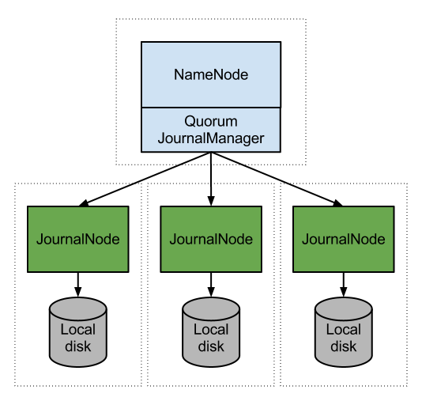
HDFS Namenode HA

Slide 18
Configure HDFS Namenode HA
Configure Namenode HA using Cloudera
Review parameter files

Slide 19
Exercise
Understand daemon processes (Namenode, Secondary Namenode, Datanode)
Commands to stop and start HDFS daemons
Copying data back and forth to HDFS
Understand parameter files and data files
Restore and recovery of Namenode
Important parameters and their defaults (dfs.blocksize, dfs.replication)
Namenode Web UI

Slide 20
Interview questions
What are different Hadoop, HDFS and Map Reduce daemons?
How data can be copied in and out of HDFS?
What is Namenode Web UI and what is default port number?
How do you restore and recover namenode?
What happens when Namenode goes down?
What is Namenode HA or Active Passive configuration?
What is fault tolerance and how it is taken care with respect to HDFS?
What is Heartbeat?

Slide 21
Map Reduce
Map Reduce is misleading term.
It is used in the context of Resource, Job Management as well as development. In this we will only talk about Resource and job management.
There are 2 ways for job management
MRv1/"Classic" (legacy and default till before Hadoop 2.0)
MRv2/YARN
We will focus on YARN as part of this course.
I will do a demo of MRv1 later

Slide 22
Hadoop Cluster – Processing (MRv1)
Mappers
Task Tracker
Reducers
Job Tracker
Mappers
Task Tracker
Reducers

Slide 23
Hadoop Cluster – Processing (MRv2/YARN)
Containers
Mappers
Reducers
App Master
Node Manager
Resource Manager
Containers
Mappers
Reducers
App Master
Node Manager

Slide 24
Understand basic design strategy for MapReduce v2 (MRv2)
Hadoop 1.0
Hadoop 2.0
MapReduce
(data processing)
Others
(non map reduce based data processing)
MapReduce
(cluster resource management & data processing)
YARN
(cluster resource management)
HDFS
(distributed, redundant and reliable storage)
HDFS2
(distributed, redundant and reliable storage with highly available namenode)

Slide 25
MRv1 Architecture
MRv1 or Classic
A job management tool which do not keep track of resources used by "non map reduce" based tools.
Daemon Processes
Master -> Job Tracker
Slave(s) -> Task tracker
Parameter Files
mapred-site.xml
Apache Web Interfaces
Job Tracker WI
Log files

Slide 26
Setup MRv1 or Classic
Configure Slaves and Master
Parameter files
Understand important parameters
Validation
Verify logs
Understand WI
mapreduce CLI

Slide 27
Configure Slaves and Master
Slaves
Task Trackers
Master
Job Tracker
Heartbeat
Task Trackers send frequent heartbeats to Job Tracker.
Task Tracker also sends the information about resources and usage to Job Tracker as part of Heartbeat

Slide 28
Parameter files
mapred-site.xml

Slide 29
Important Parameters in MRv1/Classic
File Name | Parameter Name | Parameter value | Description
mapred-site.xml | mapred.job.tracker | <ip_address>:8021 | Job Tracker ip address and port number
mapred-site.xml | mapred.job.tracker.http.address | <ip_address>:50030 | Job tracker web UI ip address and port number
mapred-site.xml | mapred.system.dir |  | HDFS directory to store Map Reduce control files
mapred-site.xml | mapred.local.dir |  | Local directory to store intermediate data files (map output)
mapred-site.xml | mapred.jobtracker.taskScheduler |  | Default is FIFO – Fair and Capacity are the viable options for production deployments
mapred-site.xml | mapred.queue.names | default | Can provide multiple queue names to set priorities while submitting the jobs
mapred-site.xml | mapred.tasktracker.map.tasks.maximum |  | Maximum Map slots per task tracker
mapred-site.xml | mapred.tasktracker.reduce.tasks.maximum |  | Maximum Reduce slots per task tracker
mapred-site.xml | mapred.reduce.tasks |  | Reduce tasks per job
mapred-site.xml

Slide 30
Validation
Using WI (Job Tracker)
Using OS commands
Using Cloudera Manager
Verify logs

Slide 31
Verify logs
Understand log files
Configuring log4j

Slide 32
Understand WI
Job Tracker WI
Monitor jobs while running
Troubleshooting issues
Understanding task level logs

Slide 33
Mapreduce CLI
mapred
Monitor jobs
Kill jobs
Check status of task trackers
etc

Slide 34
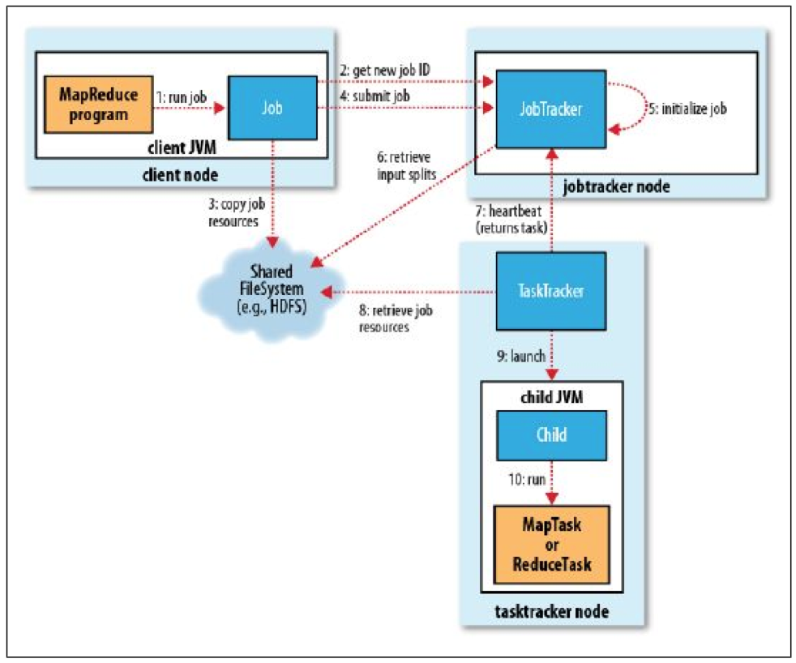
Map Reduce Job Flow (Classic)

Slide 35
MRv1 – Fault Tolerance
MapReduce v1 (MRv1) – Fault Tolerance
Task Failure
Failed due to bug in mapper/reducer code
Bugs in JVM
Hung
Number of task attempts are controlled by mapred.map.max.attempts, mapred.reduce.max.attempts (default 4)
If failures of a job can be ignored then use mapred.*.max.failures.percent (* => map/reduce)
Speculative execution – enabled by default, multiple tasks might process same data in case of slowness due to failures related to hardware (servers, memory, network etc)
Task Tracker Failure
If there are no heartbeats from task tracker to job tracker for 10 minutes, then that task tracker will be removed from the pool
If there are too many failures (default 4) for a task tracker, it will be blacklisted - mapred.max.tracker.blacklists
If there are too many failures (default 4) for a task tracker per job, it will be blacklisted - mapred.max.tracker.failures
Job Tracker Failure
Job Tracker is master for scheduling all jobs.
Job Tracker is single point of failure
No jobs can be run

Slide 36
Speculative Execution
What is it?
Initiating duplicate task for long running one.
A large job is not complete until all its mappers and reducers are complete. So if there is one long running task with out much progress, overall job execution time can be higher
How it is enabled?
mapred.map.tasks.speculative.execution (default true)
mapred.reduce.tasks.speculative.execution (default true)
yarn.app.mapreduce.am.job.speculator.class
yarn.app.mapreduce.am.job.task.estimator.class

Slide 37
Speculative Execution
How it works?
Speculative task will be created (most likely on different node) if a mapper/reducer is taking longer (lets say minute) with out much progress.
If original task finishes first then speculative task will be killed and vice versa.
What is criteria?
By default it is enabled and it is betterment of a particular job.
As there will be multiple processes for the same task, resource usage can be high. It can impact other jobs on the cluster.
If your cluster capacity is under configured, then it is better to disable speculative execution.
What is it for?
It is mainly for infrastructure/hardware issues – eg: Network, i/o or cpu issues
It is not meant for buggy code

Slide 38
Challenges with MRv1
Single point of failure
Tightly coupled of map reduce
Does not keep track of resources used by other Hadoop eco system tools – so not effective when HBase or Impala or Spark are running on the same cluster
Under utilization or contention of resources as mappers and reducers are pre-configured
Log files are scattered across all the nodes in the cluster

Slide 39
YARN Architecture
YARN – Yet Another Resource Negotiator
A generic job management tool which can share resources between "map reduce" based distributed processing tools as well as "non map reduce" based distributed processing tools.
Daemon Processes
Master -> Resource Manager
Slave(s) -> Node Managers
Per job Application Master
Parameter Files
yarn-site.xml
mapred-site.xml
Apache Web Interfaces
Resource Manager WUI
Application Master WUI
Job History Server
Log files

Slide 40
Determine how YARN handles resource allocations
Question: How YARN handles Resource Allocations?
Answer: Using Resource Manager, Node Manager and per job application master (unlike job tracker and task tracker in MRv1/classic). We need to define several parameters for resource allocation (CPU/cores and Memory).
yarn-site.xml will have parameters at node level
mapred-site.xml will have parameters at task level

Slide 41
Setup YARN
Configure Slaves and Master
Parameter files
Understand important parameters
Validation
Verify logs
Understand WI
Understand YARN and mapreduce CLI

Slide 42
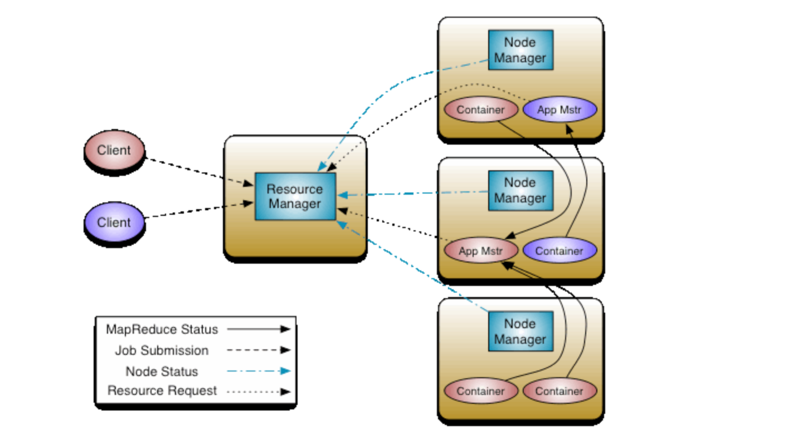
Hadoop Cluster – Processing (MRv2/YARN)

Slide 43
Configure Slaves and Masters
Slaves
Nodemanager
Masters
Resourcemanager

Slide 44
Parameter files
yarn-site.xml
Parameters related to YARN
mapred-site.xml
Parameters related to Map Reduce

Slide 45
Important parameters in MRv2/YARN
File Name | Parameter Name | Parameter value | Description
mapred-site.xml | mapreduce.framework.name | yarn
mapred-site.xml | mapreduce.jobhistory.webapp.address | <ip_address>:<port> | Job history server Web UI IP address and port number
mapred-site.xml | yarn.app.mapreduce.am.* |  | Parameters related to application master
mapred-site.xml | mapreduce.map.java.opts |  | JVM Heap size for child task of map container
mapred-site.xml | mapreduce.reduce.java.opts |  | JVM Heap size for child task of reduce container
mapred-site.xml | mapreduce.map.memory.mb |  | Size of container for map task
mapred-site.xml | mapreduce.map.cpu.vcores | 1 | Number of virtual cores required to run each map task
mapred-site.xml | mapreduce.reduce.memory.mb |  | Size of container for reduce task
mapred-site.xml | mapreduce.reduce.cpu.vcores | 1 | Number of virtual cores required to run each reduce task
mapred-site.xml

Slide 46
Important parameters in MRv2/YARN
File Name | Parameter Name | Parameter value | Description
yarn-site.xml | yarn.resourcemanager.address | <ip_address>:<port> | Resource Manager ip and port
yarn-site.xml | yarn.resourcemanager.webapp.address | <ip_address>:<port> | Resource Manager web UI ip and port
yarn-site.xml | yarn.nodemanager.resource.memory-mb |  | maximum memory YARN can utilize on the node
yarn-site.xml | yarn.scheduler.minimum-allocation-mb | 1024 | Minimum total memory for containers on each of the nodes
yarn-site.xml | yarn.scheduler.maximum-allocation-mb | 4096 | Maximum total memory for containers on each of the nodes. Same as yarn.nodemanager.resource.memory.mb
yarn-site.xml | yarn.scheduler.minimum-allocation-vcores | 1 | Minimum number of virtual cores on each of the nodes
yarn-site.xml | yarn.scheduler.maximum-allocation-vcores | 4 | Maximum number of virtual cores on each of the nodes
yarn-site.xml | yarn.resourcemanager.scheduler.class |  | Class which determines scheduler – Fair or capacity
yarn-site.xml
yarn-site.xml

Slide 47
Scheduling Jobs
FIFO Scheduler
Fair Scheduler
Capacity Scheduler

Slide 48
Validation
Using WI (Resource Manager, Application Master and Job History Server)
Using OS commands
Using Cloudera Manager
Verify logs

Slide 49
Verify logs
While jobs are running
Using Job history server

Slide 50
Understand WI
Resource Manager WI
Job History WI
Per job application master WI
Cloudera Manager

Slide 51
YARN and Mapred WI
Run a job
Monitor while job is running
Evaluate results once job is completed (Job History server)
Importance of job.xml for every job

Slide 52
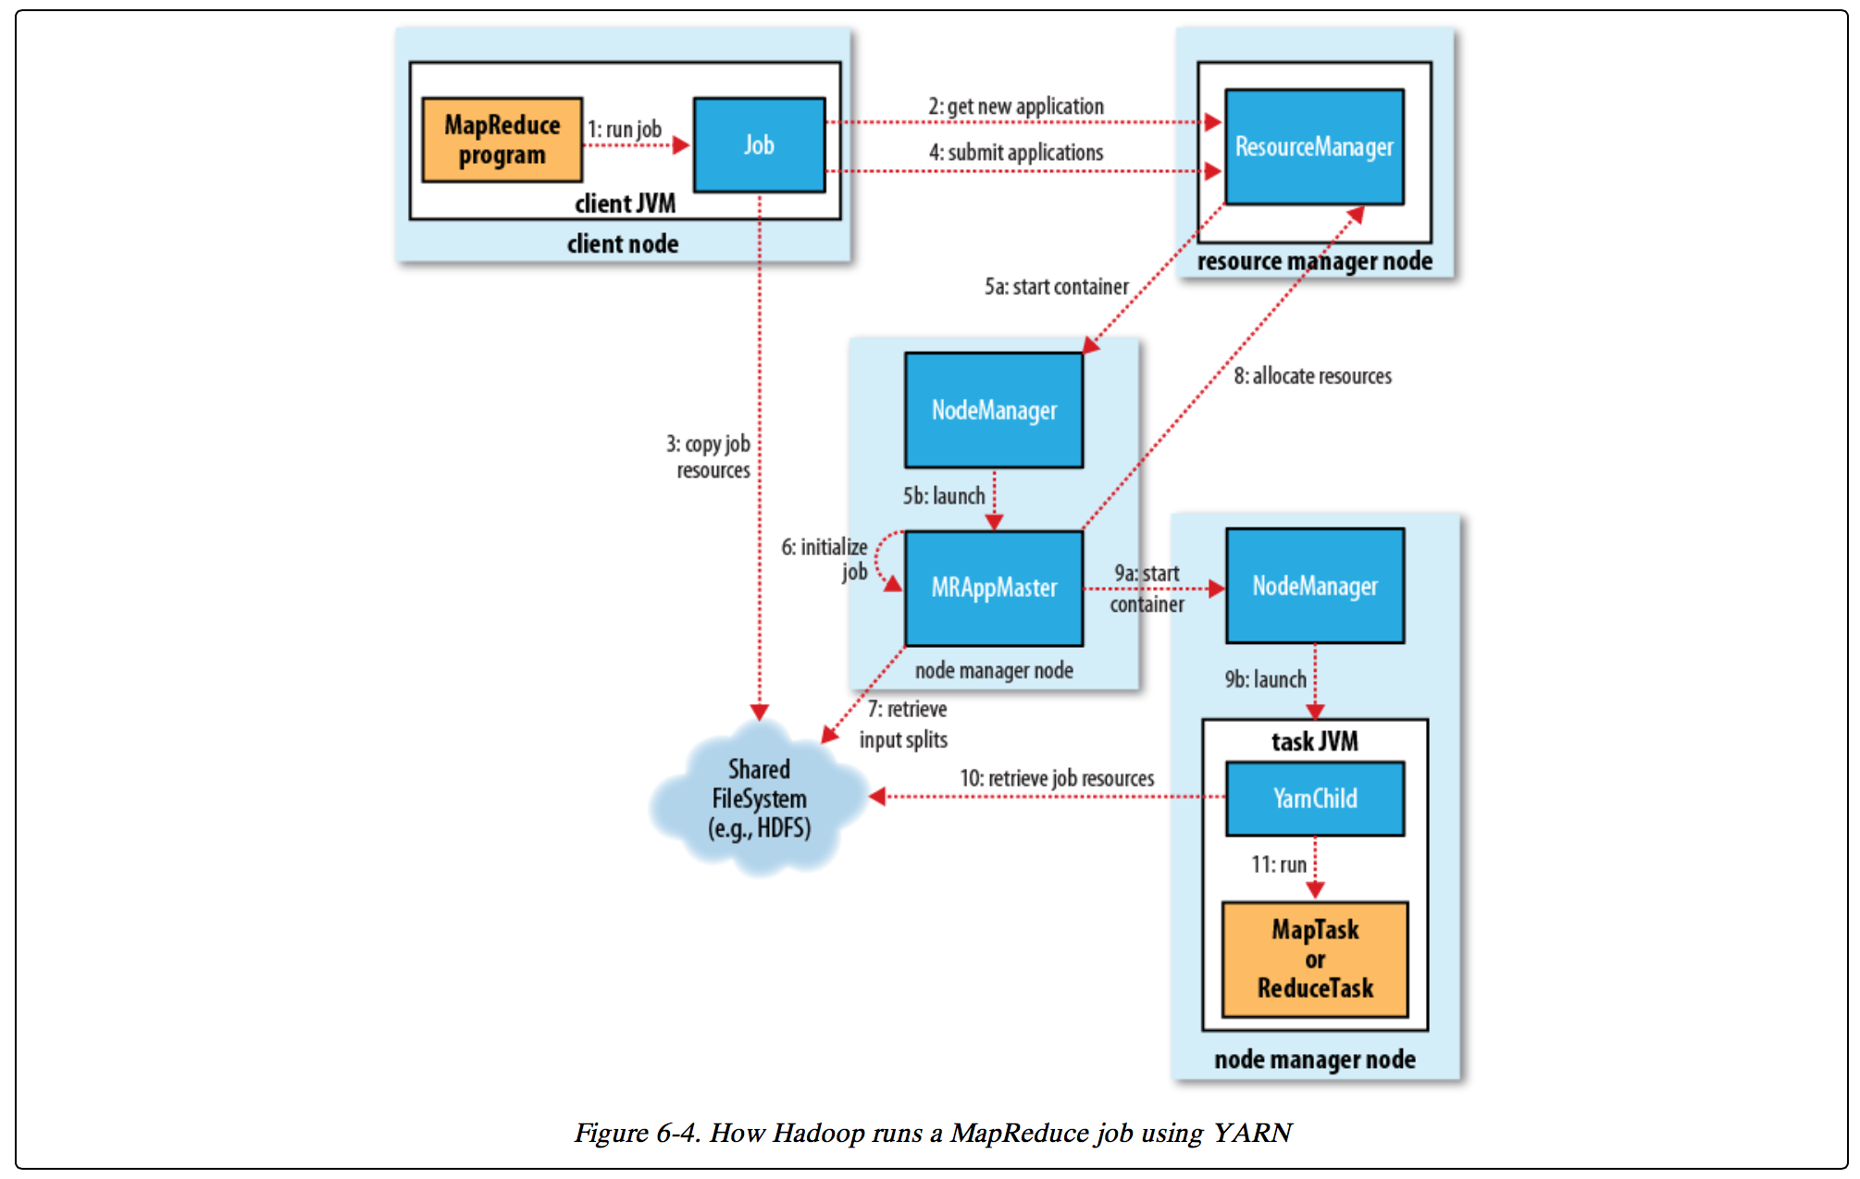
Map Reduce Job Flow (YARN)

Slide 53
YARN – Fault Tolerance
MapReduce v2 (MRv2/YARN) – Fault Tolerance
Task Failure (mostly same as classic/MRv1)
Application Master Failure
If application master is failed that means a job is failed. It can be controlled by yarn.resourcemanager.am.max.retries (default 1)
Node Manager Failure
If there are no heartbeats from Node Manager to Resource Manager for 10 minutes (default), then that task tracker will be removed from the pool
Resource Manager Failure
Although probability of Resource Manager failure is relatively low, no jobs can be submitted until RM is brought back up and running.
High availability can be configured in YARN which means there will be multiple RM running in the cluster. There is no high availability in MRv1 (only one job tracker)

Slide 54
MRv1 vs. MRv2
 | MRv1 | MRv2/YARN
Master | Job Tracker – handles both resource management as well as job processing. | Resource Manager – only looks after resource management.
Slave on each datanode | Task Tracker | Node Manager
Job | Job Tracker controls life cycle of the job | Per job application master controls life cycle of job. Application master is transient in nature and will be cleaned up after job is completed.
Mappers and reducers | Task tracker will manage the processes that runs tasks (mappers and reducers) | Containers will manage the processes that runs tasks (mappers and reducers). Containers are transient in nature and will be cleaned up when job is completed.
Mappers and reducers | Tasks for mappers and reducers on each node are pre-configured and cannot be changed. It can cause under utilization of resources. | Tasks for mappers and reducers are not pre-configured. Relatively effective utilization of resources.
Scalability | Single point of failure and probability is high as Job Tracker controls each job life cycle as well as resource consumption. Have issues with clusters more than 4000 nodes | Can configure for high availability. Resource Manager is relatively stable than Job tracker.

Slide 55
Running jobs
hadoop jar command
Overriding parameters
Validating parameters in job.xml
Understanding counters

Slide 56
Exercise
Identify daemon processes for YARN
Identify different parameter files
Difference between MRv1 – "Classic" and MRv2 - YARN
Understand important parameters and relevance of the parameters in capacity planning as well as performance tuning

Slide 57
Interview Questions
What are different daemon processes?
What is application master?
What is default port number of Resource Manager UI?
What are different type of schedulers?

Slide 58
Learning Pattern
You can apply this pattern to almost all the tools in Hadoop eco system.
Architecture
Daemon Processes
Parameter files
Log files
Validation

Slide 59

Our Promise
We believe strongly in building solid, long-lasting relationships with our clients and deliver quality services in a cost-effective way.

Slide 60
Thank You

