Slide 1


Slide 2
Setup Hive and Impala

Slide 3

Agenda
Overview
Hive Architecture
Hive Metastore
Setup Hive using Cloudera Manager
Hive parameter files
Hive log files
Hive user defined functions
Hive demo
Impala Architecture
Setup Impala using Cloudera Manager
Impala parameter files
Impala log files
Impala demo
Impala vs. Hive

Slide 4
Overview
Writing Map Reduce jobs can be tedious
Vast array of IT Stakeholders have basic proficiency in SQL
Using hive, we can write queries which will generate map reduce code to process the data.
It will accelerate application development in Hadoop eco system.
It has 3 components
DDL or Physical Modeling
Copying data (LOAD or INSERT)
Querying data (Hive QL)

Slide 5
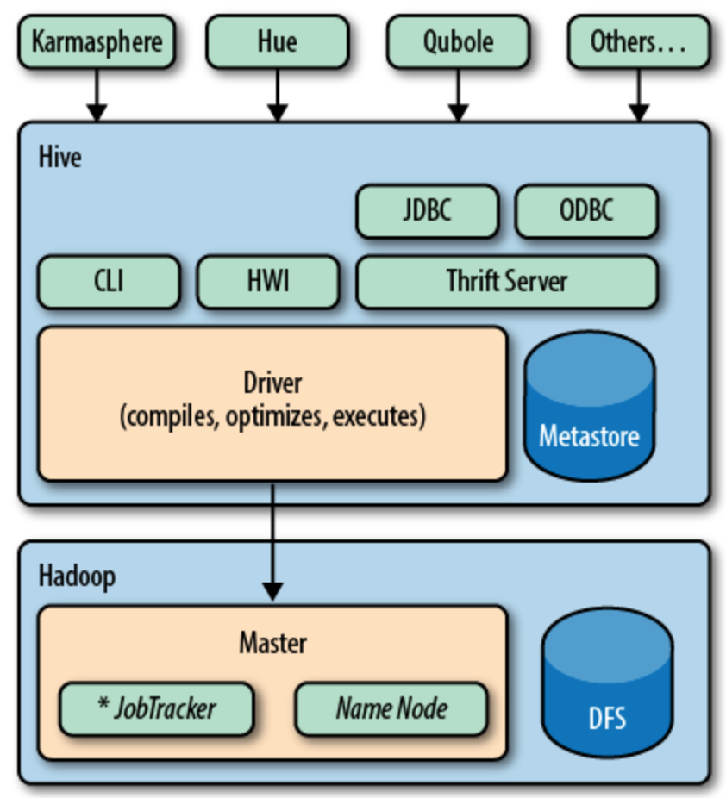
Hive Architecture

Slide 6
Hive Architecture
HDFS
All the data physically stored in HDFS
Map Reduce
Data is processed using map reduce jobs
Metastore
Stores structure of tables
Hive query engine
Generates Java code at run time
Compiles and build jar at run time
Submit as one or more map reduce jobs

Slide 7
Setup Hive using Cloudera Manager
Configure Hive metastore server
Configure hiveserver2
Configure Gateway

Slide 8
Hive parameter files
hive-site.xml
.hiverc

Slide 9
Important Parameters
File Name | Parameter Name | Parameter value | Description
hive-site.xml | javax.jdo.option.ConnectionURL |  | Connection URL (JDBC URL)
hive-site.xml | javax.jdo.option.* |  | ConnectionDriverName, ConnectionUserName, ConnectionPassword etc. Connection information to Hive Metastore
hive-site.xml | hive.metastore.warehouse.dir | /user/hive/warehouse | Default logical database in Hive
hive-site.xml | mapred.reduce.tasks | -1 | Let's hive engine to determine number of reducers based up on the size of the data
hive-site.xml | hive.zookeeper.quorum |  | Zookeeper quorum information for external java applications to connect to Hive database
hive-site.xml | hive.zookeeper.client.port | 2181
hive-site.xml
hive-site.xml
hive-site.xml
hive-site.xml

Slide 10
Hive log files
Under /tmp

Slide 11
Hive user defined functions
Adding jar files
Creating temporary function
Updating .hiverc file
Supporting development teams

Slide 12
Hive demo
Hive command line
hive -e
hive -f
-hiveconf
set
Creating databases
Creating tables
Managed
External
Copying data to HDFS via Hive tables
Running sample queries
Role of .hiverc
Troubleshooting Map Reduce jobs for hive queries

Slide 13
Impala Overview
Interactive SQL (low latency SQL)
ANSI standard
Uses HDFS as storage
Does not use map reduce for processing

Slide 14
Impala Architecture
Architecture
Metastore
Catalog daemon (catalogd)
Relays the metadata changes from Impala SQL statements to all the nodes in a cluster.
State store daemon (statestored)
Provides name service of cluster members
Distributes metadata of tables
Impala daemon (impalad)
Handles client requests
Handles all internal requests related to query execution.
* Catalogd and statestored should run on one designated node, impalad is supposed to run on all Hadoop slave nodes (where datanode and tasktracker/nodemanager runs)

Slide 15
Impala Architecture
Common Hive SQL and Interface
SQL Interfaces
(Beeswax)
Hive metastore
HDFS Namenode
ODBC
Impalad continually talks to statesstore to get metadata to use for query planning
Impala statesstore
Impalad
Impalad
Impalad
Query Planner
Query Planner
Query Planner
Query Coordinator
Query Coordinator
Query Coordinator
Query exec engine
Query exec engine
Query exec engine
HDFS DN
HBASE RS
HDFS DN
HBASE RS
HDFS DN
HBASE RS

Slide 16
Impala Architecture
Does not work on derby
It uses same metastore as hive

Slide 17
Configuration and Important Parameters
Configuration files
impalad_flags (not in xml format)
sentry-site.xml
llama-site.xml

Slide 18
Configuration and Important Parameters
-rm_always_use_defaults:
If this Boolean option is enabled, Impala ignores computed estimates and always obtains the default memory and CPU allocation from Llama at the start of the query. These default estimates are approximately 2 CPUs and 4 GB of memory, possibly varying slightly depending on cluster size, workload, and so on. Cloudera recommends enabling -rm_always_use_defaults whenever resource management is used, and relying on these default values (that is, leaving out the two following options).
-rm_default_memory=size:
Optionally sets the default estimate for memory usage for each query. You can use suffixes such as M and G for megabytes and gigabytes, the same as with the MEM_LIMIT query option. Only has an effect when -rm_always_use_defaults is also enabled.
-rm_default_cpu_cores:
Optionally sets the default estimate for number of virtual CPU cores for each query. Only has an effect when -rm_always_use_defaults is also enabled.

Slide 19
Impala WUI
http://vm02host07:25010 (statestored)
http://vm02host07:25020 (catalogd)

Slide 20
Impala Demo
Using shell
Using Hue

Slide 21
Impala vs. Hive
Impala is developed using C++
Does not use map reduce
Additional daemons on each of the data nodes
Currently supports TextInputFormat only

Slide 22
Setup Impala using Cloudera Manager
Add Service
Select the dependencies
Configure
Impala Catalog Server
Impala State Store
Impala Daemon (slaves)

Slide 23

Our Promise
We believe strongly in building solid, long-lasting relationships with our clients and deliver quality services in a cost-effective way.

Slide 24
Thank You

