Slide 1


Slide 2
Setup Sqoop

Slide 3

Agenda
Overview
Sqoop Architecture
Sqoop 2 Architecture
Setup Sqoop and Sqoop2 using Cloudera Manager
Sqoop parameter files
Sqoop log files
Sqoop demo

Slide 4
Overview
Sqoop is a map reduce based tool that can be used to copy data from relational databases to Hadoop and vice versa.
Written in Java and Open Source
Uses JDBC for DB connectivity
Uses Map Reduce framework

Slide 5
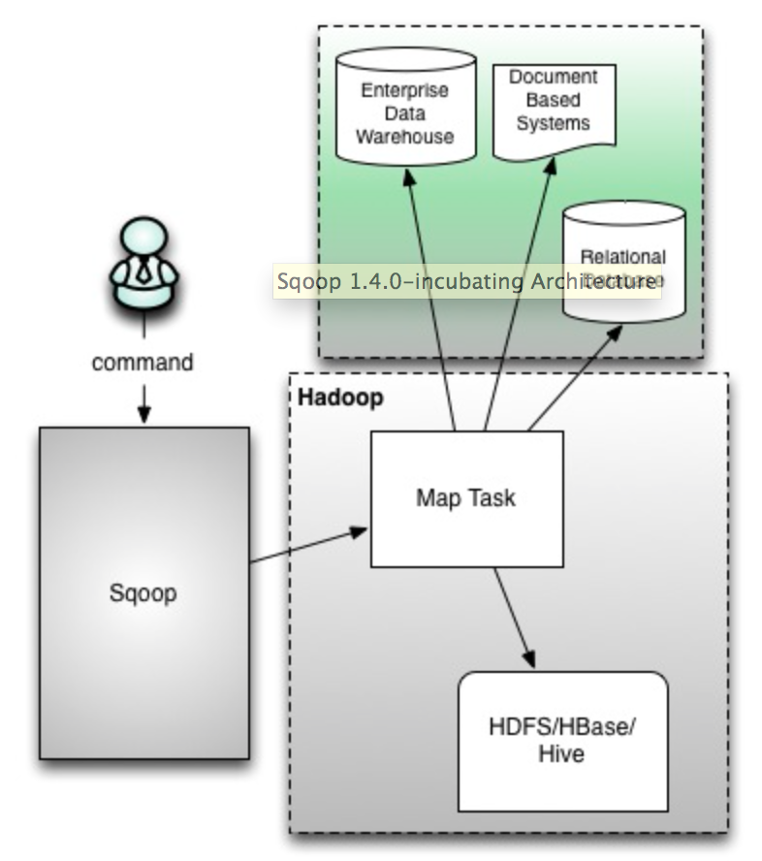
Sqoop Architecture

Slide 6
Sqoop Architecture
Map only
Command line (only)
Not secure
No client-server
If one have access to sqoop command, he will have access to all JDBC jars
Not easily extensible and no separation of duties
Both read from source and write to target is done by mapper

Slide 7
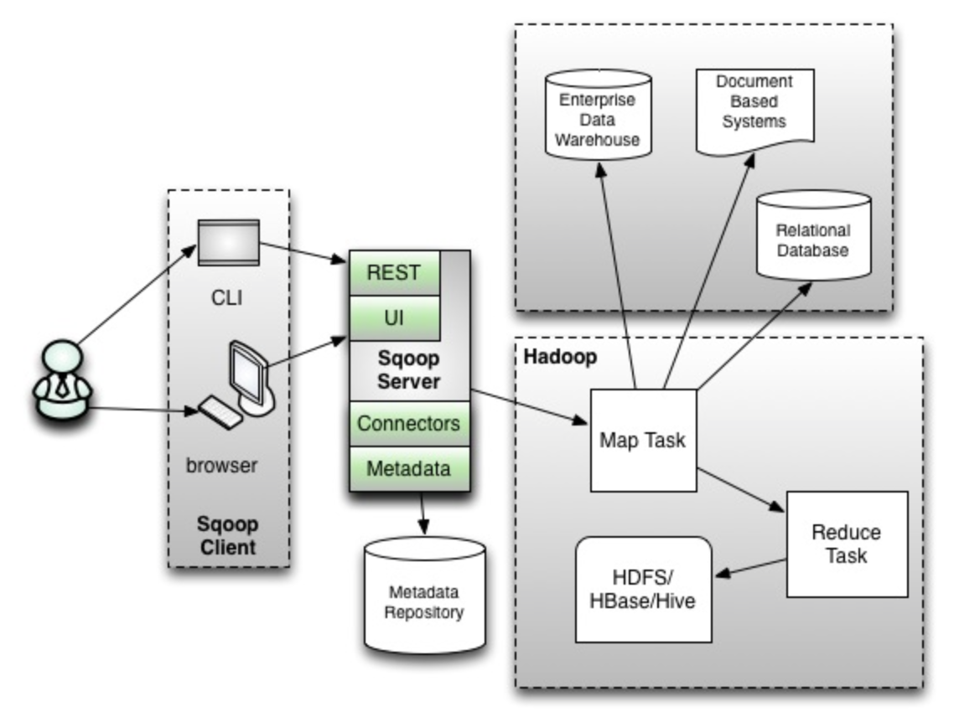
Sqoop2 Architecture

Slide 8
Sqoop2 Architecture
Client/Server architecture
Map and Reduce
Available on web, command line
Extensible and separation of duties
Highly Secure
Developers use clients
Admins set up servers
Jar files will reside on server

Slide 9
Sqoop Import
DSS
Document based
Operational
Sqoop import
Map Task/MR Task
HDFS/HBase/Hive

Slide 10
Sqoop import
Sqoop import is to get data from conventional databases and NoSql/Document based databases into Hadoop eco system.
It uses map/reduce framework to load data in parallel. Default is 4.
Execution steps
Generates custom DBWritable class reading metadata of table.
Connect to database – default 4 concurrent connections
Read and split the data using custom DBWritable class
Load data into HDFS

Slide 11
Sqoop Import
Split logic
Uses primary key or unique key
Get minimum and maximum value
Compute ranges based on number of map tasks (default 4)
Process mutually exclusive data in parallel
Without primary/unique keys import process only uses one map task

Slide 12
Sqoop incremental load
Argument | Description
--check-column (col) | Specifies the column to be examined when determining which rows to import.
--incremental (mode) | Specifies how Sqoop determines which rows are new. Legal values for mode include append and lastmodified.
--last-value (value) | Specifies the maximum value of the check column from the previous import.

Slide 13
Sqoop Export
DSS
Document based
Operational
Sqoop export
Map Task/MR Task
HDFS/HBase/Hive

Slide 14
Sqoop Export
Sqoop export is to get data out of Hadoop based systems into conventional databases/NoSql data stores.
It also uses Map/Reduce framework.
At this time it only understands HDFS directories not Hive tables (HCatalog)
It also splits data (but uses HDFS splittable logic)

Slide 15
Sqoop Considerations
Generic
Need to customize to leverage strengths of underlying source or target conventional databases.
Determining number of mappers and outliers
Working with binary data (using Sequence Files)
Might not be able to read HCatalog (Incremental exports cannot use HiveQL embedded in Sqoop commands)
Compression (needs to be splittable or file size should not be greater than split size)

Slide 16
Setup Sqoop and Sqoop2 using Cloudera Manager
Sqoop is client only
Sqoop2 requires Sqoop Server

Slide 17
Sqoop parameter files
Not that important.
As it is map reduce based tool, it uses xml files created for hdfs and mapreduce/yarn
Sqoop2 is still in beta
sqoop.properties
sqoop_bootstrap.properties

Slide 18
Sqoop log files
Sqoop does not store log files any where
You need to redirect output of the command using Linux redirect process

Slide 19
Sqoop demo
Install mysql connector
Copy connector jar to sqoop lib
Restart sqoop (if you are using sqoop2)
This demo is primarily using sqoop

Slide 20

Our Promise
We believe strongly in building solid, long-lasting relationships with our clients and deliver quality services in a cost-effective way.

Slide 21
Thank You

