Slide 1
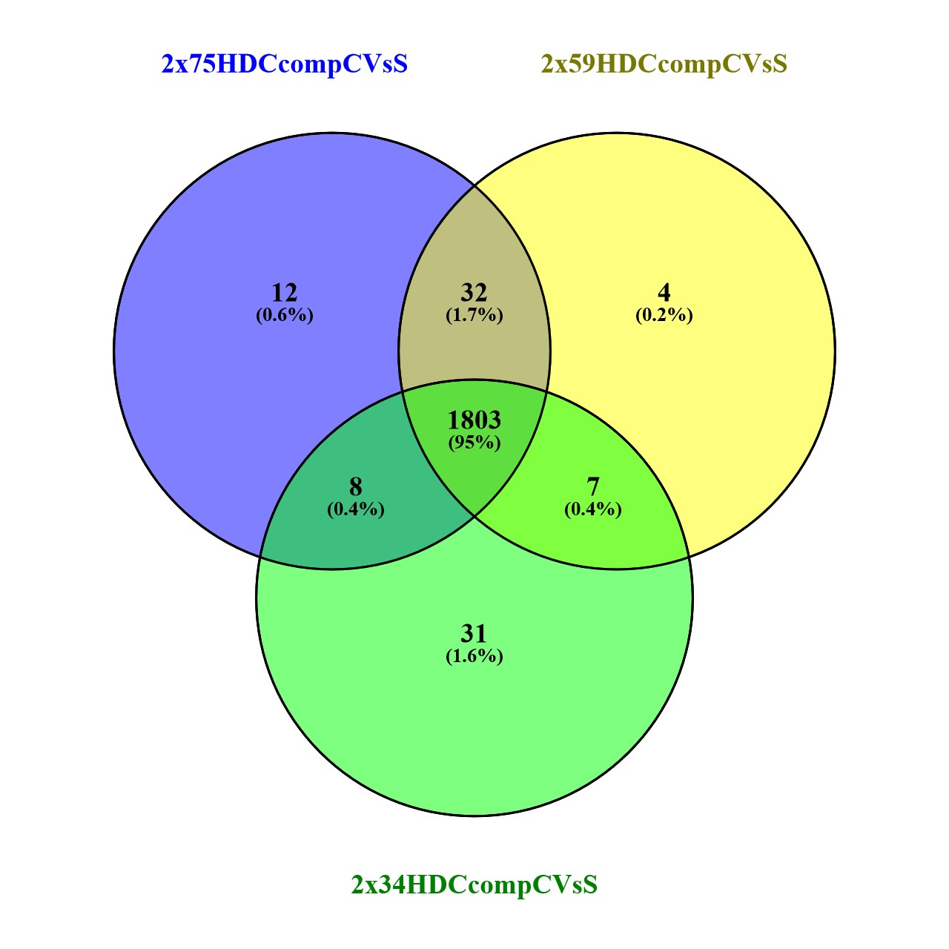
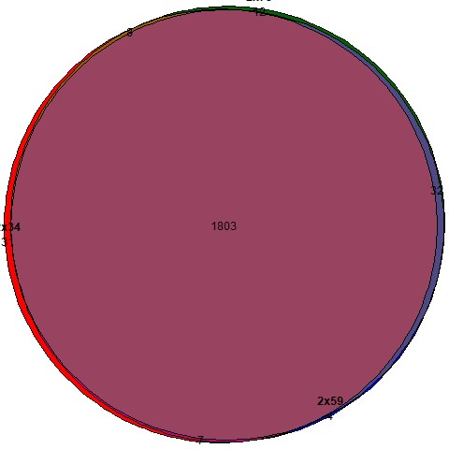
2x75_2x59_2x34_HDC1compCvsHDC1compSalt

Slide 2
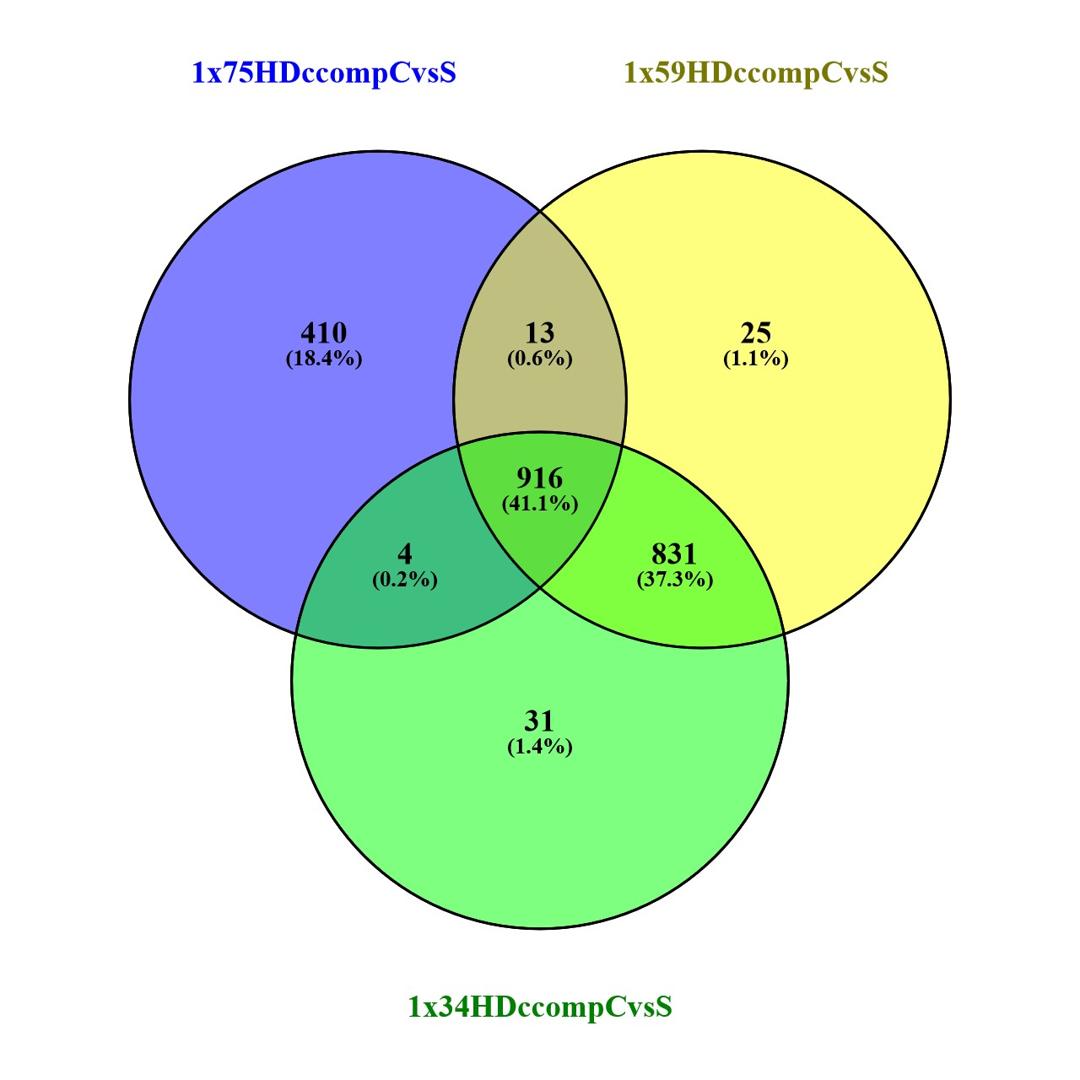
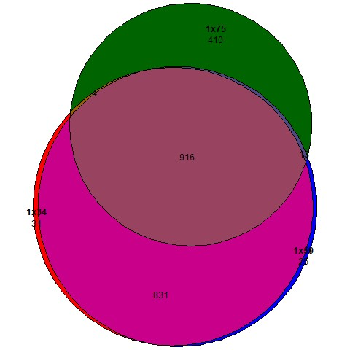
1x75 _1x59_1x34 _HDC1compCvsHDC1compSalt

Slide 3
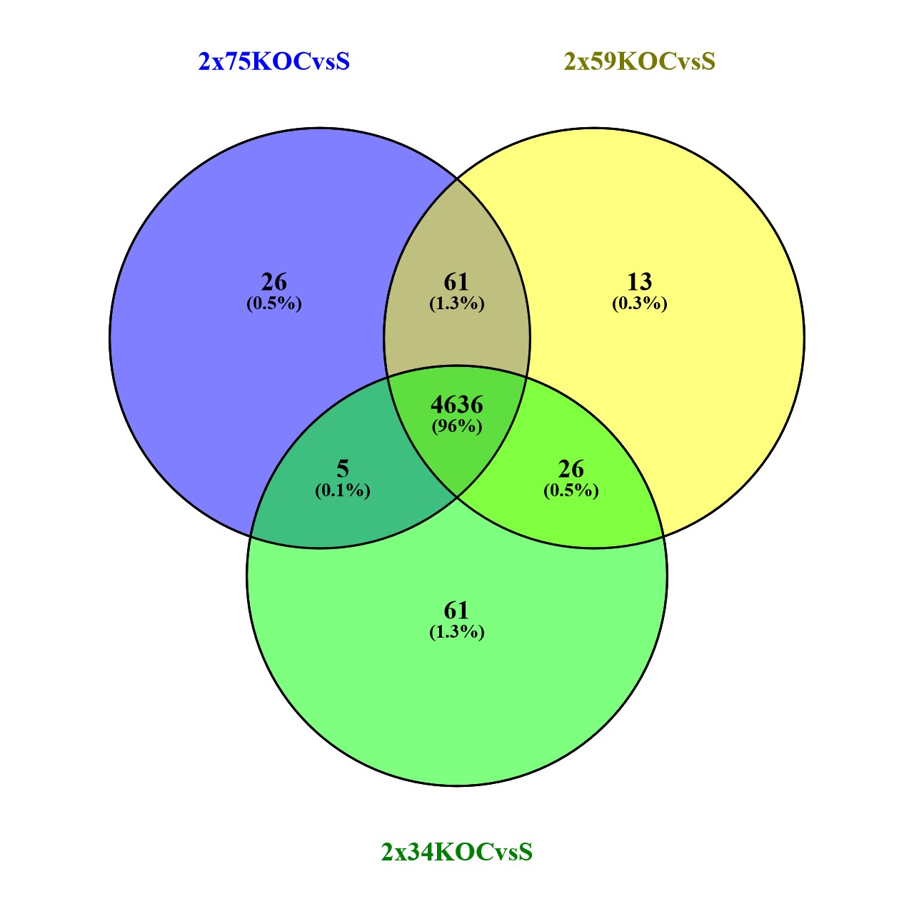
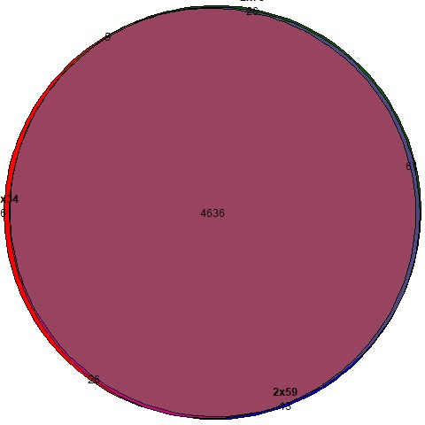
2x75_2x59_2x34_KOCvsKOSalt

Slide 4

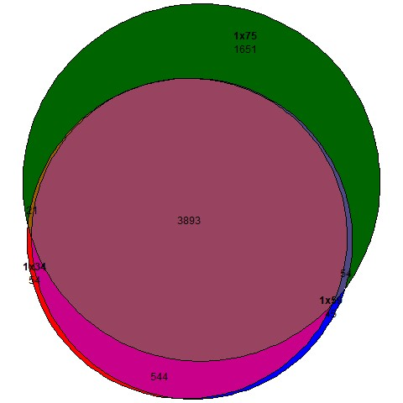
1x75_ 1x59_1x34 KOCvsKOSalt

Slide 5
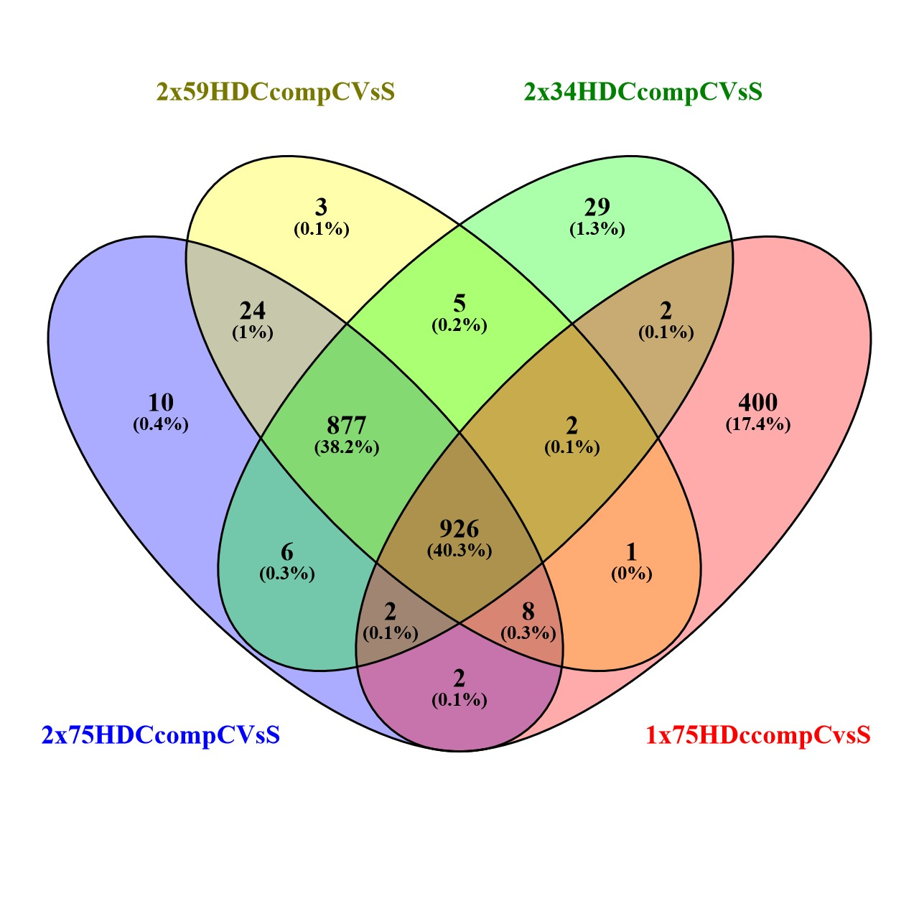
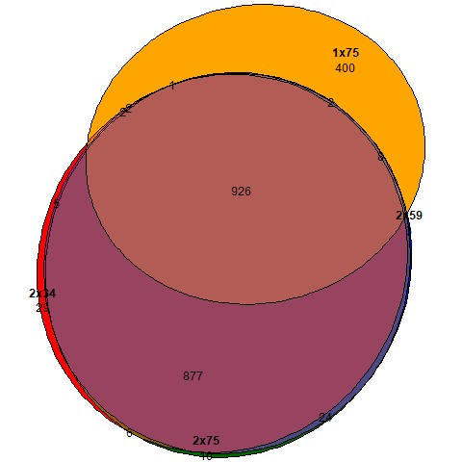
2x75_2x59_2x34_1x75_HDC1compCvsHDC1compSalt

Slide 6
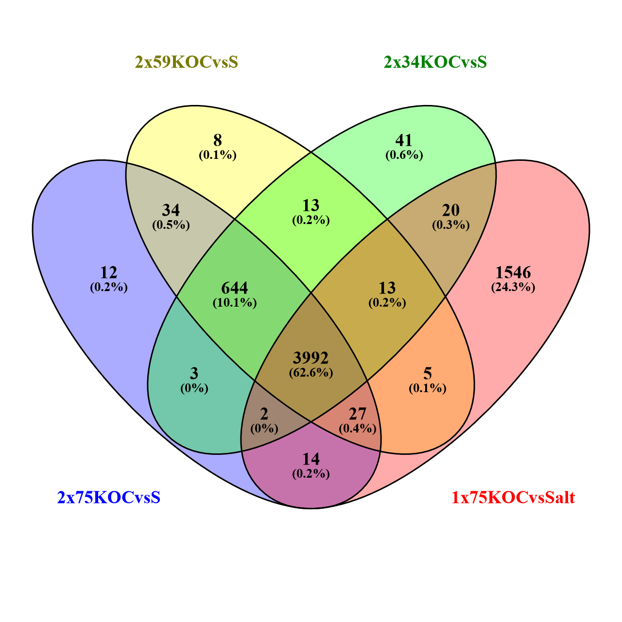
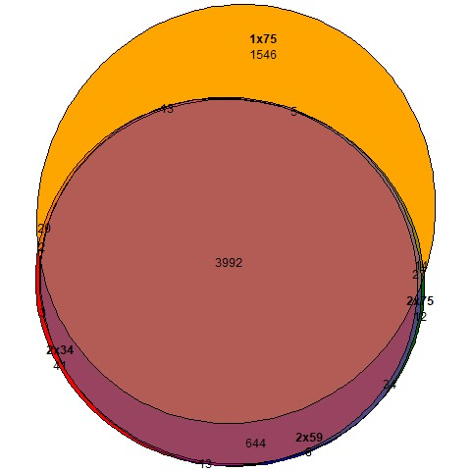
2x75_2x59_2x34_KOCvsKOSalt

