Slide 1
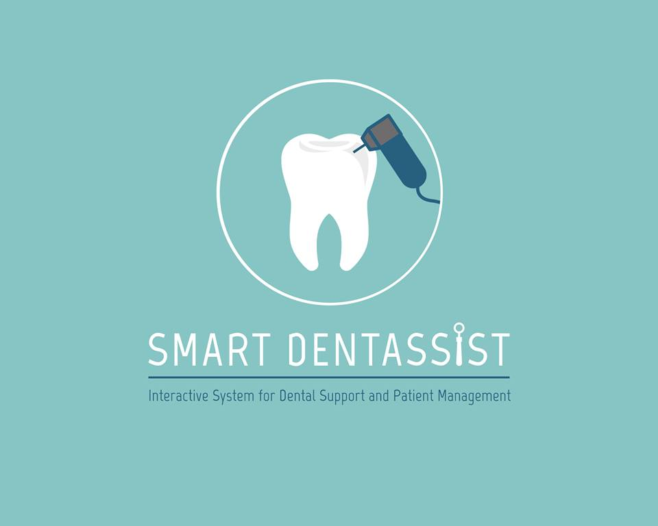

Slide 2
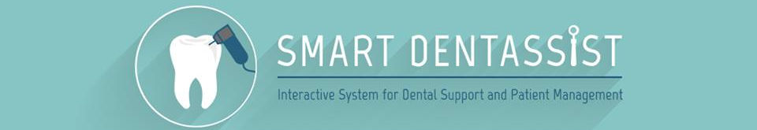
Research Team
R. M. S. M. Rathnayaka | IT 12038510
B. L. H. M. Gunarathna | IT 11229162
A. H. E. D. Kumara | IT 12043842
K. G. L. Bogahawatte | IT 12062034
Supervisor
Dr. Rohan Samarasigha

Slide 3
Global statistics

Slide 4

Adults with
severe gum diseases
Notes:
Severe periodontal (gum) disease, which may result in tooth loss, is found in 15–20% of middle-aged (35-44 years) adults. http://www.who.int/mediacentre/factsheets/fs318/en/

Slide 5

Adults with
no natural teeth
Notes:
Globally, about 30% of people aged 65–74 have no natural teeth.
http://www.who.int/mediacentre/factsheets/fs318/en/

Slide 6

School children with
dental caries
Notes:
Worldwide, 60–90% of school children and nearly 100% of adults have dental cavities.
http://www.who.int/mediacentre/factsheets/fs318/en/

Slide 7

Adults with
dental caries
Notes:
nearly 100% of adults have dental cavities.
http://www.who.int/mediacentre/factsheets/fs318/en/

Slide 8
THESE DISEASES LEAD TO

Slide 9
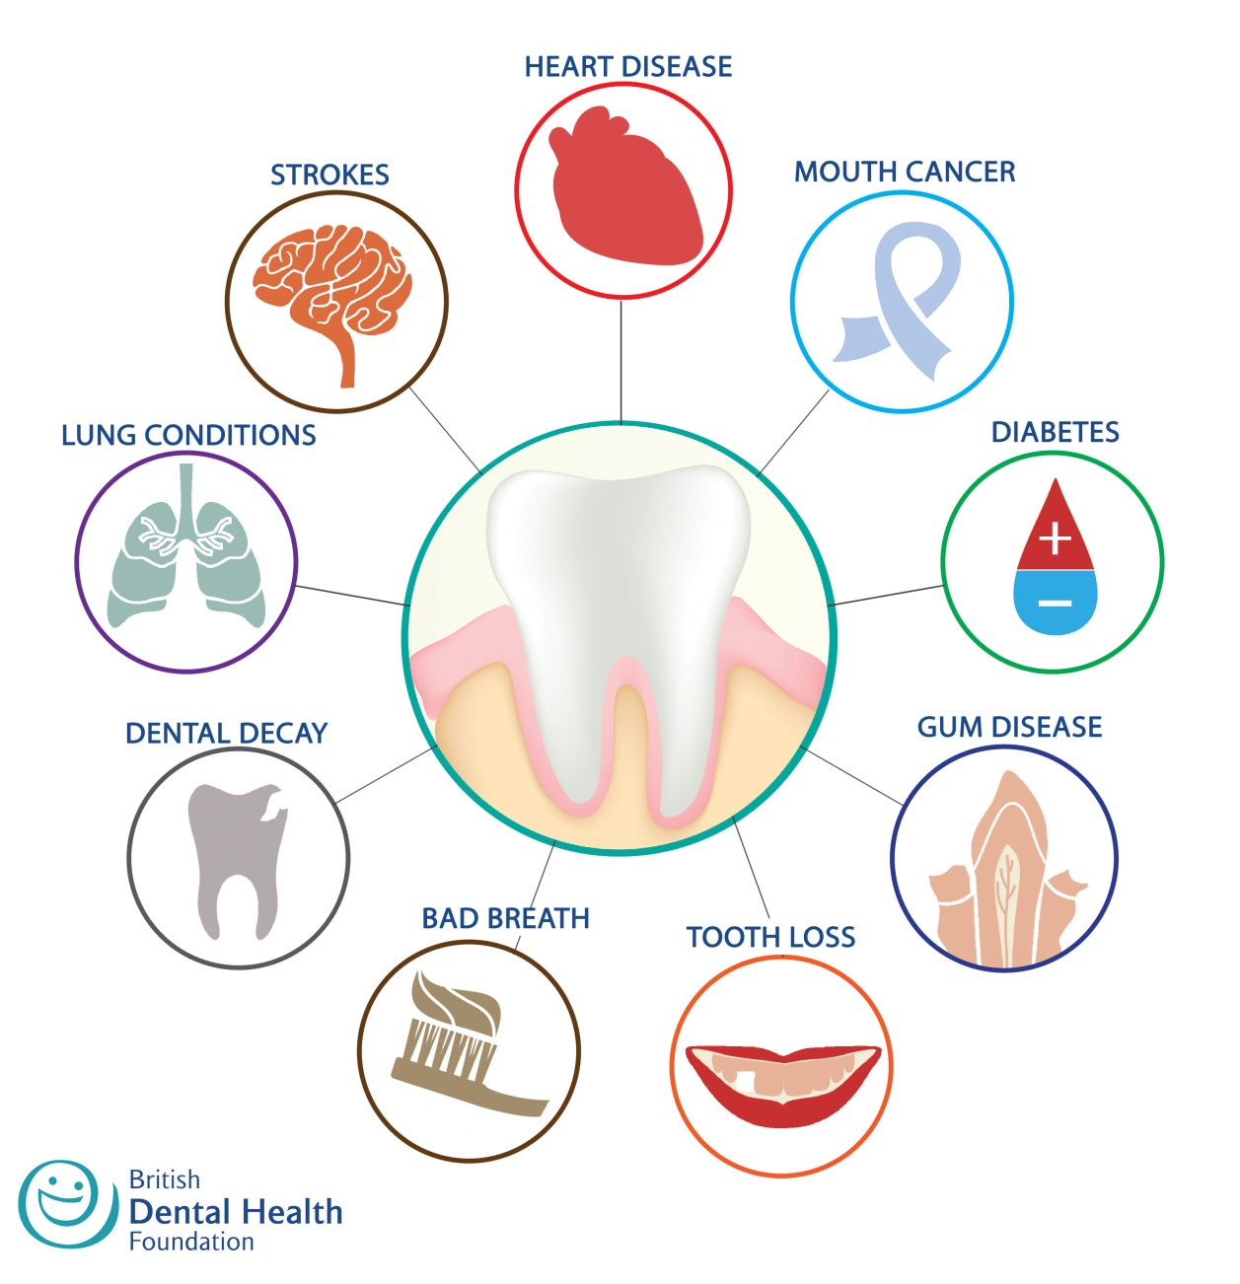

Slide 10
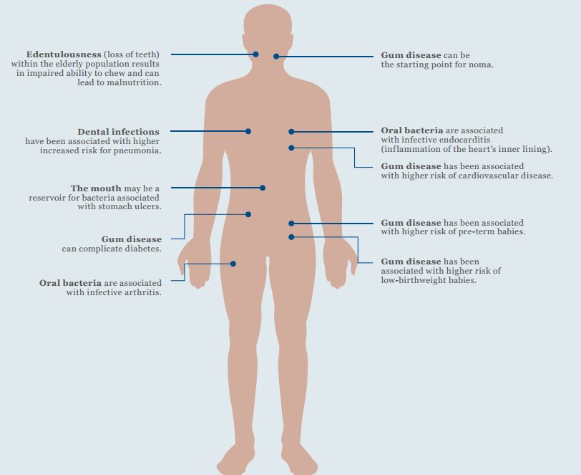

Slide 11
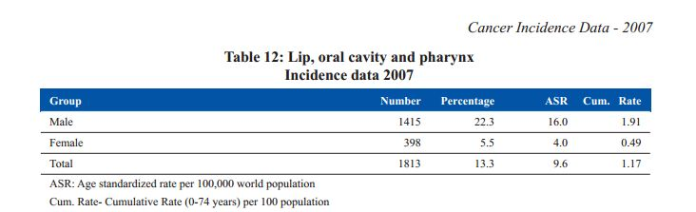
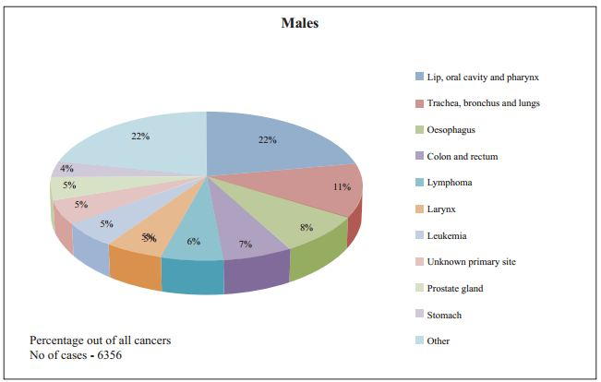

Slide 12
However …
Oral health is known to be the most neglected health aspect among adults …

Slide 13
Current situation in Sri Lanka …
A significant majority of dentists still use mouth mirrors
Use of intra oral cameras is not yet popular

Slide 14
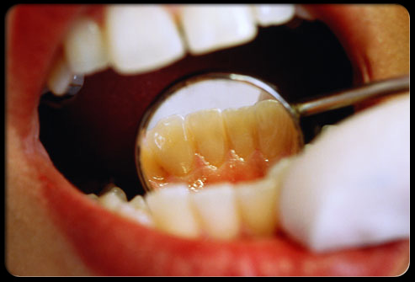
Disadvantages of mouth mirrors
The number of teeth which may be viewed using a conventional round mirror is extremely limited.
The quality of the reflective surface is not that of a standard mirror.
Once the surface is scratched, it cannot fulfill its purpose.
Notes:
http://www.rdhmag.com/articles/print/volume-27/issue-5/columns/comfort-zone/mouth-mirror-magic.html
Anne Nugent Guignon, RDH, MPH, is the senior consulting editor for RDH magazine. She is an international speaker who has published numerous articles and authored several textbook chapters. Her popular programs include ergonomics, patient comfort, burnout, and advanced diagnostics and therapeutics. Recipient of the 2004 Mentor of the Year Award, Anne is an ADHA member who has practiced dental hygiene in Houston since 1971. You can reach her at anne@anneguignon.com or (713) 974-4540. Her Web site is www.anneguignon.com.

Slide 15
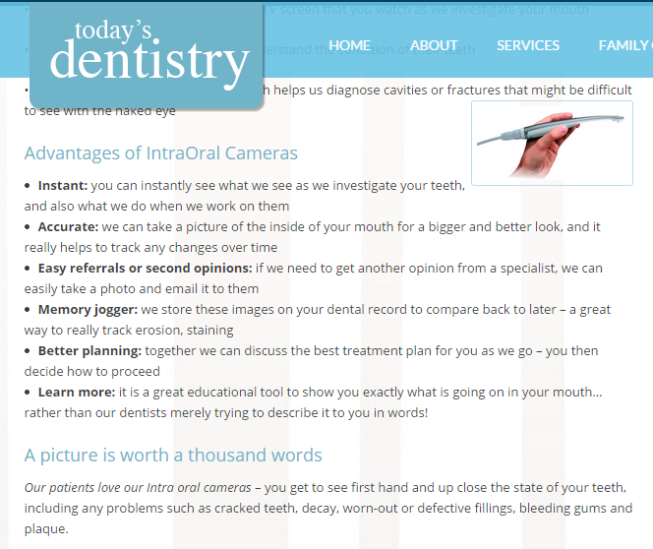
Advantages of intraoral cameras
Notes:
http://www.todaysdentistry.com.au/intraoral-cameras/

Slide 16
Our solution …

Slide 17
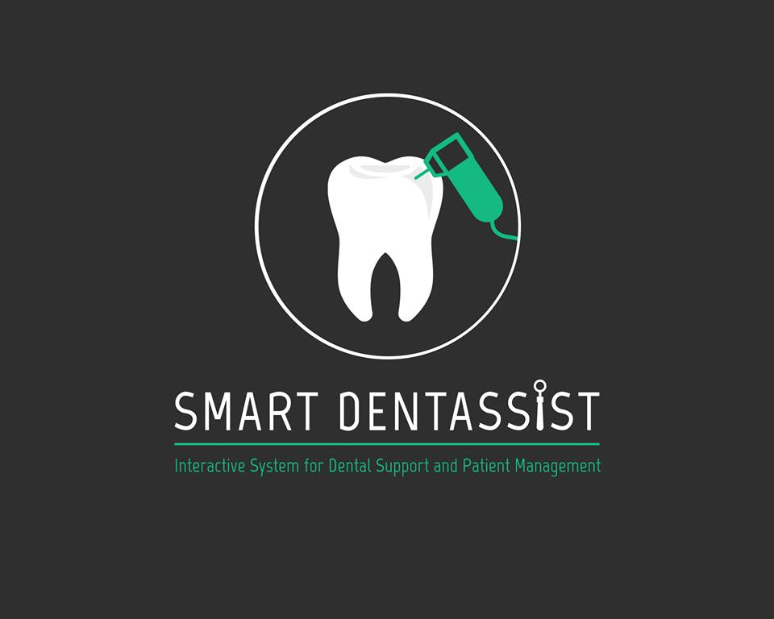

Slide 18
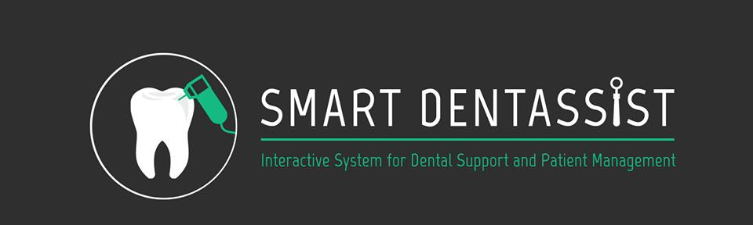
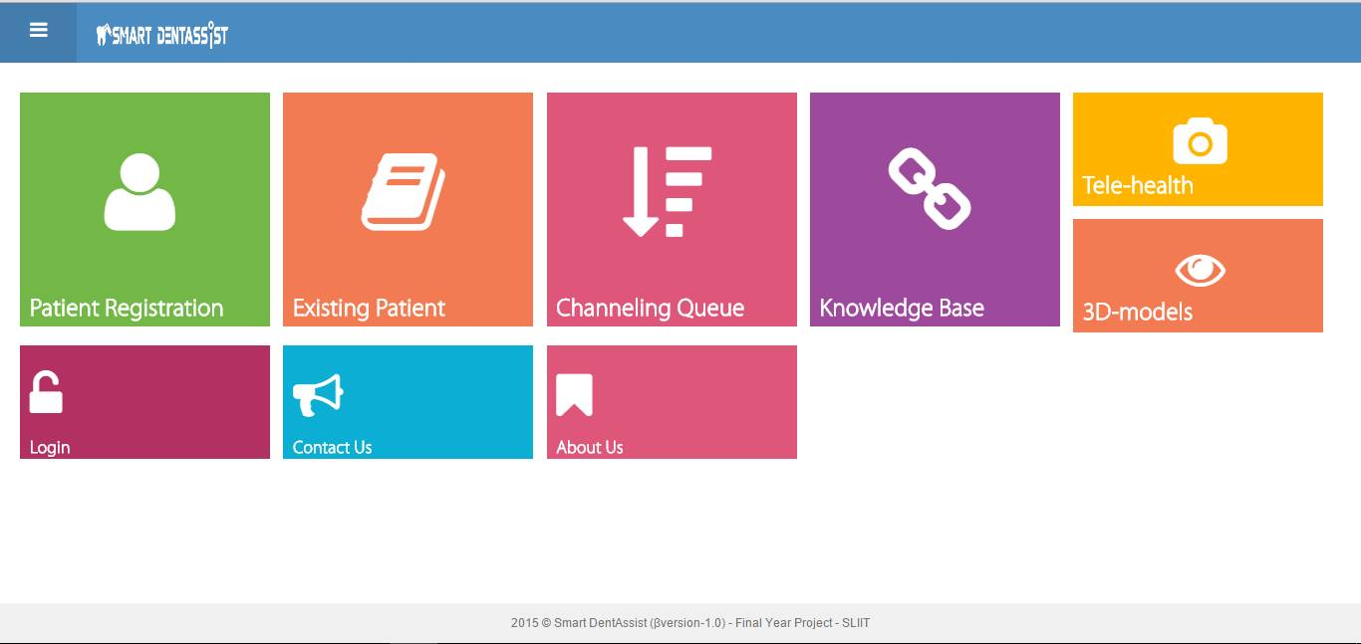
PATIENT
MANAGEMENT
SYSTEM
DIAGNOSIS,
TREATMENT & SIMULATION
DENTAL INFORMATION
KNOWLEDGE BASE
TELE-
CONFERENCING
SYSTEM

Slide 19
Technologies Used
Php
Java
JavaScript
jQuery
Blender
RTMP Protocol
X3dom
WebGL

Slide 20
Demonstration …

