Slide 1
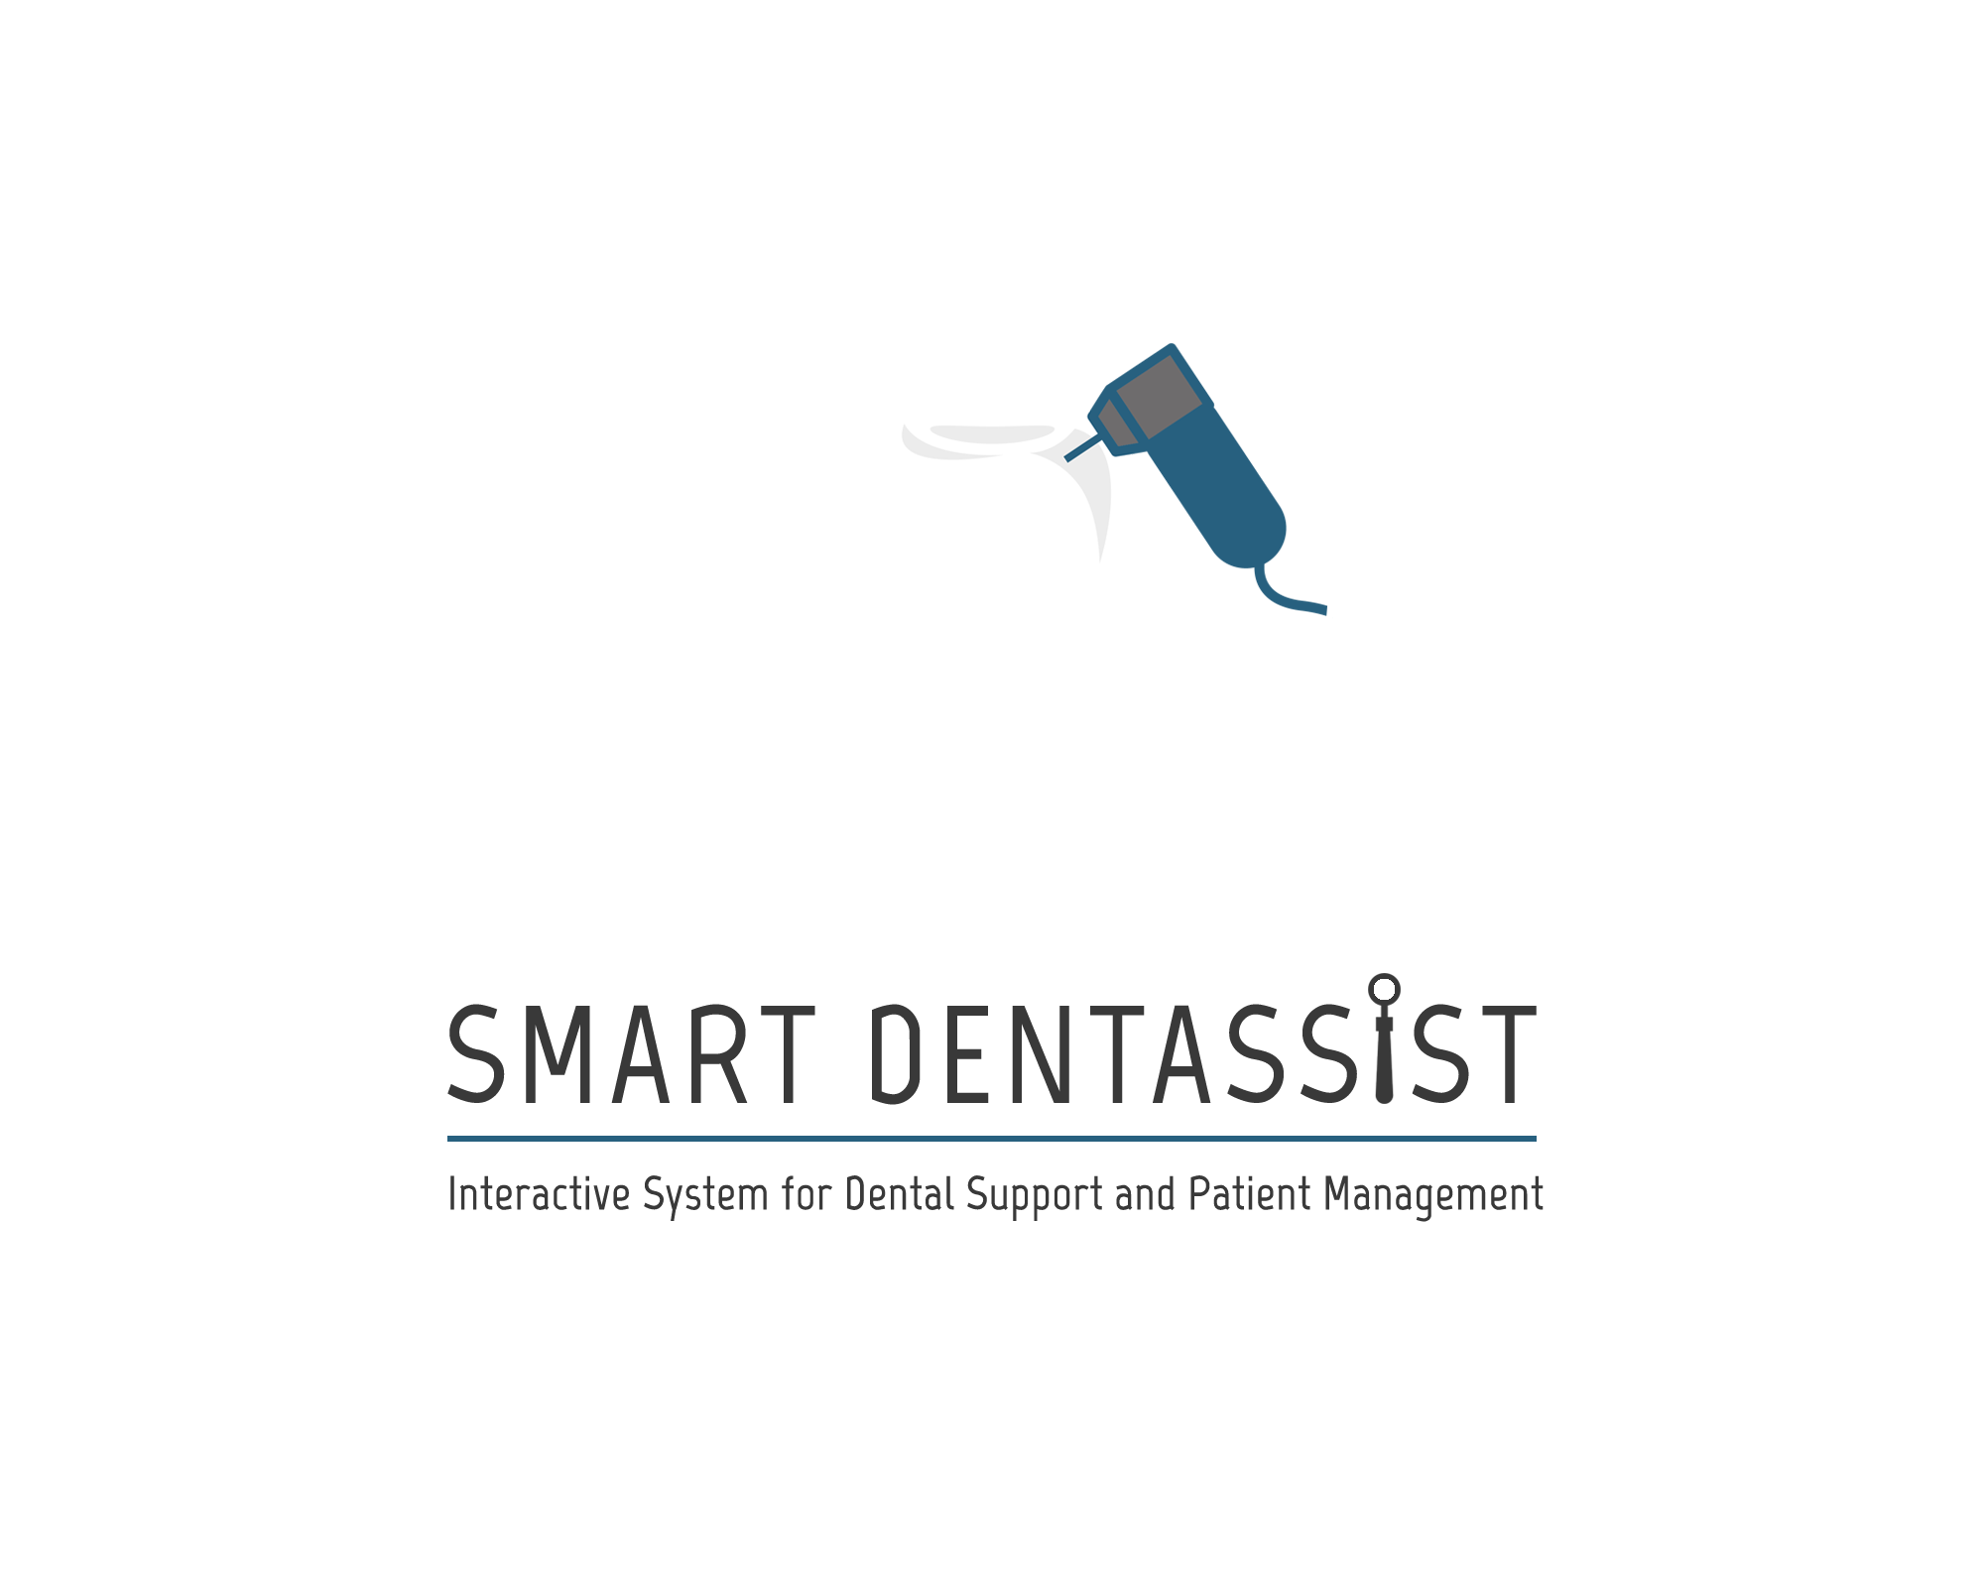

Slide 2
Why Periodontal diseases are so common ?

Slide 3
Unawareness
According to the Sri Lanka Annual Health Bulletin-2012, the unawareness of dental diseases
children - 75.81% ,
adults - 44.39%
elderly - 71.15% .

Slide 4
According to the National Oral Health Survey, prevalence of Gum Diseases ;
12-year-olds - 76 %
15-year-olds - 74 %
44 to 53-year-olds - 91 %
above 65 years - 99 %

Slide 5
Poor education
on dental caries & periodontal diseases
on causes
on prevention
on its impacts
on importance of regular checkups

Slide 6
According to Dr. K. A. A. S. Warnakulasuriya (Dental School - University of Peradeniya)
“The commonest site in which mouth cancer occurs in Sri Lanka is inside the cheek, called the "buccal cancer". This can be related to the habit of keeping or carrying betel quid adjacent to the cheek. The area behind the last standing tooth (Wisdom tooth) in the lower jaw called "retro-molar site", where the quid may stagnate and thereby predispose to cancer. “

Slide 7
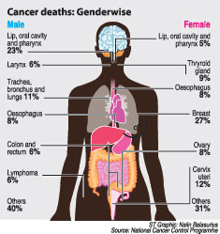

Slide 8
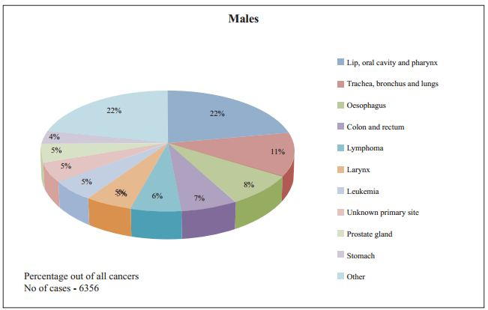

Slide 9
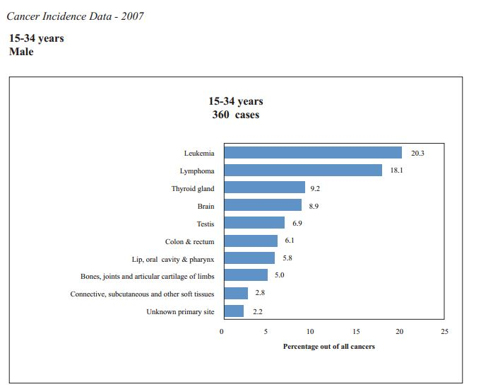

Slide 10
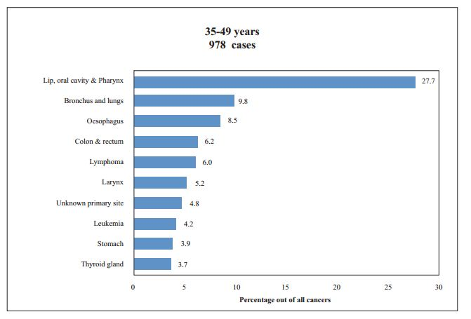

Slide 11
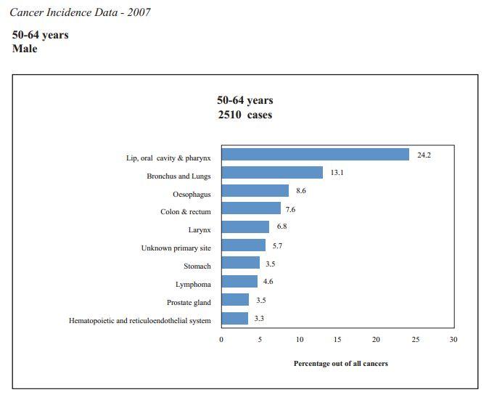

Slide 12
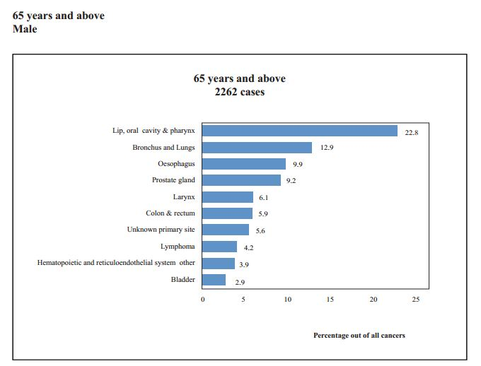

Slide 13
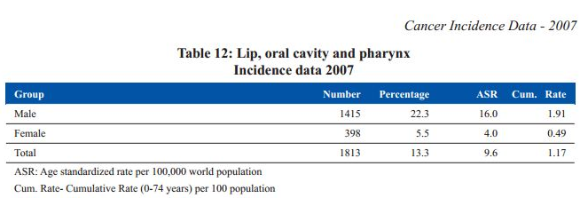

Slide 14
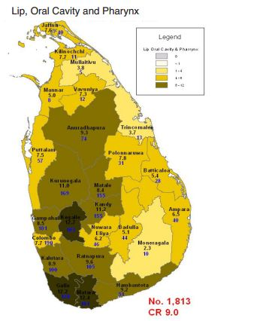

Slide 15
Doctors are not well equipped
low usage of intraoral cameras
Low usage of technology in rural areas
Unavailability of decision support systems
Unavailability of knowledge base

Slide 16
Medical facilities / personnel are not equally distributed
Number of dental surgeons per 100,000 population = 6.0
Number of dental specialists = 59
Premier institutions for oral health care :
Dental Institute, Colombo
Institute of Oral Health, Maharagama
Dental Hospital (Teaching) , Peradeniya

Slide 17
How to decrease Periodontal diseases ?

Slide 18
For people -
Provide proper dental health education
Advise people to visit dental clinics regularly
Educate them on their dental conditions

Slide 19
For dentists -
Improve dental equipment and technologies
Provide rural areas with proper facilities
Provide a way to connect dentists with specialists
Provide a constantly updating knowledge base

Slide 20
To bridge this gap ….

Slide 21
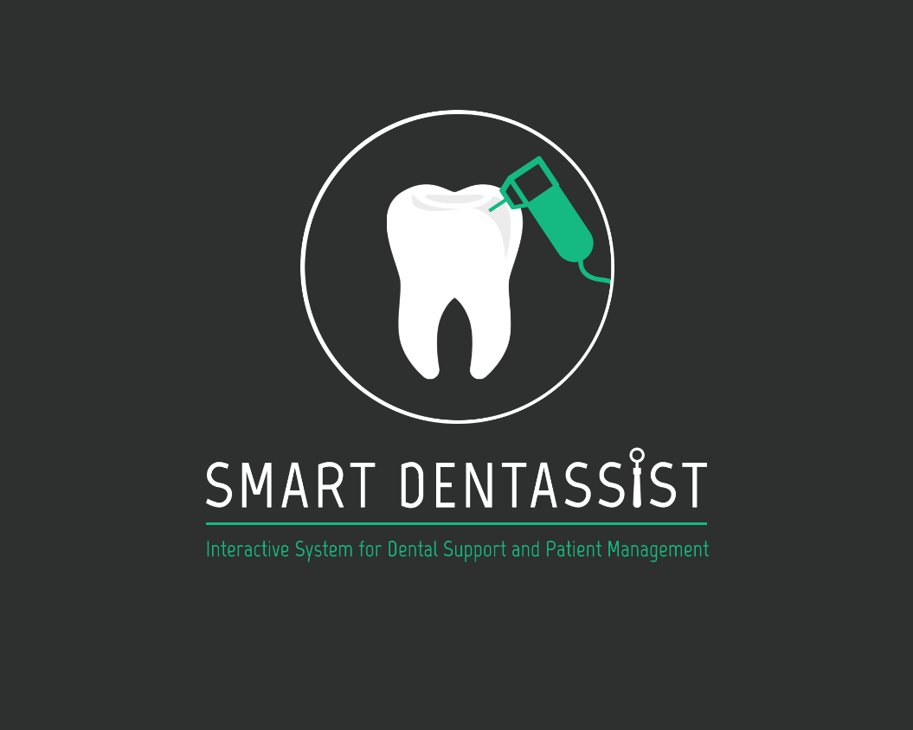

Slide 22
Smart Dentassist’s features
Oral Health Education
Patient Management System
Teleconferencing System
Diagnosing, treating and simulating outcome
Dental Information Knowledge Base

Slide 23
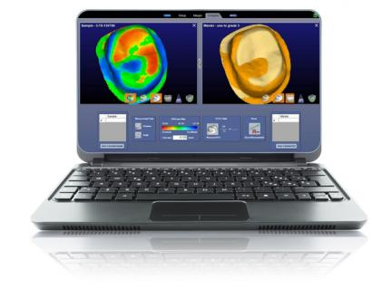
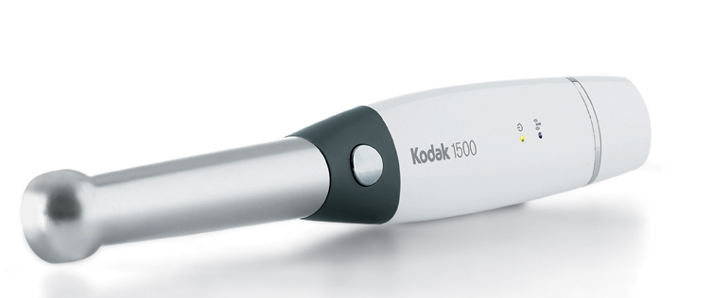
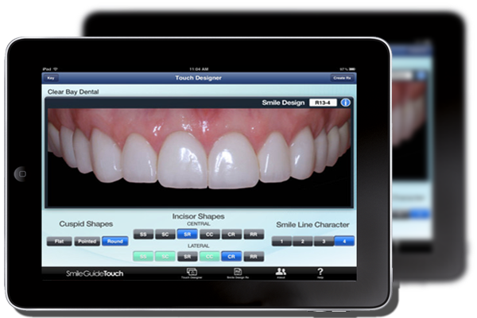
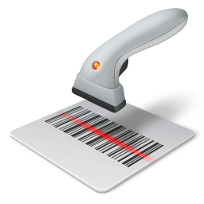
SMART DENTASSIST Hardware Components

Slide 24
SMART DENTASSIST Benefits

Slide 25
For Dentists
Ease of access of enhanced technology and knowledge
Easy communication among dentists for dental issues
Constantly updating knowledge base

Slide 26
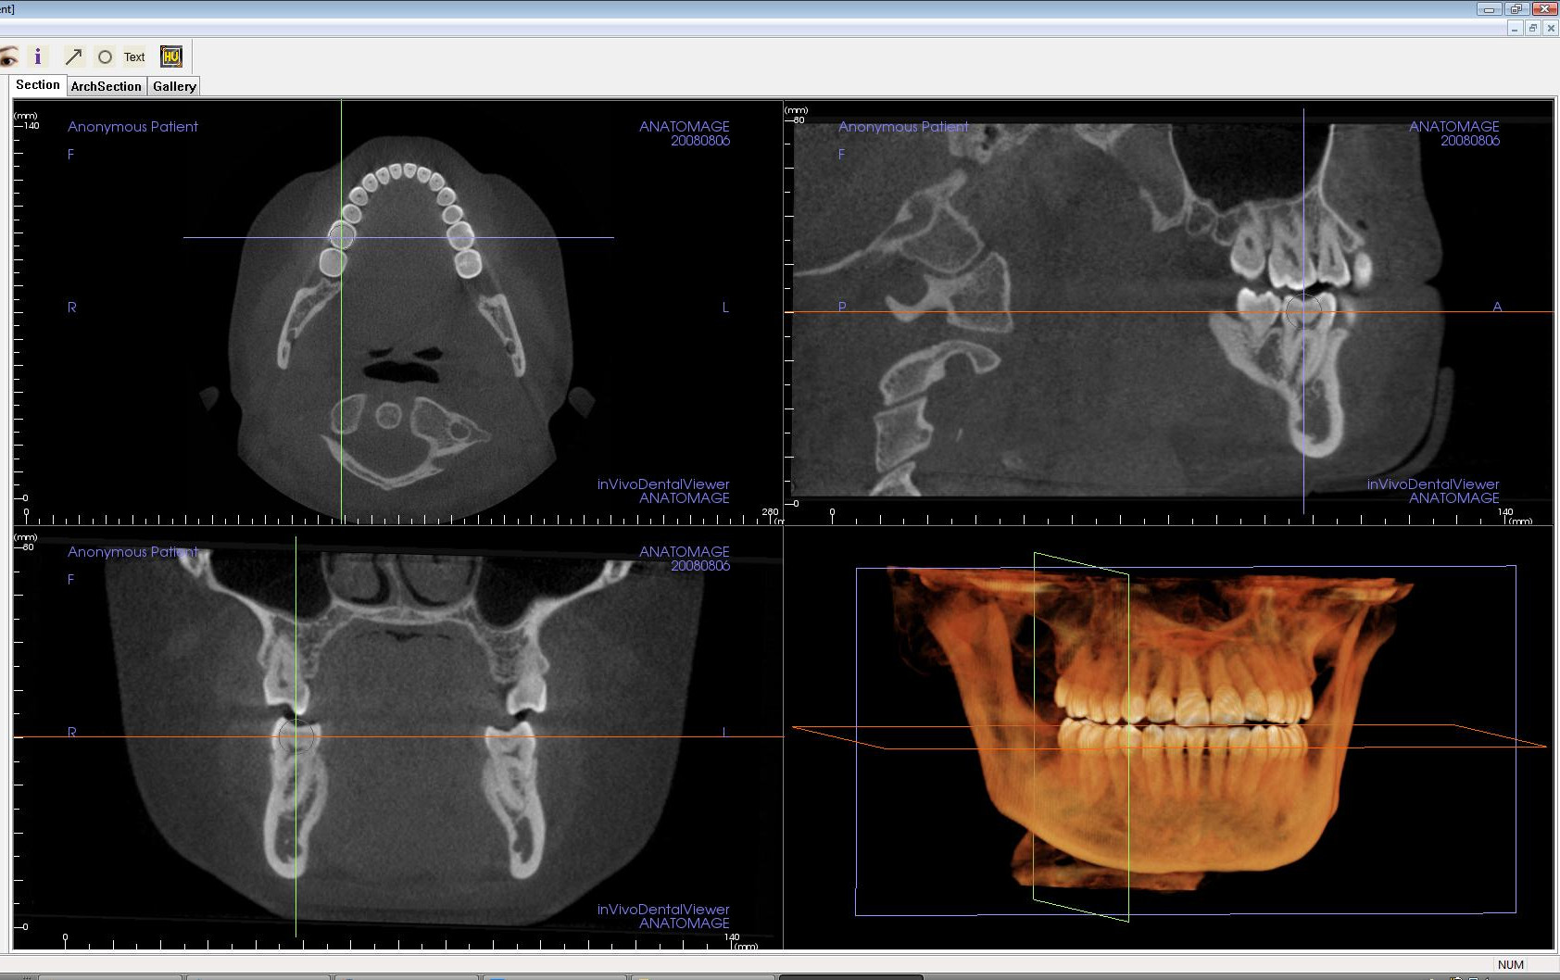
For Dentists …

Slide 27
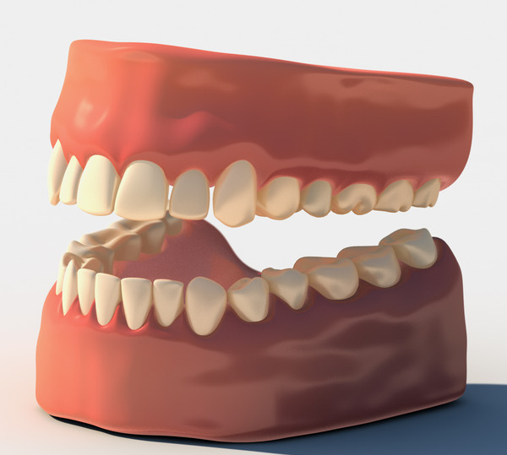
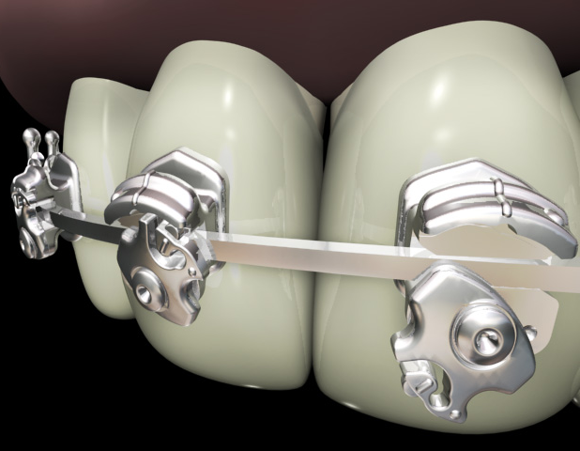
3D modelling …

Slide 28
For Patients
Enhanced dental care
Better dental education & understanding
Ability to view simulation of treatment & outcome

Slide 29
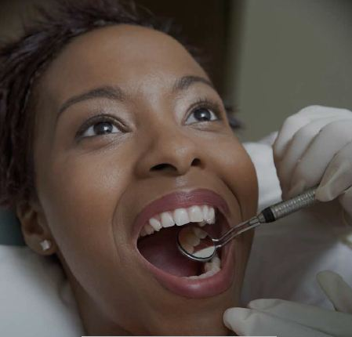
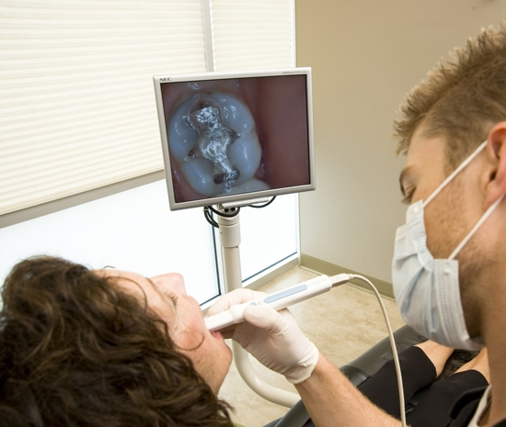
Mouth Mirrors vs Intraoral Cameras

Slide 30
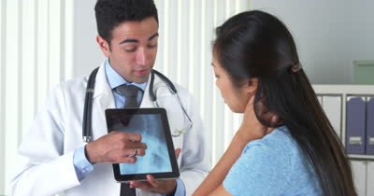
Better education

Slide 31
SMART DENTASSIST Objectives

Slide 32
To provide a better dental health care service to patients, irrespective of where they live.
To educate patients clearly on their dental conditions with the visual output of intra oral cameras.
To provide patients with a better understanding of the outcomes of treatments carried out.
For “knowledge balancing” among dentists
To provide better communication facilities for dentists
To create a “Knowledge Base” for dentists

Slide 33
Smart Dentassist Features

Slide 34
Smart Dentassist
Patient Management
Dental Information Knowledge Base
Diagnosing, treating and simulating outcome
Teleconferencing System

Slide 35
Smart Dentassist
Patient Management
Dental Information Knowledge Base
Diagnosing, treating and simulating outcome
Teleconferencing System

Slide 36
Patient Management System
Proper patient database
Send reminders for dental checkups
Maintain patient’s dental images
Maintain comments on images
Maintain dentist’s schedule
Generate virtual waiting list

Slide 37
Smart Dentassist
Patient Management
Dental Information Knowledge Base
Diagnosing, treating and simulating outcome
Teleconferencing System

Slide 38
Dental Information Knowledge Base
Maintain dental images & comments
Maintain treatments, drugs
Process images captured from intraoral camera
Share content to remote locations
Allow dentist to browse previous cases

Slide 39
Smart Dentassist
Patient Management
Dental Information Knowledge Base
Diagnosing, treating and simulating outcome
Teleconferencing System

Slide 40
Diagnosing, treating and simulating outcome
Decision support system
3D graphic modeling of patient’s current condition & outcome of treatment
Simulating the treatment process
Treatment suggestions based on images captured from intraoral camera

Slide 41
Smart Dentassist
Patient Management
Dental Information Knowledge Base
Diagnosing, treating and simulating outcome
Teleconferencing System

Slide 42
Teleconferencing System
Connecting dentists to consultants & specialists
Live stream videos from intra oral camera
Share dental images
Transmit images & live stream video to tablet PC for patient’s viewing

Slide 43
Technologies to be used…
Image Processing. (Dental Imaging)
Game development software to model simulations.
3D modelling to model dental structures
2D to 3D conversion
Statistical data analysis.

Slide 44
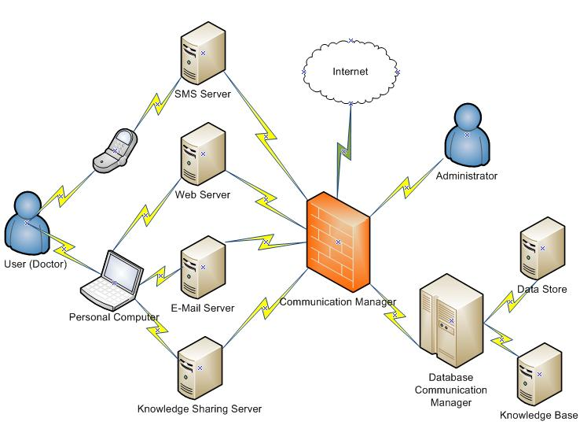

SMART DENTASSIST
Intraoral camera

Slide 45
References
[1] “Media Centre”, World Health Organization , available: http://www.who.int/mediacentre/factsheets/fs318/en/ , [accessed : 28.01.2015]
[2] “Oral Health”, National Institute of Dental and Craniofacial Research, available: http://www.nidcr.nih.gov/oralhealth/, [accessed : 28.01.2015]
[3] Oral Health Worldwide : A report by FDI World Dental Federation, Switzerland : FDI World Dental Federation
[4] “Department of Health Services”, Ministry of Healthcare and Nutrition, Sri Lanka, available: http://www.health.gov.lk/, [accessed: 02.02.2015]
[5] “Public Questions Archive”, Sri Lanka Dental Association, available: http://www.slda.lk/public/browse-questions-and-answers [accessed: 02.02.2015]

Slide 46
Thank you!

