Slide 1
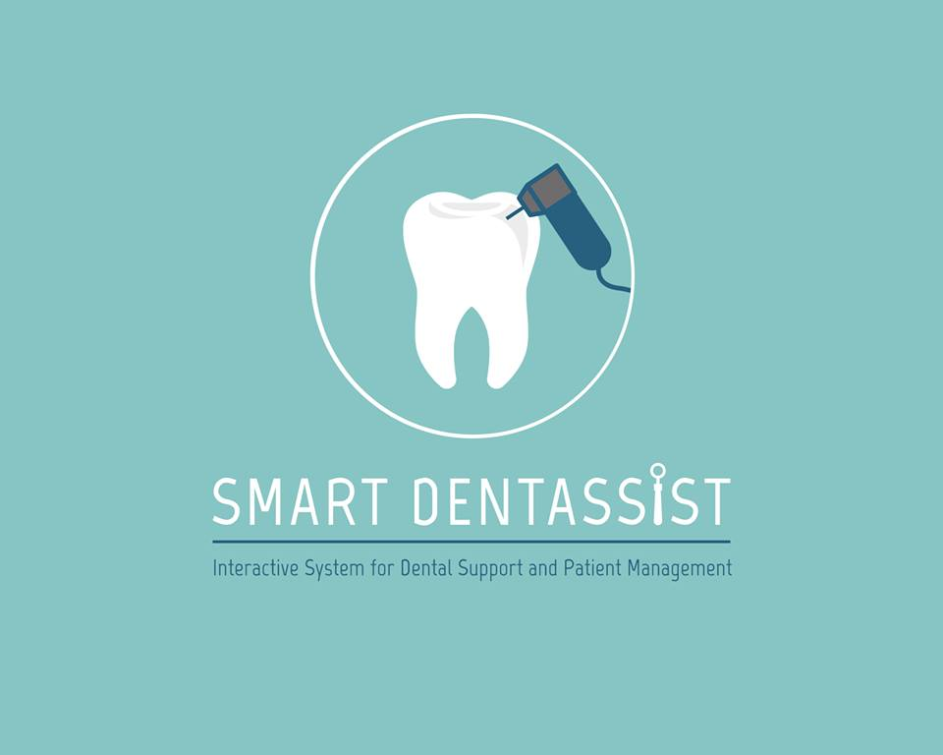

Slide 2
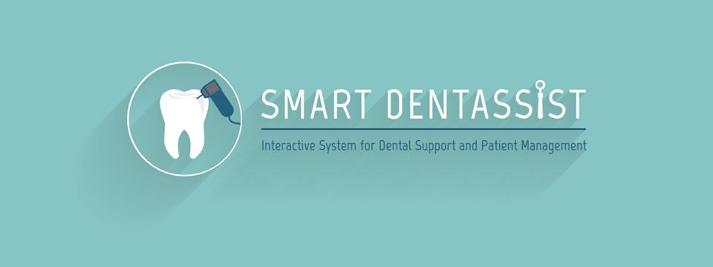
Home Page

Slide 3
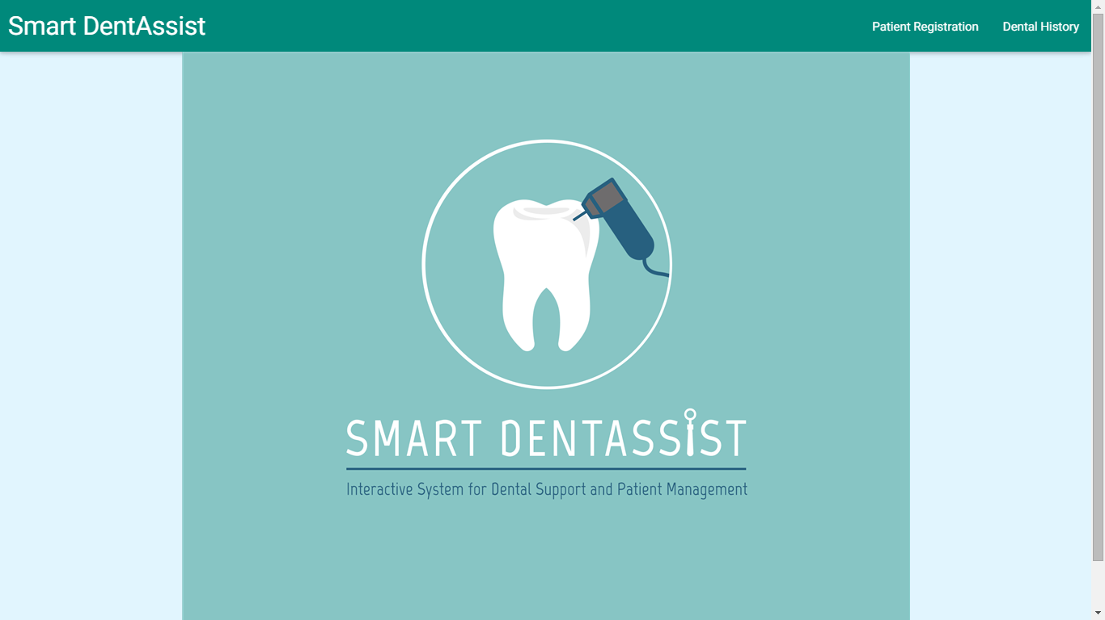

Slide 4
Patient Registration

Slide 6
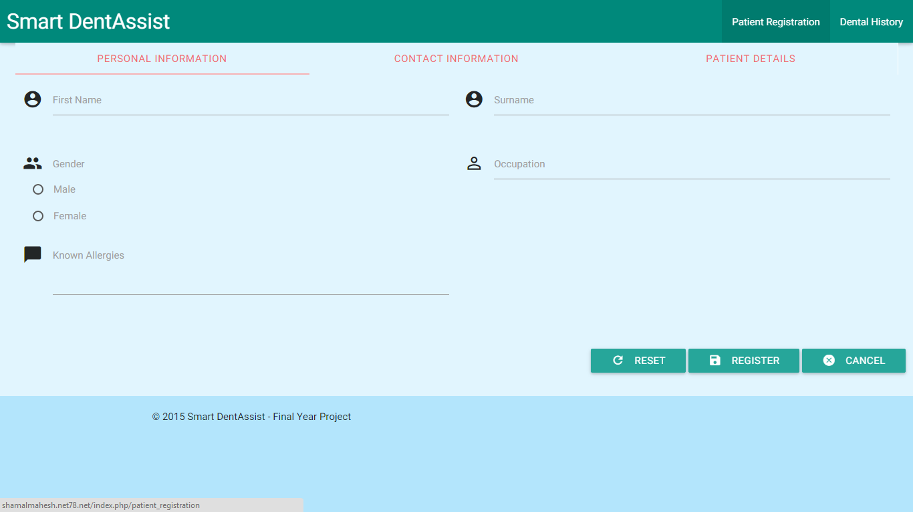
Personal Information

Slide 7
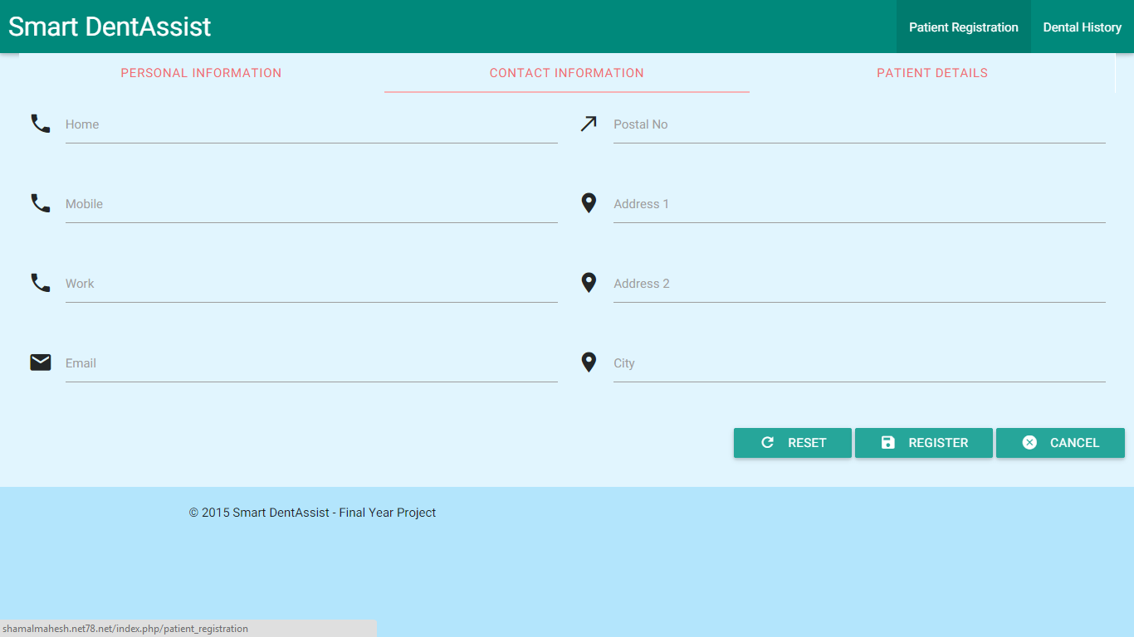
Contact Information

Slide 8
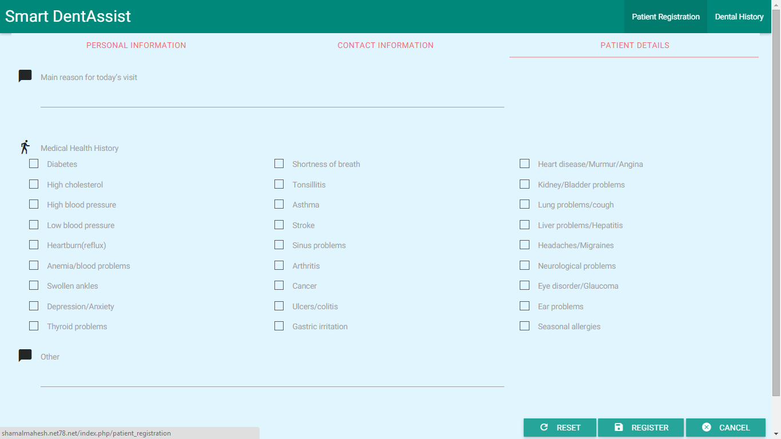
Health Information

Slide 9
Dental Health History

Slide 11
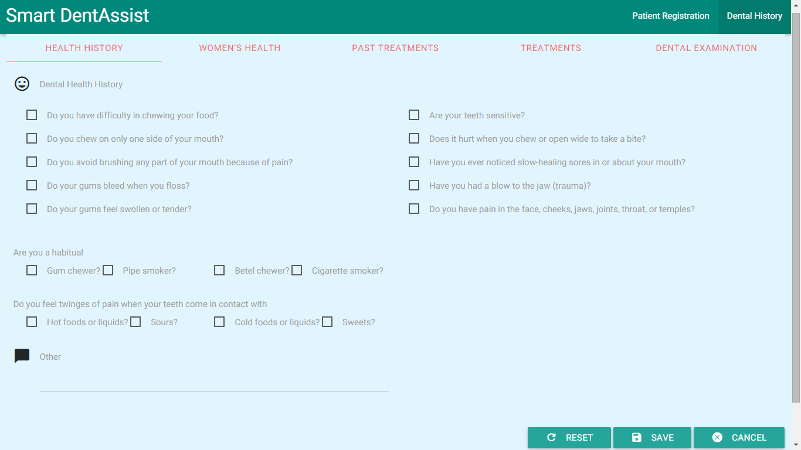
Medical Health

Slide 12
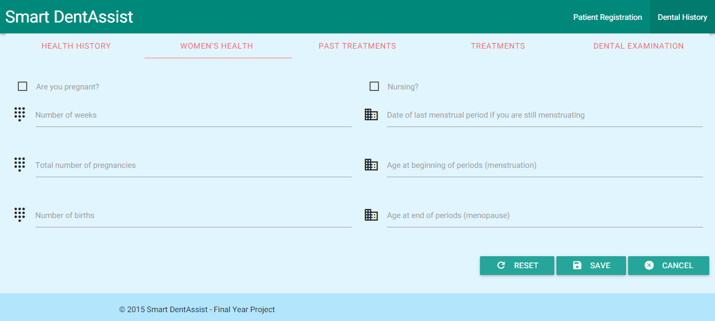
Women’s Health

Slide 13
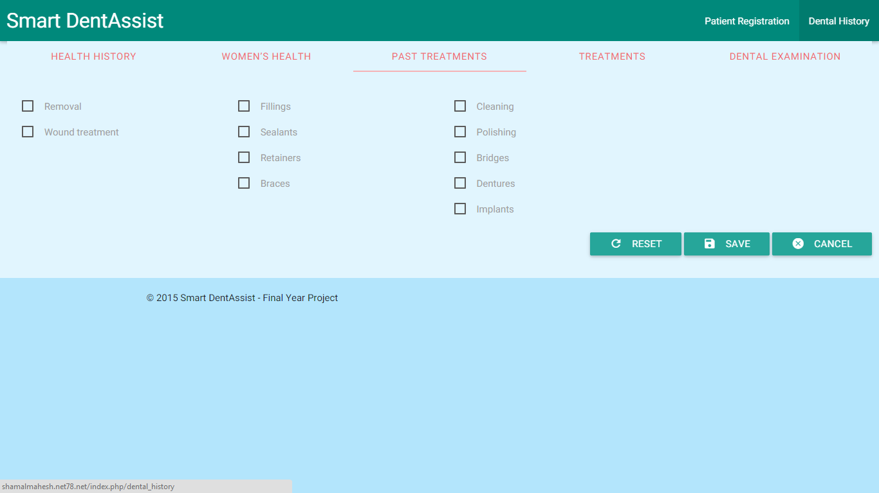
Past Dental Treatments

Slide 14
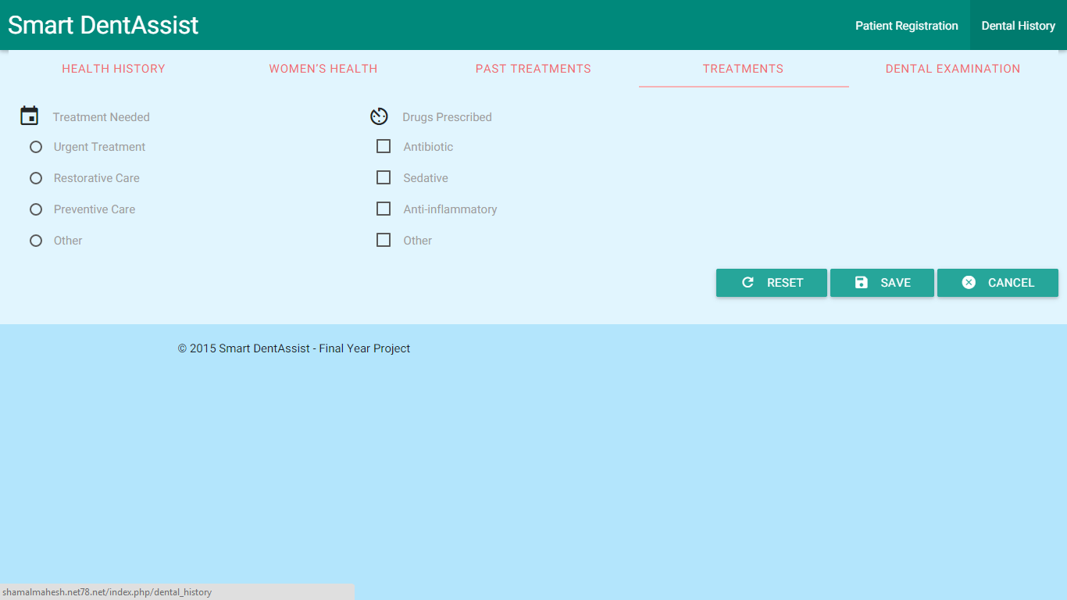
Required Treatment

Slide 15
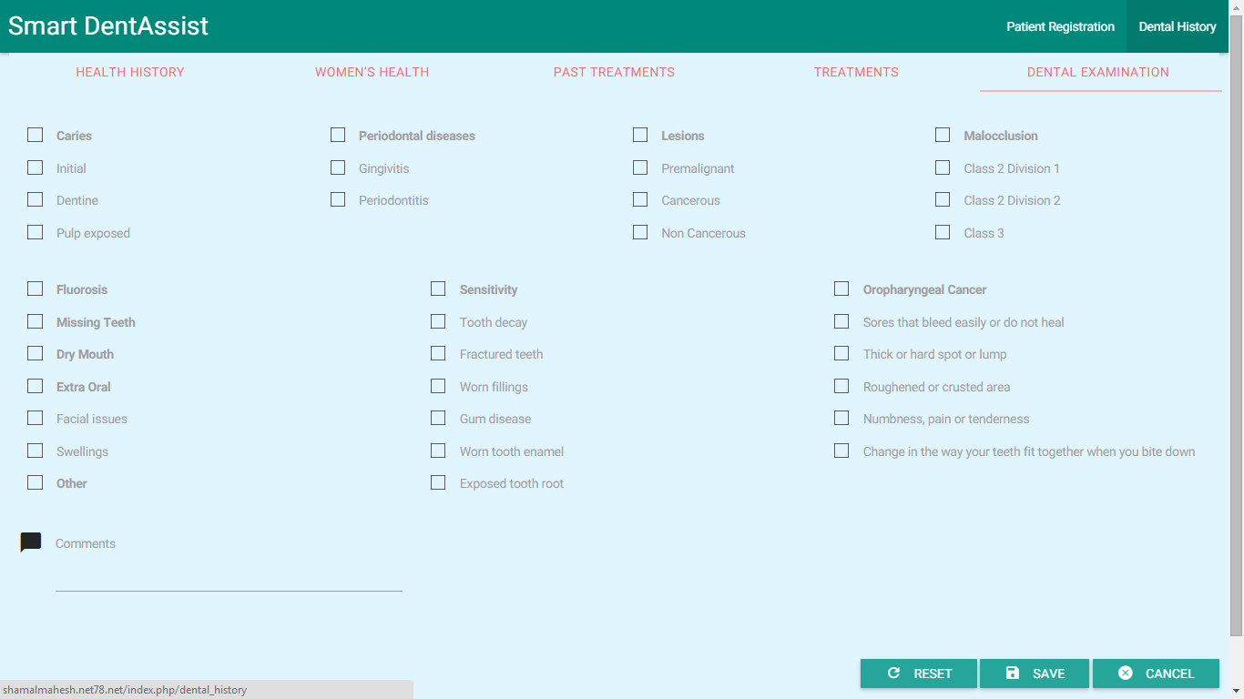
Dental Examination Observations

Slide 16
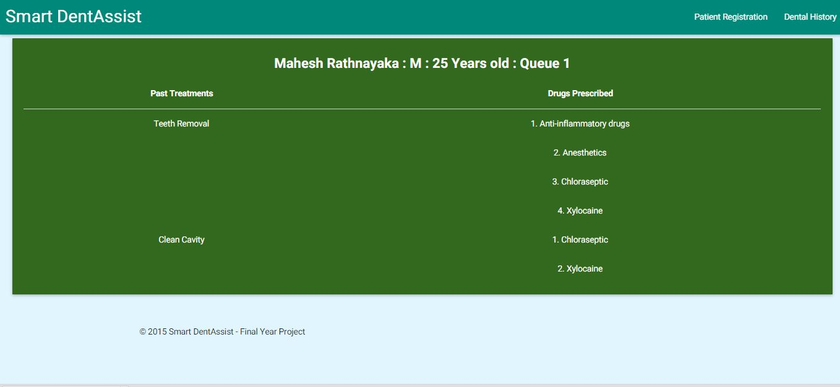
Patient History Profile

Slide 17
Hardware Interfaces

Slide 18
Laptop computer
Intraoral camera
Tablet PC
Bar code reader

Slide 19
Software Interfaces

Slide 20
The system - Java version 1.7
The webpages - php, HTML, CSS, JavaScript and jQuery.
The database - MySQL version 5.5

Slide 21
Use Cases

Slide 22
Patient Management
Dental Information Knowledge Base
Diagnosing, treating and simulating outcome
Teleconferencing System

Slide 23
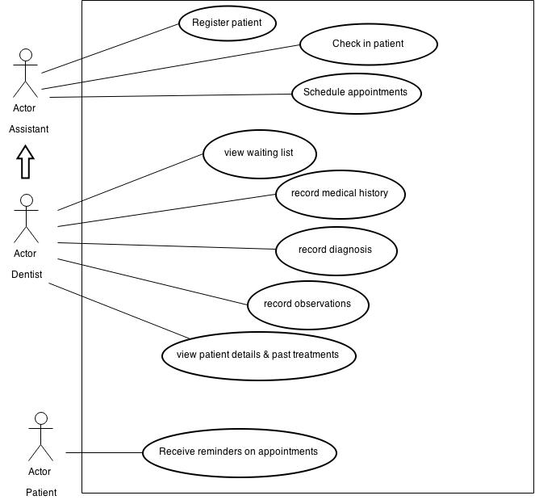

Slide 24
Use case | Register Patient
Pre-condition | Application is up and running Database connection is active
Actor | Assistant / Nurse
Main Success Scenarios | Enter patient basic personal information Enter patient contact details information Enter patients’ general medical history
Extension

Slide 25
Use case | Check in Patient
Pre-condition | Application is up and running Database connection is active Patient must be already registered
Actor | Assistant / Nurse
Main Success Scenarios | Go to check in interface Scan patient barcode with bar code reader Doctor’s waiting list & schedule are automatically updated
Extension

Slide 26
Use case | Schedule appointment
Pre-condition | Application is up and running Database connection is active Patient must be already registered
Actor | Assistant / Nurse
Main Success Scenarios | Scan patient barcode / search patient Select time and date Enter reason for appointment / patient complaint Add appointment
Extension

Slide 27
Use case | View waiting list
Pre-condition | Application is up and running Database connection is active
Actor | Dentist
Main Success Scenarios | Open daily schedule View list of upcoming appointments
Extension

Slide 28
Use case | Record medical history
Pre-condition | Application is up and running Database connection is active Patient is already registered
Actor | Dentist
Main Success Scenarios | Scan patient barcode / search patient Open dental health history interface Check/tick options and make comments if necessary Save to the system
Extension

Slide 29
Use case | Record diagnosis
Pre-condition | Application is up and running Database connection is active Patient is already registered Patient history is saved
Actor | Dentist
Main Success Scenarios | Scan patient barcode / search patient Open treatment interface Check/tick treatment types, drugs and treatment priority Add comments Save to the system
Extension | 3a. if there are any other details to be stored, the dentist can store them as comments.

Slide 30
Use case | Record observations
Pre-condition | Application is up and running Database connection is active Patient is already registered Patient history is saved
Actor | Dentist
Main Success Scenarios | Scan patient barcode / search patient Open observations interface Check/tick observations, signs, symptoms Add comments Save to the system
Extension

Slide 31
Use case | View patient details & past treatments
Pre-condition | Application is up and running Database connection is active Patient is already registered Patient history is saved Patient diagnosis & observations are saved
Actor | Dentist
Main Success Scenarios | Scan patient barcode / search patient Open patient profile interface View past treatments, methods, drugs used, outcome
Extension | 3a. If the patient is new, only the registration details will be displayed

Slide 32
Use case | Receive reminders on appointments
Pre-condition | Application is up and running Database connection is active Patient is registered in the system
Actor | Patient
Main Success Scenarios | Receive text message / mail reminders of upcoming appointments
Extension

Slide 33
Patient Management
Dental Information Knowledge Base
Diagnosing, treating and simulating outcome
Teleconferencing System

Slide 34
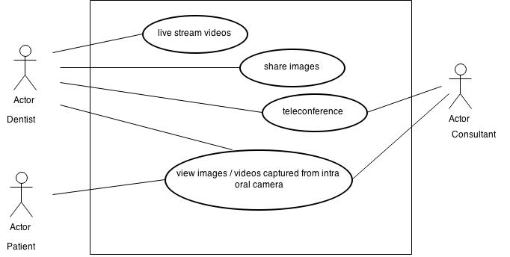

Slide 35
Use case 01 | Live Stream videos
Pre-condition | Healthy internet connection Application up and running and working hardware properly
Actor | Dentist
Main Success Scenarios | Get the list of online specialists/consultants Send request to one or more specialists/consultants Connect with people who accepted the request Make online the video via the web application
Extension | 1. a. No specialist/consultant available at the time

Slide 36
Use case 02 | View images/videos captured from intra oral camera
Pre-condition | Application is up and running Hardware device is linked with the application
Actor | Dentist/Consultant
Main Success Scenarios | Select the patient profile Connect device and get the inputs from it View/save images/videos against the selected patient online Share images/videos with other specialists/consultants
Extension | Inputs taken from the device is not recognized

Slide 37
Use case 03 | Teleconference
Pre-condition | Application is up and running Healthy internet connection
Actor | Dentist
Main Success Scenarios | Get the list of online specialists/consultants Select one or more from the list to start teleconferencing with Start the conference with the selected personnel.
Extension | 3.a. share media with the participants if needed.

Slide 38
Patient Management
Dental Information Knowledge Base
Diagnosing, treating and simulating outcome
Teleconferencing System

Slide 39
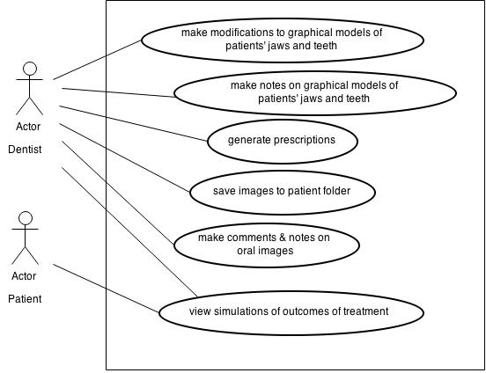

Slide 40
Use case | 3D modeling
Pre-condition | Application is up and running Images are captured
Actor | Dentist
Main Success Scenarios | Capture images Select 2D images Select output type
Extension | 1a. Captured images are not clear 2a. Select a valid source images

Slide 41
Use case | Simulating outcome
Pre-condition | Application is up and running Images are captured
Actor | Dentist
Main Success Scenarios | 1.Select 3D model. 2. Select treatment type. 3. Select treatment period 4. Click “Simulate”.
Extension | 1a. Selected model not compatible

Slide 42
Use case | 3D model editing(Manual 3d modeling)
Pre-condition | Application is up and running Images are captured
Actor | Dentist
Main Success Scenarios | 1. Select 3D model. 2. Edit 3D model. 3. Click “View”.
Extension | 1a. Selected model not compatible

Slide 43
Use case | Create prescriptions
Pre-condition | Application is up and running Images are captured Patient’s diagnosis is stored
Actor | Dentist
Main Success Scenarios | 1 Select patient’s teeth images. 2. Select treatment. 3. Comments images 3. Click “Create Prescription”.
Extension | 1a. Selected model not compatible

Slide 44
Patient Management
Dental Information Knowledge Base
Diagnosing, treating and simulating outcome
Teleconferencing System

Slide 45
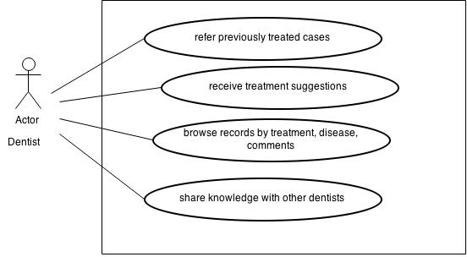

Slide 46
Use case 01 | Refer previous treatments
Pre-condition | Application is up and running Database connection is active
Actor | Dentist
Main Success Scenarios | Select the patient profile Select the patient history Patient’s previous treatments will load in the web page
Extension | 3.a. Previous treatments page not load for new patients

Slide 47
Use case 02 | Receive treatment suggestions
Pre-condition | Application is up and running Database connection is active
Actor | Dentist
Main Success Scenarios | Select the patient profile Add comments to the patient oral health Click the ‘suggestions/help’ button Popup suggestions for treatments and drugs
Extension | 3.a. Comments must filled in the web page

Slide 48
Use case 03 | Share knowledgebase
Pre-condition | Application is up and running Database connection is active
Actor | Dentist
Main Success Scenarios | Select the patient profile Click the ‘Share knowledgebase’ button Popup knowledgebase details to select Share details to central database
Extension | 2.a. Knowledgebase can share with profile to profile and also with category wise.

Slide 49
Use case 04 | Make comments on oral images
Pre-condition | Application is up and running Database connection is active
Actor | Dentist
Main Success Scenarios | Select the patient profile Click the ‘Add Image’ button Load the intra-oral camera images Select relevant image Click ‘Add Comment’ button Popup the editor panel Add comments to the image Save the image
Extension | 3.a. Images are not loaded if the location is empty

Slide 50
Use case 05 | Make notes on oral images
Pre-condition | Application is up and running Database connection is active
Actor | Dentist
Main Success Scenarios | Select the patient profile Click the ‘Add Image’ button Load the intra-oral camera images Select relevant image Click ‘Add Note’ button Popup the image editing panel Add notes on the image Save the image
Extension | 3.a. Images are not loaded if the location is empty 8.a. Notes are empty image will not saved

Slide 51
Software System Attributes

Slide 52
Correctness - The correctness of the details which is in data base should be 100% correct always.
Accuracy – The accuracy of treatment and diagnosis suggestions should be 100% accurate.

Slide 53
Availability - The dentist can access any data in the database at any time and the dentist should be able to use teleconferencing at any time.
Confidentiality – Information must be kept private from the outside world.

Slide 54
Usability – The system’s user interfaces must be kept simple and easy to handle.
Safety -Database backup is required in case of a database crash or an operating system failure. A backup shall consist of a complete reproduction of every file on the server.

Slide 55
Security - The system shall implement difference access levels to its users.
Performance – The system should process the images captured and suggest the diagnosis report which has a latency of not more than 45 seconds.

Slide 56
Deployable - System can be deployed in any platform with the minimal memory, space performance etc. requirements.
Scalability – System can be extended in future i.e. to access it through cloud servers.

Slide 57
Thank You!

