Slide 1
InterConnCause we interconnect
Mid Way Report, Milestone 1

Slide 2
IDE And Debugger Setup
Installed WAMP on local
Using PhpStorm and xzend for Debugger environment

Slide 3
DB Related:
Designed the DB Schema
Experimented on Slack
Normalized DB
Rough schema with Tables, Attributes and Relations

Slide 4
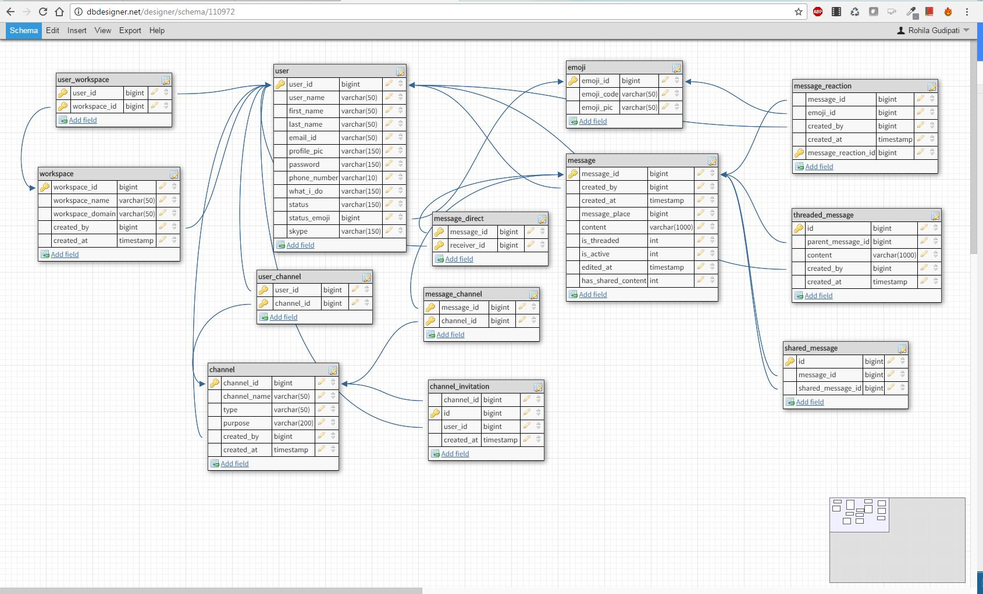

Slide 5
Requirements Achieved So Far:
Login Functionality with Session Creation
Preventing SQL Injections while logging In.
Home Page
Dynamically created list of channels
Dynamically showing the channel details on a channel click.

Slide 6
External Libraries used
JQuery (A framework on javascript for Dynamism)
Bootstrap (CSS Framework that follows Grid Layout Principles for Responsiveness)
Dockerized URL: http://rohila95.cs518.cs.odu.edu/

Slide 7
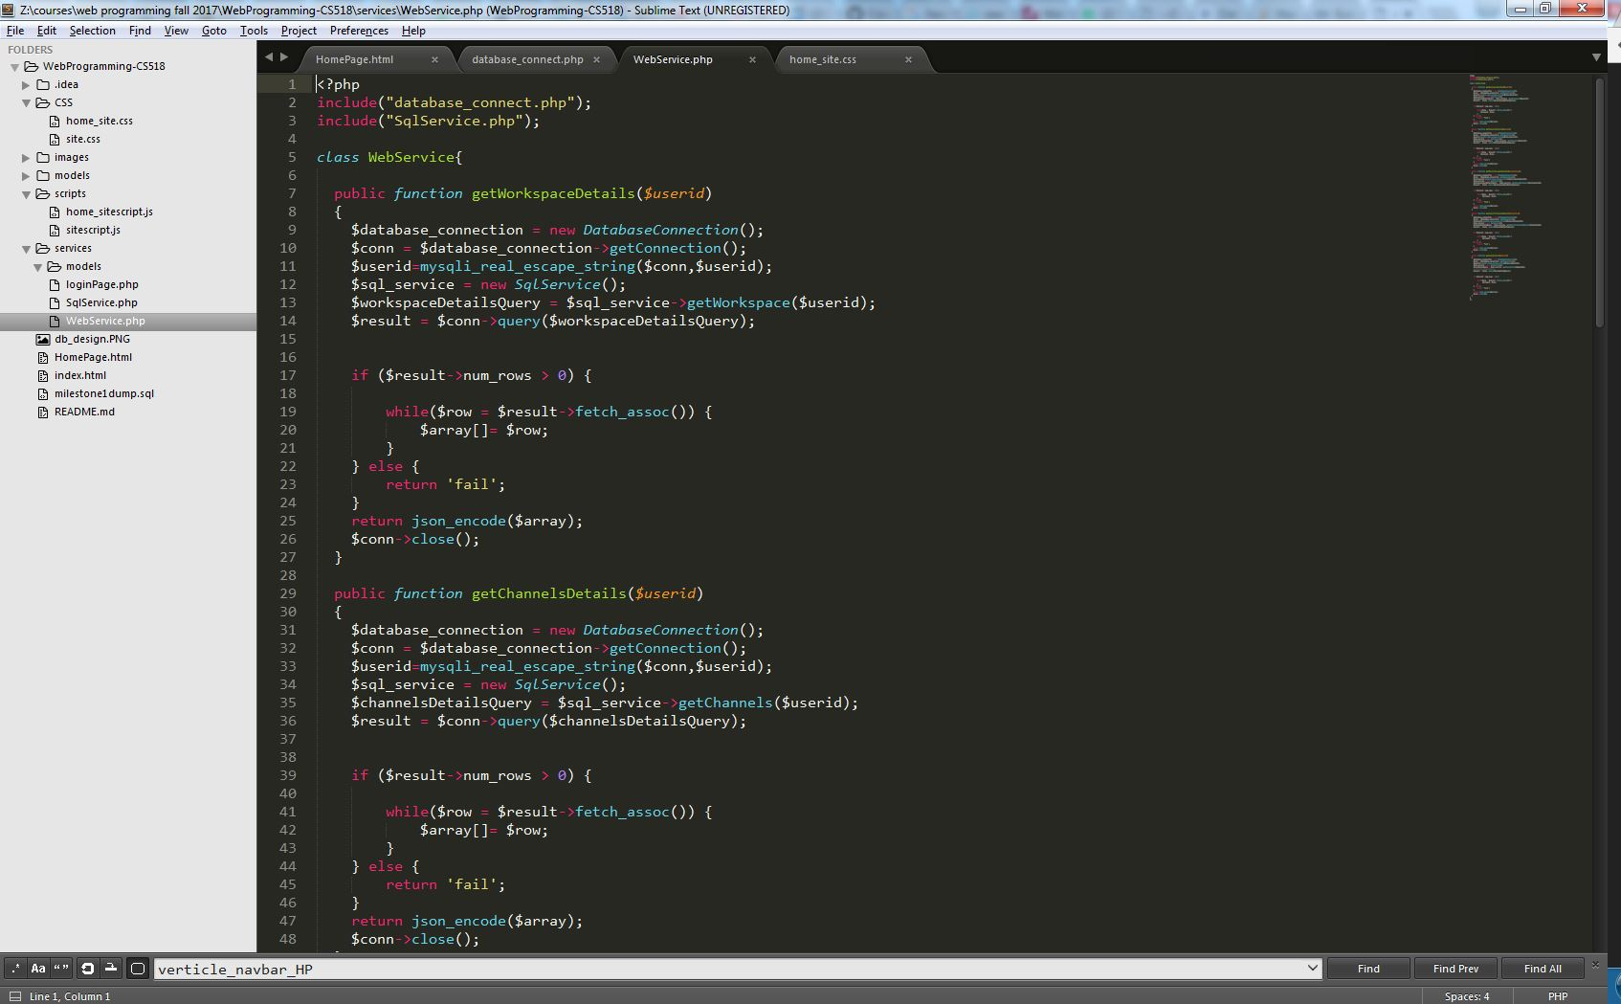
Project Folder Structure

