Slide 1
InterConnCause we interconnect
Mid Way Report, Milestone 3

Slide 2
Rectifications from the MS2 Demo
We implemented page loaders wherever necessary.
Auto scroll to the latest thread reply was overlooked by the last demo and is fixed now. Also implemented a feature to scroll to a corresponding message when thread head is clicked.
We started maintaining a file called TaskTracker, name itself says what it does. And our file looks as follow.

Slide 3
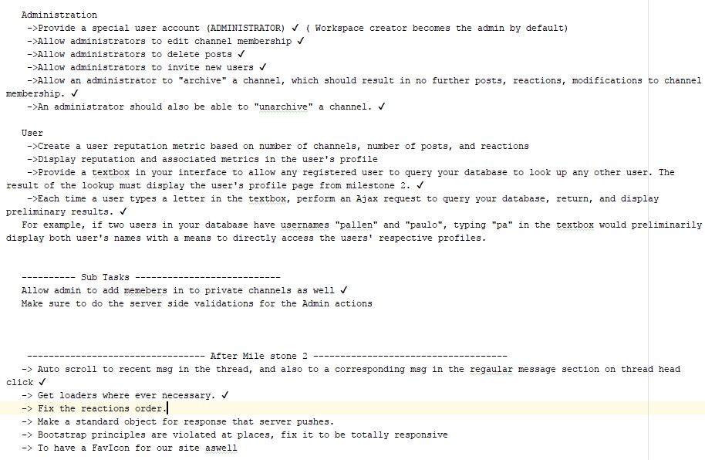

Slide 4
Preparation for MS3
Analysed all the requirements and took care of all the DB changes needed. Snapshot to follow

Slide 5
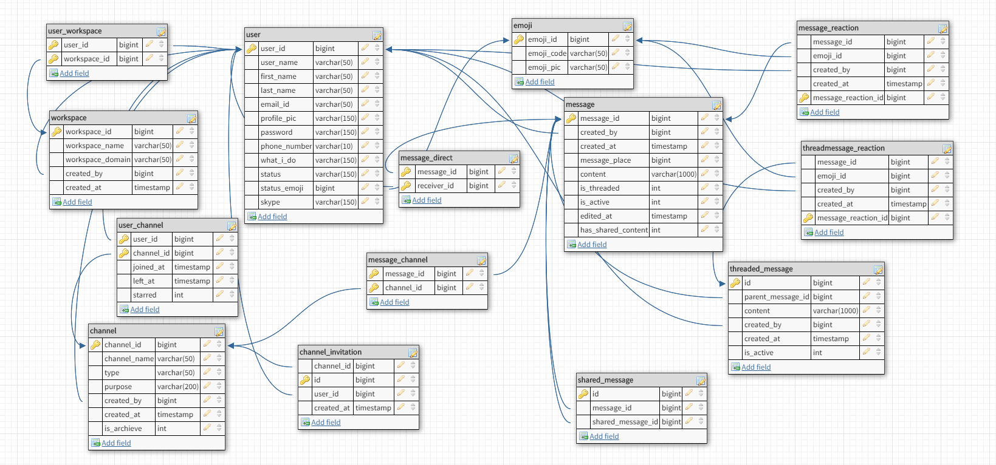

Slide 6
Implementation status for MS3
Pagination Module
Loading limited number of messages Initially.
Using AJAX to fetch more when scrolled to top of the section or on clicking load more messages tag.
Administration Module
Admin now can edit channel membership.
Can delete the posts.
Can Archive and Unarchive Channels.
User Search Module
Implemented an auto suggestive input, redirects to user profile page on selecting an user suggested.

Slide 7
To be done
Pretty formated code input ,
User reputation metric.
Help page for the site.
Finally critical testing not forgotten.
LiveSite

