Slide 1
I1 {
Create()
Read()
Update()
Delete()
}
ASP.NET Core API
dll1
Data Access Layer
CRUD
Implements I1
SQL 1 Server
Data Access Repository
Data Access Layer
CRUD
Implements I1
SQL 2 Server
dll2
Data Access Layer
CRUD
Implements I1
Oracle Server
D1
D2
D3
Dependency Container
dll3

Slide 3
IService Interface
With
CRUD Methods
Implements Interface
Implements Interface
DepartmentService
EmployeeService

Slide 4
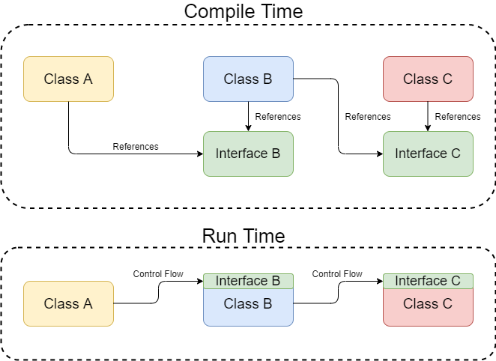
Dependency Injection in ASP.NET Core - Code Maze (code-maze.com)

Slide 5
Docker Image
Application
Application Runtime Image
Guest OS + Runtime

