Slide 1
System.Object
Reference Types
System.ValueType
System.String
System.Array
All Standard Collections, Interfaces
Record
System.Enum
User Define Classes and Interfaces
Value Types
System.Byte(1), System.Short(16), System.Int(32), Long(64, System.In64)
Float, (System.Single, 32), double (System.Float64, 64), Decimal (System.Decimal)
All Numeric Types
User Defined Types`
Booleans

Slide 2
C# Code
Check if the Syntax is followed as per the language rules, e.g. we need ‘;’ as a statement terminator. Check if expression satisfies the rule of LHS = RHS, the Common Language Specification (CLS). If a class is to be used in the code-file, then make sure that the namespace declaring this class must be imported (used with using) in the code file
To verify all types used in the source code the Common Type System (CTS) is used
Assembly is a successful compiled output from every .NET App. This is used for following 3 purposes
Execution of app with Hosting
Used as a Reusable set of Logic across all other .NET apps aka the redistributable package
Used as a Namespace for other application (extension of point 2)
C# Compiler
Assembly (.dll) Hosted by dotnet.exe
Dotnet.exe
Application Code as assembly
Dependencies
Framework Class Library
Common Services e.g. Memory Management, Managing Instances of standard classes used form Framework Class Library (FCL)

Slide 3
The Collection Type: An In-Memory Store of the data
Read from Top to Bottom (End of the collection, This is Iteration Process
Starts from the first entry in collection
Return it and then
If more record(s) present then ‘MoveNext’
The ‘IEnumerable’ interface and the process is known as Enumeration using ‘GetEnumerator()’ method

Slide 4
int x = 10;
object o = x;
Storing value type into reference type with the type of the value type as well as the value:➔ BOXING
Stack
Heap
Stack
o
System.Int32
10
x
10
Managed Heap
Obj
Memory Allocated to
obj
aka
SimpleOperations class
SimpleOperation obj =new SimpleOperation();
SimpleOperation obj = null;
There is no allocation for the obj in managed heap so there is will runtime exception

Slide 5
Application Layer
SQL DB 1
Business Workflows
Add()
Update()
ReadAll()
ReadBy()
Delete()
Data Acces
Send Data using Request
I
N
T
E
R
F
A
C
E
CRUD
SQL DB 2
Emp = {
EmpNo:101,
EmpName: “ABC”,
DeptName: “IT”,
Salary:89899
}
MAP with POCO
Connection
Queries (R/W)
{ NoSQL}
Files Upload / Download
Interface Layer MUST Map the received data with the Object / Schema / Entity
POCO: Class with Public Read/Write Properties
Files
Entity Layer , Plain Old CLR Objects (POCO)

Slide 6
EmpNo, EmpName, Address, City, PhoneNo, Email, Salary, Designation, Hra, Ta, Da, Allowances, Tax
Employee

Slide 7
Employee
+EmpNo
+EmpName
+Salary
+Address
Director Is-a Employee
Manager Is-a Employee
Single Inheritance
Single Inheritance
Director
Manager
+AirFare
+Allowanaces
+MobileBill
+ElectricityBill
+PterolAllowance
+RailwayFare
+LocalAllowance
+FoodAllowance
Hierarchical Inheritance
Multi-Level Inheritance
SalesManager
+ HotelAllowance
+ SalesCredit

Slide 8
Accountant System
Accountant Client
DirectorLogic
+GetSalary()
+ GetTax()
Employee
EmployeeLogic
Accountant System Needs Employee Object to Calculate Tax.
The GetTax() method will have Runtime Polymorphic Behavior
ManagerLogic
+GetSalary()

Slide 9
Cohesive Design
Namespace
Classes on for File Operations aka Stream
abstract class Stream {…}
Stream stream = new MemoryStream();
Stream stream = new FileStream();
Stream stream = new NetworkStream()
MemoryStream
NetworkStream
FileStream
In High Cohesive System implement the generalization of the behavior using Abstract base class and derive other specific classes from abstract base class. This also provide a optimized coupling during runtime and help in polymorphic behavior

Slide 10
Any changes in System 2 for Logger should not required any changes in System 1. In short it must be loosely coupled
System 2
System 1
Contract across Systems
Abstract class Log{}
Accept Data from the EndUser
Logger Logic
CreateLogFile(LogInfo)
WriteLog(LogInfo)
AppednLog(LogInfo)
ReadLog(LogInfo)
Request For Log
Respond with Instance
Log Entries
TextLog
TextLog
XmlLog
JsonLog
XmlLog
JsonLog

Slide 11
Code-Segment
M1()
Method
1. Jump to M1() by asking its address to the Runtime
2. Execution
Caller
M1()
3. Return data

Slide 12
Code-Segment
Delegate
2. Direct to Method
Delegate Holding Address of M1()
M1()
Method
3. Execution
3. Return data
Caller
1. Subscribe to Delegate
4. Since the Subscription is know to caller the response will be directly Delivered
Delegate Execution with Synchronous Calls

Slide 13
Banking
Raise Event
Client
Deposit
DB
Withdrawal
Subscription to the Account
Notify to the client
Notification system
Aka
Listener
Delegate
Event Listen for Transaction
.NET Runtime
System.EventHandler
Click
Mouse
Events
Keyboard
Events
System Events
a Bridge Between .NET and Host OS
.Net UI Events

Slide 14
Derive d = new Derive();
Instance
d
Base
Derive
Vendor
Utility Class for
Sealed FileOperations
Create()/Append()/Read()
Client
FileOPeration fOp = new FileoPerations();
fOp.Create();
fOp.Encrypt();
Sign

Slide 15
FileOperation
FileExtendedOperation
Lock
MyFile.cs
Files
FileoPeration fop =new FileOperation();
fop.Create(); fop.Write();
Fop.Destroy();
FileExtendedOperations opex = new FileExtendedOperations();

Slide 16
Client
Server Apps
Migration form Older Client-Server to .NET Client Server App using WinForms, WebForms

Slide 17
Client 1
Client 1
Client 1
Client 1
Client 1

Slide 18
int i = 10;
Object o = I;
Boxing: Value type to reference type
Stack
Stack
Heap
10
o
System.Inte32
i
10
P1
P2
Object
Read Object
UnBox:
Then Read the Type of the data Then Read Data
Int j = (int)o;
Cast the Object before reading it. 2 CPU Cycles for each Value

Slide 19
Object
Connections, Queries
Database
Schema + Data
Employee {
EmpNo,
EmpName, Salary
}

Slide 20
Runtime
C# Code with LINQ
Collection Loaded in Memory
QueryParser
Executed on Collection
Result Collection

Slide 21
Group
Runtime
C# Code with LINQ
Key
Collection Loaded in Memory
GroupBy QueryParser
Executed on Collection and will create groups for each key
Result Collection
Groups for Each Key
Resultant for each Group as Collection

Slide 22
Connection To Database
Read/Write Operations
Client
App
A
P I
RDBMS
4. Response
3. DB Process Request

Slide 23
Ref Dll
Ref Dll
.NET App Process aka AppDomian
App Dll
Ref Dll
Main Thread for App Execution
Ref Dll
Ref Dll
Ref Dll
Process Allocation to various Appl
Office
DB
Utility Apps
Web
Server
NET Runtime
OS
Kernel

Slide 24
Thread for Db Calls
Thread for Files

Slide 25
M
A
R
S
H
L
I
N
G
.NET Env
Handler
FileStream
OS
Request to Close from FileStream
Files
Fs = null; (Bad)
Fs.Dispose()
Finalization Q
FS
FS
Un-Managed Object
Managed Heap

Slide 26
Data Access Tech
System.Data Namespace
System.Data.SqlClient for SQL Server DB
SqlConnection
SqlCommand
SqlDataRedaer
ADO.NET
Object Relational Mapping (ORM)
Entity Framework Core (EF Core)
Connected
DisConnected
Connection
Establish Connection to DB and Open it for Transaction
ExecuteReader
Used for Select Statements
Perform CRUD Operations
Command
DataReader
ExecuteNonQuery
Insert, Update, and Delete
ExecuteScalar
For SP and Scalar Queries e.g. Count
Read-Only-Forward-Only Cursor for Reading Data

Slide 27
R
E
S
T
A
P
I
Server 1
HTTP Request
Server 2
HTTP Response
Server n

Slide 28
gRPC aka Stream
Data
Text
Utf-8 MainFrames, Windows, Unix
Pure Text Form of Data communication w/o security
Binary
Data
Original type of data was maintained, Sender and receiver used to read it with high performance, Encrypted
Platform Specific Binary Signature
JSON
Data
Schema based Text Data that can be encrypted as well as no encoding and decoding is required. Fastest over HTTP.
REpresential State Transfer (REST)
HTTP
XML
Data
Platform independent data communication as Open Standard based on DTD and Xml Schemas. Highly preferred mode of communication over HTTP using SOAP
Sender was supposed to encode the data and receiver was supposed to decode
<EmpNo>101</EmpNo>
&lt;EmpNo&gt;101&lt;%2EmpNo&gt;

Slide 29
Application Server
Entity Layer
API Controllers
Logic Layer
Data Access Services
Data Access Layer using EF Core
Identity
Exception
RDBMS
HTTS
Async
Dependency Container
All Dependencies will be injected in the layer on its left-hand-side

Slide 30
Hosting Env.
Request
Listener for the request
Asp.NET Core Runtime
Services
Middlewares
Respose
Controller Execution

Slide 31
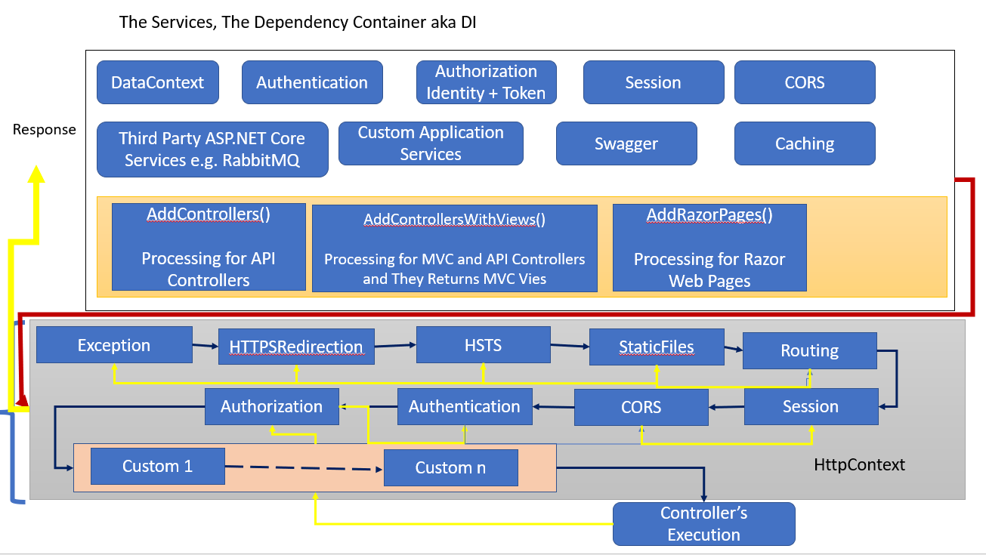

Slide 32
Controller is requested and its Security is checked
Yes
Constructor is called and dependency is injected
Check the HTTP request Type Get/Post/Put/Delete
No, UnAutho Resp
No, UnAutho Resp
Action Executing Context
Check if the Action is Authorized to current user
Customizable
If Http Get request the Action is executed. If the Request is Http POST/PUT the body data will be validated and processed. If Exception Occurs then invoke the Exception Middleware and send error response. Else Success response
Response from API
Check if the Action is Authorized to current user
Action Executed Context

Slide 33
https://www.myfrontendapp.com
https://www.myserverapp.com/api/MyControll
Server-Side App
API + BLL + DAS + DAL
Front-End
App
Angular / React/ Vue
Log Files
http request
Response
http call to server for data
From the Origin www.myfrontednapp.com
(Methods) GET / POST / PUT / DELETE
(Headers) AUTHORIZATION, Content-Type
Browser
HTML UI + JS + CSS
https://www.myfrontendapp.com Home Page

Slide 34
Vendor Mgmt. Serv
Vendor DB
Customer Mgmt. Serv
Customer DB
Product Mgmt. Serv
Product DB
Microservice
Order Mgmt. Serv
Order DB
Bill Mgmt. Serv
Order DB

Slide 35
IIS Web Server
Request Interceptor aka Listener
Http Module and Http Handler are responsible to process and Manage the Request Processing on IIS for ASP.NET Eco-System on .NET Framework
Application
Presentation Layer with cshtml
Module
WEB API Layer
Action Methods
Handler
IHttpModule and IHttpHandler
They were Request processing Objects for ASP.NET Applications those are provided by IIS
Used for
Security
Exception
CORS
Files Management
Business Layer
Data Access Layer
ASP.NET Runtime
.NET Framework

Slide 36
Http Request Message
Headers
Body
Errors
Http Header
MIME-TYPE aka Content-TYPE: The media formatter used to POST and PUT Data to the REST API e.g. application/json
Method: HET / POST / PUT / DELETE
AUTHORIZATION: ‘Basic UserName:Password’ OR ‘Bearer TOKEN’
Datatype: the type of data that MUST be parsed on server-side
Header Enhancements aka Custom Headers
VERSION of API
Custom Header values e.g. specific role type for which the REST API will be executed
CORS Policies (Recommended on Server)
URL
URL Parameter

Slide 37
Azure AD for App Security
UserName and Password
UserName and Password and Roles
Microsoft Identity
All other security measures + Tokens for REST
UserName and Password and Roles + Policies

Slide 38
Mock 3
Mock 2
Mock 4
Test
Mock 1

Slide 39
Container
Container
Container
Image
Image
Image
Application Executable
Database
Messaging
Base Image
Base Image
Base Image
Docker
Process Config
Memory Config
Network Config
Virtualization
Container Services
HOST OS
Enable for H/W Virtualization

