Slide 1
Training PPTs

Slide 2
Modern Hybrid Apps
Server-Side Application Logic
Browser
SQL
Http Request
Server-Side
Web Apps AKA Web Site
DOMAIN OR Business Workflow Layer
Data Access Layer
Object Relational Mapping (ORM) OR
Direct DB Access
HTML Page as Http Response
R
W
Oracle
Mobile Client
Http Request For Data
Public Endpoints
REST
Reports
Http Response with JSON / XML Data
MySql
Security
Browser Client App
Angular / React / Vue / Ember / jQuery
Http Request For Data
Public Endpoints
REST
Search
NoSQL
MongoDB /DynamoDB
Http Response with JSON / XML Data
Processing
Schema Classes / Entities / Value Objects / DTO

Slide 3
Front-End App
Back-End Server-Side App
Node.js Hosting
REST APIs
HTML Files
Business Workflows
JS Application Files
(React App Code)
Data Access
JS Runtime Files
(React Object Model)
http://192.168.10.3/ OR
http://myserver.com/
http://192.168.10.50/ OR
http://myfrontendapp.com/
The Back-End app and Front-End App Executes in Silos

Slide 4
Web Server
http://www.myserverapp.com
Browser
Http Request for page
App with Server-Side Pages
.aspx / cshtml
Http Response with HTML Rendered Page
Front-End Web App Server (Node.js)
http://www.frontendapp.com
Browser
With Angular app loaded
Request
Response
REST APIs
Calls for REST APIs
Browser Host HTML and JS for High Responsive Behavior
Http Request for page
App with Server-Side Pages
.aspx / cshtml using References for Production Scripts for Front End Apps
Http Response with HTML Rendered Page along with the Front-End App Scripts

Slide 5
Dotnet.exe
MVC Controller 1
MVC Controller 2
Controller 1 will store Data in Cache
Controller 2 will receive data from Cache
Session State Provider, using ISession Contract
Distributed Memory Cache
Used to Cache the Session Data
Cache Data Provider using IMemoryCache Contract
Out of Process then it is IDistributedCache

Slide 6
Dotnet.exe
Request delegated from the Reverse Proxy
Web Host Instance
ConfigureServices()
Services.AddRazorPages()
Services.AddControllersWithViews()
Services.AddControllers()
Razor Pages
RazorPages
View Compilation
GetAsync and PostAsyc
Model Binders
PageModel
Tag Helpers
Server-Side Attributes of HTML Elements
State Management
MVC Processing
Configure ()
App.UseEndPoint(()=>{
MapRAzorPages()
MapControllerRoute()
MapControllers()
})
MVC Controller
View Compilation
Manages by Action Methods of The Controllers
Model Binder, Model Class exposed to View
Tag Helpers
Server-Side Attributes of HTML Elements
State Management
API
Http Response with some State on Server-Side

Slide 7
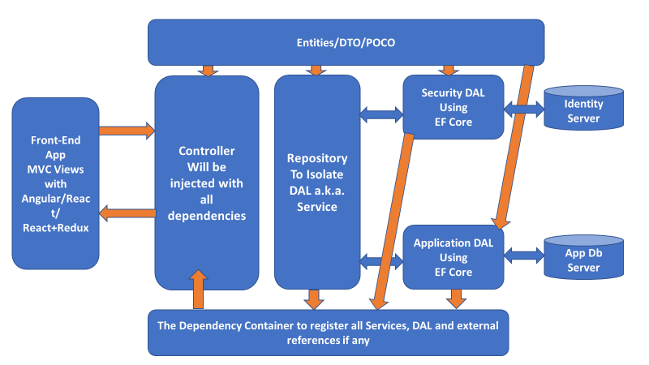
Modern Need for architecture

Slide 8
IIS
W3wp.exe
ASP.NET Runtime
HTTP Request
HttpApplication Block
Web.Config
HttpModule Block
Process Request
Global.asax
Router Handler
HTTP method Mapper (Get/Post/Put/Delete)
Http Handler
Executes Page by using CLR and Generte Html Response
HTTP Response

Slide 9
ASP.NET Web Forms
ASP.NET Core EcoSystem
Identity
Authentication /Autho
Tokens
AAD OpendIDConnect
Policies
Sessions
DI Container
Middlewares
Common HTTP Pipeline for WebForms, API and MVC
Cloud-Ready Deployment
API App
App Service
MIcroServices
MVC
APIs

Slide 10
Dotnet.exe
ASP.NET Core Hosting
Runtimeconfig.json
Application.dll
Application.dll
Windows OS / Linux /Mac OS

Slide 11
Side-By-Side .NET Core Framework Hosting
.NET Core 3.1
.NET Core 3.0
.NET Core 2.1
.NET Core 2.0
.NET Core Apps
.NET Core Apps
.NET Core Apps
.NET Core Apps

Slide 12
Windows OS (10/2016/2019)
IIS
Public Endpoint aka
Reverse Proxy
e.g. 192.168.90.10
Web.Config File with
AspNetCoreModule
HTTP Request
HTTP Response
Internal IP Port
5000 / 5001
Dotnet.exe (dotnetcore)
ASP.NET Core Application Library
Host Builder, DI, Sessions, Security, etc.
DB Server

Slide 13
HTTP Request
IIS Web Server Hosting ASP.NET App
HttpApplication → HttpModule → HttpHandler →Aspx Page
HTTP Response
HTTP Request
IIS Web Server Hosting ASP.NET MVC App
HttpApplication → HttpModule → RouteHandler → HttpHandler → Controller → ActionMethod → Views
HTTP Response
HTTP Request
IIS Web Server Hosting ASP.NET WEB API
HttpApplication → HttpModule → RouteHandler → HttpHandler → API Controller → ActionMethod → JSON Result
HTTP Response

Slide 14
.NET Framework VS .NET Core Need based Comparison
Use .NET Core
Use .NET Framework
Cross Platform Needs
Microservices Based App architectures
Using Dockers
High Performance and Scalable Systems
Apps are currently targeted .NET Frameworks
Apps are greatly depending on third party libs and NuGet packages.
Features required for your apps are not available on .NET Core
App does not need to go cross platform

Slide 15
ASP.NET CORE Application Eco-System
Third Party Apps OR
JS Front-End
Web Applications
MVC
Web Applications
Blazor Web Applications
Razor View Pages
Web
Applications
ASP.NET Core
Web
Apps
WEB API
Shared Libraries for Domain Logic, Data Access and Infra
Application
Domain Logic
Model Classes and Services
Data Access Infrastructure with
DbContext and
EF Core Migrations
Persistent
Data
Layer
SQL
Database

Slide 16
Dependency Container
DbContext
Sessions
CORS
Security
Cookies
Custom Objects
MVC Requests Processing
Web Form View Request Objects
WEB API Request Processing
Filters
Logging

Slide 17

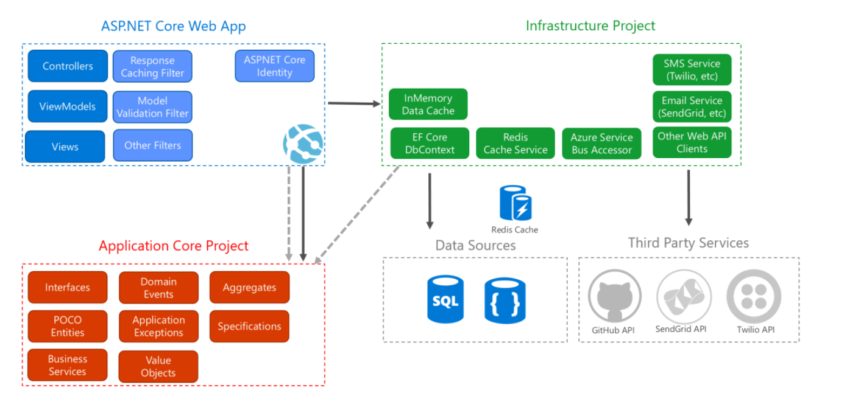
.NET Core Architecture
ASP.NET Core architecture diagram following Clean Architecture
https://blogs.msdn.microsoft.com/dotnet/2017/08/09/web-apps-aspnetcore-architecture-guidance/

Slide 18
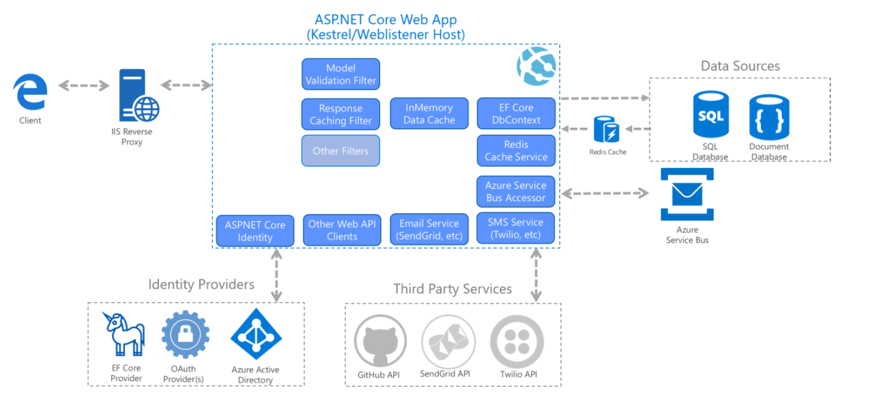
.NET Core Architecture
A sample ASP.NET Core app’s runtime architecture.

Slide 19
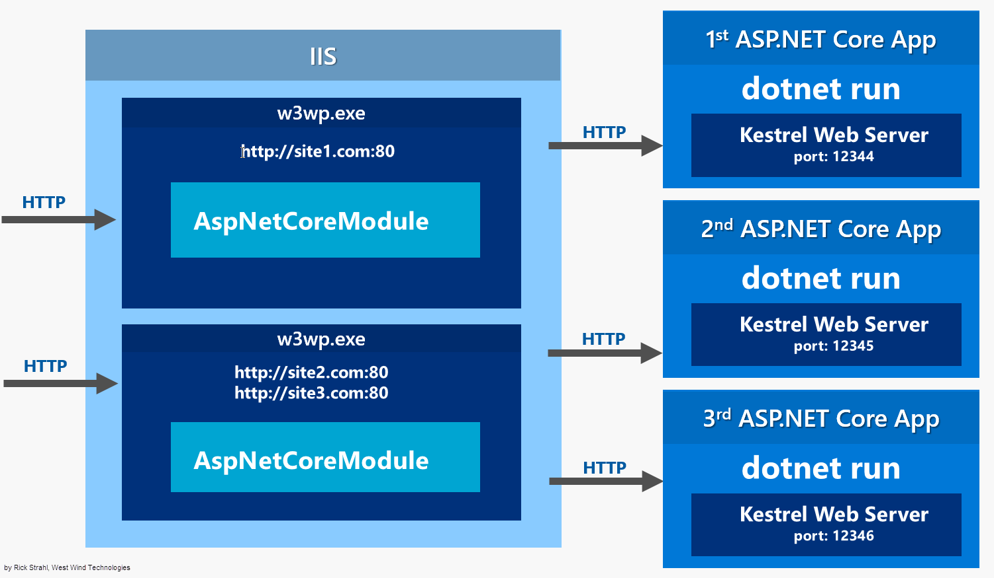
ASP.NET Core IIS Hosting
https://weblog.west-wind.com/posts/2017/Mar/16/More-on-ASPNET-Core-Running-under-IIS#a-quick-review-of-iis-hosting-for-asp.net-core

Slide 20
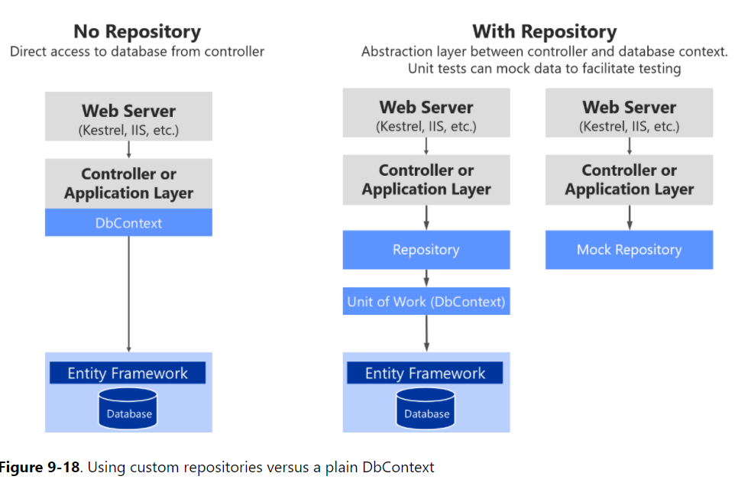
Aps.net core model with ef core
https://docs.microsoft.com/en-us/dotnet/standard/microservices-architecture/microservice-ddd-cqrs-patterns/infrastructure-persistence-layer-implemenation-entity-framework-core

Slide 21
ASP.NET Core Request Pipeline objects

Slide 22
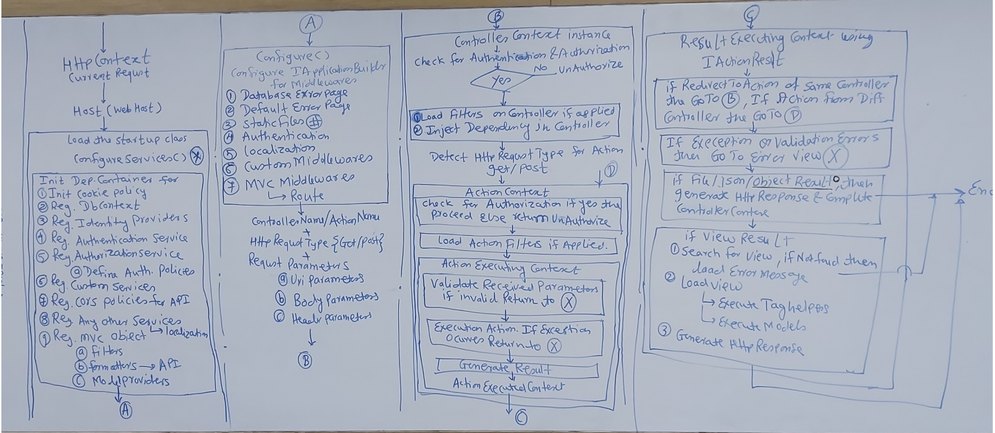
Request Processing

Slide 23
Request pipeline
Http Request
ASP.NET Core Service Configurations
Cookie Policies
Database Connections Identity and Application
Identity Services (Users and Roles)
Authentication and Authorization
Dependency Injection
MVC Services
Middlewares

Slide 24
Request pipeline
ASP.NET Core Middleware Pipeline
Exception Handling
HTTP Static Transport Security
HTTPS Redirection
Static File Server
Cookie policy
Authentication
Session
Routing Middleware
Matching to Route Entry
Route Handler

Slide 25
Request pipeline
Load Controller Object with its dependencies if Authenticated
Not Authenticated
Then
Deny
Execute Action
If Authenticated
Execute Logic
If exception Occurs
Go to Error Page
Result

Slide 26
Request pipeline
Detect Result
Detect Result
Detect Result
If ViewResult then Load View Engine and Execute TagHelper
If Different Action in Same Controller
The Execute the Action If Action form Different Controller then start from ControllerContext
If Result is Different then View
Then Direct Resource Response
e.g. JSON/File
Render Response
ViewResult
Response

Slide 27
Middlewares

Slide 28
Middlewares
Middleware is software that's assembled into an app pipeline to handle requests and responses. Each component:
Chooses whether to pass the request to the next component in the pipeline.
Can perform work before and after the next component in the pipeline.
Middleware are simpler than HTTP modules and handlers
Modules, handlers, Global.asax.cs, Web.config (except for IIS configuration) and the application life cycle are gone.
The roles of both modules and handlers have been taken over by middleware
Middleware are configured using code rather than in Web.config
Pipeline branching lets you send requests to specific middleware, based on not only the URL but also on request headers, query strings, etc.
Middleware are very similar to modules
Invoked in principle for every request
Able to short-circuit a request
Able to create their own HTTP response
https://docs.microsoft.com/en-us/aspnet/core/fundamentals/middleware/?view=aspnetcore-2.2

Slide 29
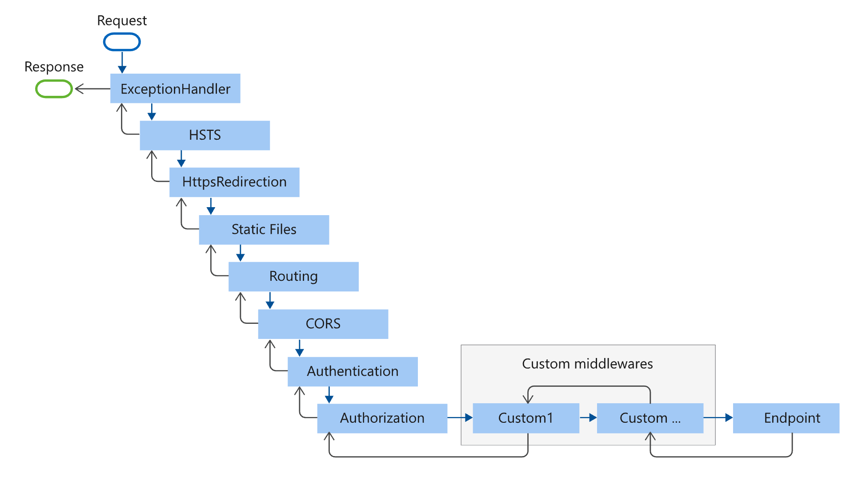

Slide 30
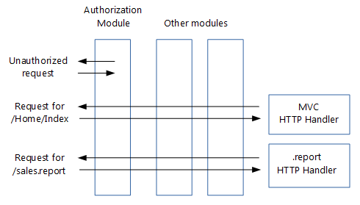
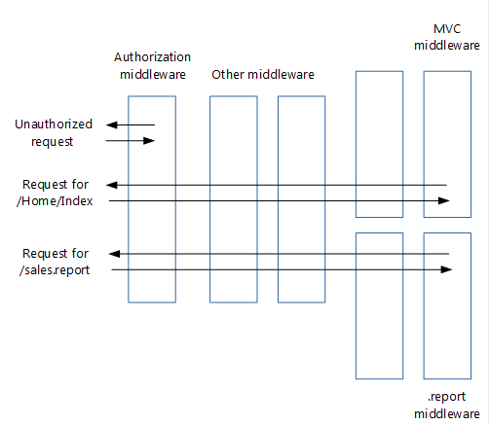
middleware
Standard ASP.NET HTTP
ASP.NET Core Middlewares
https://docs.microsoft.com/en-us/aspnet/core/migration/http-modules?view=aspnetcore-2.2

Slide 31
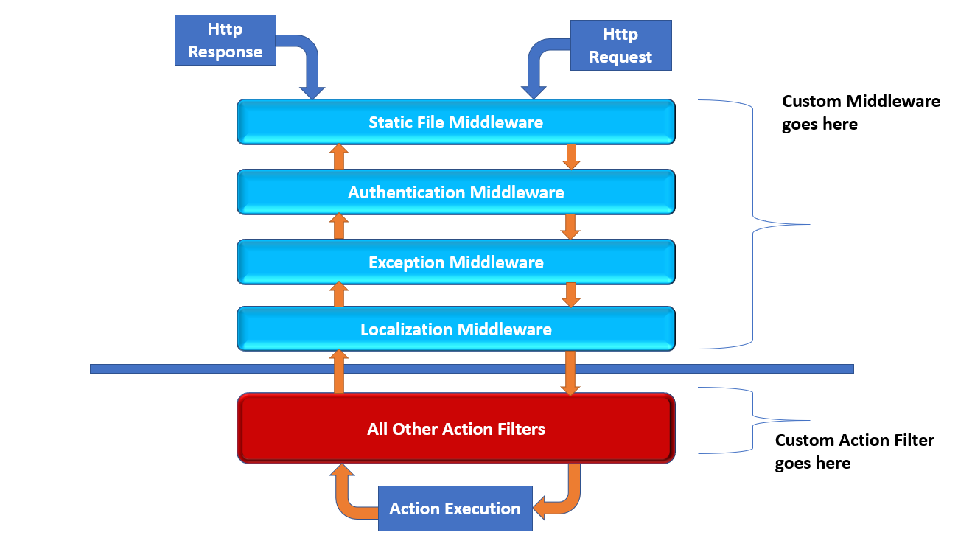
ASP.NET Core Middleware

Slide 32
ASP.NET Core Security

Slide 33
ASP.NET Core Security
Identity Based Security
User Based Security
Credentials Stored in DB
Proprietary Based Web Sites
External Credentials Authentication aka External Login Provider
Facebook, Google, Microsoft, Twitter, etc.
OAuth
Role Based Security
Proprietary based Web Sites where an organization creates a hierarchy of roles to grant access to the users.
Users are assigned to roles and app is restricted for specific roles.
Policy Based Authentications
One or more roles are granted access of specific module.
Rules for accessing an application dynamically.
Claim Based Security
The Access based on a specific type of identity.
Token Based Security
JSON Web Tokens contains claims for verifying users.
Used to grant access of WEB API to users.
B2C Security
Using Azure AD or Organizational aka On-Premises AD
Single Tenant App
B2B Security
Multi-tenant app
Multiple AD with Trust within each other
Azure AD Multi-Tenant

Slide 34
C
L
I
E
N
T
App
Makes Request With Credentials
Verifies
Request for Auth.
Y/N
Auth. Request
Access Database
Access Database
No Authentication
Token is send back to client
Generate
Token
Data
Store
Client request with Token in Http Request Header
REST APIs using ASP.NET Core
Verify Token
Response to the Client based on Token

