Slide 1
https://myecomapp.com/index.html
Browser
Web Server
Hosting The App
HTML UI
Http Request for Web Site
Static Resources
HTML, JavaScript, CSS
HTML Response with Resources
Server-Side Generated Resources like
HTML + JavaScript + CSS + Images
JS Files, CSS Files
Application
Logic
Server-Side Page Generation provide advantages like:
Dynamically adding / modifying / removing HTML UI, JavaScript, CSS
The Browser will be sent only the requested resources
Frequent generation of HTML on server will reduce the performance and the browser will be send the response which need to re-load the HTML UI for the Page on browser for each response received from the server
Limitations
Frequent calls to server will increase traffic and the server may take time to respond
The over utilization of server resources may slow-down the execution

Slide 2
Browser
Server-Side App
Server-Side Pages
.apsx , .jsp, .php, etc.
Third-Party Front-End Apps loaded in Browser
Third-Party Application
Front-End App
e.g.
Angular / React / Vue / Blazor / jQuery
Separately Hosted
Azure / AWS / GCP as Static Apps
Business Layer
&
Data Access
Layer
REST
API / WEB APIs / APIs
Endpoint
HTML + JS + CSS + Images
Accessing REST API for Data

Slide 3
Browser
Request for Data
Server
Button
JavaScript Object-Model, with CSS
The UI Should Be generated on Browser aka Client Side
Click Event Requested
Response with Data
Color : yellow

Slide 4
Static Document-Object-Model (DOM)
The HTML DOM
Responsible to SHOW UI (Presentation) to End-User
JavaScript DOM aka JS-DOM
Browser based JS Object Model
Object / number / string / Date / Boolean
Functions
Events
Properties
CustomElementRegistry
HTML Uses JSOM
HTML 5 API
DragDrop
File Access
Media Services for Graphics / Animations / Audio and Video
Socket
Device Access e.g. Camera / USB / GPS / Sound, etc
Network APIs
Http and Https with waterfall model
Socker with ws
Images
Docs
WebAsembly

Slide 5
Angular Loading in Browser
Browser
Bootstrapped Standalone Component
Component’s
HTML
&
CSS
Component’s
Properties
&
Methods
Data Binding with Properties
Event Binding with Methods
All Standard & Custom Modules, Reusable Components, Directives using ‘imports’
Dependency Container that is registering and loading Angular Services
Main.js and Other Dependency Files
polyfills.js, Coming from zone.js
Main.js, the Angular’s Developer Code Compiled File

Slide 6
UI Component
Directives
Re-Usable UI
Presentation Layer aka Component
Re-Usable Utilities Logic
Structural Directives for HTML Generation based on Data
HTML
User Interface
Attribute Directives for Data Binding
Client-Side Domain Logic
Presentation Logic
Data Members (Public Properties), used for Databinding
Methods, For Logic, used for Event Binding
Re-Usable Utilities Logic as Angular Service
Injected in Component
Service with Data Communication Across Components
Angular App Layers
Service with Asynchronous HTTP Calls

Slide 7
HTML Forms
User Interface Elements
Input Elements, Text, Number, etc.
Layout Elements, Table, Div
Interactive Event Based Elements, Button
Fields
Properties those are exposed to Input Elements
Inputs Bound with Fields are used to validate the received data, that why they are also known as ‘Templates’
name
Client-Side Logic
Only Methods those works on Data Entered by End-User as well as the Validation Logic Execution.
AKA Domain Logic
Logic
Methods, exposed to Buttons or Input Elements
Input Elements exposed to Methods, are known as ‘Templates’ , Custom Validations

Slide 8
UI Validations
Model
Domain Logic & Model Classes used for Exposing to View
5. Schema of the Data to be shown on View is Received from the Model
Form with HTML Elements with Validation Rules
Validations are Tightly Coupled with HTML Elements
2. Demand data to Model
View
3. Pass Data To Controller
Controllers
4. Pass Data to View
Model
UI Facilitator
Action Logic
View
Controllers
1. End-User Needs List of Values in List View
End-User

Slide 9
Constructor
ngOnChanges
ngOnInit
Called Only Once when the Component is Activated for Loading
Initial Values for Object Members, Scalar Properties, etc.
Look for Changed in the Component’s Properties those which will be a reason to Update UI
The Child Component will execute ngOnChanges for each @Input() change
Perform Resource Intensive Operations e.g. HTTP Calls
This will be executed only Once and Property Changes will be notified to Component and hence the Component will Update the UI
ViewContent
Generate HTML Based on Initial Property Data Set for Component
The UI will be changed only when its bounded property is changed by the Component
ngOnDestroy
Component is Being Destroyed when we move away from it or close it explicitly

Slide 10
Collection Manipulation
Utility Class as a Angular Service
Container
Component
Angular Service to Share / Communicate data across component’s those who does not related with each other
Injection of Utility Class Service in Component
Listen Value from Department Component
Show employees based on Selected DeptName with no Relationship
Store Listened Value
Department
Component
Subscribe to the Event
Employee
Component
Event that will be raised when value is received
When the Value is listened, it will be notified to the subscriber

Slide 11
COMPONENT’s HTML + CSS + Data-Binding + Events
Server-Side Application
Angular Build JS Files (JS code for Components, Services, Pipes, Validations, etc.) and CSS
Business
WF Layer
Data
Access
Layer
Browser Makes HTTP Request to API Endpoint
Using ‘Promise’ with Async Communication
JSON Data Communication
REST
APIs
Angular Front-End Application
Components + Services + Routing + CSS Framework / Library
EP

Slide 12
HTTP Pipeline
Aka
HTTP Context
Manage the Channel for Communication from Browser to API Endpoints
Browser
UI
Thread
API
Server
Thread
For
Async
Processing
HTTP Request Message
Asynchronous
HTTP Response Message
Promise
Object form
JS
From Client
Async State
Object from Server

Slide 13
JS
Client
1. HTTP request Message (GET / POST / PUT / DELETE)
API
Server
2. Server Accept the Request and Generates Acknowledgement
5. Promise Subscription
3. The Acknowledgement to Promise Object Created by Client
6. Client Continue its Execution
7.The Promise Keep Waiting for the Response from the Server
4. Server Continue an execution
10. Unpack the Response using the Subscription
9. Response Back to Promise
11. The Unpacked Response is delivered to Client
8. Server Completes Execution and ready with Response
Success
Response
Failed Response
PROMISE BASED ASYNC EXECUTION in JavaScript Apps

Slide 14
Observable
Subscriber
Provider
E
D
C
B
A
Dispatch Data to Subscriber
Observable
Subscriber
Provider A
forkJoin()
E
D
C
B
A
E1
D1
C1
B1
A1
Provider B
Dispatch Data to Subscriber

Slide 15
JS
Client
1. HTTP request Message (GET / POST / PUT / DELETE)
API
Server
2. Server Accept the Request and Generates Acknowledgement
5. Observable Subscription
Observable
Holds the Promise
3. The Acknowledgement to Promise Object Created by Client
6. Client Continue its Execution
7.The Promise Keep Waiting for the Response from the Server
4. Server Continue an execution
10. Client is Notified data from the Observable over the active subscription
11. The Unpacked Response is delivered to Client
8. Server Completes Execution and ready with Response
Success
Response
Failed Response
Observable for HTTP Calls in Angular

Slide 16
Category
10ms
CatUId | CatId | CatName | BasePrice
Angular
Component
Wait for Responses from Both Services
PUId | Pid | Pname | Man | Desc | Price
50ms
Show Data on UI by Combining / Filtering Some data received from Services
Product
CatId | Cname | ProdId | PName | Price | Man | Tax

Slide 17
Category
Back-End For Front-End (BFF)
An API that will internally Manage all Outgoing calls to get data. Then it will manipulate it as per need for UI.
This is a responsibility of Front-End Developer
Use
Node.js, ASP.NET Core, JAVA, Python
CatUId | CatId | CatName | BasePrice
Angular
Component
PUId | Pid | Pname | Man | Desc | Price
Show Data on UI by Combining / Filtering Some data received from Services
Product
CatId | Cname | ProdId | PName | Price | Man | Tax

Slide 18
Server-Side App
Login Request
Auth Token Authorization
Guards
Auth
Db
AuthAPI
ProductAPI
Browser Based App
OrderAPI
Biz
Db
BillAPI

Slide 19
Angular Signals
Angular Signals is a system that granularly tracks how and where your state is used throughout an application, allowing the framework to optimize rendering updates.
What are signals?
A signal is a wrapper around a value that can notify interested consumers when that value changes. Signals can contain any value, from simple primitives to complex data structures.
A signal's value is always read through a getter function, which allows Angular to track where the signal is used.
Signals may be either writable or read-only.

Slide 20
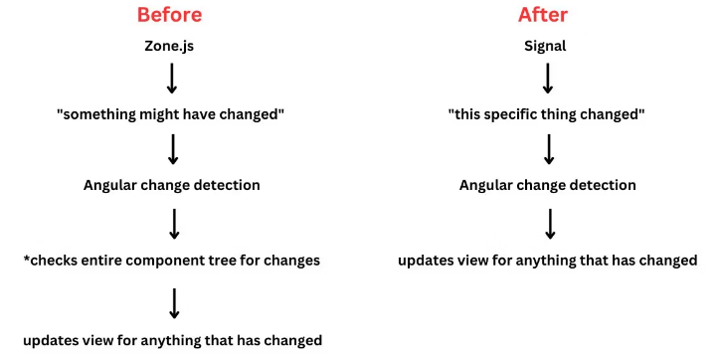
Imagine Your House: Think of your Angular application like a large house with many rooms. Each room is like a component in your app.
Change Detection Without Signals: Traditionally, when something changes in one room (component), Angular checks all other rooms to see if they’re affected. It’s like turning on all the lights in the entire house to find a change in one room.
Introducing Signals: Signals are like motion sensors in each room. When something changes in a room, only the connected rooms (components) are checked. This is more efficient because it avoids unnecessary checks.
Benefits of Signals Over Zones: Signals eliminate the need for Zones, which are like a security system. While Zones can be helpful, they add complexity. Signals offer a more straightforward way to ensure security without the overhead.
Testing Made Easier: Signals make testing Anaular applications easier. They provide a predictable and deterministic way to trigger change detection. This means you can be more confident that your tests are accurately checking what they’re supposed to.
Make applications more efficient by selectively checking only relevant components.
Offer flexibility by providing security without the added complexity of Zones.
Improve testability by providing a reliable way to trigger and test change detection.

Slide 21
Writable signals
Writable signals provide an API for updating their values directly.
You create writable signals by calling the signal function with the signal's initial value:
const count = signal(0);
// Signals are getter functions - calling them reads their value.
console.log('The count is: ' + count());
To change the value of a writable signal, you can either .set() it directly:
count.set(3);
or use the .update() operation to compute a new value from the previous one:
// Increment the count by 1.
count.update(value => value + 1);

Slide 22
Computed signals
A computed signal derives its value from other signals.
Define one using computed and specifying a derivation function:
const count: WritableSignal<number> = signal(0);
const doubleCount: Signal<number> = computed(() => count() * 2);
Computed signals are both lazily evaluated and memoized
doubleCount's derivation function does not run to calculate its value until the first time doubleCount is read.
Once calculated, this value is cached, and future reads of doubleCount will return the cached value without recalculating.
When count changes, it tells doubleCount that its cached value is no longer valid,
and the value is only recalculated on the next read of doubleCount.
As a result, it's safe to perform computationally expensive derivations in computed signals, such as filtering arrays.
Computed signals are not writable signals

Slide 23
Effects
An effect is an operation that runs whenever one or more signal values change.
You can create an effect with the effect function:
effect(() => {
console.log(`The current count is: ${count()}`);
});
Effects always run at least once. When an effect runs, it tracks any signal value reads. Whenever any of these signal values change, the effect runs again. Similar to computed signals, effects keep track of their dependencies dynamically, and only track signals which were read in the most recent execution.
Effects always execute asynchronously, during the change detection process.

Slide 24
Parent Component
name signal
nameInput signal
Child Component
Subscribe to the ‘name’ signal
Subscribe to the ‘nameInput’ signal

Slide 25
Understanding Pipes
Use pipes to transform strings, currency amounts, dates, and other data for display.
What is a pipe
Pipes are simple functions to use in template expressions to accept an input value and return a transformed value.
Pipes are useful because you can use them throughout your application, while only declaring each pipe once.
For example, you would use a pipe to show a date as April 15, 1988 rather than the raw string format.

Slide 26
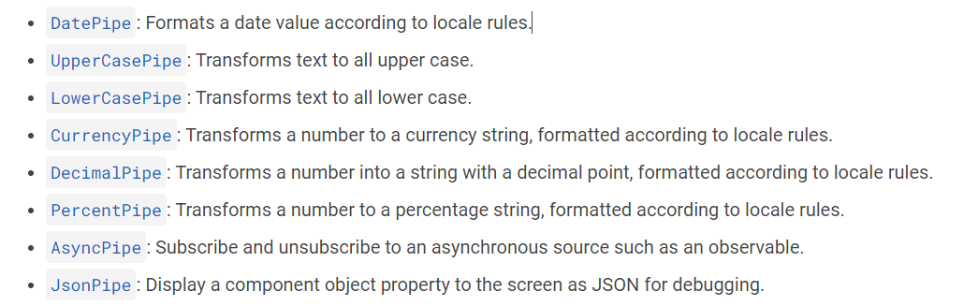
Built-in pipes

Slide 27
Server-side rendering
Server-side rendering (SSR) is a process that involves rendering pages on the server, resulting in initial HTML content which contains initial page state.
Once the HTML content is delivered to a browser, Angular initializes the application and utilizes the data contained within the HTML.

Slide 28
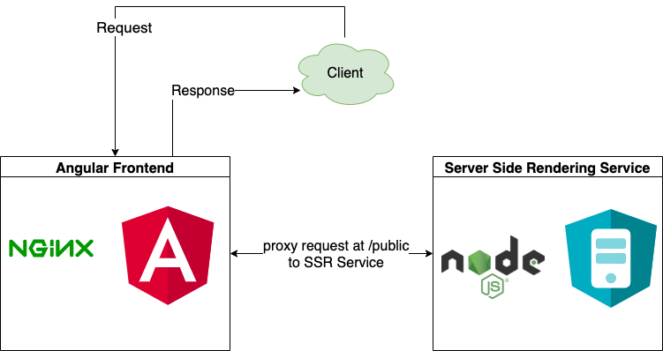
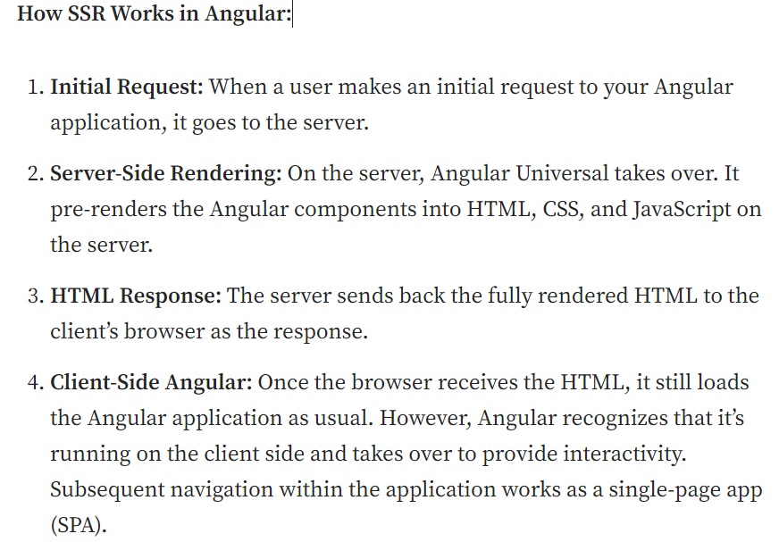
https://blog.stackademic.com/server-side-rendering-angular-universal-bd31f64182c9

Slide 29
Why use SSR?
The main advantages of SSR as compared to client-side rendering (CSR) are:
Improved performance: SSR can improve the performance of web applications by delivering fully rendered HTML to the client, which can be parsed and displayed even before the application JavaScript is downloaded. This can be especially beneficial for users on low-bandwidth connections or mobile devices.
Improved Core Web Vitals: SSR results in performance improvements that can be measured using Core Web Vitals (CWV) statistics, such as reduced First Contentful Paint (FCP) and Largest Contentful Paint (LCP), as well as Cumulative Layout Shift (CLS).
Better SEO: SSR can improve the search engine optimization (SEO) of web applications by making it easier for search engines to crawl and index the content of the application.

Slide 30
Create Angular App with SSR
ng new --ssr
For existing Angular App, enabling and adding SSR
ng add @angular/ssr
my-app
|-- server.ts # application server
└── src
|-- app
| └── app.config.server.ts # server application configuration
└── main.server.ts # main server application bootstrapping

Slide 31
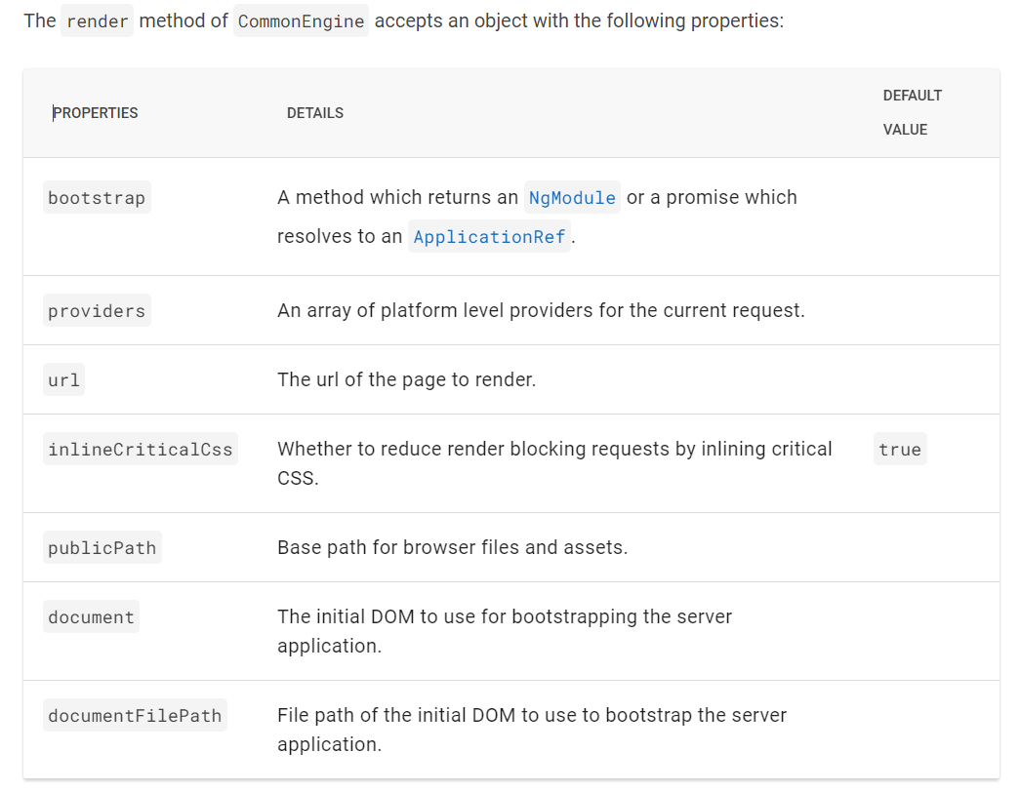
Configure server-side rendering
// All regular routes use the Angular engine
server.get('*', (req, res, next) => {
const {protocol, originalUrl, baseUrl, headers} = req;
commonEngine
.render({
bootstrap,
documentFilePath: indexHtml,
url: `${protocol}://${headers.host}${originalUrl}`,
publicPath: browserDistFolder,
providers: [{provide: APP_BASE_HREF, useValue: req.baseUrl}],
})
.then((html) => res.send(html))
.catch((err) => next(err));
});

Slide 32
Hydration
Hydration is the process that restores the server side rendered application on the client.
This includes things like reusing the server rendered DOM structures, persisting the application state, transferring application data that was retrieved already by the server, and other processes.
Hydration is enabled by default when you use SSR.

Slide 33
Why is hydration important?
Hydration improves application performance by avoiding extra work to re-create DOM nodes.
Instead, Angular tries to match existing DOM elements to the applications structure at runtime and reuses DOM nodes when possible.
This results in a performance improvement that can be measured using Core Web Vitals (CWV) statistics, such as reducing the First-contentful paint FCP and Largest Contentful Paint (LCP), as well as Cumulative Layout Shift (CLS).
Improving these numbers also affects things like SEO performance.

Slide 34
Caching data when using HttpClient
When SSR is enabled, HttpClient responses are cached while running on the server.
After that this information is serialized and transferred to a browser as a part of the initial HTML sent from the server.
In a browser, HttpClient checks whether it has data in the cache and if so, reuses it instead of making a new HTTP request during initial application rendering.
HttpClient stops using the cache once an application becomes stable while running in a browser.
Caching is performed by default for all HEAD and GET requests. You can configure this cache by using withHttpTransferCacheOptions when providing hydration.
bootstrapApplication(AppComponent, {
providers: [
provideClientHydration(
withHttpTransferCacheOptions({
includePostRequests: true,
}),
),
],
});

Slide 35
Parent-Child Relationships
Using Services to Communicate Across Components
Query Mechanism on Service Object that holds data which is shared across components
Using Browser’s Storage to share data across Components e.g. sessionStorage, localStorage
C1
C2
C3
C4
C5
C6

Slide 36
Container App / Hosting App
Cart of Purchased / Selected Products
Product Catelog UI
State-wise Tax Details on Product / Purchase
This UI is loaded based on the state of Purchase

Slide 37
Original
Observable
Pipe(
Logic for Manipulation
)
Manipulated Observable

Slide 38
Data
Provider
Operators
A Subscription management that is used by the observable to take care of Dispatching data
Subscriber 1
Functions to dela with data stored in Observable
Observable
Subscriber 2
Observer
Scheduler
Subjects
Subscriber 3
Manage the Data in the Observable, a collection of callbacks to listen to values delivered by the observables
Centralize dispatchers to control data access Concurrency
Like an EventEmitter, used to emit the latest value(s) to the subscriber

Slide 39
Angular App
X =2
Data Change
X=1 => 2
Subc1
X =1
Subc2
Subject
X = 2
Subc3
X =2
Subcn
Publishing
Company
Subject
Subscriber to Paper by Publisher

Slide 40
Subject
Angular
Service
Provide Data to Subscriber
COM1
COM2
COM3
COM4

Slide 41
Departments
Employees
Customers
Orders

Slide 42
Create Department
Subscription
Notify the newly added department from store to List Departments Component
Department Store
Dispatch Action for Adding New Department to Store
List Departments
Subscription

Slide 43
Create Department
Subscription
Notify the newly added department from store to List Departments Component
Department Store
Dispatch Action for Adding New Department to Store
List Departments
Update new Department in the Store
Reducer
Subscription

Slide 44
Comp 1
Action Creator
Sync / Async
Effect
Will Subscribe to Promise and Dispatch output Action
Dispatch Action
Async Action to Effect
HTTP Call
Sync Output Action with Resultant Data
Comp 2
Reducer
Update the Store
Async Output Action with Resultant Data
HTTP
Service
Store Subscription
Data from Store
Selector
NGRX Store for Application State

Slide 45
Lib 1
Server1/index.js
Lib 3
Server3/index.js
Landing Page
Lib 4
Server4/index.js
Lib 2
Server2/index.js
Form
Search
Shell Application
Module Federation
http://server1/index.js
http://server2/index.js
http://server3/index.js
http://server4/index.js

Slide 46
Remote App 1
Exposed on Port 4300
Remote App 2
Exposed on Port 4400
Remote App 3
Exposed on Port 4500
Host Configuration for Loading and Managing Remotes
Host App Exposed on Port 4200
A Module that Manages Remote App as well as Shared Libraries
e.g. NgRx

Slide 47
Remote App
Module
Components
Services
Models
Shell App will Access the Remote App using the Entry Module / Component
When Exposed to Shell
Module
Module
Entry Module / Component with Routing

Slide 48
Remote App 1
Angular
Remote App 2
Angular
Micro Frontend Shell / Host
UI from App1
UI from App2
Data Communication
Remote App 3
React

Slide 49
Browser
Angular Bootstrapping with first module
BrowserModule
UI of The Component
Data Properties are bound to HTML Editable Elements and Methods to their Events
First Bootstrap Component
Inject Services from Dependency Container
Data Properties and Methods
Bootstrap Module
Standard Angular Modules
e.g. Forms, Router, Http, and Custom Modules, etc.
Initialization of all Components, Directives, Pipes.
All Services registered in Dependency Container
Main.js
Polyfills.js
Zone.js
Runtime.js
Angular Object Model
Application Code
Browser Compatibility and render support files
Standard Code of Angular Application

Slide 50
Model
Component
View
(HTML Template of Component)

Slide 51
C1
S1
C2
S2
C3

Slide 52
Container Component

Slide 53
ContainerComponent
Sender Component
Receiver Component
Global Object data maintains the state of data that is shared across the Components
Using Angular Service

Slide 54
Path | Resource / Component
/emp | employeeCmp
/emp/:id | Parameter
/emp | Childern:[{}]
RouterModule

